Slide 1


PRESENTATION TO THE SELECT COMMITTEE
Briefing by the Department on its adjusted 2020/21 budget
22 July 2020

Slide 2
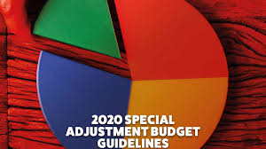
Presentation outline
Introduction
2020 MTEF Budget Allocation
Special Adjustment Budget
Broadcasting Digital Migration
Impact of the budget reduction
BDM deliverables
Current funding status Current appropriated funding and implications

Slide 3
Introduction
On the 21 April 2020 the president announced a R500 billion fiscal support package that includes spending towards COVID-19 priorities.
On 30 April National Treasury published on the “Economic Measures for COVID-19”, outlining an R500bn response, as well as identifying the funding sources for the package.
Part of the funding sources for this package is a R130 billion baseline reprioritisation in the 2020/21 financial year.
Section 16 of the PFMA: Use of funds in emergency situations. The Minister of Finance may approve the use of unappropriated funds, if it is for spending of an exceptional nature. This happens if postponing the spending to a future parliamentary appropriation would seriously prejudice the public interest.
The Special adjustment budget provides for changes in the main appropriation owing to the categories of expenditure specified in Section 30(2) of the PFMA, by programme and economic classification.
All other adjustments not included in this Special Adjustment Budget will be tabled in the October Adjustment Budget.

Slide 4

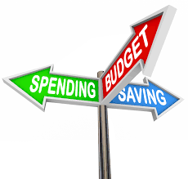
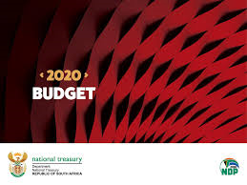
2020 MTEF Budget Allocation

Slide 5
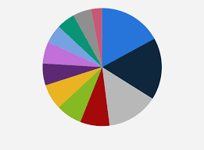
2020 MTEF Budget Allocation

Slide 6
Special Adjustment Budget

Slide 7
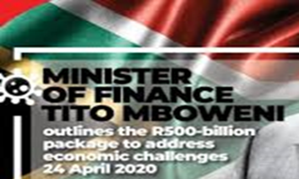
Special Adjustment Budget
Contribution of R33 million from Goods & Services – amounting to approximately 17% of G&S budget once SA Connect, Operating payment sand Property payments are removed. Cut mainly effected on subsistence & travel, advertising, consultants, training & development, venues and facilities and other items.
15% of R522 million amounting to R78,3 million reduced from the BDM budget allocation - the R78 million is from voucher system by USAASA.
National Treasury granted provisional approval for surplus funds from interest earned amounting to R242 million to be retained by USAF for the 2019/20 financial year.
These funds will be used to assist indigent Grade 12 learners affected by the lockdown due to the Covid-19 virus.
Allocation letter received from National Treasury confirming the budget cuts of R111 million in line with the Adjustments Appropriation Bill,2020, tabled in Parliament on 24 June 2020.
Programme 2 - No contribution due to the negative impact on its budget by the unfavourable exchange rate during payment of international membership fees. Savings declared shifted to defray excess costs in the programme.
Programme 4 – Mainly driven by the transfers to the entities.
Notes:
USAASA due to HR capacity is unable to rollout three programmes under BDM. The 78million is only for this financial year end. In the same vein USAASA has received 242 million interest. USAASA will present detailed plans on all three activities under BDM.

Slide 8
IMPACT OF THE BUDGET CUTS
COVID-19 related matters have been prioritized by the Department and most goods & services budget has been shifted to fund these initiatives:
  Procurement of PPE, sanitisers, sick bay, scanners;
  Decontamination of premises, etc.
  Provision of data and tools of trade to all employees.
The Department is in the process of reviewing its 2020/21 APP in light of the following developments:
  COVID-19 has fundamentally changed the way of work. The APP was developed prior to taking this into consideration. Therefore, the requirements and impact of COVID-19 necessitates a review of the mode of delivery as well as the related timeframes for several quarterly and annual targets.
  Budget cuts which affects across multiple programmes and directly impacts key projects, requires a review of the relevant APP targets.
Revisions on the 2020/21 APP will be approved by Minister and the revised APP will be re-tabled in Parliament and presented to the Portfolio Committee.

Slide 9



BDM Programme – Key Deliverables
PHASE 1: Completion stock depletion (FS, NC, NW and LP) and indigent registrations
Stakeholder Engagement and Participation Key (Underway across).
Registrations – Localization framework and COGTA/CWP (Extended registrations participation to SASSA to augment SAPO in rural areas);
Implementation – Pragmatic approach by zoning communities and addressing signal reception inconsistencies through DTH-S;
Installations – Localization framework and revival of EPWP to support local installations;
Efficient Installation Management process.
PHASE 2: Implementation of Voucher System – Industry Participation
Key ingredients:
Affordability of migration devices (decoders and IDTV sets)
DVB-T2 international standard to be around for decades to come; and
Encourage uptake of commercial DTH satellite decoders for out-of-subsidy households
Promote the adoption of digital TVs and other technologies to broaden choice.
Implementation: Approach based on early dividend spectrum release (EDR).
Supplement DTH with existing commercial products (foster collaboration).
Supplement marketing on existing broadcast and mobile platforms.
Industry social responsibility element to encourage participation

Slide 10



Current Funding Status
Total estimated indigent households is 4.7 million
1.5 million already catered for in the Phase 1 through decoder subsidy
Free State, Northern Cape, North West and Limpopo target provinces for Phase 1:
Remaining 3.2 million households to be catered for Phase 2.
  National Treasury (NT) has made R1.6 billion available for decoder subsidy.
  Cabinet approved implementation of voucher subsidy through provision of Integrated Television (IDTV).
Notes:
Leaving a shortfall of R364 million
Creating a further shortfall of approximately R4.1 billion

