Slide 1

IMPACT OF THE ADJUSTMENT BUDGET AND VALIDATED FOURTH QUARTER PERFORMANCE OF THE DEPARTMENT IN MEETING ITS PRE-DETERMINED OBJECTIVES FOR 2019/20
STANDING COMMITTEE ON APPROPRIATIONS ON THE ADJUSTMENTS APPROPRIATION BILL
22 JULY 2020

Slide 2

PRESENTATION OUTLINE
Purpose
Summary of financial and non-financial performance as at end of the 4th quarter of the 2019/20 financial year
The overall impact of the adjustment budget on the department’s ability to deliver on its mandate over the short, medium and long term
Impact on some programmes
Details of COVID-19 infrastructure related interventions made by the department in schools
The department’s role in advancing broad-based black economic empowerment in South Africa through the bill
Recommendation

Slide 3
PURPOSE
To present to the Standing Committee on Appropriations Vote 16: Basic Education: 2020/21 Special Adjustment Budget.

Slide 4

SUMMARY OF FINANCIAL AND NON-FINANCIAL PERFORMANCE AS AT END OF THE 4TH QUARTER OF THE 2019/20 FINANCIAL YEAR
4

Slide 5
NON-FINANCIAL PERFORMANCE AS AT END OF THE 4TH QUARTER OF THE 2019/20 FINANCIAL YEAR
5

Slide 6
2018/19 Validated Q4 STATUS BAR FOR INDICATORS
Programme | No. of indicators per programme | Annual Targets | Quarterly Targets | Bi-annual Targets | Q4 status 2018/19
 |  |  |  |  | Not achieved | Partially achieved | Achieved
One | 3 | 2 | 1 | - |  |  | 1
Two | 19 | 11 | 6* | 2 |  |  | 8
Three | 10 | 8 | 2 | - |  |  | 2
Four | 11 | 11 | - | -
Five | 4 | 1 | 3 | - | 2 |  | 1
Total distribution | 47 | 33 | 12 | 2 | 2/14 | 0/14 | 12/14
Percentage distribution | 100% | 70% | 26% | 4% | 14% |  | 86%
*indicator 2.4.4 is recorded as a bi-annual reporting cycle in the APP however measured on a quarterly reporting cycle due to its targets being in Q1 and Q2
All Annual Targets are WHITE unless fully achieved.
Where 50% of the target has not been achieved, the status is reflected as RED.
Where 50% or more of the target has been realised, the status is reflected as AMBER.
Where the target has been fully achieved, the status is reflected as GREEN.
6
Notes:
Still needs to be edited

Slide 7
2019/20 Validated Q4 STATUS BAR FOR INDICATORS
Programme | No. of indicators per programme | Annual Targets | Quarterly Targets | Bi-annual Targets | Q4 status 2019/20
 |  |  |  |  | Not achieved | Partially achieved | Achieved
One | 2 | 1 | 1 |  |  |  | 1
Two | 14 | 9 | 4 | 1 | 2 | 1 | 3
Three | 10 | 4 | 6 |  | - | - | 6
Four | 12 | 8 | 3 | 1* (bi-ennial) | 3 | - | -
Five | 5 | 2 | 3 |  |  | 1 | 2
Total distribution | 43 | 24 | 17 | 2 | 5/18 | 2/18 | 11/18
Percentage distribution | 100% | 56% | 40% | 5% | 28% | 11% | 61%
*Indicator 4.4.2 is biennial and zero-targeted for the 2019/20 financial year
All Annual Targets are WHITE unless fully achieved.
Where 50% of the target has not been achieved, the status is reflected as RED.
Where 50% or more of the target has been realised, the status is reflected as AMBER.
Where the target has been fully achieved, the status is reflected as GREEN.
7

Slide 8
INDICATOR TABLE: PROGRAMME 2
Performance Indicator | Frequency | Target for 2019/20 | Quarterly Milestone (for Annual Indicators) | Quarterly Output (for Quarterly Indicators) | Deviation | Reason for deviation | Challenges/ Corrective Action
2.4.1. Number of training sessions of CAPS for Technical subjects monitored | Annual | 5 Quarterly | (3)
 | Validated Q4 | 1 |  | 0 | -1 | LP and NW cancelled the training sessions, hence the planned monitoring could not take place | None
2.5.2. Number of advocacy campaigns conducted on the Rural Education Framework in the provinces | Annual | 9 Quarterly | (6)
 | Validated Q4 | 3 |  | 1 | -2 | Visits were cancelled due to Corona virus | None

Slide 9
INDICATOR TABLE: PROGRAMME 4 …
Performance Indicator | Frequency | Target for 2019/20 | Quarterly Milestone (for Annual Indicators) | Quarterly Output (for Quarterly Indicators) | Deviation | Reason for deviation | Challenges/ Corrective Action
4.2.1. Number of new schools built and completed through ASIDI. | Annual | 40 Quarterly | (21)
 | Validated Q4 | 15 |  | 2 | -13 | Underperformance by contractors appointed by implementing agents. Prior disruptive actions of the Eastern Cape Black Contractors Association (ECBCA) resulted in respective contracts not reaching completion as per the agreed timeframes. | Penalty clauses are being enforced for underperforming contractors. Valid extensions of time claims will be evaluated and adjudicated by the recently appointed DBE Quantity Surveyors. Evaluating the current performance of contractors and consider termination and calling up performance guarantees . This may include reporting non performers to NT and CIDB. The DG and the ECDOE HOD met with the ECBCA and the disruptions stopped after an agreement was reached to allow more opportunities to EC black contractors in future projects.
4.2.2. Number of schools provided with sanitation facilities through ASIDI. | Validated Q4 | 240 | (90) | 10 | -230 | Delays in obtaining approval for use of National Education Collaboration Trust (NECT) and Department of Environmental Affairs as implementing agents on SAFE projects and high construction costs which led to lengthy negotiations process. The DBSA and The Mvula Trust has completed the procurement processes and contractors have already been appointed. | Procurement challenges or bottlenecks experienced in the SAFE programme have been resolved and contractors have been appointed. Due to delay in procurement processes this projects will form part of 2020/2021financial year targets. A roll over of R474 m has been requested and approval has been received for use of Programme Support Unit to manage the SAFE programme.

Slide 10
INDICATOR TABLE: PROGRAMME 4 …
Performance Indicator | Frequency | Target for 2019/20 | Quarterly Milestone (for Annual Indicators) | Quarterly Output (for Quarterly Indicators) | Deviation | Reason for deviation | Challenges/ Corrective Action
4.2.3. Number of schools provided with water through ASIDI. | Annual | 225 Quarterly | (79)
 | Validated Q4 | 18 |  | 5 | -13 | The contractors appointed for the construction of the water projects are under-performing as a result of over commitments and as a result cannot meet PC targets; Contractual disputes and country going into lockdown | Suitable subcontractor to support the main contractor appointed, and instructed that a cession agreement be arranged. Process to replace contractors at advanced stage; Request for extension of time are being considered and a letter of non compliance written to The Mvula Trust, as the implementing agent to account for poor performance of their appointed contractors. Evaluating the current performance of contractors and consider termination and calling up performance guarantees . This may include reporting non performers to NT and CIDB.

Slide 11
FINANCIAL PERFORMANCE AS AT END OF THE 4TH QUARTER OF THE 2019/20 FINANCIAL YEAR
11

Slide 12
INTRODUCTION
The total Appropriation budget of the Department for the 2019/20 financial year amounts to R24.465 billion.
82% of the budget amounting to R20.119 billion is allocated to transfer payments as follows:
  Conditional Grants: R18.569 billion.
  Transfers to Public Entities: R155.1 million.
  Other Transfers: R1.395 billion.

Slide 13
INTRODUCTION
The remainder of the budget (R4.346 billion) is allocated to the following:
  Compensation of Employees: R479.5 million.
  Examiners and Moderators: R21.0 million.
  Earmarked Funds: R1.185 billion.
  Office Accommodation: R209.2 million.
  Specifically and Exclusively Appropriated: R1.986 billion.
  Departmental Operations: R224.0 million.
  Departmental Projects: R241.0 million.

Slide 14
INTRODUCTION (cont.)
The total actual expenditure of the Department for the 2019/20 financial year fourth quarter amounts to R23.731 billion.
Expenditure amounting to R20.111 billion is made up of transfer payments as follows:
  Conditional Grants: R18.561 billion
  Transfers to Public Entities: R155.1 million
  Other Transfers: R1.395 billion:
The remainder of the expenditure (R3.620 billion) is made up as follows
  Compensation of Employees: R465.0 million
  Examiners and Moderators: R21.5 million
  Earmarked Funds: R1.164 billion
  Office Accommodation : R203.7 million
  Specifically and Exclusively Appropriated: R1.353 billion
  Departmental Operations: R223.5 million
  Departmental Projects: R190.1 million

Slide 15
ALLOCATION AGAINST ACTUAL EXPENDITURE PER PROGRAMME FOR THE 2019/20 FINANCIAL YEAR
Programmes | 2019/20 |  |  | Expenditure as % of Appropriation
 | APPROPRIATION | ACTUAL EXPENDITURE | VARIANCE
 | R’000 | R’000 | R’000
Administration | 518 342 | 509 389 | 8 953 | 98.27%
Curriculum Policy, Support and Monitoring | 1 996 156 | 1 881 463 | 114 693 | 94.25%
Teachers, Education Human Resources Development and Institutional Development | 1 368 888 | 1 367 946 | 942 | 99.93%
Planning, Information and Assessment | 13 070 056 | 12 465 404 | 604 652 | 95.37%
Educational Enrichment Services | 7 511 089 | 7 506 938 | 4 151 | 99.95%
Total | 24 464 531 | 23 731 140 | 733 391 | 97.00%

Slide 16
CHALLENGES (DEVIATIONS) AND MITIGATORY MEASURES
CHALLENGES/DEVIATION | MITIGATORY MEASURES/PROGRESS
Programme 2: Curriculum Policy, Support and Monitoring The remaining allocation on this programme is due to funds withheld for Learners with Profound Intellectual Disability conditional grant and other projects reprioritised after workbook saving was identified. | Funds were withheld in terms of DoRA and PEDs (i.e. EC, LP, NW and WC) were assisted to apply for rollovers. The underspending on this item was due to delay in delivery of the IT equipment including tablets for schools as a result of the COVID 19 outbreak as well as delay in invoices for travelling and subsistence. Some savings from the Workbooks budget were transferred to NECT for the work being done by the GTAC on the ECD migration to DBE.

Slide 17
CHALLENGES (DEVIATIONS) AND MITIGATORY MEASURES
CHALLENGES/DEVIATION | MITIGATORY MEASURES/PROGRESS
Programme 4: Planning, Information and Assessment The bulk of the remaining budget is due to School Infrastructure Backlog Grant and National Assessment. | School Infrastructure The underspending on this programme was due to high construction costs that the contactors where charging the Department on water and sanitation projects which resulted in delays of the project. Furthermore there were disruptions by business forums. National Assessment The tender for the procurement of the service provider to conduct the National Assessment was cancelled due to the Department not getting a suitable service provider on the bidders that submitted the bids.

Slide 18
ALLOCATION AGAINST ACTUAL EXPENDITURE PER ECONOMIC CLASSIFICATIONS FOR THE 2018/19 FINANCIAL YEAR
ECONOMIC CLASSIFICATION | 2019/20 |  |  | Expenditure as % of Appropriation
 | APPROPRIATION | ACTUAL EXPENDITURE | VARIANCE
 | R’000 | R’000 | R’000
Compensation of Employees | 546 751 | 521 576 | 25 175 | 95.40%
Goods and Services | 2 008 060 | 1 951 302 | 56 758 | 97.17%
Interest and rent on land | 43 557 | 51 650 | (8 093) | 118.58%
Transfers and Subsidies | 20 119 657 | 20 110 535 | 9 121 | 99.96%
Payment for Capital Assets | 1 746 242 | 1 095 837 | 650 405 | 62.75%
Payments for Financial Assets | 264 | 240 | 24 | 90.91%
Total | 24 464 531 | 23 731 140 | 733 391 | 97.00%

Slide 19
CHALLENGES (DEVIATIONS) AND MITIGATORY MEASURES/PROGRESS
CHALLENGES/DEVIATION | MITIGATORY MEASURES/PROGRESS
Compensation of Employees | Savings realised due to non filling of vacant positions due to the restructuring of the Department.
Goods and Services: | The underspending on this item was due to delay in delivery of the IT equipment including tablets for schools as a result of the COVID 19 outbreak as well as delay in invoices for travelling and subsistence. The Department has requested roll over from National Treasury amounting to R20 million for orders/commitments on this item.

Slide 20
CHALLENGES (DEVIATIONS) AND MITIGATORY MEASURES/PROGRESS
CHALLENGES/DEVIATION | MITIGATORY MEASURES/PROGRESS
Interest on rent and land Payments for Capital Assets: The underspending on this item is in respect of the ASIDI (SAFE project) | The overspending is due to interest that was paid to contractors due to late payments of invoices on construction projects. The interest charged has been disclosed as fruitless and wasteful expenditure. The underspending on this programme was due to high construction costs that the contractors where charging the Department on water and sanitation projects which resulted in delays of the project. Furthermore there were disruptions by business forums. An amount or R474 million has been requested as roll-over.

Slide 21
THE OVERALL IMPACT OF THE ADJUSTMENT BUDGET ON THE DEPARTMENT’S ABILITY TO DELIVER ON ITS MANDATE OVER THE SHORT, MEDIUM AND LONG TERMS
21

Slide 22
PROGRAMME ALLOCATIONS
Programmes Allocation | Budget allocation R’000 | Special Adjustments Budget R’000 | Final Budget R’000
Administration | 519 401 | (14 360) | 505 041
Curriculum Policy, Support and Monitoring | 2 025 646 | (181 157) | 1 844 489
Teachers, Education Human Resources and Institutional Development | 1 437 738 | (20 390) | 1 417 348
Planning, Information and Assessment | 13 355 974 | (1 812 009) | 11 543 965
Educational Enrichment Services | 7 989 473 | (67 282) | 7 922 191
Total | 25 328 232 | (2 095 198) | 23 233 034
22

Slide 23
PROGRAMME REASONS
PROGRAMME 1: ADMINISTRATION:
The reduction is mainly on travelling, catering, venues and facilities. The reason for reduction is mainly due to non-travelling as well as hosting of meetings as most of the meetings will be done virtually. There is less travelling due to COVID 19.
PROGRAMME 2: CURRICULUM POLICY, SUPPORT AND MONITORING
Reduction is mainly on Matric Second Chance, workbooks and other items within the programme.
The other reductions are on, catering, venues and facilities.

Slide 24
ECONOMIC CLASSIFICATION ALLOCATIONS
Economic Classification | Budget allocation R’000 | Special Adjustments Budget R’000 | Final Budget R’000
Compensation of Employees | 584 252 | - | 584 252
Goods and Services | 2 042 142 | (281 856) | 1 760 286
Interest and rent on land | 42 418 | - | 42 418
Transfers and subsidies | 21 150 175 | (2 353 342) | 18 796 833
Payments of Capital assets | 1 509 245 | 540 000 | 2 049 245
Total | 25 328 232 | (2 095 198) | 23 233 034

Slide 25
ECONOMIC CLASSIFICATION REASONS
SAVING will be realised on items such as:
  catering, travelling and subsistence as most of travelling will not be taking place due to COVID 19.
  Training will also not take place as well as catering for meetings.
  There will also be no need to hire venues for meetings as the teleconferencing/virtual meetings are utilised.
  Earmarked funds such as Matric Second Chance and Workbooks will also have savings.
WORKBOOKS
The current budget reduction of R71 million is not going to have a negative effect on the workbook project. For the 2021 academic year, there are workbooks that were initially earmarked for donation to poor private schools, these books will no longer be donated to the private schools but will now be sent to public schools to fill the budget short fall.

Slide 26
ECONOMIC CLASSIFICATION REASONS (Cont…)
SECOND CHANCE MATRIC PROGRAMME (SCMP)
The budget allocated for other activities of the SCMP has been reduced to fit into the new total budget of R37 million.
The following activities may be partly or not be implemented at all:
Out of 9 Career Outreach events, only 4 will be organised instead;
Monitoring of the face-to-face classes will be limited to data collection through a tool conducted by centre managers;
The appointment of the officials to coordinate the SCMP in Provinces will not be done;
The development of study Guides for additional subjects to increase the subject offering of the programme will be done;
The appointment of a psycho-socio service provider to conduct research and develop online materials will not be done. Materials will be developed internally;
The project to convert the current Mind the Gap Study Guides into the educational short videos will be done;
Budget for the Communication project will be reduced - The project intends to use media platforms to raise the awareness about the offerings of the Programme;
The printing of promotional materials will be reduced; and
Public roadshows will be cancelled.

Slide 27
EARMARKED FUNDS ALLOCATION
EARMARKED ALLOCATION | Budget allocation R’000 | Special Adjustments Budget R’000 | Final Budget R’000
National School Nutrition Programme-Nat | 21 236 | (1 000) | 20 236
Matric Second Chance | 60 805 | (23 805) | 37 000
Oversight of Maths, Science and Technology Grant-Nat | 6 538 | - | 6 538
Learners with Severe to Profound Disabilities Grant -Nat | 17 091 | - | 17 091
Workbooks | 1 191 884 | (71 884) | 1 120 000
School Infrastructure Backlog Grant | 1 736 413 | 540 000 | 2 276 413
Total Allocation | 3 033 967 | 443 311 | 3 477 278

Slide 28
ECONOMIC CLASSIFICATION REASONS (Cont…)
TRANSFERS AND SUBSIDIES:
This item has already been explained on other sheet.
PAYMENTS OF CAPITAL ASSETS:
The increase on this item is in relation to School Backlogs Infrastructure Grant for Water tanks that have to be procured for COVID 19 support to schools.
The procurement of water tanks will be through the Schools Backlog Infrastructure Grant.

Slide 29
CONDITIONAL GRANTS ALLOCATIONS
Conditional Grants | Budget allocation R’000 | Special Adjustments Budget R’000 | Final Budget R’000
Maths, Science and Technology | 400 862 | (68 000) | 332 862
Leaners with Severe to Profound Disabilities Grant | 242 864 | - | 242 864
Education Infrastructure Grant | 11 007 967 | (2 221 000) | 8 786 967
HIV and AIDS | 246 699 | (59 604) | 187 095
National School Nutrition Programme | 7 665 887 | - | 7 665 887
Total | 19 564 279 | (2 348 604) | 17 215 675

Slide 30
CONDITIONAL GRANTS REASONS
  LEARNERS WITH SEVERE TO PROFOUND INTELLECTUAL DISABILITIES GRANT (LSPID)
13% reduction on LSPID grant is to fund the COVID 19, the procurement of COVID-19 essentials and sanitation for caregivers and therapists.
MATHS, SCIENCE AND TECHNOLOGY CONDITIONAL GRANT (MSTCG)
The MSTCG will be using the R30m to prioritise the promotion of social distancing (COVID-19) and provision of virtual classrooms which will require the Procurement of gadgets or devices (tablets for learners, laptops for teachers, and connectivity tools, including data bundles).
EDUCATION INFRASTRUCTURE GRANT
R600 million has been reprioritised towards School Infrastructure Backlogs Grant for procurement of water tanks.
Over and above the planned and committed infrastructure projects, COVID-19 demands Provinces to provide mobile classrooms, address vandalized schools, provide emergency water supply (tanks & water delivery), sanitation (chemical toilets), address storm damage, as well as basic hygiene packages.
Provinces are in the process of revising their business plans for approval by the DBE to address all these matters. This may result in the postponement, suspension or even termination of projects.

Slide 31
OTHER TRANSFER ALLOCATIONS
Other Transfers | Budget allocation R’000 | Special Adjustments Budget R’000 | Final Budget R’000
SETA | 453 | - | 453
Guidance, Counselling and Youth Development Centre for Africa: Malawi | 196 | - | 196
South African Council for Educators | 17 738 | (4 738) | 13 000
Unesco | 17 091 | - | 17 091
Association for the Development of Education in Africa | 158 | - | 158
Umalusi | 139 172 | - | 139 172
National Education Collaboration Trust (NECT) | 115 738 | - | 115 738
Southern and Eastern Africa Consortium for Monitoring | 3 671 | - | 3 671
NSFAS: Funza Lushaka | 1 291 606 | - | 1 291 606
Total Allocation | 1 585 823 | (4 738) | 1 581 085

Slide 32
IMPACT ON SOME PROGRMMES
32

Slide 33
NATIONAL ASSESSMENT AND PUBLIC EXAMINATION
33

Slide 34
NATIONAL ASSESSMENT AND PUBLIC EXAMS
The reduction in the budget for National Assessment will impact on Systemic Evaluation, the development of diagnostic tests, technical work to support National Assessments by the Australian Council for Education Research and Pilot studies and field trials on digital assessments.
In the case of Public Examinations, the amount of 13 998 mil is insufficient for the management of the November 2020/2021 exams. These include setting and moderation of question papers, brailling of question papers, payment to the IEB for non-official languages, marking guidelines discussion and centralised marking of subjects.
The management of the examination computer system will be compromised given the cut in the budget from R23m to R16m. The normal expenditure on the maintenance of the examination computer system is R45m
34

Slide 35
NATIONAL ASSESSMENT AND PUBLIC EXAMS
(d) The following new developments will be compromised:
Introduction of the General Education Certificate (GEC)
The major cost driver in the implementation of the GEC is the development of a on-line assessment system that will allow for on-line assessment by almost 1 million learners at an estimated cost R100 million over a three year period.
Electronic Marking (E-Marking)
E-marking will not only benefit the NSC Examinations but the (GEC), where the estimated cost R100million over a three year period.
Item Banking System
This is needed to improved efficiency and remote setting of question papers for the NSC, Test items for Systemic Evaluation, Test items for the GEC and diagnostic test items.
The budget cuts can be accommodated to some extent by the following:
  The combination of the June and November examinations.
  Monitoring will be done remotely using alternative modalities
  Conduct of the low stakes Marking Guideline Discussions can be done using virtual platforms
35

Slide 36
CURRICULUM IMPLEMENTATION AND MONITORING
36

Slide 37
IMPACT OF BUDGET ADJUSTMENT ON CURRICULUM IMPLEMENTATION & MONITORING
Budget cut on LSPID was on unspent CoE of 2019/20 which was diverted to procurement of COVID 19 essentials for special care centres, caregivers and learners while at home during closure of centres
The reduction on budget for venues, catering and facilities will not impact service delivery as there will be no meetings, training, etc. as online training programmes and virtual meetings are being conducted.
Monitoring the implementation of CAPS Grades R-12 will be done online as digitized monitoring tools are currently being developed.
The Second Chance Matric Programme budget reduction will have minimal effect as the May/June examination has been moved to end of 2020 to take place alongside the NSC exam.

Slide 38
SECOND CHANCE MATRIC PROGRAMME (SCMP)
38

Slide 39
IMPACT OF BUDGET ADJUSTMENT ON SECOND CHANCE MATRIC PROGRAMME (SCMP)
SECOND CHANCE MATRIC PROGRAMME (SCMP). The Programme aims to provide support to 60 000 learners to achieve subject passes towards the NSC or amended Senior Certificate qualifications
The budget allocated for other activities of the SCMP has been reduced from R65 million to fit into the new total budget of R37 million. The following activities may be partly or not be implemented at all:
Out of 9 Career Outreach events, only 4 will be organized instead;
The support will be offered through the face-to-face classes to both learners: those who had registered to write in May/June 2020 and those who have registered to write in Oct/Nov 2020. It is anticipated that the target may be reached after the combined exams in Nov/Dec 2020 examinations.
Monitoring of the face-to-face classes will be limited to data collection through a tool conducted by centre managers;
The appointment of the officials to coordinate the SCMP in Provinces will not be done;
The development of study Guides for additional subjects to increase the subject offering of the programme will be done;
The appointment of a psycho-socio service provider to conduct research and develop online materials will not be done. Materials will be developed internally;
The project to convert the current Mind the Gap Study Guides into the educational short videos will be done;
Budget for the Communication project will be reduced - The project intends to use media platforms to raise the awareness about the offerings of the Programme;
The printing of promotional materials will be reduced; and
Public roadshows will be cancelled.
39

Slide 40
SOCIAL COHESION, EQUITY IN EDUCATION, SPORTS, AND SAETY IN SCHOOLS
40

Slide 41
SOCIAL COHESION, EQUITY IN EDUCATION, SPORTS, AND SAETY IN SCHOOLS
 | IMPACT | MEASURES | MITIGATION
Sports and Enrichment in Education | The Department cancelled all activities relating to sport and other co-curricular activities. This was done as part of the safety measures in curbing the spread of Covid-19. | Roll out e-learning materials to support teachers and learners in sport, physical activities, and music. Online engagements with partners and stakeholders on virtual spaces will be used as part of cost reduction. | The use of e-learning materials to support learners and teachers.
Social Cohesion and Equity in Education | The budget allocation of R400 000 for the Commemoration of Anniversaries and Significant Events was handed over and the activity was combined with the Engagements on Constitutional Values and Human Rights | Online engagements on multimedia, digital and virtual platforms seems to enable resumption of programmes without physical gatherings. The DBE is preparing official communication to reactivate programme implementation. Social partners have been mobilised to financially support the cause as we learn through the experience of exploring alternative means. | Multi-stakeholder partnerships have been harnessed with funding partners and development agencies to support provincial and district support for social cohesion programming
School Safety | The budget for printing material for bullying prevention, -/+ R300 000. Monitoring of the implementation of the NSSF scaled down from 75 to 43 inland (districts) in five (5) provinces the pillar for School safety programmes. Support and monitoring will | Suspension of monitoring coastal districts (i.e. 4 provinces) and online engagements on multimedia, digital and virtual platforms seems to enable resumption of programmes without contact engagements. | Partnerships have been harnessed with funding partners and development agencies to support provincial and district support for school safety programmes.
41

Slide 42
NATIONAL SCHOOL NUTRITION PROGRAMME (NSNP)
42

Slide 43
NATIONAL SCHOOL NUTRITION PROGRAMME (NSNP)
Budget reprioritization to accommodate the COVID-19 pandemic impact:
The Division of Revenue Bill confirms that there is no budget cut on the NSNP, but reprioritisation of planned activities. According to the Bill, an estimated amount of R50 million has been reprioritised within the NSNP grant for additional sanitisation in food preparation and distribution areas, and the provision of personal protective equipment for food handlers.
If schools are closed due to a declared state of disaster, funds from the grant that would have been spent on providing school meals may be used to provide meals to learners through alternative means (food parcels). Provisions for this spending have already been added to the grant framework.
43

Slide 44
NSNP – CONDITIONAL GRANT FRAMEWORK PROVISIONS
If schools are closed due to a declared state of disaster, funds from the grant that would have been spent on providing meals in schools may instead be used to provide meals to learners in far flung areas through alternative means at a minimum of R170 nutritious food items per learner per month.
Provinces must report on COVID-19 activities and expenditure as part of their reports submitted in terms of the requirements of section 12 of the Division of Revenue Act.
Procure COVID 19 essentials for Volunteer Food Handlers (VFHs).
Training on COVID safety measures for VFHs.
DBE must report separately on COVID-19 expenditure, in its reports submitted in terms of the requirements of section 10 of the Division of Revenue Act, and share these reports with the National Disaster Management Centre.
Feeding of learners not yet in school using different options: staggered feeding at school; cooked food collected at school; food parcels collected at school; parcels collected at collection point other than school) is in place; and
Feeding of learners not yet in school resumed on 22 June 2020.
44

Slide 45
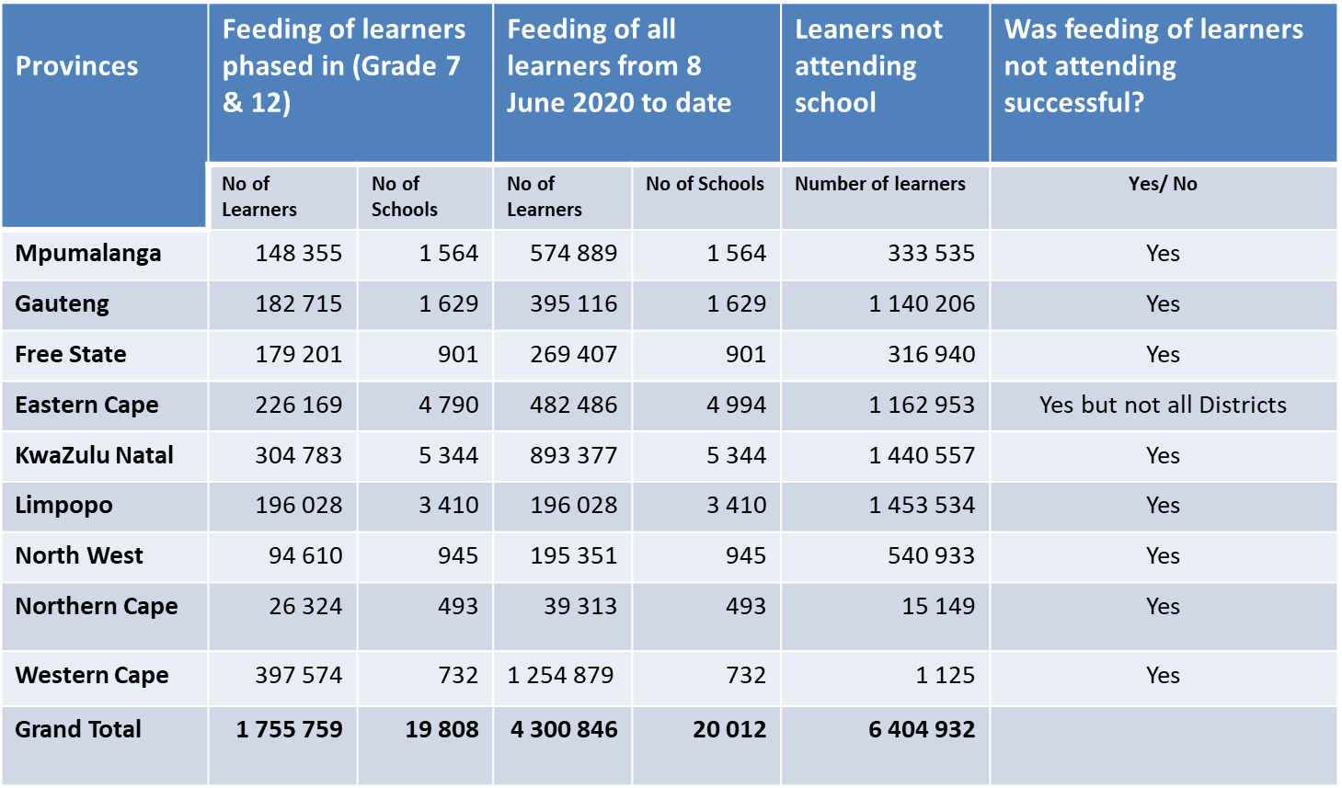
PROGRESS ON FEEDING LEARNERS THAT ARE NOT AT SCHOOL

Slide 46
DETAILS OF COVID-19 INFRASTRUCTURE RELATED INTERVENTIONS MADE BY THE DEPARTMENT IN SCHOOLS
46
45

Slide 47
EDUCATION INFRASTRUCTURE GRANT (EIG) BUDGET CUT – OVERVIEW (1)
The Education Infrastructure Grant was reduced by R1.9 billion at the beginning of the financial year, and these further cuts are certainly going to have a devastating effect:
  Procurement of COVID-19 Hygiene Packages utilised significant funding which were not part of the planned expenditure.
  The eradication of backlogs related to the Minimum Uniform Norms and Standards for Public Schools for School Infrastructure will be delayed.
  The lockdown will result in claims for extension of time which may include claims for escalation in cost.
46

Slide 48
EIG BUDGET CUT – OVERVIEW (2)
All Provincial infrastructure plans are in progress of being revised. Such revised plans to be submitted for approval by 31 July 2020.
Focus must be on the provision of water supply and sanitation services.
Focus must be on the eradication of over-crowding.
Focus must be on maintenance.
Current construction contracts must be honoured as far as possible.
Projects in planning and design stages may need to be postponed.
47

Slide 49
EIG BUDGET CUT IMPLICATIONS
Province | Projects to be stopped or delayed
EC | R114m for 17 new and replacement projects, R105m for 15 Upgrades and additions and R9m for 1 refurbishment project.
FS | R120m for 17 upgrades and additions as well as 44 maintenance projects.
GP | R9m for 55 new and replacements, R35m for 47 upgrades and additions, R162 for 168 rehabilitation and refurbishments and R17m for 32 maintenance projects.
KZN | R78m for 22 new and replacement schools and R222m for 400 repairs and renovations projects
LP | R50m for 7 new and replacement projects and R135m for 101 refurbishment and rehabilitation projects.
MP | R56m for 24 new and replacement projects, R48m for 435 maintenance projects and R56m for 249 upgrades and additions
NW | R143m for 24 new and replacement projects and R16m for 4 upgrades and additions
NC | R41m for 51 upgrades and additions and R40m for 22 new and replacements projects
WC | R159m for 200 maintenance projects
SUMMARY 1 938 Projects
New and Replacements | 168 Projects
Upgrades and additions | 388 Projects
Rehabilitation and refurbishment | 269 Projects
Repairs and renovations | 400 Projects
Maintenance | 711 Projects
48

Slide 50
EMERGENCY WATER SUPPLY & SANITATION
Due to the COVID-19 pandemic, the President announced a National lock-down and closed all schools in March 2020.
Discussions regarding the re-opening of schools quickly focussed on the availability of the water supply and sanitation services at schools.
The Department of Basic Education assisted with water supply to 3 157 schools in 6 Provinces and also assisted with sanitation to 1 428 schools in 2 Provinces.

Slide 51
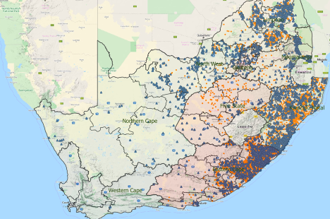
LOCATION OF WATER SUPPLY & SANITATION CHALLENGES
In 6 Provinces, DBE assisted with water supply
Water supply
Sanitation
In 2 Provinces, DBE assisted with sanitation
50

Slide 52
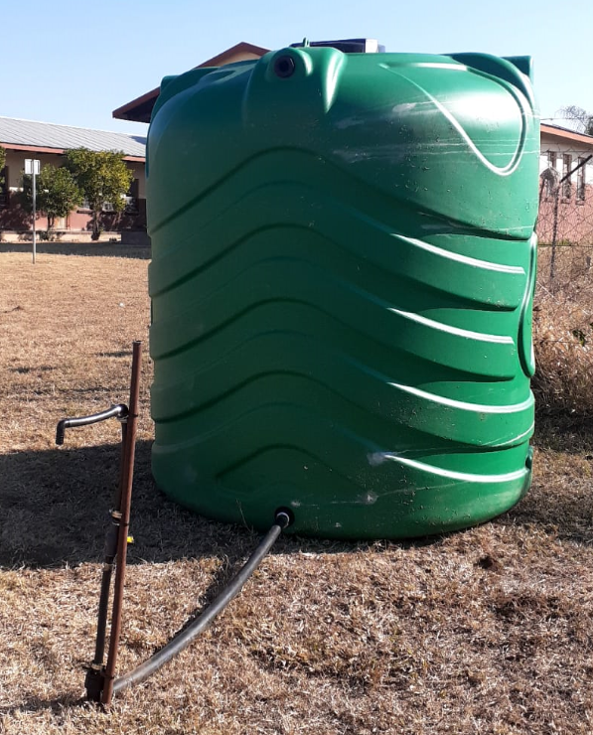
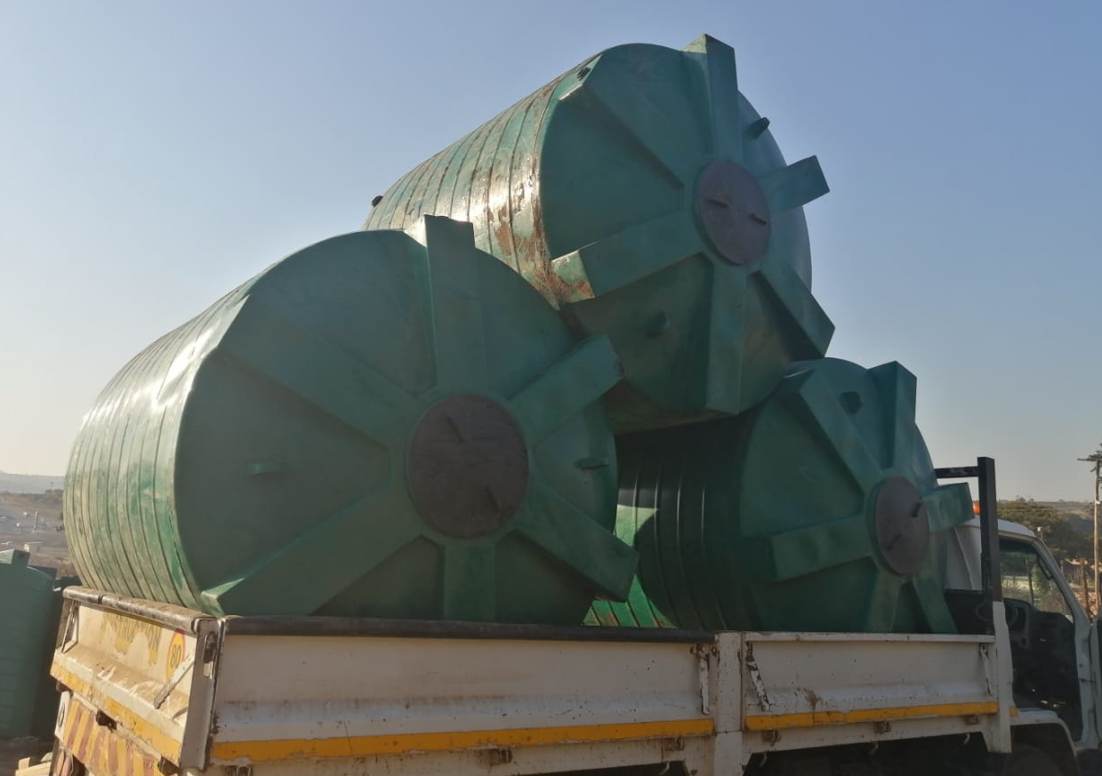
EMERGENCY WATER SUPPLY
Implementing Agent : Rand Water
Phase 1 : One tank per school with one tap on a temporary installation
51

Slide 53
EMERGENCY WATER SUPPLY : PHASE 1
52

Slide 54
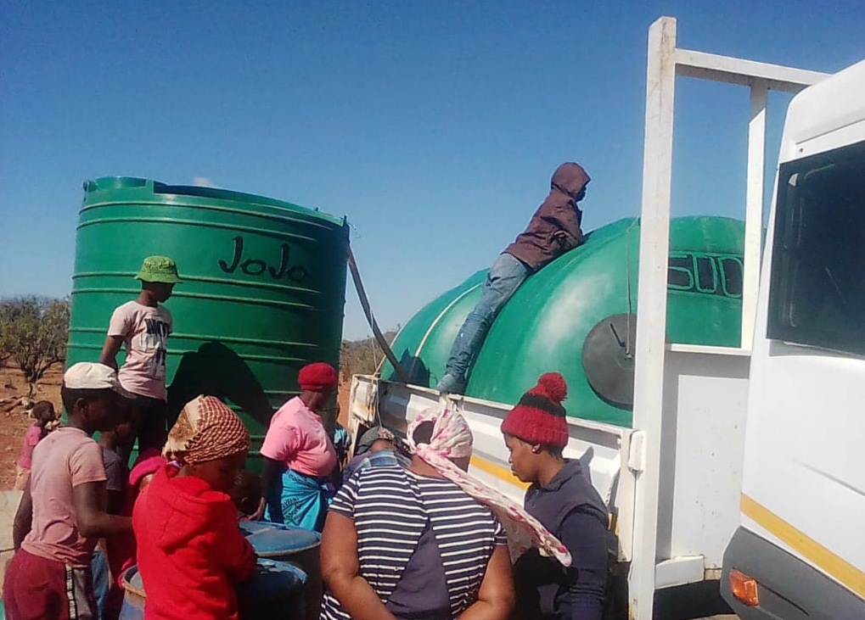
WATER SUPPLY : CHALLENGES
Reliability of Provincial data (status of water supply, availability of tanks)
Communities expected water for all
Business forums expected exclusive opportunities
Municipalities reluctant to provide water due to outstanding accounts
Availability of water tanks in the market
Implementing Agent underestimated the challenge
53

Slide 55
WATER SUPPLY : LONG TERM SOLUTION
DBE is working with DWS, COGTA, MISA & SALGA to ensure:
One-on-one link between school and water supply solution
Clear role definition between PED, DPW & Municipalities
Specific arrangement required for on-site solution
All schools
23 500
Water Services Authority (Municipality)
Water Services Provider (Municipality or Water Board)
Closest municipal water treatment works
Closest municipal water reticulation
Borehole on site
Service agreement
54

Slide 56
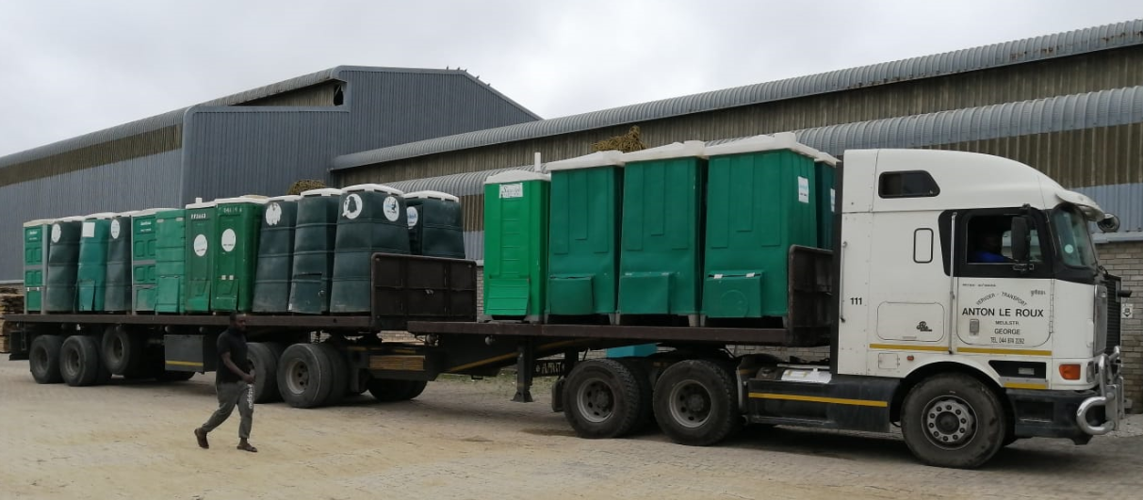
EMERGENCY SANITATION : PHASE 1
A total of 2 mobile units was installed at 100% of the 1 428 identified schools
This is currently being topped up to 4 mobile units per school (50% complete)
Rental agreements include weekly servicing of toilets
Day-to-day cleaning is responsibility of School Management
55

Slide 57
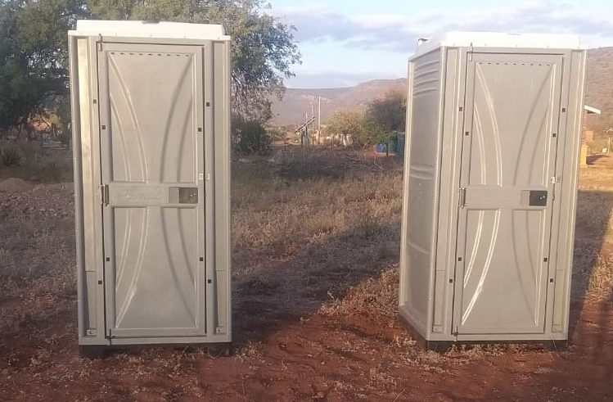
SANITATION : CHALLENGES
Reliability of Provincial data (status of sanitation, availability of toilets)
Schools expected full complement permanent toilets
Business forums expected exclusive opportunities
Municipalities reluctant to accept sewage disposal
Availability of good quality mobile toilets in the market

Slide 58
SANITATION : LONG TERM SOLUTION
DBE is working with DWS, COGTA, MISA & SALGA to ensure:
One-on-one link between school and sanitation solution
Clear role definition between PED, DPW & Municipalities
Specific arrangement required for on-site solution
All schools
23 500
Water Services Authority (Municipality)
Water Services Provider (Municipality or Water Board)
Closest municipal waste water treatment works
Closest municipal sewer system
Service agreement
57

Slide 59
THE DEPARTMENT’S ROLE IN ADVANCING BROAD-BASED BLACK ECONOMIC EMPOWERMENT IN SOUTH AFRICA THROUGH THE BILL
59
58

Slide 60
ADVANCING BROAD-BASED BLACK ECONOMIC EMPOWERMENT (BBBEE)
The department ensures that during the procurement of goods and services it takes into account the prioritisation of designated groups by incorporating in the bid documents as a mandatory requirement the subcontracting of a certain percentage of the contract value to the designated groups.
Even during the quotation process, the department focuses on those companies that are owned by individuals that are previously disadvantaged when requesting quotations so that they can be able to participate in the process.
*The figures in the next slide show the total amounts for transactions where BBBEE have been advanced. Included in the total amount there are amounts for youth, women, military veterans and disabled people who are black as well therefore the amounts does not have to add up to the total amount of orders.

Slide 61
ADVANCING BROAD-BASED BLACK ECONOMIC EMPOWERMENT (BBBEE)
Description | Amount (R )
Total transaction amount of orders | * 718 154 844,26
Total transaction amount of orders where black people participated | 557 682 376,24
Total transaction amount of orders where black women participated | 198 097 652,42
Total transaction amount of orders where youth participated | 224 630 603,75
Total transaction amount of orders where disabled people participated | 146 149,08
Total transaction amount of orders where military veterans participated | 11 800,00
61

Slide 62
RECOMMENDATION
It is recommended that Standing Committee on Appropriations discusses Vote 16: Basic Education: 2020/21 Special Adjustment Budget.
60

Slide 63


63

