Slide 1
June 2020 Budget Adjustments Funding Implications
Presentation to the Portfolio Committee on Higher Education, Science and Technology and Select Committee on Education and Technology, Sports, Arts & Culture.
14 July 2020

Slide 2
Contents Page:
Part A: 2020 Academic Year in Context
Part B: 2020 Academic Year Plans to Rescue
Part C: Innovations for 2021
Part D: Transitioning from Administration
Part E: Update on Forensic Investigations

Slide 3

PART: A
2020 Academic Year in Context

Slide 4
Funding Statistics for Universities
The 20% surge in funding in 2020 of NSFAS beneficiaries at University due to increased uptake of fee free bursaries )
TABLE 1 : COMPARISON OF THREE YEARS REG RECEIVED BY NSFAS
The number of funded students in the university sector increased by 5% from 2018 to 2019, however a steeper increase of 20% is noted from 2019 to 2020 academic year. The 2020 figures reflects records received to date and we still anticipate for second semester.
This rapid increase has been recorded in institutions that have enrolled significant numbers for NSFAS funded students. With this increase it is projected that the allocation of R28bn will be fully utilised by the end of the academic year.
COVID 19 Pandemic puts further pressure on the allocation with the potential extension of the academic year.

Slide 5
Outstanding Challenges in University Sector /1
Private Accommodation providers not receiving due payments where students pay directly to the landlord:
Private Landlord Association escalated non-payment by students to NSFAS and the DHET for consideration. The DHET consulted all stakeholders in developing a draft framework; the proposals are:
The cost for university-leased accommodation remains at the same level for the 2020 Academic Year,
For periods of non-occupation, a payment of 50% of the monthly fee could be applicable, with the remainder of the full fee spread out over the extended academic year once the student takes up occupation again.
Institutions to assist students in negotiating arrangements with the landlords.
NSFAS not receiving registration, historic debt and appeal data against agreed datelines
Some institutions consistently don’t pay students prior to end of month increasing hardship of students
Multiple Registration Records
NSFAS is faced with a challenge of students who apply and register at several institutions. This creates a problem if institutions submit a registration claim for a single student. Solution is to make available HEMIS system centralised at DHET. This cuts across both Universities and TVET Colleges.

Slide 6
Outstanding Challenges in University sector /2
Students exceeding the N+2 Qualifying Criteria
The N+2 Rule applied by NSFAS as a qualifying criteria for funding. N is the minimum qualification completion time specified by the university for a programme of study. Students who registered prior to 2018 are allowed N+2 years to complete the qualification and receive NSFAS funding, while students registered in 2018 onwards are allowed N+1.
The Minister approved once off concession for N+2 rule
Students who met the following conditions were re assed
i) Where students cancel their enrolment in the first semester the particular year will not add to the N+ calculation.
ii) Where students provide medical or psycho-social evidence that they had to cancel their studies, that year will count.
Students in their final year that exceed the N+2 provisions will be funded to teach them out of the system this year
NSFAS received 9068 N+2 appeal resubmissions. Of these 7,569 have already been approved for funding.

Slide 7
Other Funders
2020 - Payments status update
47% allocation already distributed to approved students
Private accommodation instances whereby funding did not reach landlords timeously: resolved with direct communication to institution/landlord
Unfunded Students: Implementing referral process for missing middle and postgrad
370 students referred to HW SETA for the Medicine qualification at various institutions. Similar engagements with W&R and Services SETA for the Sector specific qualifications
Claims Processing: Under Lockdown
Fast tracking to eliminate manual transactions
Move away from manual processing, refining the online processing
Study devices
Budget impact: Utilising current year funding for the devices, no additional funding expected
Advantage: Some Funders differentiate book allowance from study device, this has made it easy to support students.
DBE-FUNZA LUSHAKA: Laptop
Utilising current year funding for the devices, Offer to be sustained within the Bursary offering from 2021 onwards, guidelines to be updated
2020 PORTFOLIO Commitment | 2020 Paid | Approved Students
1,841,776,885 | 854,016,085 | 19,120

Slide 8
Funding Statistics for TVET Sector
TABLE 1 : COMPARISON OF THREE YEARS REG RECEIVED BY NSFAS
TABLE 2 : COMPARISON OF THREE YEARS REG RECEIVED BY NSFAS
The 2020 figures reflect year to date, as we still anticipate outstanding registration records for Trimester 2.The increase in the paid amounts for 2019 was due to improvements in the standardisation of allowances that were introduced.
The funding for 2020 will be sufficient due to the S2 and T3 that will no longer be implemented as per the academic calendar. However, had we had a full year we would have experienced funding challenges in the TVET sector. This already signals the potential funding shortfall for TVETs in 2021, due to the allocation of the bursary which is R6,5 billion for 2020 and increases by CPI in the MTEF.

Slide 9
Outstanding Challenges at TVET’s
Discrepancies between results received from the department and institutions impacts negatively funding of returning students. Proposed solution NSFAS to receive results for TVET students directly from the institutions
Delayed payment from TVETS managing disbursements to students
NSFAS wallet – Students not receiving allowances because of blocked accounts or cell phone and ID mismatch. This could be due to suspected fraud. These reports of failures are sent to institutions after each disbursement run and there are internal processes to respond to each category of student that has queries.
4. Sustainable funding for the laptop initiative. NSFAS will provide once off grant for digital devices for TVET students and reallocation of book line items contemplated for future sustainability

Slide 10

PART: B
Plans to Rescue 2020 Academic Year

Slide 11
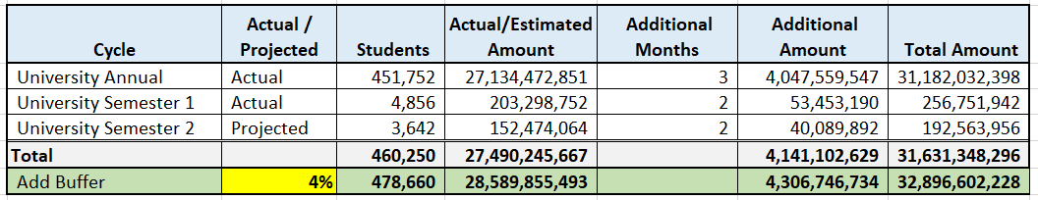

R4.3 Bn Budget Impact - Extended Academic Year
Universities – Assumption no additional tuition fees
We expect a full student intake and full budget allocation for the 2020 academic year.
A 4% “buffer” has been added to accommodate the estimation of a full in-take of students.
Budget is based on 3 additional months for Annual Cycle and 2 additional months for both cycles 1 and 2.
Allowances
  Transport, Food, Accommodation, Disability, and Allowance is included.
  Tuition is excluded.

Slide 12
R0.3 Bn Budget Impact - Extended Academic Year
TVET Colleges
Not all TVET colleges have submitted registration information to date for funded students.
Thus, a 10% buffer added to yield our overall projection of 448,058 students at a spend of R 6.4 billion for the normal academic year.
The budget for the extended period is based on the DHET revised calendar.
An additional month allocated for the annual cycle to cover exams.
The S1 and T1 extension funds will be taken from the normal allocation which would have ordinarily been used for S2 and T2 hence the same number of students are projected.

Slide 13

2020/2021 Annual Performance Plan
BUDGET - REVENUE
 | 2019/20Est R bn | 2020/21 R bn (Previously reported | 2020/21 R bn (REVISED) | 2021/22 Rbn | 2022/23 R bn
Entity revenue | 1.7bn | 1.3bn | 1.3bn | 1.4bn | 1.4bn
DHET –student funding | 30.7bn | 34.8bn | 34.8bn | 36.6bn | 38.2bn
DHET –admin funding | 0.3bn | 0.3bn | 0.4bn* | 0.3bn | 0.3bn
Admin fees-other funders | 0.1bn | 0.1bn | 0.1bn | 0.1bn | 0.1bn
Other grants | 1.8bn | 1.9bn | 1.9bn | 2.1bn | 2.2bn
Total revenue | 34.6bn | 38.4bn | 38.5bn | 40.5bn | 42.1bn
* The changes relate to additional grant for Administration extension to August 2020 amounting to R7.8million, additional grant of R36.1 million and R5.5 million reduction after supplementary budget.

Slide 14
2020/2021 Annual Performance Plan
BUDGET - EXPENDITURE
 | 2019/20Est R bn | 2020/21 R bn (Previously reported) | 2020/21 R bn (revised) | 2021/22 Rbn | 2022/23 Rbn
Compensation of employees | 0.2 bn | 0.2bn | 0.2bn | 0.2bn | 0.3bn
Goods & services | 0.2bn | 0.1bn | 0.2bn* | 0.2bn | 0.2bn
Transfers & subsidies | 32.6bn | 36.7bn | 36.7bn | 38.7bn | 40.4bn
Impairment losses | 1.6bn | 1.4bn | 1.4bn | 1.4bn | 1.2bn
Total expenditure | 34.6bn | 38.4bn | 38.5bn | 40.5bn | 42.1bn
* The changes relate to additional grant for Administration extension to August 2020 (R7.8m), cost associated with disbursement to TVET colleges (R10.3m), Contact centre consultants (R10.8m), forensic investigation (R5.0) , Court Road renovation (R10.0) and R5.5 million budget reduction after supplementary budget.

Slide 15
2020/2021 Annual Performance Plan
BUDGET – EXPENDITURE PER PROGRAMME
 | 2019/20Est R bn | 2020/21 Rbn (Previously reported) | 2020/21 Rbn (Revised) | 2021/22 Rbn | 2022/23 Rbn
Programme 1 | 0.3bn | 0.3bn | 0.4bn* | 0.3bn | 0.3bn
Programme 2 | 34.3bn | 38.1bn | 38.1bn | 40.2bn | 41.8bn
Total expenditure | 34.6bn | 38.2bn | 38.3bn | 40.5bn | 42.1bn
Programme 1 - Consists of the following service units: executive office, finance, human resources, corporate services: marketing and communication, information and communication technology, governance risk & compliance. Programme 2- This programme consists of the following service units: loans and bursaries administration, Contact centre, research & policy. * The changes relate to additional grant for Administration extension to August 2020 (R7.8m), cost associated with disbursement to TVET colleges (R10.3m), Contact centre consultants (R10.8m), forensic investigation (R5.0) , Court Road renovation (R10.0) and R5.5 million budget reduction after supplementary budget

Slide 16
The 2020/21 Revised Allocation Letter
The revised allocation letter dated 3 July 2020 has an onerous condition that NSFAS cannot comply with, without disastrous consequences.
The R2.5 billion suspension of student grant funds and the earmarking of that for student devices cannot be implemented.
The full original student grant funds is required for the normal 2020 academic year disbursements.
NSFAS recommended that student devices be funded as follows:
R2.1 billion of Recovered Funds be utilised for University students
R1.5 billion of Accumulated TVET Funds be used for TVET students.
DHET is engaging National Treasury on the onerous condition.

Slide 17
NSFAS Application Window for 2021
Applications for 2021 will open on 1 August and close on 30 November 2020
Partnership with DBE to include NSFAS procedures in career guidance and for schools to assist with applications
Virtual Outreach strategies have been developed. These include Email outreach, Mobile outreach, Social Media outreach, Print & online outreach, Radio & TV outreach as well as Institutional outreach
Several intergovernmental partnerships e.g. DSD for SASSA beneficiaries are being enhanced considering Covid19 restrictions.
Stakeholders have been identified to help us increase awareness about the application period, assist NSFAS in provincial application activations as well as increase social media marketing reach.
These partnerships include DBE; DSD; Municipalities; DHET KHETA Outreach Unit; National Libraries and Thusong Centres; Community Based Organisations; NYD; Churches etc. The support is on going through other virtual means such as WhatsApp groups which has been created to include Principals and District managers

Slide 18
Digital Devices for NSFAS Beneficiaries /1
On 30 April 2020 Minister announced that NSFAS funded students in universities and TVET colleges will be provided with a digital device to augment learning in 2020 during the COVID 19 lockdown. This program will continue into the future as the devices will become an essential part of student empowerment and capacitation. Students will own the devices outright and it is contemplated that their learning experience will be enhanced through access to learning material beyond the classroom.
The acquisition of digital devices, with the requisite software and data, for university students is already accommodated for in the NSFAS learning material allowances. Several universities have already channelled these funds towards procurement and access to digital devices with NSFAS assisting with cashflow where required.
A survey undertaken by DHET showed that over 65% of universities are in different stages (commenced or completed) of the procurement processes for the devices. Many students at these universities have already received their digital devices, while some are awaiting delivery.

Slide 19
Digital Devices for NSFAS Beneficiaries /2
Policy deviation for allocation of learning material allowance to TVET College students for the 2020 year signed off by Minister Nzimande. Funding for TVET college students does not currently make provision for a learning material allowance.
Tender advertised 26 June 2020, closing 13 July 2020. Anticipated that tender award and contracting completed by 15 August 2020.
To stimulate growth in local economy , tender provides that only BBB-EE level 1 and 2 applicants are eligible. The bidder must sub-contract at least 30% of the contract to an SMME which is at least 51% black owned. All laptop bags must be 100% locally manufactured/produced.
A MOA between institutions and NSFAS will be signed for concurrence on terms and conditions for the transfer of funds for the procurement process. List of all NSFAS funded students that require digital devices to be provided to NSFAS for verification and vetting.
NSFAS will provide the approval for the purchase order directly to the appointed service provider (s). The digital devices (including any pre-loaded learning software) will be delivered directly to NSFAS students’ premises by the appointed service provider(s).
The tender will serve as a central contract from which academic institutions will procure the requisite digital devices directly from the appointed service provider(s). The tender requires that the full quantity needs to be delivered by 30 September 2020.

Slide 20
Direct Payment of Student Allowances
NSFAS adopted the guidance from PCHET of not confining this to existing service providers, albeit NT approved.
NSFAS issued a Request for Information (RFI) on 15 May 2020. The RFI closed on 12 June 2020. 35 submissions were received.
Inputs from the submissions were considered in drafting the Request for proposal (RFP) , which has been reviewed and supported by the project steering committee on 6 July 2020.
The Chief Director: Procurement: DHET has been engaged for input into the RFP. His input was received on 7 July 2020 and considered.
The RFP document is in the process of being approved by the Administrator prior to tabling at the NSFAS Bid Specification Committee (BSC) and NSFAS Bid Adjudication Committee (BAC), for approval for advertisement.
RFP will be advertised on 24 July 2020, with closing date of 21 August 2020. Anticipate tender award and contracting concluded by 30 September 2020.
Direct payments of allowances to TVET students planned for implementation academic year 2021
Direct payments of allowances to University students is planned for implementation by latest academic year 2022
NSFAS engage sector, including students’ bodies, to open bank accounts at any bank of their choice.

Slide 21

PART: C
INNOVATIONS FOR 2021

Slide 23













Project Started and Supported By:
National Integrated Cyber Infrastructure System (NICIS) supports NSFAS in cyber security maturity.
The defense, peace, safety and security domain (CSIR) supports NSFAS in cyber security maturity.
Ongoing
Ongoing
Due: 31 August 2020
Due: 30 November 2020
Due: 30 November 2020
NSFAS Wallet (fraud-prevention),
Disbursement (fraud-prevention),
Awareness, Communication, Training, Reporting, and weekly articles
Enterprise Architecture (EA)
Gap Analysis & Tools to deploy
Vulnerability Assessments
Technical Security Controls
Access governance
Asset discovery
Change Management
Risk Assessment
Security policies & procedures review
Physical & environmental security
Incident management & response
Third party management
Cyber Security & Cloud Strategy
Due: 30 May 2021
Due: 30 November 2020
Due: 30 November 2020
Due: 30 November 2020
Source: NSFAS Cybersecurity Assessment (PwC); 2017
Operations: Cyber Security / Tools
Information Security Management System
Governance (Roles, Reporting Structure & General Manager)
Incident resilience planning & strategy
Regulatory and Legislative Compliance
Cyber Security Incident Response (CSIRT) & Cyber Security Operation Centre (SOC)

Slide 24
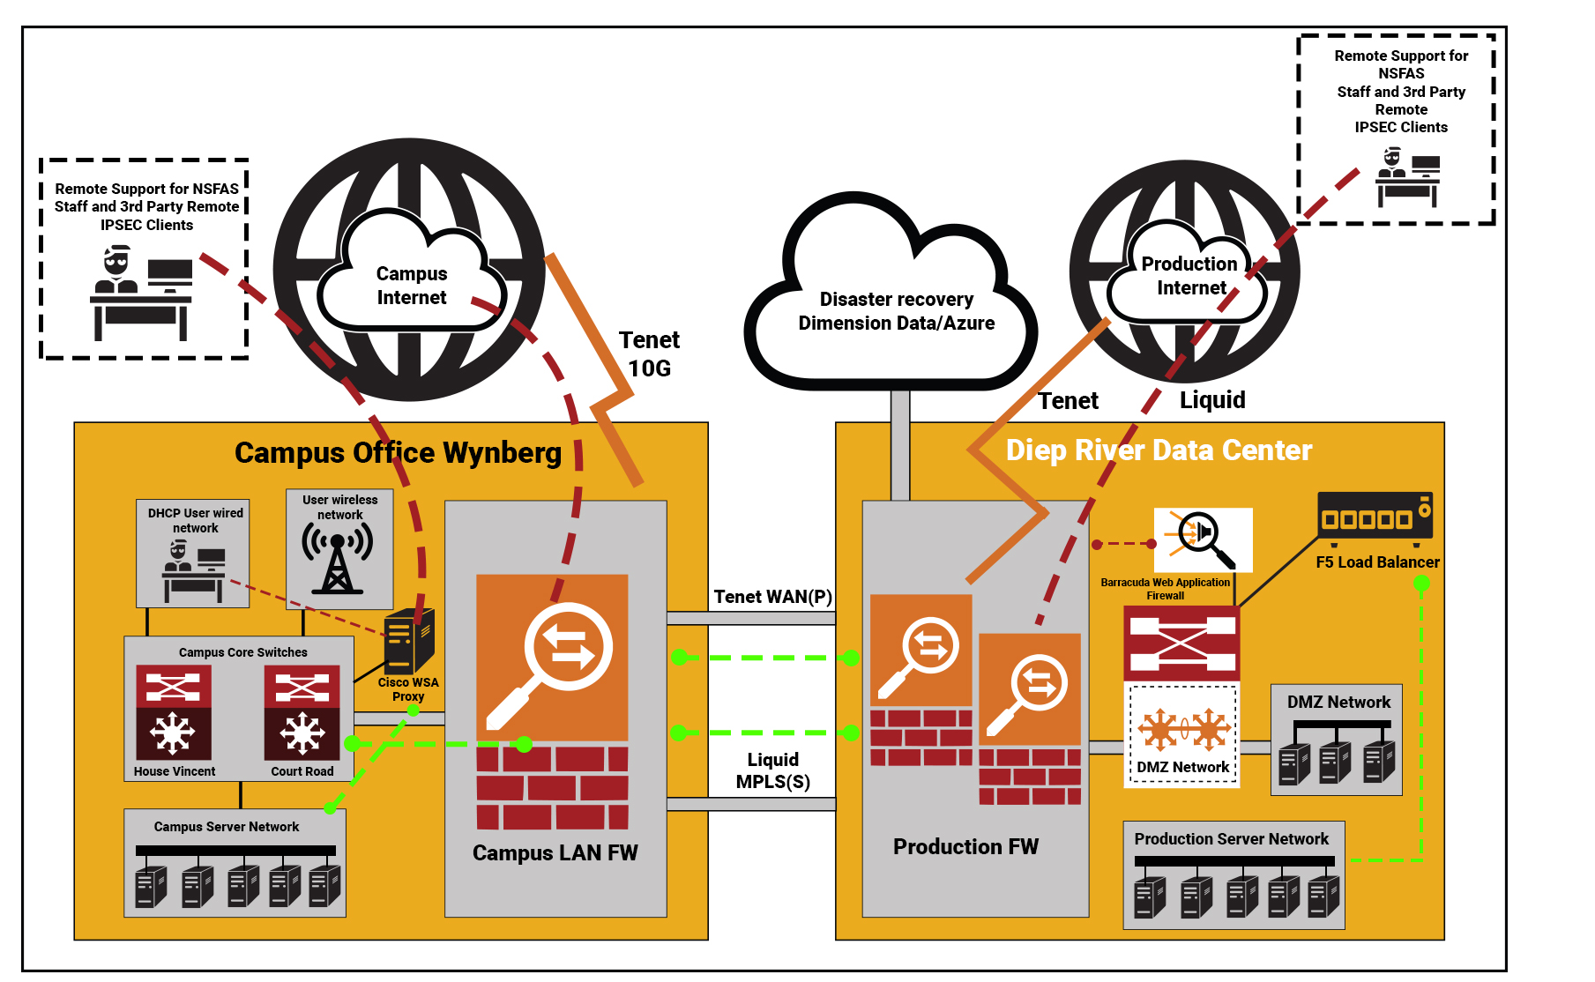


Modernising ICT Infrastructure Moving to a Government-owned Cloud Computing Platform

Slide 25
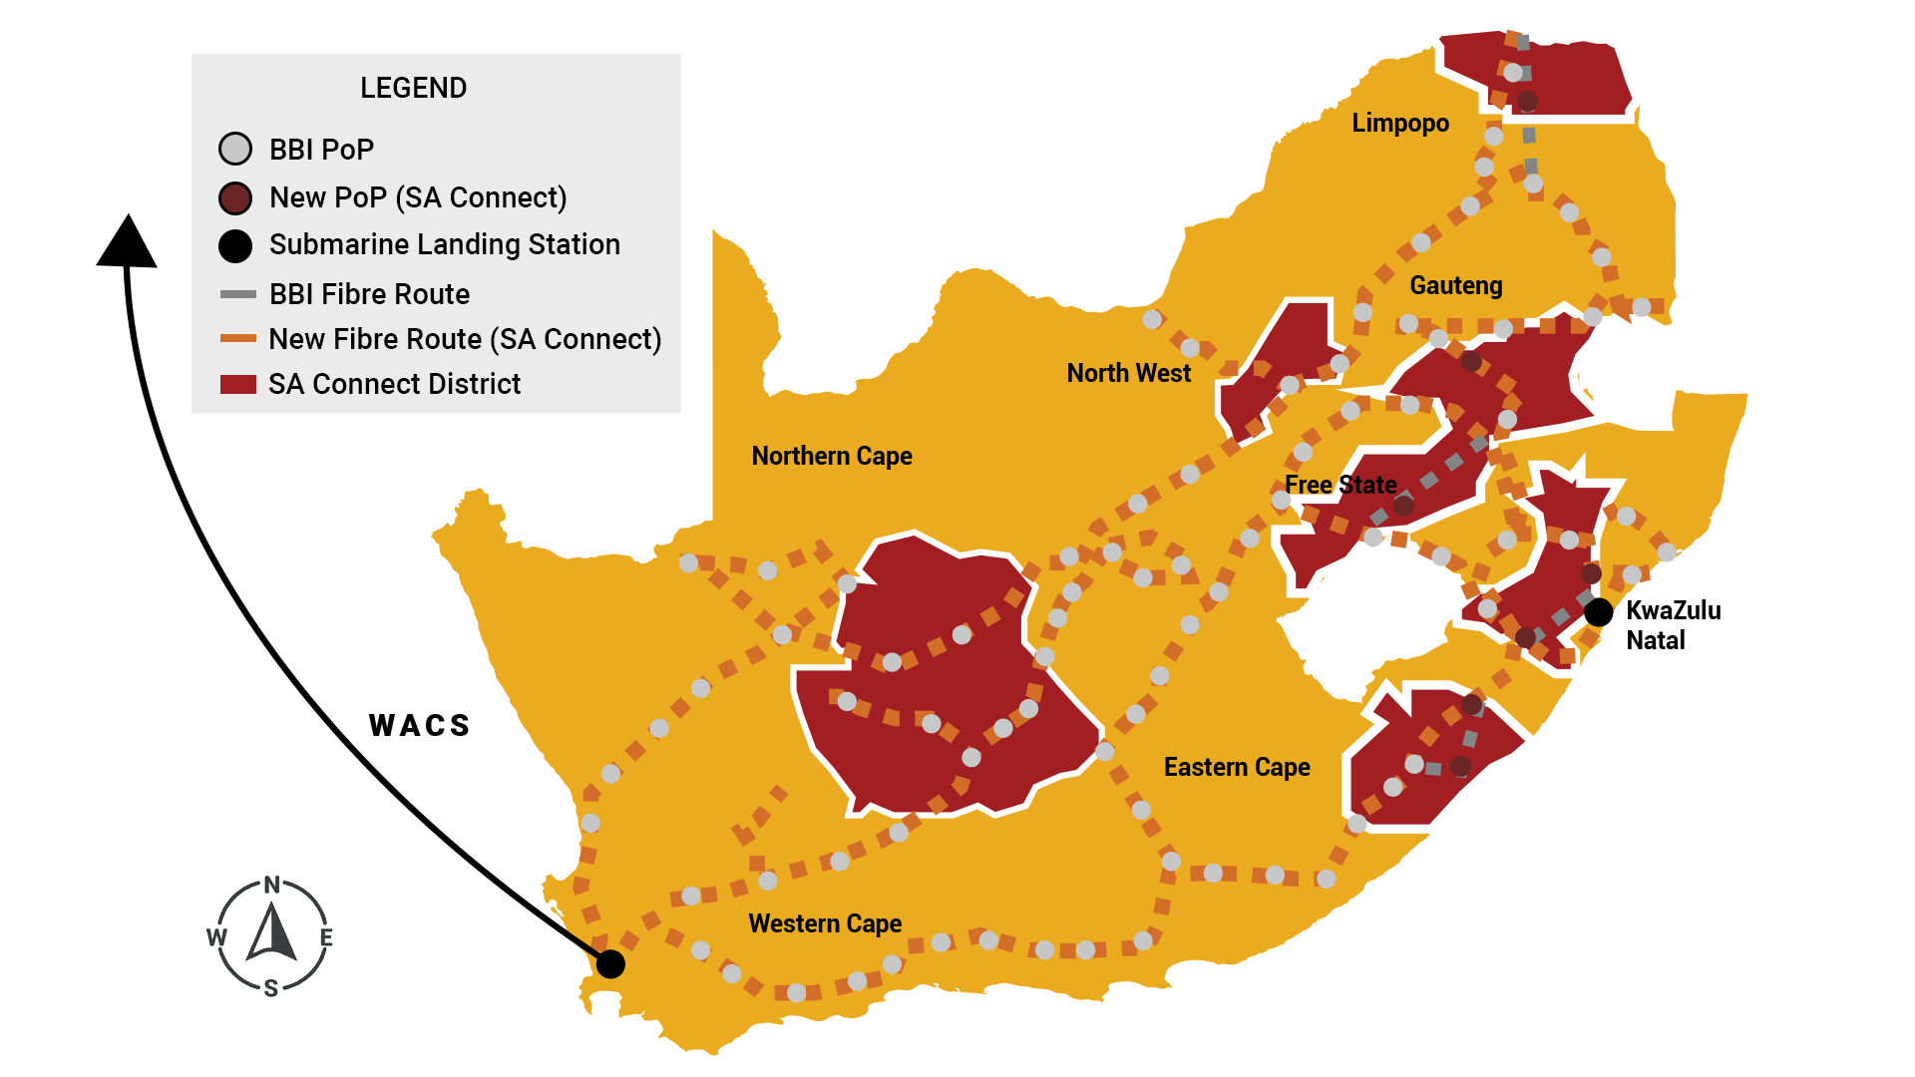
Geo-coding and Geo-mapping initiative with CSIR:
Marginalised
Students’ connectivity
(Geo-spatial Analytics)
assessment to map nearest addresses with connectivity.

Slide 26

PART: D
TRANSITIONING FROM ADMINISTRATION

Slide 27
Interim Report on ToR’s of Administrator
Recognition that critical work still needed to be consolidated and to avoid possible resurgence of instability in the sector, it was recognised that a second phase of Administration would be required, effective from August 21, 2019 to August 20, 2020 (as per Government Gazette No. 42662). The second phase of Administration turned its focus to the important longer-term work to establish NSFAS as a sustainable organization. Significant achievements have been realised in relation to the Administrator’s ToRs:
Administrator’s ToRs
Interim progress
Finalise the close out of the 2017 and 2018 student funding cycle, including the finalisation of all data exchange and final payments:
Ensure the effective close out of the 2019 funding cycle and provision of accurate data to the Department:
Ensure effective preparation for, and implementation of, the 2020 student funding cycle in consultation with the Department:
Ensure that the entity pays adequate attention to both TVET colleges and universities in all aspects of its core business processes:
Maintain a close and productive working relationship between NSFAS and the universities and TVET colleges:
Put in place the necessary management and governance controls to ensure that all risks of the 2020 student funding cycle are appropriately managed, with the support of the Department and institutions as necessary:
Manage the day -to -day work of the entity, and steer NSFAS to address its operational challenges fully:
Oversee the process of appointing new Executive staff at NSFAS, in terms of the process agreed with the Department:
Ensure a smooth transition between the administration team and the new Executive staff:
Oversee all forensic and other investigations necessary for the effective operation and management of the entity and any follow up required:
Provide support to the Ministerial Task Team appointed by the Minister to review the business processes of the entity which will make long -term recommendations on the future models, structures, systems and business processes necessary for an effective NSFAS:
Significant proportion of issues resolved and NSFAS has recommissioned 2017/18 Close Out project to complete all the outstanding work relating to funding & disbursement of allowances for 2017/2018 & 2018/2019 academic years.
NSFAS has disbursed 98% of the signed bursary contracts value
Successfully processed 2020 applications and announced funding decisions before the start of the registration period. Over 530 000 student assessed as being provisionally funded.
TVET Bursary Administration Unit established, bringing stability & improvements in processing of applications, funding decisions & data integration between Colleges & NSFAS.
Several systems enhancements, funding data exchange & data quality control improvements effected at institutions, through closer working relationships between stakeholders.
A range of controls and governance protocols have been implemented to address & manage 2020 risks. For e.g. to address N+2 complaints, multiple registration issues & strengthening of the appeals process to ensure that the eligibility of students are correctly assessed.
IT system capacity improvements have enabled stable high-volume processing to regularize payments to students and institutions. Disbursements shifted from daily to monthly run, improving oversight & control & enabling predictability in allowance & other payments.
An inclusive process was undertaken with the Department & the Office of the Ministry to confirm structure of executive team. The process of recruitment for CEO, CFO, CIO, COO & CCSO were initiated during Q1 of 2019 and the formal recruitment activities commencement in Q1 of 2020.
Recruitment of key technical skills managed under the umbrella of critical skills vacancy list. Competent individuals appointed to act in CIO & CFO roles to create required stability within Operations & ICT environments.
Investigations at various stages of completion and where NSFAS has received draft or final forensic reports, it has taken the necessary precautionary & decisive action to respond to recommendations.
Ministerial Task Team appointed, setting out specific ToR’s for its operation. Administration team & executive committed to provide support in terms of guidance and documentation

Slide 28
Audit Committee and Board Update
Audit Committee in Terms of PFMA Established
Members comprise of:
Nominated representative from National Treasury
Nomination representative from DHET
Three independent members
Established in terms of the PFMA
Orientation set for 16 July
First meeting set for 28 July
Establishment of the NSFAS Board
Nomination process is being handled by DHET
Board to be established and hand over facilitated
Board to be effective at close of Administration

Slide 29
Executive Appointments
Chief Executive Officer – The process did not yield a candidate for appointment .
Chief Risk and Governance Officer (CF) – The successful candidate assumed duties in April 2020.
Chief Operations Officer (BF) – The successful candidate assumed duties in April 2020.
Chief Information Officer (BF) - The process did not yield a candidate for appointment and the ICT advisor is acting as CIO
Chief Corporate Services Officer (BF) - The successful candidate assumed duties in June 2020.
Chief Financial Officer – The process is currently underway and scheduled for closure by end July 2020.
                Recruitment undertaken in compliance of NSFAS recruitment and selection policy.
                Advertised internally in national newspapers and via recruitment agencies.
                Selection panels for all positions included external sector professional and nominated DHET and Treasury representatives.
                Appointed candidates underwent a vigorous process which included

Slide 30

PART: E
UPDATE ON FORENSIC INVESTIGATIONS

Slide 31
Irregular expenditure
Category | Amount | Remaining actions
Shifting of earmarked funds (historic debt) | R1,963bn | All processes completed, approved by the Administrator, the amount will be written off in terms of national treasury guidelines.
Disbursements with respect to NOCLAR | R4,359bn | This is still being addressed and should be closed out during the 2020/ 2021 financial year, including recoveries, as part of the close out project.
Disbursements in excess of contract amounts | R1,236bn | The system generating loan agreements at an incorrect (lower value). The disbursements to these students were in terms of their NSFAS loan awards. The over-disbursements are thus a technical contract issue and requires that the contracts be rectified. The national credit act requires that these amended contracts are signed physically. However, the costs to do this exceed R50m, making this a non-viable option. NSFAS has applied to the credit regulator for a waiver to this legislative requirement.
Other | R6m | All investigation processes completed, an application for condonement has been sent to National Treasury

Slide 32
Total Case Load In The Last 12 Months
(Excludes Fraud Hotline Cases)
Forensic update

Slide 33
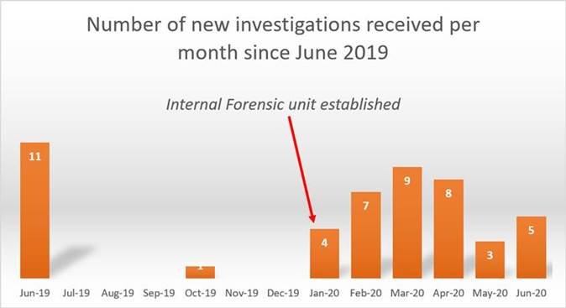
Analysis of New Investigations
(Excludes Fraud Hotline Cases)

Slide 34
HR Forensic Investigations
Key findings
Investigation: Employee existence
Investigators confirmed no ghost employees.
Investigation: Job Grading:
Policy governing job grading not followed
2017: 5 staff members graded out of process with a combined annual salary increase of R650k
2018:14 staff members graded out of process with a combined annual salary increase of R1,6m
All job grading has since been called to a halt pending review.
Contractual Studies
Processes not adhered to in terms of policy
Staff members who left or who failed and where contractual studies amounts owing was not recovered:
2017: 15 staff members amounting to R175k
2018: 16 staff members amounting to R383k

Slide 35
HR Forensic Investigations Complete
Key Findings:
Leave encashment
12 payouts in both 2017 and 2018 where no supporting documentation could be found: R378k
Overpayments of leave encashments totaling R290k due to errors in the calculations
Total leave encashment paid in 2017: R442k and 2018: R1,5m – all done outside of policy
Pension fund
No signed contract could be found
Procurement process followed could not be traced – service provider staff did not recall going through a tender process
Administrative costs higher than market
Poor record-keeping noted
NSFAS is now a member of the GEPF and a transition process is underway
Disciplinaries:
1 in progress, on hold due to lock down
1 resignation pending charges
Remaining staff identified to be charged within the next month, pending hearing calendar

Slide 36
Sbux Investigation
Key Findings:
Back door access to systems
Three access points existed to disburse vouchers, recall vouchers and create accounts requiring no user-name or password
Use of these access points traced as far as possible and closed down
Gross maladministration
Insufficient audit trails
Poor process documentation
Key person dependency
Lack of controls and oversight
No policies and procedures governing voucher disbursements
Disciplinary process being concluded

Slide 37
Sbux Investigation
Key Findings
Previously Reported:
Three staff members arrested
Security protocols upgraded resulting in no further cases being reported
Social engineering of student PINS continues
Whistle-blowers confirmed more syndicated activity still active
Month | Sum of Rand value
September ’19 | R 255,374
1 to 9 October’19 | R 83,023
Grand Total | R 338,397.48

