Slide 1


Slide 2




Directive
The implications of the Covid-19 pandemic on the mandate of the department?
How will the revised budget impact on the overall allocations to the department?
How will the revised budget impact on service delivery targets?
How will the revised budget impact on the recommendations made during the Budget Votes?

Slide 3

Impact of COVID-19 on Stats SA
1
Impact on the strategic plan
Disruption has been identified during strategy process
COVID-19 offers opportunities to fast track strategic intent e.g. alternative methodologies and technologies
Impact on the work programme
Targets in the work programme have been affected
Reprioritise activities, resources and funding
Impact on processes and methodologies
Data collection in the field (will not resume soon) – alternative approaches have been deployed
Data collection from businesses & local govt institutions have been impacted
Impact on staff
SMS staff are working from home and office
Professional and technical staff - where possible - are working from home
Data collectors – where possible - work from home (challenges due to tools and accessibility)
2
3
4

Slide 4


Changes to the Strategic Plan
The implications of the Covid-19 pandemic on the mandate of the department?
Statistics Act:
Statistical production
Statistical coordination
Provides for independence
No changes to the Strategic Plan

Slide 5

Improving lives through data ecosystems
VISION

Slide 6

Transform
the production, coordination and use of statistics
through
optimisation, partnerships and innovation
MISSION

Slide 7
Strategic thrust
10 years +
5-10 years
2-5 years
1-2 years
Tactics
Strategy
Vision
Systems-level evolution
Thrust:
Optimise
Innovate
Partner
Diversify

Slide 8

an ecosystem that is powered by
Agile operating model
Transformed capabilities
Insightful data
Inter-connected statistical systems
Value add services
Business operating model
Data eco-system
New business model

Slide 9

Budget cuts
How will the revised budget impact on the overall allocations to the department?
Special Adjustment Budget
R Thousand | Main appropriation (2020/21) | Budget reduction | Budget increases | Adjusted appropriation (2020/21)
 | 3 452 173 | (200 000) | - | 3 252 173
R200 million contribution towards Covid-19

Slide 10
Baseline split
Ring-fenced
Main appropriation
(2020/21)
R3 452 173 million

Slide 11
Budget cuts
How will the revised budget impact on the overall allocations to the department?
R Thousand | Main appropriation (2020/21) | Budget reduction | Adjusted appropriation (2020/21)
Baseline ISIC4 Other (travel & subsistence) | 2 447 173 | (17 000) (33 000) | 2 397 173
IES (Ring-fenced) | 150 000 | (150 000) | -
Census 2021 (Ring-fenced) | 855 000 | - | 855 000
Total | R3 452 173 | (200 000) | R3 252 173

Slide 12


Changes to the Work programme
How will the revised budget impact on service delivery targets?
Operations and service delivery targets have been impacted by COVID-19 and the revised budget

Slide 13
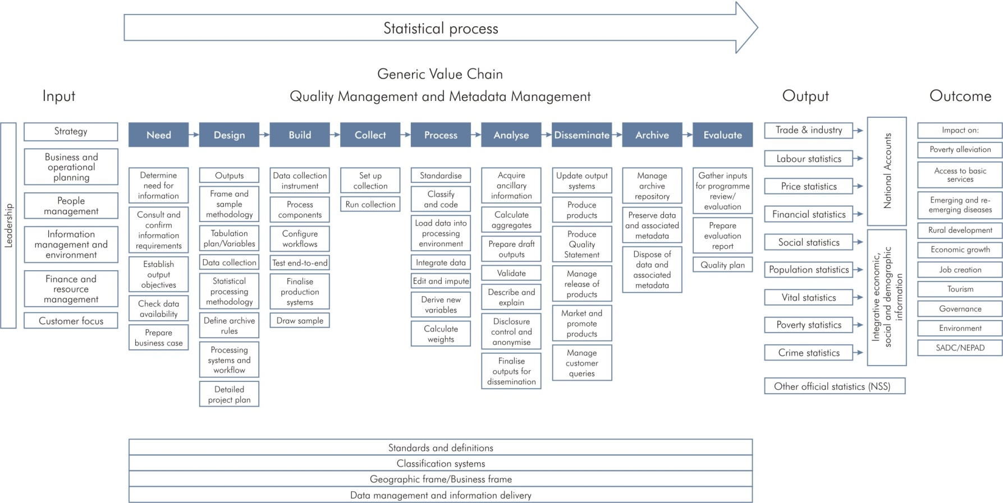
Service Delivery Model
Covid-19
Impact on

Slide 14
Insightful data
By 2025 we serve users’ basic demands on an online self-service platform
Economic Statistics
2020/21 (Q2 – Q4)
Targets deferred
  Rebasing GDP to Q1 2021/2022
  Annual report on Agriculture, Forestry and Fisheries
Targets delayed
  20 economic statistical series
  (monthly, quarterly & annual)
Targets discontinued
  2 x reports - methodological adjustments (weighting)
Sustain the quality of national indicators

Slide 15
Insightful data
By 2025 we serve users’ basic demands on an online self-service platform
2020/21 (Q2 – Q4)
Population & Social Statistics
Targets delayed
  Transport statistics
  Governance statistics
  Victims of Crime statistics
  Domestic Tourism statistics
Targets discontinued (budget cut)
  Income and Expenditure Survey (no poverty statistics measuring impact of COVID-19; impact on CPI & GDP)
Sustain the quality of national indicators
Population Census
  Changing operating model
  More testing before pilot
  Pilot scheduled for October depending on outcome of tests

Slide 16

By 2025 efficiencies in the business operating model are underpinned by innovative methodologies
Agile operating model
Objectives
Year 1
Modernise and innovate business processes to improve efficiencies
Accelerate efforts: Optimise business processes through automation
Forced to move to CATI/CAWI (risk)
Adopt/adapt international frameworks and standards to improve statistical practices
Target deferred (budget cut)
ISIC4: reclassification of the Business Register
Leverage statistical infrastructure within the data ecosystem
Operational impact
Reconceptualise geographic information frame to accommodate CATI/CAWI
Reposition and strengthen methodology function within the statistical system
Accelerate investment
Establish Innovation and Research Hub

Slide 17

By 2025 statistical systems are connected through statistical principles, standards and frameworks
Inter-connected statistical systems
Objectives
Year 1
Implement and enforce the amended Statistics Act
Draft Bill tabled in Parliament
Standardise methodological frameworks
Continue efforts:
SASQAF Online Self-Assessment Tool
Integrated Indicator Framework
Expand and strengthen strategic partnerships nationally and globally
Opportunities for new partnerships and
use of alternative data sources
National statistical system
African statistical system
Global statistical system
Envision and enable statistics in the data ecosystem
Accelerate investment in driving digital
business transformation

Slide 18




By 2025 we have adopted agile technologies and built a diverse, skilled and versatile workforce that embrace change and are able to deliver innovative solutions
Transformed capabilities
Objectives
Year 1
Invest in innovative technologies and ICT infrastructure
Deferred: Roll out Enterprise-wide architecture
Refocus: Systems development applications (CATI/CAWI)
Build a versatile and multi-skilled workforce
Explicit: EE targets and GBV programme
Focus: Develop Skills development strategy for the future
Invest in capacity building in the data ecosystem
Deferred: Invest in capacity building in Municipalities
Build a united and diverse organisation that drives transformation and change
Continue: Implementation of restructuring & redeployment of staff
Re-align Transformation and Change Agenda

Slide 19
Response to emerging data needs
1
Leading Data and statistics workstream at FOSAD
Launched online: Business impact survey of COVID-19 pandemic in South Africa
Businesses were asked how the current crisis affected their operations during lockdown
The Survey was done 3 x during lockdown
Launched Essential Products Consumer Price Index
(weekly in April 2021)
Launched online survey: Impact of COVID-19 on society
1st wave: Health behaviour and perceptions
2nd wave: Employment and Income (incl. hunger)
3rd wave: Education and time spent
2
3
4

Slide 20
Recommendations during budget vote
How will the revised budget impact on the recommendations made during the Budget Votes?
Recommendations:
Finalise and table amendment of the Statistics Act
Capacitate municipalities with statistical knowledge
Reskilling of employees on aspects such as digitisation in preparation for census
Prioritise filling of key critical positions
Stats SA together with the NT should ensure Census 2021 funding remain ring-fenced
Continue to provide statistical advice on the methodology for the administrative records
Devise a long-term connectivity strategy to link up with deep rural areas through technology

Slide 21

Strategic risks
1
DEMAND
1
2
BUDGET
Demand for statistical information growing
National/local
Continental
Global
Other
Received additional allocation for CoE (R45)
Budget cut: R200 m
Financial investment in business transformation
4
2
4
SUPPLY
Statistical releases delayed/ deferred
COVID-19 disruptions: new technologies and methodologies – not tested
New entrants to the market (quality unchecked)
3
3
PEOPLE
Skills requirement for the future
Impact of digital transformation
Work from home transition

Slide 22
Strategic Priorities
1
Sustain and protect the quality of national indicators
2
Drive business transformation and change
3
Drive Legislative reform in the statistical system

Slide 23
Ndzi Hela Kwala!

