Slide 1

Department of Defence
Impact of Adjusted Estimates
Of National Expenditures

Slide 2
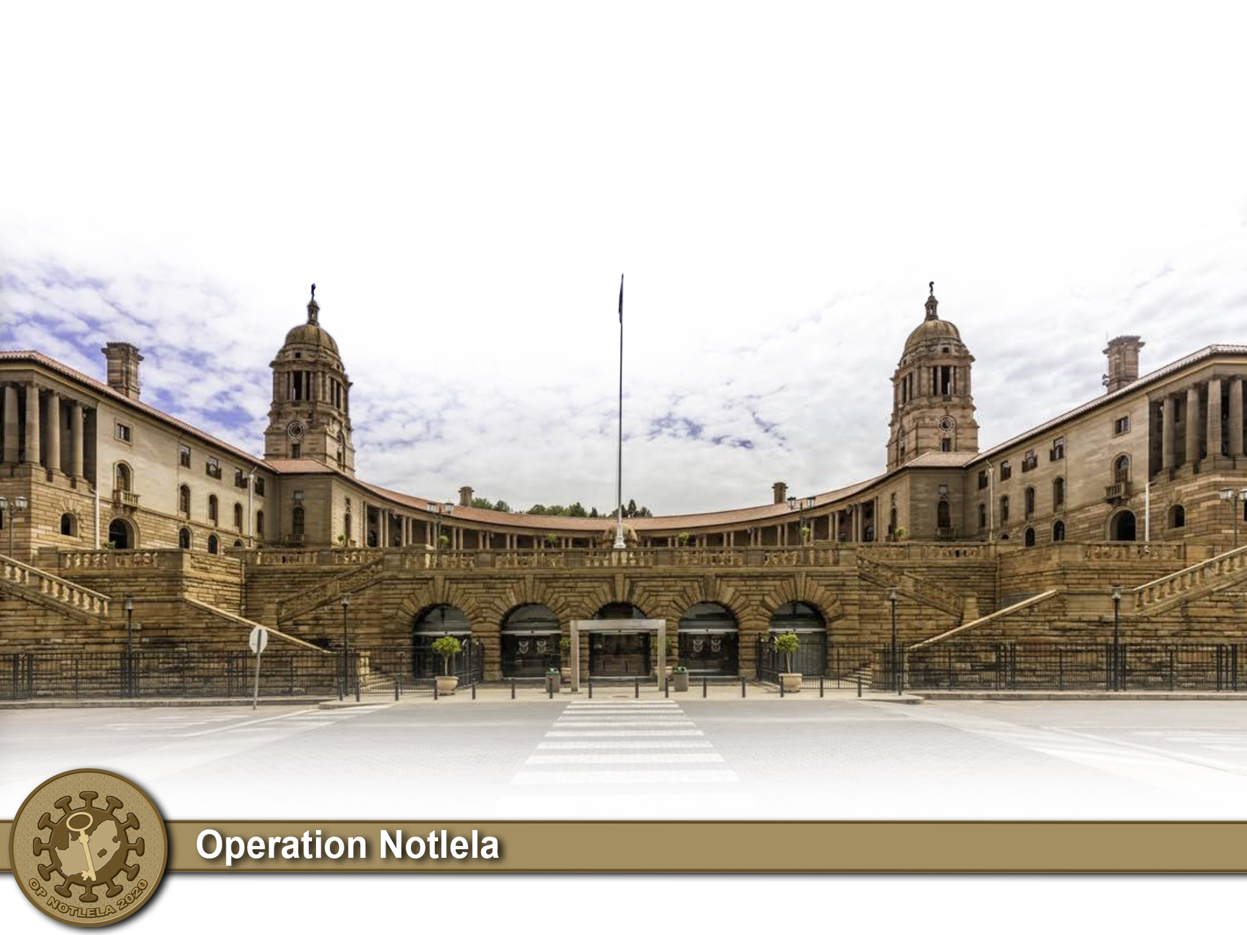
Aim
To brief the Portfolio Committee on Defence
on the impact of Adjusted Estimate of National Expenditure on the DOD Budget

Slide 3
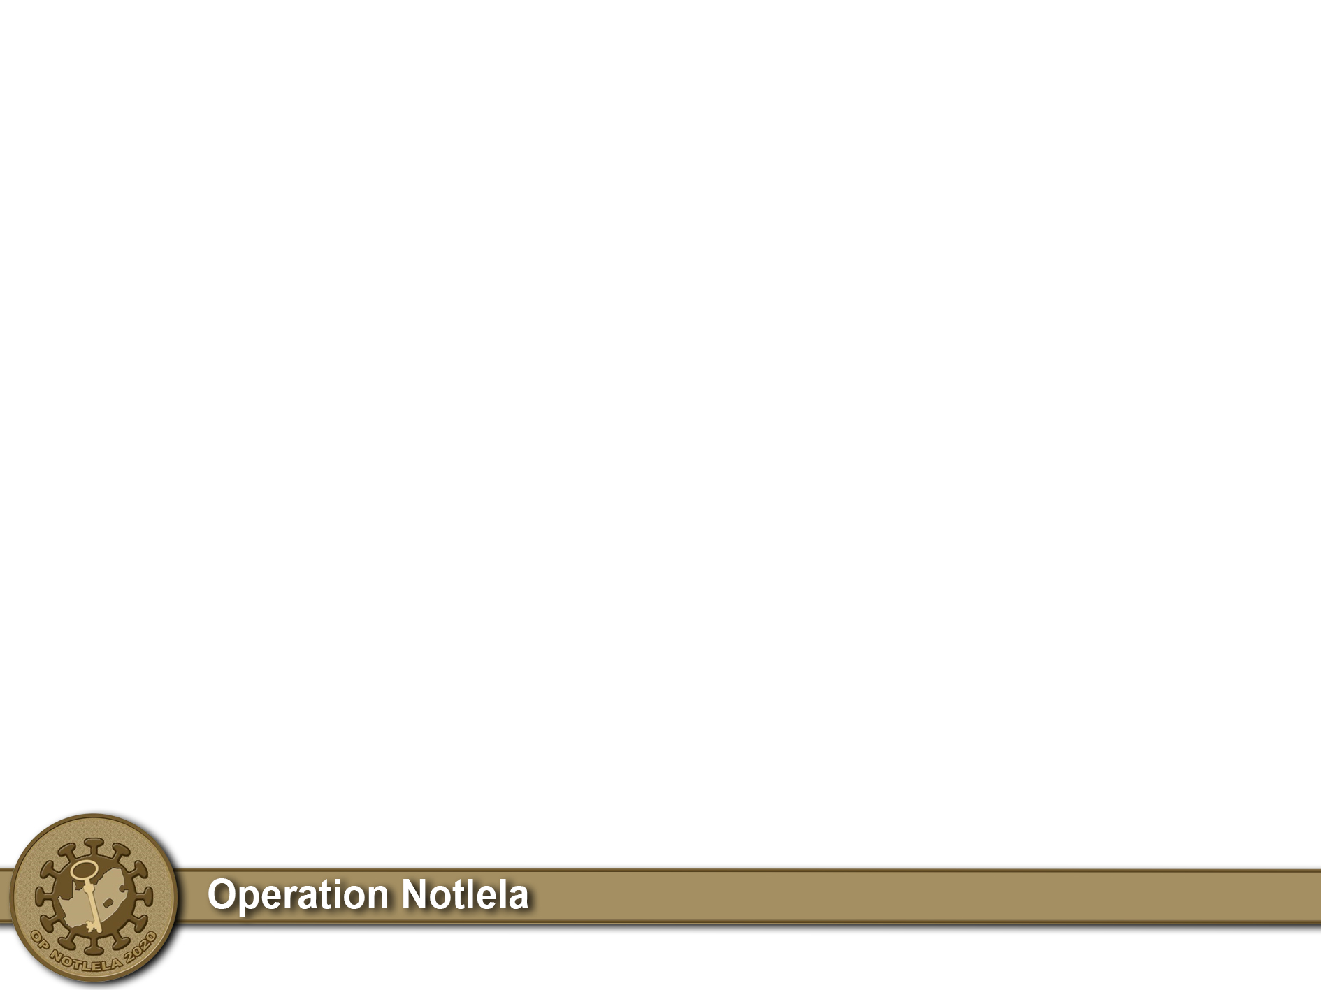
2020 SPECIAL ADJUSTMENT BUDGET
DOD submitted an estimate of R4.590 billion as a requirement for COVID 19 OP NOTLELA as illustrated in the next slide.
DOD declared an amount of R1.136 billion as a reprioritization from within the existing allocation on instruction from NT to all national departments.
On the 24th of June, Department of Defence was allocated an amount of R3.0 billion for COVID-19 related expenses.
Of the above amount, R763.4 million for Compensation of Employees increasing the ceiling to R31.9 billion. The Expected expenditure on COE for the current year is RB 34.9 with an estimated short fall of RB 3.0
R2.2 billion is an additional amount that must be utilized for COVID-19;
    R1 .0 billion for Goods and Services
    R1.2 billion for Machinery and Equipment (mainly SAMHS)
Requirement Of COVID 19 Goods and Services is RB 3.6. Short fall is RB is 1.5.
R120 million is a reduction of the transfer amount to Armscor within the DOD allocation.
An amount of R3 million was allocated and transferred by DOD within the allocation to the Castle Control Board (CCB) per their request to accommodate their expenses during COVID-19.

Slide 4
DOD COVID-19 Budget
S/N | SERVICE/DIVISION |  | Description |  | Costs
1 | REPATRIATION |  | Aircraft Charter (SA-CHINA-SA) |  | 13 888 000
2 | REPATRIATION |  | Support Costs (Quarantine Costs) |  | 14 194 000
REPATRIATION COSTS |  |  | 28 082 000
3 |  | JOINT OPERATIONS | Deployment of Reserve Force | 222 579 950
4 |  | JOINT OPERATIONS | Allowances (Regular & Reserves) | 540 844 442
5 |  | JOINT OPERATIONS | Ration Costs (Regular & Reserves) | 159 442 820
6 |  | JOINT OPERATIONS | Mobility: Fuel And Maintenance Full Costs (for 864 Vehicles) | 33 082 750
TOTAL JOINT OPERATIONS |  |  | 955 949 962
7 |  | SAAF | Air Support Operations | 416 927 731
8 |  | SA NAVY | Maritime Support Operations | 11 607 747
9 |  | LOGISTICS | PPE's | 1 204 944 091
10 |  | LOGISTICS | Rapid Test Kit | 90 250 000
11 |  | LOGISTICS | Head Scanners | 6 270 000
12 |  | LOGISTICS | Thermal Scanners | 8 280 000
13 |  | LOGISTICS | Transportation Costs | 13 888 000
14 |  | LOGISTICS | Cuban Health Specialists flight | 8 000 000
15 |  | LOGISTICS | Flight - Cargo from China | 7 000 000
16 |  | LOGISTICS | Accomodation Cuban Health Specialists | 22 000 000
17 |  | LOGISTICS | Leasing Facilities for Field Hospitals | 30 000 000
18 |  | LOGISTICS | Disinfectant Tunnels | 3 000 000
20 |  | LOGISTICS | Quarantine clinics | 864 000 000
TOTAL LOGISTICS |  |  | 2 257 632 091
14 |  | SAMHS | Field Hospital X4 |  | 249 632 740
15 |  | SAMHS | Laboratories |  | 29 278 056
16 |  | SAMHS | Medical Equipment |  | 352 450 978
17 |  | SAMHS | Pharmaceuticals |  | 65 850 545
18 |  | SAHMS | Common Logistics ( Hospital equipment inclusive of beds, sheets, blankets,etc) |  | 74 182 090
 |  | SAMHS | Vehicles (Ambulances) |  | 148 800 000
TOTAL SAMHS |  |  | 920 194 409
DOD OP NOTLELA REQUIREMENT |  |  | 4 590 393 940

Slide 5
2020 Budget Adjustment Allocation

Slide 6
DOD COVID-19 Budget Expenditure

Slide 7
DOD COVID-19 Expenditure per Budget Holder

Slide 8

Thank You

