Slide 1
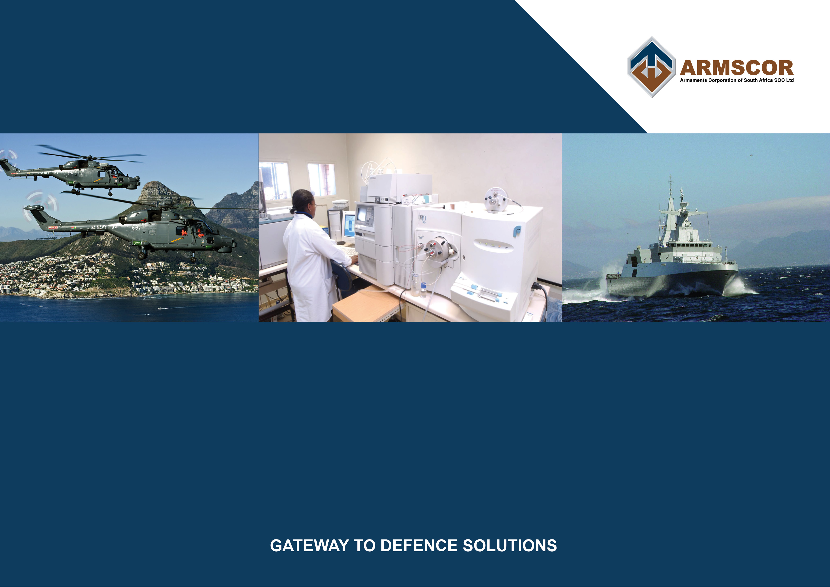
REVISED BUDGET PRESENTATION TO THE PORTFOLIO COMMITTEE ON DEFENCE
^{8 July 2020}

Slide 2
ARMSCOR’S FUNDING
Transfer payment
Finance income
GP from sales
4,9%
Other income
15,8%
3.6%
75,7%
Armscor Group
R1558,4m
Corporate (incl Acquisition)
Research and Development
Dockyard
62%
20%
18%

Slide 3
ARMSCOR GROUP - 2020/2021 FINANCIAL PLAN
(approved budget)
R’m
0,7

Slide 4
ARMSCOR’S FUNDING – IMPACT of COVID 19
Transfer payment
GP from sales
Finance income
(R37,8m)
Other income
(R86,9m)
(R 15m)
(R120m)
Armscor Group
(R243,2m)
Corporate (incl Acquisition)
Research and Development
Dockyard
(R141,8m)
(R92.6)
(R8.8m)

Slide 5
ARMSCOR’S FUNDING – IMPACT of COVID
Armscor Group
Net result
Approved : R0,7m surplus
Revised : R243,3 deficit
Corporate (incl Acquisition)
Research and Development
Dockyard
Net result
Approved : R2,4m surplus
Revised : R141,8 deficit
Net result
Approved : R1,9 deficit
Revised : R92,7 deficit
Net result
Approved : R0,3 surplus
Revised : R8,9 deficit

Slide 6
ARMSCOR’S FINANCIAL PERFORMANCE
2020/21 TO 2022/23 ( current budget)
R’m
Impact on future revenue
Economic outlook – funding allocated
SDA reduction

Slide 7

ACTIONS CONSIDERED TO REDUCE IMPACT -
2020/21
Main cost driver
Actions considered to limit significant shortfall:
No salary increases for 2020/21 – R 48m
No performance remuneration for 2020/21 – R41m
Reduction of other operating costs – 5% (R17m)
Voluntary severance packages
Retrenchments if transfer payment is reduced in following years

Slide 8
ARMSCOR GROUP - 2020/2021 FINANCIAL PLAN
(approved budget)
Group deficit after actions considered R137m

Slide 9
ARMSCOR’S FINANCIAL PERFORMANCE
2020/21 TO 2022/23 (current three year plan)
R’m
Impact on future revenue
Economic outlook
SDA reduction
Shortfall
R243,2m

Slide 10
COVID 19 –IMPACT ON SERVICE DELIVERY
TARGETS
Impact on SLA targets relating to acquisition contracting and programme execution – suppliers impacted by lockdown period and import restrictions
Strategic objectives eg. renewal of applications systems that is critical for organisation efficiency is delayed
Capital renewal programme on main building complex delayed
Financial objectives all negatively influenced – impact on future financial periods as group is supplementing budget with interest earned

Slide 11
PORTFOLIO COMMITTEE ON DEFENCE AND MILITARY VETERANS
IMPACT OF BUDGET CUTS ON DOD ACQUISITION ACTIVITIES
7 JULY 2020

Slide 12
Contents
Current status of Contracting (June 2020)
Acquisition budget trend
Trend in number of active projects
Projects to be terminated before completion.
Projects Financial Risk
Industrial Implications
Impact of DOD Budget Reduction

Slide 13
Status of Contracting (30 Jun 2020)

Slide 14
Acquisition Budget Trend

Slide 15
Funded DOD Capital Projects
 | 2018/19 | 2019/20 | 2020/21 | 2021/22
Before Budget Cuts (Feb 2018) | 39 | 40 | 30 | 29
After Budget Cuts (Excluding Roll-Overs) | 39 | 18 | 14 | 0 *
After Budget Cuts (Including Roll-Overs) ** | 47 | 39 | 35 | 0 ***
Note : * Four projects contracted with Financial Authorities for 2021/22,
but with no funding on SDA
** Increase in number of projects including roll overs, are due to projects
with no original allocation in a year, but funded only from roll-over.
*** Number of projects that will not be completed during 2020/21 and which
will continue with funding rolling from 2020/21 – not yet known.

Slide 16
Trend In Active Projects per annum
Note : Number of active projects per annum, includes
projects that rolled from previous years

Slide 17
Projects To Be Terminated Before Completion
Projects for which will be terminated after completion of Functional Baseline :
Mobile and Static Communication Network
Deployable Electronic Warfare System
Technical Field Repair & Maintenance Capability
Replacement of Submarine Torpedo
Mobile Air Picture
Static Electronic Warfare System
Sea Mine Warfare Capability
Field Artillery Gun for SA Army
Chemical Biological Defence Systems
Submarine Mid-Life Upgrade
Geographic System for SA Army
Demolition and Disposal Capability for SA Navy
SA Navy Frigate Mid-Life Upgrade
Anti-Tank Weapon System
African Soldier Capability

Slide 18
General Project Financial Risks
The Capital budget allocation from National Treasury has been reduced to zero from the 21/22 financial years onward.
A number of capital acquisition projects have been contracted with contracts that have contractual obligations during the period where there is no longer funding available on the Strategic Capital Acquisition Master Plan (SCAMP).
Significant projects that will have a contractual obligation, but with no funding on the SCAMP during 201/22 onwards :
  Project Hoefyster
  Project Hotel
  Project Biro

Slide 19
Industrial Implications
General loss of capacity in industry as a result of reduced DOD spend
Increased focus on export contracts with stringent timescales and penalties
Loss of capability – specifically in Denel – will result in inability to meet future SANDF requirements for critical capabilities
Reduction in DOD Capital Budget is resulting in no new development projects- will result in industry losing competitive edge in the international marketplace
COVID-19 Lockdown has further exacerbated the already precarious position of a large sector of the local defence industry.

Slide 20
Impact of DOD Budget Reduction
PCDMV to take note of the severe impact of the reduction in Defence spend on the indigenous defence industry. The reduction in Defence Spend is resulting in :
  Loss of capability (skills) and capacity in industry
  Loss of jobs
  Loss of strategic capabilities to the SANDF
    Strategic capabilities were created at significant cost, and will not be resurrected without a massive investment
  Reduction in competitive edge of local industry
  Reduced capability of the SANDF due to
    Obsolete and technologically aged equipment
    Inability to properly maintain critical systems (aircraft, vehicles, etc)
    Loss of technological competitive edge – force multiplier

Slide 21
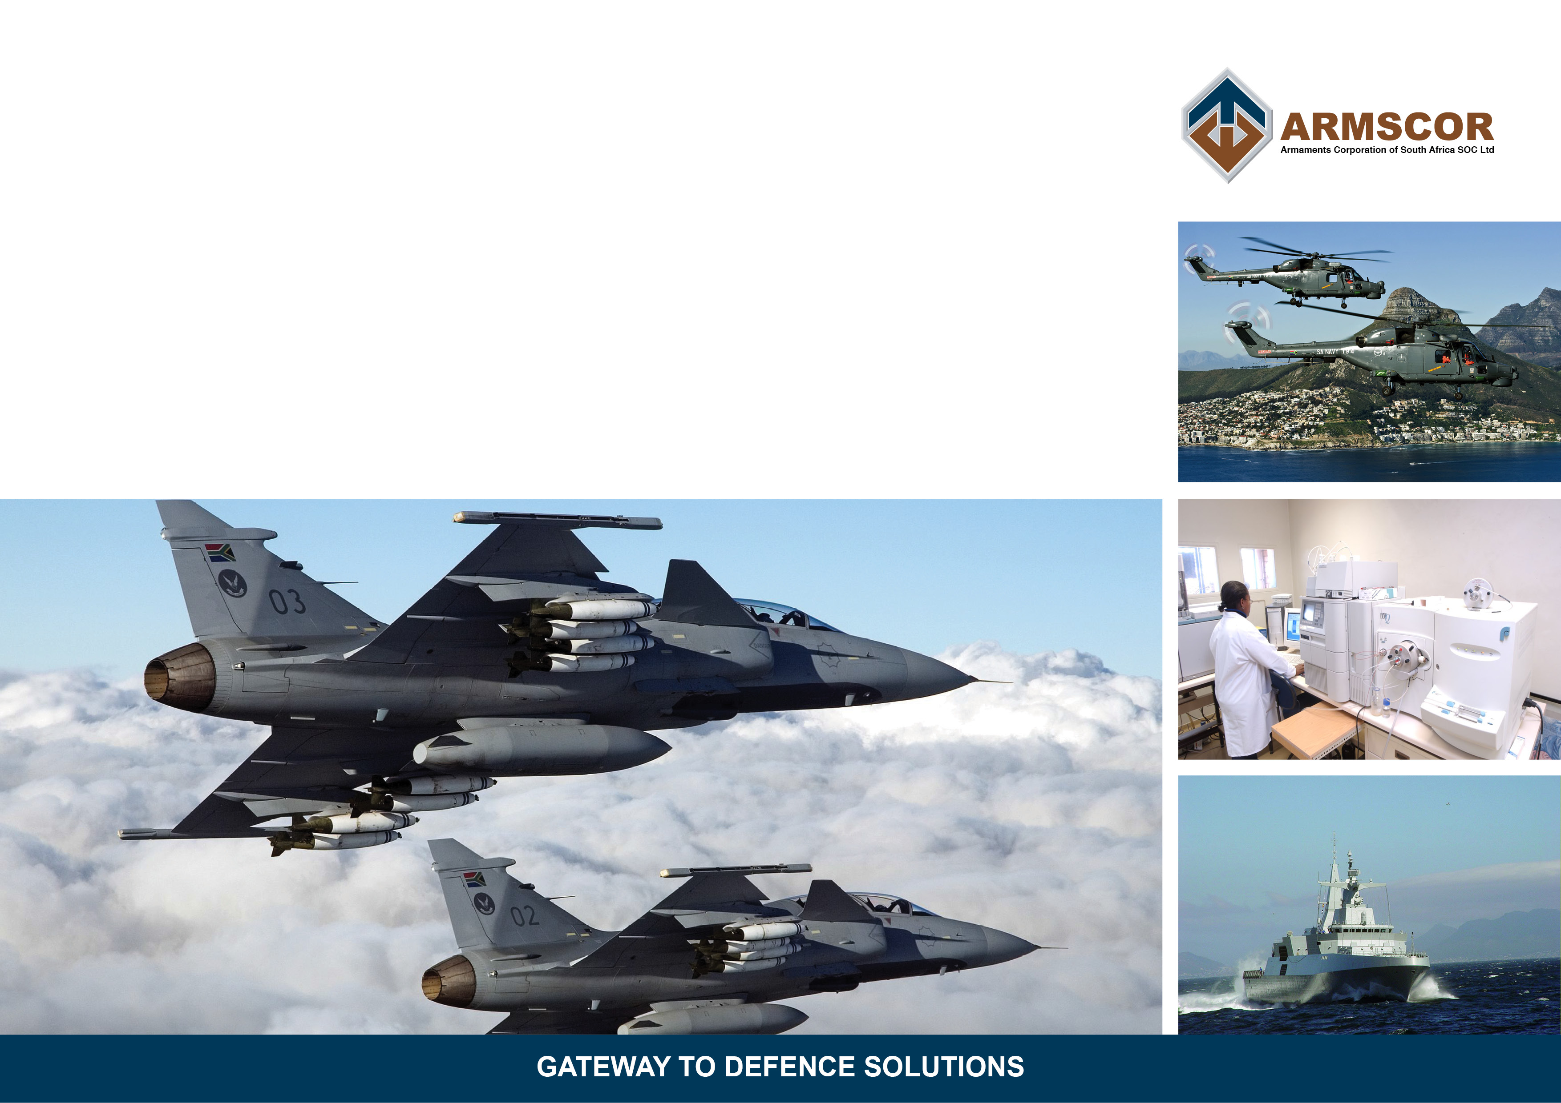
Questions ?

