Slide 1
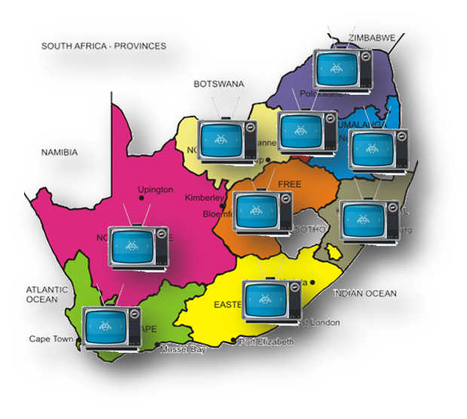
BROADCASTING DIGITAL MIGRATION PRESENTATION TO PARLIAMENT ADJUSTED BUDGET ALLOCATION 2020/21

Slide 2
THE NET EFFECT OF BDM BUDGET REDUCTION
Previously Allocated
R578,721 M @ estimated value of R1800 per DTT reception devices
321 512 of qualifying households to be issued with vouchers
Revised Allocation
R500,421 M @ estimated value of R1800 per DTT reception devices
278 017 of qualifying households to be issued with vouchers
Revised Allocation Implications
There will be a budget shortfall of R78 M
There will be a shortfall of 43 495 of qualifying households in 2020/21 to be migrated as a result of the reduction of funds
The voucher value is yet to be determined.
USAASA will assess the market value of the IDTV through the procurement bid evaluation process and provide an accurate voucher value of the IDTV
The voucher can be used by the qualifying household either to acquire an IDTV with related antennas or Set-Top-Box as per the Cabinet Revised BDM Model, December 2019
The DTT reception devices refers to either an IDTV or Set-Top-Box that comes with related antennas depending on the area of coverage whether is DTT of DTH

Slide 3
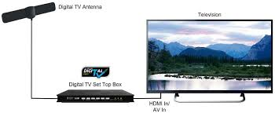
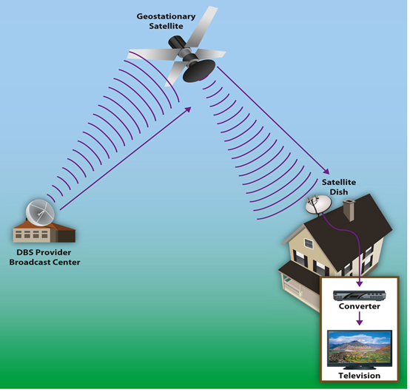
BROADCASTING DIGITAL MIGRATION (BDM)
TARGET
5, 000, 000 STBs & antennas installed at in in approved households per Cabinet (2014, Budget Vote)
OBJECTIVE
Digital Migration Analogue Switch and spectrum release critical for broadband
BDM PHASE 1
Procure, & oversee the deployment of the procured 860 000 STBs and antenna as quickly and as efficiently as possible
BDM PHASE 2
Distribute vouchers to 3.2 million households of qualifying households migrated to digital terrestrial television in terms of the Cabinet approved revised model on BDM, December 2019
Notes:
DoC Alignment: DTT / BDM Project

Slide 4
DIGITAL MIGRATION ECOSYSTEM
POLICY
Dependent on
Post ASO Policy
Digital Dividend Release
REGULATORY FRAMEWORK
Dependent on ASO
Frequency Restacking
STANDARDS
SANS 862 – (DVB-T2)
SANS 1719 – (DVB – S2)
IDTV 10352
TRANSMISSION NETWORK
Network Transmission
84% Terrestrial &
16% Satellite
Project manage installations
Digital Switch-on and
Analogue Switch-Off
Plan
ASO
Neighbouring Counterparts
(Botswana, Lesotho, Swaziland,
Mozambique & Namibia)
INTERFERENCE HARMONISATION
Digital Content and
Digital Channels
Viewer Migration
DTT DEVICES
DTT & DTH STBs
IDTV Sets
Antennae
Satellite Dishes
Registration
Distribution of STBs
CONSUMER AWARENESS
Public Awareness Strategy
Communication Plan
Implementation Plan
Consumer Support and
Public Awareness Campaign Plan
Logistics and Distribution
Sentech will project manage installations of 860 000 Set-Top-Boxes – BDM Phase 1

Slide 5
REVISED USAF APP 2020/21 Programme 1
OUTPUT INDICATORS | 2020/21 ANNUAL TARGET | QUARTERLY TARGETS
 |  | Q1 Apr - Jun 2020 | Q2 Jul - Sep 2020 | Q3 Oct - Dec 2020 | Q4 Jan - Mar 2021
Number of the subsidised Set-Top-Boxes at qualifying households | Installation of 860 000 subsidised set-top-box kits at qualifying households |  | Installation manual and standards Installation Project plan Installation of 50 000 subsidised set-top-box kits to new qualifying households ensured | Installation of 350 000 subsidised set-top-box kits to new qualifying households ensured | Installation of 460 000 subsidised set-top-box kits to new qualifying households ensured
Vouchers to the value o R500,421M issued to qualifying households for subsidised digital television installation | implementation plan to roll out the voucher system finalised | Project plan developed Bid specifications approved; Tender advertised; Plan to compile beneficiaries list; | Establishment of a panel of the suppliers to drive the mass availability of affordable Digital TVs or decoders that will enable the subsidised viewers to migrate | Distribution of vouchers to the equal amount of R250,210M towards identified qualifying households | Distribution of vouchers to the equal amount of R250,210M towards identified qualifying households
Number of identified interventions to address access to digital infrastructure and virtual learning content services | COVID - 19 Pandemic support for Grade 12s from Indigent Households Initiative | Project plan developed Bid specifications approved; Tender advertised; Plan to compile beneficiaries list; Engagement with DBE to compile list of matriculants; Engagement of Provinces to compile list of matriculants | Establishment of a panel of the suppliers for supply and installation of IDTVs to the targeted Grade 12s from indigent households. Supply and Installation of 90% of the procured IDTVs to qualifying GR 12 Indigent Households | Installation of remaining 10% of the procured Integrated Digital Television units to new qualifying GR 12 Indigent Households | -

Slide 6
REVISED USAF APP 2020/21 Programme 1
OUTPUT INDICATORS | 2020/21 ANNUAL TARGET | QUARTERLY TARGETS
 |  | Q1 Apr - Jun 2020 | Q2 Jul - Sep 2020 | Q3 Oct - Dec 2020 | Q4 Jan - Mar 2021
Number of sites with internet connectivity in targeted municipal areas | Internet connectivity to new 300 sites provided in targeted 2 (two) municipal areas* | - | Q2(2020/21) Provision of internet connectivity to new 50 sites ensured in targeted municipal areas* | Q3(2020/21) Provision of internet connectivity to new 150 sites ensured in targeted municipal areas* | Q420 20/21 Provision of internet connectivity to new 300 sites ensured in targeted municipal areas*
Percentage** of internet connectivity provided at all time at sites with existing broadband ensured | 75% of internet connectivity provided at all time at sites with existing broadband | Availability of a minimum of 75% connectivity ensured at all times at sites with existing broadband | Availability of a minimum of 75% connectivity ensured at all times at sites with existing broadband | Availability of a minimum of 75% connectivity ensured at all times at sites with existing broadband | Availability of a minimum of 75% connectivity ensured at all times at sites with existing broadband
Percentage of identified interventions to address access to underserviced municipalities | COVID – 19 Pandemic support for sites to be connected in identified local underserviced municipalities | Sites identified | 75% availability of internet connectivity provided at all times at connected COVID 19 sites in identified local underserviced municipalities. | 75% availability of internet connectivity provided at all times at connected COVID 19 sites in identified local underserviced municipalities. | 75% availability of internet connectivity provided at all times at connected COVID 19 sites in identified local underserviced municipalities

Slide 7
RISKS RELATED WITH BUDGET REDUCTION
Risk RELATED with budget reduction | Mitigation
Reduced Number of qualified households to be issued with vouchers
Revision of the planned vouchers to be issued in Quarter 3 and Quarter 4 of (2020/21) FY from 321 512 to 278 071 to acquired Integrated Digital Televisions (IDTV) sets by qualifying households | The shortfall of 43 595 will be compensated through the subsidy rollout of IDVTs for the 2020 Grade 12 learners indigent households. The number of the IDTV sets for 2020 Grade 12 learners to be procured will be increased through shrewd price negotiations process within the budgeted amount of R242 000 000.
Delays on Analogue Switch Off (ASO)
The budget reduction will impact on the 3,2 million households to be issued with subsidy vouchers for acquisition of IDTV sets and this might result in a delayed dual illumination period and also analogue switch off. | The Agency collaborating with DTT PMO Office and Sentech and other stakeholders will need to investigate other cheaper alternative means to ensure a seamless migration of views within the budgeted amount.

Slide 8
BDM Budget Historically Allocations to date
2017/18 R 79 098 000
2015/16 R181 160 000
2014/15 R791 000 000
2016/17 R589 384 000
2018/19 R320 712 000
2019/20 R 26 605 000
2020/21 R578 721 000
2011/12 R220 000 000
2012/13 R230 000 000
2013/14 R240 000 000
BDM Allocation Adjusted to R500,421 000
2020/21

Slide 9
ADJUSTED BDM APPROPRIATIONS
ADJUSTED APPROPRIATION | 2020/21 R'000 | 2021/22 R'000 | 2022/23 R'000
DETAIL OF TRANSFERS AND SUBSIDIES | Revised Baseline | Revised Baseline | Revised Baseline
Universal Service and Access Agency of South Africa | 86,881 | 91,677 | 96,037
Universal Service and Access Fund | 63,086 | 66,556 | 69,766
Universal Service and Access Fund: Broadcasting Digital Migration (Prev Allocation) | 578,721 | 1,163,363 | 62,713
Universal Service and Access Fund: Broadcasting Digital Migration (Reduction) | -78,300 | 0 | 0
Revised Allocation on BDM | 500,421 | 1,163,363 | 62,713
USAASA: Payment for distribution costs to SAPO | 178,000 | 97,000 | 0

Slide 10
THANK YOU ☺

