Slide 1

^{2020 Supplementary Budget}
Presentation to the Standing and Select Committees on Finance
^{1 July 2020}
“The Budget Justice Coalition includes the following civil society organisations: the Alternative 1Information and Development Centre (AIDC), the Children’s Institute at UCT (CI), Corruption Watch (CW),
Equal Education (EE), Equal Education Law Centre (EELC), the Institute for Economic Justice (IEJ), OxfamSA, Pietermaritzburg Economic Justice and Dignity (PMEJD), the Public Service Accountability Monitor (PSAM), the Rural Health Advocacy Project (RHAP), SECTION27 and the Treatment Action Campaign (TAC) and the Women and Democracy Initiative of the Dullah Omar Institute at UWC (DOI)”

Slide 2
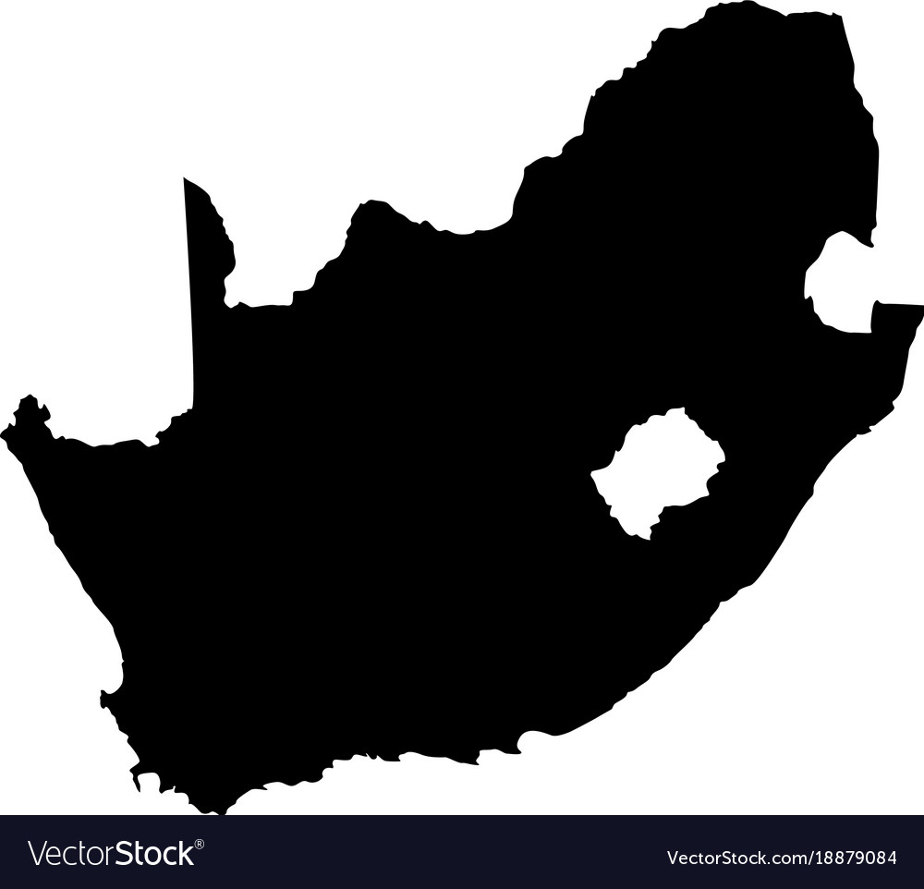

THE BUDGET JUSTICE COALITION
The purpose of the Budget Justice Coalition is to collaboratively build people’s understanding of and participation in South Africa’s planning and budgeting processes – placing power in the hands of the people to ensure that the state advances social, economic and environmental justice, to meet people’s needs and wellbeing in a developmental, equitable and redistributive way in accordance with the Constitution.
Members include: the Alternative Information and Development Centre (AIDC), the Children’s Institute at UCT (CI), Corruption Watch (CW), the Dullah Omar Institute at UWC (DOI), Equal Education (EE), Equal Education Law Centre (EELC), the Institute for Economic Justice (IEJ), OxfamSA, Pietermaritzburg Economic Justice and Dignity Group (PMEJD), the Public Service Accountability Monitor (PSAM), the Rural Health Advocacy Project (RHAP), SECTION27, and the Treatment Action Campaign (TAC).

Slide 3
INTRODUCTION
The Budget Justice Coalition makes this submission with the intention of contributing to consideration of how the relief package has faired, what measures would help citizens and the economy to recover from COVID-19, and where to appropriate funding.
High level analysis:
The budget showed little understanding of the state’s constitutional obligations to fully utilise available resources to protect people from socio-economic harm
The government is reneging on its promises in the “Economic Relief Package”
Instead, the budget proposals allow businesses to close, jobs to vanish, poverty and hunger to soar and the economy to sink into its worst contraction in a century with minimal fiscal support and government intervention.
Notes:
Say that BJC has made a detailed submission for Members to engage with numbers etc and alternative proposals.

Slide 4
GOVERNMENT IS REGRESSING ON SOCIO-ECONOMIC RIGHTS
Constitutional obligations and UN CESCR criteria for retrogressive measures
  Necessary, with all alternative financing measures comprehensively exhausted
    X government is not exhausting available revenue options
  Temporary, remaining in place only insofar as they are necessary
    X government is aiming for a primary budget surplus by 2024
  Legitimate, with the ultimate aim of protecting the totality of human rights
    X no information on how cuts will not impact rights (likelihood of opposite)
  Not directly nor indirectly discriminatory, according priority attention to disadvantaged groups;
    X in SA it is guaranteed that the 80% of the population that relies on public health, education, housing and social services will bear the brunt of the cuts
  Based on transparency and genuine participation of affected groups and subject to meaningful review and accountability procedures
    X no indication that public will participate in 2021 MTEF planning discussions
Notes:
Examples of regression provided throughout the submission

Slide 5
COVID-19 AND OTHER SPENDING PLANS
  Where is the relief package?
  Only R36 billion net new spending this financial year to deal with this grave challenge (less than 1% of GDP)
    R0 to womxn and gender-based violence – not even mentioned in the budget
    R2.9 billion to health – is this enough?
    R9 billion underspending on social grants promise - leaving children hungry
    Cuts to basic education, to provincial and municipal conditional grants including infrastructure spending, HIV/AIDS, electricity connections
  Hundreds of Billions of Rands to be slashed from spending in 2021 MTEF, when SA needs government to help it recover
  It is not too late for Parliament to take a stand against this vicious cycle of austerity budgeting

Slide 6
COVID-19 AND OTHER SPENDING PLANS
  Health care funding: too much uncertainty remains
  Only R2.9 billion net new funding to deal with this pandemic
  Provinces required to fund the bulk of COVID-19 expenditure from within their (already stretched and pared back) 2020 equitable share allocations
  Pre-COVID-19:
    A decade of overall budgets not matched to wage and other cost increases
    40 000 vacancies, including nurses, doctors and specialists
    Equipment and facilities in disrepair (mismanagement and cuts to infrastructure budgets)
    R billions annually in unpaid bills (R3bn in Eastern Cape)
    R billions in medico-legal claims
  Are provinces, especially provincial health departments, able to meet the challenge of COVID-19 with this funding envelope?

Slide 7
COVID-19 AND OTHER SPENDING PLANS
Social relief: still too little and reaching too few
DSD stopped providing food parcels when COVID-19 grant rolled out – regressive and irrational
C19 grant reaching a fraction of who needs it, immigrants unable to work or return home still excluded, no back pay – all regressive and irrational
CSG top-up per caregiver a direct assault on children: 2 million more in food poverty as a result – regressive and irrational
Government is underspending on the R50 billion promise!

Slide 8
COVID-19 AND OTHER SPENDING PLANS
  Womxn, children and gender based violence ignored
  Despite the President highlighting the “second pandemic” of patriarchal attitudes and violence against womxn – the budget is completely gender-blind
  Basic education: net loser again in the budget adjustments
    Despite the significant additional cost burden C19 places on education departments: overall funding was cut and C19 adaptation must come from within existing baselines

Slide 9
REVENUE, PUBLIC DEBT AND INTERNATIONAL LOANS
  Tax shortfall but no new revenue proposals
  Options to consider:
  annual net wealth tax
  Increases to personal income tax on the two highest brackets
  Not granting deductions on retirement fund contributions to those earning above R1 million.
Revising the primary abatement for estates
Capital gains tax should be restructured so that:
  Longer holding periods and capital reinvestment
  A surcharge is applied to taxpayers earning high levels of capital gains
  The inclusion rate is raised to 100%
  The inclusion of non-resident is simplified and widened
  The use of share buybacks to avoid paying capital gains is prohibited
  Capital gains rate of 16% - 33% is below the OECD and BRICS norm and could be raised over the medium term.

Slide 10
FURTHER REVENUE PROPOSALS
The securities transaction tax (STT) should be raised.
Reform in taxation of immovable property and land there is room for:
  A property tax over and above municipal rates and for this to cross subsidise poor municipalities.
  A surcharge on the transfer duty for the acquisition of second homes.
  Non-residents to pay higher transfer duties than residents
  A land tax, particularly of vacant/unused land be instituted.
Tax evasion must be further clamped down on.

Slide 11
DOMESTIC RESOURCE MOBILISATION
Solidarity taxation on windfall profits of big retailers and pharmacies
Solidarity taxation of high incomes, wealth and income from wealth
Taxation of digital economy
Cheap borrowing from PIC (GEPF and UIF)
Solidarity bonds
Prescribed assets

Slide 12
TRANSPARENCY AND PARTICIPATION
The public must be given a chance to participate in the crucial 2021 MTEF process from July 2020
All performance expenditure reviews must be published (including the latest round) to enable people to engage with their findings
Government must enable the public to participate in the 2021 MTEF process beginning in July. This is clearly a critical budgeting period and the voices of civil society (in the broadest sense) can add much value. The Constitution requires this.

Slide 13
KEY RECOMMENDATIONS
The immediate abandonment of austerity budgeting
A revised social and economic relief package that injects new spending into the economy
The establishment of a “human rights baseline” for budget allocations and revised spending plans that eliminate sources of corruption and wasteful expenditure
A new revenue framework that adequately taps into the wealth and high incomes of individuals and companies and ends rampant tax evasion once and for all
A universal work guarantee and basic income grant, funded from the new revenue framework
A green new deal
The achievement of womxn’s equality by systematically eradicating destructive patriarchy Enhanced opportunities for public participation in all of the above.
Enhancing opportunities for public participation in all of the above
Notes:
The establishment of a “human rights baseline” for budget allocations based on comprehensive budget review, with inputs from communities, of what spending is actually needed to implement Constitutionally mandated socio-economic rights
A green new deal encompassing energy generation, industrial transformation, the creation of millions of new jobs, the re-skilling of workers and genuine community-led development

