Slide 2
PRE-COVID 19

Slide 3
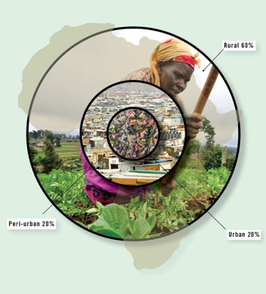
Convergence and Complexity: Africa’s crisis over the next Decade

Slide 4
CONCLUSIONS
Significant parts of Africa are reaching a dangerous tipping point
Africa is in a race against time
Transformation to address the root causes will take between 20 to 40 years
Armed, complex, and protracted conflict will characterise large parts of the African landscape in the coming decades

Slide 5
CONCLUSIONS
Prevention at the local and national levels must assume the highest priority
Increasingly mediation will be accompanied by peace enforcement

Slide 6
AFRICA’S POTENTIAL
By 2030 about 40 African countries will be oil and gas producers
Proven oil reserves…120 bib = $7.3 trillion
Proven gas reserves…510tcf = $3 trillion
Proven shale gas…1.042tcf = $6 trillion
Pan-African fish trade = $22 billion
Consumer spend 2013 = $680 billion
2030 = $2.2 trillion

Slide 7
AFRICA’S POTENTIAL
60% of the world’s uncultivated arable land
23% of Africa’s land area is forest
75% of global platinum deposits
50% of diamonds and precious stones
50% of chromium
20% of gold and uranium deposits
Africa’s U18 population will be ONE BILLION by 2050!

Slide 8
WHAT AFRICA DID WELL
Managing economies better
Debt relief – 1994 debt to GDP ratio was 130 % 2005, debt to GDP ratio dropped to 30 %
Loss making enterprises
Telecom Revolution – 2000: 11 million mobile lines 2016: 687 million mobile lines
Conflict decreased
Source: How Africa can Keep Rising: Ngozi Okonjo-Iweala

Slide 9
WHAT AFRICA DID WRONG
Lack of job creation
Quality of growth wasn’t sustainable
Inequality increased
Absolute poverty increased
Lack of invest in infrastructure
Economies retaining the same structure over decades
Governance - weak and non existent institutions
New conflicts – terrorism
Source: How Africa can Keep Rising: Ngozi Okonjo-Iweala

Slide 10
AFRICA’S SOCIO-ECONOMIC STRUCTURAL CHALLENGE
1. Agricultural Age
2. Industrial Age
3. Information Age

Slide 11
CENTRE AND PERIPHERY:
AFRICA
Population living on less than US$ 1.90 per day: 42.2 % (0%) (2013)
Population (2015): 1.2 billion
GNI PPP per capita (2015):
US$ 1, 628
(US $ 34,435)
Population (million):
2030 2050
1 679 2 478
(734 707)
Population using improved sanitation (2015):
Urban Rural
40% 23%
(99% 96%)
State
Private Sector
Civil Society
PEOPLE
Urban population (2015):
38%
(73%)
PEOPLE
Life expectancy at birth: 59 years
(80 years)
Suspected Malaria Cases (2015): 188 000
Adult population (aged 15-49) with HIV/AIDS (2014): 4.5 %
Infant mortality rate (per 1,000 live births): 56
Suspected TB Incidences (2014): 2,700,000
Sources: World Bank 2015, Population Reference Human Development Index Report 2015

Slide 12
CENTRE:
SOUTH AFRICA
CIVIL SOCIETY SECTOR
23%
PUBLIC SECTOR
18%
PRIVATE SECTOR
59%

Slide 13
Centre and Periphery:
SOUTH AFRICA
Periphery 70%
Centre 30%

Slide 14
Centre and Periphery:
KENYA
Centre 20%
Periphery 80%

Slide 15
Centre and Periphery:
BURUNDI
Periphery 95%
Centre 5%

Slide 16
CONVERGENCE AND COMPLEXITY: AFRICA’S RACE AGAINST TIME
Exponential Population Growth
Rapid Urbanisation
Global Economic Slowdown
Commodity Crisis
Climate Change
Disruptive Technology

Slide 17
COVID 19: A CONFLICT MULTIPLIER NEW CONVERGENCE
HEALTH CRISIS
ECONOMIC CRISIS
SECURITY CRISIS
HUMANITARIAN CRISIS

Slide 18
Categories of COVID-19 Related Conflict & Resilience Trends in Africa
Stigmatisation & Discrimination
Trust levels between Citizens & Institutions
Livelihood Insecurity and Economic impacts
Domestic & Gender Based Violence
Crime related incidents
Political unrest or violence
Cross-border or Inter-state tensions

Slide 19
Emerging Trends per Category

Slide 20
Emerging Trends Per Region

Slide 22
DRIVERS OF CONFLICT
Constitutional crises
Election-related conflicts (intra-party and inter-party)
Struggle over political hegemony
Conflicts over scarce resources (land, water, food, education, employment, etc.)
Exploitation of identity (religion, ethnic, racial)

Slide 23
MANIFESTATIONS
Urban unrest and social protests
Low-intensity violence, escalating to civil war
Creation of new centres of power through secession/self-determination movements
Radicalisation and rise of extremist ideologies
Emergence of criminal syndicates and proliferation of human, arms, drug trafficking

Slide 24
CONSEQUENCES OF CONFLICT
VIOLENCE AND DEATH
ECONOMIC STAGNATION (DEFICITS, RECESSION, INFLATION, PARALYSIS)
DESTRUCTION OF BASIC INFRASTRUCTURE AND GOVERNANCE CAPACITY
HUMANITARIAN CRISES
OVERFLOW OF REFUGEES AND IDPS
BREAKDOWN IN AUTHORITY AND SECURITY

Slide 25
RESPONSES
REVOLUTION/UPRISINGS
WAR
DIALOGUE

Slide 26
Why Should RSA Relations with Africa Remain A Priority?
Economic and Trade Relations between South Africa & Africa continues to grow:
In 2019, 27% of South Africa’s world exports and 12% of South Africa’s world imports were to and from the rest of Africa;
South Africa’s Intra-African exports amounted to US$ 24 billion;
South Africa’s intra-Africa imports amounted to US$10.2 billion; and
In 2018, SADC accounted for more than 86% of South Africa’s exports to Africa.
Source: https://www.tralac.org/resources/our-resources/13142-south-africa-intra-africa-trade-and-tariff-profile.html

Slide 27
Why Should RSA Relations with Africa Remain A Priority?
There is a huge potential for this intra-Africa trade to increase, if we resolve and transform our conflicts.
South Africa’s geo-strategic location, compared to other African countries and their competitiveness (e.g. Ethiopia, Nigeria, Morocco etc) must not be underestimated; therefore stronger relations with Africa is in our own national interest.
Intra-Africa migration (due to conflict, search for livelihoods etc is large).
South Africa is one of the main destinations of choice. This can only be changed, if conflicts end in Africa, and it is in the interests of South Africa to contribute to this.
Source: https://www.tralac.org/resources/our-resources/13142-south-africa-intra-africa-trade-and-tariff-profile.html

Slide 28
SOUTH AFRICA IN AFRICA
WITH WHAT?
Peace support operations, political intervention and mediation, socio-economic development
HOW?
ARF, Soft diplomacy, military support, trade etc.
WHO?
Civil society organizations, corporate South Africa, government.

Slide 29
Conflict Hotspots in North Africa and the Sahel Region

Slide 30
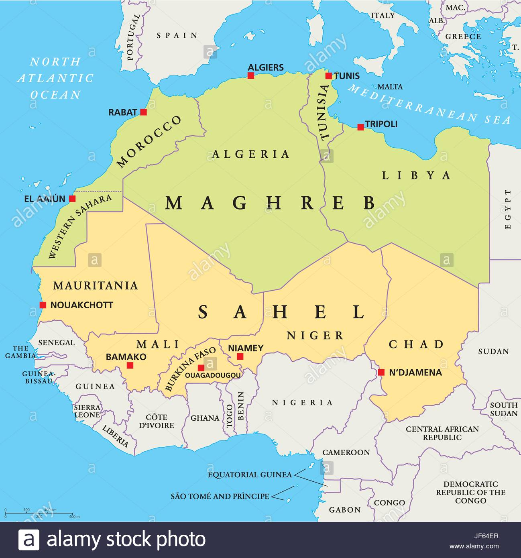

Slide 31
Libya
The war for the control of the country continues with the Libyan National Army led by General Haftar bent on unseating the recognised government.
There has been several peace efforts which include the EU, given its interests in Libya, and its instability contributing to the country being a conduit for illegal migration into Europe, illicit flow of arms and human trafficking.
Therefore, the various African Initiatives, at the level of the special envoy of the AU on Libya are crucial.
RSA’s decision as the chair of the AU to convene a special meeting on Libya was crucial because the instability in that country is directly proportional and linked to instability in the Sahel.

Slide 32
The Sahel Region
The Sahel region faces several complex challenges and conflicts.
The current conflicts the region faces include:
A food crisis
A refugee crisis
An environmental crisis
Insecurity and political insecurity crisis
An Islamic extremism crisis
A regional deterioration crisis caused by high levels of organized violence
As well as a crisis pertaining to inter-communal violence.

Slide 33
Conflict in Mali
Since the regime shift in Libya and the subsequent uprising in Northern Mali in 2012, the security situation has gone from bad to worse in much of the region. In Mali, armed groups emerged in areas neglected by national authorities for decades. Lack of state presence, poverty and unemployment made it easy for these groups to find new recruits in areas that had long been left to fend for themselves. Today armed groups have multiplied, violence has spread from the north to more central parts of the country and the conflict has already spread to neighbouring countries such as Burkina Faso and Niger.
Excerpt taken from: https://www.nrc.no/shorthand/fr/sahel---the-worlds-most-neglected-and-conflict-ridden-region/index.html

Slide 34
Conflict in Burkina-Faso
In Burkina Faso, which shares a border with Mali, thousands have been displaced in the northern provinces on the border with Mali. The level of violence is unprecedented, and the civilian population is caught in the middle of, and at times targeted by attacks, both by non-state armed groups and security forces.
Excerpt taken from: https://www.nrc.no/shorthand/fr/sahel---the-worlds-most-neglected-and-conflict-ridden-region/index.html

Slide 35
Conflict in Nigeria (Sahel Region)
In North East Nigeria, the armed conflict between non-state armed groups and security forces continues to affect neighbouring countries and has created one of the world’s worst humanitarian crises.
Niger, Cameroon and Chad have all been drawn into the conflict. Although Boko Haram is no longer a unified movement, one of its factions, the IS West African Province (ISWAP) has been growing and contributing to increased violence in the region since autumn 2018.
Excerpt taken from: https://www.nrc.no/shorthand/fr/sahel---the-worlds-most-neglected-and-conflict-ridden-region/index.html

Slide 36
Conflict in Cameroon
In Cameroon, violence caused by Boko Haram has driven out around 228,000 Cameroonians in the areas bordering Nigeria. Cameroon is simultaneously dealing with a separate conflict in a different region of the country and though that part of the country is not within the Sahel region, the effects of the conflict are devastating. Over the past two years, unrest has increased in the English-speaking South-West and North-West Regions of the largely French-speaking country.
Excerpt taken from: https://www.nrc.no/shorthand/fr/sahel---the-worlds-most-neglected-and-conflict-ridden-region/index.html

Slide 37
Hotspots in Southern Africa

Slide 38
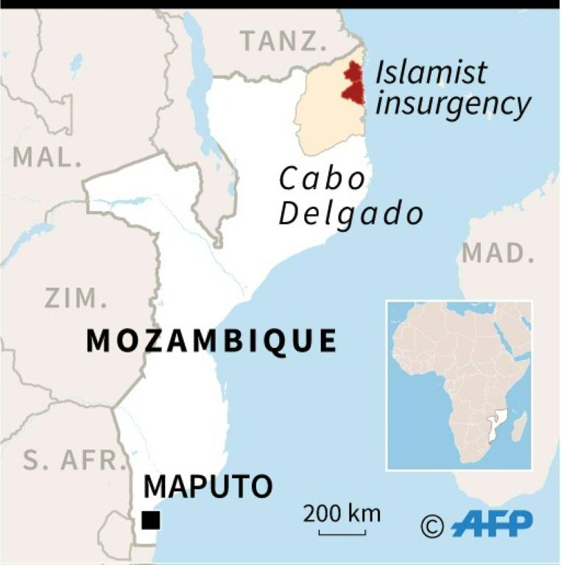

Slide 39
Mozambique: Cabo Delgado
An insurgency that has been going on since 2019 and has already resulted in 1100 number of deaths & hundreds of IDPs.
Cabo Delgado has the largest deposits of Mozambique’s natural resources.
SADC countries (in particular Zimbabwe & Tanzania) have pledged to deploy forces in aid of Mozambique.
COVID-19 having a direct impact on this insurgency: about 20% of COVID-19 cases in Mozambique come out of Cabo Delgado.
COVID-19 having an impact on the implementation of the 2019 Agreement between RENAMO & FRELIMO as important aspects such as DDR processes are affected.
The insurgency risks impacting the overall stability of the SADC region.

Slide 40
Lesotho
Political instability remains following the removal of the Prime Minister
RSA responded by sending a High-Level Delegation (led by former Minister Jeff Radebe)
Lesotho’s political dynamics have always been unstable since the 1998 election debacle.
Despite previous efforts & agreements to amend the electoral laws (from First-Past-The-Post) to a Mixed-Member Representation, the country has suffered occasional government instability.
RSA’s role key in Lesotho given its proximity & almost entirely dependent on RSA for livelihoods & RSA dependent on Lesotho for the much-needed water supply.

Slide 41
Conflicts in the Horn of Africa

Slide 42
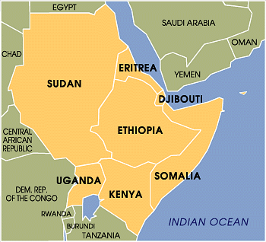

Slide 43
Somalia
2020 a crucial year as the country has to prepare for its elections under complex emergences.
COVID-19 impacting on the election preparation; and the insurgency with Al-Shabab not assisting in the situation.
AMISOM was scheduled to withdraw in 2020 but this may have to be reconsidered due to COVID-19 related challenges.
Al-Shabbad had initially denied the effect of COVID-19 but has since announced the opening of a medical facility.

Slide 44
South Sudan
The implementation of the R-ARCSS is underway.
Developments to watch include the impact of COVID-19, First-Vice President & Defence Minister reportedly contracted the Virus.
The peacekeeping force is key but has been affected due to reported cases of COVID-19 among the UN staff & force.
RSA’s role crucial as the facilitator & guarantor of the implementation of the Peace Process.

Slide 45
END

