Slide 1
SEDA QUARTER 4
PERFORMANCE
By Ms N. Majola
Acting Chief Executive Officer
24 JUNE 2020

Slide 2
SEDA PRESENTATION OUTLINE
GOVERNANCE AND COMPLIANCE
PERFORMANCE REPORT
HUMAN RESOURCES REPORT
FINANCIAL INFORMATION
RISK MANAGEMENT
CONCLUSION

Slide 3
1. GOVERNANCE AND COMPLIANCE

Slide 4
GOVERNANCE AND COMPLAINCE
JANUARY – MARCH 2020
Committee | No of Scheduled Meetings (total of Q4) | Dates
Board meetings | 2 | 30 January 2020) 27 March 2020
Strategy and organisational performance Committee (sopc) | 4 | 23 January 2020 09 February 2020 (Special Meeting) 20 March 2020 (Special Meeting) 20 March 2020 (Special Meeting)
Audit and Risk committee (arc) | 2 | 23 January 2020 12 March 2020
HUMAN RESOURCES & Remuneration Committee | 1 | 12 March 2020 (with SOPC members attending)

Slide 5
GOVERNANCE AND COMPLAINCE
JANUARY – MARCH 2020
The Board attended to the following priorities during this quarter:
- Strategy Plan 2019/20 – 2020/23
- Seda Annual Performance Plan 2020/2024
- ICT Governance Framework
- ICT Governance Strategic Plan
- Quarterly Performance and Compliance Reviews

Slide 6
2. PERFORMANCE INFORMATION

Slide 7
2019/20 MANDATE, STARTEGIC GOALS AND OBJECTIVES
 | DSBD Strategic Goals/Objectives | Seda Strategic outcome oriented goals
1. | policy and planning coherence in the sector, that promotes an enabling ecosystem for smme’s and cooperatives. | 1. Implement programmes to improve sustainability of SMMEs and Cooperatives
2. | equitable access to responsive and targeted products and services that enable the growth and development of smme’s and co-operatives. | 2. Increase Seda delivery network to reach underserviced areas
3. 4. | An enhanced contribution to the socio-economic development outcomes by the sector Sound governance and the optimal utilisation of available resources | 3. Sustainable partnerships to support the cooperatives development agenda. Sustainable partnerships to support the SMME development agenda Organisational responsiveness to Stakeholder expectations

Slide 8
PERFORMANCE AGAINST APP TARGETS
32 strategic indicators measured (Q4)
Achieved 28 strategic indicators
Organisational performance of 87.5%
Organisation did not perform well on the following indicators
Number of cooperatives assisted with access to finance
Number of clients supported through national gazelles
Number of SMMEs graduated
Number of diagnostic assessments conducted on clients business. Some of the clients couldn’t sign-off on the assessment due the Lockdown on the last week on March.

Slide 9
PERFORMANCE AGAINST APP TARGETS
Indicator | Reason for non achievement
Number of diagnostic assessment conducted on clients businesses | Variance attributed to BA vacancies and the negative impact of COVID-19 restrictions that started during the month March. Some of the clients couldn’t be reached to sign-off their assessments and that information couldn’t be captured.
Number of cooperative assisted with access to finance | It has been a challenging exercise to secure finance for newly established cooperatives. We shall Improve through Seda/Sefa alignment with regards to streamlining the requirements
Number of clients supported through National Gazelles | A 3rd Cohort was not activated as the programme will not be continuing this year.
Number of SMMEs graduated | Some of the entrepreneurs who were due to graduate by end March couldn’t finalize their processes due to the Covid-19 lockdown. These will be further delayed as these entrepreneurs will now be requiring more support in order to survive. Incubators will assess the impact and develop initiatives to assist

Slide 10
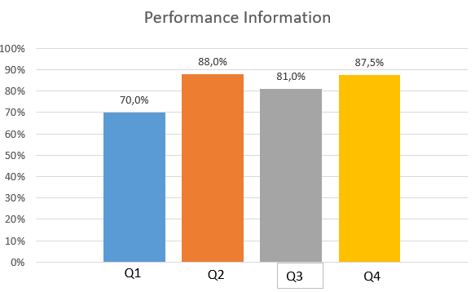
OVERALL PERFORMANCE AGAINST APP TARGETS
Increase in performance, however we could not maximize our full potential because of the outbreak of COVID-19.

Slide 11
ANNUAL PERFORMANCE PLAN – PROGRAMME 1- EDD
Strategic Objective | Strategic Initiative | Performance Measure or Indicator | Annual Target | Quarterly Milestone | Actual Achievement | Quarterly Variance | Reasons for Variance
Improve Service Access | Increase number of enterprises accessing Seda services | Number of people who attended entrepreneurship awareness (Briefing Sessions) | 22,000 | 22,000 | 36,684 | 14,684 | High number of pre-start up clients visiting the network, referrals from partnerships and successful outreach events resulted in an increase in briefing sessions.
 |  | Number of diagnostic assessment conducted on clients businesses | 11,212 | 11,212 | 11,196 | -16 | Variance attributed to BA vacancies and the negative impact of COVID-19 restrictions that started during the month March. Some of the assessments couldn’t be signed off by clients. Branches are following up on the outstanding assessments.
 |  | Number of people trained in business management (Group training etc.) | 5,000 | 5,000 | 11,320 | 6,320 | Training is based on the needs of clients and requests from stakeholders for clients they work with. All these are supported by the assessments conducted.
 |  | Number of interventions implemented on SMMEs | 4,200 | 4,200 | 4,806 | 606 | This is due to business development support services through partnerships with Productivity SA, Department of Rural Development and FNB.

Slide 12
ANNUAL PERFORMANCE PLAN – PROGRAMME 1- EDD
Improve Service Access | Increase number of cooperative accessing Seda services | Number of interventions implemented on adopted cooperatives | 150 | 150 | 627 | 477 | Increased number in adopted and assessed co-ops followed by interventions. Referrals from external stakeholders also resulted in the positive performance.
 |  | Number of cooperative assisted with access to finance | 200 | 200 | 139 | -61 | It has been a challenging exercise to secure finance for newly established cooperatives. Most financial institutions are reluctant to fund. Them.
 | Increase number of enterprises supported through enterprises development programmes | Number of clients supported through National Gazelles | 70 | 70 | 39 continuous | n/a | A 3rd Cohort was not invited, as the programme was discontinued
 |  | Number of clients supported through enterprise coaching | 370 | 370 | 372 | 2 | Increased number of Province participating in the programme at the Provincial. Branches also implement M&C interventions outside of the programme.
 |  | Number of learners participating in entrepreneurship in schools | 12,000 | 12,000 | 12,182 | 182 | A MoA between Seda and Prime Stars resulted in the increased learners participating in the entrepreneurship in schools programme.

Slide 13
ANNUAL PERFORMANCE PLAN – PROGRAMME 1- EDD
Improve Service Access |  | Number of clients supported through export, exhibitions & training | 450 | 450 | 586 | 136 | A number of Export Orientation Courses and International Trade Workshops contributed towards the achievement of this target.
 | Increase number of informal businesses accessing Seda services | Number of informal businesses supported (BESD) | 350 | 350 | 366 | 16 | The number of SMMEs that are recruited is always higher than the required to make provision for drop-outs during the programme
 |  | Number of informal businesses supported through Supplier Development Programme ( SDP) | 200 | 200 | 207 | 7 | Contract signed with Retail Motor Industry Organisation (RMI) to support 207 enterprises who are informal auto body mechanics.
 | Increase number of clients trained in quality improvement | Number of clients trained on national and international standards | 850 | 850 | 1,007 | 157 | This training is needs based and is dependent on requests from Branches. Increased requests from the Branches assisted to exceed the target
 | Increase service access points | Number of colocation points | 65 | 65 | 87 | 22 | 66 co-locations were existing from the previous Financial year. Further new 21 co-locations were established during this current financial year.

Slide 14
ANNUAL PERFORMANCE PLAN – PROGRAMME 2- STP
Strategic Objective | Strategic Initiative | Performance Measure or Indicator | Annual Target | Quarterly Milestone | Actual Achievement | Quarterly Variance | Reasons for Variance
Improve Service Access | Increase the number of incubated clients | Number of clients supported through Incubation | 2680 | 2680 | 2951 | 271 | An improved compliance with verifiable MoVs created confidence in reporting.
 | Increase the number of clients supported through innovation | Number of clients supported through pitching and innovation forums | 230 | 230 | 5 295 | 5 065 | Collaboration with Sefa and DSBD broadened outreach and number of clients that could participate.
 | Improve product and service quality of supported clients | Number of clients supported with quality interventions | 160 | 160 | 275 | 115 | An increased demand for Quality & Standards services
 | Increase in number of clients supported through TTF | Number of clients supported through Technology Transfer | 30 | 30 | 77 | 47 | Additional funding was received through budget reprioritization and increased partnerships. These resources enabled an increase support to more enterprises.

Slide 15
ANNUAL PERFORMANCE PLAN – PROGRAMME 2- STP
Strategic Objective | Strategic Initiative | Performance Measure or Indicator | Annual Target | Quarterly Milestone | Actual Achievement | Quarterly Variance | Reasons for variance
 | Increase in incubation graduates | Number of SMMEs graduated | 160 | 160 | 106 | -54 | Some of the entrepreneurs who were due to graduate by end March couldn’t finalize their processes due to the Covid-19 lockdown. These will be further delayed as these entrepreneurs will now be requiring more support in order to survive. Assess the impact and develop initiatives to assist
 |  | Number of new incubation centers established and supported | 8 | 8 | 28 | 20 | Budget reprioritization to 6th administration priorities and partnerships enabled creation of more incubators, prioritizing townships and rural areas.

Slide 16
ANNUAL PERFORMANCE PLAN - ADMINISTRATION
Strategic Objective | Strategic Initiative | Performance Measure or Indicator | Annual Target | Quarterly Milestone | Actual Achievement | Quarterly Variance | Reasons for variance
Improve strategic alignment | Delivery on shareholders compact | Percentage achievement of shareholders compact deliverables | 100% | 100% | 100% | 0 | None
Improve stakeholder engagement | Implement stakeholder engagement plan | Percentage of stakeholders engaged | 70% | 70% | 97% | 27% | Due to the various engagements in relation to the eco system facilitation role.
Improve Organisational Performance | Jobs created | Number of new jobs created by supported clients | 3,250 | 3,250 | 6 709 | 3 459 | This is due to the number of improvement assessments conducted, the impact of appropriate interventions implemented and increased number of incubatees due to increased number of incubators established.
 | Jobs sustained | Number of jobs sustained by supported clients | 8,250 | 8,250 | 22 230 | 13 980 | The high number of jobs sustained is a result of the number of interventions conducted and successfully implemented and increased number of incubators established.
 | Turnover increase | Amount increase in turnover in supported clients | R 1,5 Billion | R 1,5 Billion | R 2,055 Billion | R 555 Million | Good business performance, positive impact of interventions implemented as well as access to new markets and improved quality of products resulted in increased in client’s turnover.

Slide 17
ANNUAL PERFORMANCE PLAN - ADMINISTRATION
Strategic Objective | Strategic Initiative | Performance Measure or Indicator | Annual Target | Quarterly Milestone | Actual Achievement | Quarterly Variance | Reasons for variance
Increase funding | Improve partnering with stakeholders | Value of support leveraged from partners | R35 million | R35 million | R 87,4 Million | R 54,4 Million | Money or support in-kind received from Stakeholders
Improve cost efficiencies | Allocating most of financial resources to core service delivery | Percentage of Seda budget allocated to core delivery | 75% | 75% | 81.22% (Apr-March) | 6.22% | The 2019/20 focus on core service delivery and the bulk (more than the 75% target) was allocated to service delivery.
Improve Customer satisfaction | Measure customer satisfaction | Customer satisfaction index | 4 on a scale of 1-5 | 4 on a scale of 1-5 | 4.65 | 0.35 | Increased number of clients satisfied with the organisation’s quality of service
Improve Stakeholder satisfaction | Measure stakeholder satisfaction | Stakeholder satisfaction index | 3 on a scale of 1-5 | 3 on a scale of 1-5 | 3.4 | 0.4 | Increased stakeholders satisfaction with Seda process
 | Reduce the vacancy rate | Percentage of vacancy rate in funded positions | 5% | 5% | 5% | 5% | None

Slide 18
EXPANDING THE FOOTPRINT
Colocation
Seda ensures consistent service delivery through co-locations at 87 municipalities and partners, 23 co-locations at Seda Branches, and 11 mobile units. 5 new colocations were established in Quarter 4 as follows:
EC - Middleburg
EC - Cradock
FS - Setsoto Local Municipality
GP – GEP
NC - Mardan Enterprises

Slide 19
Improving Service Access Points
Training of LED Officers:
Seda trained 46 LED Officers on Seda Basic Diagnostic tools in the following provinces:
Eastern Cape – 8
Limpopo – 33
North West - 5
34 LED Officers were trained on the New Venture Creation in partnership with Services SETA from the following Municipalities:
City of Tswane – 2
Nkangala municipality – 1
Dihlabeng – 8
Maluti – A Phofung – 10
Nkomazi – 9
Mbombela – 4

Slide 20
REFLECTION ON SPECIAL PROJECTS FUNDED BY DSBD
Digital Hubs Established
Centre Name | Province | District | Location
1. SBTI BOTSHABELO DIGITAL HUB | FREE STATE | MANGAUNG | BOTSHABELO
2. LIMPOPO DIGITAL HUB | LIMPOPO | CAPRICORN | MANKWENG
3. 4TH INDUSTRIAL REVOLUTION | MPUMALANGA | EMALAHLENI | KROOMDRAAI
4. KWA MASHU DIGITAL HUB | KZN | ETHEKWINI | KWA MASHU
5. MAFIKENG DIGITAL HUB | NORTHWEST | NGAKA MODIRI MOLEMA | MAFIKENG
6. ALEXANDRA DIGITAL HUB | GAUTENG | JOHANNESBURG | ALEX
R 17 Million leveraged from partners

Slide 21
REFLECTION ON SPECIAL PROJECTS FUNDED BY DSBD
Township Hubs Established
Centre Name | Province | District | Location
1. PROPELLER | EASTERN CAPE | NELSON MANDELA BAY | STRUANDALE
2. BEYOND 4IR INCUBATOR | GAUTENG | TSHWANE | SOSHANGUVE
3. THE DAILY GRIND HUB | WESTERN CAPE | WEST COAST | KRAAINFONTEIN
4. LEEMA | NORTH WEST | BOJANALA WEST | MOKGWASE
5. SATEC AIDC | GAUTENG | WESTRAND, | CHAMDOR
6. SATEC AIDC | GAUTENG | TSHWANE | WINTERVELD
7. SATEC AIDC | KZN | ETHEKWINI | UMLAZI
8. GIBELA BUSINESS INCUBATOR | GAUTENG | EKURHULENI | KWA-THEMA
9. LEPHARO KHUTSONG HUB | GAUTENG | WEST RAND | CARLETONVILLE
10. LEPHARO MATLOSANA HUB | NORTH WEST | DR KENNETH KAUNDA DISTRICT | KLERKSDORP
11. IHUB GEORGE | WESTERN CAPE | GARDEN ROUTE | THEMBALETHU
12. TIMBALI (HELENA AGRI-PARK) | MPUMALANGA | NKOMAZI DISTRICT | KOMATIPOORT
13. TIMBALI (RIETFONTEIN AGRI-PARK) | MPUMALANGA | EHLANZENI DISTRICT | LYDENBERG
R 24 M leveraged from partners and two agripark infrastructure as shared facility

Slide 22
REFLECTION ON SPECIAL PROJECTS FUNDED BY DSBD
Centres for Entrepreneurship Rapid Incubators Established
operating premises
Centre Name | Province | District | Location
1. UNIVERSITY OF MPUMALANGA | MPUMALANGA | EMALAHLENI | MBOMBELA
2. WEST COAST TVET COLLEGE | WESTERN CAPE | SWARTLAND | MALMSBURY
3. NORTHERN CAPE RURAL | NORTHERN CAPE | NAMAQUALAND | KHATHU
4. ESAYIDI TVET | KZN | HARRY GWALA | KOKSTAD
5. WALTER SISULU UNIVERSITY | EAST LONDON | BUFALLO CITY | UMTATA
6. SEFAKO MAKGATHO UNIVERSITY | GAUTENG | TSHWANE | GARANKUWA
7. MALUTI TVET COLLEGE | FREE STATE | PHUTHADITJHABA | QWAQWA
8. SEKHUKHUNE TVET COLLEGE | LIMPOPO | SEKHUKHUNE | GROBLERSDAL
9. IKHALA TVET COLLEGE | EASTERN CAPE | CHRIS HANI | EZIBELENI

Slide 23
REFLECTION ON 6TH ADMINISTRATION PRIORITIES
PITCH FOR FUNDING
During the period under review, 2 290 entrepreneurs attended Pitch for Funding Master Classes and Pitch for Funding Sessions in the Vhembe District, in collaboration with sefa and DSBD. Further sessions took place covering 9 District Municipalities within KZN and reached 2 442 entrepreneurs. Moving total for the year to 4732 prepared for funding.
DISTRICT MARKETS
Feasibility studies and Business Plans for four (4) Products Markets (Umthatha, Mahikeng, Emalahleni and Musina) were completed and submitted to the Department for implementation under the Economic Infrastructure Programme
INCUBATION & BDS STANDARDs
The standard development process is taking place in partnership with SABS and 50% of the processes has been achieved by end March, Standard technical committee reviewing the documents for approval. The SABS has also set up a Technical Committee for the BDS Standards.

Slide 24
SEDA/sefa COLLABORATION
Seda and sefa continues to work together assisting with the DSBD Covid-19 Hotline.
Have been working together on the Debt Relief Scheme
Both Agencies have been serving on the various DSBD work streams that have been developing the various programmes and will be the main drivers of implementation
Development of a database for Service Providers that will offer post-funding support to sefa-funded clients.
Digitisation of the Seda/sefa referral process remains a priority

Slide 25
REFLECTION ON PARTNERSHIP AND VALUE LEVERAGED
The Bureau for Economic Research (BER) (University of Stellenbosh)
The latest Quarterly SMME Sector Update Report prepared by the Bureau for Economic Research (BER) was completed and immediately made available to stakeholders.
The report also indicates the implications of the COVID-19 pandemic on SMMEs.
The Global Entrepreneurship Research Association (GERA):
Coordinates the implementation of the GEM project across different countries.
Seda is part of the South African chapter of the GEM Report . This year Seda’s research team participated in the Global launch.
The event provided an opportunity to review the previous year's research, discuss new developments, acquire training and capacity building on GEM procedures and meet entrepreneurship researchers from around the world to share best practices in advancing entrepreneurship and small business research.

Slide 26
REFLECTION ON PARTNERSHIP AND VALUE LEVERAGED
Seda leveraged access to funding, contracts and business support from partners/stakeholders in Quarter 4 as follows:
Access to Contracts worth more than R80 million:
Aggeneys renovations secured two contracts over 2 years with Vedanta Transforming Elements (Mining) for the value of R2 million to provide painting services.
JO’s Karoo Flavour (Pty) Ltd signed an SLA with PFP Group Holdings, to supply services to the value of R120 000 per month. Jo’s is now supplying products to Shoprite.
TJ Hot Food Cafe (Pty) Ltd has managed to sign an R 1.8 million contract with SEPCO III Engineering to provide catering services at the site of the establishment of a new Solar Plant in Postmasburg.
Walla Enterprise and Cleaning CC received a contract from Brits town Primary school to the value of R230 000, while Siyaqhua General received a cleaning contract from Department of Social Development value of R307 771.

Slide 27
REFLECTION ON PARTNERSHIP AND VALUE LEVERAGED
Matongoni General Trading Pty Ltd (Gauteng) is a 100% black owned and managed firm that secured a 3 year contract with Coca Cola to supply bottles to the value of R30 million.
McVigar (Northern Cape, Kakamas) was awarded a contract by Department of Roads and Public Works worth R43 721 464, creating 80 new jobs.
Adonai Enterprise core business is Industrial Cleaning, Crushing and Screening, Drilling and Blasting. The business was awarded a 5 year contract by Kumba mine for industrial cleaning to the value of R5 million. As a result, 38 additional people were employed and turnover increased from R1,683,120 to R4,941,579.

Slide 28
REFLECTION ON PARTNERSHIP AND VALUE LEVERAGED
Access to Funding:
McVigar also received R4,9 million funding from Assmang Black Rock Mine for the purchasing of equipment and machineries.
Zastron Commonage received R1,5 million funding from the Department of Rural Development & Land Reform in the Northern Cape to establish 10 cooperatives and to assist with their other farming activities.
Konomaka Chemicals (Pty) Ltd also obtained grant funding of R 475 000.00 from the Department of Economic Development.

Slide 29
REFLECTION ON CO-OPERATIVE SUPPORT
Seed of Life: Northern Cape Ostrich Export Abattoir
Beneficiaries - 600 women in the Northern Cape with 25% shareholding.
Received trained on how to set up an organisation, different formations of Businesses, King IV, cooperative governance, corporate governance.
The training was done in conjunction with IDC, Seda and PWC.
Received assistance with a QMS (Geotechnical Investigation & Environmental Impact Assessment) as well as a QMS (Concept and Full Designs with engineering cost estimates).
Purchased an additional farm in Hartswater to add to the farm owned by the women for ostrich breeding.

Slide 30
REFLECTION ON CO-OPERATIVE SUPPORT
Pella Olive Cooperative: Northern Cape
Beneficiaries - 6 (six) members.
Received two hectare land from the municipality and planted their first 50 trees which they obtained through Seda’s Supplier Development Programme in 2009
The Department of Science and Technology donated a production facility to the local community that is currently dormant due to previous intended projects set out for its use not being active anymore.
The facility is equipped with pressing machines that can be used to manufacture olive oil.
The cooperative is looking for opportunities to utilise their facility in supporting other businesses in their area to bring income.

Slide 31
REFLECTION ON CO-OPERATIVE SUPPORT
Livestock Farming Cooperatives: Northern Cape
Beneficiaries - 140 members/Eight cooperatives in the Heuningsvlei area identified by the Department of Land Reform and Rural Development.
A total amount of R600 000 was spent to purchase 30 Bonsmara Bulls for the cooperatives.
Seda provided Bull Management training and it is working very closely with them to assist with the establishment of an abattoir.

Slide 32
REFLECTION ON CO-OPERATIVE SUPPORT
Ncera Macadamia Farm: Eastern Cape
Agriculture, Manufacturing & Textile
Beneficiaries - Imidushane Local Community in the village of Ncera 35km outside East London, owns 51% of the company. Part of their 51% equity is the offer of their land used for farming and 49% is owned by the private sector.
Three Co-operatives formed:
Women Co-operative in Manufacturing of insecticides and cleaning detergents, Seda funded the Chemin incubator commissioned to train the women in the manufacturing of chemicals
Primary Co-operative on Bee Keeping made up 9 community members
Women Primary Co-operative in Sewing comprised of 12 members

Slide 33
REFLECTION ON CO-OPERATIVE SUPPORT
Vendicom Pty Ltd : Eastern Cape
Mineral mining company based in East London
Beneficiaries - Military Veterans
Has an off take agreement from the Martilox Group for concentrated heavy minerals (THM), Zircon (Zr02), Ilmenite (Fe Ti03) and Rutile (Ti02)
Assistance provided with application for R5million to Sefa and Environmental Impact Assessment (EIA) assessment report and specialist studies/tests for Environmental Authorization and Mining Permit Application.
Expected 1500 jobs to be created.

Slide 34
REFLECTION ON CO-OPERATIVE SUPPORT
Mdantsane Mall East London, Buffalo City Metro: Eastern Cape
The new shopping mall will be developed in the Mdantsane Township
Beneficiaries – 38 SMMEs as tenants
The anchor tenant will be Boxer, a subsidiary of the Pick n Pay Group.
Assistance with signage for public to know about the development; Professional Fees & Engagement with potential tenants.
Potential to create 114 new jobs.

Slide 35
REFLECTION ON CO-OPERATIVE SUPPORT
Multi-sector Project OR Tambo District: Eastern Cape
Beneficiaries – 25 Co-operatives for 1000 ex miners
Funded by UIF and implemented by the Ntinga ORT Development Agency.
Seda to manage the enterprise development of the project valued at R7,5million.
Farmgrow Pty Ltd: Eastern Cape
This is the establishment of a fish processing plant to be developed in Port St John’s.
130 potential new Jobs.

Slide 36
REFLECTION ON CO-OPERATIVE SUPPORT
Lizwe Meat Agro-processing NMB/Sarah Baartman District: Eastern Cape
Beneficiaries – Emerging livestock farmers
Establishment of a new meat processing plant to be based at the Coega Development Zone in Port Elizabeth, Nelson Mandela Metro.
Backward and forward vertical integration opportunities, engaging Coega IDZ for a possible operational plant, ensuring strategic sourcing and supplier focused alliances that will contribute to the economic upliftment of rural and small scale producers in beef.
100 potential new jobs

Slide 37
REFLECTION ON CO-OPERATIVE SUPPORT
Makholokoeng FSPU Secondary Co-operative: Free State
Fully black owned and managed that specializes in Agro-processing and heavy agricultural equipment hire.
Beneficiaries – 9 Primary Co-operatives with 135 fulltime members and employs three general workers.
The Department of Rural Development and Land Reform has donated assets to the value of R74million to the Secondary Co-operative.
Seda assisted with development of promotional material, Pre- Incorporation workshop , training on the Co-operative Act and basic Co-operative principles, Start-up 1, Sales Management training, develop an assets management policy and branding of tractors.
Technical mentorship for 30 farmers with Garlic Production, Green pepper Production, Egg Plant Production and Turmeric Production

Slide 38
REFLECTION ON CO-OPERATIVE SUPPORT
Tlholo Co-operative Fazile Dabi District: Free State
Wholesale business provide stock and bulk buying to spaza shops.
Beneficiaries – 22 members from the Heilbron community.
Seda assisted with pre-incorporation workshop and training the Co-operative Act and basic Co-operative principles., Start-up 1 and Sales Management, Bookkeeping, Market readiness, Human Resources and Conflict Management, assistance with signage and Business Plan for access to funding.

Slide 39
REFLECTION ON CO-OPERATIVE SUPPORT
Fifteen Stars Secondary Co-operative Mangaung District: Free State
Producing and selling of chickens.
Beneficiaries – Total of 13 coops (9 operational with 75 members)
Seda and the Department of Rural Development are in the process of reviving the Co-operative.
Seda grant application of R2.5million from the DARF was approved. The funds were used for production costs.
Currently selling their chickens through the FS Poultry Agent – Dave Salvage and some local businesses.

Slide 40
REFLECTION ON CO-OPERATIVE SUPPORT
RMB Manufacturers Co-operative LTD Mangaung District: Free State
Textile industry - manufactures clothing and linen for hospitals.
Beneficiaries – 5 members, total employment currently stands at 59, (includes 22 registered employees and 33 trainees).
Main target market is Government departments which include schools and corporates. The entity recently registered with the Service SETA as a training institute and has been accredited.
Acquired a 3 year CMT (Cut-Make-Trim) contract with the Dept of Health to manufacture and supply all hospitals in the Free State with hospital clothing and linen. Including a contract of R1,2million with the Pelonomi Hospital amongst others.

Slide 41
REFLECTION ON CO-OPERATIVE SUPPORT
Support to Co-operatives in Limpopo with Development Environment and Tourism (LEDET) and Limpopo Economic Development Agency (LEDA):
Greater Sekhukhune Region Secondary Co-operative, is an Agricultural production, manufacturing, bulk buying and skill development Co-operative.
Limpopo Multi Sectoral Tertiary Co-operative, is an Agricultural production, manufacturing, bulk buying and skill development Co-operative.
Limpopo Poultry Secondary Co-operative, is a co-operative that deals with chicken broilers as well as chicken layers,
The National Retailers Empowerment Forum Primary Co-operative, is a financial empowerment, bulk buying and wholesaler of consumer goods.
Lehumo la Kgwebo Secondary Co-operative, is an Agricultural production, manufacturing, bulk buying and skill development Co-operative.

Slide 42
REFLECTION ON CO-OPERATIVE SUPPORT
Establishment of a cluster Co-operatives for the following(Limpopo):
Vhumbedzi Agri Cooperative.
Beneficiaries: more than 50 individual mango growers at Tshifudi Village.
Manufactures atchara and has a warehouse bought by DRDLR.
Received training on Co-operative Governance and Business management as well as drafting of a Business Plan.
The Tomatoes Growers Association
Approached Seda to assist them to establish a co-operative and to assist them in buying a cannery factory just outside of Tzaneen.
Seda has started with Co-operative Governance training of all the Association’s members.

Slide 43
REFLECTION ON CO-OPERATIVE SUPPORT
Nwanedi Co-operative Limpopo:
Seda assisted with the establishment of a pack house in Musina.
Nwanedi is producing different crops and are supplying to various large markets including Massmart, Goseame Fruit and Veg etc.
Other Co-operatives assisted by Seda Limpopo:
The NTL Baraka Co-operative is a large scale project in Tzaneen and also a Moringa processing plant.
Phaphazela Funeral Services Co-operative is in the funeral business and also in the financial services as they provide burial policies to their members and the general public.
Kuvhanganyani Financial Services established a financial services Co-operative.

Slide 44
REFLECTION ON CO-OPERATIVE SUPPORT
The Bapedi Sheep Club Limpopo:
Famers in Bapedi Sheep.
Forming various farmer Co-operatives and has invited Seda to come and workshop them on the processes of registering and starting Co-operatives.
Waterberg and Sekhukhune Districts Limpopo:
Continuous engagements with the mining community, sharing initiatives discussing amongst others Business Cases, Feasibility Studies and Business Plans.
There is a potential for the creation of 100 new jobs.

Slide 45
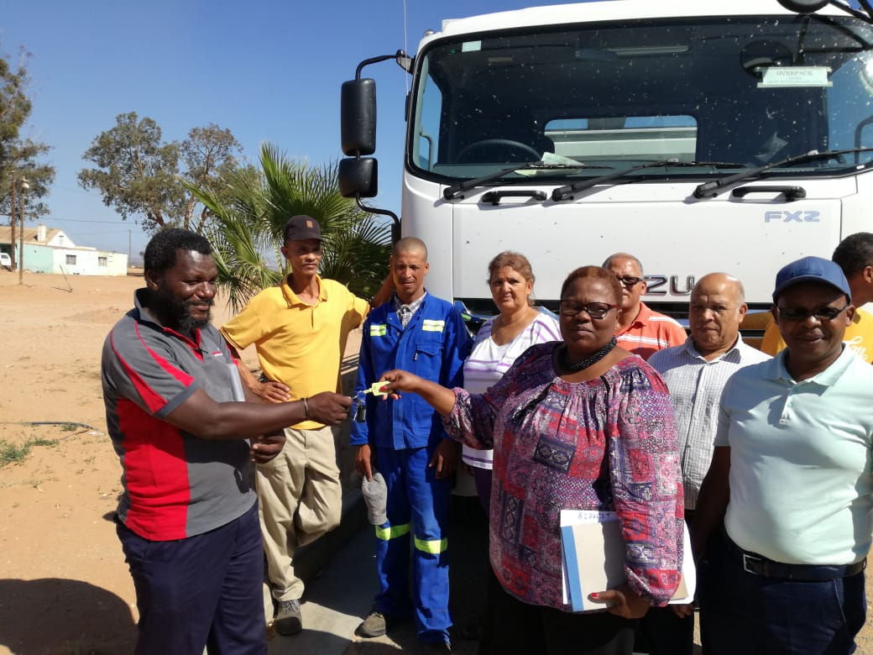
REFLECTION ON CO-OPERATIVE SUPPORT
The Farmers Production Support Unit (FPSU) Western Cape:
Beneficiaries: 181 small farmers that cultivates different commodities and livestock, participate and 1 500 local families benefits in terms of employment, income and training support:.
Ebenhaeser Farmers Support Unit Secondary Co-operative Limited leads the initiative;
Ebenhaeser Grapes Primary Co-operative Limited;
Eben Fruit and Vegetables Primary Co-operative Limited;
Eben Livestock Primary Co-operative Limited;
Ebenhaeser Agricultural Youth Primary Co-operative Limited;
FPSU Ebenhaeser Primary Co-operative Limited;
Lucern Co-operative (Reserved), and
Advanced Agric Co-operative (Reserved).
DRDLR identified the Ebenhaeser FPSU as a priority area and started to provide equipment and skills development to the local farmers in access of R8million, including a 10 Ton truck.

Slide 46
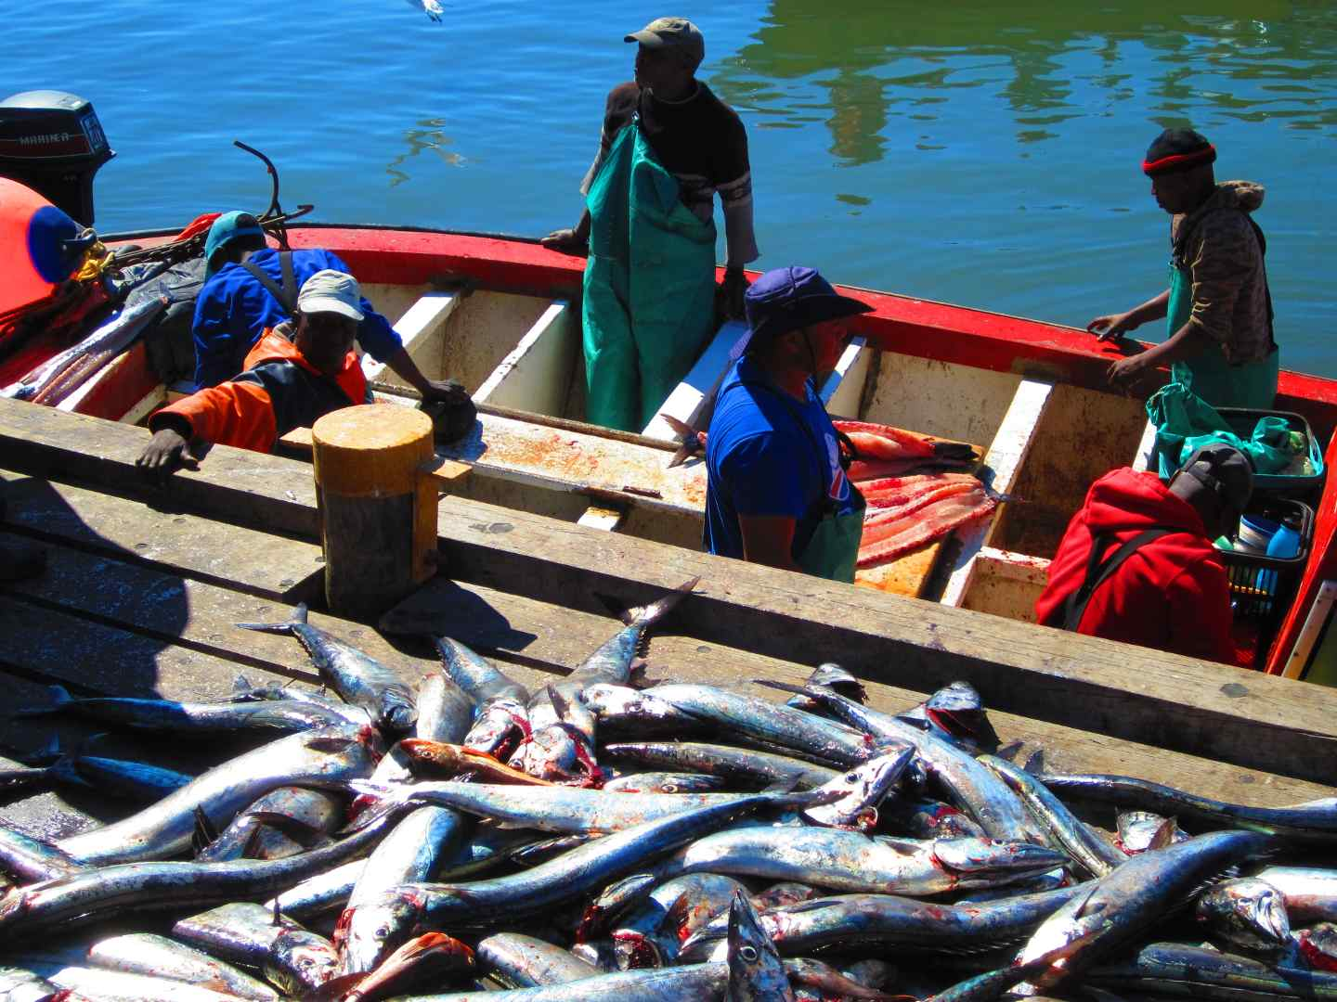
REFLECTION ON CO-OPERATIVE SUPPORT
IGQILA Fishing and Multipurpose Co-Operative Limited Western Cape:
Provide catering services and essential food supplies to the community of St Helena Bay.
The Co-operative secured catering services at the police services and local schools.
Able to buy bulk food essentials and sell it to the local community at a lower price.
Obtained a fishing quota from the Department of Sea Fisheries, which secured a sustainable income for the next five years

Slide 47
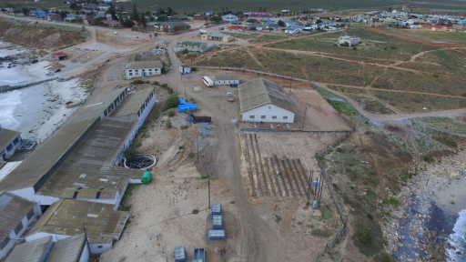
REFLECTION ON CO-OPERATIVE SUPPORT
Doring Bay Abalone Farm Western Cape:
Beneficiaries: Emerging farmers who are the community representatives through the shareholding of Auburn Malakaza. The trust owns 65% of the business.
Export to the primarily the Asian Market.
The Environmental Record of Decision was approved by the Provincial Government to increase their plant from a 40 tonnage farm to a 60 tonnage farm.
In terms of the industry benchmark of 1 job created for one ton, an additional 43 permanent jobs were created.

Slide 48
REFLECTION ON CO-OPERATIVE SUPPORT
Honeybush Tea Primary Co-operative Ltd Oudtshoorn Western Cape:
Beneficiaries: Previously disadvantaged communities from Oudtshoorn and Prins Albert.
Supply Honeybush tea products to both domestic and international markets currently Kenya and Czechoslovakia.
The export market is estimated to be in the region of R 13.92 million.
Seda’s Eden Branch assisted with the development of promotional Material, a Website as well as Mentorship and coaching, packaging and Business Plan to access funding and analyze the industry and market, as well as trade exhibition at the Cape Town International Convention Centre (CTICC).

Slide 49
REFLECTION ON CO-OPERATIVE SUPPORT
Free Heim Eggs Primary Co-operative Ltd Western Cape:
Beneficiaries: small commercial poultry farmers from Friemersheim George area.
Specialiazes in layer poultry farming production and sale of eggs.
The market for the local egg industry in the Garden Route District is estimated at over R134.6 million per year.
Sales target local retail stores, Spaza shops, bakeries, hotels and local individuals.

Slide 50
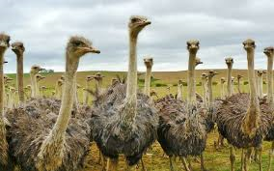
REFLECTION ON CO-OPERATIVE SUPPORT
Sakhasizwe Primary Agricultural Co-operative Ltd Western Cape:
Beneficiaries: local communities from the Oudtshoorn area.
Focused on growing day-old chicks to 5 months old and selling it to other ostrich farmers and now growing birds from day old chicks to slaughter age.
Revenue streams are from meat, skin and feathers.

Slide 51
REFLECTION ON CO-OPERATIVE SUPPORT
Co-operative Mentorship Programme KZN:
Beneficiaries: 77 Cooperatives.
Partnership with the Provincial Economic Development and Tourism Department.
R10million funding for various Seda interventions:
Establishment of KZN association for Cooperative Finance Institution
Mentorship Programme for 40 Agricultural Cooperatives
High Impact Adopted Projects

Slide 52
REFLECTION ON CO-OPERATIVE SUPPORT
Umkhambana Primary cooperative, Liberty Farmers Primary Cooperatives and Time 2 Strive KZN:
Beneficiaries: 3 Cooperatives
Supply milk to Orange Groove Diary.
International one on one mentorship programme by Danish Diary Expert for three cooperatives was undertaken through a partnership that Seda KZN has with Danish Government.
Assisted with the challenges ranging from low milk production volumes; high bacteria somatic cell count up to low quality milk.

Slide 53
REFLECTION ON CO-OPERATIVE SUPPORT
Kings of Midlands Secondary Cooperative KZN:
Collectively owned business wing of the Grange/Westgate Taxi Association.
Beneficiaries: 40 taxi associations within uMgungundlovu District, with 1 180 taxis on the road collectively.
To create a value chain operation which will support taxi industry, thereby creating a self-sustaining taxi industry independent of traditionally known service providers within the industry.
Formed from eleven (11) Primary Co-operatives in financial services; panel beating; motor mechanic; service stations and sewing industries.

Slide 54
REFLECTION ON CO-OPERATIVE SUPPORT
Harry Gwala Co-Operative Development Programme Gauteng:
Initiative of Gauteng City Region Academy (Gauteng Department of Education).
Beneficiaries: 500 unemployed youth trained on various co-operative related topics.
50 Co-operatives were registered spread as follows:
22 are in the City of Johannesburg
10 in Sedibeng
9 in West Rand
7 in Ekurhuleni
2 in Tshwane

Slide 55
REFLECTION ON CO-OPERATIVE SUPPORT
Support for Small Holder Cotton Growers Mpumalanga:
Beneficiaries: approximately 350 rural cotton growers .
The farmers have been receiving support from Cotton SA, Department of Agriculture and Land Reform and the Agricultural Research Council (ARC).
DARDLA provided the farmers with implements.
Seda has assisted the co-operatives with various Business Development Services ranging from training on governance and business management skills to mentorship and compliance with CIPC.
The National Empowerment Fund has agreed to assist the co-operative with funding to build a cotton ginnery in Nkomazi.

Slide 56
REFLECTION ON PARTNERSHIP AND VALUE LEVERAGED
The following co-operatives secured CIS grant funding through Seda’s facilitation:
Name of Co-operative | CIS Grant Funding
Sibongangazo Agricultural Primary Co-operative Ltd | R946,408.00
Sinqobile Services Primary Co-operative Ltd | R1,117,194.00
Against All Odds Primary Co-operative Ltd | R1,379,985.00
Somila Poultry and Veg Primary Co-operative Ltd | R544,618.00
Langalomso Agricultural Primary Co-operative | R984,630.00
Umbono Ngumbono Primary Co-operative Ltd | R810,400.00
Siyalunga Primary Co-operative Ltd | R446,660.00
Ulundi Lothukela Primary Co-op Ltd | R621,281.00
Silimela Ingomsolethu Agricultural Primary Co-operative | R608,698.00
Mafati Primary Co-operative Ltd | R870,029.00
Kuhle Feed & Cropping Primary Co-operative Ltd | R898,560.00
Mayidume Agricultural Primary Co-operative Ltd | R1,324,801.00
Somila Poultry and Vegetables Primary Co-operative Ltd | R453,100.00
TOTAL | R11,006,364.00

Slide 57
REFLECTION ON PARTNERSHIP AND VALUE LEVERAGED
Other Business Support through Partnerships:
Cape Bourne Studio Entertainment, which specialises in internet and printing services, was awarded a mentorship programme to the value of R10 000 from Business Partners.
IKAMVA Youth Entrepreneurship Development Co-Operative received support from Grandwest on their ESDP programme to the value of R 568 000. This has enabled the organisation to grow by increasing staff from 5 to 25.
30 Bonsmara Bulls estimated at R600 000 were donated to 8 farms in the Heuningvlei area in the Northern Cape. Bull management training amounting to R150 000 was provided to the 140 farmers on these farms.

Slide 58
3. HUMAN RESOURCES REPORT

Slide 59
HUMAN RESOURCES MANAGEMENT
Total number of staff compliment as at 31st March 2020 is 677
Of this number, 185 currently are Business Advisors (165 as per approved structure +20 MOU’s)
Staff vacancy rate at 5.%, vacancy rate for Business Advisors is 8%
Significant part of National Office are in the Enterprise Development Division and Seda Technology programme, which are part of the core services.

Slide 60
4. FINANCIAL REPORT

Slide 61
FINANCIAL REPORT - QUARTER 4
The total revenue budget for Seda for the 2018/19 financial year amounts to R862,43 million and the total expenditure budget amounts to R862,43 million.
The budget split per expenditure category is as follows:
The actual expenditure for the period 1 April to 31 December 2018 amounted to R 566,84 million resulting in a pro rata under spending of R 75,13 million (11.70%), against the pro-rata budget of R 641,97 million. Commitments at the end of December 2018 were about R 23,68 million.
Category of expenditure | R’million | % of budget
Compensation of employees | 354,40 | 41.09%
Operating costs (excluding employees compensation) | 158,12 | 18.34%
Programmes and projects | 342,66 | 39.73%
Capital | 7,25 | 0.84%

Slide 62
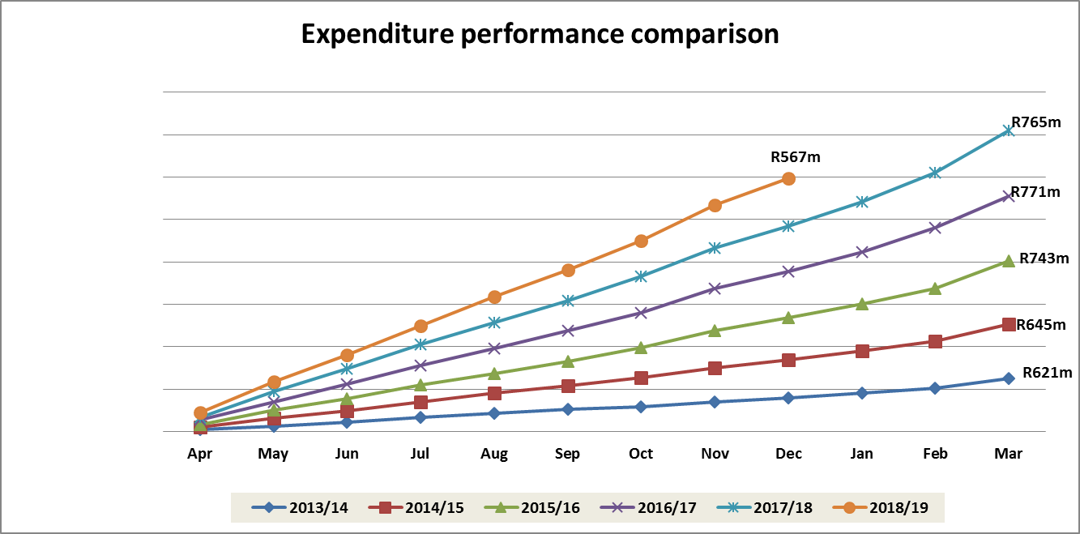
EXPENDITURE PERFORMANCE
Expenditure comparison previous periods to the period under review

Slide 63
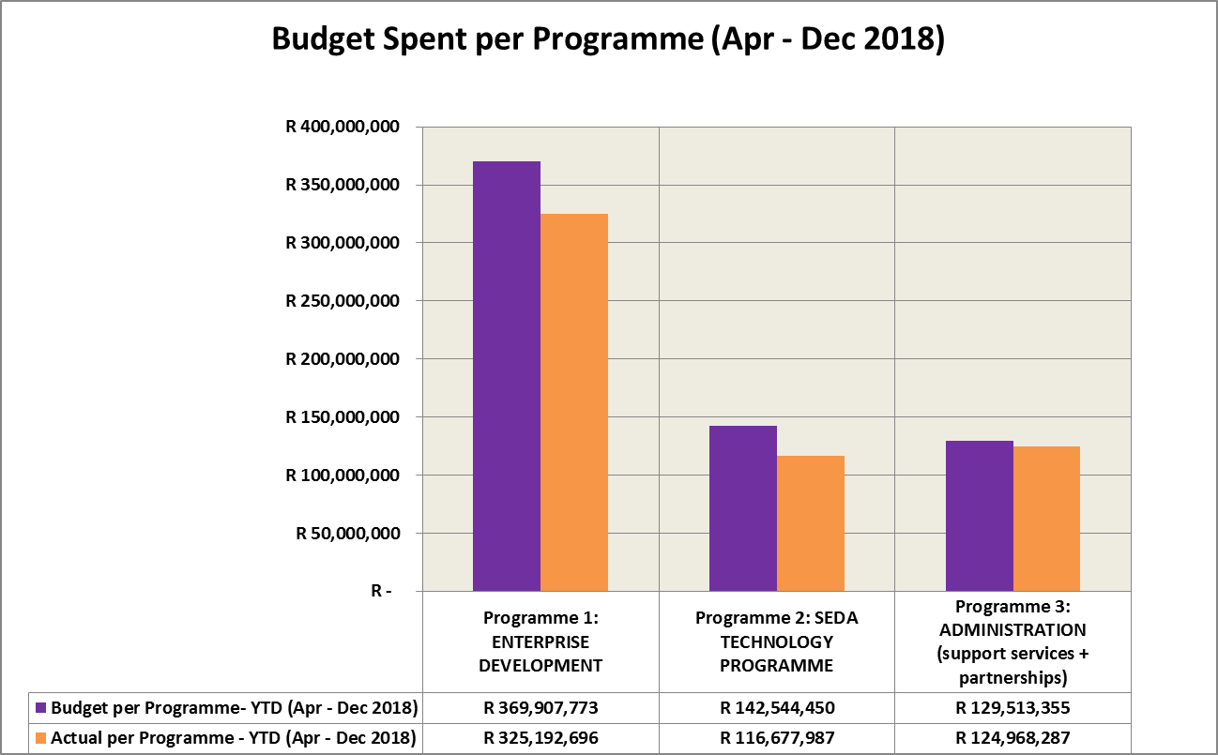
PORTFOLIO SPEND PER PROGRAMME
 | Programme 1: Enterprise Dev | Programme 2: Seda Tech Prog | Programme 3: Admin
% of Budget | 57.62% | 22.20% | 20.17%
% of Actual | 57.37% | 20.58% | 22.05%

Slide 64
5. RISK MANAGEMENT

Slide 65
RISK MANAGEMENT
STRATEGIC RISK REGISTER
Overall monitoring of the 2019/20 Strategic Risk Action Treatment Plans for the 4th quarter is as follows:
Register Name | Number of Action Plans | Not Started | In Progress | Complete
Strategic Register | 30 | 0 (0%) | 7 (23%) | 23 (77%)
Total | 30 | 0 (0%) | 7 (23%) | 23 (77%)

Slide 66
RISK MANAGEMENT
The pie-chart below depicts the implementation status of Strategic Risk Treatment action plans for the 4th quarter of 2019/ 20:
The progress on the Action Plans is currently underway, although most of them are overdue. The graph depicts that 77% of the Action Plans have been completed. 23% of the Action Plans are in progress, while 0% have not been started. It is therefore, highly recommended that management should implement all outstanding action plans as is now in the new financial year and Seda is in the new dispensation as ecosystem facilitator.

Slide 67
6. CONCLUSION

Slide 68
CONCLUSION
Covid-19 Impact on Operational Activities
Number of key activities in the Provinces and National office had to be cancelled or postponed due to restrictions that came into effect in March, like the following:
A Seminar for Business Advisors, training sessions for SMMEs, partners, service providers and practitioners, the postponement of important stakeholder engagements for the implementation of the District Delivery Model and initiation of at least two (2) large scale and high impact projects to name a few.
The restrictions on group gatherings that were put in place before lockdown also had an impact on targets for local and international exhibitions that were planned for February and March as well as some of the training that was supposed to be done by the Learning Academy.

Slide 69
CONCLUSION
PREPARATIONS FOR SEDA’S ROLE AS THE ECOSYSTEM FACILITATOR
BDS Ecosystem & Incubation Mapping Project were completed this Quarter
Discussion Paper on the Professionalisation of Business Advisory Services was completed and shared with all stakeholders and will serve as input into the The Incubation and Business Development Policy Framework that the Department of Small Business Development is working on.
Incubator Standards Gazetted
Development of Business Advisory Standards:
The proposal for the development of BA standards was approved by the SABS.
A technical Committee was set up to develop SA guidelines for an already existing international standard.
Learning Academy Business Model and Business Plan:
Purpose is to position Seda at the centre of BDS capacity building in the ecosystem was also completed this quarter and presented to committees.

Slide 70
CONCLUSION
AMONGST KEY PRIORITIES FOR THE NEW FINANCIAL YEAR ARE THE FOLLOWING:
Rolling out BDS Support for all the COVID Response & Economic Recovery Programmes for the Informal Sector as well as formal SMMEs
Enhancing our capability to deliver services virtually & general IT Capability
Resume stakeholder Engagement to get their commitment to the District Ecosystem Facilitation Model to providing support to SMMEs
Finalising the key elements of the Model:
Standards
District Information Management System
Re-Skilling our staff on new competencies that might be required by this model
Collaboration with sefa

Slide 71
END

