Slide 1
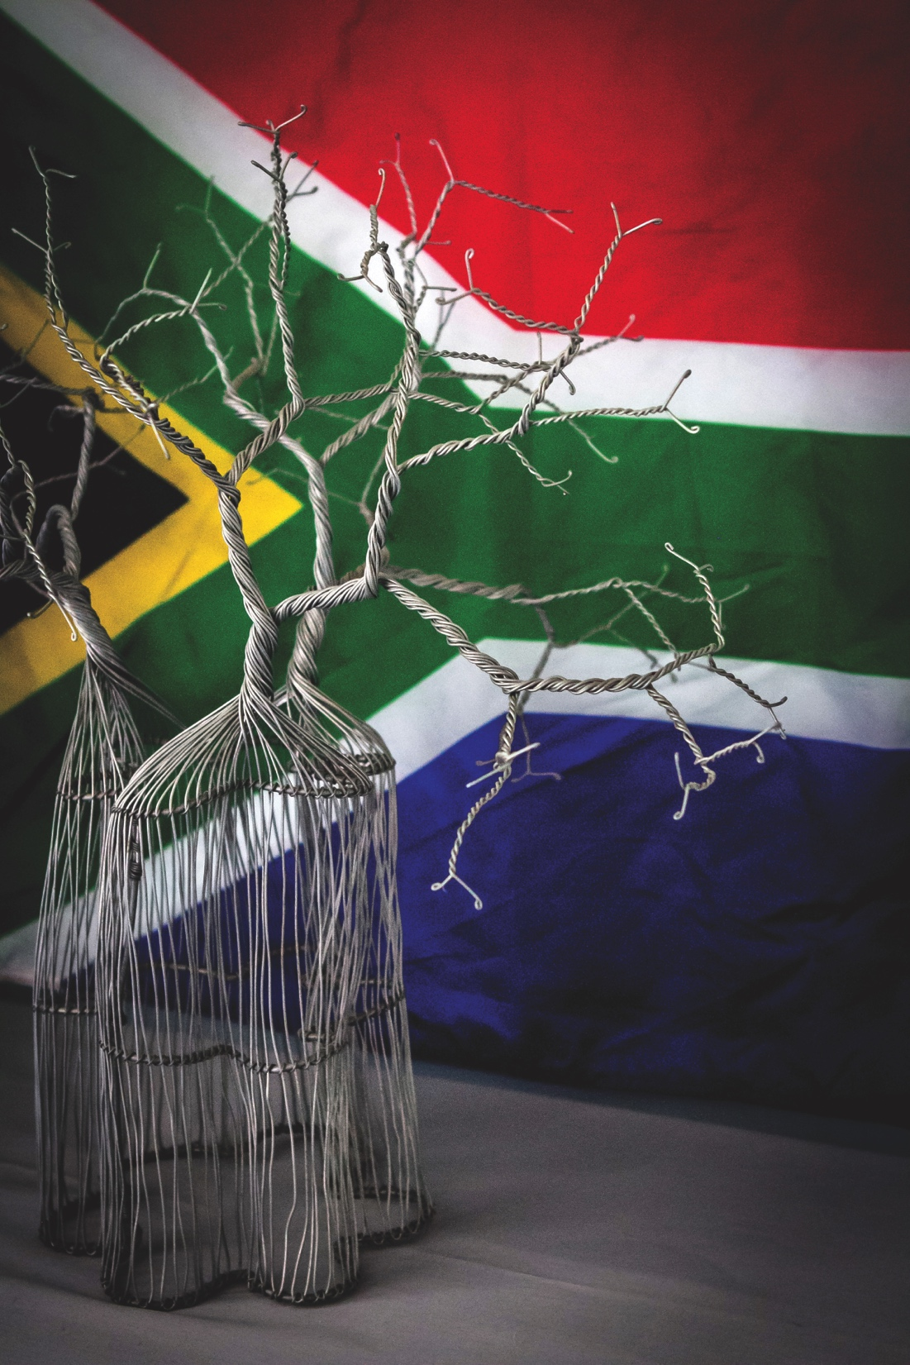
BRAND SOUTH AFRICA
Quarter 4 Progress Report
2019/2020

Slide 2
TABLE OF CONTENTS
QUARTER 4 PERFORMANCE OVERVIEW
QUARTER 4 TARGETS NOT ACHIEVED
PERFORMANCE AGAINST QUARTER 4 TARGETS
HUMAN RESOURCES
FINANCE
CLOSING REMARKS AND QUESTIONS

Slide 3
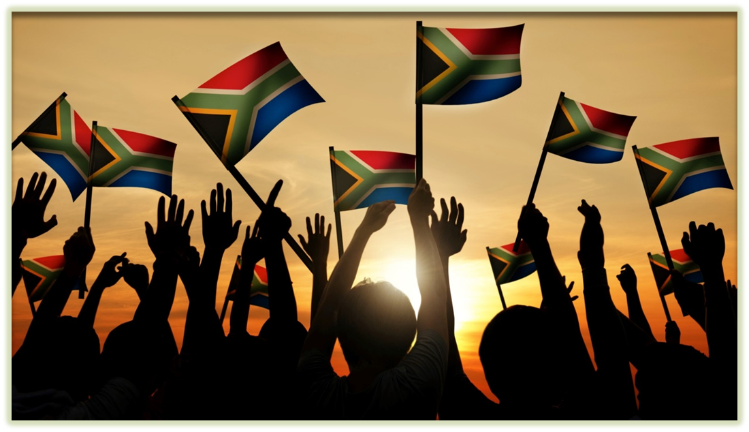
Quarter 4 performance overview

Slide 4
Quarter 4 Performance Overview

Slide 5
QUARTER 4 PERFORMANCE OVERVIEW IN %

Slide 6
Quarter 4 targets not achieved

Slide 7
Quarter 4 Targets Not achieved
Q4 Targets Not Achieved | Quarter 4 Actual Performance | Variance Explanation
90% overall organisational performance rating | 80% overall organisational performance rating | Most of the Quarter 4 targets were not achieved due to the restrictive measures put in place by government to curb the spread of COVID – 19.
1x SA Incorporated research analysis report produced | Planned SA Inc. engagement in Ghana, with University of Ghana Business School cancelled | Planned SA Inc. engagement in Ghana, with University of Ghana Business School cancelled due to COVID-19 measures taken by both the Ghanaian and South African governments
2x Nation Brand alignment training workshops implemented | No training workshops implemented | Brand SA-led workshops in the Northern Cape and Eastern Cape could not be delivered due to restrictive measures put in place by government to curb the spread of the COVID-19 pandemic.
Leverage off 1x Stakeholder-led platforms to deliver Nation Brand alignment training | Stakeholder-led workshop was not executed in Q4 | The stakeholder-led workshop in Gauteng could not be delivered due to restrictive measures put in place by government to curb the spread of the COVID-19 pandemic.
4x coordinated activities implemented in partnership with private sector stakeholders | 1.NBI Business Roundtable 2.Corporate PYP collaboration with UBank, Harmony Gold and Free State Department of Education 3. Collaboration with MTN at WEF Davos | Planned activity with Mango Airlines could not be delivered due to restrictive measures put in place by government to curb the spread of the COVID-19 pandemic

Slide 8
Performance against Quarter 4 targets

Slide 9
PERFORMANCE AGAINST QUARTER 4 TARGETS
Supporting Strategic Goal 1: Sound governance, high performance and the optimal utilisation of available resources
STRATEGIC OBJECTIVE | REPORTING PERIOD | 2019/20 ANNUAL TARGET | QUARTER 4 TARGET | QUARTER 4 ACTUAL PERFORMANCE | VARIANCE EXPLANATION
1.Sound internal controls and good governance | Annual | 1.1. Unqualified audit opinion on financial information | Not applicable | Not applicable | No variance
 | Annual | 1.2. Unqualified audit opinion on performance information | Not applicable | Not applicable | No variance
 | Bi-annual | 1.3. Quarterly satisfactory internal audit & AG reports on internal controls | 1x satisfactory Internal Audit reports on internal controls | Target Met: 1x satisfactory Internal Audit report on internal controls | No variance
2. A high performing organisation through the optimal utilisation of technological, financial and human resources | Annual | 2.1. 90% overall organisational performance rating | 90% overall organisational performance rating | Target Not Met: 80% overall organisational performance rating | Most of the Quarter 4 targets were not achieved due to the restrictive measures put in place by government to curb the spread of COVID – 19.
 | Quarterly | 2.2. 5% variance as per materiality framework on budget versus expenditure | 5% variance on budget versus expenditure | Target Met: 4.3% variance on budget versus expenditure | No variance
 | Quarterly | 2.3. 98% availability of all IT systems | 98% availability of all IT systems | Target Met: 98.39% availability of all IT systems | No variance

Slide 10
PERFORMANCE AGAINST QUARTER 4 TARGETS
Supporting Strategic Goal 2: Proactive and coordinated reputation management of the Nation Brand.
STRATEGIC OBJECTIVE | REPORTING PERIOD | 2019/20 ANNUAL TARGET | QUARTER 4 TARGET | QUARTER 4 ACTUAL PERFORMANCE | VARIANCE EXPLANATION
3. Enhanced understanding of the Nation Brand performance | Quarterly | 3.1. 12x research reports on performance of the Nation Brand produced | 4x analysis reports on performance of the Nation Brand produced | Target Met: Delivered two internal analysis reports. Meets over-all annual target of twelve. Open Budget index – internal analysis NBI and Nation Brand Equity | Two indices were released earlier in the financial year, hence only two covered in Q4. Annual target met.
 | Quarterly | 3.2. 4x SA Incorporated research analysis reports produced | 1x SA Incorporated research analysis report produced | Target not Met: Planned SA Inc. engagement in Ghana, with University of Ghana Business School cancelled | Planned SA Inc. engagement in Ghana, with University of Ghana Business School cancelled due to COVID-19 measures taken by both the Ghanaian and South African governments
 | Quarterly | 3.3. 4x quarterly domestic perceptions research conducted | 1x quarterly domestic perceptions research study conducted | Target Met: Received National Omnibus report Conducted monthly surveys – February & March Trust – qualitative research conducted Trust focus groups deferred due to COVID-19 lockdown measures | No variance
 | Annual | 3.4. 16x Market reports received | 16x Market reports received; Fieldwork completion, development of final market, regional and overall report produced | Target Not Met | During Mid-term review & Strategy planning a proposed implementation of new South Africa Global Reputation Study was recommended due to global dynamics.
 | Annual | 3.5. 1x approved Annual SA Competitiveness Forum outcome report | Not applicable | Not applicable | No variance

Slide 11
PERFORMANCE AGAINST QUARTER 4 TARGETS
Supporting Strategic Goal 2: Proactive and coordinated reputation management of the Nation Brand.
STRATEGIC OBJECTIVE | REPORTING PERIOD | 2019/20 ANNUAL TARGET | QUARTER 4 TARGET | QUARTER 4 ACTUAL PERFORMANCE | VARIANCE EXPLANATION
4. Improved Nation Brand reputation and perceptions amongst South Africans | Quarterly | 4.1. 9x PYP activities implemented | 1x Provincial PYP activities implemented | Target Met: 1. Play Your Part schools activity in Western Cape | No variance
 | Quarterly | 4.2. 10x activations utilised to promote constitutional awareness | 2x activations utilised to promote constitutional awareness | Target Met and Exceeded: Four activities implemented are: Freedom of Expression activation in Western Cape Freedom of Expression activation in Mpumalanga Promotion of Access to Information activation in Limpopo Promotion of Access to Information activation in North West | Due to requests from the Office of the Deputy Minister in the Presidency to collaborate in the execution of Limpopo and North West activities.
 | Quarterly | 4.3. 16x marketing platforms utilised for the constitutional awareness campaign | 4x marketing platforms utilised to promote the constitutional awareness campaign | Target Met and Exceeded: A total of 11 platforms were utilised to promoted constitutional awareness and to make up for Q2 & Q3 shortfall: 1. TV taxi ranks 2.Uber TV 3.Massive Metro (Taxi) 4.Taxi TV 5.Soweto Vilakazi street (Outdoor banner) 6.Sowetan Digital 7.Sowetan Print 8.Regional Radio 9.Community Radio 10. Cinema 11. . DSTV (10 channels | The promotional platform selected gave Brand South Africa an opportunity for exposure on multi platforms on DSTV. This also assisted in catching up for the targets not met in Q2 & Q3.

Slide 12
PERFORMANCE AGAINST QUARTER 4 TARGETS
Supporting Strategic Goal 3: Proactive and coordinated communication of the Nation Brand values system and value proposition
STRATEGIC OBJECTIVE | REPORTING PERIOD | 2019/20 ANNUAL TARGET | QUARTER 4 TARGET | QUARTER 4 ACTUAL PERFORMANCE | VARIANCE EXPLANATION
5. Improved Nation Brand reputation and perceptions domestically and internationally | Quarterly | 100x positive communication content pieces published | 25x of planned positive communication content pieces published | Target Met: Comedy + Poetry = Love for Community Brand South Africa “Play Your Part” ambassadors Empower Local Learners in Cape Town South Africa to draw expat goodwill and expertise in Australia Miss Universe Comes Home 14th Annual SAFTA’s Nominees Announcement in Style For the Love of the Game: South Africa to host the World Football Summit Africa The Cubing Hub: Thinking Outside the Box Let’s Make 2020 as incredible as 2019, all you have to do is play you part for SA The 26th Annual Investing in African Mining Indaba in Cape Town Congratulations to the Class of 2019 Mokopane Careerwise leveraging opportunities in the educational space Brand South Africa urges citizens around the world to play their part to unite the fight against Covid-19 If we rally together as a nation, we can stop the spread of Covid-19 Silver linings – why now is the time to step up trade between SA and Australia A blueprint for the world to learn from – decisive, quick and collaborative South Africa’s Continental Leadership Role Culinary Excellence Draws Tourists to South Africa South Africa’s Global Competitiveness Health and Medical Innovation in South Africa Positive content on social media platforms: 20. Congratulations to Team South Africa, who took first place at the 5th International School Moot Court Competition in Gdynia, Poland. 21. Recognition of South African cultural ambassador, Esther Mahlangu, whose passion for Traditional Ndebele art continues to make waves on the global stage and with mega brands. 22. Local film, The Zulu Wedding, won big at Pan African Film & Arts Festival 2020, bagging the Festival Director’s award - Best Narrative Feature | No variance

Slide 13
PERFORMANCE AGAINST QUARTER 4 TARGETS
Supporting Strategic Goal 3: Proactive and coordinated communication of the Nation Brand values system and value proposition
STRATEGIC OBJECTIVE | REPORTING PERIOD | 2019/20 ANNUAL TARGET | QUARTER 4 TARGET | QUARTER 4 ACTUAL PERFORMANCE | VARIANCE EXPLANATION
5. Improved Nation Brand reputation and perceptions domestically and internationally | Quarterly | 100x positive communication content pieces published | 25x of planned positive communication content pieces published | 25x planned positive communication content pieces published: Continued… Positive content on social media platforms: 23. Support for the #ProteasWomen T20 World Cup announcement ceremony. 24. Congratulations to the Blitzboks as they clinch their 5th championship title at the LA sevens Rugby games. 25. Congratulations Pearl Thusi and the entire Queen Sono team for securing bag and flying the flag high! Flag of South Africa | No variance

Slide 14
PERFORMANCE AGAINST QUARTER 4 TARGETS
Supporting Strategic Goal 3: Proactive and coordinated communication of the Nation Brand values system and value proposition
STRATEGIC OBJECTIVE | REPORTING PERIOD | 2019/20 ANNUAL TARGET | QUARTER 4 TARGET | QUARTER 4 ACTUAL PERFORMANCE | VARIANCE EXPLANATION
5. Improved Nation Brand reputation and perceptions domestically and internationally | Annual | 5.2. 5% increase in users who engage with Brand SA content on its digital platforms | 5% increase in users who engage with Brand SA content on its digital platforms | Target Met and Exceeded: 6.8% growth across all platforms | Annual target of 5% was exceeded due to the popularity of content posted. This was a new target and we could not be sure what to expect without a digital agency
 | Quarterly | 5.3. 11x implemented media engagement activities to strengthen relations and liaison with media | 3x implemented media engagement activities to strengthen relations and liaison with media | Target Met: Three media engagement activities implemented: 1. WEF Media Tour 2. Mining Indaba Media Engagement 3. AU Summit Media Tour | Not variance

Slide 15
PERFORMANCE AGAINST QUARTER 4 TARGETS
Supporting Strategic Goal 4: Proactive and coordinated marketing of the Nation Brand and the Nation Brand identity
STRATEGIC OBJECTIVE | REPORTING PERIOD | 2019/20 ANNUAL TARGET | QUARTER 4 TARGET | QUARTER 4 ACTUAL PERFORMANCE | VARIANCE EXPLANATION
6. Enhanced awareness of the Nation Brand identity, image, and competitiveness and Nation Brand value proposition | Quarterly | 6.1. 12x international platforms utilised to promote the Nation Brand identity, image, values and competitiveness | 2x international platforms utilised to promote the Nation Brand identity, image, values and competitiveness | Target Met and Exceeded: CEO’s Knows promoted on business day Made in SA videos promoted in the continent NASCAR Africa Project, USA | An opportunity presented itself for Brand South Africa to promote the Nation Brand at the NASCAR Africa project that was deemed strategic enough to support.
 | Quarterly | 6.2. 13x PYP domestic platforms utilised to promote the Nation Brand | 2x PYP domestic platforms utilised to promote the Nation Brand | Target Met and Exceeded: 1.Welcome and send off activation of Miss Universe 2.Promoted investment AV on ENCA 3.Human Rights day digital campaign. | There was a tactical opportunity that was strategic enough for Brand South Africa to support: Miss Universe, Zozibini’s homecoming

Slide 16
PERFORMANCE AGAINST QUARTER 4 TARGETS
Supporting Strategic Goal 4: Proactive and coordinated marketing of the Nation Brand and the Nation Brand identity
STRATEGIC OBJECTIVE | REPORTINGPERIOD | 2019/20 ANNUAL TARGET | QUARTER 4 TARGET | QAURTER 4 ACTUAL PERFORMANCE | VARIANCE EXPLANATION
7. A cohesive approach when promoting and marketing the Nation Brand amongst targeted stakeholders | Quarterly | 7.1. 9x Nation Brand alignment training workshops implemented in provinces (1x per province) | 2x Nation Brand alignment training workshops implemented | Target not Met: No training workshops implemented | Brand SA-Led workshops in the Northern Cape and Eastern Cape could not be delivered due to restrictive measures put in place by government to curb the spread of the COVID-19 pandemic.
 | Quarterly | 7.2. Leverage off 3x Stakeholder-led platforms to deliver Nation Brand alignment training | Leverage off 1x Stakeholder-led platforms to deliver Nation Brand alignment training | Target not Met: Stakeholder-led workshop was not executed in Q4 | The stakeholder-led workshop in Gauteng could not be delivered due to restrictive measures put in place by government to curb the spread of the COVID-19 pandemic.
 | Quarterly | 7.3. 500x new users on marketer’s portal | 125x new registrations on the marketer’s portal | Target Met and Exceeded: A total of 215 registrations were achieved | This can be attributed to the successful promotional campaign as well as 3 tender briefings that took place in Q4 where bidders accessed the toolkit for more information on Brand South Africa.

Slide 17
PERFORMANCE AGAINST QUARTER 4 TARGETS
Supporting Strategic Goal 4: Proactive and coordinated marketing of the Nation Brand and the Nation Brand identity
STRATEGIC OBJECTIVE | REPORTING PERIOD | 2019/20 ANNUAL TARGET | QUARTER 4 TARGET | QUARTER 4 ACTUAL PERFORMANCE | VARIANCE EXPLANATION
8. Strengthened Nation Brand advocacy, domestically and amongst South Africans living abroad | Quarterly | 8.1. 60x PYP ambassador engagements (online or offline) achieved in promoting the Nation Brand | 15x PYP ambassador engagements achieved in promoting the Nation Brand | Target Met & Exceeded: 17x PYP ambassador engagements (online or offline) achieved in promoting the Nation Brand 1. Nnusi Gazi Foundation (Education N/W) 2. Rianette, SAVE NET initiative (National) 3. Jabulile Gwala (In good company, women empowerment, Gauteng) 4. Aurelia Nxumalo + Buhle Mbele (The Professionista initiative, women empowerment, Gauteng) 5. Shamilla Ramjawan (Education, Princess D Menstrual Cup, Mpumalanga) 6. Sandiso Sibiso (C.T, Innovation) 7. Pamela Bass (DBN, Media) 8. Mpumelelo Mtintso (Book Ibhoni, Gauteng, education) 9. Thami Dish Foundation (Human rights day, Gauteng) 10. Thandy Matlaila (Wellness, Covid 19, Gauteng) 11. TTMBA (Miss Universe welcome Gauteng) 12. Ntando Kunene (Miss Universe welcome, Gauteng) 13. Jozi Cats (gender Inclusiveness, Gauteng) 14. Ntsaki Mkhari (boy’s legends initiative, Limpopo, Covid 19 call to action) 15. Goliath brothers (Gauteng, Covid 19 call to action) 16. Ntsako Mhlanga (education) 17. Azael Langa (creative arts) | PYP ambassadors were mobilised in 2 strategic and important engagements, Zozibini’ s homecoming and interventions on COVID 19 pandemic response

Slide 18
PERFORMANCE AGAINST QUARTER 4 TARGETS
Supporting Strategic Goal 4: Proactive and coordinated marketing of the Nation Brand and the Nation Brand identity
STRATEGIC OBJECTIVE | REPORTING PERIOD | 2019/20 ANNUAL TARGET | QUARTER 4 TARGET | QUARTER 4 ACTUAL PERFORMANCE | VARIANCE EXPLANATION
8. Strengthened Nation Brand advocacy, domestically and amongst South Africans living abroad | Quarterly | 8.2. 17x GSA activations | 5x GSA activations | Target met: GSA Activation, Los Angeles, USA GSA Perth, Australia GSA Activation with ICC, Perth, Australia GSA Melbourne, Australia GSA virtual Activation, Zambia | It must be noted however that the Annual target of 17 was not met. Remaining 2x GSA Activations for Q4 were postponed/cancelled due to no contact and/or travel restrictions imposed as a result of COVID-19 GSA Activation in Wales (postponed) GSA Activation Ghana (cancelled, travel not allowed)

Slide 19
PERFORMANCE AGAINST QUARTER 4 TARGETS
Supporting Strategic Goal 2: Proactive and coordinated reputation management of the Nation Brand
STRATEGIC OBJECTIVE | REPORTING PERIOD | 2019/20 ANNUAL TARGET | QUARTER 4 TARGET | QUARTER 4 ACTUAL PERFORMANCE | VARIANCE EXPLANATION
9. Enhanced relations with Stakeholders towards the promotion of the Nation Brand reputation, domestically and internationally | Annual | 9.1. 14x coordinated activities implemented in partnership with private sector stakeholders | 4x coordinated activities implemented in partnership with private sector stakeholders | Target Not Met: 1.NBI Business Roundtable 2.Corporate PYP collaboration with UBank, Harmony Gold and Free State Department of Education 3.Collaboration with MTN at WEF Davos | Planned activity with Mango Airlines could not be delivered due to restrictive measures put in place by government to curb the spread of the COVID-19 pandemic.
 | Quarterly | 9.2. 16x coordinated activities implemented in partnership with state institution stakeholders in collaboration with Global Markets for international partner | 4x coordinated activities implemented in partnership with state institution stakeholders | Target Met: Governance – collaboration with GCIS and Department of Defence Back to School collaboration with Free State Department of Basic Education SONA 2020 activities Collaboration with Gauteng provincial Gov | No variance

Slide 20
PERFORMANCE AGAINST QUARTER 4 TARGETS
Supporting Strategic Goal 2: Proactive and coordinated reputation management of the Nation Brand
STRATEGIC OBJECTIVE | REPORTING PERIOD | 2019/20 ANNUAL TARGET | QUARTER 4 TARGET | QAURTER 4 ACTUAL PERFORMANCE | VARIANCE EXPLANATION
9. Enhanced relations with Stakeholders towards the promotion of the Nation Brand reputation, domestically and internationally | Quarterly | 14x coordinated activities implemented in partnership with civil society stakeholders | 4x coordinated activities implemented in partnership with civil society stakeholders | Target Met: FBO Collaboration (Calling the called platform) Digital collaboration with JCI (joint COVID-19 awareness) Collaboration with PFP (COVID-19 awareness) Collaboration with NUMSA | No variance
 | Quarterly | 20x Brand SA-led in-market activities implemented | 5x in-market activities implemented | Target Met and Exceeded: UK-Africa Summit, London HSBC 2020 USA Sevens Rugby International Fan Exhibition, Los Angeles, USA Martin Luther King, JR. Day Economic Empowerment Business and Faith Forum, USA Commonwealth Trade Expo, Greater Birmingham, UK Leaders in Innovation Fellowship, London, UK FP Magazine Virtual Dialogue, USA | UK Global African Awards, LSE Africa Summit in the UK and in-market activity in Ghana postponed/cancelled due to travel and/or event restrictions as a result of COVID-19 outbreak in those markets Notwithstanding these challenges, a number of tactical opportunities were identified during the course of the 2019/20 FY that were deemed strategic enough to support, hence the annual target of in-market activities implemented could be met.
 | Quarterly | 8x activities implemented at strategic platforms that will secure speaking platforms at other relevant international strategic events | 2x activities implemented at strategic platforms that will secure speaking platforms at other relevant international strategic events | Target Met: Strategic platforms: WEF Davos Mining Indaba | No variance

Slide 21
HUMAN RESOURCES

Slide 22
HUMAN RESOURCES
Approved structure by the Board of Trustees in 2014 consists of 57 permanent posts. The review of the structure is currently in progress.
Current workforce = 48 permanent employees.
Vacant posts = 9 vacancies.
Vacancy rate = 15.8%.
Recruitment of the 9 vacant posts is in progress at different stages and impacted by the COVID-19 lockdown. Targeted drive to address employment equity and disability imperatives.
Training and Development as per the approved Training and Development Plan with a targeted focus on the empowerment of women, employees serving on bid committees, coaching and mentorship.

Slide 23
HUMAN RESOURCES
3. Governance
The management of human resource matters is governed by a range of relevant policies and standard operating procedures that are approved by the Board of Trustees.
Current policies are in the process of review.
There are a number of new relevant policies that have been drafted and which are currently at different stages of the consultation process on route to the Board of Trustees for approval.
Retention of talented and high-performing employees
Retention Strategy tabled at the Human Capital, Remuneration, Social and Ethics Committee on route to the Board of Trustees for approval.
A stable organization and work environment with a number of workplace culture interventions completed or in progress eg. recognition and reward mechanisms, ongoing developmental opportunities and internal communication mechanisms.

Slide 24
BRAND SOUTH AFRICA EQUITY STATISTICS

Slide 25
BRAND SOUTH AFRICA VS NATIONAL ECONOMIC ACTIVE POPULATION BY POPULATION GROUP/RACE AND GENDER AS AT MARCH 2020
KEY
 | No representation
 | Partial representation
 | Representation met and/or exceeded
 | Over representation

Slide 26
Finance

Slide 27
BUDGET vs EXPENDITURE to date
PROGRAMME | YTD Q4 BUDGET | YTD Q4 ACTUAL | YTD Q4 VARIANCE | YTD Q4 VARIANCE % | VARIANCE EXPLANATION
BRAND MARKETING | 85,599,000 | 83,629,988 | 1,969,012 | 98% | The variance is due to cancellations of activations in the fourth quarter
STAKEHOLDER RELATIONS | 19,647,000 | 16,754,314 | 2,892,686 | 85% | The variance is attributable to the postponement of Civil society and Constitutional awareness projects in the fourth quarter.
ADMINISTRATION | 102,668,000 | 98,440,238 | 4,227,762 | 96% | The variance is attributable to increase in legal services and professional fees
TOTAL | 207,914,000 | 198,824,540 | 9,089,460 | 96%

