Slide 1
briefing TO THE PORTFOLIO COMMITTEE ON MINERALS RESOURCES AND ENERGY
MINING INDUSTRY RESPONSE TO COVID-19
19 June 2020

Slide 2
This briefing
Roger Baxter Minerals Council’s approach
Dr Thuthula Balfour
on the health response
Testing and Statistics
Motsamai Motlhamme
on
Labour Issues
Tebello Chabana
on
Mining Industry in Communities.

Slide 3
Shared responsibility
Regulator
While the prime responsibility for ensuring the effective implementation of measures to ensure healthy and safe working practices rests with management, levels of responsibility rest with all involved, including employees themselves, their elected representatives and the regulator.
But it goes beyond the workplace
People are employees for only a part of their time, and they are also individuals with families and friends. This is why companies, in addition to doing their utmost to ensure health and safety in the workplace, have also made significant contributions to salaries of those who have been unable to work, made donations to the Business for SA Solidarity Fund and other funds, and carried out additional community projects.
Business
Unions
Employees

Slide 4
COVID-19
Minerals Council – health interventions

Slide 5
COVID-19: a black swan
Unprecedented socio-economic disruption
No-one has all the answers - we are all finding the best way to control and mitigate the impact of the disease
Novel virus

Slide 6
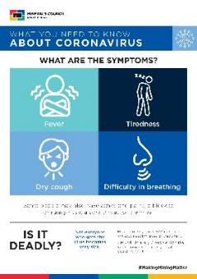
Timeline of interventions
41 people hospitalised in Wuhan City, Hubei Province, China
December 2019
WHO alerted to cluster of unknown cases of pneumonia in Hubei
31 December
SARS Cov-2 identified as cause and named COVID-19
Early
January 2020
WHO declares COVId-19 a Public health emergency of international concern
30 January
Minerals Council initiates communication plan and distributes educational material to companies
February 2020
WHO declares COVID -19 a Pandemic. Minerals Council provides further material and guidance to members
11 March 2020

Slide 7
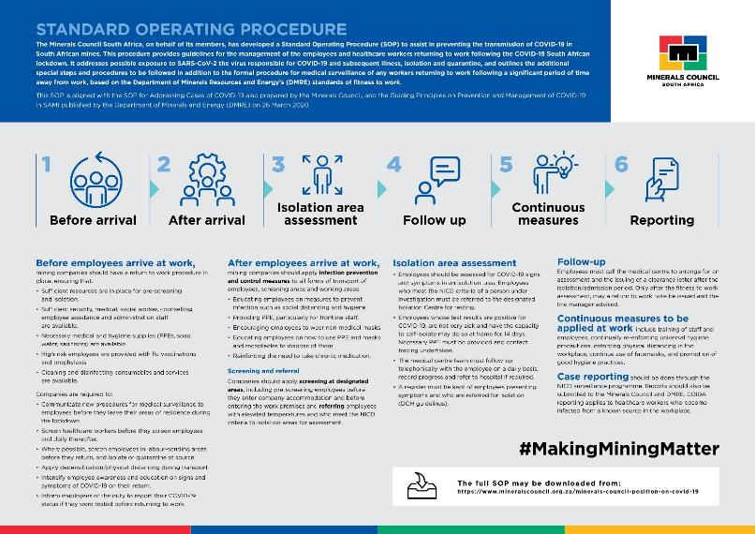
Timeline of interventions
Minerals Council initiates communication plan and distributes educational material to companies
February 2020
WHO declares COVID -19 a Pandemic
11 March 2020
Minerals Council adopts a COVID 19 Preparedness Plan (10 Point Plan)
17 March 2020
Minerals Council adopts SOP on Management of COVID-19
25 March 2020
Minerals Council adopts SOP on COVID-19 Following the Lockdown
9 April 2020
Minerals Council issues Guidance on PPE for COVID-19
21 April 2020

Slide 8
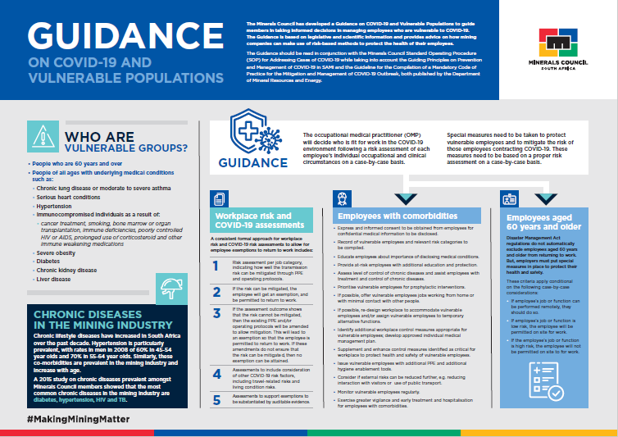
Most recent guidance on vulnerable populations

Slide 9
Key elements of interventions
Prevention
Risk assessment of workplaces and vulnerable employees
Management of cases, including screening, testing, isolation, quarantine and reporting
Collaboration on regional basis among companies and with the public health system

Slide 10
CEO-led initiative to reduce mortality in the industry under CEO Zero Harm Forum
Additional funding allocated for:
Behavioural training
Disease mapping
Fundamental research

Slide 11
Current stats
June 2020

Slide 12
Mining industry statistics
Global statistics
RSA statistics
Testing rates by
population
Number of mines 385
Global cases
8,274,596
RSA cases
76,334
Global test rate
1.50%
Total screening 261,710
Total tests 12,131
Tests pending 803
Global deaths
446,390
RSA deaths
1,625
RSA recovered
RSA test rate
1.98%
Mining test rate
2.70%
Total positive cases 1,133
Active cases 741
Deaths 2
Global recovered
4,333,422
Recovered 390
42,063
Status of mining cases
Cases and deaths per commodity
1.5K
1K
1,133
2
34.4%
Active cases
Recovered
Deaths
500
564
0 35 0
462
₁ 72 ₁
65.4%
0
Gold
Coal
Platinum
Other
Total
Positive cases
Deaths
Mi ner al s Co unc i l po s i t i o n o n CO V ID -19
17 June 2020,
DAY
104

Slide 13
Daily and total cases diagnosed over time
Positive cases per population and per tests taken
s
e
s
a
c
y l
i
a
D
120
1.2K
s
e
s
a
c l
a
t
o
T
10%
9.34%
100
1K
5%
6.51%
7.07%
80
800
0.25%
0.13%
0.11%
60
600
0%
RSA Mining
RSA
Global
40
400
Positive cases per population
Positive cases per test taken
20
200
Recovered cases and deaths per positive cases
60%
55.1%
0
0
5.39%
52.37%
Jun 3, 2020
Jun 7, 2020
40%
Mar 4, 2020
Apr 13, 2020
May 8, 2020
Jun 11, 2020
Apr 30, 2020
May 13, 2020
Jun 15, 2020
Mar 28, 2020
May 18, 2020
May 22, 2020
May 26, 2020
May 30, 2020
0.18%
34.42%
2.13%
20%
Daily cases
Total cases
0%
RSA Mining
RSA
Global
Cases and deaths per region to date
Deaths per positive cases
Recovered per positive cases
600
400
1
495
0
468
47
200
0
0
110
1
0 7 0 3 0 2 0 1 0 0
North West
Gauteng
Limpopo
Mpumalanga
Free State
Northern Cape
KwaZulu-Natal
Western Cape Eastern Cape
Deaths by province
Cases by province
Minerals Council position on COVID-19
17 June 2020,
DAY 104

Slide 14
Industry statistics in context

Slide 15
Context for reported high numbers of COVID-19 cases
Given the high level of preparedness of the mining sector, the industry is doing more screening and testing than any other sector. If other sectors of the economy were doing the same level of screening and testing, they would also be detecting the real case numbers in society.
More COVID-19 infections diagnosed in mining as proportion of workforce than positive diagnoses as proportion of population as a whole - mistaken to assume that mining is more prone to spread of virus than population as a whole
Clusters have contributed to high incidences in particular areas
Mining companies conscious of risk of employees returning to work from different locations can potentially transport the virus - industry committed to strict routines for employees returning from other countries or regional “hotspots”
Industry COVID-19 death rate of miners far lower than for similar age groups in country as a whole - industry taken very cautious approach to taking extra measures for individuals who may be at greater risk
Intensive daily screening, thorough contact tracing and testing of contacts means that the overall incidence is no higher than the population as a whole, and is more likely lower, given especially the intensive hygiene and social distancing measures required at every workplace

Slide 16
Issue of testing
Testing done on any person displaying any symptoms
Screening and testing undertaken in line with protocols determined by NICD
In South Africa, as in most of the rest of the world, testing resources are limited. It would be unfair to everyone else if a big share of total testing capacity was allocated to one industry
Number of mining companies have been seeking to boost testing capacity within companies and regions in which they operate
Testing not panacea – it is at a point of time with infection happening only minutes after a test has been done
Biggest defence is prevention through hygiene and social distancing practices, combined with exclusion of those who may be infected from workplace, and the care and isolation of those who may become ill

Slide 17
Labour interventions

Slide 18
Labour interventions
The Minerals Council has been part of broader business engagements on labour issues pertaining to Covid-19 and the lock-down (B4SA)
Part of Nedlac engagements on labour market aspects
Provision of information and guidance to members on various labour issues

Slide 19
Labour issues
Issues at roadblocks
With our partner TEBA managed to facilitate passage of employees from the Labour Sending Areas
Created a standard format for the essential services permit for members
Issues affecting transport
Through TEBA and engagement with the relevant government departments – resolved transportation issues with the Taxi Associations
Health and safety issues such as sanitisation, social distancing, de-densification etc
Progress with return to work
Around 60% of recalled employees have return to mines to date. Constraints at Teba offices (screening and fitness tests) a reason for delays
Payment of salaries
Employees who have been at work during the lock-down have been paid their normal salaries by companies
Most members decided to pay employees who were not working for the first 21 days of lock-down
Some of the companies could not afford to pay salaries for the first 21 days and for extended lock-down and claimed from UIF TERS benefit on behalf of employees
Initial issues experienced with the UIF application portal resulted in delays in the payment for April. Some of the issues sorted out but foreign nationals remained a major challenge until mid-May
Delays in the processing and payment of May applications.

Slide 20
Return of mineworkers
Foreign national mineworkers have played important role in mining industry for decades, and employment in SA is critical component of GDPs of these countries - number of foreign national employees estimated around 10% of national mining workforce.
Some employees remained in South Africa during lockdown period
Out of more than 20, 000 employees located outside of country around 9,500 are currently scheduled for return to work
Return of foreign employees will take place under strict agreed conditions
Minerals Council will have responsibility for facilitating coordination of screening, testing, border logistics, transportation, and quarantining of all returning foreign mine workers for 14 days
Initial quarantine facilities will be located near mines. Employees will need to be kept isolated during the trip from border post to quarantine facilities
Minerals Council commissioned TEBA to manage logistics of returning workers. TEBA will carry out screening of individuals in country of origin, transport and, where necessary, overnight accommodation
Screening and testing of employees in quarantine carried out according to NICD guidelines
Returning foreign employees will be advised that they will not be able to return to their home countries for duration of pandemic to avoid dangers presented by continual cross-border travel
Those who fail testing will be diverted to local district health system. Mining companies will have duty of care, including through facilitating testing and providing medication and car

Slide 21
Mining Industry Support of Communities
In addition to fulfilling Social and Labour Plan commitments, mining have committed to supporting communities in the fight against COVID-19
Financial assistance that has thus far been provided or pledged includes the following:
Provision of equipment and consumables for testing facilities
Provision and/or purchasing of PPE and critical medical equipment for health and social development personnel in the field and in hospitals and clinics
Purchase of water tanks to public facilities and communities
Provision of food parcels to vulnerable families in host of communities
Contribution to Solidarity Fund and other non-governmental organisations (NGOs); and
Increase awareness through radio and print and social media
Non Financial Support
Provision of tracers in priority municipalities
Access to mine ambulances and paramedics
Provision of access to tap stations, underutilised water tanks, mine water and tankers to refill water at various locations; and
Provision of facilities that could be used for self-isolation by mine workers and other community members who test positive
Currently engaging with schools to explore different ways of providing support

Slide 22
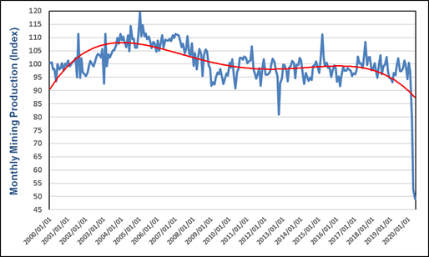
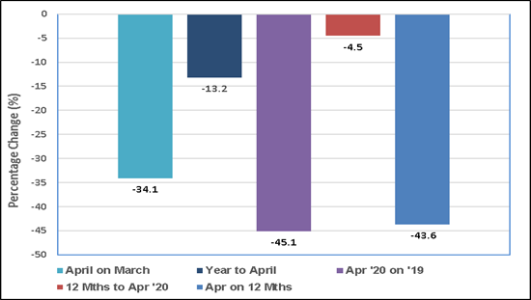
Production and trend, and Changes/declines over different time periods

Slide 23
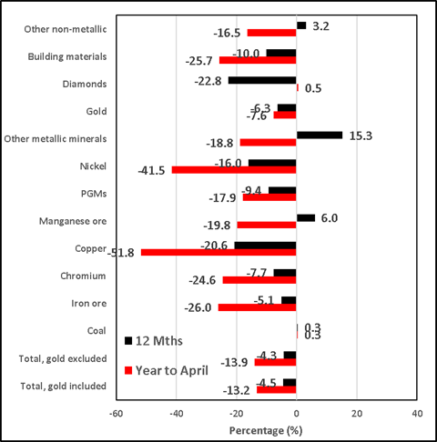
Production performance by Commodity

Slide 24
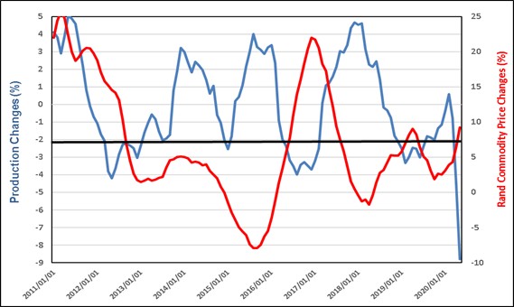
Decline in Production versus Commodity prices holding up (mainly due to gold and PGM’s)

Slide 25
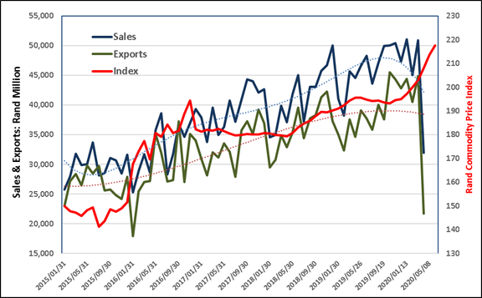
Sales Performance
Sales performance has been as dismal; if you take into account that this is the effect of March and April production, a similar performance could be expected in May and even June, due to weaker commodity demand

Slide 26
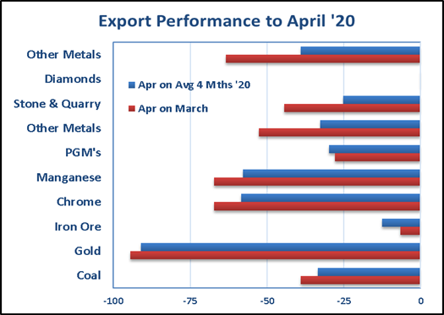
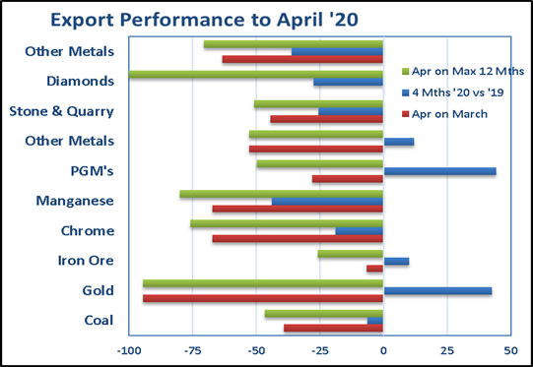
Export Data
We have export data for April (from SARS) which shows the combined impact of lower sales and lower demand for commodities

Slide 27
Documents attached to provide detailed information
The following documents have been provided to the Committee to give more information on some of the issues being discussed
Minerals Council FAQ host communities
Minerals Council FAQ foreign nationals
Minerals Council getting back to work under COVID-19
Economic Impact of COVID-19

