Slide 1

COVID-19 RESPONSE PLANS
PRESENTATION TO THE PORTFOLIO COMMITTEE ON CoGTA
12 JUNE 2020

Slide 2

OUTLINE
NMBM context for COVID-19
Multi sectoral Plan for the Nelson Mandela Metro
Water Crisis – short/medium and long-term plan
Revenue Collection Trends
Economic Recovery
Assistance required from Provincial and National Governments
2

Slide 3
THE COVID-19 LEGAL FRAMEWORK AND CONTEXT
The Constitution
The Disaster Management Act
The Covid-19 Regulations
The MFMA & National Treasury Regulations
The Local Government Municipal Structures Act
The Local Government Municipal Systems Act
3

Slide 4
NMBM DEMOGRAPHICS AND DEVELOPMENT PATTERNS
4

Slide 5
HISTORY AND BACKGROUND
NMBM, situated in the Eastern Cape Province, has largely been affected by the separate development and these skewed development patterns present themselves in the following regions (BEPP):
Northern Areas – Predominantly coloured and poverty stricken with high unemployment and crime rates.
Ibhayi & Motherwell – Predominantly black and Poverty Stricken with high unemployment rates and poverty stricken.
Western Suburbs – affluent areas.
Uitenhage/Dispatch – Dominated by townships and farms.
Inner City/Walmer – Affluent.
5

Slide 6
PROFILE
Size | 1 959 km² (Source: StatsSA)
Population | 1 271 776 (Source: StatsSA)
Total Households | 365 973 (Source: StatsSA)
Total Informal Households | 76 426 (Source: Shisaka, 2017)
Informal Households Backyard shacks | 16 774 (Source: Shisaka, 2017)
Informal Households in Informal Settlements | 59 652 (Source: Shisaka, 2017)
Number of Informal Settlements | 94
Indigent Households | 30% households receive at least one social grant
Unemployment | 35% (Source: ECSECC)
Access to sanitation | 6010 buckets in circulation at March 2020
Capital Budget | R1,76 billion
Capital Grant dependency | 77%
Operating Budget | R12,1 billion
Non-revenue water | 33,49% (Real water losses)
Electricity losses | 13,95% (Technical and non-technical losses)
6

Slide 7
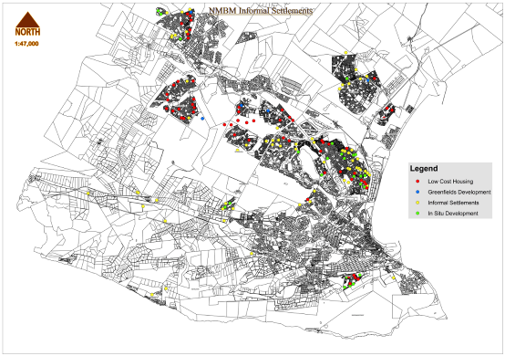
LOCATION OF INFORMAL SETTLEMENTS
7

Slide 8
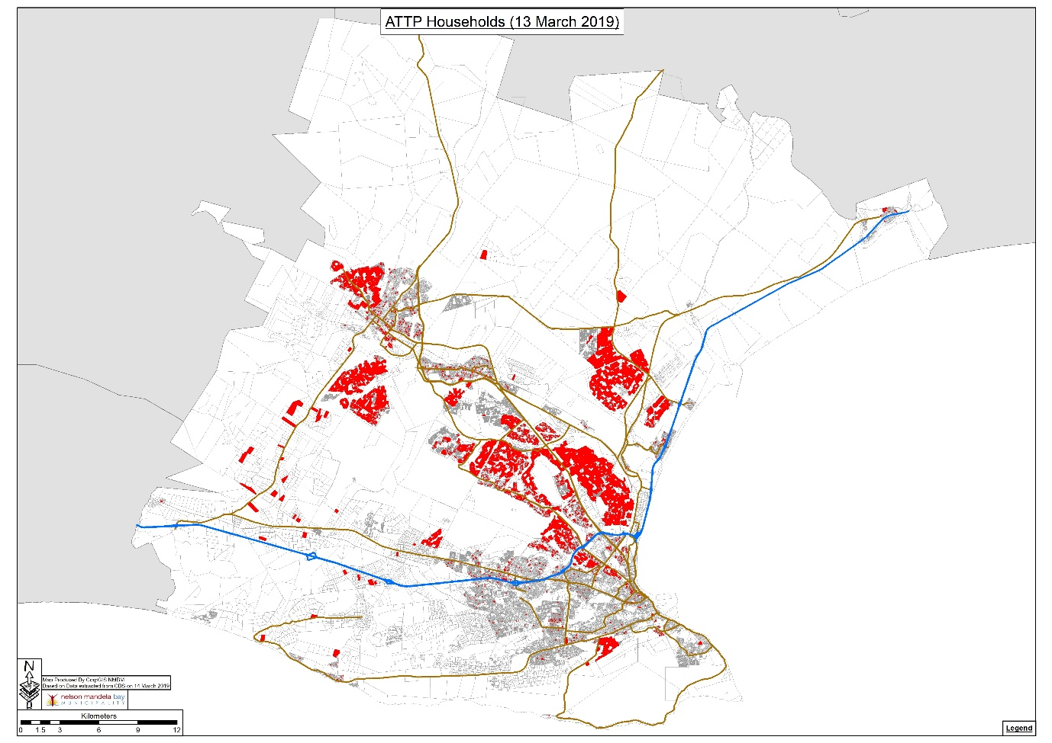
DISTRIBUTION OF ATTP PROGRAMME BENEFICIARIES

Slide 9
The COVID-19 PAndemic

Slide 10
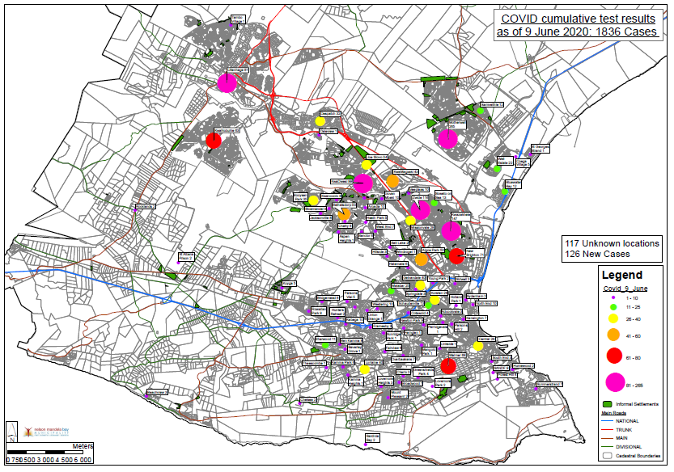

COVID CASES VS POVERTY AREAS
The attached maps show a direct relationship between the incidence of COVID-19 cases and areas of poverty in Nelson Mandela Bay.
ATTP Beneficiaries
Informal settlements

Slide 11
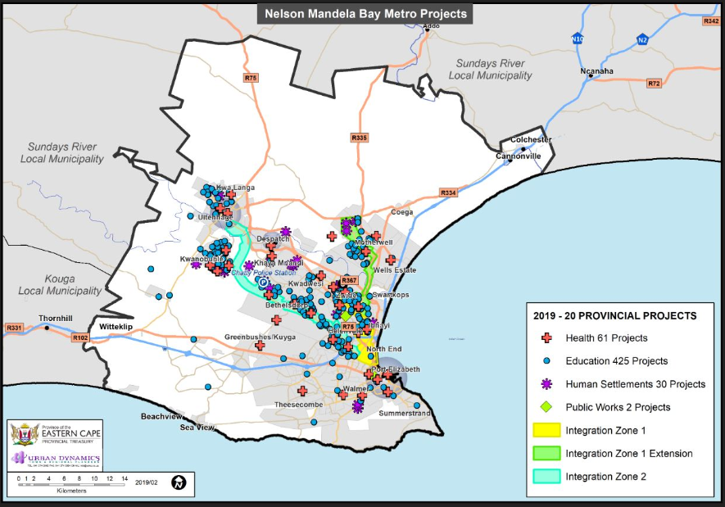
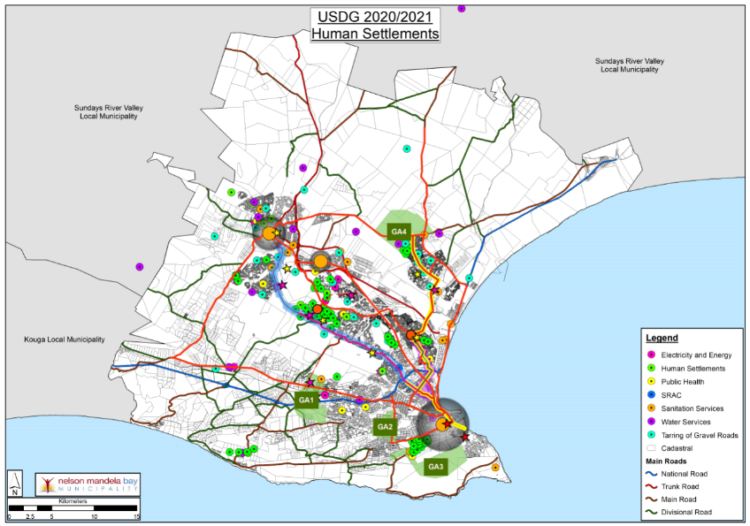
INVESTMENT IN COVID AREAS
Traditionally the Municipality and Province have spent the majority of its capital funding on projects that service the poorest areas of the City.
It is these areas where the COVID-19 outbreak is manifesting most.
Future capital budgets are also biased towards these areas.
Provincial Projects
NMBM projects
11

Slide 12
COVID-19 INFECTIONS BY AREA: CUMULATIVE TEST RESULTS
12

Slide 13
FINANCING COVID-19
ADJUSTMENT BUDGET TO FINANCE COVID-19 AND IMPACT OF COVID-19 ON 2020/21 TO 2022/23 DRAFT BUDGET
13

Slide 14
FINANCING COVID-19
No budget was made for COVID-19 in the 2019/2010 adjustment budget.
The municipality approached National Treasury for reprioritizations of the USDG and authority was granted to re-prioritize an amount of R231 million of the USDG to respond to COVID-19.
Covid-19 Lockdown Regulations, coupled with the impact of lockdown on the entire economy necessitated a total review of the Draft Budget and service delivery projects and programmes, to match the collection rate which has lowered to 84% currently.
14

Slide 15
FINANCING COVID-19
MAJOR BUDGET REDUCTIONS
As proposed in the 2020/21 to 2022/23 draft budget, the following reductions are proposed for implementation:
Reduction of grants to the municipal entity (MBDA), for the MTEF period by R12 Million, R13 million and R14 million respectively.
Freezing of approximately 80% of all budgeted vacancies across the institution.
Reduction of all new Capital projects funded from the Fuel Levy for the MTEF period by R67.4 million, R117.4 million and 165.4 million respectively.
15

Slide 16
FINANCING COVID-19
MAJOR BUDGET REDUCTIONS (cont.)
Reduction of the contribution funded from the Property Rates to operationalise the IPTS Bus system due to affordability.
Reducing travelling and accommodation budgets resulting from the COVID-19 pandemic (use of other modes for meeting, viz Zoom/Microsoft Teams etc.)
Reducing the budget for international travelling to zero.
16

Slide 17
FINANCING COVID-19
MAJOR BUDGET REDUCTIONS
Flowing from above, the following processes will unfold:
Draft budget, which was presented to a Council meeting of 5 June 2020 will be presented to Council on 15 June 2020 for noting.
COVID-19 adjustment budget will be tabled to Council on 15 June 2020 for adoption.
Draft budget will be submitted to National Treasury and Department of Local Government for perusal, before being presented to Council for final adoption.
17

Slide 18
FINANCING COVID-19
MAJOR BUDGET REDUCTIONS (cont.)
c) COVID-19 expenditure report will be submitted to National Treasury and Council as prescribed.
d) payment relief programme to assist local residents and businesses experiencing financial hardship will be presented to Council for approval on 15 June 2020.
e) 2020/21 to 2022/23 budget and IDP will be presented to Council for adoption by 30 June 2020.
18

Slide 19
NMB COVID-19 DISASTER MANAGEMENT STRUCTURE
NMBM COUNCIL
IDDMC
NMBM DISASTER MANAGEMENT CENTRE
CITY MANAGER
DISASTER MANAGEMENT ADVISORY FORUM
DOH
SAPS, SANDF, Traffic, NMBBC, NAFCOC, Economic Development, PDMC, Communications, B&T, Metro Police, Fire, NMBM Security, SRAC, Human Settlements, I&E, E&E, NMBM Public Health, Dept. of Employment & Labour, SOCDEV, SASSA, Harbour Masters, ACSA, Tourism, DoE, DOJ, Liquor Board, Home Affairs, IPTS, Transport,
Epi & Surveillance
Case Management
Media & Social Mobilization
Lab Services
Ports of Entry
Management / Coordination
Emergency Medical Services
NMBM INSTITUTIONAL RISK TASK TEAM
Chaired by NMBM Public Health
Support

Slide 20
NMB COVID-19 DISASTER MANAGEMENT STRUCTURE (cont.)
NMBM DMAF
NMB COVID 19 TASK TEAM
DOH
7 streams
NMB DROUGHT TASK TEAM
Health Work Stream
Economic, Tourism & Business Work Stream
Education & Social Work Stream
Safety, Security & Transport Work Stream
Communications Work Stream
International Relations
Tourism
Economic Development
SRAC
NMBBC
NAFCOC
Labour (CCMA)
Dept. of Employment & Labour
Health
SOCDEV
DoE
DoHE
SASSA
Health
SAPS
DOJ
NMB Traffic
Prov Traffic
Metro Police
Transport
IPTS
Liquor Board
Home Affairs
Taxi Associations
SANDF
Health
NMB Communications
GCIS
SAPS Media Liaison
Health
NMB DISASTER MANAGEMENT CENTRE

Slide 21
COVID-19 INTERVENTION REPORT BY SECTOR INFRASTRUCTURE AND
HUMAN SETTLEMENTS
Based on the attached plan that was submitted to National Treasury for reprioritization of USDG, the following progress have been made:
500 Chemical toilets and water standpipes have been provided giving access to water and sanitation to households.
Service providers have been appointed and is busy with installation of precast toilets to 2000 households across the metro.
40 temporary shelters have been provided to the vulnerable elderly community members, with corresponding appointed of home helpers through EPWP program. Roll out of 1500.
15 Water tankers have been provided to continuously fill JOJO tanks (108 JOJO tanks provided by the Department of Water and Sanitation).
21

Slide 22
COVID-19 INTERVENTION REPORT BY SECTOR: PUBLIC HEALTH
22

Slide 23
STRATEGY
ROLE PLAYERS
Ward Councillor
Street Committees
Clinic Committees
NGOs + NPOs
SAPS
DoSD
DoE /SGBs
CPF
Church Leaders
Shop Owners
Taxi Industry
Traditional Leaders
Traditional Healers
HEALTH TEAM STRUCTURE
Family Physician (Cuban)
Prof Nurse x 8
Enrolled Nurse x 16
CHW x 120
Health Promoter x 8
EHP
Roving Epidemiologists (Cuban and NICD)
Clinical Psychologists/Social Workers
TARGETED STREETS
Msengana
Masoka
Madlwibinga
Dlova Masiza
Mpondo
Koyana
Siphondo
Mana
Mkhumathela
Lusa
W27
W28
W25
ZWIDE
Cluster 2
W30
Shop workers
Police Offofficers
SASSA workers
23

Slide 24
INTEGRATED DISTRICT DEVELOPMENT/ MASIPHATISANE APPROACH
Category | Role
Family Physician | Team Leader Organise the team Identify sick persons requiring medical care Referral of patients to appropriate levels of care
PN | Co-Team Leader, Track, trace contacts , Testing , prepare clients for quarantine or isolation, compile report for team
EN | Interview clients for testing ,complete laboratory forms
CHWs | H/H Screening and education
HP | Social mobilization , education and awareness
EHP | Prepare facilities for quarantine and isolation Facilitate decontamination of facilities with confirmed cases
Epidemiologists | Disease surveillance and case investigations
Stakeholders | Role
Ward Councillor | Local JoC Leader Community mobilization Advocacy
Street committees | Community mobilization Safety of Tracer Teams
Clinic Committees Church Leaders Traditional Leaders Traditional Healers Shop Owners | Community mobilization Safety of Tracer Teams
CPF | Safety of Tracer Teams
SAPS | Safety of Tracer Teams Support collection of patients for isolation
Taxi Industry | Transportation of clients for quarantine
24

Slide 25
APPROACH
Fully deployed team fulltime in the cluster. Cluster can be a number of wards.
Masiphatisane approach where all stakeholders form part of the team
Core Health team with named leader and all categories MO, PN, EN, CHW & HP. Local & Cuban Doctors have to be incorporated (both Family Physicians and Epidemiologists).
Municipality resources, such as EPWP & Environmental Health Practitioners. Municipality also assists with alternate housing as part of the improved spatial redistribution to improve quarantine and social distancing.
Local Councillors to be the lead in community communication and engagement. This assists with ease of entry, community buy-in and ensuring de-stigmatisation.
25

Slide 26
APPROACH (cont.)
Team goes into the cluster area and combs it ensuring that everyone in the cluster has been screened.
Team is resident and does follow-ups and engages through local Councillors on new entries into the area.
The SAPS is part of the team to ensure compliance with Lockdown protocols and assists in situations of resistance especially for isolation, quarantine and social distancing (e.g. in malls).
26

Slide 27
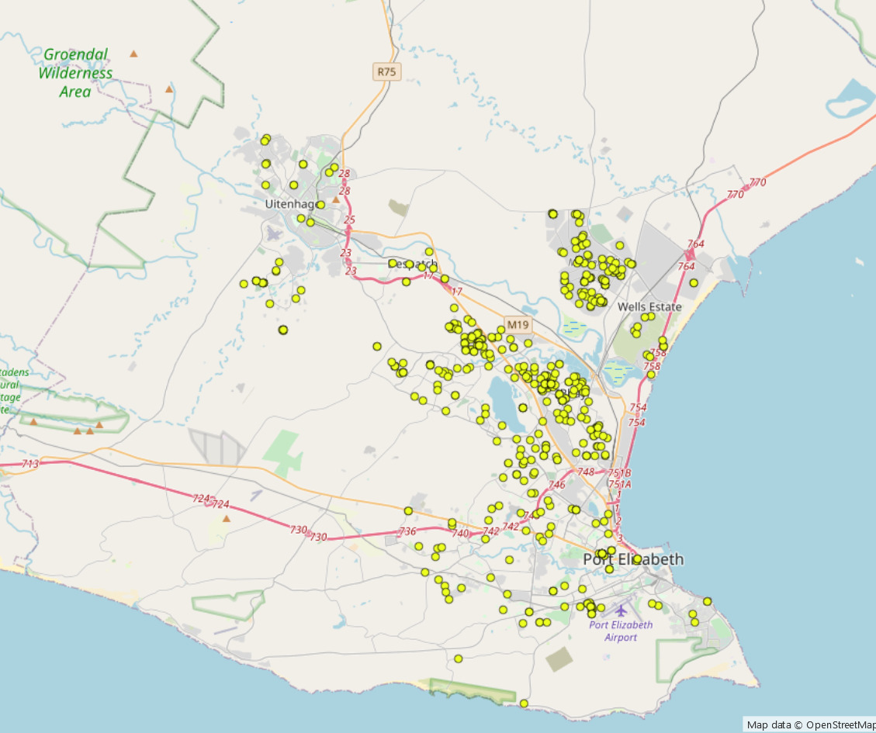
RECOVERIES
27

Slide 28
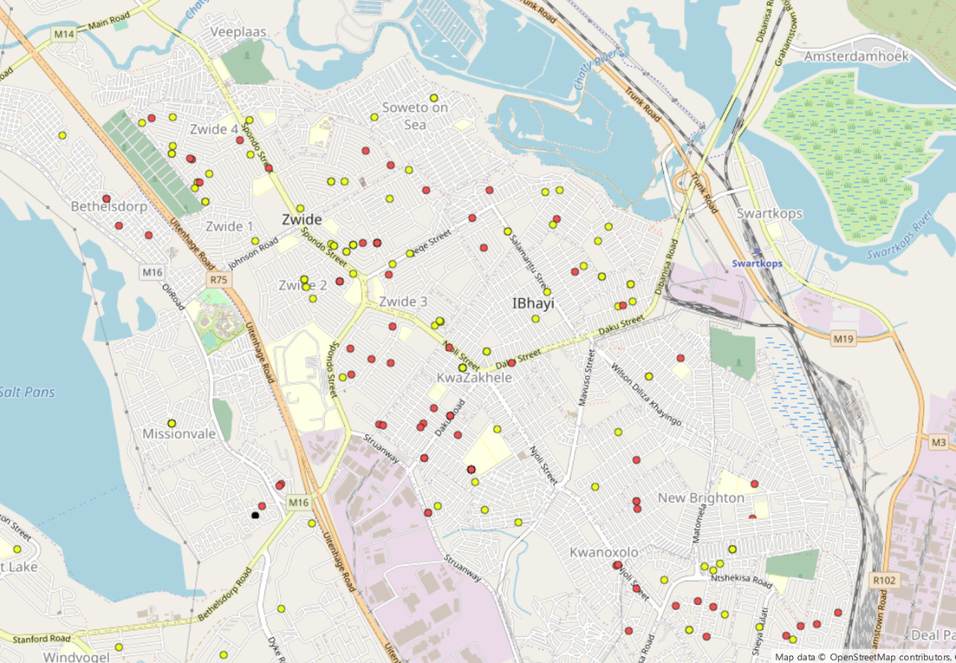
CASES IN ZWIDE
28

Slide 29
PPE STATUS
Period | 3-Ply Masks | N95 Masks | Aprons | Disposable Gowns | Gloves | Hand Sanitizer (l) | Hand Soap (l) | Goggles | Visors | Coveralls | Thermometers
Clinics /Outreach | 101 800 | 14 156 | 280 | 41 | 11 293 | 171 | 45 | - | 501 | 50 | 38
Uitenhage | 390 | 193 | 21 846 | 663 | 155 | - | 40 | 42 | 171 | 48 | 2
Empilweni TB | 7 350 | 2 600 | 12 200 | 95 | 33 373 | 211 | 7 | 48 | - | - | 3
EDH | 4 877 | 1 000 | 46 000 | 105 | 18 100 | 130 | 60 | - | 4 | -
Forensic Pathology | 38 495 | 2 442 | 1 055 | 2 139 | 76 920 | 136 | 125 | 47 | 1 744 | 229 | 0
Orsmond | 7 350 | 3 270 | 5 700 | 70 | 18 200 | 10 | 30 | 17 | - | 51 | 4
Jose Pearson | 4 350 | 3 650 | 70 | 52 | 5 892 | 200 | 45 | 3 | 275 | 40 | 0
Livingstone | 2 850 | 19 785 | 80 000 | 4 447 | 27 309 | 2 164 | 200 | 63 | 1 222 | 140 | 0
Dora | 21 000 | 8 800 | 6 000 | 150 | 52 540 | 1 524 | 100 | - | 75 | 100 | 0
EMS | 4 000 | 6 010 | 3 000 | 300 | 10 560 | 24 | 18 | 12 | 30 | 1 200 | 0
Stadium | 3 700 | 26 | 176 | 206 | 550 | 60 | 45 | - | 15 | 20 | 0
Total | 196 162 | 61 932 | 176 327 | 8 268 | 254 892 | 4 630 | 715 | 232 | 4 037 | 1 878 | 47
Planned Weekly Usage | 30500 | 10000 | 42000 | 6000 | 40000 | 3600 | 1020
Stock on hand in Weeks | 6 | 6 | 4 | 1 | 6 | 1 | 1
ISUZU | 334140 | 12600 |  | 2154 | 259200 | 8750 | 1000 |  |  | 300 | 4
29

Slide 30
DEPLOYMENT OF SECURITY PERSONNEL AND RESOURCES INTO THE RESPONSE PLAN
HUMAN RESOURCES | VEHICLES
SAPS: 194 Metro Police: 27 Traffic & Licensing: 43 Security Services: 29 Fire & Emergency: 50 Disaster Management: 10 Infrastructure & Engineering :+/- 600 Electricity & Energy : +/-338 SANDF: 30 TOTAL MANPOWER: 1 321 | SAPS: 54 Metro Police: 9 Traffic & Licensing: 35 Security Services: 8 Fire & Emergency: 31 Disaster Management: 9 Electricity & Energy: 122 SANDF: 3 TOTAL VEHICLES: 371

Slide 31
WATER CRISIS
SHORT-MEDIUM-LONG-TERM PLAN
34
31

Slide 32
WATER CRISIS
SHORT-MEDIUM-LONG-TERM PLAN
NMBM was declared a water disaster area.
The COVID 19 pandemic has added burden on the already water-trapped municipality.
32

Slide 33
DAM STORAGE STATUS
Major Storage Dams Supplying the NMBM
Dam | Capacity (11 May 2020) | Capacity ( 25 Oct. 2018) | Capacity (3 Sept 2018)
Kouga | 10.38% | 54.58% | 6.79%
Churchill | 63.88% | 100% | 16.45%
Impofu | 16.45% | 38.37% | 27.27%
Groendal | 34.79% | 62.20% | 38.92%
Total Average | 20.70% | 54.80% | 17.82%
33

Slide 34
DROUGHT INTERVENTIONS: REDUCTION OF WATER USAGE
Short Term (3 to 6 months):
 | ACTIVITY | DATE | WATER USAGE
 |  |  | 300
1 | Leak Repairs: | Sep-20
 | Reducing water wastage by fixing water leaks is one of the most effective ways of saving:
1.1 | Use emergency contractors to carry out urgent repairs: |  | -5
1.2 | Installation of flow restrictors disks and electronic restrictions. |  | -10
2 | Water Conservation Campaign: | Sep-20
2.1 | Reduction of water consumption as a result of behavior change through water saving awareness campaign. |  | -10
 |  |  | 275
3 | Pressure Management | Dec-20 | -10
4 | Flow limiting & Restrictions |  | -15
 |  |  | 250
NOTE: Technical interventions to augment water supply will run parallel to conservation interventions
35

Slide 35
WATER SUPPLY VS DEMAND
No. | Water Treatment Works & Sources | Jun-20 | Jul-20 | Aug-20 | Sep-20 | Oct-20 | Nov-20 | Dec-20 | Jan-21 | Feb-21 | Mar-21 | Apr-21 | May-21 | Jun-21 | LONG-TERM
 |  | SHORT TERM |  |  |  |  |  |  | MEDIUM TERM
1 | Churchill | 90 | 90 | 30 | 30 | 30 | 30 | 30 | 30 | 30
2 | Impofu |  |  | 30 | 30 | 30 | 30 | 30 | 30 | 35 | 35 | 35 | 35 | 35
3 | Loerie / Kouga | 30 | 30 | 30
4 | Groendal | 10 | 10 | 10 | 10 | 10 | 10
5 | Springs | 6 | 6 | 6 | 6 | 6 | 6 | 6 | 6 | 6 | 6 | 6 | 6 | 6 | 6
6 | Linton | 6 | 6 | 6 | 6 | 6 | 6 | 6 | 6 | 6 | 6 | 6 | 6 | 6 | 6
7 | Nooitgedagt Ph2 | 140 | 140 | 140 | 140 | 140 | 140 | 140 | 140 | 140 | 140 | 140 | 140 | 140 | 140
 | Nooitgedagt / Grassridge | 30 | 30 | 60 | 60 | 60 | 60 | 60 | 60 | 60 | 60 | 60 | 60 | 60 | 60
8 | Desalination | 0
8.1 | Coega |  |  |  |  |  |  |  |  |  |  |  |  | 15 | 60
8.2 | Skoenmakerskop |  |  |  |  |  |  |  |  |  |  |  |  |  | 60
9 | Boreholes: | 0
9.1 | Bushy Park |  |  |  |  | 10 | 15 | 15 | 15 | 15 | 15 | 15 | 15 | 15
9.2 | Reservoirs |  |  |  |  |  |  | 1 | 1 | 1 | 1 | 1 | 1 | 1
9.3 | Coega Kop |  |  |  |  |  |  |  |  |  |  |  |  |  | 20
9.4 | Churchill | 0 |  |  |  |  |  |  |  |  | 10 | 10 | 10 | 10
 |  | 312 | 312 | 312 | 282 | 292 | 297 | 288 | 288 | 293 | 273 | 273 | 273 | 288 | 352
 | Note: Reduction in water consumption will preserve the current resources into the future.
36

Slide 36
Revenue Collection Trends

Slide 37
Introduction
Collection rate is not calculated per service, but rather based on a basket of services.
Thus, billing is based on a basket of services and debtors are not allowed to choose which service they are paying.
Payments are allocated to first clear interest and then oldest debt outstanding.
Remainder of payment is allocated to services in a pre-determined order.
Collection rate is thus not calculated per service, but rather based on a basket of services.

Slide 38
Collection rate for basket of services 2019/2020

Slide 40
Average under collection for next financial year (2020/2021) based on current trends

Slide 41
Payment Relief
A council meeting is scheduled for 5 June 2020 to consider and possibly approve a payment relief programme to assist local residents and businesses experience financial hardship.

Slide 42
ECONOMIC ACTION & RECOVERY
Like all metros, NMBM has been hard by the COVID-19 pandemic and this has already affected the collection rate and is expected to continue in the next financial year on average, as follows:
41
37

Slide 43
ECONOMIC ACTION & RECOVERY (cont.)
With the developmental mandate of the municipality, the Mayoral Committee resolved to propose an Economic Recovery Plan to Council.
This plan will be submitted to the CoGTA and National Treasury when draft budget and IDP are submitted for perusal.
38

Slide 44
ECONOMIC ACTION & RECOVERY (cont.)
A Business Recovery Centre (BRC) to help local companies get the assistance they need to re-open or stay open is being established as a one-stop shop.
  to facilitate access to local, provincial, and national resources for businesses during and after the COVID-19 pandemic.
  focus on case management which is an approach that provides business with financial and technical assistance on its own turf and dispensing recovery staff to individual businesses.
  carries out COVID-19 business recovery functions through a centralised location.
NMBM will work with organisations such as Community Futures and other national agencies to develop loan programmes.
39

Slide 45
ECONOMIC ACTION & RECOVERY (cont.)
NMBM must partner with the private sector to ensure an appropriate response and speedy recovery – aspects can include:
  Technical support services or in-kind donations of goods or services.
  Improve COVID-19 consciousness of the general population and local business community as part of a sustained communication plan.
  Contribute time, products, and money.
  Make a commitment to stay in Nelson Mandela Bay, to rebuild, retain employees, even expand and reinvest. This helps build community confidence which is critical to recovery.
43
40

Slide 46
ECONOMIC ACTION & RECOVERY (cont.)
  Identify issues for post-COVID-19 business re-entry and help develop a tiered system for business re-entry.
  Identify contracting and procurement opportunities for economic recovery services for local businesses.
  Organize capital availability for businesses.
  Review plans and preparedness tactics - many large corporations have emergency response planners on staff.
  Help identify other financial resources.
  Identify local resources for technical assistance to businesses.
43
41

Slide 47
ECONOMIC ACTION & RECOVERY (cont.)
NMBM will engage businesses to establish a Business Emergency Response/ Recovery Team (BERT).
  It will identify the roles and responsibilities for the economic development organizations; other business, trade and professional organizations; individual business owners and operators; and non-profit organizations that support economic resiliency.
  NMBM will engage a variety of lending sources such as local banks, credit institutions and other alternative financial institutions to identify available lending products, financial terms.
  A differentiated approach to support between established business in specific sectors and SME sector and informal economy.
  Consideration of various incentives and/or tax holidays tailor made for specific sectors i.e. tourism.
42

Slide 48
ECONOMIC ACTION & RECOVERY (cont.)
The above requires a delicate balance between maintaining maximum levels of revenue for the City and providing such financial relief affected businesses.
Priority will be given to ensure that the capital infrastructure spend of the City prioritises labour intensive projects with sufficient provision of opportunities for SME sector.
Reprioritisation of the City’s overall budget to finance more productive and employment creation capital programmes.
45
43

Slide 49
EXPERIENCES SINCE DECLARATION OF DISASTER
While the Constitution reserves various functions for concurrent competence of National and Provincial Governments, the COVID-19 revealed a need to devolve such functions as Health, Social Development, Human Settlements to municipalities. During the COVID -19 PANDEMIC, NMBM was compelled to go beyond its mandate and outside to perform such functions as, provision of shelter to the homeless, which functions are unfunded mandates and which interventions expose NMBM to risks of material audit queries.
The IGR needs to be strengthened as it became evident during this period that high collaboration of stakeholders provides effectiveness in service delivery.
44

Slide 50
EXPERIENCES SINCE DECLARATION OF DISASTER (cont.)
There is a need to address under-development and segregation in the development patterns, as it became evident, though no formal study was undertaken, that poverty stricken communities are vulnerable during disaster.
Over-reliance on grant funding is unsustainable and the municipality must expand its revenue base.
Robust plans have to be undertaken to unlock development through expansion of economic activity and implementation of catalytic projects must be fast-tracked to boost economy.
45

Slide 51
ASSISTANCE REQUIRED FROM LOCAL AND NATIONAL GOVERNMENT
To prioritize the transfer of all conditional grants (2019/2020) to the NMBM.
The government departments to prioritize the payment of rates and services.
46

Slide 52
THANK YOU

