Slide 1
Presentation to: The Portfolio Committee on Higher Education, Science & Technology National Assembly
17 June 2020

Slide 2
Status of the Council
Council is fully constituted (with a total of 16 members) appointed in terms of Section 10(4) (b) to (g) of the CET Act, 16 of 2006. Sixty percent of members are external persons.
Council continues to perform all its functions which are necessary to govern the public college, subject to this Act and other applicable legislations, regulations and policies.

Slide 3
Skills profile of the Council members
Council, in consultation with the Minister, has appointed members with variety of skills as shown below:
Finance, Accounting and Auditing, Banking and Commerce (6);
Labour Relations Management; Human Resources Management, Corporate Law (2);
Education(3)
Informatics and Computer Sciences (2)
Administration (1)
Acting President of SRC
Secretary General of SRC
Please note that there is a great overlap of skills within members to improve the governance of the College.

Slide 4
Skills profile of the Council members
Of the 16 members Council of the ORBIT TVET College
2 members hold PhD
4 members hold MA (of which 1 is a PhD candidate)
3 members hold Hons
2 members with Higher Diploma
2 members with B-Degree
1 member with Diploma
2 are college students still studying towards their qualifications

Slide 5
Regularity of meetings
Council and its Committees viz.
Audit & Risk,
Executive,
Conditions of Employment,
Finance,
Planning and Resource
Meetings are held at least once a quarter. Additional meetings i.e., special meetings and emergency meetings were called at the discretion of the Chairperson and the Principal of the College to address issues deemed urgent. All Committees of Council function well and hold meetings in accordance to the specifications outlined in the Council Induction Manual.

Slide 6
Concerns around governance that the Committee should know about
Managing stakeholder relationships with particular reference to unprecedented strikes by members of the SRC was a major challenge to Council and subsequently to governance of the College.
The notable challenge was observed when one of the Campuses (Mankwe) was shut-down for the entire first quarter of the academic year 2020.
The major issues of contention being the re-convening of the SRC Lekgotla which collapsed earlier in the previous year and the academic exclusion of a student who happened to be the SRC President. The overall tumult that ensued constituted a grave concern to Council that Council would like to bring to the attention of the Portfolio Committee as this nearly brought governance to its knees.
The matter is receiving attention and I would like to ensure the Chairperson of and the Honourable Members of the Portfolio Committee that Council is doing all to improve the internal relationships between the parties involved.

Slide 7
Interface between governance and management
Council and Management have interacted on various levels to ensure sound governance, ethical compliance of laws and regulations, transparency and disclosure as well as accountability.
Council worked on the Auditor General report as a baseline for its interaction with management.
Council has also firmly realigned the reporting methods to be consistent with the Strategic Plan to meet the strategic objectives of the College.
The realignment has been adopted during the first ordinary Council meeting and the templates have been approved by Council.
Interaction with Management (in all the Committees and Council sittings ) is therefore, aligned to this resolution.

Slide 8
Investigations conducted against the Council, findings, recommendations and implementation of the recommendations
At the moment, there is no investigations conducted and/or litigations instituted against Council.

Slide 9
Thank you Chairperson, Hon Mapulane and the Members of the Portfolio Committee on Higher Education, Science & Technology

Slide 10
MANAGEMENT
Presented by:
Mr DF Mokoena
Principal
ORBIT TVET College

Slide 11
Geographical Spread

Slide 12
Status of Senior Management
The Principal was appointed May 2018 and assumed duty July 2018.
The College has Deputy Principal Finance, Deputy Principal Academic Affairs, Deputy Principal Corporate, two (2) appointed Campus Managers for Brits and Rustenburg Campus, and one (1) Acting Campus for Mankwe Campus.

Slide 13
Interface between Management, Students and Labour
Interface between Management and Labour
Currently there are four Trade Unions that actively operate at the College, namely:
NAPTOSA
NEHAWU
PSA; and
SADTU
Management has a direct line of communication with each of the Trade Unions .
Management has also established a structured forum through which meetings can be held with the Unions as a combined bloc.
It must be indicated that the above meetings between the College Management and Social Partners would be additional to the meetings that would have been held between the Management of each Site/Campus and the Branch Leadership of the Union resident at that particular site/Campus.

Slide 14
Interface between Management, Students and Labour (continues)
Interface between Management and Labour
The Social Partners are also consistently involved in the recruitment and selection of employees in line with the public service regulations and applicable collective agreements.
Social Partners are consulted in the development of Employee Health and Wellness Programmes.
They will also actively participate in the matching and placement of staff as envisaged by the Department’s recently approved Post Provisioning Norms.
It can therefore be said that there is generally a sound relationship between Management and Organised Labour .
This can be attested by the relatively peaceful organisational climate that the College has enjoyed over the years.

Slide 15
Interface between Management, Students and Labour (continues)
Interface between Management and SRC
SRC Training 08 – 10 March 2019
SRC Mid-year Review: 19 – 21 July 2019
SRC President meeting with the Principal: September 2019
SRC and Student Formations Lekgotla: 18 – 20 October 2019
SRC and Student Formations meeting with Senior Management and Management Board members: To engage regarding the failed SRC Lekgotla 21 October 2019
SRC Strike: confrontation of Mankwe Campus with Security Guards that lead to injured students
SRC reps and Community members: February 2020 – Strike at Mankwe Campus

Slide 16
Student Enrolment
PROGRAMME |  | Target | Actual | Variance
NCV Programmes total |  | 3280 | 3897 | 617
NCV: Engineering Studies |  | 1250 | 1452 | 202
 | Civil Engineering | 240 | 243 | 3
 | Electrical Infrastructure & Construction | 610 | 702 | 92
 | Engineering & Related Design | 400 | 507 | 107
NCV: Business Studies |  | 1355 | 1611 | 256
 | Finance, Economics & Accounting | 365 | 419 | 54
 | Management | 210 | 240 | 30
 | Office Administration | 780 | 952 | 172
NCV: Services Studies |  | 490 | 652 | 162
 | Tourism | 140 | 221 | 81
 | Hospitality | 140 | 213 | 73
 | Transport & Logistics | 210 | 218 | 8
NCV: Other |  | 185 | 182 | -3
 | Information Technology & Computer Science | 185 | 182 | -3

Slide 17
Student Enrolment (continues)
PROGRAMME |  | Target | Actual | Variance
Report 191 Programmes |  | 3219 | 4216 | 997
Report 191: Engineering Studies (N1 - N3) |  | 1170 | 1534 | 364
 | Civil | 23 | 30 | 7
 | Electrical | 542 | 683 | 141
 | Mechanical | 465 | 675 | 210
 | Automotive | 140 | 146 | 6
Report 191: Engineering Studies (N4 - N6) |  | 595 | 621 | 26
 | Electrical | 333 | 403 | 70
 | Mechanical | 262 | 218 | -44
Report 191: Business Studies |  | 1454 | 2061 | 607
 | Financial Management | 210 | 215 | 5
 | HR Management | 430 | 548 | 118
 | Management Assistant | 438 | 632 | 194
 | Business Management | 105 | 85 | -20
 | Tourism | 70 | 165 | 95
 | Popular Music | 18 | 24 | 6
 | Educare | 98 | 189 | 91
 | Hospitality & Catering Services | 70 | 145 | 75
 | Art & Design | 15 | 58 | 43

Slide 18
Student Enrolment (continues)
PROGRAMME |  | Target | Actual | Variance
PRE-VOCATIOAL |  | 100
 | Pre-Vocational Learning Programme | 100 | 100
CENTRE OF SPECIALISATION |  | 120 | 55
 | Electrical | 60 | 27
 | Diesel | 60 | 28

Slide 19
Investigation conducted against the management, findings, recommendation and implementation of the recommendations
There are no investigations conducted against Management

Slide 20
Reporting on status of College Administration
1. Current staff establishment
Total number of employees as at 8 June 2020 | PERSAL – 416 College Council - 19
Management staff (PSA) | 4
Lecturers | PERSAL – 235 College Council – 12
Support Staff | PERSAL – 181 College Council – 7
Interns | 84
Outsourced services (cleaning and security) | 53

Slide 21
Reporting on status of College Administration (continues)
2. Staff compliment by gender
235 (54.02%) are Females; and
200 (45.98%) are Males
3. Staff compliment by race
Race | Number | %-tage
African | 406 | 93.33
Coloured | 1 | 0.23
Indian | 3 | 0.69
White | 25 | 5 75
Total | 435 | 100

Slide 22
Reporting on status of College Administration (continues)
4. Staff compliment by age
Age group | Number | Percentage
25 -34 | 109 | 25.05
35 - 44 | 169 | 38.85
45 - 54 | 115 | 26.44
55 - 64 | 42 | 9.66
Total | 435 | 100

Slide 23
Reporting on status of College Administration (continues)
5. Leave administration
The College has established internal controls and systems to ensure the effective administration of leave taken by employees. The leave application forms are captured and approved on PERSAL to which the College HR have access. Following is a comparative summary of leave taken by employees:
Leave category | No of leave days during the Year ended
 | 31 May 2020 | 31 March 2019 | 31 March 2018
Family Responsibility | 51 | 345 | 299
Leave without pay | - | 121 | 2
Maternity | 3 | 8 | 14
Paternity | 1 | 5 | 7
Pre-natal | 1 | 6 | 21
Shop stewards | 4 | 60 | 45
Sick leave - full | 199 | 1241 | 830
Special | 35 | 433 | 492
Vacation | 297 | 1274 | 1275
Temporary incapacity | - | 4 | 25

Slide 24
Reporting on status of College Administration (continues)
6. Performance Management
The performance of employees is managed in terms of the DPSA’ Performance Management System (PMDS) for Support Staff and Integrated Quality Management System (IQMS) for Lecturing Staff.

Slide 25
Reporting on status of College Administration (continues)
7. Management of and response to the outbreak of Covid-19
The outbreak of Covid-19 is managed in accordance with the guidelines of Higher Health
The College has established Steering Committees both at College and Campus levels
The Committees consist of Representatives of Management, Organised Labour and the SRC
All sites have been fumigated and cleaned prior to the reopening and return Staff and Students to the College
Campuses have been given the green light to procure additional services in order to ensure that frequently touched surfaces are cleaned regularly in line with the Higher Health protocols
Screening of protocols have been developed and are implemented without fail
Each individual was supplied with the necessary PPEs
In spite of the above, an employee has tested positive.

Slide 26
Summary- National Student Financial Aid Scheme 2019
 | Descriptions | Amounts | Number of Students
1 | NSFAS 2019 Remittances - Allowances | R 65 528 227.00 | 5 465
2 | Disbursement of Allowances | R 55 845 385.47 | 4 801
The remaining amount of unallocated allowances are due to outstanding banking details and students not registered with the College.
The College used all possible platforms to request students to provide their banking details.

Slide 27
Summary- National Student Financial Aid Scheme 2020
 | Descriptions | Amounts
1 | NSFAS 2020 Remittances - Allowances | R 47,041,189.00
2 | Disbursement of Allowances | R 31,741,189,00
2020 financial period the College become one of the 32 TVET Colleges where the NSFAS Allowances are disbursed by NSFAS via the NSFAS Wallet System.
The above funded students relate to Cycle 1 (i.e. NCV; Trimester 1; and Semester 1)

Slide 28
Academic Performance

Slide 29
Academic Performance (continues)

Slide 30
Academic Performance (continues)

Slide 31
Academic Performance (continues)

Slide 32
FINANCIAL MANAGEMENT

Slide 33
FINANCIAL MANAGEMENT CAPACITY & COMPENTENCIES
The Finance Department is headed by the Deputy Principal Finance
It consists of three divisions: Finance; Supply Chain Management and Asset Management
The Finance Department has 10 appointed employees with 1 vacancy
The Supply Chain Department has 9 appointed employees with 1 vacancy
The Asset Management Department has 5 appointed employees with 1 vacancy

Slide 34
AUDIT IMPROVEMENT PLAN
AUDIT REPORT QUALIFICATIONS | AUDIT ACTION PLAN PROGRESS | TIME FRAMES | STAGES OF COMPLETION
Trade & Other Receivables from Exchange Transactions (Debtors) The Provision of Doubtful Debts was not in line with the College Policy and therefore the valuation was incorrect Overstatement of Student Debtors due to the NSFAS Control Account Liability | Adoption of the final version of the DHET Debt Management Policy for the correct compilation of Provision of Doubtful Debts Outstanding Debtors relating to Projects have been provided with Debt Confirmation (refer to Project Audit Action Plan Progress) Obtained outstanding remittance lists from NSFAS | 2020-06-30 | 95%

Slide 35
AUDIT IMPROVEMENT PLAN
AUDIT REPORT QUALIFICATIONS | AUDIT ACTION PLAN PROGRESS | TIME FRAMES | STAGES OF COMPLETION
Payable from Exchange Transactions NSFAS Control Account Liability limitation of scope and therefore unable to determine the existence of the liability North West Provincial Education Department Liability limitation of scope and therefore unable to determine the existence of the liability. | NSFAS Liability Obtained outstanding remittance lists from NSFAS for financial period 2016 – 2018 . Performed reconciliation for the clearance of the Control Account. Listings developed for the remaining balance in the Control Account (i.e. Liability Account) North West Provincial Education Department Liability This relates to the TVET College Persal Payroll that was administered by the North West Provincial Education Department prior to the TVET Colleges migration to the DHET. Obtained the NW PED BAS Persal Reconciliation for the 2015 financial period Liaising with the NW PED Finance Department to assist with the confirmation of the amount owed indicated in the above mention | 2020-06-30 2020-11-30 | 80%

Slide 36
AUDIT IMPROVEMENT PLAN
AUDIT REPORT QUALIFICATIONS | AUDIT ACTION PLAN PROGRESS | TIMEFRAME | STAGE OF COMPLETION
Inventory Completeness & Existence of Stock based on Stock Counts Accuracy of the Costing of the Inventory in terms of lower of cost or current replacement cost Limitation with regards to the issuing of inventory due to issued of cut off of Inventory | Inventory Inventory Policy Revision (including Procedures) Year End Stock Counts conducted Updates performed in the Inventory Sub-system for correction of year end stock count figures Revision of stock codes in the Inventory Sub-system for identification of obsolete stock Manual Inventory Register Compilation (interim measure) Plans to upgrade the Inventory Sub-system in the Financial Management system | 2020-01-30 | 100%

Slide 37
AUDIT IMPROVEMENT PLAN
AUDIT REPORT QUALIFICATIONS | AUDIT ACTION PLAN PROGRESS | TIMEFRAME | STAGE OF COMPLETION
Projects The closing balance of Projects does not reconcile due to differences identified in the movement The profit and loss on the projects were overstated | Revision of the Project Register from 2016 to 2018 Agreed Projects in the register to the respective MoUs between the College and the Funder of the project. Adjustments made according to the differences identified in the movements of the respective years Issued Debtors Confirmation Letters to Funders of Projects for confirmation of the amounts owing to the College Balances not confirmed are to be included in the Provision of Doubtful Debts as irrecoverable | 2020-06-11 | 100%

Slide 38
AUDIT IMPROVEMENT PLAN
AUDIT REPORT QUALIFICATIONS | AUDIT ACTION PLAN PROGRESS | TIMEFRAME | STAGE OF COMPLETION
Commitments Differences identified with regards Commitments indicated in the Commitment Register and the Disclosure Note for Commitments Erroneous Omission of Commitments in the Disclosure Note | Commitments Register Obtained prior year 2018 Contract Register and updated Contract Register accordingly Identify Lease Contracts; Operational Capital Commitments obtained the Capital Assets WIP Register and include the Commitments as at 31st December 2019 relating to the Commitments for the completion of the Capital Asset | 2020-06-30 | 95%

Slide 39
AUDIT IMPROVEMENT PLAN
AUDIT REPORT QUALIFICATIONS | AUDIT ACTION PLAN PROGRESS | TIMEFRAME | STAGE OF COMPLETION
Accumulated Surplus Limitation of scope in terms of the prior period adjustment disclosed in the accumulated surplus | Prior Period Error Disclosure The qualification is due to a disagreement in terms of the disclosure of adjustments in Accumulated Surplus in the Statement of Changes in Equity The Prior Period Errors have been revised during the preparation of the 2019 Annual Financial Statements A reconciliation has been compiled with regards to the journals for the prior period adjustments. (including attaching the supporting documentation) Balances in the 2019 Annual Financial Statements have been restated accordingly Disclosure Note of Prior Period Error has been revised and corrected. | 2020-06-30 | 95%

Slide 40
AUDIT IMPROVEMENT PLAN
AUDIT REPORT QUALIFICATIONS | AUDIT ACTION PLAN PROGRESS | TIMEFRAME | STAGE OF COMPLETION
Cash Flow Statements Material differences identified in the Cash Flow Statement | Cash Flow Statement Compilation Acquired accounting Annual Financial Statement software that enables the compilation of cash flow statement. Recalculation of the Cash Flow Statement for the 2018 financial period as part of the preparation of Annual Financial Statements based on the restated 2017 and 2018 balances. | 2020-06-30 | 95%

Slide 41
AUDIT IMPROVEMENT PLAN
Sustainable Measures
11 DHET Developed TVET College Finance Policies adopted and approved
Audit Steering Committee established in line with the DHET Recommended Standard Operating Procedures for Audit Action Plan Progress
Finance Department trained on Annual Financial Statements Accounting Software
Supply Chain Management Department trained on Inventory Management conducted by the National School of Government
Planned upgrading of Financial Management System with emphasis on Inventory and Asset Management Sub-systems
Monitoring and review of monthly reconciliations

Slide 42
Summary: Maintenance & Infrastructure Funds Utilisation
 | Descriptions | Amounts
1 | Amount in the Dedicated CIEG Bank Account as at 31 May 2020 | R 43 827 628.35
2 | Approved CIEG Projects | R 41 865 432.28
3 | Actual Expense | R 587 046.49
4 | Commitment: Contractors awaiting payment | R 106 211.70
5 | Commitment: Order Created and Supplier to Commence with work | R 305 500.00
6 | Tenders out in the Market: 05 June 2020 | R 28 790 824.76
9 | Project Manager Salary | R 515 936.52
10 | Projected expenditure by September 2020 | R 29 789 582.95
Notes:
1- The Balance is after actual expenses in number 3.
2- This is the value of 14 projects approved for CIEG by the DHET Infrastructure Department
3- Relates to two payments for Professional Fees – Quantity Surveyor and the Structural Engineer
4- Refurbishment of the Hospitality lab at Mankwe Campus
5- Two tenders are out- Fumigation of the entire Mankwe Campus and a Diesel Generator at Mankwe Campus. Please note this tenders due to COVIS-19 had to be re-advertised.
6- Three tenders are out which relates to refurbishment of the entire Mankwe Campus Residences and Chapel, Entrance Garage, Storage and Cafeteria and Rustenburg Recreation Centre
7- This will be Brits Civil work project
8- This is the yearly salary of the Project Manager who started from 01 June 2020. It excludes his travel allowances and other miscellaneous expenses. This is a three (3) year contract.

Slide 43
SAVING THE 2020 ACADEMIC YEAR
#Save life save academic year

Slide 44
NO. | ACTIVITY | PROCESS FLOW
1. | Time Tabling: In respect of the 33% cohort on site and issues of social distancing | Venues arranged according to the 2 meter distance. Learners will not be moving between periods. Names of leaners pasted on the desk so that a learner sits at the same place per period. For computer lab periods, learners will either go in the first period and or last. Learners will leave the campus immediately after their first morning session to avoid breaks in between. The next cohort in days where there is a need will be arriving into the campus 30 minutes before their afternoon session commences which will be 12:30 to 16:30 Lecturers are also encourage to leave when they done teaching unless if they have preparations and want to access resources. The time table also caters for Saturday teaching and learning where there is a need. Remote teaching will also continue.

Slide 45
NO. | ACTIVITY | IMPLEMENTAITON DATE
2. | College Website zero rated | Completed
 | TV lessons (GAUTV) | Completed
 | Video clips from TV lessons to be uploaded on the College website | 30 June 2020
 | Reverse billing of use of College site and student portal | 30 June 2020
 | Creation of emails for all students | 30 June 2020
 | Lecturers per all sites were trained on Microsoft Teams. | Completed
 | Procurement of laptops/tablets for lecturers | 31 July 2020

Slide 46
NO. | ACTIVITY | PROCESS FLOW
3. | Assessments | Trimester 1 Assessments for T1 were written and the students have a term marks. Catch-up Plan implemented for preparation of exam. Semester 1 Semester 1 is carried over to the next semester so the challenges are less. Chance to write all assessments will be there. NCV Priority will be attending to practical subjects to prepare them for ISAT. For Theory Subjects, students are given tasks to do at home as well as previous question papers to help them prepare for assessments and final exam. Assignments for Level 2 students are loaded on our website. Students were sent sms bundles with a link for those assignments. These are assignments that they normally do research and submit. The plan is that the students will start with these assighments and when phased in they will submit. Level 3 and 4 assignments are done on site.

Slide 47
NO. | ACTIVITY | PROCESS FLOW
4. | Exam preparations | Final exam time tables for all programmes received from DHET. For T1 Examination, the College is ready.
5. | College initiatives | College Website SMS Bundles College WhatsApp Lecturers WhatsApp groups with students I-Enabler
6. | E-Learning Software | AST Tutor – The college has this installed in all the labs Mathematics Maths Literacy English Life Orientation Science

Slide 48
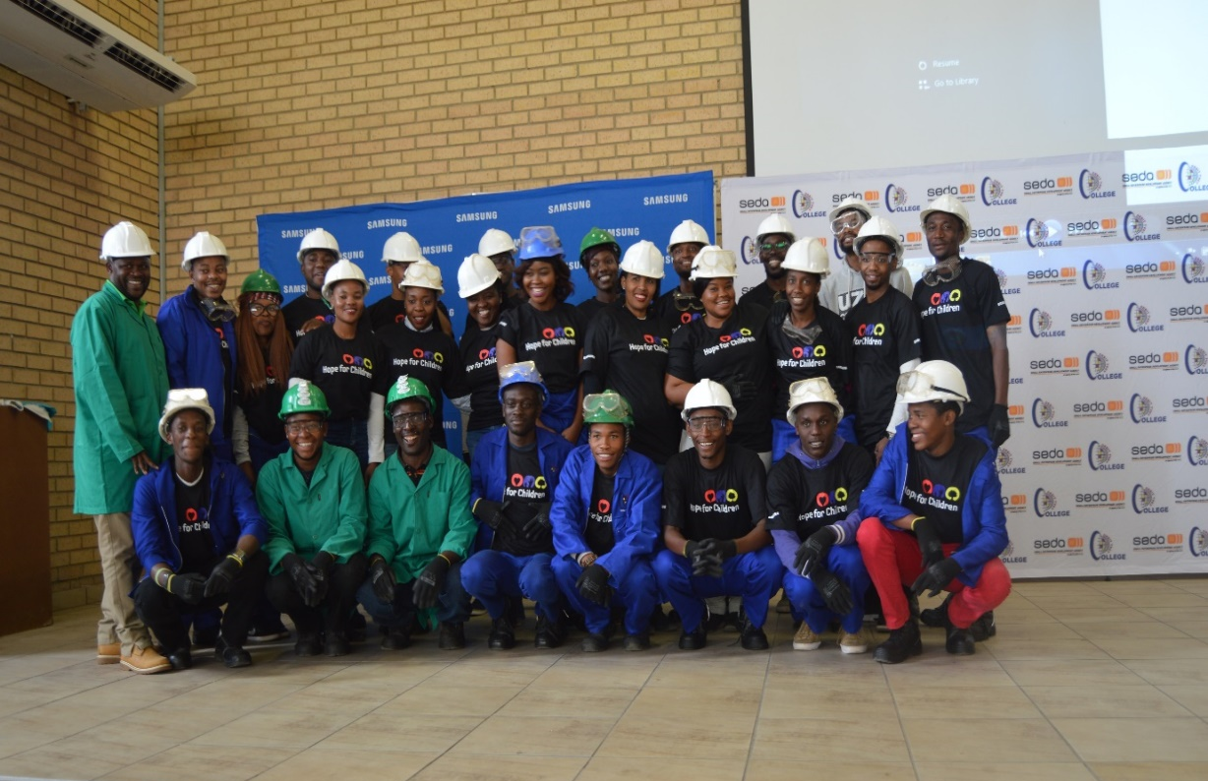
Centre for Entrepreneurship
Small, Medium and Micro Enterprises Established:
20 Students trained on Enterprise development for 5 days and also e-waste management

Slide 49
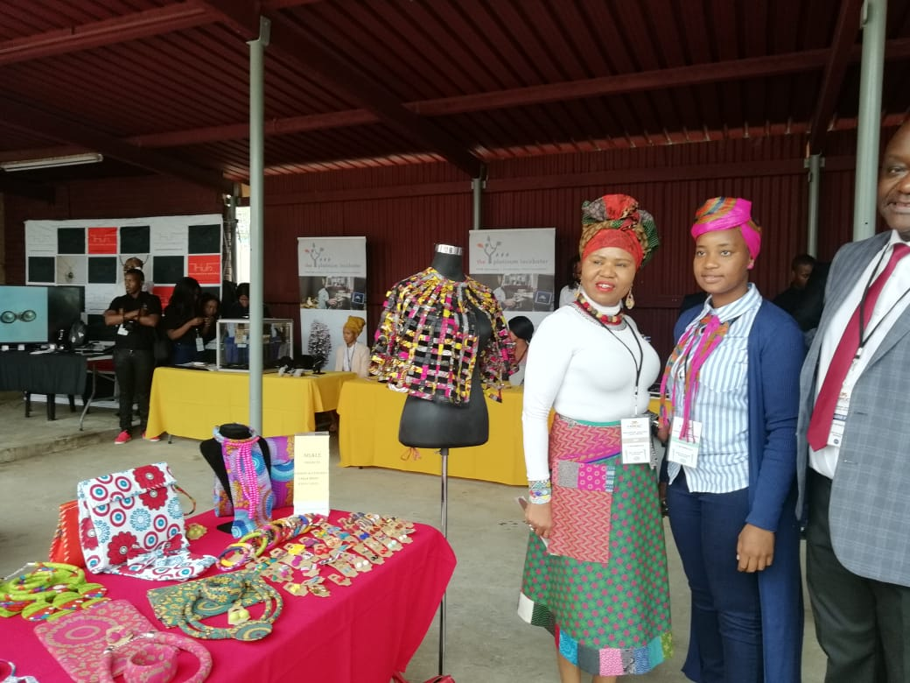
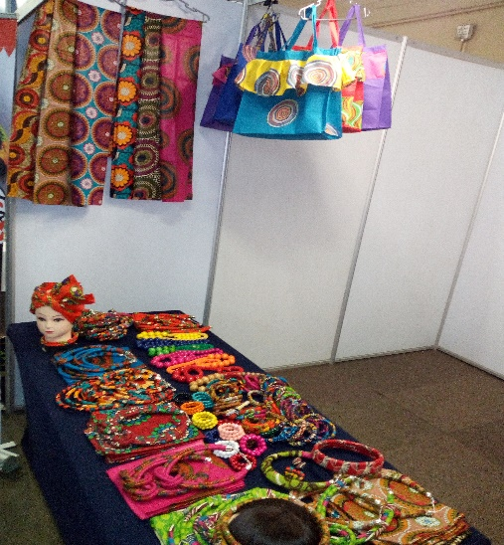
Centre for Entrepreneurship
Small, Medium and Micro Enterprises Established:
Supported Student entrepreneurs during an exhibition

Slide 50
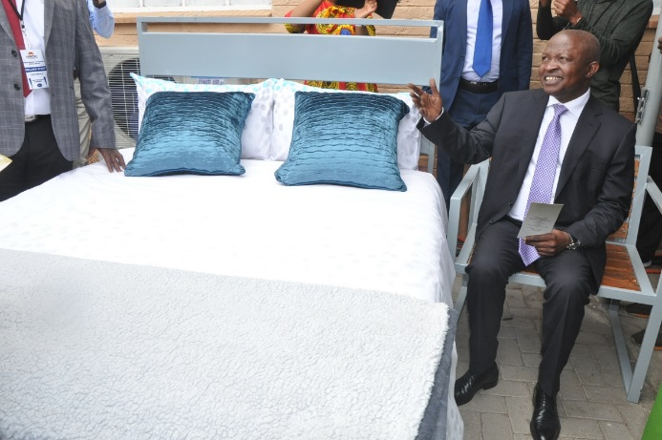
Centre for Entrepreneurship
Small, Medium and Micro Enterprises Established:
Deputy President David Mabuza sit on one of the garden chairs he had bought from ORBIT TVET College- Centre for Entrepreneurship Rapid Incubator. The entrepreneur is an incubatee of the Centre

Slide 51
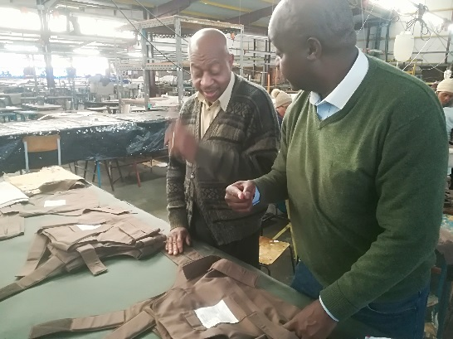
Centre for Entrepreneurship
Small, Medium and Micro Enterprises Established:
With vast experience in the clothing and textile sector Mr Vusi Kambili came to the centre to register a company and was
offered Business development services which included access to market and access to finance.
To date he created 65 jobs at Mogwase.

Slide 53
DECLARATION OF AUTHENTICITY
Hereby I, D Mokoena College Principal of ORBIT TVET COLLEGE declares that the information supplied in the report has been verified by me and is correct to the best of my knowledge.
Signature
Date | 17 June 2020

