Slide 1



SESSION 1
Part one: Impact of COVID 19 on Current Budget and the 2020/21 Budget

Slide 2
PRELIMINARY ESTIMATIONS
COVID-19 IMPACT
As per the IMF Forecasts, SA’s growth is expected to be lower by 6,60% due to COVID-19
The SARB expects the economy to contract by 6,10% during 2021 and other sources expects the economy to contract by even as much as 10% and higher
The Free State economy is expected to contract at a rate greater than the SA economy due to higher unemployment and lower growth
The projected growth of Mangaung is therefore expected between -8,00% and -10,00% due to COVID-19

Slide 3
PRELIMINARY ESTIMATIONS
COVID-19 IMPACT
Collection VS Billed – 2019/2020 Financial Year:

Slide 4
PRELIMINARY ESTIMATIONS
COVID-19 IMPACT
The total actual collection rate till April 2020 was 85,85%
If the projected months of May and June 2020 is also included, the total collection rate for the FY would decrease to 84,04%
The total decrease in collections due to COVID-19 is expected to be approximately 28,16%
Payments by National/Provincial Government with regards to arrear debt have lessened the blow in order to keep the collection rate at an higher level
Total expected loss of revenue till April 2020 is estimated to be R 70,6 million across all services, with primarily water, electricity and interest affected (no interest was charged during this period)
It should however be noted that meters could not be read during March (Only small amount) and in total for April. Actual readings will only be available between May and June 2020 and therefore could influence revenue projections

Slide 5
PRELIMINARY ESTIMATIONS
COVID-19 IMPACT
The total estimated loss in monies collected till April is R 89 Million across all services with estimated drop percentages per services as follows:
  Water 40,10%
  Electricity 27,76%
  Rates 15,05%
  Sanitation 24,96%
  Refuse 24,66%
Based on initial collections and projections for May 2020, it is expected to be similar to that of the month of April 2020 and therefore both the month of May and June was estimated in line with that assumption. The new measures expected to be announced for Level 3 of the lockdown may impact those estimations
It should however be noted that the municipality is currently well on track to still meet its revenue projections and it is expected that we will exceed our budgeted revenue amount by approximately R 80 million for the current FY

Slide 6
PRELIMINARY ESTIMATIONS
COVID-19 IMPACT
Payment Methods | Feb-20 | Mar-20 | Apr-20 | Total | % Contribution
Over the counter (pay points) | 10'182'980 | 10'032'859 | 312'980 | 20'528'819 | 6,22%
Third Party | 22'531'406 | 20'403'340 | 12'422'757 | 55'357'503 | 13,77%
EFTs/Direct Deposit | 130'900'593 | 136'972'534 | 120'946'862 | 388'819'990 | 80,01%
Total Collected | 163'614'979 | 167'408'733 | 133'682'599 | 464'706'312 | 100,00%
Electricity (Centlec) - Mostly Prepaid | 202'534'400 | 254'693'932 | 182'849'003 | 640'077'335
New Total | 366'149'379 | 422'102'665 | 316'531'602 | 1'104'783'647
As can be seen from above information, there was a significant drop in collection
during the month of April 2020.
Noticeable is the drop of collection from pay points with approximate 97% drop in
collections.
Third parties as well as EFT’s/Direct deposits was also severely affected

Slide 7
RELIEF OFFERED TO CONSUMERS DURING COVID-19 PANDEMIC
Interest was waived during the months of April and May 2020. Interest will also still be waived for the months of June and July 2020
Extended Payment arrangements are offered to consumers to settle outstanding debt over an extended period and no interest charged if arrangement are maintained
Consumers now earning less than the threshold (3 X State pensions) due to loss of income or jobs can apply for indigent relief and all the benefits associated with that
All pensioners can apply for an additional rebate for property rates for a reduction of market value of R 250 000 for the purposes of paying property rates

Slide 8
ADDITIONAL MEASURES IN PLACE DURING COVID-19 PANDEMIC
The municipality has created an account balance portal on its website where consumers are able to check their outstanding balance
Consumers can apply for email statements or request statement via enquiries@mangaung.co.za or via call centre 0800 111 300
Meter readings has (in part) started again since 7 May 2020. Consumers can also mail their readings through to meterreadings@mangaung.co.za if not read
It is expected that postal statements can commence again from 1 June 2020 and shall be commenced as such
A Number of media communication were sent out during the period to inform consumers how they are able to get or pay their accounts
Payments of accounts can be processed through banking app or website as well as through eft, via third parties and recently via pay points

Slide 9
COMPLETENESS OF REVENUE
The valuation roll is fully reconciled to the Deeds office every time a new General valuation is performed. All supplementary valuation rolls is also reconciled once issued – cannot be performed on quarterly basis due to high costs associated with this
The municipality is also in the process to reconcile the dewetsdorp, wepener, vanstadensrus and soutpan areas to ensure that these areas are complete (approx. 12 000 stands)
Additional processes have been implemented in rates department to ensure accuracy and completeness of all accounts registered at the deeds office including additional checklists, controls and monthly reconciliations
Additional water meters have also been identified as part of reconciliations performed between information of contractors and municipal records (approx. 3000 meters have been corrected as such)
Tariffs were also corrected for water meters with regards basic charges which were not previously added (approx. 450 accounts)

Slide 10
expenditure items experienced spike during COVID19
Description | Amount required for 2019/20 FY | Funded through approved reprioritization of USDG/PTNG | Additional funds required for 2019/20
Health System | R10,2 million | - | R10,2 million
Disaster Management and Public Safety | R1,6 million | - | R1,6 million
Informal Settlements (basic services) | R10,7 million | - | R10,7 million
Water and Sanitation (maintenance) | R68,6 million | R66,3 m (R62,1 m – USDG) (R4,2 m – PTNG | R2,3 million
Municipal Facilities and PPEs | R12,8 million | - | R12,8 million
Overtime | R6,6 million | - | R6,6 million
ICT | R5,7 million | - | R5,7 million
Security | R18 million | - | R18 million
Total Expenditure requirements | R134,2 million | R66,3 million | R67,9 million

Slide 11
COVID 19 IMPACT ON the sustainability of the municipality’s finances
Higher levels of unemployment and lower real disposable income are likely to increase levels of indebtedness and defaulting on payments
Property rates and services revenue collection is highly vulnerable to defaulting by households as a result of income losses
While defaulting may not be as high for businesses, a number of businesses may have closed down, resulting in a shrinking commercial rates base

Slide 12
SESSION 3
Part six: Presentation on the tabled 2020/20 MTREF

Slide 13
Section 1: Long term planning
Section 2: Revenue optimisation
Section 3: Operational expenditure
Section 4: Capital budget
Section 5: Progress with implementation of mSCOA

Slide 14
Section 1: Long term planning

Slide 15
Long term financial strategy to achieve strategic objectives and sustainability
The municipality does not have long term financial strategy.
A detailed Long Term Financial Plan will be developed in consultation with National Treasury in order to balance the funding mix for Infrastructure development.

Slide 16
Section 2: Revenue Optimization

Slide 17
TARIFFS INCREASES (AVERAGES)
4.90%
Rates
8.50%
Sanitation
Water
*4.90%
8.09%
9.00%
Electricity
Refuse
Removal
*Subject to NERSA increases (to be implemented)

Slide 18
Tariffs summary of increases
Services | 2020/21 | 2021/22 | 2022/23
 | % | % | %
Property Rates
- Residential | 4,90% | 5,30% | 5,60%
- Non-residential | 4,90% | 5,30% | 5,60%
Sewerage Charges
- Residential | 8,30% | 6,60% | 6,80%
- Non-residential | 8,85% | 7,40% | 7,50%
Refuse Revenue
- Residential
* 0 - 600 Square meters | 7,00% | 7,40% | 7,80%
* 600 - 900 Square meters | 7,50% | 7,90% | 8,30%
* 900 - 1500 Square meters | 8,00% | 8,90% | 8,80%
* 1500 or more Square meters | 9,20% | 9,90% | 10,00%
- Business | 10,20% | 11,40% | 11,00%
Water
- Residential
* 0 - 6 kl | 7,00% | 7,16% | 7,62%
* 7 - 15 kl | 8,00% | 8,18% | 8,71%
* 16 - 30 kl | 9,50% | 9,71% | 10,34%
* 31 - 60 kl | 11,50% | 11,76% | 12,52%
* 61 kl and more | 12,00% | 12,27% | 13,07%
* Fixed Tariff | 10,00% | 10,22% | 10,89%
- Business
* 0 - 60 kl | 8,00% | 8,18% | 8,71%
* 61 - 100 kl | 10,50% | 10,73% | 11,43%
* 101 kl and more | 11,00% | 11,24% | 11,98%
* Fixed Tariff | 10,00% | 10,22% | 10,89%

Slide 19
Reasons for tariff increases
The following factors were considered in the determination of the increase of the tariffs of property rates by 4.90%:
  The inflation rate of 4.60% as per Circular 98 issued by National Treasury on 6 December 2019;
  Consideration of the impact of the growth of the city, new supplementary valuations and outcomes of the objections and appeals process.
The following factors were considered in the determination of the increase of the tariffs of water by 9.00%:
  The inflation rate of 4.60% as per Circular 98 issued by National Treasury on 6 December 2019;
  The increase in costs from Bloemwater is expected to be 9.00% for bulk water. Bulk water is the main driver in costs for water. In addition, thereto, the total expected costs for water service are R 1.771 billion, which is significantly higher than expected revenue of R 983.100 million. A further increase of 4.40% is required.

Slide 20
Reasons for tariff increases
The following factors were considered in the determination of the increase of the tariffs of sanitation by 8.50%:
  The inflation rate of 4.60% as per Circular 98 issued by National Treasury on 6 December 2019;
  The projected costs for the sanitation service are R 623,592 million which is significantly higher than expected revenue of R 364,526 million. To move towards achieving cost recovery, a further increase of 3.90% is thus required.
The following factors were considered in the determination of the increase of the tariffs of refuse by 8.09%:
  The inflation rate of 4.60% as per Circular 98 issued by National Treasury on 6 December 2019;
  The projected costs for the refuse service are R 366,716 million which is significantly higher than expected revenue of R 148,264 million. To move towards achieving cost recovery, a further increase of 3.49% is thus required.

Slide 21
CONSIDERATIONS FOR
REVENUE BUDGETING
Zero-based budgeting for all major revenue services
Costing has been performed on all major services and informs tariff increases
For Property Rates, budgeting based on disaggregated valuation roll, objections and appeals, implementation of general/supplementary valuation roll and growth parameters for the city
For Sanitation, budgeting based on disaggregated valuation roll (Sanitation based on market values), services linked to accounts, implementation of general/supplementary valuation roll and growth parameters of the City
For refuse, budgeting based on disaggregated valuation roll (based on erf sizes), services linked to accounts and growth parameters of the city
For water, budgeting based upon expected water demand, step levels, restriction levels, past history and growth parameters of the city
For electricity, budgeting based upon electricity demand, NERSA directives, step levels and growth parameters of the city

Slide 22
RECONCILIATION OF REVENUE
PROPERTY RATES
Rates Recon: | Amounts | %
Adjustment Budget | 1'266'537'837
Increase in tariff | 62'060'354 | 4,90%
Allowance of 5% | (5'446’113) | -0,43%
New Supplementaries | 33'309'945 | 2,63%
Properties exceeding threshold | 10'992'378 | 0,87%
Growth of the City | 8'865'765 | 0,70%
 | 1'376'320'166 | 8,67%
2020/21 Budget | 1'376'320'166 | 8,67%
Difference | 0 | 0,00%

Slide 23
RECONCILIATION OF REVENUE
SANITATION
Sanitation Recon: | Amounts | %
Adjustment Budget | 327'614'700
Increase in tariff | 27'847'250 | 8,50%
Allowance of 5% | -3'915'407 | -1,20%
New Supplementaries | 7'862'753 | 2,40%
Properties exceeding threshold | 2'823'747 | 0,87%
Growth of the City | 2'293'303 | 0,70%
 | 364'526'345 | 11,27%
2020/21 Budget | 364'526'345 | 11,27%
Difference | 0 | 0,00%

Slide 24
RECONCILIATION OF REVENUE
REFUSE
Refuse Recon: | Amounts | %
Adjustment Budget | 135'206'958
Increase in tariff | 10'938'243 | 8,09%
Properties exceeding threshold | 1'172'785 | 0,87%
Growth of the City | 946'449 | 0,70%
 | 148'264'434 | 9,66%
2020/21 Budget | 148'264'434 | 9,66%
Difference | 0 | 0,00%

Slide 25
RECONCILIATION OF REVENUE
WATER
Water Recon: | Amounts | %
Adjustment Budget | 823'391'629
Increase in tariff | 74'105'247 | 9,00%
Change from 10 kl to 6 kl | 79'839'024 | 9,70%
Growth of the City | 5'763'741 | 0,70%
 | 983'099'641 | 19,40%
2020/21 Budget | 983'099'641 | 19,40%
Difference | 0 | 0,00%

Slide 26
RECONCILIATION OF REVENUE
ELECTRICITY
Electricity Recon: | Amounts | %
Adjustment Budget | 2 663 732 947,00
Increase in tariff | 166 216 935,89 | 6,24%
Growth of the City | - 300 558 253,94 | -11,28%
 | 2 529 391 628,95
2020/21 Budget | 2 529 391 629,00
Difference | 0,00 | 0%

Slide 27
FREE BASIC SERVICES
Rates
First R 80 000 of residential property is exempted
First R 250 000 of residential property value of senior citizen and disabled exempted
All registered indigents are exempted from paying rates and taxes
Water
10 kl free for all indigents
Metered Communal taps for all informal settlements
Refuse
One pickup per household per week
Property owners with properties valued at less than R 80 000 are exempted from paying for refuse
All indigents are exempted from paying for refuse removal
Electricity
50 kw free for all registered indigents

Slide 28
FREE BASIC SERVICES
FORMAL SETTLEMENTS
2020-21
Budget
2022-23
Forecast
2019—20
Adj. Budget
Component
2021-22
Forecast
Property Rates
R 115.3 m
R 110.7 m
R 114 m
R 123.8 m
Water
R 177.6 m
R 102 m
R 111.6 m
R 122.2 m
Sanitation
R 133.9 m
R 140.2 m
R 149.8 m
R 160.4 m
Electricity
R 16.6 m
R 17.4 m
R 18.2 m
R 19,1 m
Refuse Removal
R 82.4 m
R 85.6 m
R 94.2 m
R 104 m
Total FBS
R525.8 m
R 455.9 m
R 487.8 m
R 529.5 m
Number of indigents
66 546
67 012
67 615
68 426

Slide 29
FREE BASIC SERVICES
INFORMAL SETTLEMENTS
Detail of Free Basic Services (FBS) provided |  |  |  | 2016/17 | 2017/18 | 2018/19 | Current Year 2019/20 |  |  | 2020/21 Medium Term Revenue & Expenditure Framework
 |  |  |  | Outcome | Outcome | Outcome | Original Budget | Adjusted Budget | Full Year Forecast | Budget Year 2020/21 | Budget Year +1 2021/22 | Budget Year +2 2022/23
Electricity | Ref. | Location of households for each type of FBS
Formal Settlements - |  | Formal settlements - (50 kwh per indigent household per month Rands) |  | – | 19'137'493 | 19'683'456 | 66'559'260 | 16'589'826 | 16'589'826 | 17'352'958 | 18'185'900 | 19'058'823
Number Of Households |  | Number of HH receiving this type of FBS |  | 29'036'934 | 19'137'493 | – | 45'118'188 | 45'118'188 | 45'118'188 | 48'113'798 | 51'345'234 | –
 |  | Informal settlements (Rands)
 |  | Number of HH receiving this type of FBS |  | – | – | – | 21'441'072 | 21'441'072 | 21'441'072 | 22'864'518 | 24'399'776 | –
 |  | Informal settlements targeted for upgrading (Rands)
 |  | Number of HH receiving this type of FBS
 |  | Living in informal backyard rental agreement (Rands)
 |  | Number of HH receiving this type of FBS |  | 14'221 | – | – | – | – | – | – | – | –
 |  | Other (Rands)
 |  | Number of HH receiving this type of FBS
 |  | Total cost of FBS - Electricity for informal settlements |  | – | – | – | – | – | – | – | – | –
Water | Ref. | Location of households for each type of FBS
Formal Settlements - |  | Formal settlements - (6 kilolitre per indigent household per month Rands) |  | – | 49'408'769 | 80'894'402 | 177'614'384 | 177'614'384 | 177'614'384 | 101'984'423 | 111'588'175 | 122'216'590
Number Of Households For Is |  | Number of HH receiving this type of FBS |  |  | 62'812 | 65'953 | 66'546 | 66'546 | 66'546 | 67'012 | 67'615 | 68'426
Informal Settments |  | Informal settlements (Rands) |  |  | 98'648'000 | 105'926'000 | 75'371'145 | 75'371'145 | 75'371'145 | 129'591'317 | 139'643'101 | 150'938'711
 |  | Number of HH receiving this type of FBS |  |  | 30'727 | 31'342 | 31'624 | 31'624 | 31'624 | 31'845 | 32'132 | 32'517
 |  | Informal settlements targeted for upgrading (Rands)
 |  | Number of HH receiving this type of FBS
 |  | Living in informal backyard rental agreement (Rands)
 |  | Number of HH receiving this type of FBS |  | – | – | – |  |  |  |  |  | –
 |  | Other (Rands)
 |  | Number of HH receiving this type of FBS
 |  | Total cost of FBS - Water for informal settlements |  | – | 98'648'000 | 105'926'000 | 75'371'145 | 75'371'145 | 75'371'145 | 129'591'317 | 139'643'101 | 150'938'711

Slide 30
FREE BASIC SERVICES
INFORMAL SETTLEMENTS
Detail of Free Basic Services (FBS) provided |  |  |  | 2016/17 | 2017/18 | 2018/19 | Current Year 2019/20 |  |  | 2020/21 Medium Term Revenue & Expenditure Framework
 |  |  |  | Outcome | Outcome | Outcome | Original Budget | Adjusted Budget | Full Year Forecast | Budget Year 2020/21 | Budget Year +1 2021/22 | Budget Year +2 2022/23
Sanitation | Ref. | Location of households for each type of FBS
Formal Settlements - |  | Formal settlements - (free sanitation service to indigent households) |  | – | 112'233'382 | 122'355'657 | 133'898'299 | 133'898'299 | 133'898'299 | 140'201'206 | 149'751'317 | 160'409'930
Number Of Households |  | Number of HH receiving this type of FBS |  |  | 62'812 | 65'953 | 66'546 | 66'546 | 66'546 | 67'012 | 67'615 | 68'426
Informal Settments |  | Informal settlements (Rands) |  |  | 36'013'000 | 37'579'000 | 43'350'812 | 43'350'812 | 43'350'812 | 87'000'540 | 92'957'876 | 99'599'571
Number Of Households For Is |  | Number of HH receiving this type of FBS |  |  | 30'727 | 31'342 | 31'624 | 31'624 | 31'624 | 31'845 | 32'132 | 32'517
 |  | Informal settlements targeted for upgrading (Rands)
 |  | Number of HH receiving this type of FBS
 |  | Living in informal backyard rental agreement (Rands)
 |  | Number of HH receiving this type of FBS
 |  | Other (Rands)
 |  | Number of HH receiving this type of FBS
 |  | Total cost of FBS - Sanitation for informal settlements |  | – | 36'013'000 | 37'579'000 | 43'350'812 | 43'350'812 | 43'350'812 | 87'000'540 | 92'957'876 | 99'599'571
Refuse Removal | Ref. | Location of households for each type of FBS
Formal Settlements - |  | Formal settlements - (removed once a week to indigent households) |  | – | 67'949'989 | 74'679'498 | 82'407'435 | 82'407'435 | 82'407'435 | 85'573'129 | 94'231'651 | 103'963'006
Number Of Households |  | Number of HH receiving this type of FBS |  |  | 62'812 | 65'953 | 66'546 | 66'546 | 66'546 | 67'012 | 67'615 | 68'426
Informal Settments |  | Informal settlements (Rands) |  |  | 36'806'000 | 37'548'000 | 40'984'704 | 40'984'704 | 40'984'704 | 51'174'915 | 55'074'248 | 59'441'076
Number Of Households For Is |  | Number of HH receiving this type of FBS |  |  | 30'727 | 31'342 | 31'624 | 31'624 | 31'624 | 31'845 | 32'132 | 32'517
 |  | Informal settlements targeted for upgrading (Rands)
 |  | Number of HH receiving this type of FBS
 |  | Living in informal backyard rental agreement (Rands)
 |  | Number of HH receiving this type of FBS
 |  | Other (Rands)
 |  | Number of HH receiving this type of FBS
 |  | Total cost of FBS - Refuse Removal for informal settlements |  | – | 36'806'000 | 37'548'000 | 40'984'704 | 40'984'704 | 40'984'704 | 51'174'915 | 55'074'248 | 59'441'076

Slide 31
RECONCILIATION OF FREE BASIC SERVICES TO EQUITABLE SHARE
DESCRIPTION | 2020/21 | 2021/22 | 2022/23
FBS Formal | R 455,9 M | R 487,8 M | R 529,5 M
FBS Informal | R 267,8 M | R 287,7 M | R 310 M
Total FBS | R 723.7 M | R 775,5 M | R 839.5 M
Equitable Share | R 800.3 M | R 741.9 M | R 790.3 M
Difference | (R 76,6 M) | R 33,6 M | R 49,2 M
% FBS of ES | 90.43% | 104.53% | 106.23%

Slide 32
PREPAID WATER METER
PROJECT
Till end of April 2020 a total of 35 490 prepaid water meters has been installed
Total expenditure on Project to date (since March 2015) is R 290 684 465
This conversion is therefore extremely capital intensive
Please see below Prepaid collections for the financial YTD:
Month | Sales Revenue
Jul-19 | 3'955'303
Aug-19 | 4'823'969
Sep-19 | 5'490'291
Oct-19 | 6'490'845
Nov-19 | 6'644'399
Dec-19 | 5'704'350
Jan-20 | 4'972'050
Feb-20 | 4'940'454
Mar-20 | 5'588'413
Apr-20 | 3'779'778
TOTAL | 52'389'851
Dry summer months
Decrease due to COVID19 – 32,36% drop in sales

Slide 33
PAYMENTS PER GROUP
DEBTORS
Debtor Type | Jan-20 | Feb-20 | Mar-20 | Apr-20
Business | R 55 887 230 | R 62 244 637 | R 55 792 424 | R 31 480 684
Residential | R 75 740 906 | R 80 425 347 | R 79 362 785 | R 54 314 183
Government | R 26 830 158 | R 8 175 358 | R 68 400 948 | R 34 856 998
Provincial Public Works | R 14 619 288 | R 739 335 | R 43 665 896 | R 30 775 322
Schools (Water only) | R 1 672 697 | R 2 281 490 | R 5 305 169 | R 619 476
National Public Works | R 9 014 387 | R 4 847 081 | R 18 790 422 | R 3 139 372
Department of Land & Rural Development | R 1 507 663 | R 8 844 | R 308 213 | R -
FDC | R 16 122 | R 298 609 | R 331 248 | R 322 829
Centlec electricity receipts | R 284 793 686 | R 285 493 954 | R 298 198 147 | R 257 991 236
Total Revenue | R 443 251 980 | R 436 339 295 | R 501 754 304 | R 378 643 101
Average collection (Jan 2020 to March 2020) |  |  | R 460 448 526
Reduction in revenue due to COVID-19 |  |  | -R 81 805 425
% |  |  | -18%

Slide 34
PAYMENTS PER GROUP
DEBTORS
As can be seen from the payments table above, government as a whole is paying more
frequently for their rates and services
However government departments are still significantly underpaying their municipal
accounts, leading to increased arrear balances every year
One of biggest challenges is with regards to FDC, who is almost not paying their accounts
at all.
NOTE: With FDC we are currently in a process to separate the tenant accounts for each of
their tenants so that the tenants directly pay the municipality for their water to ensure
Increased collection. That process is 90% done.

Slide 35
ELECTRICITY LOSSES AND STEPS TAKEN TO REDUCE
2018/2019 |  |  | 2019/2020 | 18/19-19/20 Difference
Period | Losses (kWh) | % Losses | Period | Losses (kWh) | % Losses
18-Jul | 18 971 717,89 | 11,98% | 19-Jul | 20 120 531,29 | 12,74% | 0,77%
18-Aug | 17 091 991,65 | 11,17% | 19-Aug | 4 010 451,36 | 2,76% | 0,00%
18-Sep | 11 917 480,56 | 8,77% | 19-Sep | 8 667 423,84 | 6,58% | -2,19%
18-Oct | 9 635 416,49 | 7,17% | 19-Oct | 11 495 951,73 | 8,47% | 1,31%
18-Nov | 8 692 888,75 | 6,56% | 19-Nov | 599 157,95 | 0,48% | -6,08%
18-Dec | 9 999 424,45 | 7,83% | 19-Dec | 17 711 062,30 | 13,41% | 5,58%
19-Jan | 13 955 946,35 | 10,17% | 20-Jan | 7 081 473,48 | 5,54% | -4,64%
19-Feb | 6 159 458,24 | 5,05% | 20-Feb | 8 666 796,59 | 6,95% | 1,90%
19-Mar | 6 752 298,74 | 5,06% | 20-Mar | 4 269 546,37 | 3,40% | -1,65%
19-Apr | 9 232 746,33 | 7,21% | 20-Apr | - |  | -7,21%
19-May | 10 783 062,31 | 7,77% | 20-May | - |  | -7,77%
19-Jun | 17 678 810,77 | 12,18% | 20-Jun | - |  | -12,18%
FY 1819 Ave | 11 739 270,21 | 8,41% | FY 1920 Ave | 6 885 199,58 | 6,70% | -1,71%
FY 1819 Accum. (kWh) | 140 871 242,52 |  | FY 1920 Accum. (kWh) | 82 622 394,93 |  | 58 248 847,58
The above table is a month to month comparison energy losses
According to NERSA regulation the electricity losses should not exceed the threshold of 12%
The energy purchased and sales are monitored on monthly basis steps taken to reduce losses
Maintenance and inspections is conducted on both bulk and prepaid meters and reported on the SDBIP to address the non technical losses.

Slide 36
WATER LOSS INTERVENTIONS
(MDRG PROJECT)
Leak repairs on various water infrastructure components e.g Reservoirs, valves, water pipes (trunk & reticulation mains) etc.
Replacement of old water pipes: 13.5km
Commissioning and re-commissioning of Pressure Reducing
  PRVs Audit Report Completed
  Valves (PRVs): 34 of 65 PRVs refurbished
Installation & Replacement of old and dysfunctional post-paid meters with prepaid meters: 35699 since project inception
Output Report with GIS-based theoretical pipe replacement model with a register of pipelines/infrastructure to be replaced together with costing estimate including total infrastructure to be replaced has been has been completed

Slide 37
Water savings: mdrg project
Note
Financial savings calculated based on Bloem Water potable water tariff of R 9.06/kl.
Project Name | Volume of Water Savings (kl/d) | Financial Savings (R/d)
Project 4: Old Arboretum Reservoir Leak Repair | 143 kl/d | R 1,296 /day
Project 7: Pressure and Network Zone Management | 1,827 kl/d | R 16,553/day
Project 8A: Pro-Active Leak Detection & Repair Programme | 1,562 kl/d | R 14,152 /day
Total | 3,532 kl/d | R 32,001 /day
Total Volume Savings per Year
1,289 Ml/yr
Total Financial Savings per Year
R 11.7mil /yr

Slide 38
REVENUE PROTECTION
Steps taken on electrical meter tampering's
The planned area inspection, tip offs from the public, tampered meters and illegal connections are discovered.
The following are the steps taken when the meter is being found tampered with or illegally connected:
  Customer is called to witness the tampered meter or illegal connection
  The photo of the tampered or illegally connected meter is captured for evidence
  Meter is removed
  Penalty is issued to the customer
If there is a negative consumption on the meter due to tampering, that negative consumption is calculated and the customer must pay for that consumption together with the tamper penalty
After the customer has paid the full amount the meter is reinstalled
If the customer does not have the full amount an arrangement can be made at Finance and thereafter the meter can be reinstalled.

Slide 39
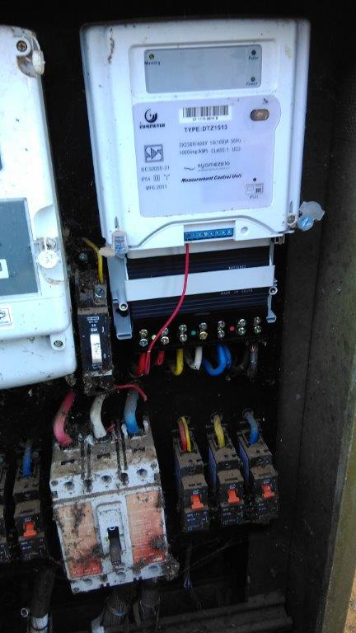
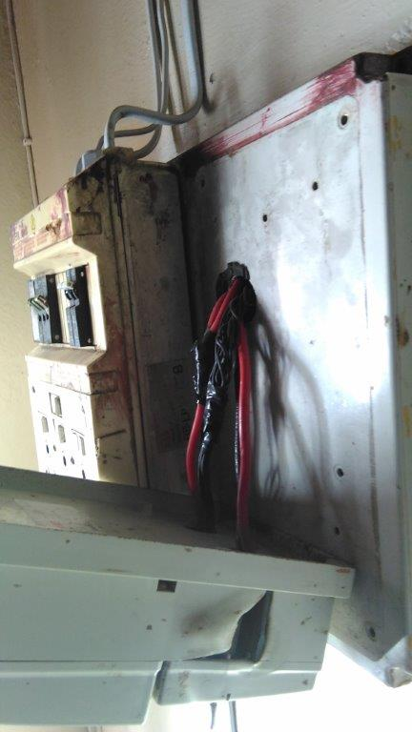
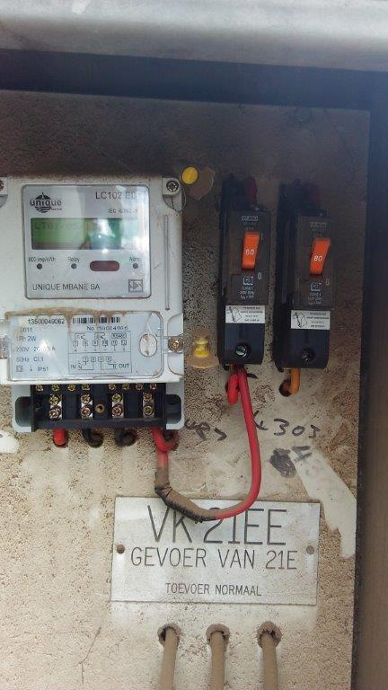
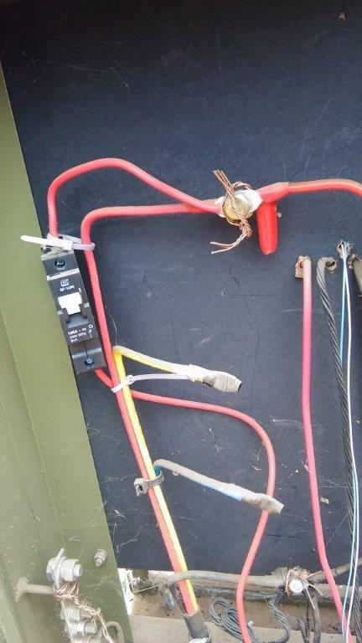
REVENUE PROTECTION example of illegal connection electricity meters

Slide 40
REVENUE PROTECTION
STEPS TAKEN
Penalty fees are charged to consumers who contravene the water bylaws including:
  Illegal connections
  Tampering
  Illegal removal of meters
  Bypassing of meters
Water clearance needs to be issued when property is sold to ensure compliance to water bylaws and that there is no illegal/tampered water meter
Removal of water meter if consistent tampering/illegal connection

Slide 41
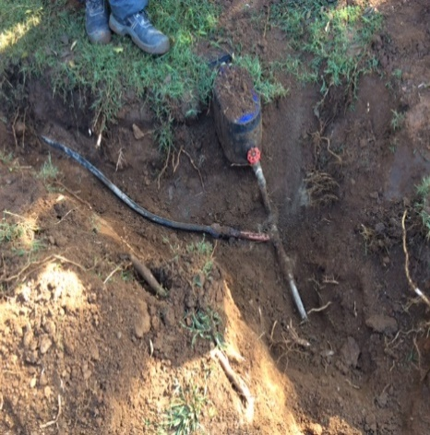
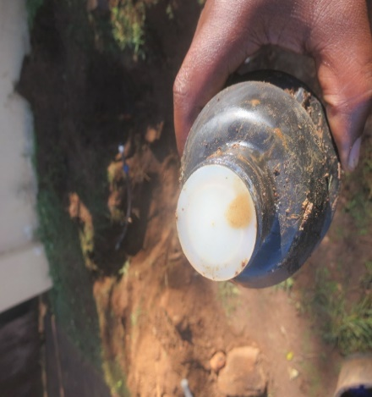
REVENUE PROTECTION
EXAMPLE OF ILLEGAL CONNECTION
An illegal connection was suspected at the above mentioned address.
An investigation was conducted and the findings are as follows:
During excavation at the above mentioned address an illegal connection was discovered. The meter was disked and found a pipe connected from the supply pipe.
The illegal connection was removed and the site was left rehabilitated and to standard.
Illegal connection
Disked meter

Slide 42
Section 3:Operational Expenditure

Slide 43


OPERATING EXPENDITURE

Slide 44
Operating expenditure Assumptions
Expenditure item | % increase / decrease in 2020/21 | %% increase / decrease in 2021/22 | % increase / decrease in 2022/23
Bulk electricity | 4,6% | 4,8% | 4,8%
Bulk water | 6..5% | 6..5% | 6..5%
Salaries | 7.0% | 7,0% | 7,0%
Councillor allowances | 4,9% | 4,8% | 4,8%
CPI | 4,9% | 4,8% | 4,8%

Slide 45
Operating expenditure by type
Description | 2019/20 Adjusted Budget | % Change | Budget Year 2020/21 | Budget Year 2021/22 | Budget Year 2022/23
Employee related costs | 2 006 019 | 3,85 | 2 083 205 | 2 301 339 | 2 421 621
Remuneration of councillors | 67 267 | 7,00 | 71 976 | 77 014 | 82 405
Depreciation & asset impairment | 307 761 | 5,68 | 325 234 | 343 858 | 363 557
Finance charges | 233 946 | -4,96 | 222 333 | 199 458 | 181 001
Bulk purchases | 2 000 040 | 10,44 | 2 208 863 | 2 401 790 | 2 525 917
Other materials | 63 654 | -12,23 | 55 872 | 69 807 | 73 157
Transfers and grants | 2 553 | -12,22 | 2 241 | 2 807 | 2 941
Contracted services | 399 730 | 14,17 | 456 389 | 518 065 | 541 657
Other' Expenditure | 268 710 | 24,46 | 334 449 | 359 636 | 367 794
Debt impairment | 1 107 533 | 0,65 | 1 114 764 | 1 059 496 | 1 112 431
Total | 6 457 213 |  | 6 875 324 | 7 333 270 | 7 672 482

Slide 46
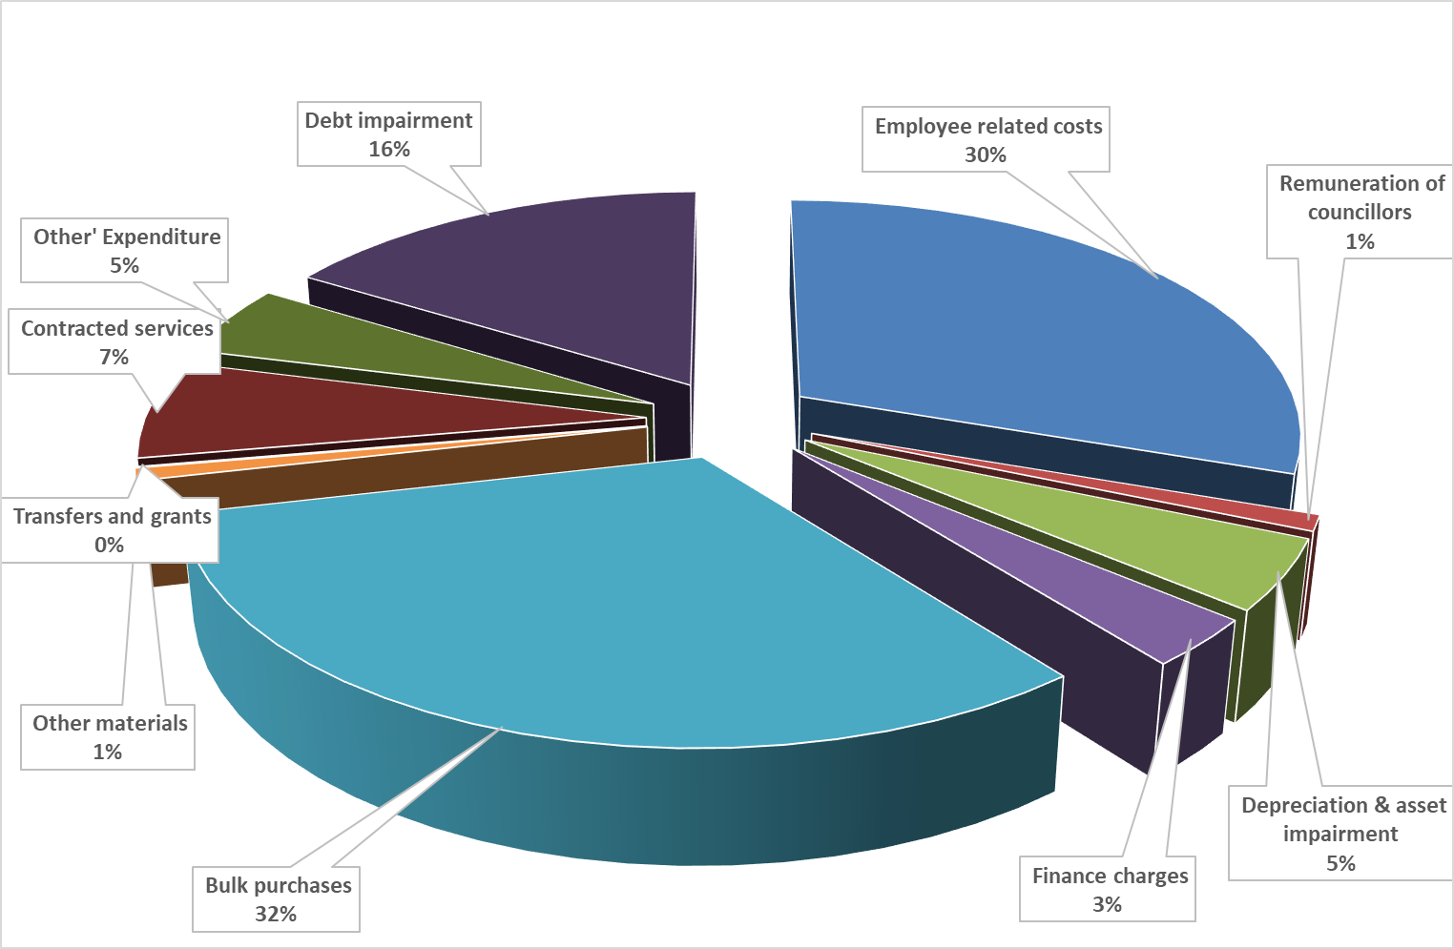

Operating expenditure by type : 2020-21

Slide 47
COST CUTTING MEASURES
Usage of recent technology to monitor usage of telephone;
Managing and monitoring of overtime by supervisors and management;
Monitoring of ICT costs;
Implementation of water demand projects to reduce water loss
Reduction of expenditure on events, conferences, meetings, workshops, trainings, seminars, etc;
Review of Travelling Policy and align to MFMA Circular 82
Gradual migration from printed statements to e-statements
Scaling down the cost of consulting services and contracted services;
Development of Donations policy
Review outsourcing of security services, waste removal, grass cutting, etc.
Value for money procurement
Rolling out internal control to user department to monitor the expenditure on consumables eg. Fuel; printing paper; toilet paper etc.

Slide 48
Section 4: Capital Budget

Slide 49
Funding and spending trends
Funding Mix
FUNDED BY: | 2015/16 | 2016/17 | 2017/18 | 2018/19 | 2019/20 | 2020/21 | 2021/22
Grants & subsidies | 790,009,562 | 912,279,300 | 944,703,021 | 953,483,000 | 1,036,829,622 | 969,913,282 | 1,046,909,087
Public Contributions and Donations | 36,603,064 | 30,744,351 | 26,761,603 | 14,762,339 | 13,408,079 | 12,092,564 | 12,818,118
Borrowing | 390,239,730 | 465,067,686 | 29,599,094 | 33,188,260 | 77,707,953 | 85,179,220 | 56,448,097
Internally generated funds | 394,408,592 | 273,811,484 | 142,957,889 | 227,423,724 | 254,276,242 | 269,665,331 | 278,781,058
Total Capital Funding | 1,611,260,948 | 1,681,902,821 | 1,144,021,607 | 1,228,857,323 | 1,382,221,896 | 1,336,850,397 | 1,394,956,361

Slide 50
Capital budget summary
2020-21
BUDGET
R 1.136 billion
- Own Funds:
R 127.9 million
- External Loans:
R 85.1 million
Grants:
R 911.5 billion
Public Contributions
R11.9 million
2021-22
BUDGET
Own Funds:
R184.3 million
- External Loans:
R 56.4 million
Grants:
R 695 million
Public Contributions
R12.5 million
2022-23
BUDGET
R892 million
Own Funds:
R 182.1 million
- External Loans:
0
Grants:
R 696,8 million
Public Contributions
R13.1 million
R948 million

Slide 51
Capital budget per vote
BUDGET PER VOTE | BUDGET 2020/2021 | BUDGET 2021/2022 | BUDGET 2022/2023
Corporate Services | 103 179 220 | 75 312 097 | 19 769 472
Planning & Dev | 53 576 122 | 82 813 718 | 77 640 247
Comm. & Social | 3 918 395 | 32 560 000 | 31 000 000
Housing | 211 265 482 | 123 000 000 | 123 223 651
Metro Police | - | 6 690 000 | 3 000 000
Sport & Recreation | 9 918 667 | 3 650 010 | 1 788 186
Waste Water Man | 129 146 720 | 94 345 890 | 103 076 001
Waste Management | 9 000 272 | 5 000 000 | -
Road Transport | 316 007 681 | 272 873 520 | 240 495 733
Water | 131 116 854 | 100 676 842 | 135 364 864
Electricity Distr | 169 432 826 | 151 414 087 | 156 689 873
Total | 1 136 562 240 | 948 336 163 | 892 048 027

Slide 52
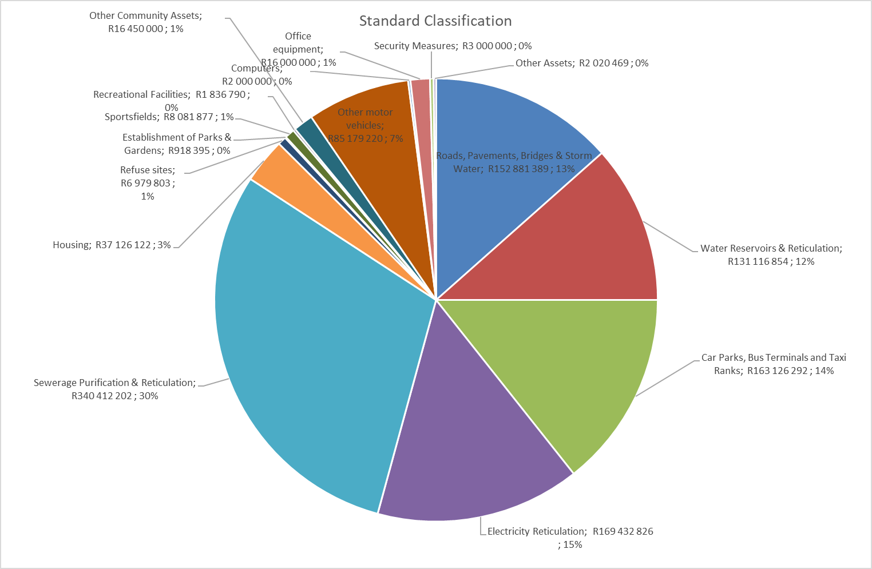
Capex per asset class

Slide 53
Summary of capital budget per Asset Class

Slide 54
Section 5: Progress with implementation of mSCOA

Slide 55

MSCOA enabling alignment of planning, budgeting and reporting
The Metro has embraced and adopted the new performance reforms at all levels, as articulated in the MFMA Circular No 88.
Mangaung Metro’s budgeting and reporting systems are MSCOA compliant

Slide 56
THANK
YOU
?

