Slide 1
Report on unemployed graduates and internships undergoing Public Service orientation A presentation to the Portfolio Committee: Public Service & Administration and Planning, Monitoring & Evaluation
Mr Busani Ngcaweni
Principal

Slide 2
Purpose
The overall purpose of this presentation is to provide a briefing on unemployed graduates and internships undergoing Public Service orientation offered by the National School of Government (NSG)

Slide 3
Purpose
The presentation will cover:
The Breaking Barriers to Entry into the Public Service (BB2E) programme
Lessons from a comprehensive evaluation of the BB2E programme
Induction and Orientation to the Formal Graduate Recruitment Scheme
Plan to transition from the 5 Day BB2E to the 18 Months Cadet Programme

Slide 4
Content
Background to youth training and development programmes
BB2E Curriculum and its alignment to NSG courses
Partnerships
Training Statistics
Evaluation of the BB2E programme
Orientation to the Graduate Recruitment Scheme
Youth/Cadet Orientation and Training Programme
Proposed future plan
Conclusion

Slide 5
Background
In the Budget Vote Speech of 2009/10, the Minister for Public Service and Administration (MPSA) announced a programme “… meant to enhance the employment potential of (unemployed) graduates”
The main intentions of this programme are to break the twin barriers to entry into the Public Service: lack of appropriate skills for employment in the Public Service; and lack of/inadequate work experience
In 2009, the MPSA approved an Internship Directive that created a policy environment for implementation of the programme to break the identified barriers to entry into the Public Service (BB2E)
Prior to 2009, the National Youth Development Agency (NYDA) was established and the Act, Act No. 54 of 2008 was passed and enabled the NSG to source unemployed graduates from the NYDA’s well-established database
The programme was piloted in 2009 and approved on 2 October 2010

Slide 6
Background
These regulatory environment enabled the NSG to collaborate with the following structures in the design, development and delivery of BB2E:
National Youth Development Agency
Department of Public Service & Administration
Inter-departmental committee on youth affairs
The Presidency
Sectoral and Provincial training academies
National interventions (NARYSEC)

Slide 7
BB2E Curriculum and its alignment to NSG courses
The BB2E programme was designed in a manner to develop 15 feeder competencies for salary-levels 6-10 (the area which had the most vacancies in the Public Service)
Its design integrated 23 NSG courses into a single 5-day programme – an aspect that did not necessitate request for copyright approval of course content
The NSG used M&E feedback to review the materials, and the results of the piloted materials were used to revise the Programme. The Units of the BB2E Programme are as follows:
Unit 1: The Constitution, Public Service and Administration (Day 1)
Unit 2: How Government is Organised and Functions (Day 1)
Unit 3: Attributes of a ‘Public Service Cadre’ (Day 2)
Unit 4: Delivering Public Service and Administering and Managing Public Funds (Day 3)
Unit 5: Administration and Communication Skills in Public Service (Day 4)
Unit 6: Human Resource Processes for Public Service (Day 4 and 5)

Slide 8
Course Map of BB2E
Unit 1: The Constitution, Public Service and Administration
1.1 Demonstrating an understanding of the Constitution of South Africa.
1.2 Explain the concepts of Government, Public Administration and Public Service.
1.3 Demonstrate understanding of the role of the Public Administration in achieving the goals of National Development Plan.
Unit 2: How Government is Organised and Functions
2.1 Explain the system, structures and spheres of Government.
2.2 Understand the policy roles and responsibilities of Government in all its spheres and branches.
2.3 Explain how the work of Government is organised and coordinated

Slide 9
Course Map of BB2E
Unit 3: Attributes of a Public Service Cadre
3.1 Explain the attributes of a Public Service cadre.
3.2 Understand how the attributes of a Public Service cadre relate to the Batho Pele principles.
3.3 Apply a code of conduct for the Public Service.
Unit 4: Delivering Public Service and Administering and Managing Public Funds
4.1 Identify the Primary Sites of Service Delivery.
4.2 Describe strategies by Government to ensure Quality Service Delivery.
4.3 Describe how Government facilitates participation by citizens to ensure Quality Service Delivery.

Slide 10
Course Map of BB2E
Unit 5: Administration and Communications skills in the Public Service
5.1 Understand the concepts of public office systems.
5.2 Know basic skills for administrative writing in Public Service.
5.3 Demonstrate knowledge of courteous and effective telephone skills.
5.4 Apply basic record keeping skills.
Unit 6: Human Resource Processes for Public Service
6.1 Demonstrate knowledge of recruitment, selection and appointment in Public Service institutions.
6.2 Demonstrate knowledge of conditions of service, performance management and development in Public Service institutions.
6.3 Develop skills and techniques to apply for positions of employment in Public Service institutions.

Slide 11
Other key information BB2E
The programme was first presented with no cost implications. However, since the 2013 financial year the BB2E tariff was introduced at a rate of R770 per participant for 5 days.
The tariff of R770 has not changed since 2013. Because of the tariff unemployed graduates who are not in internships or do not have anyone paying for them, have very limited access to the programme
The NSG has invested in building facilitation capacity in various national and provincial departments – a total of 244 trainers across all 9 provinces are trained to facilitate the BB2E training.
Uptake of BB2E training in 2019/20 was lower than targeted primarily because of the extension of internships to 2 years. Most departments had already trained their interns the previous year.
As the presentation will show, we are rethinking and redesigning our youth orientation programme

Slide 12
Partnerships
Over the last 10 years, the NSG has worked with different partners and institutions to deliver the programme and we have reported on these on many occasions during our presentations to the Portcom. These include:
NYDA: Was involved in the initial stages of the programme including through providing the NSG with data of unemployed graduates as well as support for the initial pilot. In some cases partnership has not been directly with NYDA but the NYDA supported training provided by the NSG. For example Orientation of 300 Young Patriots from the Department of Sports, Arts and Culture was done through support of the NYDA in 2017.
We worked with Departments of Defence (DoD) and Rural Development and Land Reform (DRDLR) in2013/14 for rollout of BB2E as part of the NARYSEC Programme
In 2018, the European Union (EU) supported sessions in KZN, Bloemfontein, Limpopo, Eastern Cape & Gauteng. Departments paid the R770 per participants and the EU funded venues, catering & trainers. This partnership is continuing. Much of the BB2E training conducted in 2019/20 was supported by the EU.
We are in discussions with MISA and LGSETA for possible development of a Graduate Recruitment Training programme which will also support the professionalization of young engineers and other graduates.
We continue to work with all other departments at national and provincial departments that continue to enrol their interns in our programme.

Slide 13
Number of Youth Oriented through BB2E
Note: These numbers are in the main comprise of Interns in the public service whose departments are able to or willing to enrol them on the programme

Slide 14
BB2E Orientations by Province (2019/20)
Notes:
The important aspect of these numbers is to note that the NSG paid for unemployed youth to attend the BB2E training.
Departments were invited to TOT sessions and sent some of their interns. When the interns returned to their work place – the return on investment was immense, and the BB2E sessions picked over a very short time
The deterrent to departments was the issue that the training cost R770 per learner, but over time they (the departments) believed that it was a worthwhile investment.
The NSG has learnt that the greatest value to the learner and the department comes when the youth are trained very early following their appointment, and the knowledge is imbedded and they proceed during their internship.
Unemployed youth have used the lessons in the BB2E programme in two different ways. Some use it to advance applications to the public service with greater confidence and knowledge, and anecdotal evidence show that there is strong fit between employee and department.
Other learners have no intention of joining the public service, but rather wish to continue into the private sector or into small, micro enterprises (such as catering, supplies etc). These learners use the information to better understand tender process, the financial frameworks and what challenges they may experience when working for government

Slide 15
Evaluation of the BB2E
In 2019, the NSG undertook a comprehensive evaluation of the BB2E with the support from the EU
The evaluation was aimed at finding out if BB2E had managed to achieve its main purpose which was:
To prepare unemployed graduates to access employment opportunities in the public service by increasing their knowledge of the public service and how it works as well provide some basic skills in reading, writing, completing application forms, preparing and participating in a job interview.
The research was underpinned by the following– Relevance, Effectiveness, Efficiency, Impact/Results and Sustainability

Slide 16
Evaluation of the BB2E
The evaluation found that:
BB2E was relevant and fit as an Induction/orientation course for public sector interns. However it did not contribute substantially to breaking barriers to employment in the public sector or elsewhere.
BB2E was effective as a basic Induction course. Participants gained both knowledge and skills as intended. Hence it was highly approved among users.
The cost recovery model and associated procurement processes caused substantial delays in BB2E delivery. Departments viewed the course as expensive given they had to carry costs for logistics associated with organizing training including catering, transportation, accommodation etc.

Slide 17
Evaluation of the BB2E
BB2E achieved high scores for knowledge and skills but relatively low for impact on the employability status or income of past participants.
In short to medium term the need for a sustainable Induction course such as BB2E remains, including for programmes such as the Graduate Recruitment Scheme.
The report has made some recommendations. We are using these recommendations together with other feedback received from other authorities including the Portfolio Committee and the Ministry for Public Service and Administration to reposition and expand the work that the NSG is doing in youth training and development

Slide 18
Orientation to the Graduate Recruitment Scheme
In 2019, the NSG received an allocation of R10m to rollout what have been identified as Mandatory programmes.
One of the programmes is the Orientation and Support to the Graduate Recruitment Scheme. A target of 700 was set for young people to be trained in 2019/20.
In March 2020 the NSG trained 363 unemployed graduates (not in internships) in the North West as a pilot for the new programme. Sessions for the remaining number were postponed due to Covid 19, and the declaration of the National State of Disaster by the President. The target could otherwise have been achieved.
A database with contact details of the participants was developed and kept with an intention to monitor and track their progress. The orientation was not only about the public service put also about basics of entrepreneurship.

Slide 19
The Youth/Cadet Orientation and Training Programme
Whereas BB2E was offered over 5 days through face to face contact sessions, the NSG is finalising a new programme which will be offered to the new cohort of unemployed graduates recruited to participate in various programmes of government including Cadet, Graduate Schemes and Internships.
The programme is designed to be offered over 18 months in line with extension of internship to 2 years. Enrolment into the programme will be per module so that participants may be able to exit as and when their circumstances change. The programme is captured below.

Slide 20
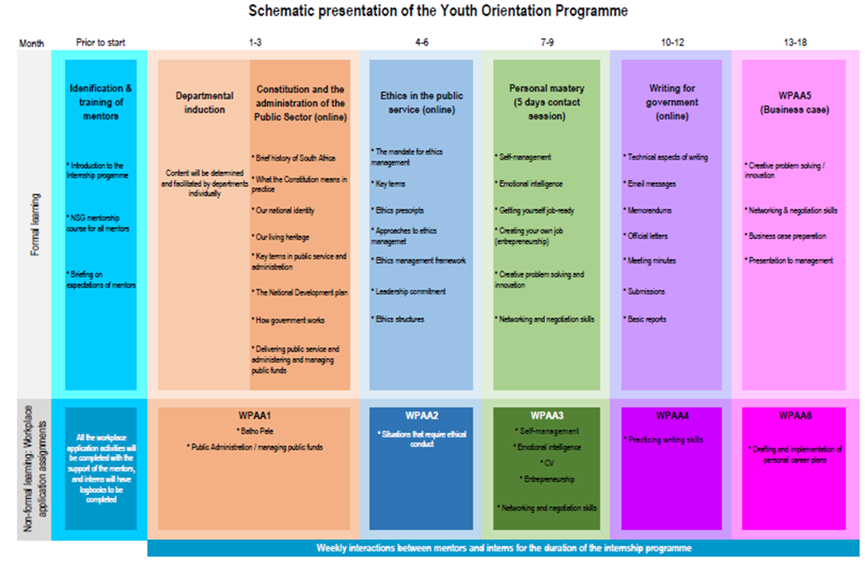
The 18 Month Youth/Cadet Orientation and Training Programme

Slide 21
Challenges in BB2E rollout and Youth Training
Since inception, BB2E and youth training in general were in the true sense, an add on to the work of the Induction Unit at the NSG. The department has never had focused capacity to deal with the issue of youth.
This could be because the mandate of the NSG is in the main – training of public servants. The mandate and authority of the NSG has not been clear when it comes to youth. The NSG is just another training institute that competes with all others.
Recruitment and orientation of interns is a decentralized function that takes place at departmental level. Although DPSA’s Determinations on Internship prescribed the need for Interns to be trained, over the years nothing has forced departments to take up orientation offered by the NSG.

Slide 22
Challenges in BB2E rollout and Youth Training
BB2E or Orientation into the public service, is not a requirement for unemployment graduates to access any job opportunity in the public service. It is for the same reason that the, NSG has also struggled to mobilise partners to fund training of unemployed graduates through the programme.
For the year 2019/20, the target for BB2E was 3000. The NSG trained 2433. It would appear that the numbers were impacted by the extension of the internships to 2 years. Departments that recruited and oriented the previous year (2018/19), did not have to do so the following year(2019/20).
The 18 month programme will also deal with this challenge as well.

Slide 23
Our vision for Youth Training and Development
A more coordinated and streamlined way of recruiting, orientating and placing graduates into the public service. Currently youth training and development is too decentralized and fragmented. Too many programme exist.
All along the NSG never had a unit focused on youth training. Our new structure provides for a Chief Directorate which will deal with Cadet and Foundational Training. Among others this CD will work closely with relevant youth organisations and in particular the DPSA and departments to strengthen the work being done in Graduate Recruitment Scheme to ensure a well coordinated recruitment of graduates, their orientation and placement in entry level positions in government.
As the DPSA oversees the implementations of various graduate recruitment programmes, the mandate of the NSG must be expanded to ensure that such graduates are adequately oriented and that all training that they are exposed to, either through the NSG or other institutions is reported on. A directive might be necessary for this.

Slide 24
Our vision for Youth Training and Development
To position ourselves properly in this area of youth training and development and expand our work going forward – we are in the process of finalizing (with support from EU) a desktop analysis of all work being done by various other stakeholders with unemployed graduates.
Our view is also that recruitment, orientation and placement of unemployed graduates in national departments in particular would be much easier to account for it , if it was centralized and fully accounted for either through the NSG or DPSA. This might be made possible through amendment in some aspects of the legislation.
The model below will apply.

Slide 25
Our vision - The Model
Graduate is recruited into the funded posts at entry level
Graduate acquires a qualification in Public Administration and other relevant fields from other institutions'
Graduate completes a week long Induction/Orientation to the public service (Currently BB2E).
Graduate is registered in the Centralised Database of Public Sector Graduate Recruitment Scheme managed by the NSG
Graduate is placed in Cadet/internship of FGRS in a Public Sector Entity - based on needs, a relevant qualification and province where possible and necessary and is enrolled in the 18 months programme
Further Training through other relevant courses

Slide 26
Conclusion
Addressing the challenges of unemployment, inequality and poverty remain key for government. The NSG has a critical role to play in the developmental agenda in terms of building a capable developmental state
The NSG has also prioritised youth employment opportunities, our mission is to strengthen and expand our work to support all government initiatives related to unemployed graduates
It is thus recommended that the Portfolio Committee notes the work of the NSG in rolling out the various programmes, despite some of the challenges as articulated in the previous slides.
The support of the Portfolio Committee will also be welcomed in areas such as additional resources, provision of necessary directives and in the oversight of government departments who may not be working with the NSG in providing youth training and development opportunities.

Slide 27
Thank you

