Slide 1
Briefing on 2020 Appropriation Bill
Select Committee on Appropriations
10 June 2020

Slide 2
Outline
Introduction
Background to the development of the 2020 Appropriations
Changes to the economic outlook since the tabling of the 2020 Budget
Impact of Covid-19 on the Economy and the Budget
Overview of public expenditure
Structure of the 2020 Appropriations
Unforeseen and unavoidable expenditure
Disaster relief funds and programmes available to respond to the Covid-19 pandemic
Authorisation required for reprioritisation, changes to conditions and outputs
Preliminary provisions and possibilities for reprioritisation within the 2020/21 allocations
Conclusion

Slide 3
Introduction
Parliament must pass, with or without amendments, or reject the Appropriation Bill within four months after the start of the financial year to which it relates.
The PBO was established to support the Finance and Appropriations Committees in both Houses of Parliament with the implementation of the Money Bills and Related Matters Act of 2009, including the Appropriations Bill, which amongst others provides for the:
Appropriation of money from the National Revenue Fund for the requirements of the State in the 2020/21 financial year to the main divisions within a vote for the purposes that are specified per programme
The spending of funds withdrawn from the National Revenue Fund before this Act takes effect

Slide 4
Background to the development of the 2020 Appropriations Bill
The 2020 Budget proposed a significant reduction in growth of expenditure to reduce the budget deficit and level of debt
Lower debt requires targeted spending cuts of specific programmes
Steps proposed in the 2020 budget included:
Reduction of the public wage bill
Reform of state-owned companies and the Road Accident Fund
Across-the-board cuts that affect core government programmes
These steps will moderate spending as a share of GDP and adjust the composition of expenditure, but will not reduce the debt level
Further expenditure cuts could severely harm service delivery
Critical factors include:
Efficiency and effectiveness, together with monitoring and evaluation
Discussions on increased taxes in the current economic environment

Slide 5
Changes to the economic outlook since the tabling of the 2020 Budget
SA was already on a slow growth path, with rising socio-economic demands, record-high unemployment, and concerns over sustainability of national debt
Covid-19 and policy responses to reduce and contain spread (lock-down, travel restrictions) will push the world and SA economy into a deep and prolonged recession
Forecasts during a recession are especially uncertain and varied
SA will (almost) certainly experience a recession, with large losses to income and employment

Slide 6
Broad impact of Covid-19 on the South African Economy
Channels by which the national lockdown and efforts to contain the spread of Covid-19 impact on economic activity:
A forced reduction in production and other restrictions on non-essential business operations;
A large, but indeterminate reduction in household demands for goods, especially, services (travel and movement restrictions affect tourist and related activities);
The disruption in global production and supply chains which could greatly affect South African exports;
The effect of uncertainty on business investment; and
As businesses open, employers and workers fear growing infections and further disruptions.

Slide 7
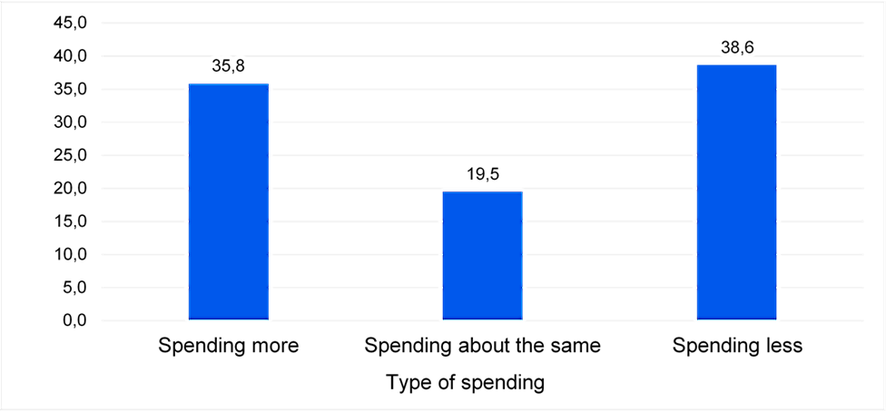
Impact of Covid-19 on South African Households
* The national lockdown in the graphs refers to its first 6 weeks, beginning on the 26th of March 2020- to the 6th of May 2020.
Figure 1: Percentage change in income source for respondents, before and during the national lockdown*.
Figure 2: Weekly spending behaviour of respondents during the national lockdown*, as a percentage.
Source: StatsSA, “Results from Wave 2 survey on the impact of the COVID-19 pandemic on employment and income in South Africa”, 2020.
Notes:
Household financial wellness is closely connected to economic growth. Aggregate shocks to economic activity can affect welfare (and well-being) at the household and individual level through labour income and consumption.
Labour income is impacted through a decline in quantity of work, or through a reduction in hours of employment. For the self-employed income is reduced via a reduction in economic activity (as a result of a fall in demand and disruptions in supply of inputs), or due to mobility restrictions.
Changes in prices and shortages of basic consumption goods and essentials due to disruptions in the functioning of markets, ( including a decline in trade through import or export restrictions), have negatively affected how much households consume.
Statistics South Africa (Stats SA) embarked on a series of online surveys to measure the impact of the COVID-19 pandemic on individuals in the country. StatsSA’s second online survey focused on employment, income and hunger-related issues that affected individuals.
In figure 1, it is key to note that the percentage of respondents who reported no income increased from 5,2% before the lockdown to 15,4% by the sixth week of the national lockdown. The majority of respondents reported salaries/wages as their primary source of income before and during the national lockdown. However, the percentage of respondents who received an income from salaries/wages decreased from 76,6% before the national lockdown to 66,7% by the sixth week of the national lockdown. This decrease in income from salaries/wages seems to have been offset by increases in the percentage of individuals reporting income from savings and investments (increasing from 4,8% prior to the lockdown to 6,0% during the lockdown), from UIF (increasing from 0,3% to 2,1%), and from taking loans from friends, family and/or businesses (increasing from 1,7% to 3,3%).
In figure 2, approximately 19,5% of respondents said that their spending was about the same before and after the lockdown. However, almost forty percent of respondents (38,6%) reported that they were spending less per week during the lockdown compared to before the national lockdown, while above one-third (35,8%) indicated that they were spending more per week.

Slide 8
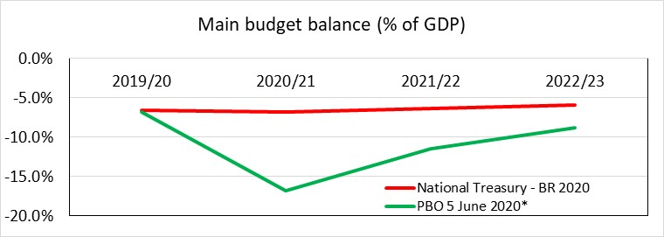
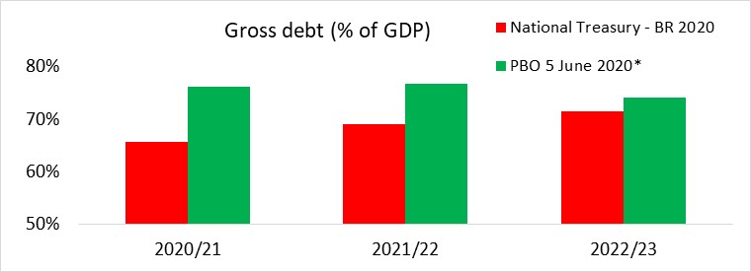
Implications for Budget and 2020 MTEF
*PBO scenario based on median outlook of forecasts
Data for April shows a 9.1% fall in gross revenue collected compared with the previous year (CIT: -66.6% PIT: -4.9% VAT: -1.6%)
This trend is likely to worsen over the rest of the year
Revisions to budget are necessary to take account of the changed outlook, and finance measures to respond to the crisis, and stimulate economy

Slide 9
Overview of public expenditure during the period of fiscal consolidation
Real government expenditure per capita has been slow during the fiscal consolidation era
It was lower in each of the years 2016/17, 2018/19 and 2019/20 than it was in 2015/16
There was a significant reduction in real per capita expenditure on housing and community amenities
Real per capita expenditure on Health and Education was very slow
Social Protection expenditure was flat until there were slightly bigger increases in 2019/20
Most of the increase in expenditure from 2019/20 to 2020/21 was to assist Eskom

Slide 13
Departments Expenditure outcomes between 2017/18 and 2019/20
Average expenditure on current expenditure amounts to 92% over the three year period. Departments with below 85% expenditure on current expenditure are:
Communication
Cooperative Governance and Traditional Affairs
National Treasury
Average expenditure on capital assets amounts to 69% over the three-year period. Departments with below 65% expenditure on capital assets are:
International Relations and Cooperation
National Treasury
Higher Education and Training
Social Development
Economic Development
Energy
Telecommunications and Postal Services
Arts and Culture
Notes:
Across-the-board cuts that affect core government programmes
Three year expenditure outcomes (2017/18-2019/20) show slow budget spending by various government departments;
On average Departments had spent 92% of their current expenditure over the three year period.
The following departments spent 85% or less on current expenditure:
Communication
Cooperative Governance and Traditional Affairs
National Treasury
Departments had on average spent 69% of their capital assets expenditure over the three-year period,
The following departments spent 65% or less on their capital assets expenditure;
International Relations and Cooperation
National Treasury
Higher Education and Training
Social Development
Economic Development
Energy
Telecommunications and Postal Services
Arts and Culture

Slide 14
Adjustments to main budget non-interest expenditure since 2019 Budget
Notes:
Some of these cuts were informed by the slow budget spending by various government departments;
R 7 499:
Post-retirement medical assistance
Common Monetary Area Compensation Municipal Revenue Management Improvement Programme
Township Entrepreneurship Fund Universal Service and Access Fund: New model for broadcasting digital migration
Innovation Fund South African Revenue Service: Infrastructure-related projects Provincial conditional grants
Other allocations¹
Table 5.2 BR

Slide 15
2020 Appropriations per vote compared with preliminary outcome for 2019/20
Notes:
R14 670.7 millon over spending by social development
R 2 662.8 million over spending
Compensation growth 2% from 2019/20 to 2020/21
Goods and Services growth 5.3%
Non-profit institutions growth: 10.6%
Payment for capital assets: 11.3%

Slide 16
Estimated proportions allocated per economic classification
Notes:
The biggest proportion of the budget is still in terms of Transfers and subsidies to other spheres of government or institutions that provide services on behalf of government.
% spend on COE changes from 10.9% to 37.9% after deducting transfers and subsidies

Slide 17
Examples of how the appropriations are structured
Public Works and Infrastructure
R8 billion
Transfers 87%
Property Management Entity
62% (R4.4 billon)
EPWP
34% (R2.4 billion)
Current 13%
COE 55% (R594 million)
G&S 43% (R460 million)
Cooperative Governance
R96 billion
Transfers 94.8%
Current 5.1%
COE 8% (R395 million)
LGES 81.8%
Conditional Grants
G&S 92% of which CWP (R3.6 billion)
Notes:
PW: COE changes to almost 50 per cent after transfers have been deducted
CG: COE changes to almost 50 per cent after transfers have been deducted

Slide 18
Examples of how the appropriations are structured (contd.)
Agriculture, Land Reform and Rural Development R16.8 billion
Transfers 50% (R8.4 billion)
Conditional Grants
25.6% (R2.2 billon)
Other
74.4% (R6.3 billion)
Current 47.8% (R8 billion)
COE 55% (R4.4 billion)
G&S 45% (R3.6 billion)
Ilima/Letsema projects grant 6.5%
Land and Agricultural Development Bank 4.8%
Land reform grants: Land redistribution payments 6%
Restitution grants 31.9% (2.7 billion)
Land care programme grant 1%
Comprehensive agricultural support programme 18.1%
Agricultural Research Council 15.1%
Agricultural land holding account 10.6%
Notes:
% spend on COE changes from 10.9% to 37.9% after deducting transfers and subsidies

Slide 19
The unforeseen and unavoidable: Covid-19
The coronavirus not only exposes long-standing deep underlying problems such as inequality, failure to deliver key services and a failing health system.
It requires:
Government to act immediately with funds provided for disasters
Reprioritise plans and budgets tabled to provide:
Fiscal support
Preventative measures
Policing
New programmes with new objectives
Recovery plans for fiscal sustainability and economic growth

Slide 20
Disaster Relief Funds of R982 million in the 2020/21 Budget for immediate response
R138 million: Provincial Disaster Relief Grant: To provide for the immediate release of funds for disaster response
R295 million: Provincial Emergency Housing Grant: Provides funding to provinces for the provision of temporary shelter assistance to households affected by disasters or a housing emergency
R354 million: Municipal Disaster Relief Grant: To provide for the immediate release of funds for disaster response
R195 million: Municipal Emergency Housing Grant: Provides funding to municipalities for the provision of temporary shelter assistance to households affected by disasters or a housing emergency

Slide 21
Programmes available in the 2020/21 Budget to respond to disasters
Cooperative Governance: National Disaster Management Centre
Health: Communicable and Non- Communicable Diseases
Social Development:
Social Assistance
Welfare Services Policy and Implementation Support
Defence: Military Health Support
Police: Visible Policing
Housing: Informal Settlements (temporary housing)
Science and Innovation: Technology Innovation (health research)
Trade, Industry and Competition: Industrial Financing
Water and Sanitation: Water Infrastructure Development

Slide 22
Outputs of Conditional Grants require amendments
NT suggests changes to grant frameworks to accommodate spending on additional needs of Covid-19(for example the purchasing of personal protective equipment):
School Infrastructure Backlogs Grant
The trucking of water to fill tanks
Conditions must allow for the submission of an amended business plan
Education Infrastructure Grant
Allow the grant to fund the costs to connect to local water supplies or drill and equip boreholes
Allow the grant to be used to truck water to schools for a limited period of time, subject to approval by the Department of Basic Education

Slide 23
Outputs of Conditional Grants require amendments (contd.)
National School Nutrition Programme Grant
Add a condition that personal protective equipment (PPE) and sanitation equipment may be funded from the grant
Add a condition that if schools are closed due to a declared state of disaster, funds from the grant that would have been spent on providing meals in schools may instead be used to provide meals to learners through alternative means
Maths, Science and Technology Grant
Add conditions to allow funds to be used to support catch up activities.
Add provision for provinces to be exempted from percentage spending restrictions prescribed for existing business plans.

Slide 24
Outputs of Conditional Grants require amendments (contd.)
Learners with Profound Intellectual Disabilities Grant
Add a condition to allow purchase of PPE and sanitizer.
HIV, Aids Life Skills Grant
Add conditions to allow funds to be used to support catch up activities and to provide education on measures to respond to the pandemic.
Community Library Services Grant
Add a condition to allow purchase of PPE and sanitizer from the grant and to pay for the deep cleaning of libraries.
Early Childhood Development Grant
Add a condition that allows the maintenance component of the grant to be used to install additional hand washing facilities and to provide PPE for ECD practitioners.

Slide 25
Outputs of Conditional Grants require amendments (contd.)
Public Transport Operations Grant
Add outputs for the number of vehicles and public transport facilities sanitized and personal protective equipment provided for drivers and other employees
Add a condition that provinces may use funds form this grant to pay for the sanitizing of busses and public transport facilities and the provision of personal protective equipment for staff of the bus operators and provision for hand washing and sanitisation for passengers
HIV, TB, Malaria, Community Outreach Grant
Create a new COVID-19 component. The Department of Health has reallocated R452 million to this component.
In the Community Outreach component, add outputs for number of people screened for COVID-19 and number of COVID-19 contacts traced

Slide 26
Preliminary provisions to address Covid-19 pandemic pressures
R500 billion fiscal support package combines revenue and spending measures, as well as loan guarantees:
R200 billion: Credit Guarantee scheme
R100 billion: Job creation and support for SME and informal businesses (R95 billion borrowing from multilateral finance institutions)
R70 billion: Measures for income support (Tax deferrals, SDL holiday and ETI extension)
R130 billion reprioritisation:
R50 billion support to vulnerable households for 6 month
R40 billion wage protection (UIF)
R20 billion to health and other frontline services
R20 billion to municipalities
R15 billion in Social Development 2020/21 budget (social grant payments for April paid in March)
Notes:
Unemployment Insurance Fund
The UIF pays benefits to those who are out of work due to retrenchment, illness or maternity leave. Benefit payments are expected to grow from R11 billion in 2018/19 to R22 billion in 2022/23. Over this period, the fund will run an average surplus of R3.6 billion on an accrual basis and a cash deficit. The latter is the result of retrospective payments to claimants who were assessed and paid at a rate based on the old legislation, when they were meant to be paid based on higher rates in the amended act. The additional benefits are expected to cost R12.7 billion. The fund plans to finalise these claims by 2020/21. The UIF’s net asset value is set to increase from R144.3 billion in 2018/19 to R175 billion in 2022/23.

Slide 27
Authorisation of expenditure before the introduction of an Adjustments Appropriation Bill
(1)The Minister may approve expenditure, if it cannot be delayed for:
(a) Unforeseeable and unavoidable
(b) Announced during the tabling of the 2020/21 national annual budget
(c) Was approved in the appropriation for the 2019/20 financial year and shall be proposed to be rolled over to the 2020/21 financial year in order to finalise expenditure that could not take place in the 2019/20 financial year as originally planned.
The amount of expenditure approved in terms of subsection (1)
May not exceed the total amount for contingencies for the financial year
Any expenditure approved in terms of subsection (1)(b) may not exceed the amount announced by the Minister for a specific item during the tabling of the national annual budget
Expenditure approved in terms of subsection (1)
Is a direct charge against the National Revenue Fund
May be made subject to conditions imposed by the Minister
Must be disclosed in the National Treasury’s next quarterly report to the relevant Parliamentary Committees
Must be included in the Adjustments Appropriation Bill for the 2020/21 financial year

Slide 28
Responding to the COVID-19 pandemic in the 2019/20 municipal financial year
National Treasury has granted approvals that funds transferred to municipalities can be reallocated to be used to respond to the COVID-19 pandemic.
R2.4 billion in Urban Settlements Development Grant: To provide water and sanitation, mainly in under-serviced informal settlements and to cover the increased costs of more frequent waste management and other services.
R1.5 billion in Municipal Infrastructure Grant allocations can be reallocated: To provide for water and sanitation, including where urgent maintenance is needed to restore the functionality of water infrastructure.
R970 million in Public Transport Network Grant allocations may be reallocated, mainly for sanitisation of public transport facilities.

Slide 29
Responding to the COVID-19 pandemic in the 2019/20 municipal financial year (contd.)
R306 million in the indirect Regional Bulk Infrastructure Grant was reallocated at the end of the 2019/20 national financial year and transferred to Rand Water to fund the roll-out of water tanks to supply communities without reliable access to water services.
R151 million from the Municipal Disaster Relief Grant to support non-metropolitan municipalities with the costs of sanitisation, and increased provision of other municipal services. Government is also supporting municipalities to reallocate funds from other conditional grants that are projected to be underspent.
Details of further support to municipalities in the 2020/21 municipal financial year will be announced when the Minister of Finance tables the special adjustment budget to respond to the COVID-19 pandemic that was announced by the President.
Notes:
To put the 2020/21 financial year perspective

Slide 30
Expenditure by National Vote, April 2020
Notes:
Home Affairs: capital budget of R13 011 thousand budget, spent R75 903 thousand in Administration Budget: 0.14 % of total budget of R9 029 million
Transfer: 26%/R2 389 million of total budget of R9 029 million, spent R460 million in April 2020 mainly for electoral commission: operations
Public Works: Transfer to Property management trading entity, EPWP and various institutions for work opportunities
Traditional Affairs: transfer to Commission for the promotion and protection of the rights of cultural, religious and linguistic communities: operation
Independent police investigation directorate: capital in administration and investigation and information management: 1.5% of total budget, R5.5 million of R356 million total budget R2.856 million spent in April 2020
Employment and Labour: transfers38% of total budget. Transfers to departmental agencies, mainly CCMA
Tourism: capital: 0.15 % of total spent in Administration: Budget R3.8 million of RR2 481 million budget and spent R1.072 million in April

Slide 31
An example of a Goods and Services budget

Slide 32
Adjustments
Notes:
When comparing the 2019 adjustments with the provisions in the 2020 budget the following are provisions to be appropriated/reprioritised in the 2020 adjustments budget:
Provisional allocation for Eskom restructuring R23 000 million
Provision for South African Airways: R6 502 million
Provision for disaster recovery efforts: R500 million
Other: R19 million (a.o. demarcation board)
Provisional allocations not assigned to votes: R-7.8 billion
Compensation of employees adjustment R-37 806.7 million
Infrastructure fund not assigned: nothing in 2020/21
Contingency: R5 billion

Slide 33
Conclusion
The 2020 Budget proposes expenditure reductions based on economic and fiscal pressures on government
The Covid-19 pandemic has put additional pressures on government not only to respond to the needs of the crisis, but also to ensure economic and fiscal sustainability
Although current programmes and conditional funding to other spheres of government are available for immediate response, reprioritisation, additional funding and criteria for spending are required
Legislation provides for the implementation of such measures as well as for the regular reporting and monitoring through the oversight processes

Slide 34
Thank You

Slide 35
Economic impact of Covid-19
Many developing countries’ economic growth rates had already slowed by the final quarter of 2019 and several had entered into technical recessions.
Conditions have deteriorated since then and the full effects of the Covid-19 pandemic have yet to be felt.
Notable transmission mechanisms for the impact of Covid-19 developing economies are:
Businesses operations are constrained and lower demand
Reduced volumes of international trade and lower global demand
Financial pressures as a result of foreign capital outflows and domestic constraints related to efforts to deal with Covid-19’s health and economic impacts
There is a huge impact on labour markets as millions of workers, particularly those with precarious employment, face job losses
As countries open, employers and workers fear growing infections and further disruptions
Notes:
WITH RESPECT TO INTERNATIONAL TRADE: Even after considering implementation of the effective $1.4 trillion stimulus by advanced economies and China, slow growth in these countries will take place throughout 2020. This will mean significantly lower demand for exports from developing economies, and developing countries lowering their own demand for imports. Other items on the current account, such as remittances, royalty payments and profit outflows are likely to add to the financing difficulties facing many developing countries over the course of the coming year.
WITH REGARDS TO THE FINANCE CHANNEL: The flight to safety has caused record capital outflows from emerging economies, triggering large currency depreciations against lead currencies and widening spreads. In countries with a high exposure to foreign debt, be it private or public, these trends put pressure on their debt sustainability, by reducing future access to refinancing, all the while driving up their value in foreign currency.
IMPACT OF COVID-19 ON THE WORLD OF WORK: Following travel bans, border closures and quarantine measures, many workers cannot move to their places of work or carry out their jobs in the way that they used to. Given the current environment of uncertainty and fear, enterprises are likely to delay investments, purchases of goods and the hiring of workers.
Unprotected workers, including the self-employed, casual and gig workers, are likely to be disproportionately hit by the virus since they do not have access to paid or sick leave, and are less protected by social protection contracts and other forms of income protection.

Slide 39
Notes:
The PBO was established to support the Finance and Appropriations Committees in both Houses of Parliament with the implementation of the Money Bills and Related Matters Act
Our pre-budget presentation is one of our standard outputs to facilitate a discussion in preparing for the legislative stage of the budget cycle, which started off with:
Planning for the 2020 medium term expenditure framework (MTEF), which also marks the beginning of a new 5-year planning and budgeting cycle
A critical factor in the planning cycle is the alignment of resources with policy intent
It is also regarded as critical to enable the implementation of the NDP through departmental strategic and annual performance plans
The Medium Term Budget Policy Statement (approved in 2019) provided the funding priorities for the formulation of the 2020 budget
On Budget day the Minister of Finance will introduce the National Budget, the Division of Revenue Bill, Appropriation Bill and some revenue proposals which require:
Approval or recommendations for amendment
Members are then required to monitor and evaluate processes during the implementation stage

Slide 40
Notes:
The PBO was established to support the Finance and Appropriations Committees in both Houses of Parliament with the implementation of the Money Bills and Related Matters Act
Our pre-budget presentation is one of our standard outputs to facilitate a discussion in preparing for the legislative stage of the budget cycle, which started off with:
Planning for the 2020 medium term expenditure framework (MTEF), which also marks the beginning of a new 5-year planning and budgeting cycle
A critical factor in the planning cycle is the alignment of resources with policy intent
It is also regarded as critical to enable the implementation of the NDP through departmental strategic and annual performance plans
The Medium Term Budget Policy Statement (approved in 2019) provided the funding priorities for the formulation of the 2020 budget
On Budget day the Minister of Finance will introduce the National Budget, the Division of Revenue Bill, Appropriation Bill and some revenue proposals which require:
Approval or recommendations for amendment
Members are then required to monitor and evaluate processes during the implementation stage

