Slide 1
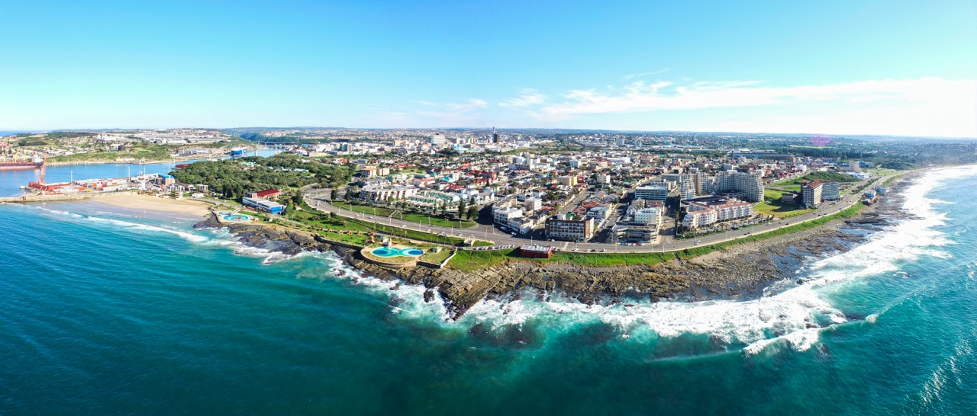
BUFFALO CITY METROPOLITAN MUNICIPALITY
COVID-19 RESPONSE PLAN

Slide 2
TABLE OF CONTENT
WORKSTREAM REPORTS
Health, Safety & Security A
Infrastructure Services & Public Works B
Municipal Services C
Economic & Social Development D
Logistics, Communication, Legal & Records E

Slide 3
WORKSTREAM REPORT
HEALTH, SAFETY AND SECURITY
ANNEXURE A

Slide 4
TABLE OF CONTENT
WORKSTREAMS REPORT
Law Enforcement, SAPS, Traffic and SANDF
District Health
Municipal Health Services
Disaster Management & Fire and Rescue

Slide 5
WORKSTREAM ON HEALTH, SAFETY & SECURITY:
Force Levels / Man power
Date | Traffic Off. | Law Enf. | SAPS | SANDF | Total
29/05/20 | 73 | 39 | 92 | 7 | 211
30/05/20 | 38 | 38 | 92 | 7 | 175
31/05/20 | 64 | 35 | 92 | 7 | 198
1/06/20 | 83 | 27 | 92 | 7 | 209
2/06/20 | 82 | 32 | 92 | 7 | 213
3/06/20 | 67 | 39 | 92 | 7 | 205
5/06/20 | 71 | 30 | 92 | 7 | 200
6/06/20 | 37 | 22 | 92 | 7 | 158

Slide 6
WORKSTREAM ON HEALTH, SAFETY & SECURITY:
SAPS: Arrests Executed for various offences from the 29/05/2020 to – /07/2020
Total Arrest Stats received from SAPS:
East London: 5
King Williams Town: 70
Mdantsane: 5

Slide 7
WORKSTREAM ON HEALTH, SAFETY & SECURITY:
SAPS Operational Focus area's
Beacon Bay
Buffalo Flats
Chalumna
Duncan Village
East London
Gonubie
Kidds Beach
Scenery Park
22 Vehicle Check Points were conducted between 29/05 – 4/06

Slide 8
WORKSTREAM ON HEALTH, SAFETY & SECURITY:
SAPS Action Stats from 29 May – 7 June 2020:
492 Vehicles Stop and Searches
822Persons Searched
34 Taxi Ranks Visited
41 Shopping Malls Visited
320 Business Premises Visited
407Spaza shops visited
98 ATM/Banks Visited

Slide 9
WORKSTREAM ON HEALTH, SAFETY & SECURITY:
SAPS Action Stats from 29 May – 7 June 2020:
45 Butcheries Visited
9 Mosques Visited
53 Schools Visited
253 Total Liquor outlets Visited
10 Post Offices Visited
17 Pay Points Visited
9 Covid 19 related arrests

Slide 10
WORKSTREAM ON HEALTH, SAFETY & SECURITY:
In addition to the above BCMM Traffic & Law Enforcement executions
Offence/Execution | Total executions 29/05 – 07/06
Vehicles Screened | 9631
Taxis Stopped & Inspected | 345
Liquor Outlets Inspected | 101
Shops Inspected | 10
Gatherings investigated | 5

Slide 11
WORKSTREAM ON HEALTH, SAFETY & SECURITY:
In addition to the above BCMM Traffic & Law Enforcement executions:
Hawkers removed from streets | 2
Various prosecutions | 1147
Vehicles impounded | 5
Illegal Electricity Connections | 2100
Speed Cases (Dcam) | 6229
Arrests Made | 1
Vehicle Suspended | 19
People Stopped And Searched | 19

Slide 12
WORKSTREAM ON HEALTH, SAFETY & SECURITY:
Case description of non-compliance (sporting, entertainment, cultural, religious, protest, marches, etc.): where the following non-Compliance was observed.
On the 29th of May, Law Enforcement officers and Disaster Management inspected a funeral that was taking place at 458 C- Section Duncan Village. All in attendance were in compliance and everything was in order.

Slide 13
WORKSTREAM ON HEALTH, SAFETY & SECURITY:
Illegal Electrical Disconnections
380 Illegal Electricity connections disconnected at Nompumelelo Township. (30/05/2020)
620 Illegal Electricity connections disconnected at Redshack. (31/05/2020)
350 illegal electricity connections disconnected at Santa. (31/05/2020)

Slide 14
WORKSTREAM ON HEALTH, SAFETY & SECURITY:
Illegal Electrical Disconnections cont..
350 illegal electricity connections disconnected at Proveg (MUVHENGO) near Egoli. (1/06/2020)
150 illegal connections disconnected at Woolwash road. (1/06/2020)
250 illegal electricity connections disconnected in Mzomonhle (3/06/2020)

Slide 15
WORKSTREAM ON HEALTH, SAFETY & SECURITY:
Land Invasions
Law Enforcement Services attended a land invasion complaint at Reeston behind Mabuye Bus transport. 3 fully built structures and 3 half built structures were found. The complaint was received from Land Administration Department who were then informed that a TLB would be required to demolish the shacks. (1/06/2020)

Slide 16
WORKSTREAM ON HEALTH, SAFETY & SECURITY:
Law Enforcement officers Arrested 1 Person for Contravening the Disaster Management Act 2002 in selling in Cigarettes (1/06/2020). The following items were confiscated:
R 286.00;
Snuff x 30;
20's packet Peter Stuyvesant
Sun Cigarette loose x 13;
Peter Stuyvesant loose x 8;

Slide 17
WORKSTREAM ON HEALTH, SAFETY & SECURITY:
Unrests
The community were burning tyres on the N2 and the entrance of Newlands from Mount Ruth due they had no electricity. Law Enforcement monitored the situation.(2/06/2020)
Law Enforcement officers warned 6 public members for drinking in public in the Greenfields area. Law Enforcement emptied 3 open units of beer owned by the above mentioned public members.

Slide 18
WORKSTREAM ON HEALTH, SAFETY & SECURITY:
Law Enforcement Services monitored social distancing at the various SASSA pay-out points and found that all was in order.

Slide 19
WORKSTREAM ON HEALTH, SAFETY & SECURITY:
Dates | No screened | No tested | No of confirmed cases | No of active cases | No of recoveries | No of deaths
01.06.2020 | 2444 | 146 | 1244 | 568 | 663 | 13
02.06.2020 | 1594 | 63 | 1294 | 618 | 663 | 13
03.06.2020 | 3426 | 31 | 1320 | 572 | 735 | 13
04.06.2020 | 4319 | 201 | 1412 | 664 | 735 | 13
05.06.2020 | 3966 | 74 | 1451 | 666 | 772 | 13
06.06.2020 | None | None | 1560 | 524 | 1023 | 13

Slide 20
WORKSTREAM ON HEALTH, SAFETY & SECURITY:
EPIDEMIC CURVE

Slide 21
WORKSTREAM ON HEALTH, SAFETY & SECURITY:
NARRATIVE
The figure here above is the Epidemic Curve of cases in the Buffalo City Metro from the 8th of April to the 02 June 2020. The curve shows a gradual step-wise increase in the number of cases. As of the 03 June 2020, the district reported to have 1 320 cumulative cases

Slide 22
WORKSTREAM ON HEALTH, SAFETY & SECURITY:
GEOGRAPHIC SPREAD OF THE CASES WITHIN BCM 02/06/2020

Slide 23
WORKSTREAM ON HEALTH, SAFETY & SECURITY:
Here below is the geographical distribution of cases in BCM.
The red dots are the current COVID-19 active cases and the green the recovered cases.
With the transition of the lockdown regulations from level 4 to level 3, there has been a gradual increase of cases especially in sub districts which were previously reporting a low number of cases per day, observed in the graph.
East London has been marked a hotspot, however, at the current projection, Bhisho/ King William’s Town is becoming an emerging hotspot, and Mdantsane would soon follow suite.

Slide 24
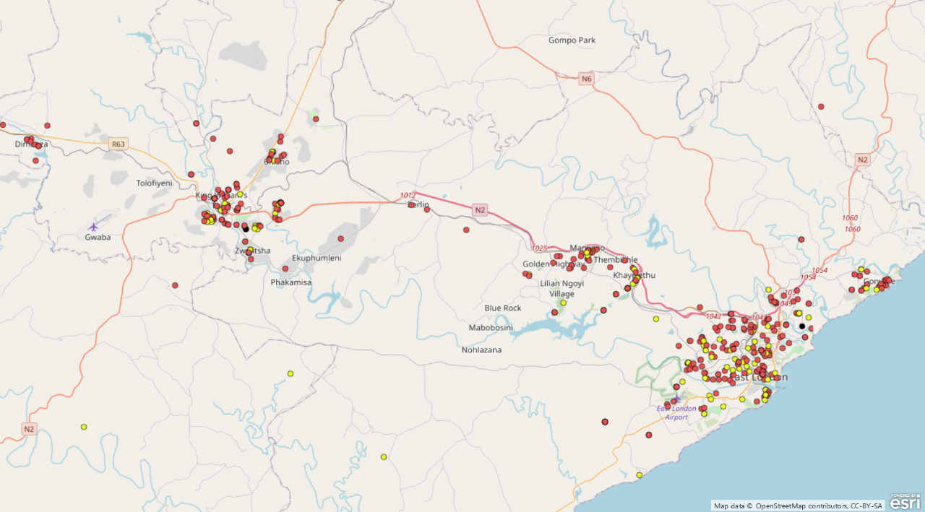
WORKSTREAM ON HEALTH, SAFETY & SECURITY:
GEO-SPATIAL DISTRIBUTION OF CASES WITHIN BCM

Slide 25
WORKSTREAM ON HEALTH, SAFETY & SECURITY:

Slide 26
WORKSTREAM ON HEALTH, SAFETY & SECURITY:
Age Analysis

Slide 27
WORKSTREAM ON HEALTH, SAFETY & SECURITY:
The graph here above illustrates the distribution of cases based on their age categories.
There is a general pattern across the Sub districts, where the category 30-39 years has the highest number of cases, followed by 40-49 years, 20-29 years and 50-59 years. Age categories 10-19 and 70+ years are the least affected .

Slide 28
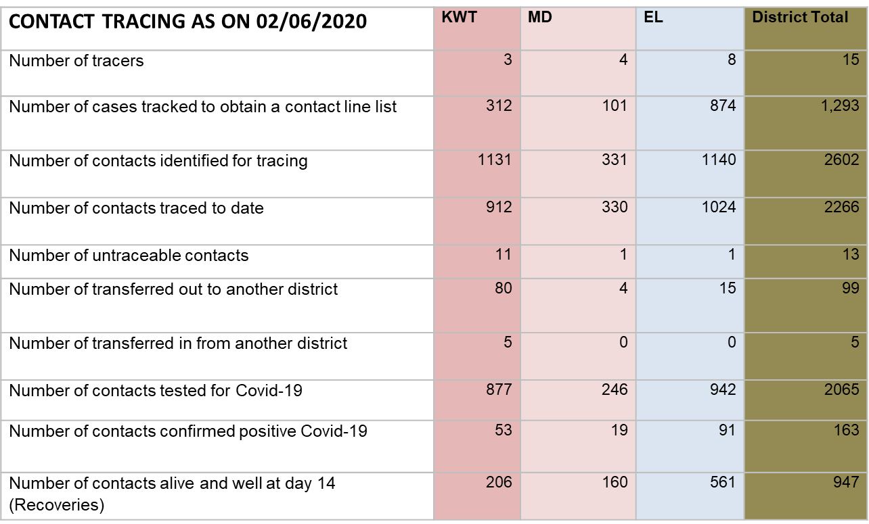
WORKSTREAM ON HEALTH, SAFETY & SECURITY:

Slide 29
WORKSTREAM ON HEALTH, SAFETY & SECURITY:
Mass screening and targeted testing continues.
Here below is a graph which depicts that as of 02/06/2020
As on 02/06/2020, the Mass screening and testing teams have screened approximately 98,322 individuals, and there are 24,298 identified contacts and 13, 510 patients tested.

Slide 30
WORKSTREAM ON HEALTH, SAFETY & SECURITY:
DAILY MASS SCREENING ACTIVITIES

Slide 31
WORKSTREAM ON HEALTH, SAFETY & SECURITY:
Screening and Testing

Slide 32
WORKSTREAM ON HEALTH, SAFETY & SECURITY:
ISOLATION AND QUARANTINE SITES
X 3 quarantine sites are actively admitting cases for quarantine
31 cases are in the 3 sites
13 discharged

Slide 33
WORKSTREAM ON HEALTH, SAFETY & SECURITY:
Inspections conducted
Supermarkets closed due to COVID-19 cases
Checkers Hemmingways (Closed until 8/06);
Shoprite Gilwell Mall (Closed until 8/06);
Super Spar Amalinda;
Derby-Lee Super Spar Greenfields

Slide 34
WORKSTREAM ON HEALTH, SAFETY & SECURITY:
Inspections conducted
Out of the 52 Liquor outlets visited on the 6th of June, 1 liquor outlet was found non compliant. Bonaco Pub and Pool Bar was operating and people were found locked inside, SAPS were called to deal with the issue.

Slide 35
WORKSTREAM ON HEALTH, SAFETY & SECURITY:
Inspections conducted
On the 6th of June, from 9am to 11am a roadblock was held at N2 Berlin area with KWT cluster & Mdantsane police. 270 motor vehicles stopped and searched during the roadblock.

Slide 36
WORKSTREAM ON HEALTH, SAFETY & SECURITY:
Inspections conducted
FOOD CONTROL
Steers Beachfront;
Debonairs Beachfront;
Fish Aways Beachfront;
Promenade Beachfront;
Windmill Roadhouse, Beachfront;
Windmill Pizza, Beachfront

Slide 37
WORKSTREAM ON HEALTH, SAFETY & SECURITY:
Inspections conducted cont..
FOOD CONTROL
Windmill Convenient Shop, Beachfront;
Café Neo, Beachfront;
Zebro’s Chicken, Ward 16;
Bongiwe Supermarket, Ward 48;
Tawaka Spaza Shop, Ward 17;
Summerpride Supermarket, Ward 16; and
Spar Abbotsford.

Slide 38
WORKSTREAM ON HEALTH, SAFETY & SECURITY:
Inspections conducted cont…
Food Premises
13 Food Premises were Inspected (R638 compliance) & Assessed (Covid-19 OHS Compliance) – Lockdown Regulations: Temperature checks, Hand Sanitizing at entrances, Social Distancing, Staff wearing Masks │R638 Requirements in place.

Slide 39
WORKSTREAM ON HEALTH, SAFETY & SECURITY:
Inspections conducted cont…
COVID-19 HEALTH & HYGIENE EDUCATION: NON- FOOD PREMISES
Hemmingway's Mall Stores (Cape Union Mart, Pep Stores, Multi Serve, Takkie Town)
Summer pride Bottle Store
Hope School Ward 16

Slide 40
WORKSTREAM ON HEALTH, SAFETY & SECURITY:
Inspections conducted cont..
Workplace Health Risk Assessment (Premises With Reported Positive Covid-19 Cases) –
TI Automotive, ELIDZ
Simba Company, Woodbrook
Bid Daddy, KWT
Epol, Berlin
MA Automotive, Berlin; and
Checkers Nahoon (Closed until 5/06).

Slide 41
WORKSTREAM ON HEALTH, SAFETY & SECURITY:
Inspections conducted cont..
Risk Assessment done by MHS, Disaster Management & Department of Labour
Continuous decontamination done
Covid-19 H&H Training and Education done by MHS
Recommendations made
BCMHD notified of contacts for tracing & testing
Isolation of Contacts identified done & continues.

Slide 42
WORKSTREAM ON HEALTH, SAFETY & SECURITY:
Inspections conducted cont…
Law Enforcement Agencies inspected a Covid-19 funeral at Gobozana location Pops and TRT were already on site. BCMM Disaster Management services and Environmental Health Department were waiting for Department of health to arrive to test everybody as they travelled from the Western Cape with the deceased. (30/05/2020)

Slide 43
WORKSTREAM ON HEALTH, SAFETY & SECURITY:
Inspections Conducted cont….
A mobile kitchen was removed from the taxi rank in KWT for selling cooked food and the owner was warned.
Law Enforcement officers removed a mobile kitchen at KWT Taxi Rank (1/06/2020).

Slide 44
WORKSTREAM ON HEALTH, SAFETY & SECURITY:
Inspections conducted cont….
Liquor Outlets Inspected
Mafungwashe Tarven Mzamomhle
Xoliswa Tavern Mzamomhle
Masivelane Tavern
MPumies Tarven
kwa Funiwe Tarven
Ponkies place

Slide 45
WORKSTREAM ON HEALTH, SAFETY & SECURITY:
Inspections conducted cont….
SAPS and BCMM Disaster Management advised all taverns with no work plan and PPE to close down and open when their taverns comply with the lockdown regulations

Slide 46
WORKSTREAM ON HEALTH, SAFETY & SECURITY:
Inspections conducted cont….
Liquor Outlets Inspected
Tops spar Gonubie mall
Gully's way blue bottle liquors
Pick and Pay Liquor
Liquor City
Tops at Quicks Spar in Gonubie
Preston's Liquor Stores Gonubie

Slide 47
WORKSTREAM ON HEALTH, SAFETY & SECURITY:
Inspections conducted cont….
Tops Spar Beacon Bay (Sparges mall)
Spar Spargs Beacon Bay
OK liquor Beacon Bay
OK Cambridge Liquor stores
Southernwood
Ultra-Liquors
Tops at Spar Southernwood

Slide 48
WORKSTREAM ON HEALTH, SAFETY & SECURITY:
Southernwood Liquor stores:
Ultra-Liquors
Social distancing not adhered to.
The management used a list that was developed early to serve customers.
The store capacity take ±24-30 people inside the store and 25 outside the store (Parking area).
The elderly and physical challenged communities were not given first preferences

Slide 49
WORKSTREAM ON HEALTH, SAFETY & SECURITY:
Inspections conducted cont….
There was SABC television reporter busy interviewing consumers on site.
The customers were sanitized and checked temperature on entering the store.
The store provided staff members to monitor social distancing inside their premises and inside the store

Slide 50
WORKSTREAM ON HEALTH, SAFETY & SECURITY:
Inspections conducted cont….
East London CBD
Big Daddy Liquor wholesale
Big Daddy Liquor
Prestons Liquor Store
Greenfields:
Tops at spar Quigney
Prestons Liquor

Slide 51
WORKSTREAM ON HEALTH, SAFETY & SECURITY:
Inspections conducted cont….
Monitoring Of Burials For Compliance
Hanover, Ward 43 (2/06);
Fort Jackson Cemetery X 2 Burials (3&4/06);
Dimbaza (Madakeni), Ward 36 – 2 Bodies (7/06);
Cambridge Crematoria (6/06).

Slide 52
WORKSTREAM ON HEALTH, SAFETY & SECURITY:
FOOD SAMPLING – DAIRY STANDARDS SAMPLING RUN AT NAHOON SPAR–
Products samples & dispatched for microbiological analysis:
Low Fat Cottage Cheese;
Medium Fat Cream Cheese;
Medium Far Sour Cream;
Ladismith Cheddar Cheese;
Sundale Pasteurized Full Cream Milk; and
Fair Cape Dairies Full Cream Milk.
Results are pending.

Slide 53
WORKSTREAM ON HEALTH, SAFETY & SECURITY:
WATER QUALITY MONITORING – PUBLIC HEALTH ESTABLISHMENTS –
Water Samples were taken from BCMHD Clinics for Microbiological analysis at NHLS, Frere Hospital, and they are:
Empilweni CHC;
Gompo Clinic;
Braelyn Ext.10 Clinic;
Cambridge Clinic.
Results Pending

Slide 54
WORKSTREAM ON HEALTH, SAFETY & SECURITY:
Place of Worship Visited
SAPS, BCMM Municipal Health, BCMM Disaster Management and Department of Health.
Church Education and training session in Zone 10 Mdantsane Baptist Church
Church Leaders were trained on Disaster Management regulations and what they should do under level 3 regulations

Slide 55
WORKSTREAM ON HEALTH, SAFETY & SECURITY:
DECONTAMINATION/ DISINFECTION PROGRAMME
BCMM SCM Offices
BCMM Sports & Recreation Offices.
KWT Amahlathi Regional Office
KWT Electricity Depot
KWT Traffic Depot
Bisho Traffic Depot

Slide 56
WORKSTREAM ON HEALTH, SAFETY & SECURITY:
DECONTAMINATION/ DISINFECTION PROGRAMME
O.R Tambo Hall Zwelitsha
Gompo Arts Centre
Phumlani Day Clinic
Fort Grey Clinic
BCMM Call Centre IDZ.

Slide 57
WORKSTREAM ON HEALTH, SAFETY & SECURITY:
DECONTAMINATION/ DISINFECTION PROGRAMME
War Memorial Hall
Bisho Civic Centre Council Chambers
Greenfields Hall
BCMM Job Evaluation Offices.
Ilitha Clinic

Slide 58
WORKSTREAM ON HEALTH, SAFETY & SECURITY:
DECONTAMINATION/ DISINFECTION PROGRAMME
NU 6 Mdantsane Rent Office
Redstone Councillor’s Office
Scenery Park Councillor’s Office
Duncan Office Councillor’s Office
Revenue Management Dept Offices
Nahoon Clinic

Slide 59
WORKSTREAM ON HEALTH, SAFETY & SECURITY:
DECONTAMINATION/ DISINFECTION PROGRAMME
KWT Solid Waste Dept
Mbi’s family homes (deceases person’s homes) in Mt. Coke & Zwelitsha, KWT.
Mnyande Family homes (deceases person’s homes) in Zwelitsha & West Bank, KWT.

Slide 60
WORKSTREAM ON HEALTH, SAFETY & SECURITY:
DECONTAMINATION/ DISINFECTION PROGRAMME
Law Enforcement Offices
Vehicle Fleet
BCMM Old Mutual Building
Mdantsane NU6 Depot (All Departments)
BCMM Wellness Centre
Gonubie Rent Office
EL Electricity Department.

Slide 61
WORKSTREAM ON HEALTH, SAFETY & SECURITY:
DECONTAMINATION/ DISINFECTION PROGRAMME
Coastal Region – Gompo A Clinic
EL City Hall Cllr’s Offices
BCMM Speakers Office
BCMM Wippery/ Chief-Wipp’s Office
Cllr’s Office Kiwane Hall & Cadali Hall
Gonubie Cllr’s Office.
Grey Hospital OPD
Dimbaza, Madakeni Ward 36

Slide 62
WORKSTREAM ON HEALTH, SAFETY & SECURITY:
DECONTAMINATION/ DISINFECTION PROGRAMME
Decontamination of Inland Cllrs offices
Ward 25
Ward 34
Ward 35
Ward 36
Ward 37

Slide 63
WORKSTREAM ON HEALTH, SAFETY & SECURITY:
DECONTAMINATION/ DISINFECTION PROGRAMME
Decontamination of Inland Cllrs offices
Ward 38
Ward 39
Ward 40
Ward 41
Ward 44
Ward 45

Slide 64
WORKSTREAM ON HEALTH, SAFETY & SECURITY:
DECONTAMINATION/ DISINFECTION PROGRAMME
Decontamination Midland Councillor’s offices
Ward 11
Ward 12
Ward 14
Ward 17
Ward 20

Slide 65
WORKSTREAM ON HEALTH, SAFETY & SECURITY:
DECONTAMINATION/ DISINFECTION PROGRAMME
Decontamination Midland Councillor’s offices
Ward 21
Ward 22
Ward 23
Ward 26
Ward 30
Ward 42
Ward 48

Slide 66
WORKSTREAM ON HEALTH, SAFETY & SECURITY:
DECONTAMINATION/ DISINFECTION PROGRAMME
Decontamination of Duncan Village Councillor's offices
Ward 2
Ward 5
Ward 6
Ward 7
Ward 8
Ward 9
Ward 10
Ward 13

Slide 67
WORKSTREAM ON HEALTH, SAFETY & SECURITY:
DECONTAMINATION/ DISINFECTION PROGRAMME
Decontamination of Coastal Region Councillor’s offices
Ward 15
Ward 18
Ward 27
Ward 31
Ward 32
Ward 33
Ward 46
Ward 47
Ward 50

Slide 68
WORKSTREAM ON HEALTH, SAFETY & SECURITY:
Recommendations
All persons visiting the Eastern Cape during lockdown must be Isolated or quarantined to limit the virus spread of the virus .
All persons conducting funerals must report to their local Police station to avoid COVID-19 funerals from other provinces taking place without compliance

Slide 69
WORKSTREAM ON HEALTH, SAFETY & SECURITY:
Recommendations
There must be more focus on the inspection of Taverns in Villages and informal Settlements in order to ensure compliance to C19 lockdown measures

Slide 70
WORKSTREAMS REPORTS
HEALTH SAFETY AND SECURITY
END OF ANNEXURE A

Slide 72
WORKSTREAM REPORT
Infrastructure Services & Public Works B

Slide 73
WORKSTREAM ON INFRASTRUCTURE & PUBLIC WORKS WORKSTREAM WORK IN PROGRESS REPORT

Slide 74
WORKSTREAMS REPORTS
Infrastructure Services & Public Works A

Slide 75
WORKSTREAM ON INFRASTRUCTURE & PUBLIC WORKS……..……………………………………………
Water and Sanitation
Installation of 31 outstanding water tanks still in progress. Completion of the total of 72 anticipated at end of June 2020.
Amatola Water is the implementing agent.
Contractor for installation of 7 COGTA donated tanks will commence on 9 June 2020.
These tanks are distributed to the villages identified jointly with the traditional leaders as the application was submitted by the ECHoTL

Slide 76
WORKSTREAM ON INFRASTRUCTURE & PUBLIC WORKS Cont……………………………………………
Water and Sanitation
2 Additional tankers were hired for 5 days last week to cover the gap left by the withdrawn DWS tankers.
The current 13 BCMM water tankers remain delivering services to the affected areas.
Difficulties are experienced when there are breakdowns of one or more tankers at the same time
Weekly water quality monitoring continues .
Compliance with the drinking water quality standards SANS 241:1 is assured.

Slide 77
WORKSTREAM ON INFRASTRUCTURE & PUBLIC WORKS Cont……………………………………………
Water and Sanitation
Department of Education has requested assistance with schools where there is no portable water
A list of 9 schools was submitted last week to BCMM
Assessment is complete with findings, that 1 school is not close to a water network
Water tanks will be recommended in the current period.
However some of the schools are affected by the water interruptions from Amatola Water system such as Mncotsho. Proper solution are to be customized.

Slide 78
Additional/New Ablution Facilities Construction Status Report
Ward | Number of new seats | Suburb | Progress
1 | 4 | Bashe, Mazwi and Ntsenyego streets. | Contractor started on 8 June 2020
2 | 12 | 4 Barbatorn,4 Mandela park, | Complete. Caretaker appointment being finalized.
5 | 6 | scenary park | Contractor on site, platforms are complete (35% progress)
6 | 10 | 4 Dukashe, 4 Eluxolweni, 6 Moscow | 10 seats Complete. Dukashe is 75% complete. Caretaker appointment being finalized.
6 | 0 (fence) | Jiba & Siphumelele | Fencing complete at Jiba and Siphumele with minor refurbishments done.
9 | 6 | Seats stonery drift( tip site) | 4 seats complete.
13 | 6 | Bakaneni & Power station | 6 toilets competed on the 21 May 2020.
17 | 1(disabled) | NU 9 | Contractor on site, platform & services complete (60% progress)
30 | 8 | Manyano Thembelihle | 4 seats complete, completed slabs and top structure and busy with the plumbing in Bagdad 1,2 & 3.
27 | Required 45 | Mzamomhle | Work is progressing well. Completion anticipated end of June 2020.
46 | From 5 to 10 | Orange groove | Pipe located on site of ablution, busy consulting ward councilor on a new site for the ablution. Contractor has to wait for the new site to be identified.
Total | 101

Slide 79
WORKSTREAM ON INFRASTRUCTURE & PUBLIC WORKS
BUFFALO CITY FIELD HOSPITAL
The Buffalo City Command Council has resolved to establish and prioritise a Field Hospital at the Buffalo City Stadium.
The stadium has existing buildings comprising, inter alia, A and B rugby fields, Administration Offices, Suites, Ablutions and Kitchen.
A portion of the Stadium is leased to WSU for Sport Management and IT courses.
WSU Radio Network is on the BCMM high mast lights

Slide 80
WORKSTREAM ON INFRASTRUCTURE & PUBLIC WORKS
FIELD HOSPITAL cont…
The hospital will be utilised to Quarantine those awaiting results and Isolate the positive people and will not be used for sick people.
The Department of Health on 28 May 2020, has determined that the North East Wing pavilion have adequate spaces to serve the requirements identified as administration in the accommodation schedule, the area need refurbishment.

Slide 81
WORKSTREAM ON INFRASTRUCTURE & PUBLIC WORKS
FIELD HOSPITAL cont…
“A” Field will be where the 200 beds Field Hospital will be laid out in 10 temporary superblocks
There will be 10 superblocks, 2 of which are for Quarantine and 8 for Isolation.
The Quarantine Block will be single units with ensuites and for males and the other for females.
8 isolation blocks will comprise shared units of 4 beds per room and will be sharing ablutions comprising 4 showers, 4 Hand wash basin and 4 water closets.

Slide 82
WORKSTREAM ON INFRASTRUCTURE & PUBLIC WORKS
FIELD HOSPITAL cont…
In each of the blocks there will be an allowance for paraplegic facilities.
There will also be an allowance for family rooms within the Isolation 8 blocks.
It is proposed that noise controlled interleading rooms be utilized so as to accommodate families with children.
The following activities have been undertaken which will inform the commencement date of FH operations.

Slide 83
WORKSTREAM ON INFRASTRUCTURE & PUBLIC WORKS
FIELD HOSPITAL cont…
A FIELD
Detail of proposed Hospital- submitted 9 May 2020
Calculate extent of the “A” Field – done on 14 May 2020
site dimensions determination – done on 14 May 2020
Contour Plan completed on 25 May 2020 and forwarded to Department of Health on 29 May 2020 to be able to prepare Site Development Plan which was duly completed on 2 June 2020.
Field Layout –Contour plan completed – see next slide
Temporary Structures Specifications being finalised and is awaiting outstanding information.
Procurement of Temporary Structures depends on funding availabilty

Slide 84
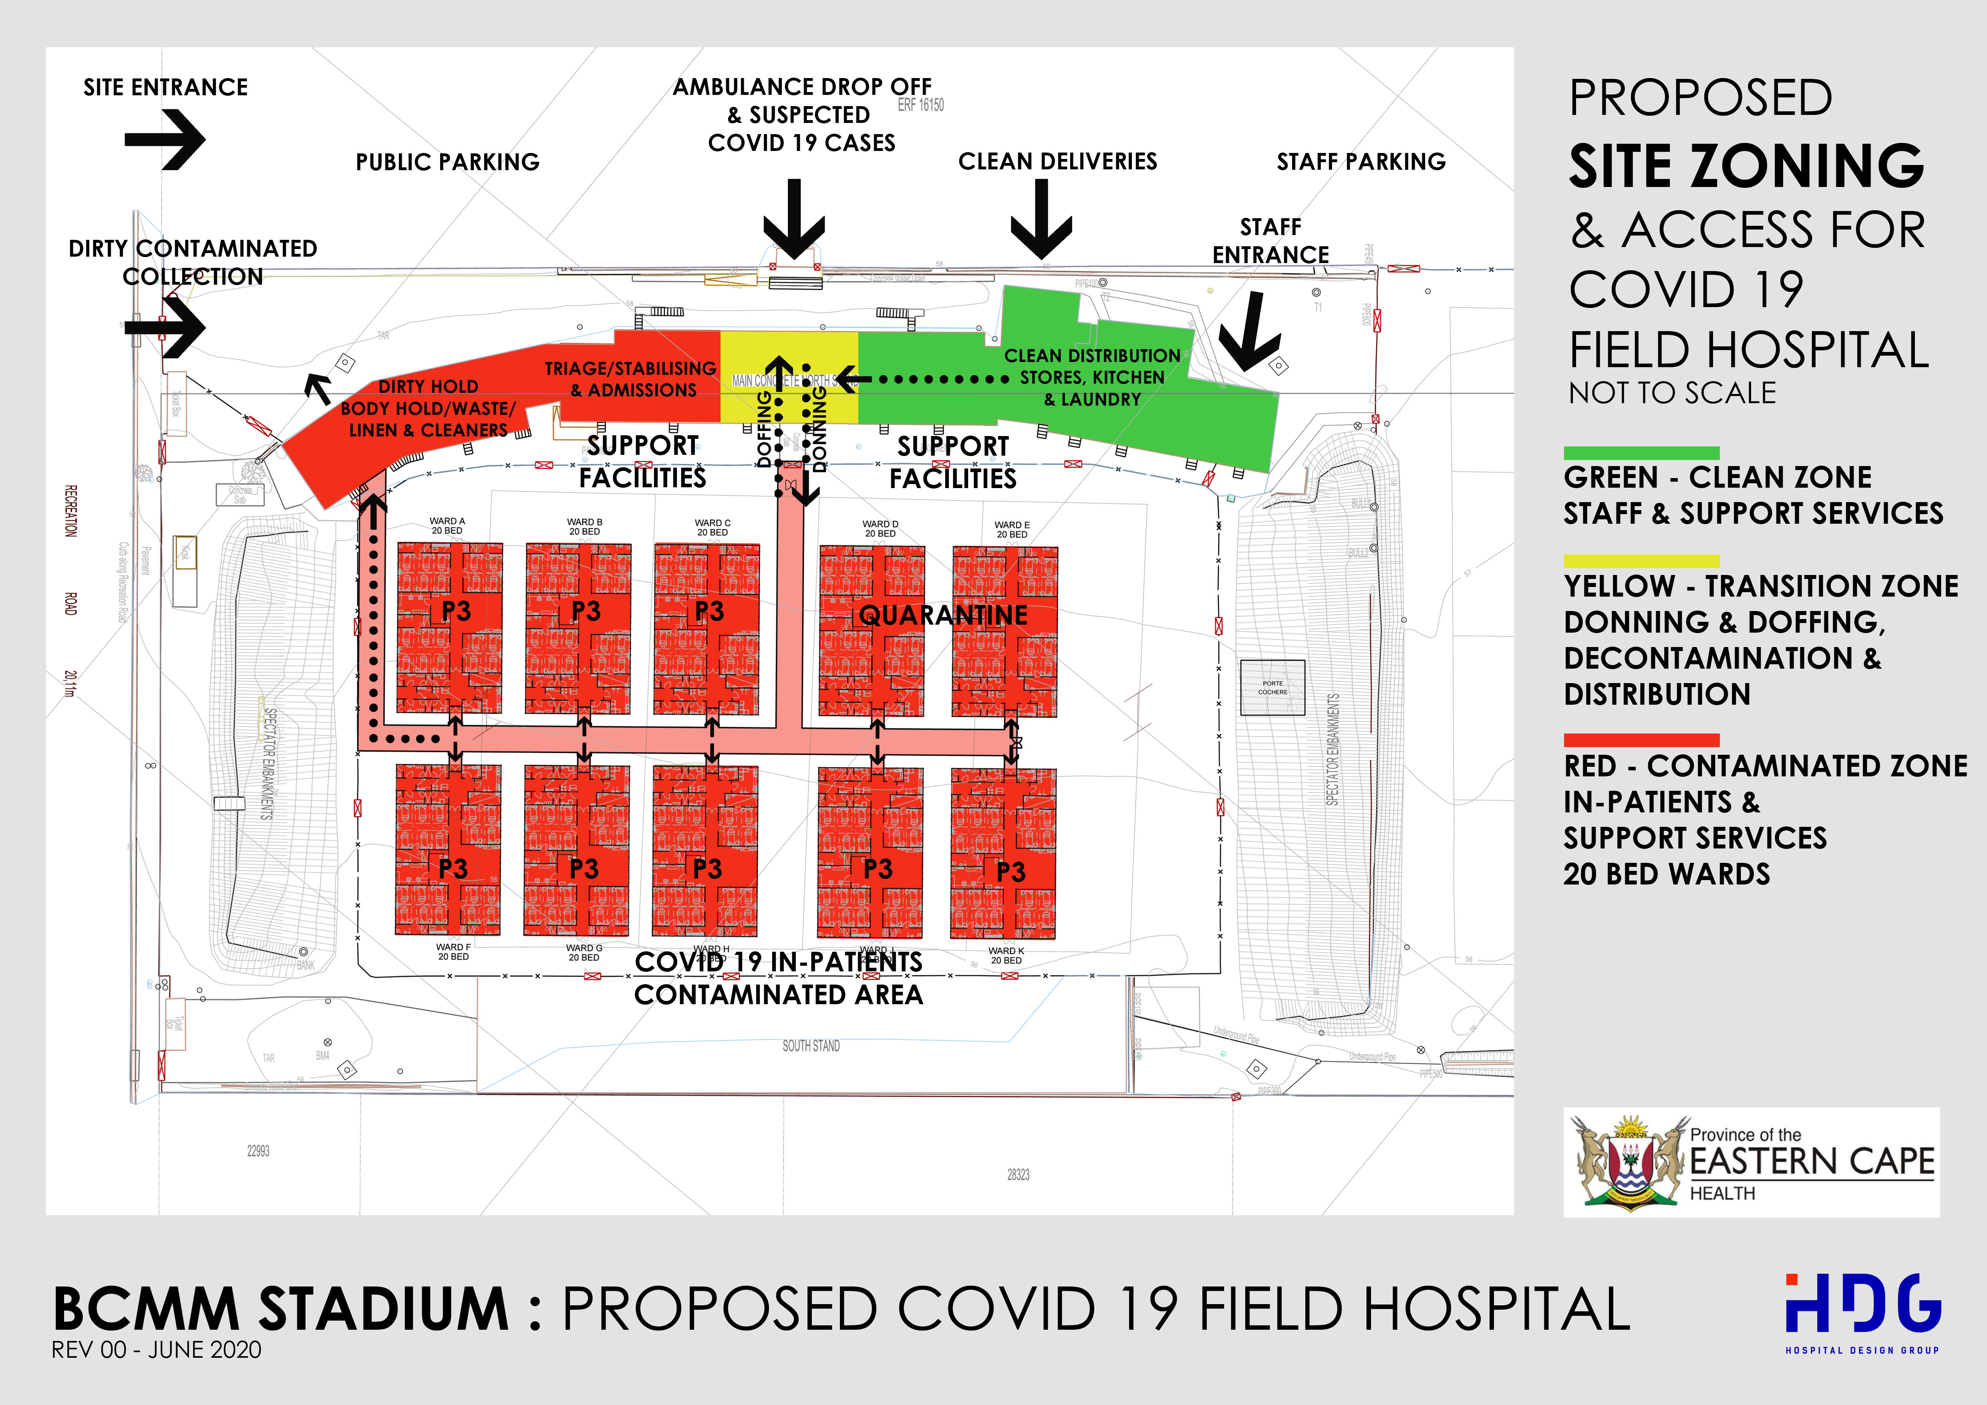

Slide 85
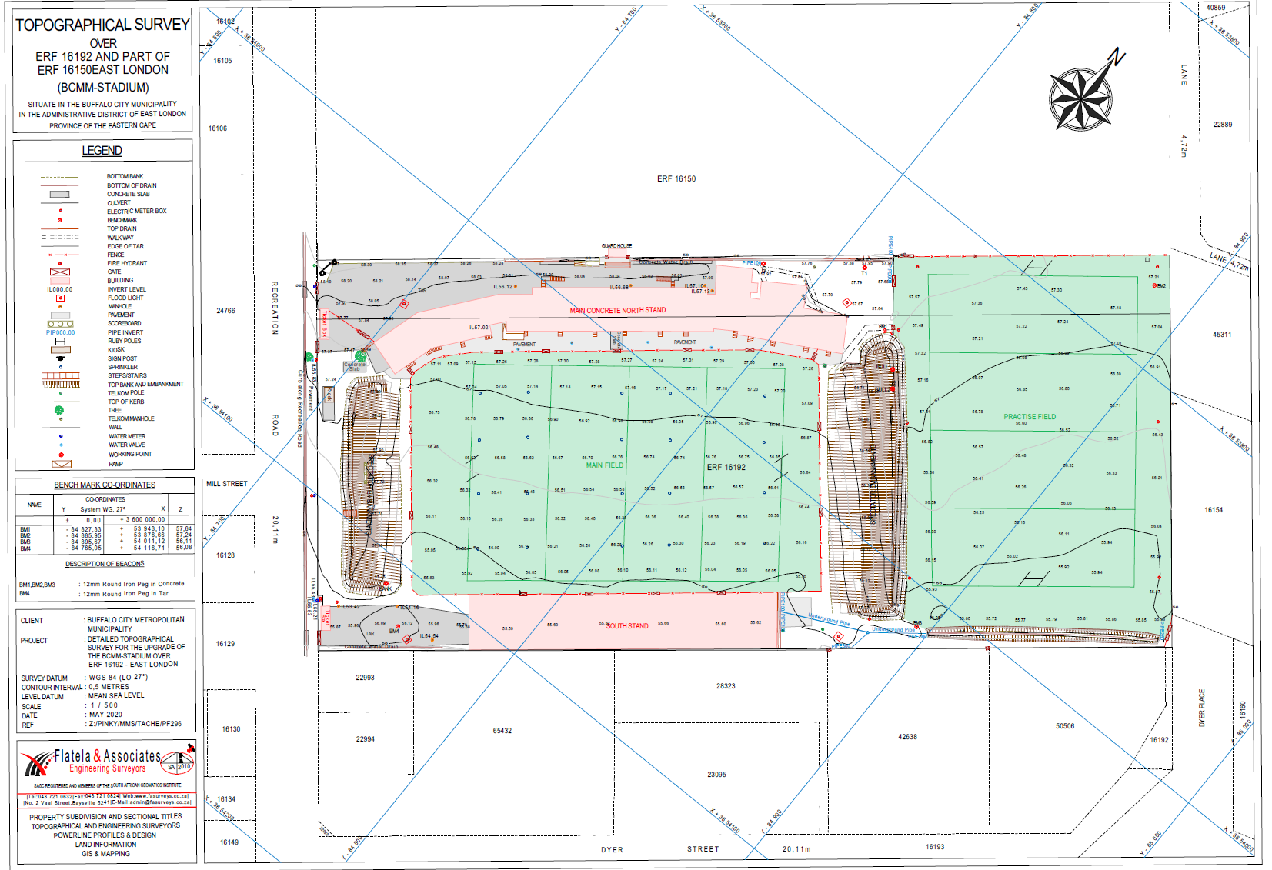

Slide 86
WORKSTREAM ON INFRASTRUCTURE & PUBLIC WORKS
FIELD HOSPITAL cont.
ADMINISTRATION BUILDING
Building Assessment - Completed on 22 May 2020. scope of work for maintenance to be finalized.
Fire Regulations assessment – assessment completed
Security assessment, Health liaised with the Deputy Provincial security cluster, regarding VOC, cameras and human resource.

Slide 87
WORKSTREAM ON INFRASTRUCTURE & PUBLIC WORKS
FIELD HOSPITAL cont.
Provision of “A” field with high fence for the security of the facility and to screen off the site from WSU . This is being costed.
Detail of the Evacuation Plan will be provided.
With regard to Fire Compliance and also Building Regulation:
All existing fire equipment at the stadium are required to be serviced.

Slide 88
WORKSTREAM ON INFRASTRUCTURE & PUBLIC WORKS cont….
All internal signages are required to be SANS 1186-5 and external signage SANS 1186-1 all signages are required to be hang by a chain, in a frame and screwed into wall if no frame.
All escape doors require thumb turn locking devices.
Network connectivity to be discussed with BCMM ICT and WSU.

Slide 89
WORKSTREAM ON INFRASTRUCTURE & PUBLIC WORKS
PROPOSED ROLES AND RESPONSIBILITIES
BCMM
Maintenance of the Buildings
Structures
General Guidance and Direction Signage
House keeping
Backup Generator
Fencing (Perimeter and field)
Domestic waste

Slide 90
WORKSTREAM ON INFRASTRUCTURE & PUBLIC WORKS
PROPOSED ROLES AND RESPONSIBILITIES
HEALTH
Operational Costs including
24hr security
Furniture and Linen
Water and lights (metered)
Catering
Laundry
Cleaners
Medical waste

Slide 91
WORKSTREAM ON INFRASTRUCTURE & PUBLIC WORKS
HEALTH STATE OF READINESS (TO PROVIDE CAD DRAWINGS)
Temporary Building Alteration
Players change room, earmarked to be the reception / information desk/ security area. The area has easy access to ablutions (for staff).
Medical Suite, earmarked to be an examination and treatment room.
Kitchen, the area has been recommended for the kitchen and catering purposes as it has easy vehicular access from the parking lot.

Slide 92
WORKSTREAM ON INFRASTRUCTURE & PUBLIC WORKS cont..
HEALTH STATE OF READINESS (TO PROVIDE CAD DRAWINGS)
Temporary Building Alteration
VIP Suite/ canteen on first floor, the area is suitable as staff rest room / canteen
Medical waste store at the main pavilion south west corner. A room on the ground floor with direct access to the pitch and delivery access road is identified and will be converted to medical waste store, a ramp will be created into the room.

Slide 93
WORKSTREAM ON INFRASTRUCTURE & PUBLIC WORKS Cont.
Other quarantine and Isolation Sites
Gonubie and Nahoon Caravan Parks : Temporary structure
BCMM Geomatics completed the measurements of sites dimensions
This will enable the determination of the size of the temporary structures to be procured and compliance with the guidelines
Caravan Parks
Site Dimensions and extents of both Nahoon and Gonubie have been measured by BCMM Geomatics Division. This will determine site specific temporary structures – “see next slide”.

Slide 94
SCHEDULE OF NAHOON CAMP SITES (52)
SITE_NO | LENGTH | WIDTH | AREA | SITE_NO | LENGTH | WIDTH | AREA
1 | 14,10 | 6,40 | 90,24 | 49 | 6,90 | 10,50 | 72,45
2 | 7,70 | 8,80 | 67,76 | 50 | 5,70 | 13,20 | 75,24
4 | 8,70 | 11,40 | 99,18 | 51 | 7,50 | 7,50 | 56,25
5 | 19,20 | 8,10 | 155,52 | 3A | 13,10 | 7,30 | 95,63
6 | 13,60 | 12,00 | 163,20 | 3B | 11,20 | 8,40 | 94,08
7 | 8,10 | 15,20 | 123,12 | 52A | 10,20 | 8,60 | 87,72
8 | 5,50 | 10,10 | 55,55 | 52B | 8,00 | 8,20 | 65,60
9 | 6,20 | 8,70 | 53,94
10 | 6,70 | 8,40 | 56,28
11 | 9,00 | 8,40 | 75,60
13 | 10,10 | 12,10 | 122,21
14 | 8,30 | 12,60 | 104,58
15 | 7,10 | 7,00 | 49,70
16 | 7,00 | 7,60 | 53,20
17 | 9,40 | 12,40 | 116,56
18 | 11,40 | 11,10 | 126,54
19 | 11,10 | 11,40 | 126,54
20 | 13,00 | 11,60 | 150,80
21 | 9,10 | 10,10 | 91,91
22 | 6,20 | 8,90 | 55,18
23 | 13,10 | 16,60 | 217,46
24 | 10,00 | 9,80 | 98,00
25 | 7,40 | 8,50 | 62,90
26 | 7,50 | 8,00 | 60,00
27 | 8,00 | 10,00 | 80,00
29 | 7,80 | 8,90 | 69,42
30 | 7,00 | 6,20 | 43,40
31 | 5,20 | 6,20 | 32,24
32 | 6,10 | 6,60 | 40,26
33 | 11,30 | 7,90 | 89,27
34 | 10,90 | 8,70 | 94,83
35 | 7,80 | 7,70 | 60,06
36 | 10,10 | 10,50 | 106,05
37 | 8,60 | 9,50 | 81,70
38 | 10,40 | 12,40 | 128,96
39 | 10,20 | 8,90 | 90,78
40 | 8,10 | 7,70 | 62,37
41 | 6,90 | 8,70 | 60,03
42 | 8,10 | 7,70 | 62,37
43 | 6,40 | 7,20 | 46,08
44 | 8,80 | 7,60 | 66,88
45 | 5,80 | 7,80 | 45,24
46 | 10,40 | 9,70 | 100,88
47 | 7,70 | 9,40 | 72,38
48 | 11,00 | 8,20 | 90,20

Slide 95
SCHEDULE OF GONUBIE CAMP SITES (79)
SITE_NO | LENGTH | WIDTH | AREA | SITE_NO | LENGTH | WIDTH | AREA
1 | 9,10 | 9,80 | 89,18 | 52 | 11,20 | 5,80 | 64,96
2 | 7,70 | 8,00 | 61,60 | 53 | 5,80 | 6,00 | 34,80
3 | 8,80 | 9,00 | 79,20 | 54 | 9,60 | 6,30 | 60,48
4 | 10,20 | 5,30 | 54,06 | 55 | 6,70 | 9,50 | 63,65
5 | 5,20 | 10,20 | 53,04 | 57 | 5,40 | 6,50 | 35,10
6 | 8,30 | 6,40 | 53,12 | 58 | 6,40 | 7,20 | 46,08
7 | 8,70 | 6,40 | 55,68 | 61 | 8,20 | 10,70 | 87,74
8 | 7,00 | 12,90 | 90,30 | 62 | 10,70 | 5,90 | 63,13
9 | 7,00 | 12,00 | 84,00 | 63 | 5,30 | 7,80 | 41,34
10 | 7,00 | 9,60 | 67,20 | 64 | 7,80 | 8,40 | 65,52
11 | 10,00 | 8,90 | 89,00 | 65 | 7,80 | 7,80 | 60,84
12 | 10,00 | 9,60 | 96,00 | 66 | 16,20 | 7,90 | 127,98
13 | 10,00 | 7,20 | 72,00 | 67 | 8,60 | 15,70 | 135,02
14 | 7,50 | 10,00 | 75,00 | 68 | 9,40 | 16,90 | 158,86
15 | 9,50 | 10,80 | 102,60 | 69 | 12,20 | 9,80 | 119,56
17 | 7,70 | 5,00 | 38,50 | 70 | 11,90 | 10,70 | 127,33
18 | 8,00 | 7,20 | 57,60 | 71 | 7,70 | 8,30 | 63,91
19 | 8,00 | 9,50 | 76,00 | 72 | 9,70 | 9,70 | 94,09
20 | 8,00 | 6,80 | 54,40 | 73 | 16,00 | 8,10 | 129,60
21 | 8,20 | 12,70 | 104,14 | 74 | 15,90 | 7,10 | 112,89
22 | 14,00 | 12,80 | 179,20 | 75 | 14,10 | 8,20 | 115,62
23 | 10,00 | 14,00 | 140,00 | 76 | 9,00 | 10,20 | 91,80
24 | 8,50 | 11,10 | 94,35 | 77 | 11,00 | 8,40 | 92,40
25 | 10,20 | 11,10 | 113,22 | 78 | 7,80 | 8,20 | 63,96
26 | 7,00 | 11,20 | 78,40 | 79 | 6,60 | 9,10 | 60,06
27 | 10,90 | 10,80 | 117,72 | 80 | 8,10 | 5,10 | 41,31
28 | 10,20 | 7,30 | 74,46 | 82 | 4,90 | 10,20 | 49,98
29 | 10,20 | 8,00 | 81,60 | 83 | 6,70 | 9,30 | 62,31
30 | 7,10 | 7,50 | 53,25 | 84 | 11,60 | 6,70 | 77,72
31 | 10,00 | 5,80 | 58,00 | 85 | 7,60 | 12,20 | 92,72
32 | 8,30 | 9,80 | 81,34 | 86 | 7,60 | 9,50 | 72,20
33 | 5,50 | 8,00 | 44,00 | 87 | 5,90 | 13,20 | 77,88
34 | 10,10 | 8,00 | 80,80 | 88 | 10,30 | 9,20 | 94,76
35 | 10,20 | 7,30 | 74,46
36 | 8,20 | 9,00 | 73,80
37 | 8,10 | 10,50 | 85,05
38 | 10,50 | 9,20 | 96,60
42 | 9,00 | 8,00 | 72,00
44 | 7,60 | 8,50 | 64,60
45 | 3,80 | 14,10 | 53,58
46 | 8,50 | 14,60 | 124,10
47 | 7,70 | 7,00 | 53,90
48 | 6,10 | 8,20 | 50,02
49 | 6,10 | 14,10 | 86,01
50 | 6,80 | 10,00 | 68,00
51 | 9,10 | 10,80 | 98,28

Slide 96
WORKSTREAM ON INFRASTRUCTURE & PUBLIC WORKS Cont.
Resorts
Both the Kiwane and Gonubie resorts were visited by Health, Public Works and BCMM for compliance. A compliance letter awaited from the Department of Labour and Public Works.
Tyiptyip/ Bekruipkop/Sekunjalo site has since been excluded from the list and duly recommended to the Command Council to rescind resolution as it is in the Ngqushwa Municipality.

Slide 97
WORKSTREAM ON INFRASTRUCTURE & PUBLIC WORKS
OTHER QUARANTINE AND ISOLATION SITES
Kiwane and Gonubie Resorts
The two resorts are municipal owned and awaiting final assessment and confirmation of compliance by the Departments of Health and Public Works
The planned visit BCMM/DPW was conducted on 20 May 2020 and 21 May 2020 respectively
Health to be provided with catering, linen etc in compliance with the guideline and health protocols
)

Slide 98
WORKSTREAM ON INFRASTRUCTURE & PUBLIC WORKS
Acquisition of Temporary Structures for containment
Call for proposals for the provision of structures will be for the “A” field and caravan sites to commence as soon as a decision for funding model is finalised and budget availed

Slide 99
WORKSTREAM ON INFRASTRUCTURE & PUBLIC WORKS
BUDGET AND FUNDING MODEL
Funding model for Field Hospital is awaiting budget availability
Budget confirmation will inform the Procurement of structure and associated services for the FH.

Slide 100
WORKSTREAM ON INFRASTRUCTURE & PUBLIC WORKS
Procurement
All procurement activities as reported previously are complete.
Buffalo City field hospital cost estimate done for the
field hospital,
building renovations,
backup generator,
fencing,
network connection,
electrification,
guiding signage,

Slide 101
WORKSTREAM ON INFRASTRUCTURE & PUBLIC WORKS Cont.
Procurement Cont.
fire equipment,
cameras,
sewer connection, and
structures
To liaise with the CFO and the City Manager to discuss budget availability.
Will finalise specification and call for proposals next week.
Appointment for other work to be done as soon as budget estimate of R55 million is confirmed but this excludes minor alterations to be done to meet the Field Hospital and Health Workers protocols

Slide 102
RESPONSE TO COVID 19: - HUMAN SETTLEMENTS STATUS QUO AS AT 1 June 2020
SILVERTOWN TRA ERVEN 81,87 & 88 MDANTSANE PROJECT: (1174 TRUs)
The Contractor has established on site on 11 May 2020. Labour recruitment has been completed within the beneficiary wards. The show temporary relocation unit (TRU) has been completed and necessary amendments undertaken.

Slide 103
RESPONSE TO COVID 19: - HUMAN SETTLEMENTS STATUS QUO AS AT O8 JUNE 2020
Progress to Date is as follows:
40 Local Labourers have been engaged thus far.
PSC Training to resume on 09 June 2020.
Community Liaison Officer and the Health and Safety Officer have been engaged.
About 5 SMMEs are projected to be engaged for this current phase of the project.

Slide 104
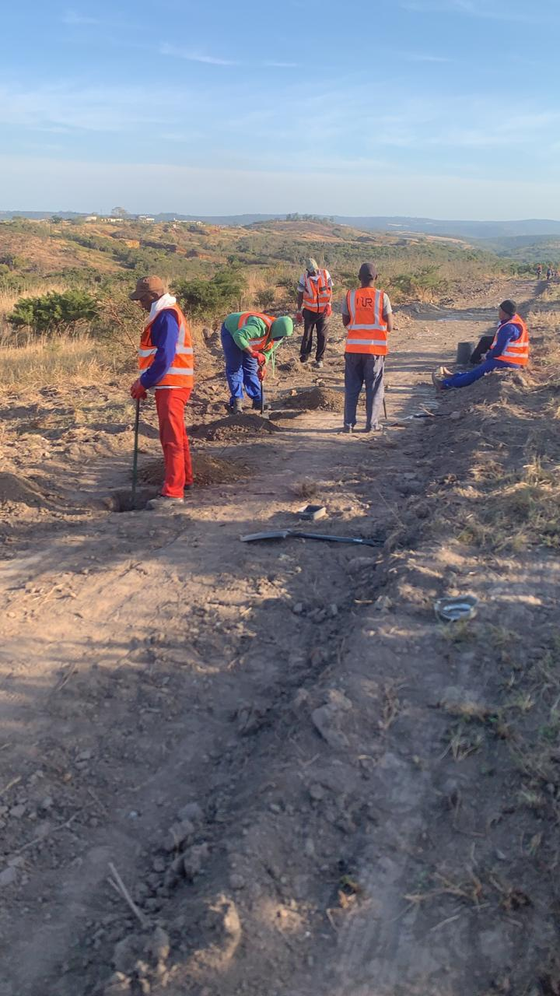

Slide 105
ZIPHUNZANA BYPASS TRA PROJECTS (2000 Trus) - 08 JUNE 2020.
The Contractor has established on site on 11 May 2020 and the contractor is physically present on site and has started with the Project implementation.
The induction and training of the PSC was completed on 28 May 2020. .
The works was disrupted on 29 May 2020 by the Duncan Village Business Forums as they want to be involved and nominate SMMEs to Participate in DV Development Projects.
Matter was partly resolved on 02 June and contractor is back on site.

Slide 106
ZIPHUNZANA BYPASS TRA PROJECTS (2000 Trus) – 08 JUNE 2020
A resolution was undertaken that all directorates that undertaking capital projects in Duncan Village will present their projects accordingly at meeting to be convened by the DRVI unit on 11 June 2020..
The works was disrupted on 29 May 2020 by the Duncan Village Business Forums as they want to be involved and nominate SMMEs to Participate in DV Development Projects.
The site clearance and the pegging of the site is being undertaken by the main contractor.

Slide 107
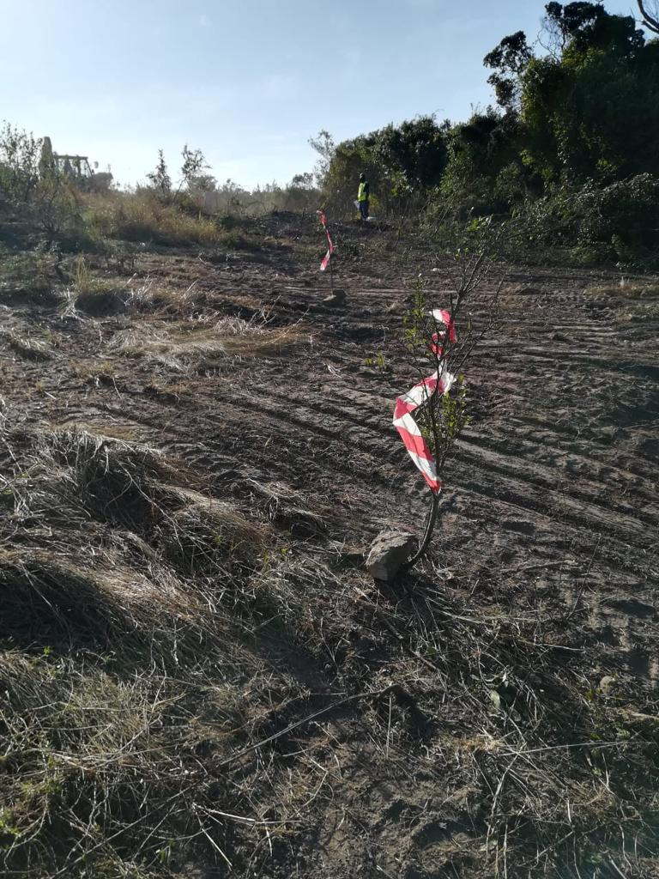

Slide 108
FYNBOS EVICTEES (335 TRUs) - 08 JUNE 2020
The approval of the utilization of the sites for the Trus has been supported and approved by all stakeholders.
The award has been undertaken is projected to be finalized by 10th of June 2020.
The contractors are projected to be on site 15 June 2020 due to minor delays.
The fencing of the three (3) identified land parcels for the evictees will start on 01 June 2020 as works orders were issued on 25 May 2020.

Slide 109
ACCOMMODATION FOR HOMELESS PEOPLE: 08 JUNE 2020
The Directorate has provided about 4 tents and Mobile Toilets for the homeless people and is in the process of purchasing the following for the Emergency Housing and for the Homeless Peoples and to assist with quarantine Accommodation:
The bids for the delivery of following has close on 05 June 2020.
20 no. Of 49m2 Units of Parkhomes.
30no. of 30m2 Units of Parkhomes.
100 units of Trus to be supplied and delivered.

Slide 110
ZIPHUNZANA BYPASS TRA PROJECTS (2000 Trus)
The Contractor has established on site on 11 May 2020 and the contractor will be physical available on site from 22 May 2020 to start implementing stage 1 of this project.
The induction of the Project Steering Committee has taken place on 21 May 2020 and the training of the PSC has been completed on 28 May 2020.
The contractor and the BCMM Staff will be interviewing local SMMEs for Work-packages.
On 20 May 2020 the contractor has finalized the appointment of a Community Liaison Officer (CLO).

Slide 111
FYNBOS EVICTEES (335 TRUs)
The approval of the utilization of the sites for the TRU has been supported and approved by all stakeholders
The Bids for the supply of 335 TRUs were advertised on 08 May 2020 and closed on 15 May 2020.
The award is anticipated to be undertaken by or before 28 May 2020.
The contractors are projected to be on site 07 June 2020.
The fencing of the three (3) identified land parcels for the evictees will start on 01 June 2020 as works orders were issued on 25 May 2020.

Slide 112
ACCOMMODATION FOR HOMELESS PEOPLE:
The Directorate has provided about 4 tents for the homeless people and is in the process of purchasing the following for the Emergency Housing and for the Homeless Peoples and to assist with quarantine Accommodation:
The units to be delivered are as follows:
20 no. Of 49m2 Units of Parkhomes - Currently at Procurement Stage
30 no. of 30m2 Units of Parkhomes - Currently at Procurement Stage
100 units of Trus to be supplied and delivered. – Currently at Procurement Stage

Slide 113
DISTRIBUTION OF GLOVES, MUSKS, SANITIZERS AND SOAPS
The Human Settlements Directorate has distributed Gloves, Masks, Sanitizers and Soaps to the Fynbos Phases 1&2 Evictees that are staying at the Billy Francis Hall on 07/04/20, 29/04/20 and 12 /05/20.
The Soaps have been distributed to the Informal Settlements of Wards 2,6,7, 8 and 1 and the remaining wards with Informal Settlements will have their Soaps delivered from the 18 May till 21 May 2020.

Slide 114
WORKSTREAMS REPORTS
ANNEXURE B
Infrastructure Services and Public Works
END OF ANNEXURE B

Slide 116
WORKSTREAMS REPORTS
MUNICIPAL SERVICES
ANNEXURE C

Slide 117
WORKSTREAMS REPORTS
MUNICIPAL SERVICES
ANNEXURE C

Slide 118
WORKSTREAM ON MUNICIPAL SERVICES
SOLID WASTE MANAGEMENT SERVICES
Public Convenience Facilities
Refuse Removal Status
Clearing of Illegal dumps
Distribution of black refuse bags
Blitz and Fix with Good Green Deeds
PARKS AND CEMETERIES
Grass Cutting
Burial per Region
Graves Digging and Back-filling (Rural Areas)
SPORT AND RECREATION FACILITIES
Grass Cutting – Recreational Amenities
Grass Cutting – Sport Facilities

Slide 119
WORKSTREAM ON MUNICIPAL SERVICES (CONT..)
Public Convenience Facilities
Cleaning and disinfecting the facilities daily.
As a measure to curb the transmission of COVID 19, the staff has been provided with cleaning materials as well as sanitizers for the members of the public before and after using these Public Convenience Facilities:
Coastal- Oriental Plaza, Shoprite CBD, Argyle CBD, Beacon Bay, Gonubie
Midland – Highway Taxi rank
Inland – Civic Centre

Slide 120
WORKSTREAM ON MUNICIPAL SERVICES
REFUSE REMOVAL SERVICES (01st to 05th June 2020)
COASTAL REGION
Refuse removal (businesses and households) covered all areas as per the collection schedule.
N.B: No Refuse Removal Backlog
MIDLANDS REGION
Refuse removal (businesses and households) covered all areas as per the collection schedule.
N.B: No Refuse Removal Backlog

Slide 121
WORKSTREAM ON MUNICIPAL SERVICES
REFUSE REMOVAL SERVICES (01st to 07th June 2020)
INLAND REGION
Refuse removal (businesses and households) covered all areas as per the collection schedule.
N.B: No Refuse Removal Backlog
CLEARING OF ILLEGAL DUMPS
KWT CBD
Bhisho (Independence Avenue)
KWT Clubview
Blue Crane Dam (Bhisho)

Slide 122
WORKSTREAM ON MUNICIPAL SERVICES
CLEARING OF ILLEGAL DUMPS (01st to 07th June 2020)
COASTAL REGION
Amalinda Forest
Wilsonia Industrial Park (Area)
Pefferville and Parkside
Duncan Village (Douglas Smith Highway) – Jamento Supermarket
MIDLANDS REGION
N.U 14
N.U 15
N.U 16
N.U 17

Slide 123
WORKSTREAM ON MUNICIPAL SERVICES
DISTRIBUTION OF BLACK REFUSE BAGS
Solid Waste Department is in a process of distributing black refuse bags in all regions (Coastal, Midlands & Inland)
Midlands Region completed N.U 15, N.U 13, N.U 12, N.U 11, and N.U 9.
In Coastal Region, Mzamomhle and Nompumelelo have already been done.
Inland Region not yet started
The attached ANNEXURE “A” is the distribution schedule

Slide 124
WORKSTREAM ON MUNICIPAL SERVICES (CONT..)
BLITZ AND FIX (GOOD GREEN DEEDS) 05th JUNE 2020
Programme was disrupted due to some challenges in Inland Region and rescheduled for 12th June 2020.
Coastal Region
Focus Areas: Amalinda Forest
Midlands Region
Focus Area: N.U 14 and N.U 16
Inland Region
Focus Area: KWT CBD
Activities: Grass Cutting, Gutter Clearing, Litter Picking, Street Sweeping, Clearing of Illegal Dumps.

Slide 125
WORKSTREAM ON MUNICIPAL SERVICES (CONT..)
BLITZ AND FIX (GOOD GREEN DEEDS) 12th JUNE 2020
Inland Region (Ward 36)
Focus Areas: Dimbaza (Around Dimbaza Primary, Around Dimbaza Police Station, and other Hot Spots
Assembly Point: Time Housing Park (Dimbaza Main Entrance)
Activities: Grass Cutting, Gutter clearing, Litter Picking, Street Sweeping, Clearing of Illegal Dumps and Road Markings.

Slide 126
WORKSTREAM ON MUNICIPAL SERVICES (CONT..)
PARKS AND CEMETERIES (GRASS CUTTING)
Coastal Region
Buffalo Road
Ridge Forest (Beacon Bay)
Settlers Way
Jan Smuts Avenue
Botha Street
Lukin Road
Dawson Road
Santa Community Hall
Art Gallery
Saint James Street
Torquey

Slide 127
WORKSTREAM ON MUNICIPAL SERVICES (CONT..)
PARKS AND CEMETERIES (GRASS CUTTING)
Coastal Region
Buffalo Street
Beach Front
Amalinda Forest
Old Transkei Road
Gonubie Traffic Department
Cambridge
East Bank and Buffalo Flats Cemetery

Slide 128
WORKSTREAM ON MUNICIPAL SERVICES (CONT..)
PARKS AND CEMETERIES (GRASS CUTTING)
Midlands Region
Phakamisa
Zwelitsha
Bhisho Independence Avenue
Bhisho Central
Queens Road
Balasi Valley
Dimbaza and KWT/Clubview Cemeteries

Slide 129
WORKSTREAM ON MUNICIPAL SERVICES (CONT..)
PARKS AND CEMETERIES (GRASS CUTTING)
Inland Region
N.U 1
N.U 3
Highway Park
Berlin CBD
Fort Jackson Entrance
N.U 12
Mdantsane Prison Area

Slide 130
WORKSTREAM ON MUNICIPAL SERVICES
Statistics from 01st to the 07th June 2020
Coastal Region
Coastal Areas
BCMM Cemeteries (Funerals) | 19
Cremations | 21
Rural Areas (Digging of graves) 15
Zozo | 2
Gwala | 2
Ncera Village 4 | 1
Lasimest | 1
Nkampini | 1
Gquwala | 1
Twecu Moni | 1
Welcomewood | 2
Twecu Hill | 1
Tyhushe | 1
Sunny South | 1
Altile | 1

Slide 131
WORKSTREAM ON MUNICIPAL SERVICES (CONT..)
Statistics from 01st to the 07th June 2020
Midland Region
Midland Areas
BCMM Cemeteries (Funerals) | 17
Rural Areas (Digging of Graves) 08
Ntlabathi | 3
Cuba | 1
Saint (St) Mary’s | 1
Kwetyana | 1
Espnqunseni | 1
Gwiqi | 1

Slide 132
WORKSTREAM ON MUNICIPAL SERVICES
Inland Statistics from 01st to the 07th June 2020
Inland Areas
BCMM Cemeteries (Funerals) | 20
Rural Areas (Digging of Graves) 42
Tyusha | 1
Rhayi | 1
Kwelerhana | 4
Majali | 1
Lower Mngqesha | 1
Ndevana | 6
Mzitshane | 1
Mxaxo B | 1
Mdingi | 1
Nonibe | 1
Godidi | 1
Masingatha | 1
Tshabo 3 | 3
Ezikhalini | 1
Liefeltd | 1
Nyanisweni | 2
Zinyoka | 1
Pirrie Mission | 1
Mzontsundu | 1
Ndileka | 1
Balasi Location | 1
Tolofiyeni | 1
Mount Coke | 1
Mlakalaka | 1

Slide 133
WORKSTREAM ON MUNICIPAL SERVICES (CONT..)
Statistics from 01st to the 07th June 2020
Coastal Region (Cont…)
Coastal Areas
BCMM Cemeteries (Funerals)
Rural Areas (Digging of Graves)
Tshatshu | 3
Jubisa | 1
Madakeni | 3

Slide 134
WORKSTREAM ON MUNICIPAL SERVICES (CONT..)
SPORT AND RECREATION FACILITIES ACTIVITIES (01st to 07th June 2020
NAME OF FACILITY | ACTIVITY | DATE
Nahoon Beach Picnic | Grass cutting in the picnic spots and open spaces
Parkside Pool | Grass cutting
King William’s Town Pool | Grass cutting
Zwelitsha Pool | Grass cutting
Nahoon Main Beach | Grass cutting
Schoeman Cricket and Hockey Fields | Grass cutting (playing surface and surroundings)
Selborne Recreation Grounds | Grass cutting (playing surface and surroundings)
Scenery Park Soccer Fields | Grass cutting (playing surface and surroundings)
N.U 16 Soccer Fields | Grass cutting (playing surface and surroundings)
N.U 17 Soccer Fields | Grass cutting (playing surface and surroundings)
Dimbaza Sportfields | Grass cutting (playing surface and surroundings)
Sisa Dukashe Stadium | Removing Scarified Rubble

Slide 135
WORKSTREAM ON MUNICIPAL SERVICES (CONT..)
SPORT AND RECREATION FACILITIES ACTIVITIES (01st to 07th June 2020
NAME OF FACILITY | ACTIVITY
Dice Soccer Field | Grass cutting (playing surface and surroundings)
Reeston Soccer Field | Grass cutting (playing surface and surroundings)
Phakamisa Soccer Field | Grass cutting (playing surface and surroundings)
Bhisho Stadium | Grass cutting (playing surface and surroundings)

Slide 136
WORKSTREAMS REPORTS
ANNEXURE C
Municipal Services
END OF ANNEXURE C

Slide 138
WORKSTREAM REPORT
Economic & Social Development D

Slide 139
TABLE OF CONTENT
ECONOMIC AND SOCIAL DEVELOPMENT WORKSTREAM REPORTS
AGRICULTURE & FOOD INDUSTRY
TRADE & INDUSTRY
BASIC EDUCATION
DEPARTMENT OF HIGHER LEARNING
DEPARTMENT OF LABOUR
EAST LONDON IDZ

Slide 140
WORKSTREAM ON ECONOMIC & SOCIAL…
AGRICULTURE DISASTER FUND
BCMM will be supporting 18 community gardens operating in various areas with production inputs like seedlings, fertilizers, chemicals and animal feed.
The following are the gardens to be supported:
Scenery park primary producers, Ncera vegetable garden, Twecu food producers, Needs camp home gardens, Santa vegetables producers, Tyusha women project, Dimbaza gardens, Nkosiyane farmers, Qalashe vegetable garden, Zeleni primary producers, Zalaza youth projects, Ginsberg youth Cooperative, Newlands vegetables project, Khonkcoshe project, Zwelitsha youth , Kwelerha gardens, Zikhova women Cooperatives and N.U.9 Mdantsane food gardens

Slide 141
WORKSTREAM ON ECONOMIC & SOCIAL…
IDC COVID-19 RELIEF FUND
IDC Covid -19 essential supplies intervention is designed to provide funding to companies that have capacity to acquire and or manufacture products needed to treat, curtail and combat the spread of the COVID-19 pandemic
4 applications received for the relief COVID -19 fund – none has been successful but there is 1 that has been taken up for due diligence, hoping for a positive outcome

Slide 142
WORKSTREAM ON ECONOMIC & SOCIAL…
DEPARTMENT OF SMALL BUSINESS DEVELOPMENT(DSBD) SMME COVID – 19 RELIEF FUND APPROVALS
DSBD has initiated three (3) COVID-19 relief packages:
spaza shop support scheme,
Debt relief finance scheme and
Business growth / resilience facility to support businesses during the pandemic
Businesses had to apply directly to the Department
As per the report from DSBD 58 businesses were approved for the relief support from BCMM
Midlands 7, Inland 1 and Coastal 50, it has not been specified as to which fund the approvals are from

Slide 143
WORKSTREAM ON ECONOMIC & SOCIAL…
DEPARTMENT OF SMALL BUSINESS DEVELOPMENT(DSBD) SMME COVID – 19 RELIEF FUND APPROVALS
Funds are to be utilised towards rentals or salaries for employees
Also the report does not specify the sectors that these businesses operate in as it only gives the names of businesses

Slide 144
WORKSTREAM ON ECONOMIC & SOCIAL CONT.
EAST LONDON IDZ
34 investors were all cleared and are open for business
Construction of factories to resume next week 08/06/2020
The Decontamination of all buildings has been done for the return of employees

Slide 145
WORKSTREAM ON ECONOMIC & SOCIAL CONT.
BASIC EDUCATION
A word of thanks and gratitude to Mr. Nceba Ncunyana for the assistance he provided with water tanks and water for the Berlin and Tshabo areas.
All schools with Gr. 7 and Gr.12 will be opening on 8 June 2020. Rest of grades will be introduced in a phase in approach.
PPE’s being delivered and SGB’s busy cleaning schools.
All employees are being orientated and trained with regards to COVID 19 Regulations.
A third of the workforce will be returning to District Offices as from next week.

Slide 146
WORKSTREAM ON ECONOMIC & SOCIAL CONT.
BASIC EDUCATION: MATTERS OF CONCERN
A bilateral is required with BCMM and DoH with regards to places / clinics closest to schools where learners and educators can be referred to for assistance should possible infections be identified.
53 Schools in the District have now been vandalised. 7 during the past week

Slide 147
WORKSTREAM ON ECONOMIC & SOCIAL CONT.
HIGHER LEARNING-WALTER SISULU UNIVERSITY.
Support staff back on campus.
Academic staff to commence on the 08/06/2020.
Students to be back on the 15th June 2020.
In BCMM Campuses 1 491 students are expected by the 15th June 2020.

Slide 148
WORKSTREAM ON ECONOMIC & SOCIAL…
DEPARTMENT OF LABOUR
OHS inspectors planning to visit quarantine sites in BCMM - need to undertake joint inspection.
Done with all hospital Inspections except for Nkqubela.
Got relief fund for UIF for employees and employers.
DOEL will start working from 08/06/2020, they are busy with final touches for the opening.
Summary Payments so far:
Province Employers Employees Amount
Eastern Cape 18495 186789 R912 893 113.65

Slide 149
UIF PAYMENTS PER LABOUR CENTRE PERIOD: 25 – 29 May 2020
WORKSTREAM ON ECONOMIC & SOCIAL…
Office | Payment forms | Payments | Incomplete | Total Payments | Payments | Payments | Amount paid
 | brought over | forms | Payment | to be | Processed | to be processed
 | from previous week | received | Forms | Processed
East London | 0 | 490 | 0 | 490 | 490 | 0 | R 1 662 441.03
KWT | 0 | 80 | 0 | 80 | 80 | 0 | R 493 870.86
Mdantsane | 108 | 151 | 0 | 259 | 134 | 125 | R 507 943.55
TOTAL | 108 | 621 | 0 | 629 | 704 | 108 | R 2 664255.44

Slide 150
COVID 19 OHS INSPECTIONS
WORKSTREAM ON ECONOMIC & SOCIAL CONT.
Sector | Number conducted | Compliance |  | Notices Issued
 |  | Yes | No | Contravention | Improvement | Prohibition
GOVERNMENT SECTOR
Depart of health |  |  |  | None | None | None
PRIVATE SECTOR
Community Services |  |  |  | None | None | None
Food & Bev | 3 | 3 |  | None | None | None
Agriculture
Hospitality | 1 | 1 |  | None | None | None
Manufacturing | 1 | 1 |  | None | None | None
Wholesale & Retail | 4 | 4 |  | None | None | None
Pharmacy | 1 | 1 |  |  | None | None
Security | 0 | 0
Petrol station | 1 | 1
Finance | 1 | 1 |  | None | None | None
TOTAL | 12 | 12 |  | None

Slide 151
WORKSTREAM ON ECONOMIC & SOCIAL CONT.
SOCIAL DEVELOPMENT
33 People relocated from Assemblies of God in Southernwood, 3 from Mdantsane and 2 from KWT.
OTHER COST DRIVERS: need collaborative efforts
Eletricity, water, Cleaning and Security programmes and centre management.
Social workers contacted Buffalo City FET College for possibility of enrolling the homeless when the College re-opens.

Slide 152
WORKSTREAMS REPORTS
ECONOMIC AND SOCIAL DEVELOPMENT WORK STREAM
END OF ANNEXURE D

Slide 154
WORKSTREAMS REPORTS
ANNEXURE E
LOGISTICS, COMMUNICATION, LEGAL & RECORDS

Slide 155
WORKSTREAMS REPORTS
08 June 2020
LOGISTICS, COMMUNICATION,
LEGAL & RECORDS
Reports received today, busy with update

Slide 156
Logistics, Communication, Legal & Records
BCMM Financial Reporting
BCMM Employee Wellness Centre
BCMM Communications
BCMM Public Participation
Government Communication & Information System (GCIS)
BCMM Legal Services (Tracking of Regulations, Directives, Guidelines, Notices, Circulars & Interpretation of Law)
BCMM Council Support (Records)
Home Affairs

Slide 157
COVID-19 AS AT 04 JUNE 2020
DESCRIPTION | TOTAL EXPENDITURE MAY 2020
EMPTY CONTAINERS | 96 446
FACE SHIELDS | 40 285
THERMOMETRES | 295 100
DISINFECTANTS | 375 190
GLOVES | 262 582
MASKS | 3 463 054
CLOTH MASKS | 300 000
SANITIZERS | 2 256 263
SANITISER FOOT STANDS | 82 000
RESPONSE TO COVID-19 (GROCERY VOUCHERS & SOAPS) | 25 143 592
TOILETS AND TENTS HIRE | 702 600
PLANT HIRE | 1 274 764
FACILITATION AND DECANTING (TUNNEL PROJECT) | 1 738 664
TOTAL | 36 030 540

Slide 158
IMPLICATIONS OF COVID-19 IN BUFFALO CITY METRO
COVID-19 has resulted in the following financial impact for the Metro:
The revenue collection has decreased. Collection rate is 80.18% as at 30 April 2020 (mid-year 85.71%) vs 92.5% budgeted in 2019/2020.
Decrease in electricity consumption and thus decrease in electricity revenue
Decrease in other services due to lockdown

Slide 159
IMPLICATIONS OF COVID-19: BUFFALO CITY METRO
The Metro has escalation of costs pertaining to COVID-19 mitigating measures that were unforeseen and unavoidable, e.g.
purchase of personal protective equipment (PPE)
hiring of plant
decontamination and disinfection of municipal building and other public facilities

Slide 160
LOGISTICS, COMMUNICATION, LEGAL & RECORDS WORKSTREAMS REPORTS
DRAFT BCMM COVID READINESS WORKPLACE PLAN IN TERMS OF REGULATION 16(6)(B)

Slide 161
LOGISTICS, COMMUNICATION, LEGAL & RECORDS WORKSTREAMS REPORTS
TASK
PREPERATIONS FOR READINESS
TIME FRAME
30 April
RESPONSIBLE OFFICIAL
Corporate Services HOD
ACTIVITIES
Providing PPE’s to all Staff.
Comments
Ascertain the availability of PPE and sanitizer at all works places by 2nd May

Slide 162
LOGISTICS, COMMUNICATION, LEGAL & RECORDS WORKSTREAMS REPORTS
TASK
PREPERATIONS FOR READINESS
TIME FRAME
01 May
RESPONSIBLE OFFICIAL
Health and Public Safety
ACTIVITIES
Disinfection of Municipal Buildings outside and inside

Slide 163
LOGISTICS, COMMUNICATION, LEGAL & RECORDS WORKSTREAMS REPORTS
TASK
PREPERATIONS FOR READINESS
TIME FRAME
04 May
RESPONSIBLE OFFICIAL
Corporate Services HOD
ACTIVITIES
PPE has been distributed to sections and staff returning and will continue to be distributed to them.

Slide 164
LOGISTICS, COMMUNICATION, LEGAL & RECORDS WORKSTREAMS REPORTS
BCMM Employee Wellness Centre
Personal Protective Equipment Issued
Non Touch Thermal Scanners – 134
Gloves - 103 750
Masks - 102 558
Sanitizers (L) - 6 637
500(ML) - 229
Spray Bottles - 481
Disinfectant (L) - 1 501
Face Shields - 294
Goggles - 26
Disposable Covers - 82

Slide 165
LOGISTICS, COMMUNICATION, LEGAL & RECORDS WORKSTREAMS REPORTS
BCMM Employee Wellness Centre
SCREENING AND TESTING
All entrances to BCMM building was issued with thermal scanners for screening of every person that enters the buildings
8 employees trained on how to operate the thermometers
30 employees were screened through the use of a COVID – 19 questionnaire from the Finance and Electricity Departments.
10 Confirmed cases in BCMM and 1 Recovery
8 Active cases that are in isolation from (Law Enforcement, Finance, Human Resources, Trust Centre, Solid Waste and Water Works).
10 Referrals were done for direct contact employees from Law Enforcement for testing

Slide 166
LOGISTICS, COMMUNICATION, LEGAL & RECORDS
IDP Roadshows
IDP roadshows Communications and mobilization plan being implemented
Designs approved, recording presentation underway, radio stations booked, social media platforms on standby; awaiting confirmation of dates
Council Virtual meeting
To adverts on website and social media
Working with ICT to link journalists to be part of the meeting
Updates will be carried on the Facebook page during the meeting
Speaker to carry interviews with community radio stations to explain Council decisions

Slide 167
LOGISTICS, COMMUNICATION, LEGAL & RECORDS
Posters
No mask No entry posters delivered, rolling out line distancing floor strips
Lockdown level 3
Level 3 Communications plan in place
BCM part of the Covid-19 Hotspot Cities Communication task team chaired by GCIS
BCM Comms Core team activated. Members GCIS, Salga, OTP, Cogta and Eskom
Partnership with Aefesis Corplan, NGO publishing research study by the NGO released to media every fortnightly on interventions in water, refuse, sanitation
Partnership with Harambe to publicise opportunities for the youth

Slide 168
LOGISTICS, COMMUNICATION, LEGAL & RECORDS Continue
Communication
Weekly Media Monitoring report (29 May to 04 June)
According to our Media Monitoring report for this week the coverage by the media about the City on mainstream, print and social media is as follows is as follows:
Broadcast Media: 3
Print Media: 17
Social media: 360
Twitter: 231
Facebook: 67
YouTube: 0

Slide 169
LOGISTICS, COMMUNICATION, LEGAL & RECORDS
Major stories:
* Family traumatised as coffin goes missing at cemetery (Daily Dispatch)
* Pakati pencils in BCM tariff hike proposal (Daily Dispatch)
* Deputy Mayor Graduates at 59 (Daily Dispatch)
* BCM asks for residents ‘patience in fixing burst pipes (Daily Dispatch)
* Liquor price after two months of no sale, authorities control crowds (SABC)
* The Buffalo City Metro has welcomed the study which reveals the has been improvement in the provision of water and sanitation in informal settlements (Algoa FM)
* City urges liquor outlets to put people first over profits (Keith Ngesi Radio, Community radio stations, SABC)
*All Buffalo City Metro building are operating on a no mask no entry policy (Facebook, Website)
* Municipality turns focus to tar Mdantsane internal roads Buffalo City Executive Mayor Xola Pakati has turned the sod (Dispatch, social media)
* Buffalo City traffic services resume services (social media)
* The BCMM Call Centre will be closed today at 3pm for the purpose disinfecting the premises (social media)

Slide 171
LOGISTICS, COMMUNICATION, LEGAL & RECORDS WORKSTREAMS REPORTS
BCMM LEGAL
As Legal Services we have find it prudent to advise the Covid-19 Cluster on the recent directives published under Alert Level 3 of the COVID-19 national lockdown period and its impact on the BCMM. The directives considered are as follows:
Regulations issued in terms of section 27(2) of the Disaster Management Act, 2002.

Slide 172
LOGISTICS, COMMUNICATION, LEGAL & RECORDS WORKSTREAMS REPORTS
De Beer & Another v Minister of COGTA
The regulations promulgated by the Minister of Cooperation and Traditional Affairs ("the Minister") in terms of section 27(2) of the Disaster Management Act 57 of 2002 are declared unconstitutional and invalid.
The declaration of invalidity is suspended until such time as the Minister, after consultation with the relevant cabinet minister/s, review, amend an republish the regulations mentioned above (save for regulations 36, 38, 39 )(d) and (e) and 41 of the regulations promulgated in respect of Alert Level 3 due consideration to the limitation each regulation has on the rights guar in the Bill of Rights contained in the Constitution.

Slide 173
LOGISTICS, COMMUNICATION, LEGAL & RECORDS WORKSTREAMS REPORTS
De Beer & Another v Minister of COGTA
The Minister is Directed to comply with the process ordered in paragraph 2 above within 14 (Fourteen) business days from date of this order, or such longer time as this court may, on good grounds shown, allow and to report such compliance to this court.
During the period of suspension, the regulations published in Government Gazette No 43364 of 28 May 2020 as Chapter 4 of the regulations designated as: "Alert Level 3", shall apply.

Slide 174
LOGISTICS, COMMUNICATION, LEGAL & RECORDS WORKSTREAMS REPORTS
The staff leave policy only makes provision for quarantine leave of 10 days per annum. It is a well-known fact that quarantine in relation to Covid 19 is normally at least 14 days.
Given this fact it is proposed that consideration be given to increasing the number of leave days in this category to accommodate complete quarantine periods if applicable and to be given to employees who need to vacate their workplaces for decontamination to occur.
It is proposed that in order to have control of the situation this leave will be recorded as quarantine leave and the excess be approved by the HOD:CS/ CM given the current state of affairs.

Slide 175
LOGISTICS, COMMUNICATION, LEGAL & RECORDS WORKSTREAMS REPORTS
The challenge relating to the sensitivity of employees
declaring co-morbidities is complex in nature and
requires the necessary care when dealing with this.
It must be stressed however that the actual medical
condition need not be specified if confidential
Engagement is needed with Organised Labour to deal
with the need to use leave and sick leave for the 2
categories of employees most vulnerable

Slide 176
LOGISTICS, COMMUNICATION, LEGAL & RECORDS WORKSTREAMS REPORTS
BCMM Council Support (Records)
New Schedule of meetings to be published
Electronic Document Management System on track and updated
Committee Secretariat tools of trade upgrade and training in progress to ensure compliance of meetings
Action Plan Being Finalised – roles and responsibilities for meetings

Slide 177
LOGISTICS, COMMUNICATION, LEGAL & RECORDS WORKSTREAMS REPORTS
Information System
Training Microsoft Teams ongoing
Office 365 Roll out in progress
Upgrade of workstations ongoing
Venues for virtual meetings currently being extended to BCMM Halls as backup.

Slide 178
WORKSTREAMS REPORTS
LOGISTICS, COMMUNICATION, LEGAL & RECORDS
END OF ANNEXURE E

