Slide 1
2019/20
DEPARTMENT OF DEFENCE
Presentation to the PCD&MV
03 June 2020

Slide 2
Aim
Information brief to the
Portfolio Committee of Defence and Military Veterans
on the
DOD Q4 Preliminary Performance Report

Slide 3
Presentation Structure
Legislative Requirements
DOD Q4 Performance Report as on 31 Mar 2020
Analysis of DOD Performance Indicators
Q4 Strategic Overview
DOD Selected Performance Indicators
Q4 Performance Status
Q4 Financial Performance Information

Slide 4
Legislative Requirements
In terms of Section 38(1)(a)(i) and (ii) of the PFMA, 1999 as amended, the “Accounting Officer for a department must ensure that the department has and maintains effective, efficient and transparent systems of financial and risk management and internal control; and a system of internal audit under the control and direction of an audit committee”.
The Treasury Regulations, section 5.3.1 states that, the Accounting Officer of an institution must establish procedures for quarterly reporting to the Executive Authority to facilitate effective performance monitoring, evaluation and corrective action.

Slide 5
Legislative Requirements
The Revised Framework for Strategic Plans and Annual Performance Plans, states that “reporting is a vital component of the monitoring process and must be undertaken with the intent to use the findings to inform management and oversight decision making. Reporting entails tracking progress against a plan and it improves accountability for delivering on the priorities of government, and provides focus on the use of allocated budgets by institutions. It also provides an opportunity for institutions to indicate measures that will be taken to ensure that implementation of plans remains on track.”

Slide 6
Legislative Requirements
“Quarterly Performance Reports (QPRs) provide progress on the implementation of an institutions’ Annual Performance Plan on a quarterly basis, with particular reference to monitoring performance against outputs.”
DPME in the Presidency’s “Guidelines for the Preparation of Quarterly Performance Reports” dated May 2019 indicates that preliminary information must be submitted within 30 days after the end of each quarter and actual information must be submitted with preliminary data of the next quarter.

Slide 7
DOD Q4 Performance
Report

Slide 8
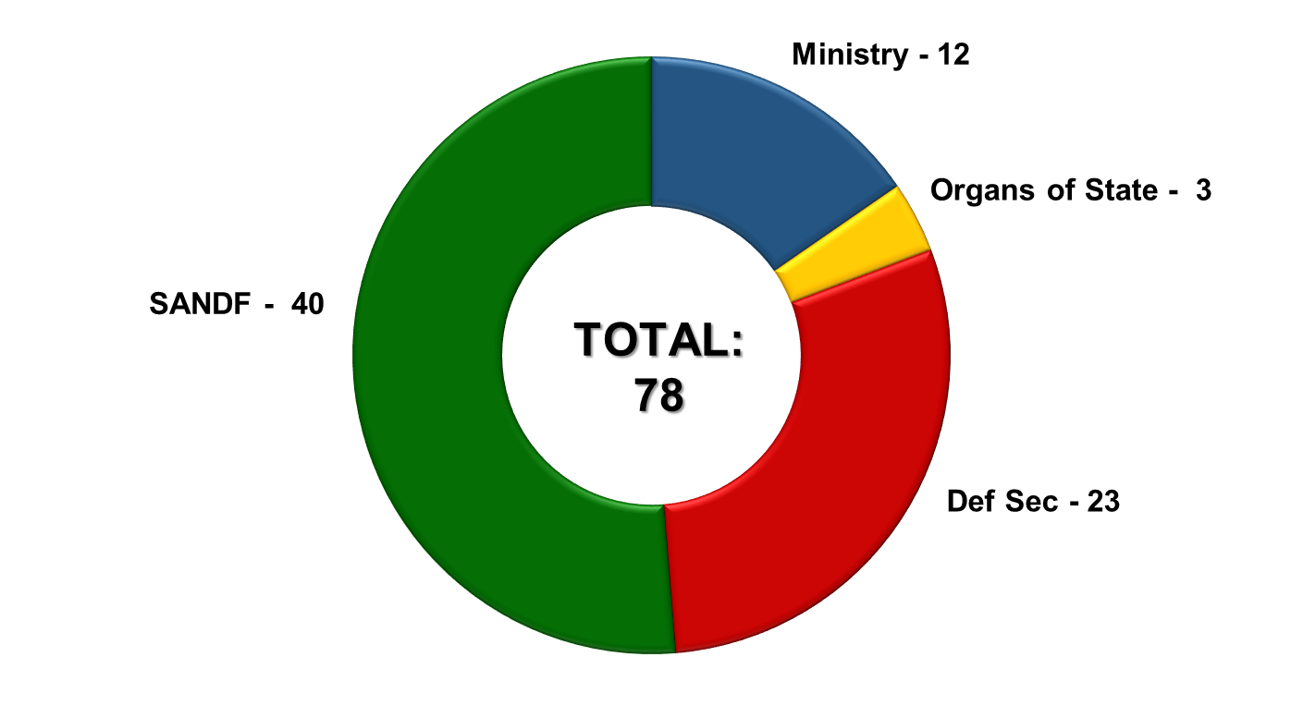
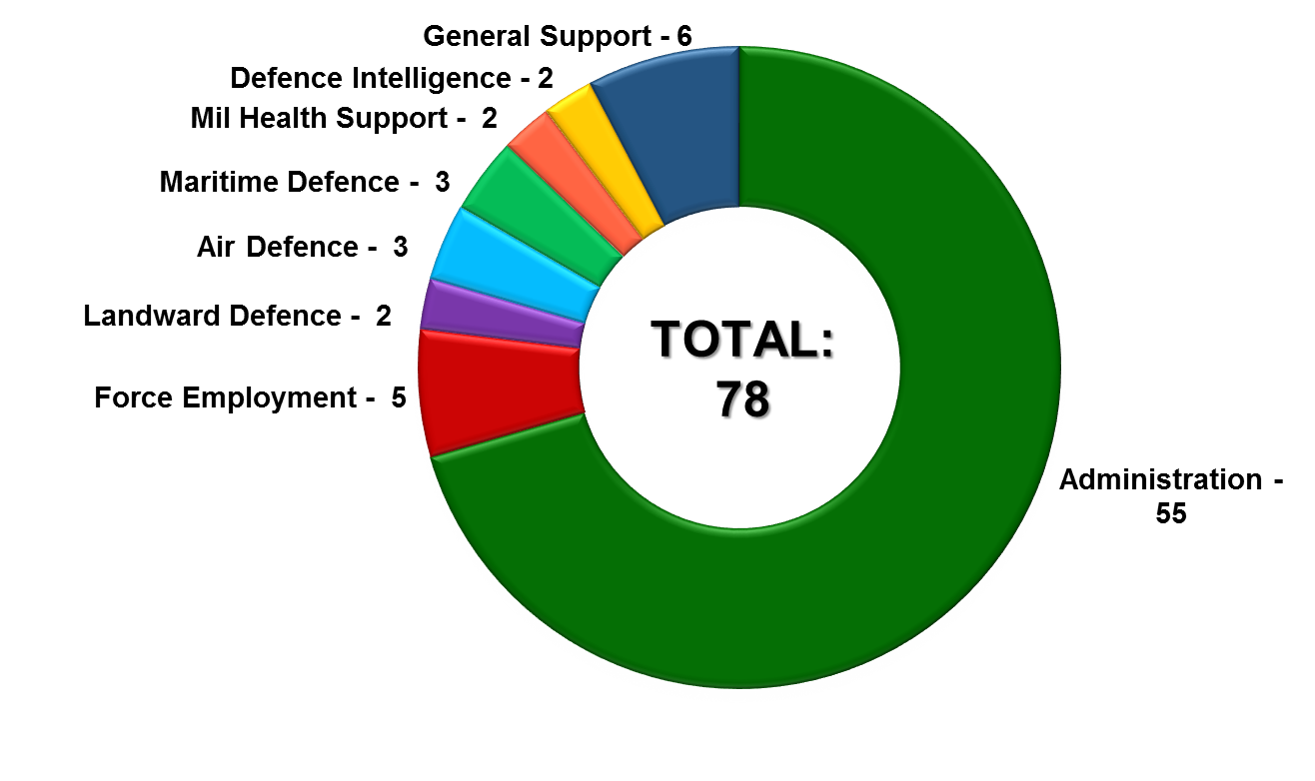
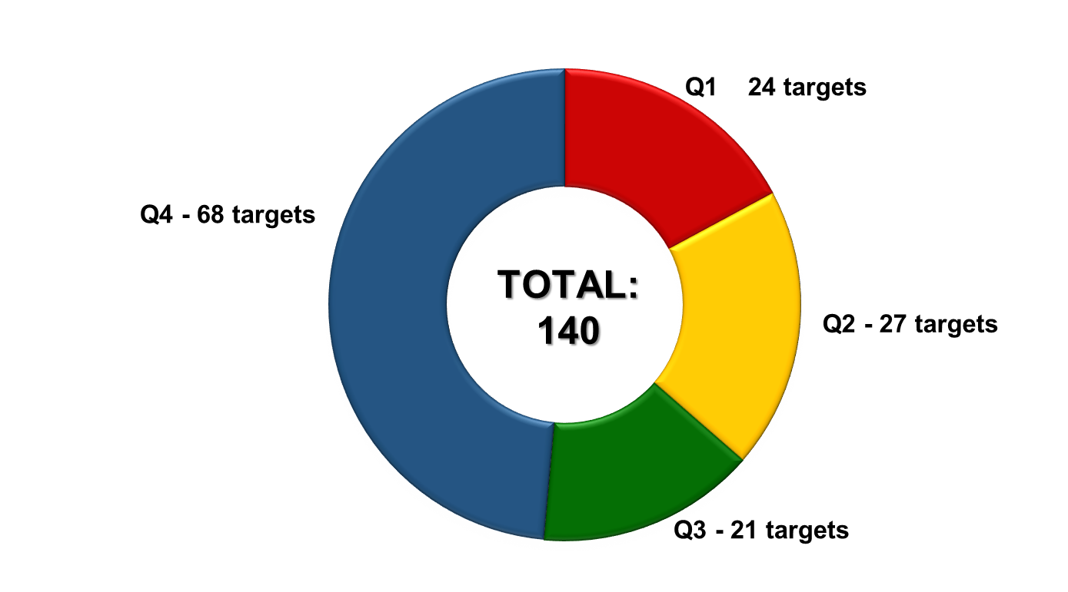
Analysis of DOD Performance Indicators
The DOD reported against 78 Performance Indicators (PInds), consisting of 140 targets, in the FY2019/20.

Slide 9
Analysis of DOD Targets per Main Programme
Programme | Q1 | Q2 | Q3 | Q4 | Total
Administration | 15 | 16 | 11 | 47 | 89
Force Employment | - | - | - | 5 | 5
Landward Defence | 1 | 1 | 2 | 2 | 6
Air Defence | 1 | 2 | 1 | 2 | 6
Maritime Defence | 1 | 2 | 1 | 2 | 6
Military Health Support | 2 | 2 | 2 | 2 | 8
Defence Intelligence | 2 | 2 | 2 | 2 | 8
General Support | 2 | 2 | 2 | 6 | 12
TOTAL | 24 | 27 | 21 | 68 | 140

Slide 10
Q4 Strategic Overview

Slide 11
SA Defence Review 2015 Implementation Status
The implementation of the Defence Review 2015 remains totally dependent on an improved funding trajectory to the DOD.
A presentation on the funding trajectory was made to the Council of Defence on 27 Jan 2020, where after the President and the DG of the NT was briefed on 06 and 10 Feb 2020 respectively.
The implementation of the Defence Review 2015 remains work in progress.

Slide 12
Corporate Human Resource Status
During the year under review, the DOD planned and budgeted for an average personnel strength of 74 901 at a cost of Rb31,89. On receipt of the Final Letter of Allocation from NT dated 29 Oct 2018, the CoE allocation was confirmed as follows.
FY2019/20: R29 193 710 000
FY2020/21: R31 365 882 000
FY2021/22: R33 404 665 000
The reduction in the CoE budget, as imposed by NT, presupposes that the DOD must reduce its personnel strength to fit within the allocation whilst executing a Rejuvenation Strategy.
The imposed CoE budget ceiling did not take account of ordered commitments, current operations and exercises for which trained uniformed personnel are required.

Slide 13
Corporate Human Resource Status
The DOD requires an average HR strength of 77 000. In order to assure a more sustainable defence capability, an average HR strength of 75 500, together with planned Reserve Force mandays of 2 693 048, were maintained to execute the DOD’s mandate over the MTEF.
The DOD reduced its strength from 78 632 on 31 Mar 2014 to 74 096 on 31 Mar 2020, constituting a reduction in strength of 4 536 over this period.
The planned average strength of the DOD for the FY2019/20 was reduced from 74 901 to 74 104 at a cost of Rb31.8, resulting in a shortfall of R2.6 billion.

Slide 14
Corporate Governance and Accountability
Governance Arrangements
During the period under review, the Secretary for Defence provided strategic direction to the DOD through various governance activities and interventions.
These included timely decision-making on strategic and defence diplomacy matters, effective management and processing of official departmental documents, chairing of various DOD management bodies, as well as the attendance of Director-Generals’ meetings, Cabinet Lekgotlas and Government Clusters.

Slide 15
Corporate Governance and Accountability
COVID-19
Following the nationwide lockdown, the President instructed that NATJOINTS must serve as a the custodian of all reports on the COVID-19 pandemic at DG level.
The President appointed the JCPS Cluster Co-Chairpersons (Secretary for Defence and National Commissioner of SA Police Services [SAPS]) to coordinate and facilitate all work related to various work streams on COVID-19, which includes the following sectors: economic, health, security, education, legal and regulatory framework, communications and labour sectors.

Slide 16
Corporate Governance and Accountability
COVID-19
The Secretary for Defence, in his capacity as the Co-Chairperson of the JCPS Cluster has since played an instrumental role in leading and coordinating:
The repatriation of 114 South Africans from the City of Wuhan, Hubei Province in the People’s Republic of China.
The establishment of COVID-19 work streams.
The formulation of a Socio-Economic Recovery Plan for the country, post COVID-19 national lockdown.

Slide 17
Corporate Governance and Accountability
COVID-19 (continued)
Work of the Multi-Disciplinary Team, comprising of all work stream leaders on COVID-19 and Clusters Co-Chairs, in developing and consolidating a Draft Framework on the Risk Adjusted Strategy.
The aim of this Strategy is to bring different sectors of the economy back to work under level four of the lockdown. In undertaking the Risk Adjusted Strategy, the National Coronavirus Command Council and the Ministerial Advisory Committee on COVID-19 intends to sequence and phase in key sectors and priority areas with a view to deepening the fight against COVID-19.

Slide 18
Corporate Governance and Accountability
Defence Diplomacy
The DOD was able to ensure the 100% validity of the enabling bilateral international agreements mandating the conducting of bilateral and multilateral engagements with partner countries in its area of responsibility within Africa (ie Burundi and Zambia), as well as Asia and the Middle East (ie India).
The DOD participated in multilateral engagements in the UN and AU initiatives in support of the role of the MOD&MV. During Q4, the DOD supported the MOD&MV at the 33rd AU Ordinary Session of the Assembly held in Addis Ababa, on 09 Feb 2020. The DOD also facilitated the DOD Annual Report on the SA Annual Treaty Obligations to the UN on 16 Mar 2020.

Slide 19
Corporate Governance and Accountability
Defence Diplomacy
The DOD facilitated the processing and signing of Defence Cooperation Agreements (Legal instruments) between the RSA and various countries, namely; Kenya, Republic of Cameroon, Russia Federation, Portugal, Serbia and Brazil.
The DOD also assisted and facilitated the drafting and signing of the outstanding two Letters of Assist, one for the provision of three Rooivalk Military Attack Helicopters and the other for provision of five Oryx Utility Helicopters to the UN MONUSCO, both dated 06 Feb 2020.

Slide 20
Command of Forces
In terms of Support to the People, in support of Outcome 3, “All people in South Africa are and feel safe” the SANDF deployed 15 sub-units to execute Op CORONA (Border Safeguarding) in Limpopo, Mpumalanga, KwaZulu-Natal, Free State, Eastern Cape, Northern Cape and North-West Provinces.
An Op CORONA maritime patrol along the West Coast in the Hermanus and Gansbay area over the period 13 to 31 Jan 2020.

Slide 21
Op CORONA Operational Successes
Force Employment Performance Status for FY2019/20
Operational Successes | Q1 | Q2 | Q3 | Q4 | YTD
Weapons Recovered | 8 | 16 | 11 | 8 | 43
Illegal Foreigners Apprehended | 2 629 | 1 291 | 2 093 | 7 264 | 13 277
Criminals Arrested | 162 | 192 | 149 | 94 | 597
Stolen Vehicles Recovered | 48 | 50 | 41 | 41 | 180
Dagga Confiscated | 3 477 kg | 2 175kg | 2 018kg | 2 840kg | 10 510kg
Live-stock Recovered | 818 | 1 069 | 1 941 | 1 848 | 5 676
Contraband Goods Confiscated | R8.6 million | R16 million | R12 million | R4.9 million | R41 million
Precious Metals Confiscated | 929 kg | - | - | - | 929 kg

Slide 22
Command of Forces
In support to Government Departments (Op PROSPER), the SANDF operational concept for Safety and Security Support is to employ multi-rolled military capabilities on request and according to the prescripts of the Defence Act 42 of 2002. During Q4, the SANDF supported other Departments, as follows:
The SANDF continued assisting the North-West Provincial Government in the Department of Water and Sanitation by providing infrastructure support in order to maintain essential services in the Ditsobotla Local Municipality area.
The SANDF rendered Safety and Security Support against Gang Violence to the SAPS in the Cape Flats between 12 Jul 2019 and 31 Mar 2020.

Slide 23
Command of Forces
In terms of Disaster Aid and Relief (Op CHARIOT), the SA Air Force assisted in:
Hoisting of an injured person in KwaSwayimane, KwaZulu-Natal on 15 Jan 2020.
Hoisting and medical evacuation of hikers that got lost and injured in the Du Toit’s Kloof Pass, Western Cape on 15 Feb 2020.

Slide 24
Command of Forces
In terms of search and rescue (Op ARABELLA), the SANDF provided assistance in the:
The medical evacuation of five poisoned sailors from a ship (BOKA VANGUARD) in the Durban area, on 07 Jan 2020.
The medical evacuation of a sailor from a ship in the Durban area, on 13 Feb 2020.
The search and rescue for of a downed South African Civil Aviation Authority aircraft in the George area, on 23 Jan 2020.
The search and rescue of a rubber-duck boat with six occupants that went missing in the Houtbay/Robben Island area, on 03 Feb 2020.
The search and rescue for a capsized rubber-duck boat with 13 sailors, 5 nautical miles from Cape Town, on 27 Feb 2020.

Slide 25
Command of Forces
In terms of Op DITABA, the SANDF supported the Departments of International Relations and Corporation and Health to repatriate 114 South African nationals from Wuhan City, to Polokwane in the Limpopo Province and quarantine them between 11 Mar 2020 and 01 Apr 2020.

Slide 26
Command of Forces
On 15 Mar 2020, the Commander-in-Chief declared COVID-19 as a National State of Disaster and directed the major deployment of the SANDF (Op NOTLELA) to support the national effort to mitigate the spread of the Coronavirus, from 24 Mar 2020 to 23 Jun 2020, in all nine Provinces of the RSA, including land, air and sea borders.
With the escalation of the number of cases of the Coronavirus in the RSA, the President took a decision to enforce a nationwide lockdown (with effect from 26 Mar 2020 to 16 Apr 2020, which was extended to 30 Apr 2020). This decisive measure is aimed at potentially saving millions of South Africans from infections and save lives of hundreds / thousands of people.

Slide 27
Command of Forces
In terms of Regional Security, in support of Outcome 11, “Creating a better South Africa and contributing to a better and safer Africa in a better World”, the SANDF continued to:
Provide Force Structure Elements to the United Nations PSO in the DRC (Op MISTRAL).
As part of Op COPPER, in support of the Mozambican Defence Force, the SAS DRAKENBERG conducted a long-range Patrol (counter-piracy operations), in the Northern area of operations from Pemba towards the Tanzanian border from 11 Feb 2020 to 27 Mar 2020.

Slide 28
Armed Forces Day 2020
The SANDF successfully planned and executed Armed Forces Day 2020 in Polokwane, Limpopo Province over the period 03 to 23 Feb 2020.
Various events were presented by the military including; the opening of the Fan Park at Peter Mokaba Stadium, career exhibitions, sports and the display of military equipment leading up to the main Parade on 21 Feb 2020.
Other activities of note included the capability and night shooting demonstration at Roodewal Bombing Range.
The event also marked the SANDF’s annual commemoration of the sinking of the SS Mendi.

Slide 29
DOD Selected
(included in the ENE) Performance Indicators

Slide 30
Selected Performance Indicator Summary
Performance Indicator | Target | Q1 | Q2 | Q3 | Q4 | YTD
Total number of Defence Attaché Offices | 44 | 44 | 44 | 44 | 44 | 100%
Number of Military Skills Development Members in the System per year | 3 510 | 3 374 | 3 295 | 3 226 | 3 761 | 107%
Number of reserve force mandays | 2 693 048 | 655 104 | 691 782 | 700 957 | 691 721 | 102%
Percentage compliance with the Southern African Development Community Standby Force Pledge | 100% | 100% | 100% | 100% | 100% | 100%
Percentage compliance with number of ordered commitments (external operations) | 100% | 100% | 100% | 100% | 100% | 100%

Slide 31
Selected Performance Indicator Summary
Performance Indicator | Target | Q1 | Q2 | Q3 | Q4 | YTD
Percentage compliance with number of ordered commitments (internal operations) | 100% | 100% | 100% | 100% | 100% | 100%
Number of joint, interdepartmental, interagency and multinational military exercises conducted per year | 1 | - | - | 1 | - | 100%
Number of landward sub-units deployed on border safeguarding per year | 15 | 15 | 15 | 15 | 15 | 100%
Number of hours flown per year | 17 200 | 4 369.60 | 4 573.20 | 3 971.20 | 3 318.60 | 94%
Number of hours at sea per year | 10 000 | 1 336.84 | 2 690.93 | 1 078.67 | 1 506.11 | 66%

Slide 32
DOD Number of Hours Flown per Year
Flying Hours Year-On-Year Analysis
Flying Hour Type | FY2017/18 |  | FY2018/19 |  | FY2019/20
 | Target | Actual | Target | Actual | Planned | YTD
Force Employment | 4 000 | 3 629.20 (90.7%) | 4 000 | 2 441.60 (61%) | 4 000 | 2 576.00 (64%)
VVIP | 1 000 | 496.30 (49.6%) | 1 000 | 545.70 (54.6%) | 1 000 | 907.10 (91%)
Force Preparation | – | – | 20 000 | 14 882.90 (74.4%) | 12 200 | 12 749.50 (105%)
TOTAL | 5 000 | 4 125.50 (82.5%) | 25 000 | 17 870.20 (71.5%) | 17 200 | 16 232.60 (94%)

Slide 33
DOD Number of Hours at Sea per Year
Sea Hours Year-On-Year Analysis
Sea Hour Type | FY2017/18 |  | FY2018/19 |  | FY2019/20
 | Target | Actual | Target | Actual | Planned | YTD
Force Employment | 12 000 | 3 470.26 (28.9%) | 12 000 | 4 545.00 (37.9%) | 10 000 | 3 866.70 (39%)
Force Preparation |  | 2 576.42 (21.5%) |  | 3 159.13 (26.3%) |  | 2 745.85 (27%)
TOTAL | 12 000 | 6 046.68 (50.4%) | 12 000 | 7 704.13 (64.2%) | 10 000 | 6 612.55 (66%)

Slide 34
Q4 Performance Status

Slide 35
Performance Status on Targets per Quarter
 | Q1 | Q2 | Q3 | Q4 | YTD Status
Achieved | 16 (66.7%) | 18 (66.7%) | 17 (81%) | 50 (74%) | 72%
Not Achieved | 8 (33.3%) | 9 (33.3%) | 4 (19%) | 18 (26%) | 23%
TOTAL | 24 | 27 | 21 | 68 | 140

Slide 36
Q4 Financial Performance Information

Slide 37
Summary of State of Expenditure: 31 Mar 2020
DOD Planned Expenditure: 100%
 | R’000
Budget Allocation | 50 888 132
Less: Expenditure | 50 886 707
Total Amount Available | 1 425
% Expenditure (Paid) | 99.98%

Slide 38
Summary of State of Expenditure: 31 Mar 2020
Programme | 2019/20 ENE | Available Funds | Actual Expenditure | Actual Expenditure | Variance | Variance
 | R'000 | R'000 | R'000 | % | R'000 | %
a | b | c | d | e=(d/c) | f=(c-d) | i=(h/d)
Administration | 6 187 144 | 5 992 369 | 5 990 944 | 99.98% | 1 425 | 0.02%
Force Employment | 3 620 718 | 3 491 273 | 3 491 273 | 100.00% | 0 | 0.00%
Landward Defence | 16 464 299 | 16 763 605 | 16 763 605 | 100.00% | 0 | 0.00%
Air Defence | 6 977 747 | 6 700 902 | 6 700 902 | 100.00% | 0 | 0.00%
Maritime Defence | 4 517 878 | 4 709 361 | 4 709 361 | 100.00% | 0 | 0.00%
Military Health Support | 5 375 266 | 5 370 886 | 5 370 886 | 100.00% | 0 | 0.00%
Defence Intelligence | 1 020 469 | 1 002 197 | 1 002 197 | 100.00% | 0 | 0.00%
General Support | 6 349 471 | 6 857 539 | 6 857 539 | 100.00% | 0 | 0.00%
Total | 50 512 992 | 50 888 132 | 50 886 707 | 99.997% | 1 425 | 0.003%
Note:
It should be noted that the final accounting of suspense accounts are not yet finalised, hence the actual expenditure in the Appropriation Statement will change accordingly.

Slide 39
Summary of State of Expenditure
per Economic Classification: 31 Mar 2020
Economic Classification | 2019/20 ENE | Available Funds | Actual Expenditure | Actual Expenditure | Variance | Variance
 | R'000 | R'000 | R'000 | % | R'000 | %
a | b | c | d | e=(d/c) | f=(c-d) | i=(h/d)
Compensation of Employees | 29 193 710 | 29 193 710 | 31 803 026 | 108.94% | -2 609 316 | -8.94%
Goods and Services | 12 934 153 | 13 575 483 | 10 964 742 | 80.77% | 2 610 741 | 20.19%
Total Transfers and Subsidies | 7 622 351 | 6 674 371 | 6 674 371 | 100.00% | 0 | 0.00%
Payments for Capital Assets | 762 778 | 1 417 557 | 1 417 557 | 100.00% | 0 | 0.00%
Payments for Financial Assets | 0 | 27 011 | 27 011 | 100.00% | 0 | 0.00%
Total Expenditure | 50 512 992 | 50 888 132 | 50 886 707 | 99.997% | 1 425 | 0.003%
Note:
It should be noted that the final accounting of suspense accounts are not yet finalised, hence the actual expenditure in the Appropriation Statement will change accordingly.

Slide 40
Comments on of State of Expenditure per
Economic Classification: 31 Mar 2020
Contributing factors to negative or positive balances of more than 8% of actual drawings per economic classification are as follows:
Compensation of Employees. Over expenditure of R2.609 billion was mainly due to:
The NT MTEF allocations dated 29 Oct 2018 indicated that personnel related costs estimates should be prepared in line with the approach set out in the 2019 MTEF guidelines for costing and budgeting for CoE issued by the NT. The Vote (ceiling amount) in terms of CoE was set at R29.194 billion, which was specifically and exclusively earmarked.
It was already evident during the MTEC process that the DOD would not be able to adhere to the latter, due to the departmental position, to maintain an average Regular Force strength of 75 000 and the utilisation of 2 693 048 mandays for Reserve Forces in support of operations.
The NT was approached during the AENE process to increase the budget ceiling amount, however it was indicated that the NT did not approve the Department’s request to increase the Compensation of Employees ceiling leaving the budget limit unchanged.

Slide 41
Comments on of State of Expenditure per
Economic Classification: 31 Mar 2020
Contributing factors to negative or positive balances of more than 8% of actual drawings per economic classification are as follows:
Goods and Services. Under expenditure of R2.611 billion was mainly due to:
The contingency budget provided for the envisaged shortfall on CoE. R2.609 billion were made available through reprioritisation as well as the implementation of mitigation actions by the Department to accommodate the Virement to defray the over expenditure within CoE.
The office of the Military Ombud underspent the budget allocation within Subsistence and Travel expenditure with R1.425 million. It should be noted that the budget of the Military Ombud was specifically and exclusively appropriated and could not be allocated to defray critical operational requirements within the DOD.

Slide 42
Irregular Expenditure (IE)
IE for the DOD as at 31 Mar 2020 amounts to Rb7.9, made up from the following categories:
Category | Amount (R’000)
IE as at 31 Mar 2020 |  | 7 877 000
Underfunding of CoE (FY2017/18, FY2018/19 & FY2019/20) | 5 647 000
Non-compliance with Supply Chain Prescripts | 2 230 000
Category | Amount (R’000)
IE for the FY2019/20 |  | 2 778 000
Underfunding of CoE | 2 609 000
Non-compliance with Supply Chain Prescripts | 169 000

Slide 43
Irregular Expenditure (IE)
Main contributors to IE of Rb7.9 as at 31 Mar 2020, are as follows:
Description | Financial Year | Amount (R’000)
Asset verification contract | FY2017/18 | 165 295
 | FY2018/19 | 134 914
 | FY2019/20 | 143 466
2 x SA Navy spare parts and storage contract | FY2019/20 | 19 459
Procurement of ICT services without MPSA authority | FY2017/18 | 73 139
 | FY2018/19 | 46 660
TLCM contract | FY2018/19 | 72 216
2 x ICT services and licenses | FY2018/19 | 216 714

Slide 44
Thank you…

