Slide 1
STATUS OF THE DOD
PORTFOLIO COMMITTEE ON DEFENCE
27 MAY 2020

Slide 2
Aim
To Brief the Portfolio Committee on Defence on the Areas requiring Rejuvenation

Slide 3
Scope
Strategic Dilemma – Defence Review 2015
POSTEDFIT
Areas of Under Funding
Questions / Comments

Slide 4
Strategic Dilemma
“the Defence Force is in a critical state of decline which is characterized by force imbalance, unaffordability of its main operating systems, inability to meet current standing defence commitments, and the lack of critical mobility. Left unchecked and at present funding levels, this decline will severely compromise and further fragment South Africa’s defence capability”. (DR2015)

Slide 5
POSTEDFIT:
System Elements Requiring Rejuvenation

Slide 6
POSTEDFIT
P
Personnel: The required characteristics of the human resources.
O
Organisation: Related command and control characteristics of the SANDF.
S
Sustainment: The required characteristics of the logistics, personnel and financial support.
T
Training: The required training to prepare human resources.
E
Equipment: The type, quantity and the required characteristics of the defence equipment.
D
Doctrine: The required characteristics of the doctrine, aids, operating procedures etc.
F
Facilities: The required characteristics of the military facilities.
I
Information: The required characteristics of defence intelligence, information and data.
T
Technology: The required characteristics of commercial and/or military technologies.
(B)
The POSTEDFIT attributes are defined in functional terms and relates to what the SANDF, as a capability, must be able to do. The elements are the essential components of the SANDF and describe what the SANDF consists of.
(Budget)

Slide 7
Budget Allocation Ratios (Final Letter of Allocation)
 | *R000 | 2018/19 (Actual) | 2019/20 | 2020/21 | 2021/22 | 2022/23 | Optimal Ratios
 | Budget Allocation | 48 492 072 | 50 512 992 | 52 438 621 | 50 852 491 | 52 993 577
P | CoE Allocation | 27 116 696 55.91% | 29 193 710 57.79% | 31 177 687 59.45% | 33 204237 65.29% | 34 648416 65.38% | 40%
 | Projected CoE | 30 011 960 61,89% | 31 891 704 63,15% | 34 195 252 65,21% | 36 597 365 71,96% | 39 224 288 74,02%
O | Operating | 17 177 474 35.42% | 16 619 280 32.90% | 18 684 529 35.56% | 17 526 903 34.46% | 18 425 899 34.77% | 30%
 | Internal Adjustment | 14 282 211 29,46% | 13 921 356 27,55% | 12 866 422 24.53% | 12 912 609 25.39% | 12 337 407 23.28%
C | SDA baseline | 4 197 902 8.65% | 4 699 932 9.30% | 5 376 947 10.25% | 1 342 517 2.64% | 1 431 882 2.70% | 30%
Personnel = CoE
Operating = All funds not allocated to CoE and SDA. (Goods and Services, Transfers and Subsidies, Payments of Capital and Financial assets)
SD Folio 2 Fund Allocation

Slide 8
Personnel DOD Rejuvenation Plan
PERSONNEL (FY 2018/19)
Challenges
Clearly defined, rejuvenation of the HR component of the SANDF is premised on alignment of the HR component to the combat profile to meet military operational requirements and to prevent the stagnation (knowledge gap) by filling vacancies that occur as a result of attrition. The strategic intent of the DoD is to maintain the current force levels (75,000) whilst at the same time ensuring the continued rejuvenation of the force. This model does not propose any savings in the first MTSF period.
Implications
Re-muster from combat to support corps.
Demilitarise to PSAP funded vacancies within the DOD.
Inter-departmental transfers
Larger intake beyond attrition (based on the success of the above implications).

Slide 9
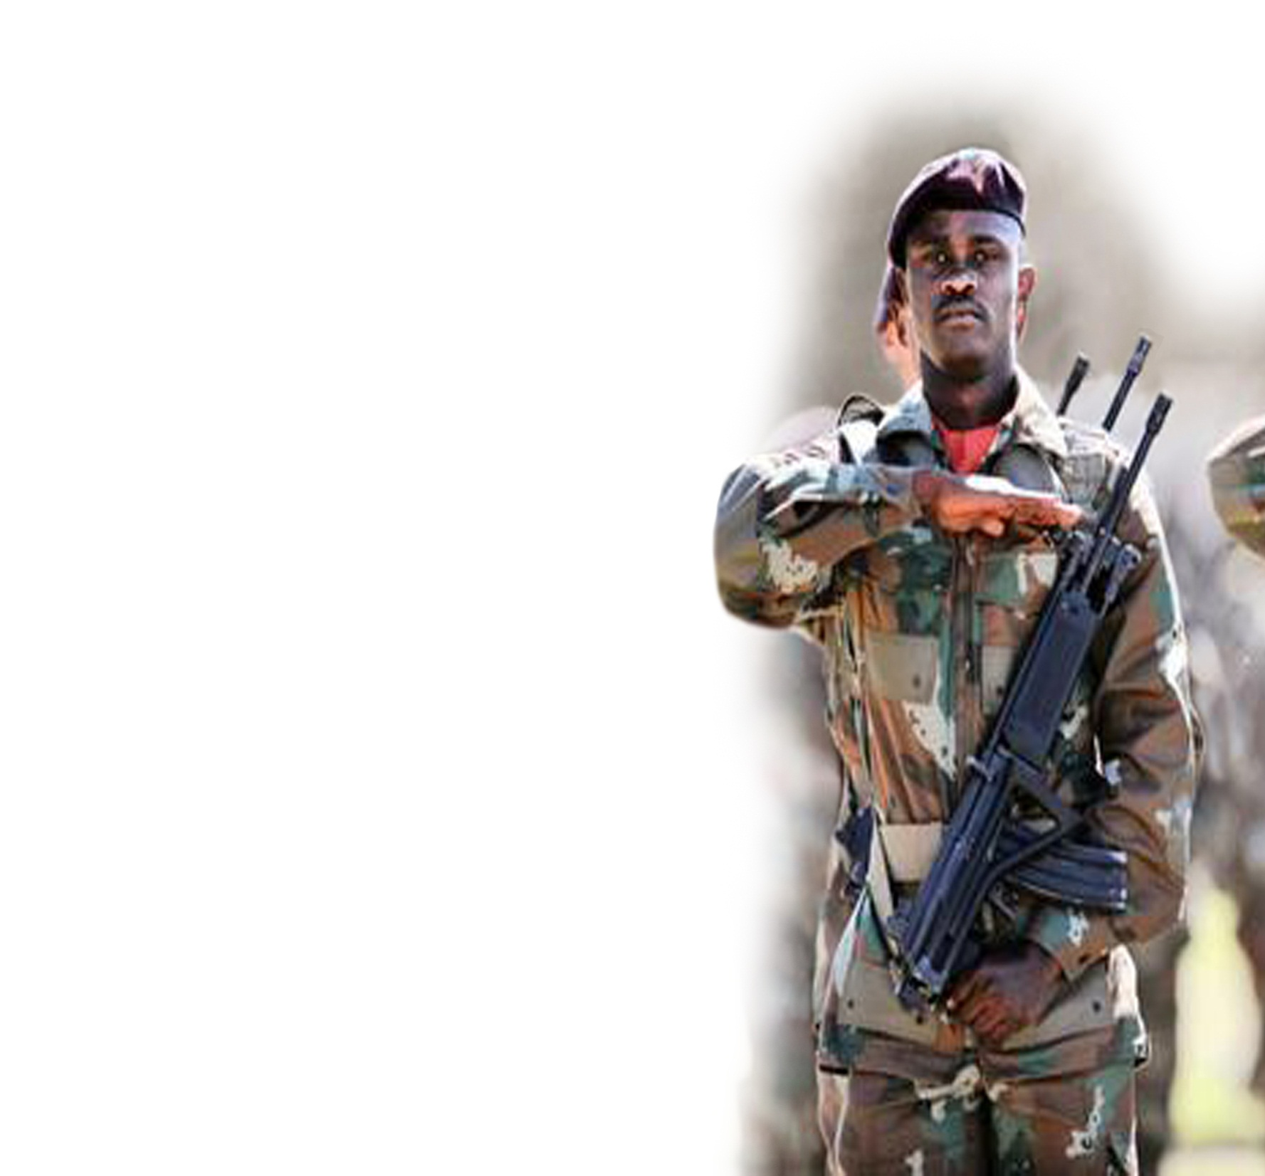
PERSONNEL (FY 2018/19)
Personnel
KEY ISSUES
Challenge
The HR component will eventually consume all resources required by the DOD to execute its mandate. This is largely due to consistent budget cuts and the capping of the CoE ceiling below the existing strength compelling the Department to source additional funding from the operating portion of the budget.
Implication
The DoD may be unable to provide value against its funding from the fiscus as all other elements of POSTEDFIT will be negatively affected.
Lifting of the CoE through additional funding.

Slide 10
Historic Actual Strength of the DOD
PERSONNEL (FY 2018/19)
Personnel DOD Rejuvenation Plan
79,108
78,586
78,979
78,513
77,964
77,383
76,173
74,851
73,988
Strength as on 31 March 2020

Slide 11
Mustering Distribution in the SANDF
PERSONNEL (FY 2018/19)
Personnel DOD Rejuvenation Plan
Total Strength
Uniform | 64 313
Civilian | 9 675
Grand Total | 73 988
MUSTERING CATEGORY | AVE AGE | AVE YRS IN RANK
Combat | 38 | 8
Professional | 41 | 7
Support | 40 | 6
Technical | 39 | 6
Grand Total | 39 | 7

Slide 12
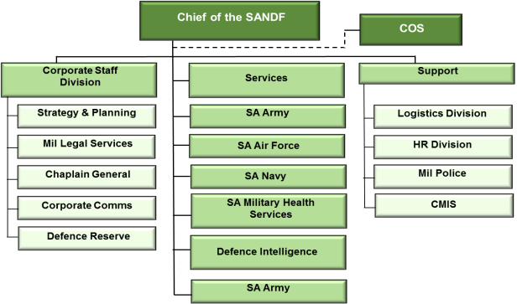
Organisation
KEY ISSUES
Challenge
The Defence Allocation only funds 63% of the organisational full requirement. The relative decline in resource allocation to the operating portion (goods and services) of the budget significantly inhibits performance and sustainability of military operations and the day-to-day functioning of the DOD.
The standard models used for inflation adjustments to the allocation do not apply to Defence. (Defence Inflation is higher)
Implication
This has led to a decline in the ability to execute efficient and effective military operations.

Slide 13
Organisation
KEY ISSUES
Challenge
Capital Budget - The SDA budget allocation for the renewal and modernisation of PME has been withdrawn almost entirely (2021). This will certainly cause irreparable harm to the status of PME as well as the future viability of the Defence Industry.
Implication
No new acquisition and no partial acquisition for the SANDF. No technology renewal. The DOD will experience declining equipment availability for operations due to poor serviceability and inadequate maintenance owing to ageing. DOD PME is characterized by growing obsolescence in combat equipment and systems leading to incomplete or partial capabilities. Reduced overall combat readiness.

Slide 14
SPECIAL DEFENCE ACCOUNT
Special Defence Account
The Sovereignty Question. The major defence contractor at this stage is DENEL with almost 80% of orders coming from the SANDF (DOD). The forfeiture/loss of the Special Defence Account implies the loss of local defence industry including the skill set. Sovereign technology innovation may not realise. In situations of war or external aggression, South Africa will not have a defence related industry of its own for arms manufacturing and modernisation. Partly our sovereignty is at risk of being eroded due to future reliance on foreign defence industries

Slide 15
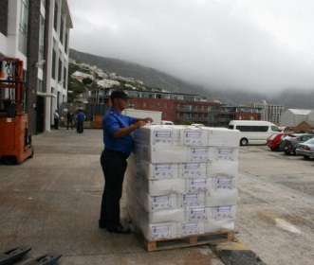
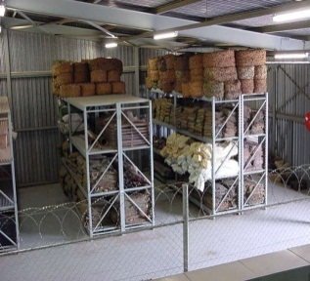
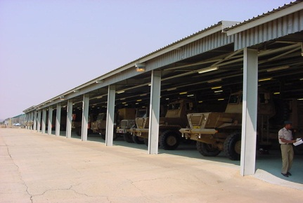
Sustainment
KEY ISSUES
Challenge
Year on year experience indicates a decline in the ability to maintain and sustain military processes and activities especially pertaining to military specific commodities and equipment. Notably, Stock levels are inadequate to support current defence commitments.
Implication
This has led to a decline in defence capabilities and effective military operations.

Slide 16
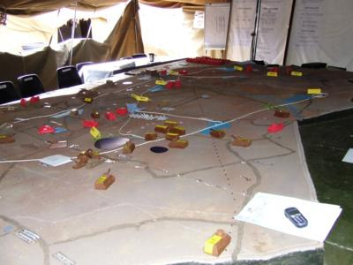
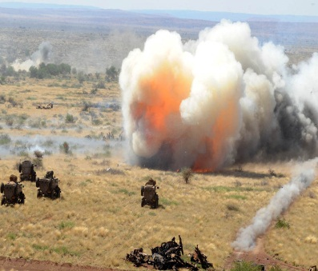
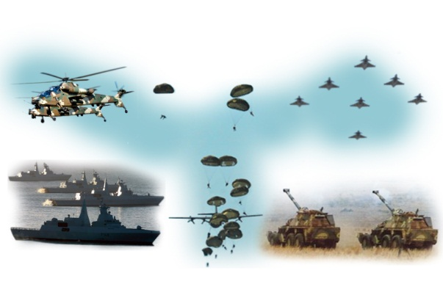
PERSONNEL (FY 2018/19)
Training and Doctrine
KEY ISSUES
Challenge
The relative decline in resource allocation to the operating portion of the budget significantly inhibits the ability of the SANDF to provide effective training for individuals, single service and joint domains. Training has been significantly reduced. The training Centre's of Excellence are losing the ability to offer and execute required quality combat training to enable effective operations. Doctrinal knowledge gap becomes an obvious risk.
Implications
Military capabilities are not prepared to the required level of combat readiness leading to the inability to execute the expected range of operations. This introduces significant risk in terms of command and control and safety.

Slide 17
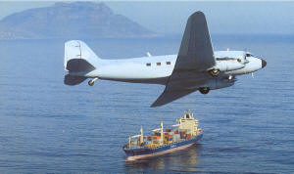
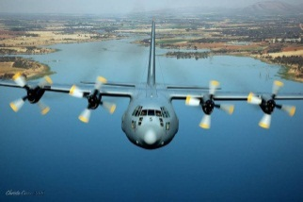
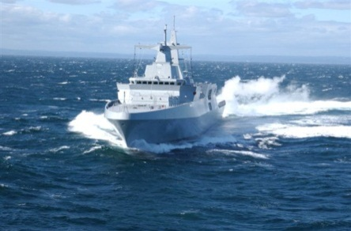
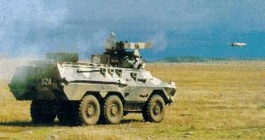
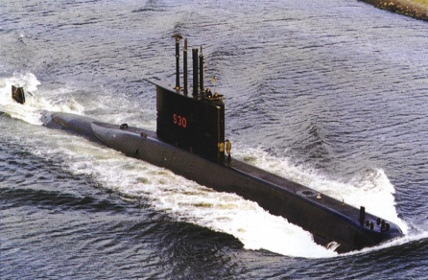
Equipment
KEY ISSUES
Challenge
The SANDF faces equipment obsolescence and the DR 2015 has had no direct intervention to avert the current state of decline in defence capabilities. Most of the PME are ageing with very slim prospects for modernization.
Implications
Maintenance backlog will continue with consequent loss of industry expertise and PME unless funding is made available. The backlog on Rotational Preventative Maintenance may collapse PME.

Slide 18
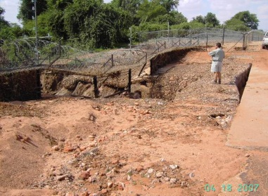
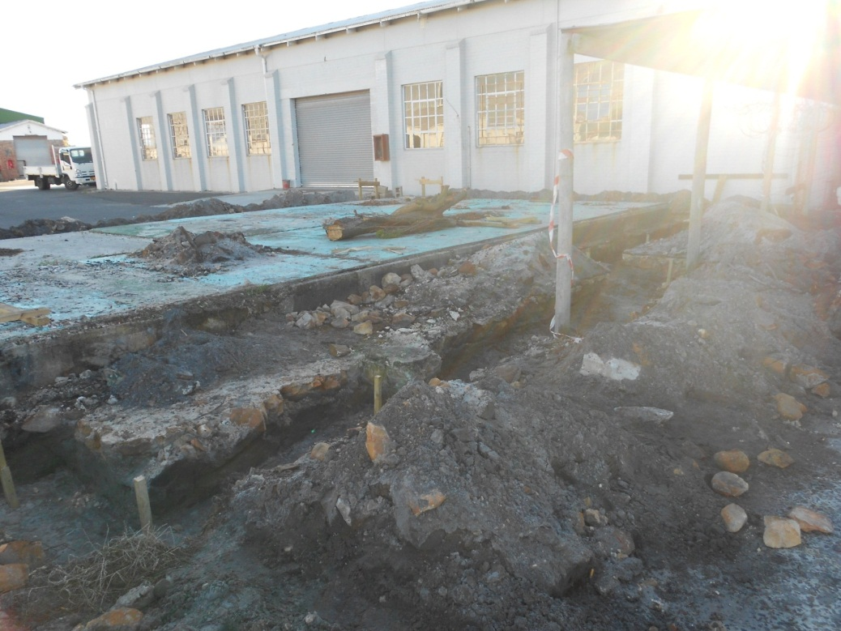
Facilities
KEY ISSUES
Challenge
The relative underfunding of DOD facilities has resulted in the degradation of the property portfolio. Combat readiness is extremely affected because the endowment property portfolio cannot be optimally utilised (OHS challenges) due to the inability of NDPW to maintain them. Internal capacity has been established but requires professionals for planning and quality assurance – the funding question. At this stage they are responsible for maintenance and refurbishment of endowment properties.
Implications
Maintenance and repair backlogs will continue in the medium term, with consequent exponential increases in the costs to maintain the current facility footprint.

Slide 19
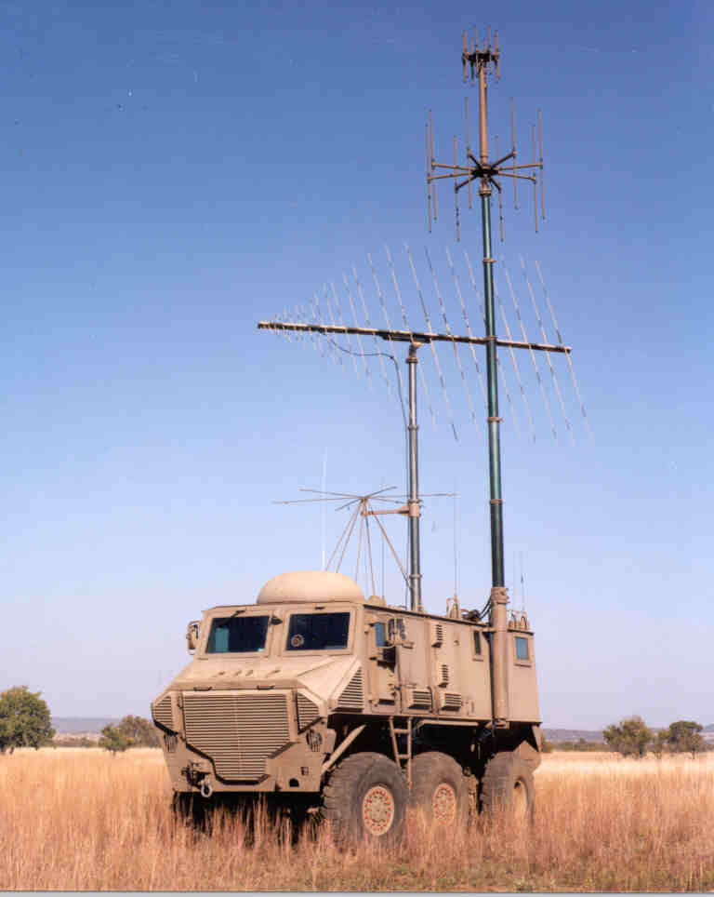
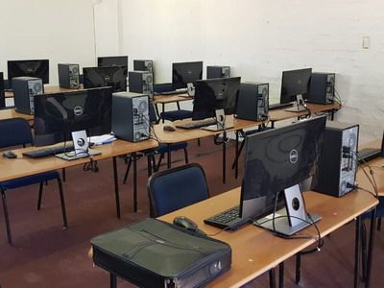
Information
KEY ISSUES
Challenge
The current DOD enterprise architecture is not coherent, fit for purpose and compatible with modern information systems and therefore does not provide sufficient real-time management information for decision making and compliance to governance requirements.
Implications
Defence ICT systems are largely legacy systems becoming increasingly unstable and vulnerable to cyber threats. Essential components of the enterprise system suffers down-time resulting in non-compliance with a number of audit and accounting requirements.

Slide 20
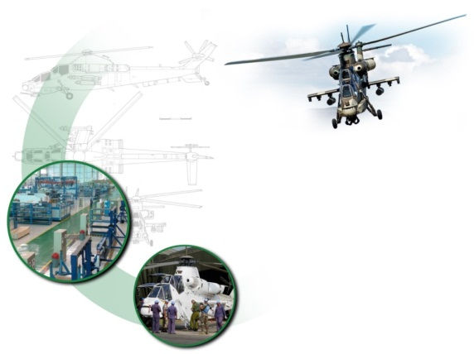
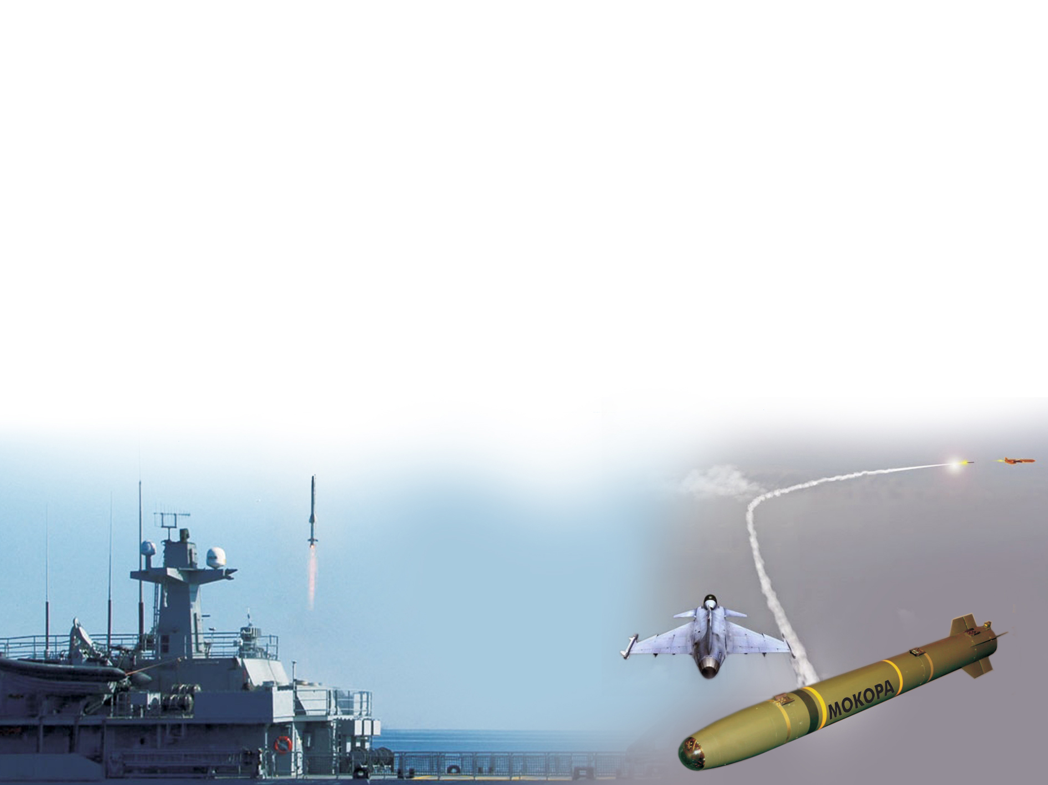
Technology
KEY ISSUES
Challenge
South Africa used to be the amongst the best in the world wrt technological development. The continuous need to renew, maintain and modernise landward, aerospace and maritime technology is seriously affected. However, the need to provide a real time operating picture to enhance “boots on the ground” during military operations remains.
Implications
Sovereign technology can no longer be guaranteed. Outdated technology providing less winning edge may continue to be utilised during military operations.
Loss of IP.

Slide 21
DEFENCE BUDGET ALLOCATION: AREAS OF UNDERFUNDING /UNDERSPENDING
Defence Budget Allocation
2019
0.97% GDP

Slide 22
BUDGET REDUCTIONS AND REPRIORITISATION (2008/09 – 2020/21)
Defence Budget Allocation
MTEF Cycle | 2008/09 | 2009/10 | 2010/11 | 2011/12 | 2012/13 | 2013/14 | 2014/15 | 2015/16 | 2016/17 | 2017/18 | 2018/19 | 2019/20 | 2020/21 | 2021/22 | 2022/23 | TOTAL
 | R Million | R Million | R Million | R Million | R Million | R Million | R Million | R Million | R Million | R Million | R Million | R Million | R Million | R Million | R Million | R Million
2008/09 | -23 | -50 | -99 |  |  |  |  |  |  |  |  |  |  |  |  | -172
2009/10 |  | -450 | -544 | -596 |  |  |  |  |  |  |  |  |  |  |  | -1 590
2010/11 |  |  | -447 | -627 | -624 |  |  |  |  |  |  |  |  |  |  | -1 698
2011/12 |  |  |  | -507 | -568 | -549 |  |  |  |  |  |  |  |  |  | -1 624
2012/13 |  |  |  |  | -516 | -531 | -663 |  |  |  |  |  |  |  |  | -1 710
2013/14 |  |  |  |  |  | -50 | -85 | -350 |  |  |  |  |  |  |  | -485
2014/15 |  |  |  |  |  |  | -500 | -700 | -900 |  |  |  |  |  |  | -2 100
2015/16 |  |  |  |  |  |  |  | -722 | -1 062 | -985 |  |  |  |  |  | -2 769
2016/17 |  |  |  |  |  |  |  |  | -51 | -1 369 | -2 324 |  |  |  |  | -3 744
2017/18 |  |  |  |  |  |  |  |  |  | -113 | -102 | -131 |  |  |  | -346
2018/19 |  |  |  |  |  |  |  |  |  |  | -2 660 | -3 338 | -3 521 |  |  | -9 519
2019/20 |  |  |  |  |  |  |  |  |  |  |  | -183 | -174 | -5 035 |  | -5 392
2020/21 |  |  |  |  |  |  |  |  |  |  |  |  | -750 | -756 | -583 | -1 506
TOTAL | -23 | -500 | -1 090 | -1 730 | -1 708 | -1 130 | -1 248 | -1 772 | -2 013 | -2 467 | -5 086 | -3 652 | -4 445 | -5 791 | -583 | -32 655

Slide 23
Underfunding: Compensation of Employees
Planned on the bases of 75 000 HR strength
R’000 | 2018/19 | 2019/20 | 2020/21 | 2021/22 | 2022/23
CoE ceiling (Indicative baseline) | 27 116 696 | 29 193 710 | 30 489 144 | 32 528 400 | 33 730 459
Baseline adjustment | _ | _ | 688 543 | 675 837 | 917 957
CoE ceiling (revised baseline) | 27 116 696 | 29 193 710 | 31 177 687 | 33 204 237 | 34 648 416
CoE Full Cost (Planned) | 30 011 960 | 31 891 704 | 34 195 252 | 36 597 365 | 39 224 288
Shortfall | - 2 895 264 | -2 697 994 | -3 017 565 | -3 393 128 | -4 575 872
Note: Real time Information as on 13/02/2020

Slide 24
Underfunding Operating: Requirement vs Allocation
R’000 | 2018/19 (Actual) | 2019/20 | 2020/21 | 2021/22 | 2022/23
*Operating | 17 177 474 | 16 619 280 | 18 684 529 | 17 526 903 | 18 425 899
Baseline reductions | (2 895 263) | (2 697 924) | (5 818 107) | (4 614 294) | (6 088 492)
Revised Baseline | 14 282 211 | 13 921 356 | 12 866 422 | 12 912 609 | 12 337 407
% Reduction | 16.85% | 16.23% | 31.13% | 26.32% | 33.04%
Full Cost (Planned) | 40 042 332 | 35 522 063 | 35 627 551
Shortfall/ Surplus | (-25 760 121) | (-21 902 707) | (-22 761 129)
Note: As on 01/04/2019
Accumulative over cycles
* Operating = Full allocation minus (CoE plus SDA)

Slide 25
Conclusion
The changing nature of conflict and the complexities that arise thereto no longer afford any country the luxury of long lead times to prepare for counter measures against the threats that will disrupt the nation state. It is for this reason that very careful consideration be given to the funding of the defence function.
The Defence Force’s vision remains as “effective defence for a democratic South Africa”, a vision that must be carried and inculcated to the next generation of soldiers in a patriotic manner.

