Slide 1
DPSA 2020 – 2025 STRATEGIC PLAN & 2020/2021 ANNUAL PERFORMANCE PLAN
May 2020

Slide 2
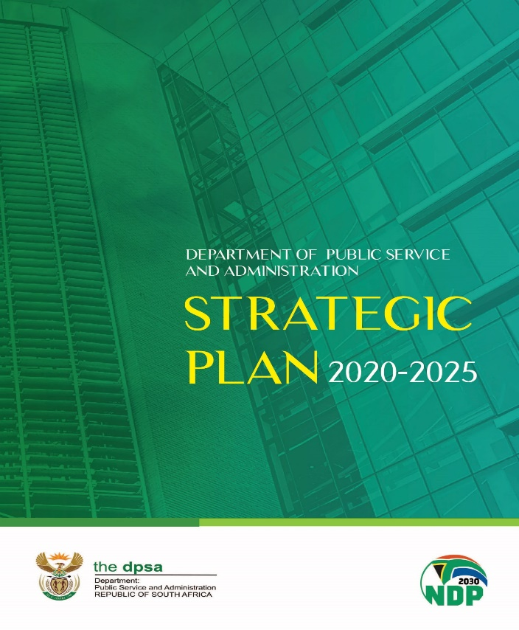
PRESENTATION OUTLINE
Introduction
Constitutional and Legislative Mandates
Strategic Alignment
2020 – 2025 Strategic Plan and 2020/2021 Annual Performance Plan
2020/2021 DPSA Annual Performance Plan Targets
2020/2021 – 2022/2023 Budget Allocations

Slide 3
INTRODUCTION
The Department of Public Service and Administration’s 2020 – 2025 Strategic Plan and 2020/21 Annual Performance Plan (APP) were tabled in Parliament in April 2020.
Both the Strategic Plan and APP are informed by and aligned to the Priority 1 (one) “Building a Capable, Ethical and Developmental State” of the 2019 – 2024 Medium Term Strategic Framework (MTSF) and the DPSA’s policy related priorities.
For the 2020/21 financial year, the Department has 32 annual targets in the APP as compared to 35 annual targets in the 2019/20 financial year.
Of the 32 annual targets, 12 (38%) targets are derived from the 2019 – 2024 Medium Term Strategic Framework and the other targets are in line with the Minister’s priorities as well as the Department’s mandate and policy priorities.

Slide 4
CONSTITUTIONAL AND LEGISLATIVE MANDATES (1)
The DPSA draws its mandate from;
Section 197 (1) and (2) of the Constitution,
Public Service Act, 1994
Public Administration Management Act ( PAMA), 2014

Slide 5
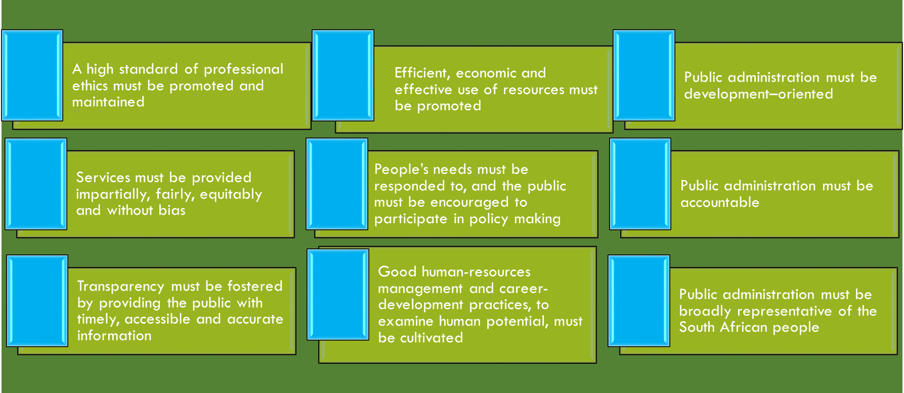
CONSTITUTIONAL AND LEGISLATIVE MANDATES (2)
According to Chapter 10 (Section 195 [1] of the Constitution of the Republic of South Africa,
within public administration there is a Public Service for the Republic, which must function, and be structured, in terms of national legislation, and which must loyally execute the lawful policies of the government of the day. The terms and conditions of employment in the Public Service must be regulated by national legislation. Employees are entitled to a fair pension as regulated by national legislation.
public administration must be governed by the democratic values and principles enshrined in the Constitution, including the following 9 (Nine) principles:

Slide 6
CONSTITUTIONAL AND LEGISLATIVE MANDATES (3)
In terms of the Public Service Act of 1994 the Minister for the Public Service and Administration is responsible for establishing norms and standards relating to;
The functions of the Public Service;
The organisational structures and establishments of departments and other organisational and governance arrangements in the Public Service;
The conditions of service and other employment practices for employees;
Labour relations in the Public Service;
Health and wellness of employees;
Information management in the Public Service;
Electronic government;
Integrity, ethics, conduct and anti-corruption in the Public Service; and
Transformation, reform, innovation and any other matter to improve the effectiveness and efficiency of the Public Service and its service delivery to the public.

Slide 7
CONSTITUTIONAL AND LEGISLATIVE MANDATES (4)
The Public Administration Management Act, 2014 seeks to provide a uniform legal framework across the three spheres of government for bringing some degree of commonality of purpose in key public administration areas, was signed into law by the President of the Republic of South Africa in December 2014.
The Act aims to:
promote and give effect to the values and principles in Section 195 (1) of the Constitution;
provide for the transfer and secondment of employees;
promote a high standard of professional ethics in the public administration;
promote the use of information and communication technologies in the public administration;
promote efficient service delivery in the public administration;
facilitate the eradication and prevention of unethical practices in the public administration; and
provide for the setting of minimum norms and standards to give effect to the values and principles of section 195 (1) of the Constitution.

Slide 8
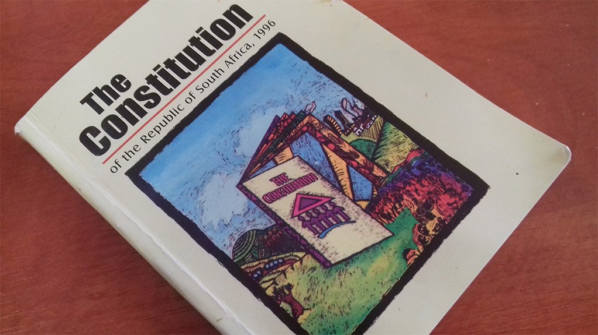
STRATEGIC ALIGNMENT
CONSTITUTION & LEGISLATIVE MANDATE
(Chapter 10)
Public administration governed by democratic values and principles
NATIONAL DEVELOPMENT PLAN
(Chapter 13)
Building a Capable and Developmental State
RULING PARTY ELECTION MANIFESTO
2019 - 2024
MEDIUM TERM STRATEGIC FRAMEWORK
(Priority 1)
Building a Capable, Ethical and
Developmental State
STATE OF THE NATION ADDRESS
DEPARMENTAL PLANS
2020 - 2025 Strategic Plan
2020/2021 Annual Performance Plan
2020/2021 Annual Operational Plan

Slide 9
2020 – 2025 STRATEGIC PLAN AND 2020/2021 ANNUAL PERFORMANCE PLAN
The MTSF targets which the DPSA is leading are the following:
Public Service Amendment Bill, 1994 submitted to Parliament by 2023 to include devolution of administrative powers from of executive authorities to heads of department. Regulations for the Public Administration Management Act, 2014 submitted to relevant stakeholders for concurrence by 2024. Public Administration Management Amendment Bill submitted to Parliament by 2023. Organisational Functionality Assessment Tool implemented as a mechanism to measure the levels of productivity and functionality (efficiency and effectiveness) of departments in supporting service delivery objectives by 2022. Business Processes Modernisation Programme in the Public Service approved by 2020 and implemented by 2023. | National e-Government Strategy and Roadmap implemented by 2024 towards digitalisation of government services. Job Competency Framework for the Public Service implemented by 2023. Programme to institutionalise professional code of ethics in the public administration by 2023. Lifestyle Audit Guideline developed and approved by March 2021. Income differential data collection tool (EEA4 form) for designated employers developed by 2022 (this target has not been included in the APP as clarity on the DPSA’s role will be sought from the Department of Planning, Monitoring and Evaluation. The form is developed by the Department of Employment and Labour).

Slide 10
2020/2021 DPSA ANNUAL PERFORMANCE PLAN TARGETS (1)
PROGRAMME 1: ADMINISTRATION
1. | Fruitless, wasteful and irregular expenditure monitored
2. | Compliance on the Broad-Based Black Economic Empowerment (BBBEE) status monitored
3. | Draft Public Service Amendment Bill submitted to the Office of the Chief State Law Advisor for pre-certification (MTSF Target)
4. | Consultations with the Department of Cooperative Governance on the draft Public Administration Management Amendment Bill (MTSF Target)
5. | Regulations on selected areas of the Public Administration Management Act developed (MTSF Target)
6. | Review of the identified DPSA policies commenced
7. | Annual report on the compliance by national and provincial departments with DPSA policies produced

Slide 11
2020/2021 DPSA ANNUAL PERFORMANCE PLAN TARGETS (2)
PROGRAMME 2: POLICY DEVELOPMENT, RESEARCH AND ANALYSIS
1. | Organisational Functionality Assessment Tool issued to national and provincial departments for implementation by all national and provincial departments (MTSF Target)
2. | Quarterly report on the compliance by national and provincial departments with DPSA policies produced

Slide 12
2020/2021 DPSA ANNUAL PERFORMANCE PLAN TARGETS (3)
PROGRAMME 3: PUBLIC SERVICE EMPLOYMENT AND CONDITIONS OF SERVICE
Wage Setting mechanism for the Public Service developed Transition plan for the implementation of the Uniform Job Grading System developed Guideline for the implementation of proposals on the reduction of costs in public administration issued Programme to improve the management of discipline within the Public Service developed Implementation of the Performance Management and Development System for Heads of Department, Senior Management Service and levels 1 - 12 monitored Approved Senior Management Service post provisioning norms and standards issued for implementation by national and provincial departments Quarterly report on the compliance by national and provincial departments with DPSA policies produced

Slide 13
2020/2021 DPSA ANNUAL PERFORMANCE PLAN TARGETS (4)
PROGRAMME 4: GOVERNMENT CHIEF INFORMATION OFFICER
Audit report on the implementation of the National e-Government Strategy issued to national and provincial departments (MTSF Target) Public Service Data Governance Framework submitted for approval Status and recommendations for improvements on the Public Service Information and Communication Technology infrastructure developed Public Service Information Security Standard issued to national and provincial departments Quarterly report on the compliance by national and provincial departments with DPSA policies produced

Slide 14
2020/2021 DPSA ANNUAL PERFORMANCE PLAN TARGETS (5)
PROGRAMME 5: SERVICE DELIVERY SUPPORT
Implementation plan and road map for the Revised Batho Pele Programme, Public Service Month and Batho Pele Awards submitted for approval African Peer Review Mechanism 2nd Generation country review conducted Business Processes Modernisation Programme developed (MTSF Target) Quarterly report on the compliance by national and provincial departments with DPSA policies produced

Slide 15
2020/2021 DPSA ANNUAL PERFORMANCE PLAN TARGETS (6)
PROGRAMME 6: GOVERNANCE OF PUBLIC ADMINISTRATION
Guidelines on conducting lifestyle audits issued to national and provincial departments (MTSF Target) Database on Public Service employees appointed as board members to entities compiled (MTSF Target) Further category of employees in the Public Service designated to disclose their financial interests Analysis conducted on the adherence by designated employees from national and provincial departments to the Financial Disclosure Framework (MTSF Target) Cabinet Memorandum on the retention of Heads of Department developed Job Competency Framework for the Public Service developed (MTSF Target) Guidelines for Senior Management Service members participation in professional bodies issued to national and provincial departments (MTSF Target)

Slide 16
BUDGET ALLOCATIONS
DPSA 2020/21 - 2022/23 Medium Term Expenditure Framework (MTEF) Allocation = R1 800 Billion
DPSA Annual Allocation for 2020/21 = R565 706 Million
As from 1 April 2020, the DPSA will no longer be making transfer payments to the Public Service Commission (PSC) and the National School of Government (NSG) as these entities will be receiving their funding directly from the National Treasury.

Slide 17
APPROPRIATION FOR 2020/21 – 2022/23
DESCRIPTION | 2020/21 R’000 | 2021/22 R’000 | 2022/23 R’000
Administration | 258,264 | 275,692 | 286,621
Policy Development, Research and Analysis | 39,541 | 41,865 | 42,446
Public Service Employment and Condition of Service | 77,690 | 81,929 | 84,095
Government Chief Information Officer | 28,575 | 30,271 | 31,671
Service Delivery Support | 60,557 | 64,393 | 65,522
Governance of Public Administration | 60,245 | 69,172 | 72,062
Total DPSA Budget Allocations | 524,872 | 563,322 | 582,417
Centre for Public Service Innovation | 40,834 | 43,302 | 45,090
TOTAL MPSA BUDGET ALLOCATIONS | 565,706 | 606,624 | 627,507

Slide 18
BREAKDOWN OF 2020/21 ANNUAL ALLOCATION

Slide 19
2020/21 ALLOCATION PER ECONOMIC CLASSIFICATION
DESCRIPTION | 2020/21 R’000 | 2021/22 R’000 | 2022/23 R’000
Compensation of Employees | 333,700 | 360,689 | 376,441
Goods and Services | 185,890 | 197,064 | 200,144
Transfers and Subsidies | 43,195 | 45,791 | 47,669
Payment of Capital Assets | 2,921 | 3,080 | 3,253
TOTAL | 565,706 | 606,624 | 627,507

Slide 20
Enkosi

