Slide 1
STANDING COMMITTEE ON HUMAN SETTLEMENTS
Presented by: Ms. J Samson
Date: 20 May 2020

Slide 2
Contents
Introduction
Stakeholder Engagements: Du Noon
New design concept
Benefits of new generation PRA
Prototypes
Conceptual layout
Specification

Slide 3
1. INTRODUCTION
On the 15th of March 2020, President Ramaphosa declared the current COVID-19 pandemic to be a National Disaster in terms of Act 57 of 2002.
The National Departments were subsequently requested to initiate programmes and / issue directives and regulations under their respective portfolios to contain the spread of the virus.
The National Department of Human Settlements identified amongst other things, the need to de-densify overcrowded areas as a response to the containment of the virus.
29 informal settlements were subsequently identified across the country targeting 356 010 households.
The following three (3) areas were identified in the Western Cape:
Du Noon: 1 500
Kosovo: 2 000
Khayelitsha: 3 000

Slide 4
1. INTRODUCTION CONT…
The Department already had plans in the pipeline for 2 out of the 3 areas identified and land was secured for Du Noon (2018) and Kosovo (2019) respectively.
These land parcels are within walking distance from the existing settlements.
Due to scarcity of land to accommodate 3000 households within Khayelitsha, iThemba, which is currently owned by NDPW, was identified as the suitable site to accommodate households from Khayelitsha and Airport Precinct.
The COVID-19 pandemic coupled with Minister Sisulu’s directive has necessitated that the Department immediately accelerate the plans to de-densify the overcrowded areas of Du Noon, Kosovo and Khayelitsha in order to combat the potential disastrous spread of the virus.
The Department is working closely with the City of Cape Town and the Housing Development Agency (HDA), and has developed an implementation plan for the de-densification of the identified areas.

Slide 5
2. STAKEHOLDER ENGAGEMENTS: DU NOON
Date | Stakeholders | Purpose
11 – 30 April 2020 | Sub council chairperson Ward committee members Ward Councillor Officials | To inform the meeting that Du Noon will be de-densified and to inform them of developments.
20 April 2020 | Provincial Minister of HS Mayoral Committee for HS in the CoCT Head of Department – Provincial Department of HS HDA Regional Head Ward Councillor | To provide the National Minister of Human Settlement with a report of the interventions which will accommodate households from the high density settlements.

Slide 6
2. STAKEHOLDER ENGAGEMENTS: DU NOON CONT…
Date | Stakeholders | Purpose | Resolution
28 – 29 April 2020 | Premier of the Western Cape Provincial Minister of HS Executive Mayor of the CoCT Mayoral Committee Members responsible of HS (CoCT) Ward Councillor | Race Park requested meeting to raise their concerns regarding the RISSUP project. | A follow up meetings to be convened with the Race Park Rate Payers Association and the officials from the Provincial DHS and the CoCT Meeting resolved that a fourth option should be explored and presented at the next meeting Traffic engineer to meet with the Race Park representatives to discuss some matters related to the entrance to the park.

Slide 7
3. NEW DESIGN CONCEPT
Significant inroads have been made in terms of the provision of housing and access to basic services.
The challenge still remains:
growth in the number of informal settlements;
Increase in the housing backlog.
Based on the latest housing demand appr R100 billion is required to address the backlog.
This together with the shrinking economy requires a different delivery and funding model.
In response, the Department is seeking to pilot a new approach to the informal settlement upgrading and housing delivery in general.
The current COVID-19 challenge has presented an opportunity for reforms within the sector to look at ramping up housing delivery by accelerating the speed at which houses are delivered at reduced costs without compromising on quality of life.

Slide 8
4. BENEFITS OF NEW GENERATION PRA
Standard Emergency Housing Programme | New Generation ”PRA”
1 ablution for 5 families | 1 kitchen for each family & 1 ablution for 2 families sharing
1 water point or tap for every 25 families | 1 water tap to 1 family
The Shelter size is - 18m² - 30m² | Shelter size 24m² ⁻30m²
High maintenance cost | Low maintenance cost
Sewer and stormwater blockages | Blockages will be reduced and easily managed
Interim municipal services, prone to vandalism and wastage | Formalised municipal services (water & electricity)
Short life span. Informal structures creating slums “ Blikkiesdorp” | Durable and longer life span Flexible to be used as permanent structure
 | Can be modified /adapted to BNG and / Social Housing

Slide 9
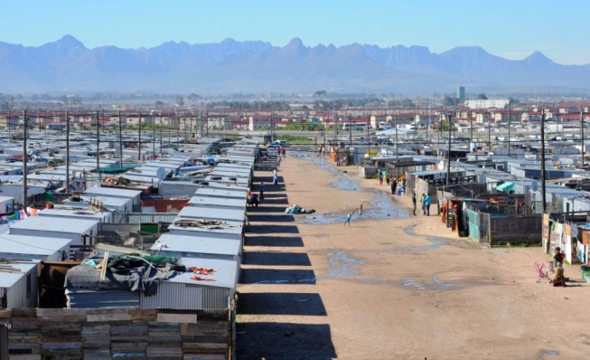
5. PROTOTYPES
Move away from

Slide 10
5. PROTOTYPES CONT…..
Move away from

Slide 11
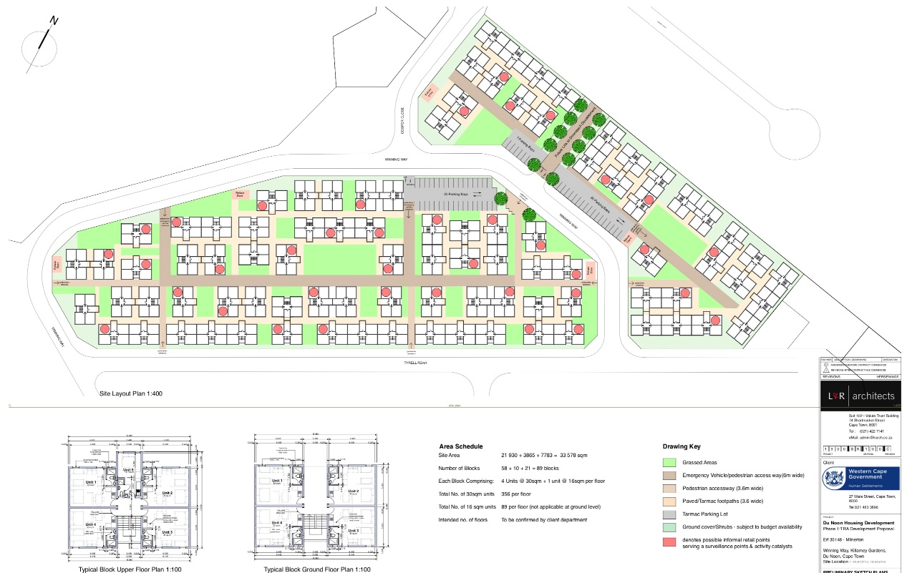
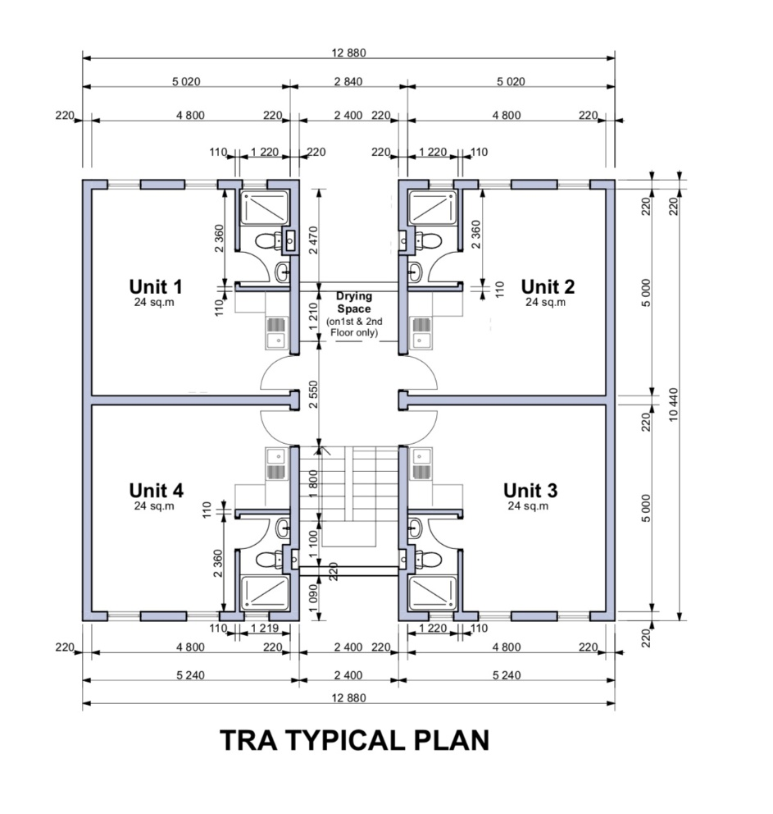
6. CONCEPTUAL LAYOUT
SITE LAYOUT AND TRA UNIT PLAN: DU NOON

Slide 12
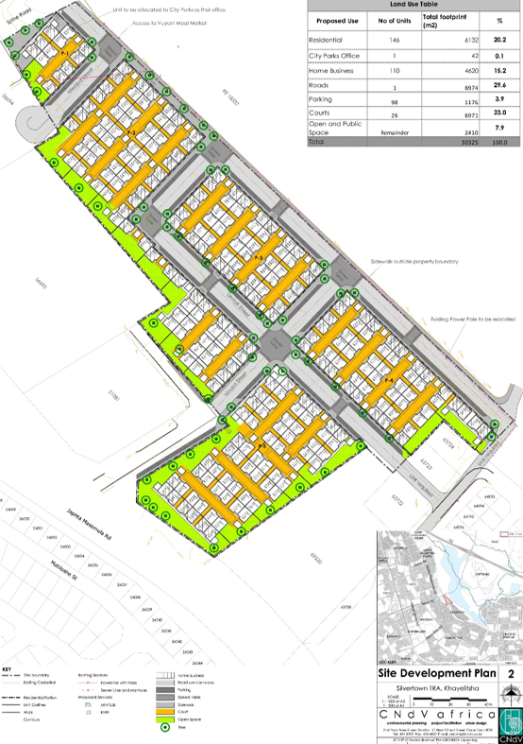
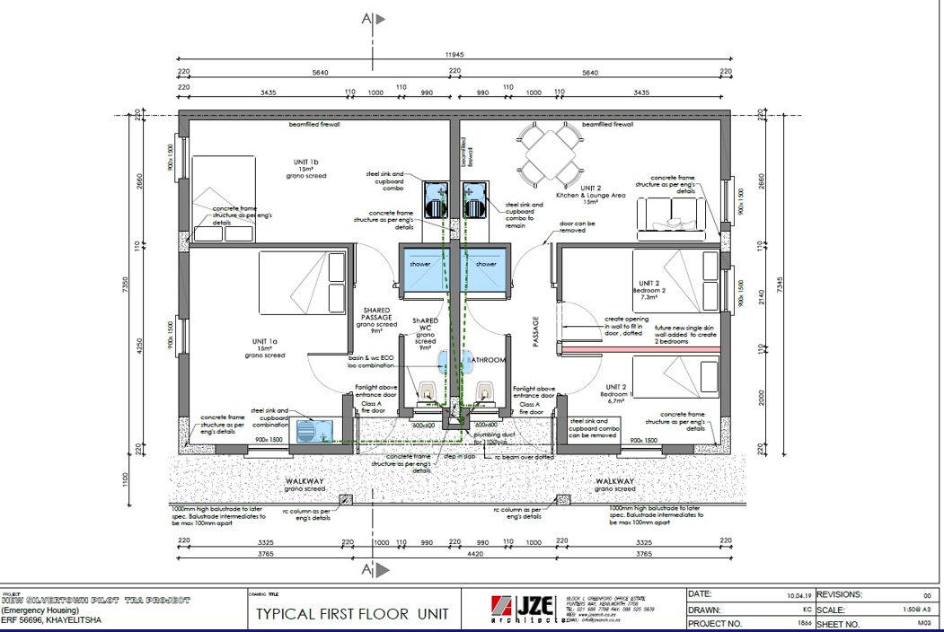
6. CONCEPTUAL LAYOUT CONT…
SITE LAYOUT AND TRA UNIT PLAN: SILVERTOWN (KHAYELITSHA)
Will ACCOMMODATE 1542 FAMILIES

Slide 13
7. SPECIFICATION
Concrete / Steel /Wooden framed structure infilled with ABT material that meets the following criteria:
Thermal performance;
Acoustic;
Resistance of water penetration;
Energy usage;
Condensation;
High durability;
60 minutes fire rating.

Slide 14
7. SPECIFICATION CONT…
GENERAL SPECIFICATIONS
The design of unit to consist of a minimum internal size of 24m2 – 30m2.
Must include area for bathroom – bathroom to consist of shower, toilet and basin.
Units must include the supply and installation of a kitchen sink on a cupboard.
All units to be signed off by a PR: Structural Engineer registered with ECSA and following certification to be submitted prior to hand over and occupation
Soil stability certificate and tests (signed by structural engineer) (DCP’s);
Structural stability;
Plumbing;
Glazing;
A19 roof certificate.
All units to comply with fire, rain penetration and insulation requirements as per SANS 10-400.

