Slide 1
PRESENTATION OF THE STRATEGIC PLAN 2020/21 – 2024/25
AND
ANNUAL PERFORMANCE PLAN 2020/21
20-05-2020

Slide 2
TABLE OF CONTENTS
Mandate, Vision, Mission, Values and Services
Compensation Fund Strategic Plan 2020/21- 2024/25
Compensation Fund Annual Performance Plan 2020 – 2021

Slide 3
1. Mandate, Vision, Mission, Values and Services

Slide 4
MANDATE
The Compensation Fund is established in terms of section 15 of the Compensation for Occupational Injuries and Diseases Act as amended.
The main objective of the Act is to provide compensation for disablement caused by occupational injuries or diseases sustained or contracted by employees or for death resulting from such injuries or diseases and provide for matters connected therewith.

Slide 5
VISION
To be a world class provider of sustainable compensation for occupational injuries and diseases, rehabilitation and reintegration services

Slide 6
MISSION
The Mission of the Compensation Fund is to:
Provide efficient, quality, client centric and accessible COID service
Sustain financial viability
Ensure an organisation which takes care of the needs of its staff for effective service delivery

Slide 7
VALUES
We shall adhere to the following values:
Respect: We will treat our customers and colleagues with respect.
Excellence: We execute our duties with dedication and fortitude.
Sinobuntu: Treat each other and clients with dignity and, care.
Pride: We model highest standard of personal and professional behaviour.
Integrity: Communicate openly and honestly with relationship based on trust.
Client-centric by Providing excellent & world class service to all.

Slide 8
FUNCTIONAL STRUCTURE
GOVERNANCE
COIDA Services
Medical Benefits
Rehabilitation
COMPLIANCE
CORPORATE SUPPORT

Slide 9
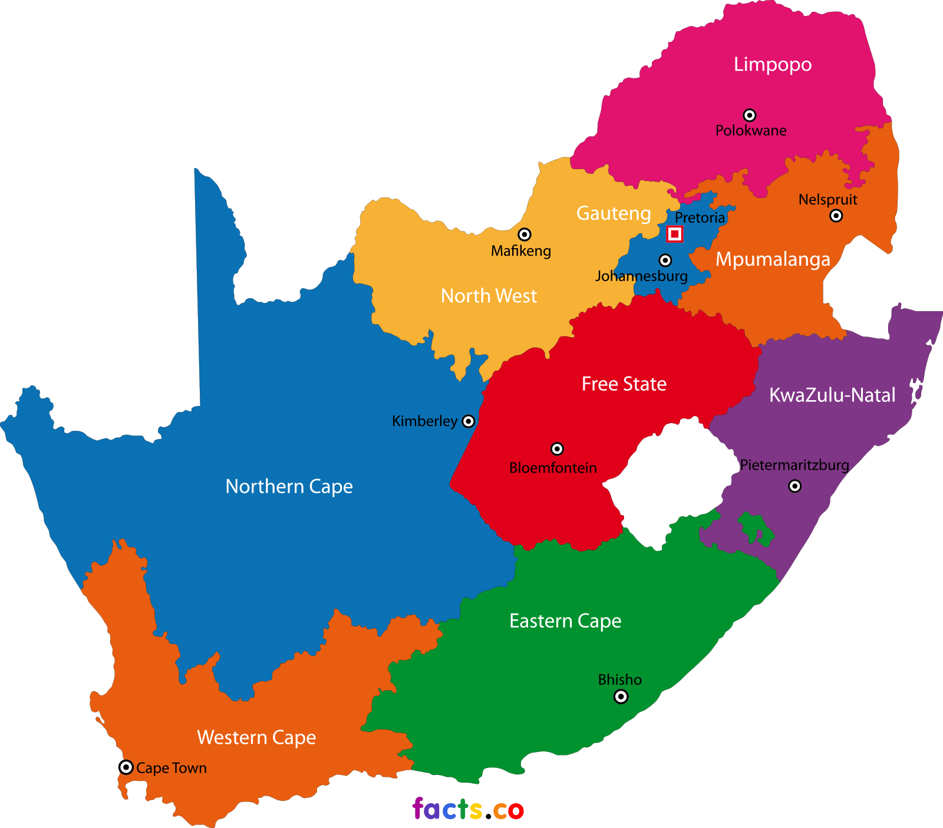
FOOTPRINT
126 LABOUR CENTRES
33 LABOUR CENTRES WITH COID FUNCTIONS

Slide 10
CHANGES TO THE LEGISLATIVE FRAMEWORK
Amendments to the Compensation for Occupational Injuries and Diseases Act (COIDA Amendment Bill) going through the approval processes:
Changes to the COIDA Include:
In order to eliminate discrimination, the Bill removes the express exclusion of domestic workers as employees. This is in conformity with international labour standards.
Negligence (contribution by the employee in occurrence of an accident) on the part of the employee will no longer be considered in accepting liability and assessment of disability whether there is serious disablement or not.

Slide 11
CHANGES TO THE LEGISLATIVE FRAMEWORK
Changes to the COIDA Include (cont…):
Strengthening Governance
Compensation benefits in the form of pension will continue to apply to the surviving dependents.
Introduction of penalties for non compliance by employers in reporting incidents
Broadening the scope of the medical advisory panel to include occupational injuries.
Introduction of Rehabilitation and Return to work

Slide 12
2. COMPENSATION FUND STRATEGIC PLAN 2020/21 – 2024/25

Slide 13
CURRENT CHALLENGES AND PROPOSED SOLUTIONS

Slide 14
CF STRATEGIC PRIORITIES IN THE NEXT MTSF
Financial Management Improve the system of internal control and maintain financial soundness. | Customer Services 2. Ensure appropriate benefits are delivered to intended beneficiaries, efficiently and at a reasonable cost. 3. Contribute to employment and economic growth through rehabilitation and re-integration.
Organisational Capacity 4. Develop the capacity of the Fund to deliver according to its mandate. | Internal Business Process 5. Improve Operational efficiency through process reengineering and technological innovation.
Anti-Fraud and Corruption elimination 6. Improved ethic and zero tolerance to fraud and corruption

Slide 15
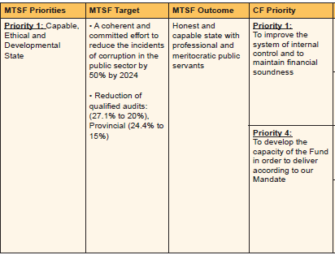
ALIGNMENT OF THE CF PRIORITIES TO THE MEDIUM TERM STRATEGIC FRAMEWORK (MTSF)

Slide 16
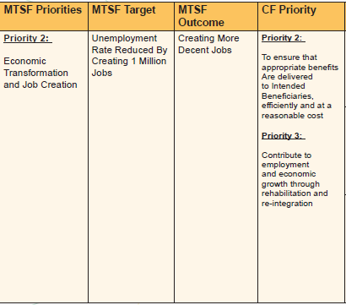
ALIGNMENT OF THE CF PRIORITIES TO THE MEDIUM TERM STRATEGIC FRAMEWORK (MTSF)

Slide 17
ALIGNMENT OF THE CF PRIORITIES TO THE MEDIUM TERM STRATEGIC FRAMEWORK (MTSF)
MTSF Priorities | MTSF Target | MTSF Outcome | CF Priority
Priority 4: Consolidating the Social Wage through Reliable and Basic Services | Implementation of the comprehensive social protection system by 2024 | Comprehensive social security coverage; efficient and effective | Priority 5: To improve operational efficiency through process reengineering and technological innovation
 |  |  | Priority 2: To ensure that appropriate benefits are delivered to Intended Beneficiaries, efficiently and at a reasonable cost
 |  |  | Priority 3: Contribute to employment and economic growth through rehabilitation and re-integration.

Slide 18
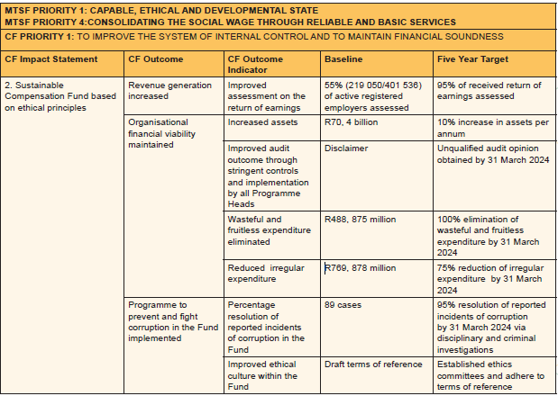
CF 5 YEAR STRATEGIC PLAN 2020/21-2024/25

Slide 19
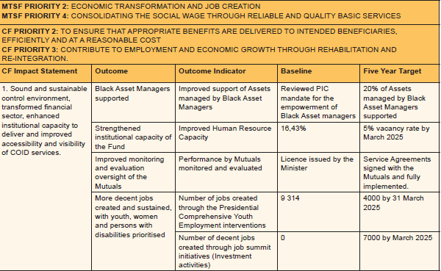
CF 5 YEAR STRATEGIC PLAN 2020/21-2024/25

Slide 20
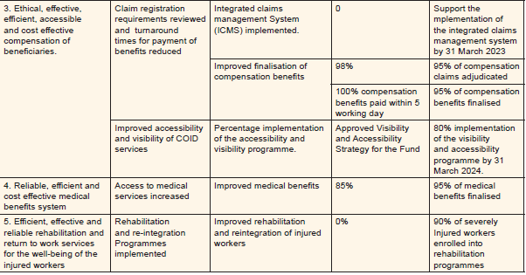
CF 5 YEAR STRATEGIC PLAN 2020/21-2024/25

Slide 21
3. COMPENSATION FUND ANNUAL PERFORMANCE PLAN 2020/21

Slide 22
PROGRAMMES OF THE COMPENSATION FUND
PROGRAMME 1: ADMINISTRATION
PROGRAMME 2: COID SERVICES
PROGRAMME 3: MEDICAL BENEFITS
PROGRAMME 4: ORTHOTICS AND REHABILITATION SERVICES

Slide 23
PERFORMANCE INDICATORS PER STRATEGIC OBJECTIVE AND PER PROGRAMME
PROGRAMME 1: Administration
1.1 Percentage of assets under Management allocated to Black Asset Managers.
1.2 Number of decent job created through investment activities
1.3 Number of jobs created through the Presidential Comprehensive Youth Employment interventions
1.4 Percentage increase in total assets per annum.
1.5 Percentage reduction in matters affecting the audit opinion
1.6 Percentage of wasteful and fruitless expenditure eliminated
1.7 Percentage of irregular expenditure reduced
1.8 Percentage implementation of programmes in the Visibility and accessibility strategy.

Slide 24
PERFORMANCE INDICATORS PER STRATEGIC OBJECTIVE AND PER PROGRAMME
PROGRAMME 1: Administration (Cont….)
1.9 Percentage of reported cases investigated
1.10 Implement ethics management Programme
1.11 Percentage reduction in vacancy rate
1.12 Number of quarterly and annual reports on monitored performance of Mutuals reporting to the Fund
PROGRAMME 2: COID Services
2.1 Percentage of received return of earnings assessed annually.
2.2 Percentage of claims adjudicated within 20 working days of receipt.
2.3 Percentage of approved benefits paid within 5 working days.

Slide 25
PERFORMANCE INDICATORS PER STRATEGIC OBJECTIVE AND PER PROGRAMME (Cont…)
PROGRAMME 3: Medical Benefits
3.1 Percentage of requests for pre-authorisation of Specialised Medical Interventions finalised within 10 working days of receipt.
3.2 Percentage of High Value and Complex Medical Cases enrolled into Case Management Programme within 7 working days.
3.3 Percentage of accepted medical invoices finalised within 30 working days of receipt.
PROGRAMME 4: Orthotic and Rehabilitation Services
4.1 Percentage of compliant requests for assistive devices finalised within 15 working days.
4.3 Number of students enrolled at Post-School Education and Training (PSET) institutions in priority qualifications funded.
4.4 Number of Persons with Disabilities enrolled in Vocational Rehabilitation Programme through Post-School Education and Training institutions funded.

Slide 26
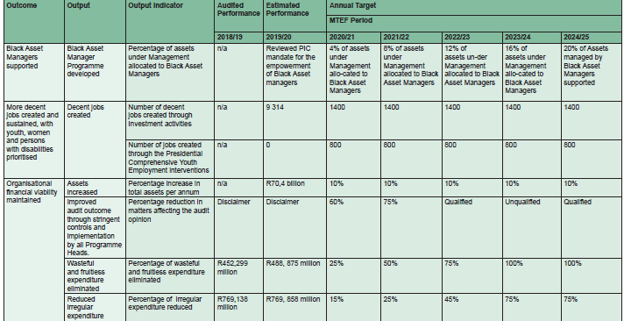
PROGRAMME 1: ADMINISTRATION
Outcomes, Outputs, Performance Indicators and Targets

Slide 27
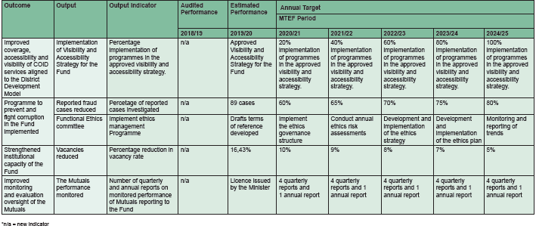
PROGRAMME 1: ADMINISTRATION
Outcomes, Outputs, Performance Indicators and Targets

Slide 28
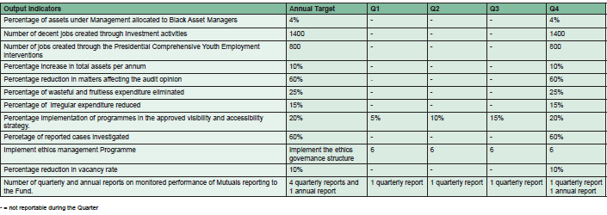
PROGRAMME 1: ADMINISTRATION
Outcomes, Outputs, Performance Indicators and Targets

Slide 29
PROGRAMME 2: COID SERVICES
Outcomes, Outputs, Performance Indicators and Targets
Outcome | Output | Output Indicator |  |  | Annual Target
 |  |  | Audited Performance | Estimated Performance | MTEF Period
 |  |  | 2018/19 | 2019/20 | 2020/21 | 2021/22 | 2022/23 | 2023/24 | 2024/25
Revenue generation increased | Assessment of the Return of Earning received | Percentage of received return of earnings assessed annually. | n/a | 55% (219 050/401 536) of active registered employers assessed | 80% | 85% | 87.5% | 90% | 95%
Access to compensation benefits increased | Claims adjudicated | Percentage of claims adjudicated within 20 working days of receipt | 94% of claims adjudicated within 40 working days of receipt. | 90% of claims adjudicated within 30 working days of receipt | 85% of claims adjudicated within 20 working days of receipt | 90% of claims received adjudicated within 15 working days | 90% of claims received adjudicated within 10 working days | 90% of claims received adjudicated within 10 working days | 90% of claims received adjudicated within 5 working days
 | Benefits paid | Percentage of approved benefits paid within 5 working days | 98% | 100% | 100% | 100% | 100% | 100% | 100%

Slide 30
PROGRAMME 2: COID SERVICES
Output Indicators | Annual Target | Q1 | Q2 | Q3 | Q4
Percentage of received return of earnings assessed annually. | 80% | - | - | - | 80%
Percentage of claims adjudicated within 20 working days of receipt | 85% | 85% | 85% | 85% | 85%
Percentage of approved benefits paid within 5 working days | 100% | 100% | 100% | 100% | 100%

Slide 31
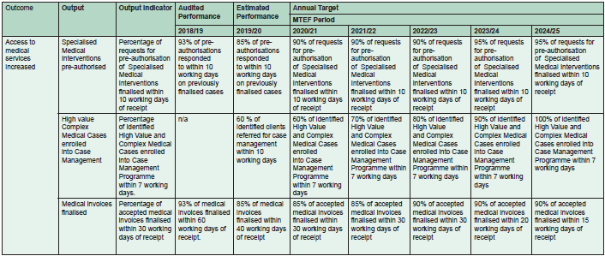
PROGRAMME 3: MEDICAL BENEFITS
Outcomes, Outputs, Performance Indicators and Targets

Slide 32
PROGRAMME 3: MEDICAL BENEFITS
Output Indicators: Annual and Quarterly Targets
Output Indicators | Annual Target | Q1 | Q2 | Q3 | Q4
Percentage of requests for pre-authorisation of Specialised Medical Interventions finalised within 10 working days of receipt | 90% of requests for pre-authorisation of Specialised Medical Interventions finalised within 10 working days of receipt | 90% | 90% | 90% | 90%
Percentage of identified High Value and Complex Medical Cases enrolled into Case Management Programme within 7 working days. | 60% of identified High Value and Complex Medical Cases enrolled into Case Management Programme within 7 working days | 60% | 60% | 60% | 60%
Percentage of accepted medical invoices finalised within 30 working days of receipt | 85% of accepted medical invoices finalised within 30 working days of receipt | 85% | 85% | 85% | 85%

Slide 33
PROGRAMME 4: ORTHOTIC AND REHABILITATION SERVICES
Output Indicators: Annual and Quarterly Targets
Outcome | Output | Output Indicator | Audited Performance | Estimated Performance | Annual Target
 |  |  |  |  | MTEF Period
 |  |  | 2018/19 | 2019/20 | 2020/21 | 2021/22 | 2022/23 | 2023/24 | 2024/25
Rehabilitation and re-integration Programmes implemented | Requests for assistive devices finalised | Percentage of compliant requests for assistive devices finalised within 15 working days | 93% | 93% | 85% | 85% | 90% | 95% | 95%
 | Eligible Post-School Education and Training (PSET) students funded | Number of students enrolled at Post-School Education and Training (PSET) institutions in priority qualifications funded | n/a | 311 | 500 | 1350 | 2200 | 3100 | 4000
 | Persons with Disabilities funded | Number of Persons with Disabilities enrolled in Vocational Rehabilitation Programme through Post-School Education and Training institutions funded. | n/a | n/a | 100 | 250 | 450 | 700 | 1000

Slide 34
PROGRAMME 4: ORTHOTIC AND REHABILITATION SERVICES
Output Indicators: Annual and Quarterly Targets
Output Indicators | Annual Target | Q1 | Q2 | Q3 | Q4
Percentage of compliant requests for assistive devices finalised within 15 working days | 85% | 85% | 85% | 85% | 85%
Number of students enrolled at Post-School Education and Training (PSET) institutions in priority qualifications funded | 500 | 500 | - | - | -
Number of Persons with Disabilities enrolled in Vocational Rehabilitation Programme through Post-School Education and Training institutions funded. | 100 | 45 | 70 | 80 | 100

Slide 35
BUDGET
Budget per item
Revenue: R14 145 817
Benefits: R4 149 889
Administration Expenses: R2 960 940
Budget per programme
Programme 1 – Administration: R2 685 184
Programme 2 – COID Services: R1 121 692
Programme 3 – Medical Benefits: R3 083 820
Programme 4 - Orthotic and Medical Rehabilitation: R220 133

Slide 36
Thank You…

