Slide 1
Strategic Plan 2020-2025
Presentation to the Portfolio Committee on
Higher Education, Science & Technology

Slide 2
TIA Act
“To support the State in stimulating and intensifying technological innovation in order to improve economic growth and the quality of life of all South African by developing and exploiting technological innovations”
Vision
To be a world class technology innovation agency that stimulates and supports technological innovation to improve the quality of life for all South Africans
Mission
To facilitate the translation of South Africa’s knowledge resources into sustainable commercial opportunities

Slide 3

The Business Case
TIA - a public entity that enhances the country’s capacity to translate local R&D into commercial technology products and services;
Tasked with exploiting the existing body of knowledge at universities and public research institutions, channeling this towards the development of technology based industries;
Ensuring connectedness along the innovation value chain
TIA is thus a national public entity, that serves as the key institutional intervention to bridge the innovation chasm.

Slide 4
Business Case
Goal | Ultimate goal is to use South Africa's science and technology base to develop new industries, create sustainable jobs and help diversify the economy away from commodity exports towards knowledge-based industries equipped to address modern global challenges
Strategic Interventions | Appropriately structured financial and non-financial interventions for the commercialization of R&D results; Development and maintenance of advanced human capacity for innovation as opposed to just R&D human capital; Building a culture of innovation in the South African economy; Leveraging local and international partnerships to facilitate joint innovation, in-bound technology transfer, building local technological competencies, and encourage foreign direct investment for the commercialization of technologies in South Africa.

Slide 5
Ministerial Review Report - Recommendations
TIA is a “hub” to serve as interface for conversion of ideas into commercial activities
Public instrument to ensure NSI functioning at maximum efficiency and effectiveness
Need to enhance the role of Technology Stations to support SMMEs
Clarifying approach to Regionalisation
Improvement to operational efficiencies
Approach to Return on Investment
People as innovators

Slide 6
Funding Instruments

Slide 7






Innovation Enabling & Support
Collaborative RDI programmes that leverage the strengths of partners to develop a technology
Enables universities to provide innovative SET solutions to SMEs
Facilitate access to key infrastructure and expertise for technology innovation
Technology Innovation Cluster Programmes
Technology Stations Programme
Technology Platforms Programmes
Promotes innovations by youth between ages of 18 – 35 with funding, mentorship and enterprise development
Strengthens the fundamental business skills required by technopreneurs
A Business Acceleration Programme for SMMEs in renewables, energy, waste and water
Youth Technology Innovation Programme
Innovation Skills Development
Global Cleantech
Innovation Programme (UNIDO)

Slide 8
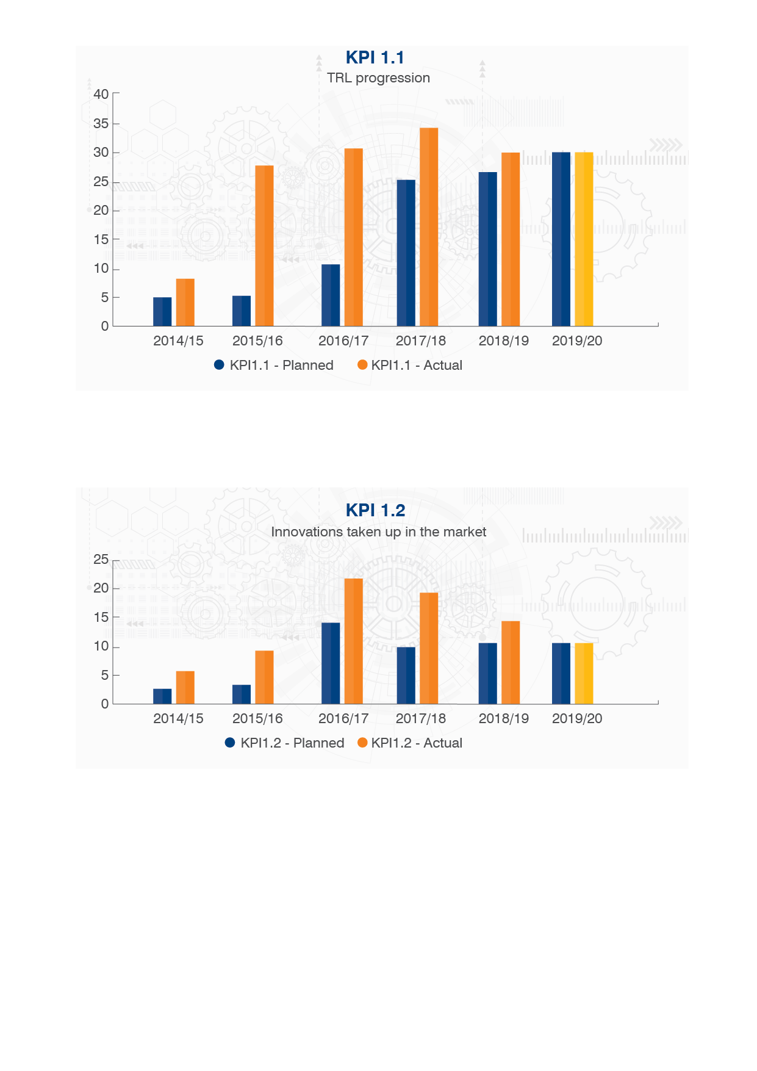
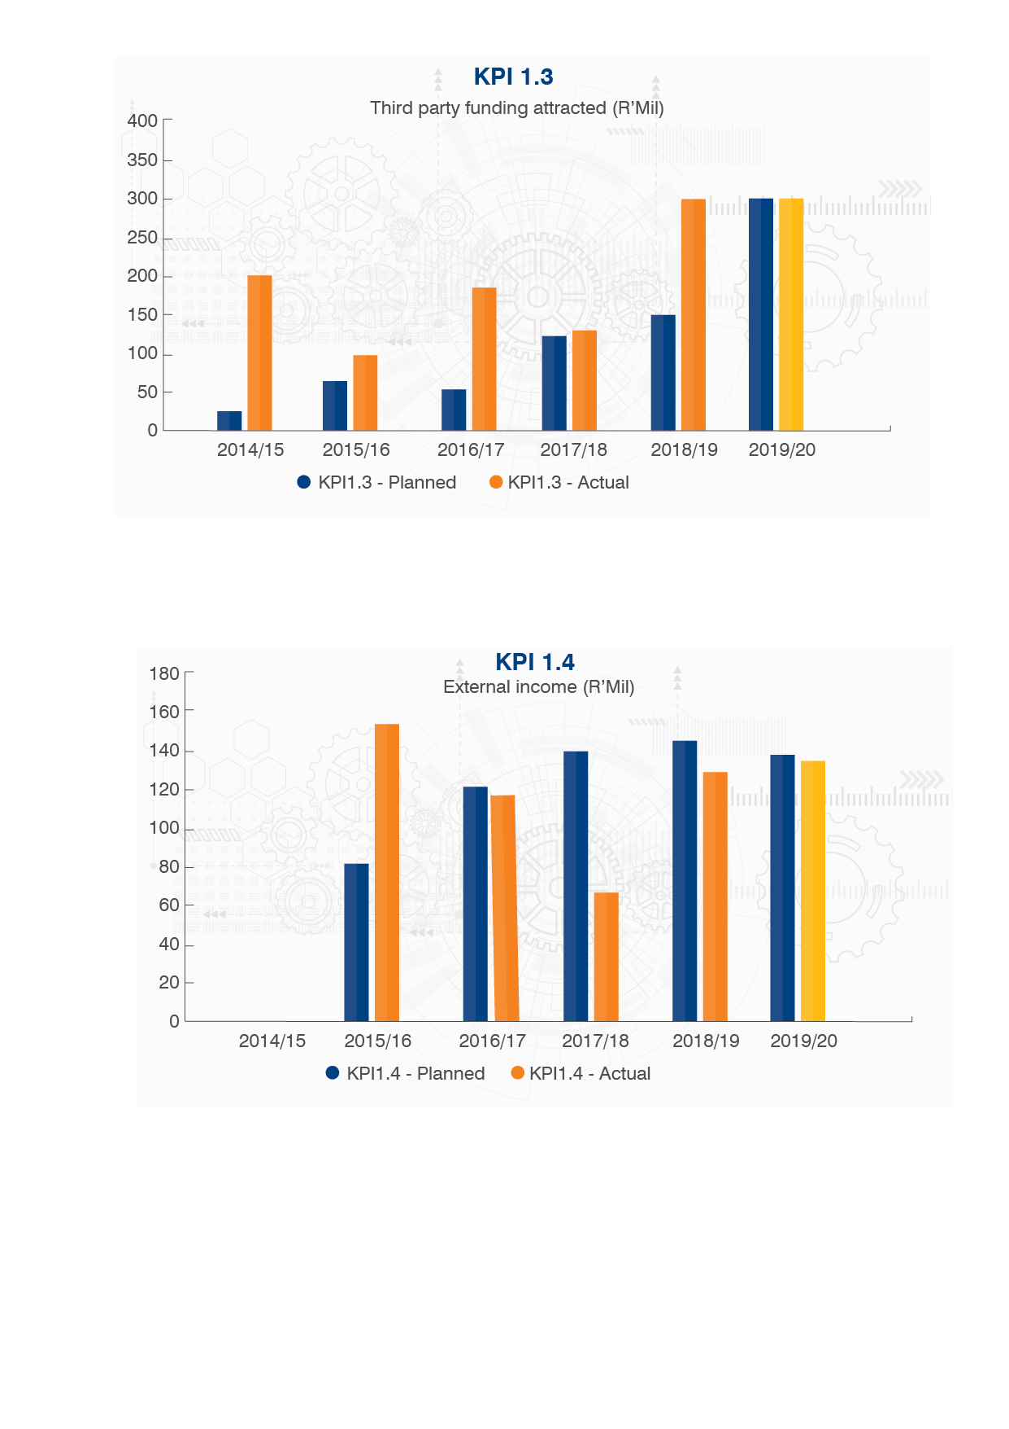
Performance against Strategic Plan 2015-2020
Yellow bars are projections for 2019/20.

Slide 9
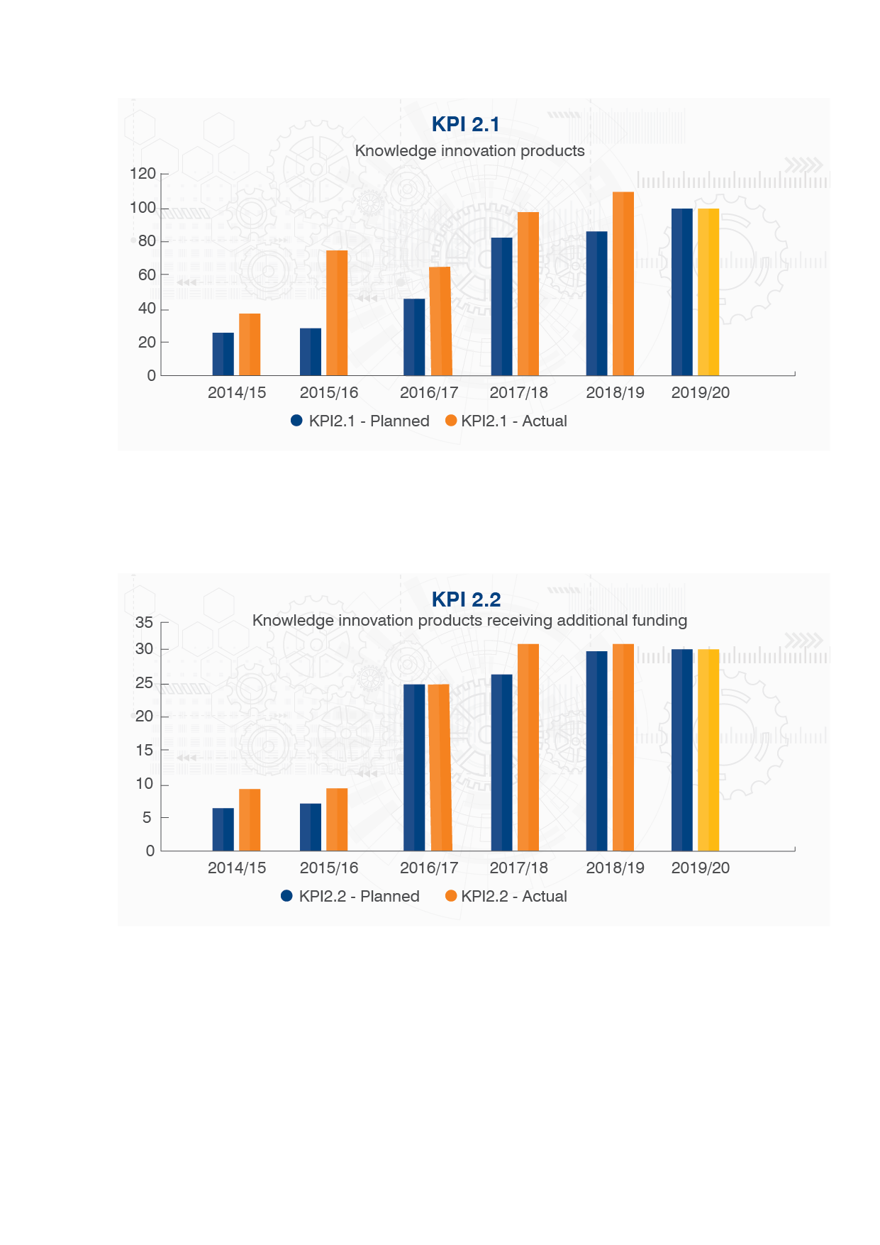
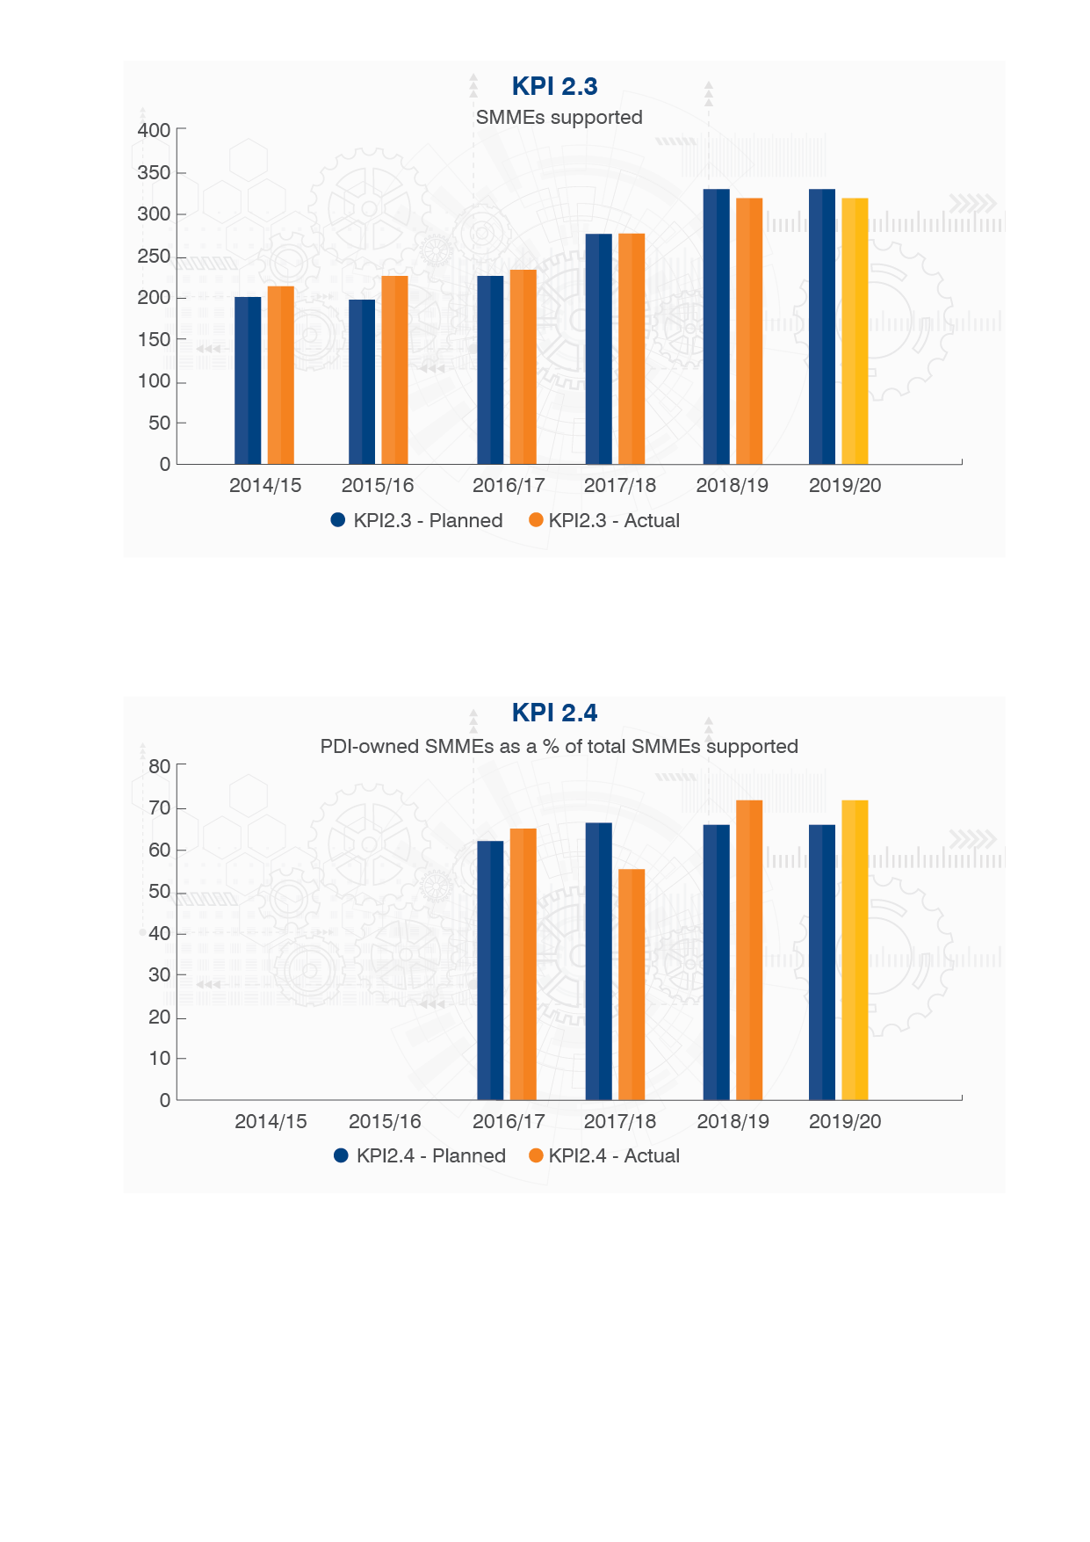
Performance against Strategic Plan 2015-2020
Yellow bars are projections for 2019/20.
9

Slide 10
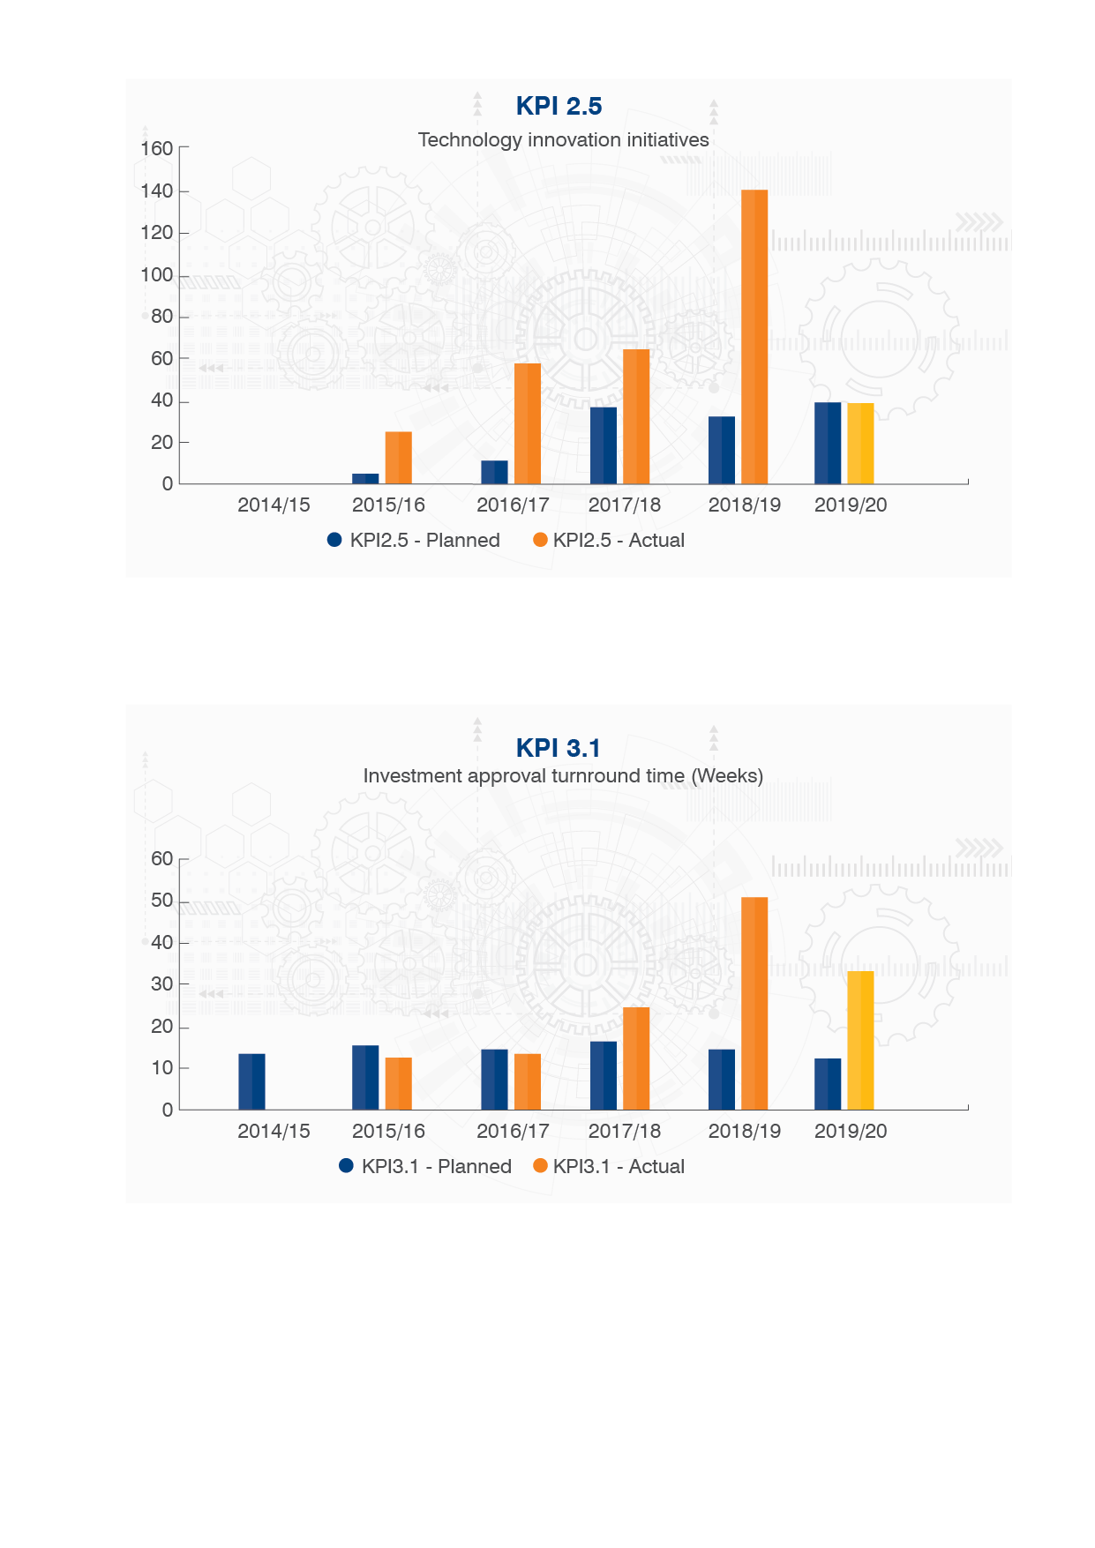
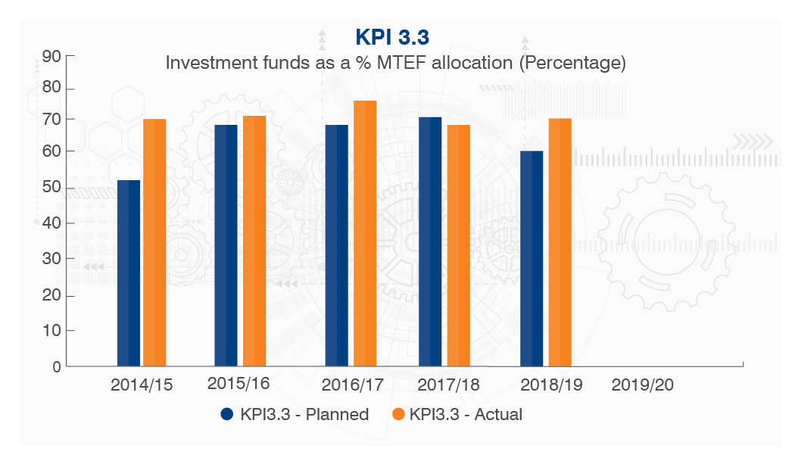
Performance against Strategic Plan 2015-2020
Yellow bars are projections for 2019/20.
10

Slide 11
Impact-2015/16-2018/19
Indicator | Achievement
# Knowledge innovation products | 413
# Technologies taken up in the market | 80
# SMMEs supported | 10 530
Disbursed for technology development | R2,2b
Revenue generated by TIA Investees | R2.5b
Economic Impact Multiplier | R3.26
# Jobs created | 18 536
Rand Value Contribution to GDP | R7.5b
11

Slide 12
Towards 2025
12

Slide 13
Strategic Planning Context
Key Drivers for the Strategic Planning
NDP – MTSF 2019- 2024
White Paper on STI - 2019
National Spatial Development Framework
Applicable RDI Roadmaps
Decadal Plan (To align once completed)
DSI 2020/25 Strategic Plan
Economic Transformation and Job Creation
Education, Skills and Health
Consolidating the Social Wage through Reliable and Quality Basic Services
Spatial Integration, Human Settlements and Local Government
Social Cohesion and Safe Communities
A Capable, Ethical and Developmental State
A better Africa and World
13

Slide 14

White Paper on STI - 2019
Instil a culture of valuing STI, and integrate STI into government planning and budgeting at the highest levels.
Adopt a whole-of-government approach to innovation.
Create an enabling and inclusive governance environment.
Create a more innovation-enabling environment.
Increase and transform NSI human capabilities.
Expand and transform the research system.
Expand and transform the institutional landscape.
Increase funding and funding efficiencies.
14

Slide 15
Strategic Challenges & Context
2009 NSI Context was different;
NSI small and characterized by low productive levels;
The context required TIA to stimulate NSI productivity through a technology innovation focus [aligned to the MTSF 2015-20];
However TIA has not been entirely successful on connecting, coordinating and creating a buzz in the NSI. Stakeholder satisfaction rate is very low due to internal operational inefficiencies and lack of responsiveness;
Ministerial recommendations not fully implemented;
Strategic programmes such as the Bio-economy Strategy not adequately supported – largely due to poor organizational design
Translation mandate not fully exploited. Low commercialisation rate and loss of strategic positioning in the NSI
15

Slide 16
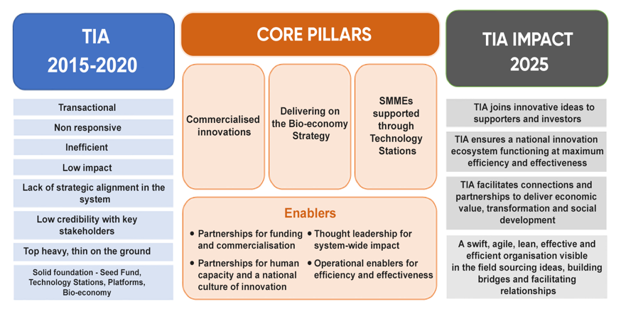
Strategic Thrust 2020 - 2025
16

Slide 17
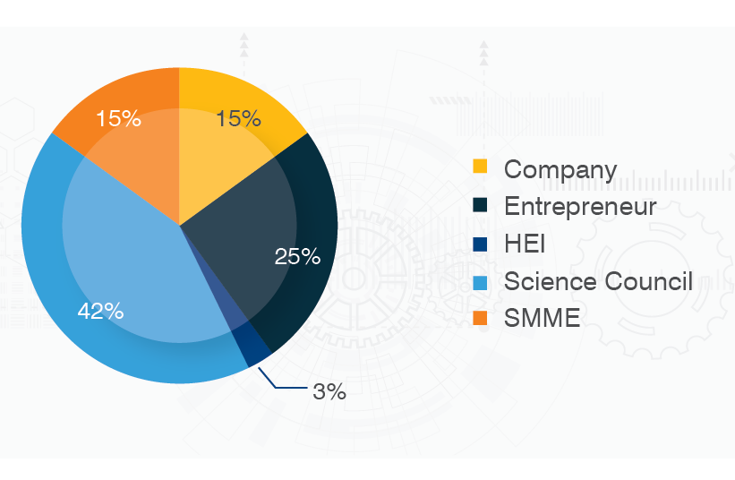

Portfolio by Market Segment
Current State
Strategic Intent
Increase spend for publicly-funded research to 70%
Scale up Seed Fund and intensify its deployment
Strengthen partnership with NIPMO to source disclosed IP
Collaborate with NIPMO to strengthen OTT capacity
Strategic Emphasis: give special attention to Previously Disadvantage Individuals and Institutions
57% Spend on publicly-funded research
17

Slide 18
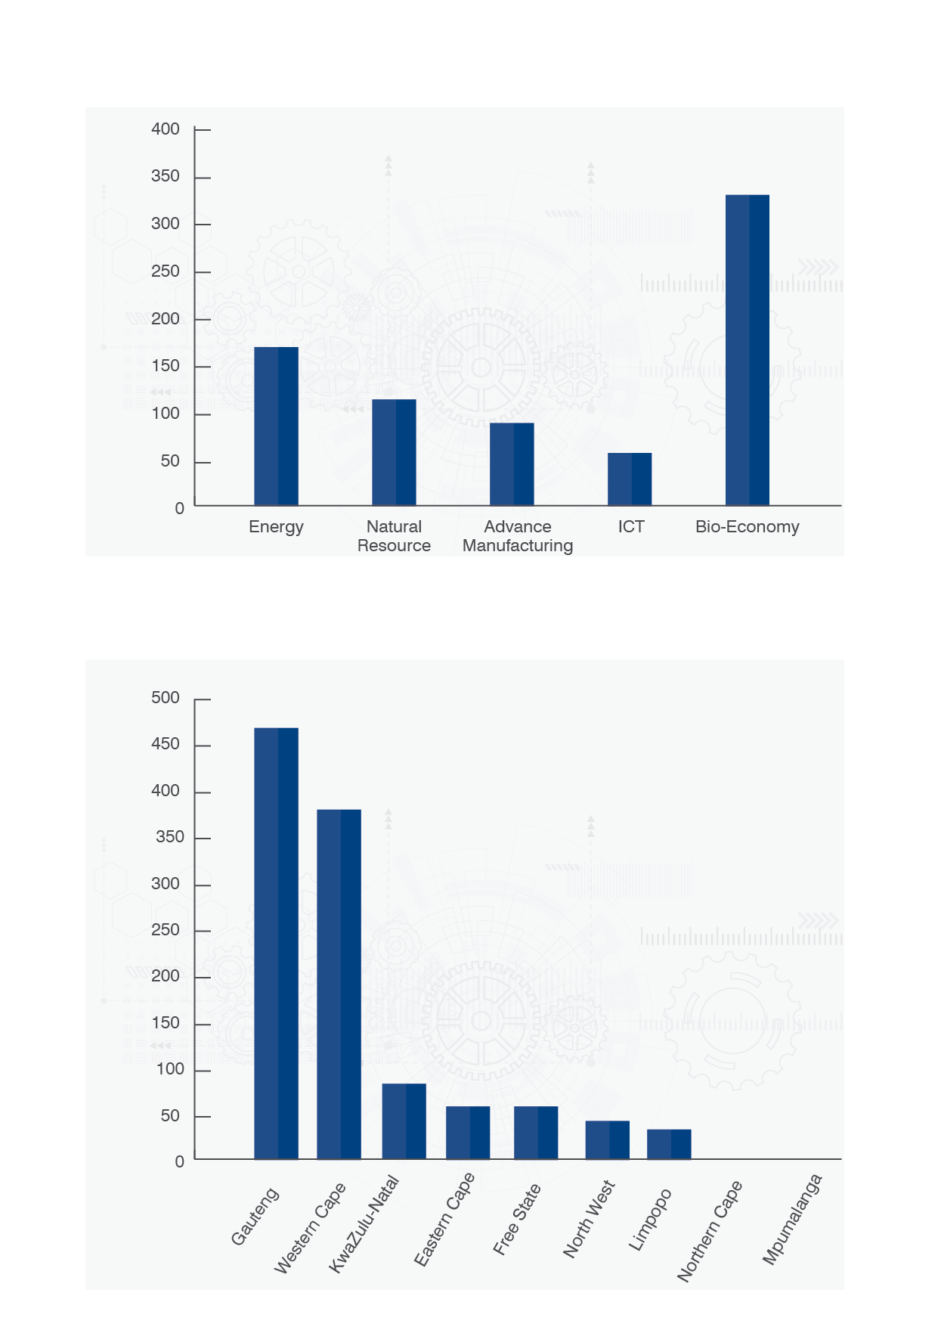
Portfolio by Focus Area
Current State
Strategic Intent
Investment Expenditure by Sector
2015/16-2019/20 (R’m)
Increase support for IP commercialisation from publicly-funded research to 70%
Thematic approach to support government policy priorities
Key guiding policies from DSI: Decadal Plan; Sectoral Masterplans; Technology Missions; etc.
Increase investments in Bioeconomy
18

Slide 19
Portfolio by Geographical Spread
Current State
Strategic Intent
TIA Investment per province over the five years (2015/16-2019/20) (R’m)
Broaden spatial footprint through increased support for underserved provinces
Link to provincial economic growth and development strategies
Support the District Development Model
Expand Technology Stations and other models such as Living Labs and incubators
Increase TIA’s physical presence through greater use of Technology Stations and co-location with partners (e.g. SEDA & Regional Agencies)
19

Slide 20
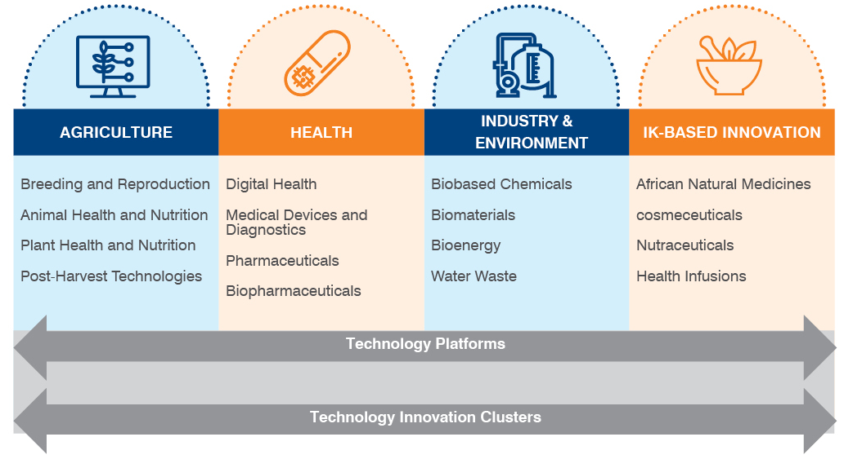
Enhancing the role of bio-economy in economic development
Direct efforts to create new bio-based products and processes; increase the contribution of Bioeconomy to GDP, creation of new enterprises, job creation. Indigenous Knowledge Systems (IKS) will receive special attention as an important an area with greater potential to promote inclusive development and transformation
20

Slide 21
Bioeconomy Strategic Intents
Ensuring Food Security
Managing Natural Resources Sustainably
Reducing Dependence on Non-Renewable Resources
Mitigating and Adapting to Climate Change
Creating Jobs and Improving Competitiveness
Contributing to coherence in Policy Environment
Investment in Knowledge, Innovation and Skills
New Infrastructure and Instruments
21

Slide 22
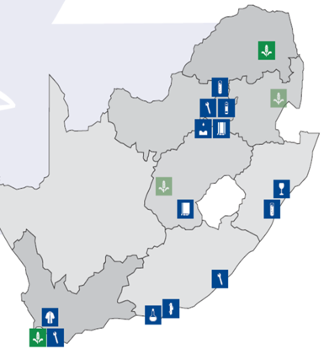
Increasing SMME access to SET Support through
Technology Stations
Extend the reach of Technology Stations through co-location with industry and incubators; partners, township hubs, accelerators
Increase availability of accredited facilities through partnership with industry;
Establish Living Labs as co-creation facilities and Walk-in Centres with TVET and FET Colleges to expand reach to underserved communities;
Skills development for empowering emerging enterprises, and
Strengthen the capacity of Technology Stations for support of 4IR and future industry trends
22

Slide 23
Key Enablers
Partnerships for funding
3 new funds in partnership bodies with TIA being the innovation derisker
Partnerships for innovation human capacity and a national Innovation culture
Innovation awareness training in TVET institutions, SETA partnerships, community awareness programmes
Thought Leadership for system wide impact
Operational effectiveness and efficiency
Turn-around Times & Efficiency Ratio
23

Slide 24
Measuring Performance
Part C
24

Slide 25
Outcome 1 - Commercialisation
Commercialised innovations
Contribution to MTSF
Priory 1: Economic Transformation & Job Creation
Increased contribution of GERD as a % of GDP
Commercialisation of publicly funded IP
Increased adoption & deployment of ICT for competitiveness
Contribution to Sectoral Masterplans developed for all national priorities
Other MTSF Outcomes
Designated groups: Women, youth, people with disabilities
Spatial transformation and increased geographical footprint through initiatives that support the District Development Model
Outcome Indicator(s) | Baseline | Target
Number of technologies commercialised | 77 | 100
25

Slide 26
APP Performance Targets - MTEF 2020/2023
Outcome 1- Commercialisation
Purpose: To support the development of technological innovations by translating knowledge into market-ready innovations
Outputs | Output Indicators | MTEF Annual Targets
 |  | 2020/21 | 2021/22 | 2022/23
Technologies developed | Number of successfully demonstrated technologies | 8 | 10 | 12
Technologies diffused for inclusive development | Number of successfully diffused technologies | 5 | 8 | 9
Funding leveraged | Total value of signed agreements entered into with third parties | R127m | R160m | R195m
26

Slide 27
Outcome 2 - Bioeconomy
Delivering on the Bio-economy Strategy
Contribution to MTSF
Priory 1: Economic Transformation & Job Creation
Increased contribution of GERD as a % of GDP, with specific emphasis on bioeconomy;
Commercialisation of publicly funded IP;
Priority 2: Education, Skills and Health
TB Treatment success rate
Treatment & prevention technologies for HIV, NCD and Maternal Health care
Outcome Indicators | Baseline | Target
# Number of bio-based technologies commercialised | New KPI | 60
# Number of bio-based entrepreneurs and organisations accessing high-end science, engineering and technical services | New KPI | 600
27

Slide 28
APP Performance Targets - MTEF 2020/2023
Outcome 2-Delivering on the Bio-economy Strategy
Outputs | Output Indicators | MTEF Annual Targets
 |  | 2020/21 | 2021/22 | 2022/23
Bio-based technologies developed | Number of successfully demonstrated bio-based technologies | 13 | 17 | 24
Existing Technology Platforms managed and supported | Number of existing Technology Platforms that are operational and functional | 9 | 9 | 10
New Technology Platforms established and supported | Number of new Technology Platforms in targeted regions | 0 | 1 | 1
Technology Innovation Clusters managed and supported | Number of existing Technology Innovation Clusters that are operational and functional | 8 | 8 | 8
28

Slide 29
Outcome 3 - Technology Stations
SMMEs supported through strategically informed and regionally distributed Technology Stations
Contribution to MTSF
Priory 1: Economic Transformation & Job Creation
Investing for accelerated inclusive growth [skills development]
Industrialisation, localization and exports
Improve competitiveness through ICT adoption [Commercialisation of IP]
Other MTSF Outcomes
Designated Groups: Women, youth and people with disabilities
Inclusive rural economy
Spatial transformation through initiatives that support the District Development Model
Outcome Indicators | Baseline | Target
Number of small, medium and micro enterprises accessing science, engineering and technical services | 10 530 | 15 750
29

Slide 30
APP Performance Targets - MTEF 2020/2023
Outcome 3 - Technology Stations
Purpose: Provision of access to science, engineering and technology body of knowledge and expertise in technology innovation, process improvements and product development to innovators and small, medium and micro enterprises to enable them to become competitive.
Outputs | Output Indicators | MTEF Annual Targets
 |  | 2020/21 | 2021/22 | 2022/23
Existing Technology Stations and centres managed and supported | Number of existing Technology Stations and centres providing SET support that are operational and functional | 18 | 19 | 20
New centres established and supported | Number of new centres providing SET support in targeted regions | 1 | 1 | 1
30

Slide 31
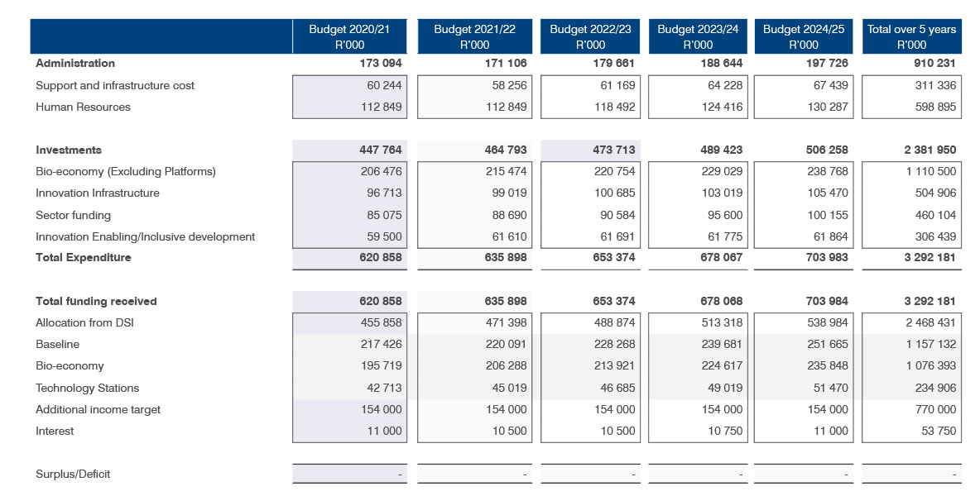
2020-2025 MTSF Budget
31

Slide 32
2020-2025 MTSF Budget highlights
Salary costs will be maintained at the same levels for the first 2 years
Savings from administrative costs to be allocated to commercialisation
Bio-economy significant portion of investment budget
Additional income through partnership with DSI and others to be maintained
Interest and royalty plough back to innovation initiative
32

Slide 33

Thank You
33

