Slide 1
USAASA & USAF PRESENTATION ON 2020/21 ANNUAL PERFROMANCE PLAN AND BUDGET
“Universal ICT access and service for all.”
Mr. Basil Ford, USAASA Executive Caretaker
May 2020

Slide 2
INTRODCUTION
The development of the USAASA & USAF Strategic Plan 2020-25 and USAASA & USAF Annual Performance Plan (APP) 2020-21 is a process which involves detailed analysis of the internal and external environment.
The USAASA and USAF Strategic Plan and USAASA and USAF APPS are aligned to the National Development Plan (NDP), Government 2019-2014 Medium Term Strategic Framework (MSTF) , National Integrated ICT Policy White Paper, Department of Communications and Digital Technologies (DCDT) key priorities and changes in the external and internal environment.
The USAASA APP 2020 - 21 comprises of 6 (six) output indicators implemented across 3 (three) outcomes and 2 (two) budget programmes.
USAF APP 2020 - 21 comprises of 4 (four) output indicators implemented across 2 (two) outcomes and 1 budget programme divided into 3 sub-programmes.

Slide 3
USAASA ORGANISATIONAL IDENTITY
Vision | The vision of USAASA is aligned to, and supports, the vision of the Department of Communications and Digital Technologies to be “a leader in enabling a connected and digitally transformed South Africa. Universal ICT access and service for all.
Mission | To promote and pursue the goal of universal access and service, and to contribute to building South Africa’s sustainable knowledge society through a response to the 4IR, innovation, research, monitoring, evaluation and advisory services. To effectively manage the Universal Service and Access Fund (USAF)
Values | Batho Pele Integrity Accountability Innovation Transparency Teamwork

Slide 4
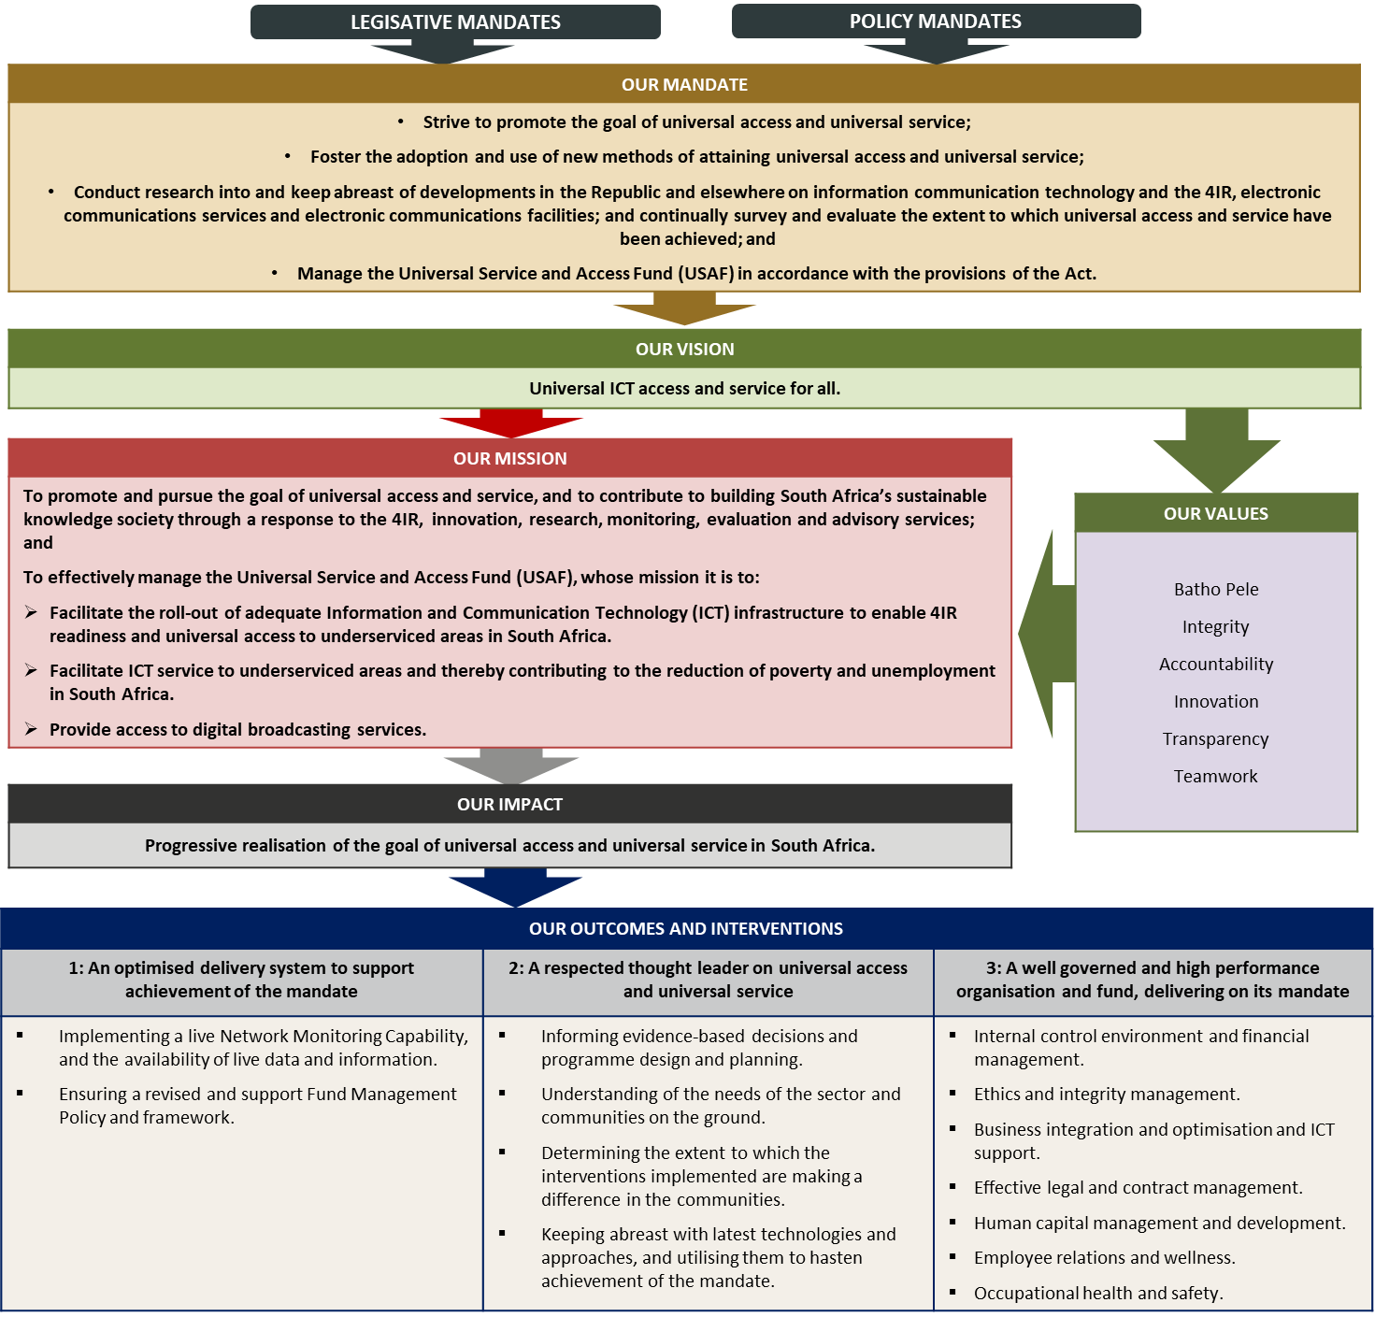
The USAASA strategic focus to 2025

Slide 5
LINKING 2019-2024 MSTF TO DCDT & USAASA/USAF PRIORITIES
MTSF Priority and Impact
MTSF Outcomes and Interventions
DCDT Strategic Plan Response
Addressed by USAASA / USAF Focus Areas
Priority 1: Economic transformation and job creation
Outcome 2: Improve competitiveness through ICT adoption
Increased access to secure digital infrastructure;
Enabling policies and strategies for digital transformation;
Transformed digital society;
Improved locally developed content, applications and services.
Facilitation of Digital migration
Facilitation of broadband connectivity
Development of market intelligence and understanding of universal access and universal service trends and needs
Research and development of viable alternatives to achieving universal access and universal service that reflect the current and future technology

Slide 6
LINKING 2019-2024 MSTF TO DCDT & USAASA/USAF PRIORITIES
MTSF Priority and Impact
MTSF Outcomes and Interventions
DCDT Strategic Plan Response
Addressed by USAASA / USAF Focus Areas
Priority 6: A capable, ethical and developmental State
Outcome 1: Improved governance and accountability:
Well-governed SOEs that are strategically supported to deliver on their mandate;
Rationalised SOEs to optimally develop on their mandate;
High-performing organisation to enable achievement of the Department’s mandate.
Effective governance, management and leadership to enable delivery of the mandate

Slide 7
USAASA INSTITUTIONAL PERFORMANCE INFORMATION
Impact Statement | Progressive realisation of the goal of universal access and universal service in South Africa.
MEASURING OUTCOMES | Outcome | Outcome Indicator | Baseline (2019/20) | Five-year target (To March 2025)
 | 1: An optimised delivery system to support achievement of the mandate | Project Management Office to manage STB Installations | New indicator | PMO procured; BDM migration completed.
 |  | Partnership with organ(s) of state to provide and to monitor broadband connectivity, | New indicator | Partnership with organ(s) of state established to provide and to monitor broadband connectivity roll out of broadband connections per USAF targets
7

Slide 8
USAASA INSTITUTIONAL PERFORMANCE INFORMATION
Impact Statement | Progressive realisation of the goal of universal access and universal service in South Africa.
MEASURING OUTCOMES | Outcome | Outcome Indicator | Baseline (2019/20) | Five-year target (To March 2025)
 | 2: A respected thought leader on universal access and universal service | Universal Access and Universal Service trend reports produced | New indicator | 3x Annual Universal Access and Universal Service trend report produced (from 2022/23 – 2024/25)
 | 3: A well governed and high performance organisation and fund, delivering on its mandate | Approved and implemented Workplace Skills Plan, aligned to strategy | New indicator | Employees capable of delivering on strategy
 |  | USAASA enterprise risk maturity level | New indicator | Manage risks in line with strategy
 |  | Key vacant positions in the organisational structure filled | New indicator | Organisaton capacitated to deliver on strategy
8

Slide 9
USAASA KEY STRATEGIC RISKS
Outcome | Key Risk | Risk Mitigation
Outcome 1: An optimised delivery system to support achievement of the mandate | Failure to implement an optimised system | Engagement with Organ(s) of State to provide and monitor broadband connectivity; Project Management Office to manage STB installations and installer oversight
Outcome 2: A respected thought leader on universal access and universal service | Failure to be relevant to the universal service and access sector | Partnerships with Academic and Research Institutions Implementation of GIS and supporting systems Use and interpretation of data
Outcome 3: A well governed and high performance organisation and fund, delivering on its mandate | Weak governance and financial management | Strengthening internal controls and financial management Effective policies and procedures Skills and capability development
9

Slide 10
USAASA Programme 1
The purpose of Programme 1: Business Support is to provide strategic leadership, management and support services to the Agency, and to the Universal Service and Access Fund (USAF).
OUTPUT INDICATORS | 2020/21 ANNUAL TARGET | QUARTERLY TARGETS
 |  | Q1 Apr - Jun 2020 | Q2 Jul - Sep 2020 | Q3 Oct - Dec 2020 | Q4 Jan - Mar 2021
Capacitate the organisation | Key vacant positions in the organisational structure filled | key organisational vacant positions recruited and filled | N/A | N/A | N/A
Project Management Office to manage BDM rollout | Appointment of Project Management Office to manage BDM rollout | Terms of reference (ToR) developed Project Management Office appointed | N/A | N/A | N/A
Partnership with organ(s) of state to provide and to monitor broadband connectivity | Appointment of organ(s) of state to manage Broadband connectivity | - Relevant Authorisation for the appointment of organ(s) of state obtained - Organ(s) of State for broadband connectivity appointed | N/A | N/A | N/A
Skilled workforce | Workplace Skills Plan (WSP) aligned to USAASA and USAF mandate developed and implemented | Workplace Skills Plan (WSP), aligned to USAASA and USAF mandate, developed and approved. | Planned 1st Quarter Training interventions, aligned to USAASA and USAF mandate, implemented and reported | Planned 2nd Quarter Training interventions, aligned to USAASA and USAF mandate, implemented and reported | Planned 3rd Quarter Training interventions, aligned to USAASA and USAF mandate, implemented and reported
10

Slide 11
USAASA Programme 1
The purpose of Programme 1: Business Support is to provide strategic leadership, management and support services to the Agency, and to the Universal Service and Access Fund (USAF).
OUTPUT INDICATORS | 2020/21 ANNUAL TARGET | QUARTERLY TARGETS
 |  | Q1 Apr - Jun 2020 | Q2 Jul - Sep 2020 | Q3 Oct - Dec 2020 | Q4 Jan - Mar 2021
USAASA enterprise risk maturity level established | Enterprise Risk Maturity assessment conducted to establish baseline | Development of the Questionnaire for Enterprise Risk Maturity Assessment finalised. | Enterprise Risk Maturity Assessment conducted to establish baseline | Improvement Plan developed based on assessment findings | Improvement Plan implemented.
Percentage of valid invoices paid within 30 days from date of receipt | 100% of valid invoices paid within 30 days from date of receipt | 100% of valid invoices paid within 30 days from date of receipt | 100% of valid invoices paid within 30 days from date of receipt | 100% of valid invoices paid within 30 days from date of receipt | 100% of valid invoices paid within 30 days from date of receipt

Slide 12
USAASA Programme 2
The purpose of Programme 2: Business Intelligence is to promote effective and efficient service delivery of universal services and access in underserved and underserviced areas through planning, monitoring, reporting and evaluation, and research.
OUTPUT INDICATORS | 2020/21 ANNUAL TARGET | QUARTERLY TARGETS
 |  | Q1 Apr - Jun 2020 | Q2 Jul - Sep 2020 | Q3 Oct - Dec 2020 | Q4 Jan - Mar 2021
Progress towards development of Universal Access and Universal Service Geographic Information (GIS) Mapping capability | Universal Access and Universal Service Geographic Information Mapping capability plan approved | Scoping of development of Universal Access and Universal Service Geographic Information Mapping capability conducted. | Consultation and scoping of development of Universal Access and Universal Service Geographic Information Mapping capability conducted | Universal Access and Universal Service Geographic Information Mapping capability developed | Universal Access and Universal Service Geographic Information Mapping capability plan approved

Slide 13
THE USAASA ANNUAL BUDGET FOR 2020/21 AND THE MTEF
Projected Income Statement for 2020/21
Statement of financial performance | Revised | Medium-term estimate
 | estimate
R thousand | 2019/20 | 2020/21 | 2021/22 | 2022/23
Revenue
Non-tax revenue | 900 | 800 | 700 | 740
Transfers received | 82 949 | 264 881* | 188 677* | 95 039
Total revenue | 83 849 | 265 681 | 189 377 | 95 779
Expenses
Current expenses
Compensation of employees | 53 313 | 58 171 | 62 269 | 66 196
Goods and services | 30 536 | 207 510* | 127 108* | 29 583
Total expenses | 83 849 | 265 681 | 189 377 | 95 779
Surplus/(Deficit) | – | – | – | –
*Once-off allocation of R 275 million was made available over the medium term for payments to SAPO for the distribution costs relating to the new model for BDM: R 178 million for 2020/21 and R 97 million in 2021/22.
13

Slide 14
UNIVERSAL SERVICE & ACCESS FUND

Slide 15
USAF IDENTITY
Vision | The vision of USAF is aligned to, and supports, the vision of the Department of Communications and Digital Technologies to be “a leader in enabling a connected and digitally transformed South Africa.” Effective project implementation towards the goal of universal ICT access and service for all.
Mission | To facilitate the roll-out of adequate Information and Communication Technology (ICT) infrastructure to enable 4IR readiness and universal access to underserviced areas in South Africa; To facilitate ICT service to underserviced areas, thereby contributing to the reduction of poverty and unemployment in South Africa; and To broaden access to digital broadcasting services by qualifying households.
Values | Batho Pele Integrity Accountability Innovation Transparency Teamwork
15

Slide 16
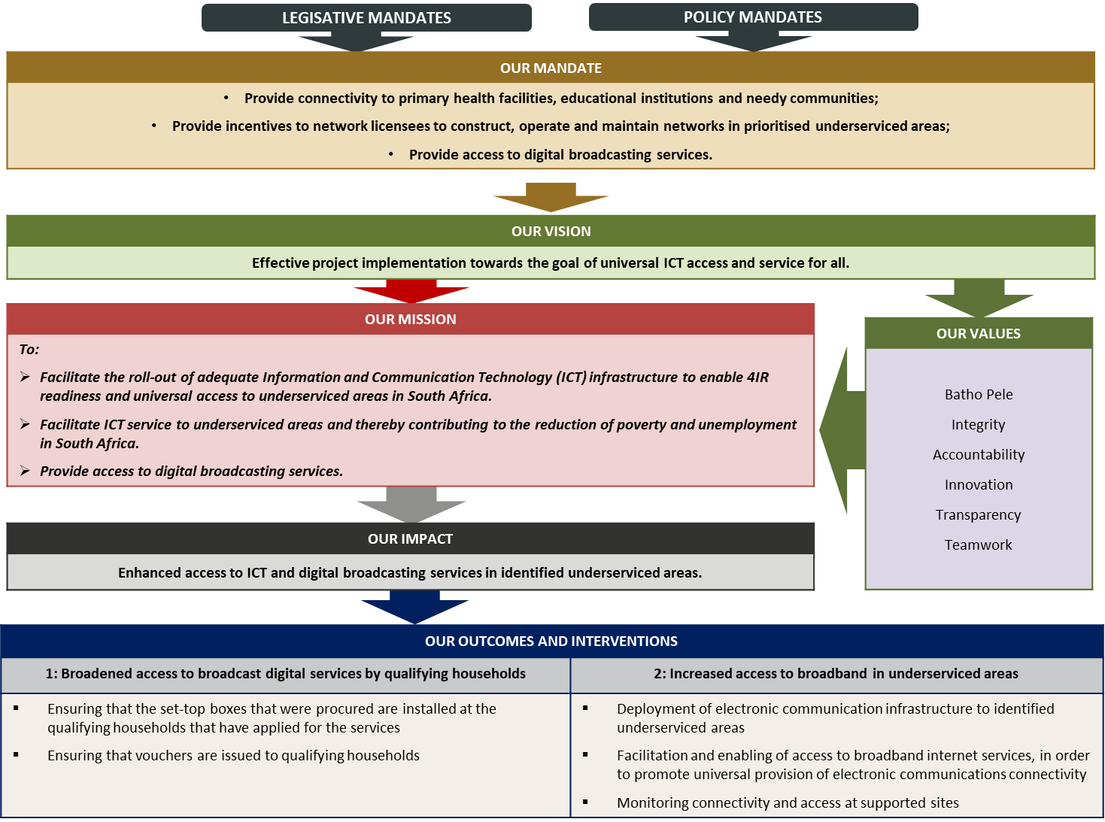
The USAF strategic focus to 2025
16

Slide 17
USAF INSTITUTIONAL PERFORMANCE INFORMATION
Impact Statement | Enhanced access to ICT and digital broadcasting services in identified underserviced areas.
MEASURING OUTCOMES | Outcome | Outcome Indicator | Baseline (2019/20) | Five-year target (To March 2025)
 | 1: Broadened access to broadcast digital services by qualifying households | Number of qualifying households provided with access to broadcast digital services | 511 368 qualifying households (2015/16 – 2018/19) | 3.2m qualifying households (Government Technical Advisory Centre (GTAC) Study, January 2019)
 | 2: Increased access to broadband in underserviced areas | Number of identified underserviced local municipal areas that have access to electronic communication infrastructure | Cumulatively, 8 identified underserviced local municipal areas (2013/14 – 2018/19) | Cumulatively, 18 identified underserviced local municipal areas by March 2025 (10 new)
17

Slide 18
USAF KEY STRATEGIC RISKS
Outcome | Key Risk | Risk Mitigation
1: Broadened access to broadcast digital services by qualifying households | Failure to install the targeted number of digital services | Installation plan Project management Office
2: Increased access to broadband in underserviced areas | Failure to realise the increase in access for targeted underserviced areas | Installation plan Engagement of and/or partnership with organ(s) subject to relevant required approvals
18

Slide 19
USAF Programme 1
The purpose of Programme 1: Business Operations, as per Section 82 of the ECA, can be summarised as that of a facilitator and playing a monitoring role to improve research capacity on universal service and access. It has a mandate to provide accurate and credible information on universal service and access gaps.
OUTPUT INDICATORS | 2020/21 ANNUAL TARGET | QUARTERLY TARGETS
 |  | Q1 Apr - Jun 2020 | Q2 Jul - Sep 2020 | Q3 Oct - Dec 2020 | Q4 Jan - Mar 2021
Number of the subsidised set-top-box kits installed at qualifying households | Installation of 860 000 subsidised set-top-box kits at qualifying households | N/A | Installation of 250 000 subsidised set-top-box kits to new qualifying households ensured | Installation of 260 000 subsidised set-top-box kits to new qualifying households ensured | Installation of 350 000 subsidised set-top-box kits to new qualifying households ensured
Number of vouchers issued to qualifying households for subsidised digital television installation | Implementation plan to roll out the voucher system finalised | Stakeholders’ consultations conducted on the roll out of the voucher system | Draft implementation plan on the roll out of the voucher system developed | Implementation plan on the roll out of the voucher system finalised | N/A
19

Slide 20
USAF Programme 1
The purpose of Programme 1: Business Operations, as per Section 82 of the ECA, can be summarised as that of a facilitator and playing a monitoring role to improve research capacity on universal service and access. It has a mandate to provide accurate and credible information on universal service and access gaps.
OUTPUT INDICATORS | 2020/21 ANNUAL TARGET | QUARTERLY TARGETS
 |  | Q1 Apr - Jun 2020 | Q2 Jul - Sep 2020 | Q3 Oct - Dec 2020 | Q4 Jan - Mar 2021
Number of sites with internet connectivity in targeted municipal areas | Internet connectivity to new 300 sites provided in targeted 2 (two) municipal areas | N/A | Q2(2020/21) Provision of internet connectivity to new 50 sites ensured in targeted municipal areas | Q3(2020/21) Provision of internet connectivity to new 100 sites ensured in targeted municipal areas | Q4(2020/21) Provision of internet connectivity to new 150 sites ensured in targeted municipal areas
Percentage of internet connectivity provided at all time at sites with existing broadband ensured | 75% of internet connectivity provided at all time at sites with existing broadband | Availability of a minimum of 75% connectivity ensured at all times at sites with existing broadband. | Availability of a minimum of 75% connectivity ensured at all times at sites with existing broadband. | Availability of a minimum of 75% connectivity ensured at all times at sites with existing broadband. | Availability of a minimum of 75% connectivity ensured at all times at sites with existing broadband.
20

Slide 21
THE USAF ANNUAL BUDGET FOR 2020/21 AND THE MTEF
Projected Income Statement for 2020/21
Statement of financial performance | Revised | Medium-term estimate
 | estimate
R thousand | 2019/20 | 2020/21 | 2021/22 | 2022/23
Revenue
Interest | 65 000 | 100 000 | 120 000 | 10 000
Transfers received | 63 622 | 641 807* | 1 229 919* | 131 097
Total revenue | 128 622 | 741 807 | 1 349 919 | 141 097
Expenses
Compensation of employees | – | – | – | –
Goods and services | 3 936 | 4 152 | 4 381 | 4 591
Transfers and subsidies | 102 492 | 737 655* | 1 345 538* | 136 506
Total expenses | 106 428 | 741 807 | 1 349 919 | 141 097
Surplus/(Deficit) | 22 194 | – | – | –
* Once-off additional allocation amounting to R1.6 billion over the medium term for implementation of Broadcasting Digital Migration (BDM) project using the new model: R522 million for 2020/21 and R 1 103 522 billion in 2021/22.
21

Slide 22
THE USAF ANNUAL BUDGET FOR 2020/21 AND THE MTEF
Operational Budget Projections for 2020/21
 | Revised estimate | Medium-term expenditure
 |  | estimate
R million | 2019/20 | 2020/21 | 2021/22 | 2022/23
Administration | 3 936 | 4 152 | 4 381 | 4 591
Broadband infrastructure and Connectivity | 75 887 | 158 934 | 182 175 | 76 135
Broadcasting Digital Migration | 26 605 | 578 721* | 1 163 363* | 60 371
Total | 106 428 | 741 807 | 1 349 919 | 141 097
* Once-off additional allocation amounting to R1.6 billion over the medium term for implementation of Broadcasting Digital Migration (BDM) project using the new model: R522 million for 2020/21 and R 1 103 522 billion in 2021/22.
22

Slide 23
THANK YOU ☺

