Slide 1
nyda presentation to portfolio committee on women, youth, persons with disabilities
2020 / 2021

Slide 2

Agenda
Impact of Covid -19 & Youth Enterprise Micro Relief Fund
NDP and 25 year review
Key Youth Development Statistics
NYDA Strategy
Linking strategic outcomes and performance
Key sectors
Annual Performance Plan
Integrated Marketing and Communications
Financial matters
Human Resources
Partnerships with Departments
Legislative amendments
Questions

Slide 3
Impact of covid – 19 and youth micro enterprise relief fund

Slide 4
Impact of Covid-19
The NYDA continues to be available online and through social media. To those who don’t have data, can call the toll free call center.
All staff members are working from home – data and tools of trade have been provided.
Applications are being received for 1000 businesses in 100 days but disbursements will be done at level 3 of lockdown.
Applications and disbursements are being done for the Youth Micro Enterprise Relief Fund.
Supporting young people and businesses with applications to the Unemployment Insurance Fund.
Offer to support the Department of Social Development with registering young people for the special Covid grant.
Support to child headed households in vulnerable communities through NGO’s in the NYS program.

Slide 5
Youth Micro Enterprise Relief Fund
Fund targeted at niche community of youth micro enterprises which may be missed by other relief funds.
R10 million capital provided by NYDA – ongoing fundraising through National Treasury and Provincial Government.
Criteria: Youth owned, in existence for the last six months, three month bank statements, proof of existence, CIPC certificate if formal enterprise.
Grant capped at maximum of R10 000, to subsidize losses during the lockdown.
NYDA continues to refer those who may not qualify to other funds: SMME Fund, Skuma Fund, Tourism Fund, Spaza Relief, Agriculture Fund. All funds have set asides for youth.
Applications received: 4550, Approved applications: 226
We need support from Treasury to scale up the fund.
Fund was featured on TV and national and community based radio stations.

Slide 6

Beneficiary story
I am writing to thank you and your team for the speedy action in regards to the payment of the COVID Relief grant that we received last week from the NYDA. Further to this, I would like to outline how this money has saved our company and has enabled us to diversify and be able to not only meet our obligation to pay our staff members but be flexible in finding a solution to keeping the business moving forward.
With the R10 000 received from the NYDA last week, we were able to pay our artisans, allowing us room to purchase material to meet our reusable mask obligations. We have since landed a contract to supply the Sasol Group (their HQ as well as their mining sites) with reusable masks and have since last week delivered over 3000 mask and are due to deliver 3000 – 4000 each week until masks are no longer a requirement. Just to put things into perspective, The R10 000 received has multiplied itself to over R21 000 in just one days order. We have also taken the initiative to launch a website which will allow individuals to also purchase their ISO approved masks through our online store.

Slide 7
Through and After Covid-19
Phased return to work
Phase 1:
This phase will start on Level 4.
In phase 1, only employees using private transport would return to work.
There will be social distancing of at least 1.5 meters between all employees.
A meeting of more than three people will be prohibited.
Mobile sanitisers to be installed on each floor.
Each employee to be screened daily for temperature.
Employees who feel ill must not return to work
Masks to be compulsory.
Full compliance to level 4 regulations.
Employees who are over 60, have chronic condition or are pregnant to work from home.
Phase 2:
Linked to lifting of phases by the National Command Centre.
Employees using public transport to return.
Staff shuttle to be sanitised daily.
Possible increase of small meetings.
All other phase 1 restrictions to remain.
Full compliance to level restrictions.
Phase 3:
Employees over 60 and with conditions to possibly return to work.
Linked to lifting of phases by the NCC.

Slide 8
Through and After Covid-19
Training
Training is likely to remain off the table for the remainder of 2020. We are thus working on a process to migrate all training online. The Presidency is working with us to ensure all the JOBS modules are placed on the SA Youth.Mobi application and that there is a data subsidy for the application. We are working on migrating all NYDA Youth entrepreneurship modules online. Our trainers will then become online trainers. We are working on a data subsidy similarly to that which Universities have announced.
Grants
Small businesses will most likely play a role in a new economy – however it is important to note that some sectors and industries may take time to recover (e.g.) hospitality and tourism. We therefore are of the view that we should consider the future economic strategy of the country and its impact on our grant program. We should continue with the Youth Micro Enterprise Relief Fund which has been set up in direct response to Covid-19 and 1000 businesses in 100 days.
Youth service
Given the expected contraction of the economy and increase in unemployment, there is a view that a fast scale up of the Presidential Youth Service from a commitment of 250 000 to 1 million is necessary. Policy papers are being drafted in this regard to be presented to the Project Management Office in the Presidency. Youth service is also playing a role through empowering NGO’s which are supporting communities during the lockdown.
Youth Month and June 16th
It is likely that a digital message will be shared for June 16th. We are also looking at innovating ways that youth can share youth culture digitally for June 16th. We can also host online webinars which we have already started during in the lockdown.

Slide 9
Reimagining a new economy
Reduced data costs and bridge digital divide
Greater localization – more support for young entrepreneurs
Scaled up public employment
Anticipation of budget adjustment – reprioritsation will have to be undertaken.
Minimum employment guarantee for youth
Greater opportunities to do paid service – Health and Social Development

Slide 10
Key youth development statistics

Slide 11
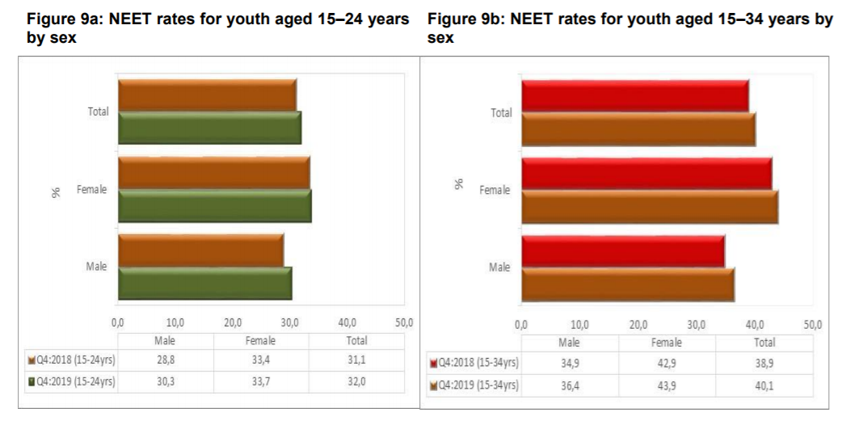
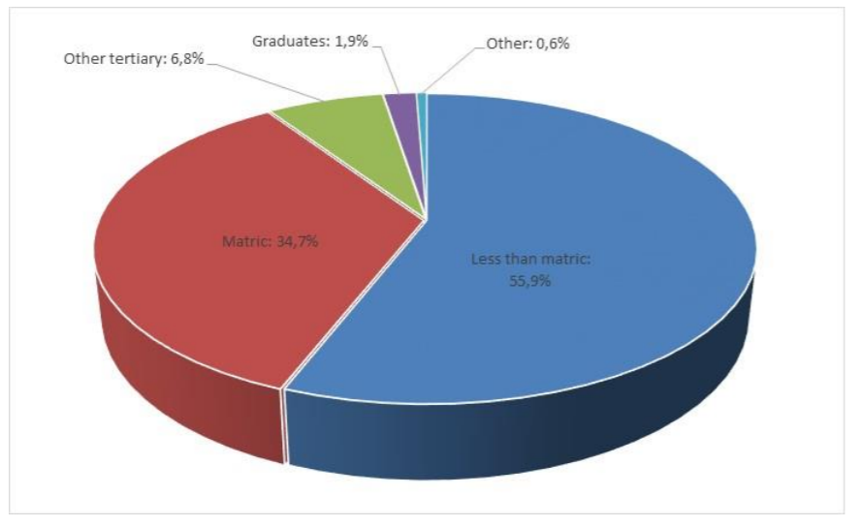
Key youth development statistics - NEET

Slide 12
Key Youth Development Statistics – Labor market transitions

Slide 13
25 year review and mtsf priorities

Slide 14
25 year review, manifesto and MTSF priorities
2 million youth into jobs through combination of jobs programs, public employment programs, SETA’s and ETI.
100 000 youth entrepreneurs per annum across DFI’s with private sector support.
250 000 youth over five years placed in NYS programs
One coordinating body that can oversee the workings of the different departments with regards to youth training and employment, accompanied by clear lines of accountability to a parliamentary portfolio committee

Slide 15
Sona 2020

Slide 16
SONA commitment
The President committed in his July 2019 SONA to develop a comprehensive plan, driven and coordinated from the Presidency, to address youth unemployment. The Presidential Youth Employment Intervention, announced last week, is the outcome of that process, and has now commenced implementation.
The commitments made at SONA 2020 for the Presidential Youth Employment Intervention are that in the next year, the Presidential Youth Employment Intervention will:
Launch five prototype sites in five provinces that will grow to a national network. These sites will allow young people to receive active support, information and work readiness training to increase their employability and match themselves to opportunities.
Fund and offer business support to 1000 youth owned businesses in the next 100 days through a partnership of NYDA and the Department of Small Business Development. The target is 50 youth owned businesses per week with the final 1000 businesses announced on June 16th 2020. (268 when lockdown was announced)
Establish the first cohort of a Presidential Youth Service program that will unlock the agency of young people and provide opportunities for them to earn an income while contributing to nation building.

Slide 17
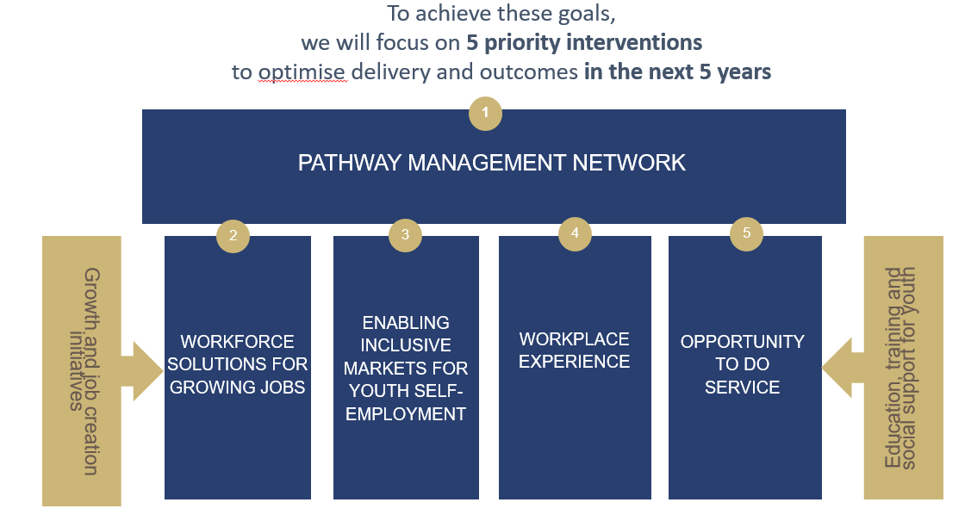
Presidential Youth Employment Intervention

Slide 18
Nyda strategy

Slide 19
Methodology
Multiple sources of information is considered including but not limited to the NDP 2030, NYP, 25 year review, MTSF, Priorities of Government, SONA and Budget Speech, BRR, Stats SA reports.
NYDA Act guides development of strategy.
Existing baselines are considered as guidelines.
International best practice including AU Youth Charter, SDG’s, Y20 and BRICS Youth are considered.
Overall strategy is formulated and performance indicators linked to strategy are developed.
Budget and human resources are aligned to each program. Targets are specifically allocated on gender (50%) and persons with disabilities (7%).
Strategy is consulted with Department and young people.
NYDA avoids duplication as far as possible – where another government department / agency has function we would rather partner than duplicate.
Key partners are identified who can assist us is strategy implementation.
Targets monitored by M&E Unit and audited by internal and external audit.

Slide 20
NYDA Strategy
Economic development through youth entrepreneurship;
Decent employment through jobs program;
Social cohesion and pathway for economic emancipation through coordination of National Youth Service;
Universal access for vulnerable youth.
Research work to inform policy development for young people

Slide 21
Linking strategic outcome and performance plan

Slide 22
LINK BETWEEN THE NYDA PROGRAMMES AND ITS STRATEGIC OUTCOMES
PROGRAMME | STRATEGIC OUTCOME | Sub-programme/INTERVENTION
Programme 1: Administration | Improved application of correct financial principles, procedures and executing supply chain management plan. | Quarterly Financial Reports Annual Workplace Skills Plan ERP activation/implementation/roll-out Public and Private sectors to support the youth development programmes
Programme 2: Programme Design, Development and Delivery (PDDD) | Increased access to socio-economic opportunities, viable business opportunities and support for young people to participate in the economy. | Grant Programme Voucher Programme Business Development Training Programme Market Linkages Mentorship Programme Rural Development Branch -Walk-in Outreach Call Centre Media Platforms

Slide 23
LINK BETWEEN THE NYDA PROGRAMMES AND ITS STRATEGIC OUTCOMES
PROGRAMME | STRATEGIC OUTCOME | Sub-programme/INTERVENTION
Programme 3: National Youth Service | Increased co-ordination and implementation of NYS programmes across all sectors of society | National Youth Service Programme Government programs Presidential Youth Service Higher Education Youth Service
Programme 4: Research and Policy | Produce research reports which influences change in youth sector and build sustainable relationships | Customer surveys Impact programme evaluations Stakeholder engagement- Annual report on government wide priorities. Youth status outlook reports

Slide 24
Key economic sectors

Slide 25
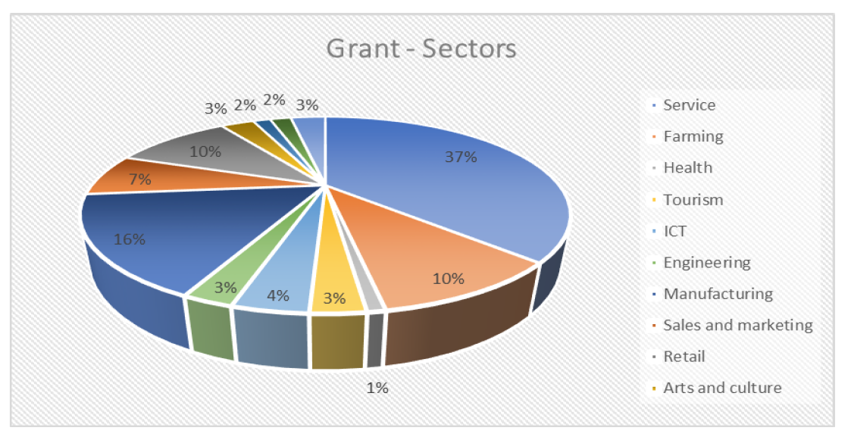
NYDA Funding in 2019 / 2020

Slide 26
Oceans economy (Operation Phakisa)
South Africa is surrounded by a vast ocean which has not fully taken advantage of the immense potential of this untapped resource. The oceans have the potential to contribute up to 177 billion rand to the gross domestic product (GDP) and create just over one million jobs by 2033
NYDA role:
Partner with key provincial governments (i.e.) Kwa Zulu Natal, Western Cape, Eastern Cape to unlock funding for youth enterprises in the oceans economy.
Fund youth owned enterprises in the oceans economy (e.g.) fisheries, beachfront retail and services, tourism programs.
Partner with the SETA’s for training programs to skill young people for jobs in the oceans economy.

Slide 27
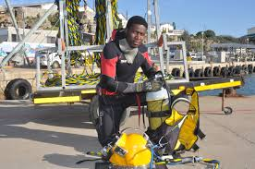
Beneficiary story

Slide 28
Agriculture economy
Agriculture as a percentage of GDP has decreased over past four decades, currently contributing around 2%. This implies that the economy is maturing, moving towards the secondary and tertiary sectors.
However, farming remains vitally important to the economy with 638 000 people formally employed – although it’s estimated that around 8,5-million people are directly or indirectly dependent on agriculture for their employment and income.
The sector’s significance is largely because of its potential to create jobs, and is a key focus of the New Growth Path, a plan by the government to create 5-million new jobs by 2020. Plans include programmes to promote commercially oriented small-scale farming. Support is also available to smallholders on land acquired through land reform.
NYDA role:
Partner with National and Provincial Department of Agriculture and Rural Development to identify land opportunities for young people to farm.
Partner with the Land Bank to increase funding available.
Profile agricultural opportunities for youth.
Fund small scale agriculture projects for youth.
Partner with SETA’s for agriculture training programs.
In 2019 / 2020 we funded 110 agriculture enterprises with 53 being cooperatives.

Slide 29

Beneficiary story

Slide 30
ICT economy
ICT’s contribution, is at 2,7% (or R93 billion); larger than agriculture, but slightly shy of tourism’s contribution of 3,1%. In other words, for every R100 that the economy produced in 2014, R2,70 was due to activities related to ICT.
Over two-thirds of the R93 billion was a result of activities related to telecommunications services that include, among other things, private broadcasting and cellphone services. The remaining third consisted of computer services (e.g. data processing and software development), manufacturing of ICT equipment (such as electronic components and devices), and activities related to the development of content and media.
A country experiences a trade deficit when it imports more than it exports. South Africa has consistently imported more ICT products than it has exported. The trade deficit for ICT has grown since 2011, from R42 billion in 2011 to R97 billion in 2014.
Almost half of ICT imports – 47,5%, in fact – consisted of radio, television and communication equipment, and 30,7% consisted of office and computing machinery. This highlights South Africa’s reliance on other countries to provide it with ICT equipment, such as smartphones, tablets, computers and servers.
South Africa’s largest ICT export – 60,5% of all ICT exports – was broadcasting, telecommunications and information supply services. This is due to South Africa’s expansion into the African continent with cellphone services and pay television.
NYDA role:
We have to as a country reduce the cost of data and bridge the digital divide.
There are numerous opportunities in global business services, one of the only sectors creating new jobs.
Partnerships with the MICT SETA to skill young people for ICT jobs.
We have partnered with the large technology companies, Microsoft and Google for skills programs for youth.
Funding for new and emerging ICT enterprises.

Slide 31

Beneficiary story

Slide 32
Mining economy
In 2018 the mining sector contributed R351 billion to the South African gross domestic product (GDP)
A total of 456,438 people were employed in the mining sector in 2018
Each person employed in the mining sector has up to nine indirect dependants
The mining sector has, for many years, attracted valuable foreign direct investment to South Africa
NYDA role:
Participated for the first time at the Mining Indaba – Youth in Mining raised important questions for the Mining Sector to consider.
Work with large mining companies, De Beers, Anglo American on skills programs for young people especially in vulnerable communities.
NYDA funding not sufficient to support capital intensive mining projects. DMRE has committed to unlocking funding for Youth in Mining.

Slide 33
Annual performance plan 2020 / 2021

Slide 34
PROGRAM 1: ADMINISTRATION
Outcome | Output Indicators | 2020/2021 | 2021/2022 | 2022/2023
Improved application of correct financial principles, procedures and executing supply chain management plan. | Produced Quarterly Financial Management Reports | 4 Quarterly Financial Management Reports produced | 4 Quarterly Financial Management Reports produced | 4 Quarterly Financial Management Reports produced
Enable NYDA by producing in-house skills that will promote youth development delivery. | Implemented an Annual Workplace Skills Plan | Implement Annual Workplace Skills Plan | Review and implement Annual Workplace Skills Plan | Review and Implement Annual Workplace Skills Plan
ERP Modules implemented in all Divisions of NYDA | ERP Modules deployed in all NYDA Divisions | ERP Modules deployed in all NYDA Divisions | Review and deployment of ERP Modules in all NYDA Divisions | Review and deployment of ERP Modules in all NYDA Divisions

Slide 35
PROGRAM 1: ADMINISTRATION
Outcome | Outcome Indicator | 2020/2021 | 2021/2022 | 2022/2023
To provide administrative support resulting in improved internal efficiencies and service delivery. | Value of funds sourced from the public and private sectors to support the youth development programmes. | R100 million | R150 million | R150 million
 | Number of funded SETA partnerships established | 8 funded SETA partnerships established | 10 of funded SETA partnerships established | 10 of funded SETA partnerships established
 | Number of partnerships signed with technology companies | 2 Partnerships signed with technology companies | 2 Partnerships signed with technology companies | 2 Partnerships signed with technology companies

Slide 36
PROGRAM 2: PROGRAM DESIGN, DEVELOPMENT AND DELIVERY
Outcome | Output Indicator | 2020/2021 | 2021/2022 | 2022/2023
Increased access to socio-economic opportunities, viable business opportunities and support for young people to participate in the economy. | Number of youth owned enterprises supported with financial interventions | 1100 | 1100 | 1200
 | Number of youth supported with Business Consultancy Services | 2000 | 2100 | 2200
 | Number of youth supported with non-financial business development interventions | 10000 | 10100 | 10200
 | Number of jobs created and sustained through supporting entrepreneurs and enterprises. | 5000 | 5100 | 5200
 | Number of jobs facilitated through placements in Job opportunities. | 5000 | 5100 | 5200
Provide information and universal access to young people | Number of outreach activities for providing youth development information | 250 | 280 | 300
Increased number of young people entering the job market trained | Number of young people capacitated with skills to enter the job market | 15000 | 18000 | 20000
 | Number of young people capacitated with skills to participate in the economy | 20000 | 22500 | 25000

Slide 37
PROGRAM 3: NATIONAL YOUTH SERVICE
Outcome | Output Indicator | 2020/2021 | 2021/2022 | 2022/2023
To coordinate the implementation of NYS across all sectors of society | Review and Implement the NYS Communications and Marketing Strategy | Review and Implement the NYS Communications and Marketing Strategy | Implement the NYS Communications and Marketing Strategy | Implement the NYS Communications and Marketing Strategy
 | Number of National Youth Service projects registered | 100 | 200 | 300
 | Number of partnerships coordinated to deliver on NYS programmes | 20 | 40 | 60
 | Presidential Youth Service Programme designed | Design a Presidential Youth Service Programme | Implement the Presidential Youth Service Programme | Implement the Presidential Youth Service Programme
 | Higher Education Youth Service program designed | Design a Higher Education Youth Service program | Implement the Higher Education Youth Service program | Implement the Higher Education Youth Service program

Slide 38
PROGRAM 4: RESEARCH AND POLICY
Outcome | Output Indicator | 2020/2021 | 2021/2022 | 2022/2023
To produce research and policy which influences change in youth sector and build sustainable relationships | Number of customer surveys conducted. | 4 | 4 | 4
 | Number of impact programme evaluations conducted. | 3 | 3 | 3
 | Produce Annual report on government wide priorities. | Produce Annual report on government wide priorities | Produce Annual report on government wide priorities | Produce Annual report on government wide priorities
 | Number of youth status outlook reports produced. | 4 Youth status outlook reports produced. | 4 Youth status outlook reports produced. | 4 Youth status outlook reports produced.

Slide 39
NYDA District Presence
Province | District | Location
Eastern Cape | Nelson Mandela | Port Elizabeth
Eastern Cape | Chris Hani | Queenstown
Eastern Cape | Sarah Baartmann | Alexandria
Eastern Cape | Buffalo city | East London
Eastern Cape | Alfred Nzo | Mount Alyf
Eastern Cape | Joe Gqabi | Lady Grey
Eastern Cape | OR Tambo | Mthatha
Free State | Mangaung | Bloemfontein
Free State | Lejweleputswa | Welkom
Free State | Fezile Dabi | Tweeling
Free State | Xhariep | Trompsburg
Gauteng | Tshwane | Pretoria
Gauteng | Johannesburg | Johannesburg
Gauteng | East Rand | Ekurhuleni
Gauteng | Sedibeng | Sebokeng
Gauteng | West Rand | Randfoentein
KwaZulu-Natal | Ethekwini | Durban
KwaZulu-Natal | uMgungundlovu | Pietermaritzburg
KwaZulu-Natal | Ugu | Port Shepstone
KwaZulu-Natal | King Cetshwayo | Richards bay
KwaZulu-Natal | Umkhanyakude | Mbazwana
KwaZulu-Natal | Amajuba | NewCastle
KwaZulu-Natal | Uthukela | Ladysmith
Limpopo | Capricorn | Polokwane
Limpopo | Waterberg | Thabazimbi
Limpopo | Sekhukhune | Groblersdal
Limpopo | Thulamela | Thulamela
Limpopo | Mopani | Tzaneen
Mpumalanga | Ehlanzeni | Nelspruit
Mpumalanga | Ehlanzeni | Thulamahatshe
Mpumalanga | Nkangala | eMalahleni
Mpumalanga | Gert Sibande | Secunda
North West | Bojanala | Rustenburg
North West | Ngaka Modiri Molema | Mahikeng
North West | Dr Ruth Segomotsi Mompati | Vryburg
Northern Cape | Frances Baard | Kimberley
Northern Cape | John Taolo Gaetsewe | Kuruman
Western Cape | Cape Town | Cape Town
Western Cape | Eden | George
Western Cape | Central Karoo | Beaufort West

Slide 40
Recommendations of BRR
Accessibility and visibility of the NYDA – outreach events and six new mobile outreach vehicles are assisting. All NYDA branches have been equipped with free Wi-Fi services.
Greater partnerships with SETA’s – specific target on the APP.
Reduce administration budget – reduced by further 2% in 2020 / 2021

Slide 41
Integrated marketing and communications

Slide 42

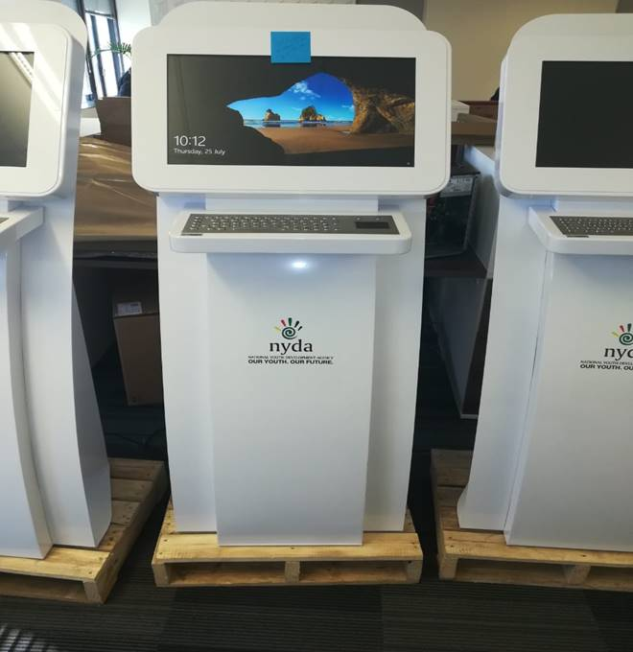
NYDA IMC
In terms of rural reach:
Use of outreach vehicles & mobile offices to reach youth in the rural areas
Dissemination of NYDA information using information kiosk placed in areas where youth frequent
More NYDA Mobile Offices have been procured and sent out to provinces
Outreach activations in communities, schools, institutions of higher learning
Partnerships with community media to publicize NYDA Products and Services
Establishments of district offices in areas such as Bushbuckridge, Tzaneen, Umtata, etc.
Stakeholder engagements with NGOs, private sector, etc.
Access to free Wi-Fi at our district offices and full service branches
Enhanced Customer Services through our call centre toll free number
Co-hosting of events and campaigns with various local and community organisations
Sponsorship of community-based organizations with specific focus on rural based initiatives

Slide 43
Financial information

Slide 44
Budget analysis
Description | 2019 / 2020 | 2020 / 2021
DWYPD – transfer payment | R447 000 000 | R478 700 000
Interest income | R6 000 000 | R9 002 000
Donor funded income | R48 000 000 | R57 300 000
Total | R501 000 000 | R545 002 000

Slide 45
Annual Budget 2020 / 2021
Key Programmatic Area | Budget allocation 18 / 19 | % | Budget allocation 19 / 20 | % | Budget allocation 20 / 21 | Medium Term Strategic Framework outcome
Economic Participation (Program 2) | R97 853 745 | -5% | R92 784 557 | 7% | R99 496 349 | Decent employment through inclusive economic growth
JOBS (Program 2) | R64 714 815 | -32% | R43 736 499 | 11% | R48 526 918 | Quality basic education & decent employment through inclusive economic growth
National Youth Service (Program 3) | R30 120 850 | 16% | R35 004 459 | 50% | R52 618 800 | Nation building and social cohesion
Universal access to opportunities (Program 2) | R54 604 949 | -9% | R49 503 439 | 0% | R49 417 522 | An efficient, effective and development orientated public service
Research and Policy (Program 4) | R10 411 400 | -26% | R7 728 000 | 27% | R9 833 000 | Decent employment through inclusive economic growth
Administration (Program 1) | R82 294 241 | 6% | R87 320 046 | -2% | R85 437 977 | An efficient, effective and development orientated public service
Employee costs | R170 000 000 | 9% | R185 000 000 | 8% | R199 635 434 | An efficient, effective and development orientated public service
Total | R510 000 000 | -2% | R501 077 000 | 9% | R545 002 000

Slide 46
Committed donor funding
Partner | Funds raised | Project description
Services SETA | R10 million | Artisan training
Department of Arts and Culture | R9 million | The Young Patriots Program
Flemish Government | R1 million | NYS Volunteer Program
KZN Department of Economic Development | R1.5 million | Grant program
UIF | R17 million | NYS Artisan program
Department of Small Business Development | R8.4 million | Braai Café
Department of Small Business Development | R10.4 million | 1000 businesses in 100 days
Total | R57.3 million

Slide 47
Employee costs analysis per program
Program | Expenditure | Percentage allocation
Program Design, Development, Delivery | R131 852 534 | 66%
National Youth Service | R5 879 090 | 3%
Research and policy | R12 912 901 | 6%
Administration | R48 990 909 | 25%
Total | R199 635 434

Slide 48
Cost of accommodation
Office accommodation | Cost
Head Office | R9 777 709
Branches (14) | R14 683 704
Service centers (23) | Rent free
Total rental | R24 461 743
Cost of head office and NYDA centers in provinces
Office accommodation | Cost
Head Office | R215 258 677
Branches, service centers in provinces | R329 743 323
Total | R545 002 000

Slide 49
Outreach events
Outreach events are always done in collaboration with municipality / NSFAS / SEDA / SEFA / DSBD / DHET / Provincial Government or at times private sector to share costs.
This is to build awareness amongst young people and link them to products and services of the NYDA and to wider government.
At times we are invited to exhibit at events.
Scenario 1 | Scenario 2 | Scenario 3
Travel to free / partner exhibition | Exhibition where catering is provided to young people | Paid for exhibition
Cost = R5 000 (including free Wi-Fi) | Cost = R10 000 – R25 000 R65 pp for catering | Cost = R10 000 – R40 000 Cost for set up of stand
Consultants
The NYDA does not make use of consultants and has not done so for the past three financial years.

Slide 50
Human resources

Slide 51
NYDA Structure
Presidency
Minister
- DWYPD
NYDA – Board of Directors
Financial Services
Corporate Strategy & Planning
Communication and ICT
Program Design & Development
Executive Directors Office
CEO
National Youth Service
HR and Legal

Slide 52
Nyda Vacancies
The NYDA total headcount as per the approved structure is 609 with 514 posts filled by the end of the last quarter of 2019/2020. The lower headcount is due to reprioritization of the budget , which resulted to various positions being put on hold. Vacant posts do have an impact, however the PSETA is assisting us with two year program for internships for entry level posts.
We have submitted detailed organogram.
The table below is a list of vacant positions:
Vacant Position | Total Number of vacant positions
Senior Manager | 5
Manager HQ | 4
Branch Manager | 5
Specialist HQ | 7
District Coordinator | 3
Business Advisor | 12
Skills Facilitator | 12
Officer HQ | 4
Information /Jobs Officer | 12
Receptionist | 2
District Administrator | 12
Business Administrator | 8
Administrator HQ | 9
TOTAL | 95

Slide 53
Relationship between nyda and departments

Slide 54
Working relationship between Departments and NYDA
NYDA and DWYPD have agreed shareholders compact – relationship mainly exists between the Youth Branch and NYDA. Youth Branch is responsible for youth policy while NYDA for policy implementation.
Youth branch invited to attend NYDA Strategic Sessions and Audit Committee meetings and provides input to the Annual Performance Plan and Five Year Strategic Plan.
DWYPD shares policy information as it relates to all vulnerable groups so that such information can be used in the design of youth programs.
NYDA works with many government Departments to scale up the implementation of youth programs. These programs cross youth entrepreneurship, jobs and skills development programs and National Youth Service programs.

Slide 55
Programs between NYDA and partners
Department | Program
DWYPD | Upscale existing programmes such as TECHNOGIRLS and initiate new programmes to improve the pass rate of girls studying mathematics, physical science and technology. Provide sanitary towels to indigent girls and women in schools and TVET colleges.
DHET | NSFAS – application process run through NYDA centers. SETA’s – skills programs with Services SETA, CHIETA, W&R SETA and MICT SETA
DEFF | Youth Environmental Service (YES)
DPW | Expanded Public Works Program (EPWP)
COGTA | Community Works Program (CWP)
DACSR | Young Patriots Program
Presidency | Presidential Youth Employment Intervention
DEL | Start here campaign and project
Health | Community Health Workers Program
HSWS | Youth brigades program
DSBD | 1000 businesses in 100 days Braai Café project

Slide 56
Legislative amendments

Slide 57
Legislative amendments
The review of the NYDA Act is led by the Youth Branch in the Department. The NYDA is a stakeholder in the process of the review and has made formal submissions to the Department.
The National Youth Policy 2030 is also a policy document of the Youth Unit in the Department. The NYDA is a stakeholder in the process of the review and has made formal submissions to the Department.
The NYDA will develop the IYDS aligned to the NDP 2030 and the NYP 2030, once the process of the NYP 2030 review is completed.

Slide 58
Customer service
The NYDA has a customer service team through a call center that attends to all queries and complaints. Each complaint is investigated and a report is provided including detailed feedback to the young person.
Call center number is toll free.
We are continuously working on getting the website zero rated.
Call Centre: 0800 52 52 52
E-Mail: info@nyda.gov.za

Slide 59
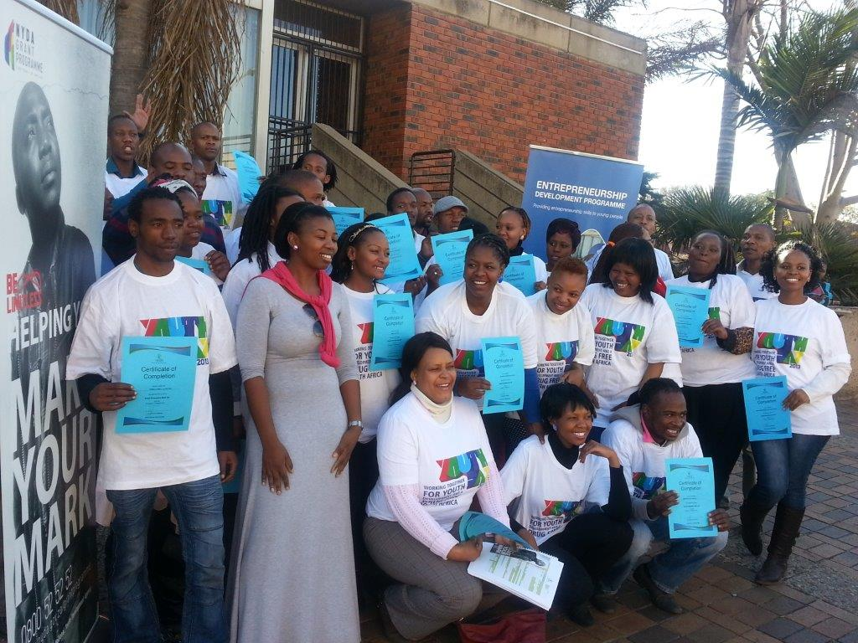
questions

