Slide 1

DEPARTMENT OF FORESTRY, FISHERIES AND THE ENVIRONMENT
STRATEGIC PLAN 2019/20 – 2023/24 AND 2020/21 ANNUAL PERFORMANCE PLAN

Slide 2
Strategic Overview and
Alignment of Department’s Strategic Plan with Government Priorities

Slide 3
Alignment of Departmental Work with Government Priorities
GOVERNMENT PRIORITY | DEPARTMENTAL RESPONSE
Economic transformation and job creation | Implementation of the Chemical and Waste Economy Phakisa which will result in the creation of 5 500 jobs from the Chemicals and Waste sector by 2024. Initiatives for the programme include: Industrial waste streams used in manufacturing and construction of infrastructure (Increase uptake of ash, gypsum and slag in brickmaking, roads construction and building markets (mainly local markets). Implementation of the Oceans Economy Phakisa: Facilitation of ocean economic activities and investment in the total ocean sectors, including Marine Transport and Manufacturing, Offshore Oil & Gas, Aquaculture, Coastal and Marine Tourism, Small Harbours Development, as well as Marine Protection and Ocean Governance which will result in 6200 jobs by 2024

Slide 4
Alignment of Departmental Work with Government Priorities
GOVERNMENT PRIORITY | DEPARTMENTAL RESPONSE
Economic transformation and job creation | Implementation of biodiversity economy initiatives: South Africa’s biodiversity underpins the economy, society and human wellbeing. Continued investment in managing and conserving biodiversity is essential so that jobs that depend on biodiversity can continue to increase. Key interventions include the following: Training of 2000 Biodiversity beneficiaries/entrepreneurs Identifying and cultivating 2500 hectares of land 15 000 heads of game donated to PDI’s and communities 4000 Jobs Created
Consolidating social wage | Biological invasions can cause irreversible impacts on the ecological functioning of natural systems. This is not just intensifying the loss of species but fundamentally changing the productive potential of land and water, and weakening the goods and services upon which we depend. The impact on the “carrying capacity” of the earth, such as for water security, food security, exacerbating “natural” disasters, and emerging diseases has intensified. These are mitigated through the Implementation of the Expanded Public Works Programme (EPWP) for the Environment Sector. It is estimated that 307 480 work opportunities will be created through the implementation of Environmental Programmes by 2023/24. An estimated 199 862 of these beneficiaries will be young people.

Slide 5
Alignment of Departmental Work with Government Priorities
GOVERNMENT PRIORITY | DEPARTMENTAL RESPONSE
Education , skills and health | Investment in environmental education, marine science, and research is essential for knowledge generation and to inform decision making. Improved capacity for the environment sector will be achieved through the following interventions: Implementation of the DFFE internship and environment education programmes: 424 young people who will participate in the internship programme. A further 1000 students will be placed in the Work Integrated Learning Programme (WIL) 2000 teachers will receive training in Environmental Management through the Fundisa for Change programme Environmental Management Education and awareness campaigns will be conducted in 7 500 schools focusing on Climate Change and Biodiversity Conservation; Environmental protection and waste management; Ocean economy, Marine protection and sustainability Threats on environmental quality and human health Mitigated: Ensure that South African Communities are exposed to clean and healthy air that meets the ambient air quality standards and is not harmful to the health of people and the environment.
Social Cohesion and Safe communities | Climate Change Mitigation & Adaptation: South Africa must take immediate action in planning for, and responding to intensified climate change impacts. In particular, urgent action is needed in respect of managing water resources in a changing climate, planning for the potential impact on agricultural production, and ensuring that local governments are able to anticipate and reduce the risk of extreme events (such as fires, floods and droughts) on human settlements.

Slide 6
Alignment of Departmental Work with Government Priorities
GOVERNMENT PRIORITY | DEPARTMENTAL RESPONSE
A better Africa and World | South Africa is committed to advance sustainable development goals in the continent . These are pursued through various conventions in the areas of Climate Change, Chemicals and Waste Management, Oceans and coastal Management, Biodiversity and Conservation. To this end South Africa will advance, post 2020 a new deal for nature and people
Spatial Integration , Human settlements and local government | Spatial planning and land-use restrictions should be applied to flood prone areas, with limitations to infrastructure development in high risk areas. Priority should be given to the re-development of open spaces that can improve storm water management. Any settlement should take into consideration the current and future climate risks. Our focus is on Local Government Support to enable effective planning in the context of sustainable development goals. The implementation of Waste Management, Air Quality and Climate Change programmes aimed at: Sound environmental Management of hazardous waste streams to protect communities from being affected by dumped or badly managed waste Implement effective air quality management interventions to ensure the reduction of atmospheric emissions from major polluters Improve access to coastal areas, through spatial planning and economic development in priority areas working closely with municipalities to enhance growth of tourism opportunities, subsistence and recreational fishing and fair access to coastal recreational amenities.

Slide 7
Alignment of Departmental Work with Government Priorities
GOVERNMENT PRIORITY | DEPARTMENTAL RESPONSE
A capable, ethical and developmental state | The department will improve the system of corporate governance and internal controls and implement oversight mechanisms for managing operations of the Public Entities. The department will enhance partnerships and stakeholder engagements

Slide 8
PROGRAMME 1 :
ADMINISTRATION

Slide 9
PROGRAMME 1: ADMINISTRATION
Purpose: Provide strategic leadership, management and support services to the department.
What do we do?
Contribute towards an efficient, accountable and capable state
Provide administrative and executive support to the Director-General and administrative support to the Department
Provide support to the development and implementation of the strategic and operational plans for the Department
Co-ordinate the Department’s planning, implementation and facilitate cooperative governance to improve performance
Provide effective and sound corporate and cooperative governance within the Department and its Entities
Communications services aimed at ensuring that internal and external public is informed, educated and mobilised to play an active role in realising a society that lives in harmony with its environment
Manage facilities, security, vetting and travel services to meet the operation and strategic needs of the department
Provide effective and efficient Information and Communication Technology Services to the Department
Provide strategic and efficient human capital management services to the Department

Slide 10
EFFICIENT, ACCOUNTABLE AND CAPABLE STATE
Good governance, compliance with legislative requirements and effective financial management:
  Unqualified audit opinion: Ensures that the department implements improved controls and recommendations emanating from audit recommendations and provide assurance to the department and continuous Identification and management of Performance Risks.
Improved systems of corporate governance: Internal audit planning and execution which assist the Department to detect gaps and areas of improvement in controls and governance.
Expenditure on BBBEE, rural and township enterprises
Profiling of Environment Sector:
Environmental Management Education and awareness campaigns. Stakeholder Engagement: DFFE will host quarterly stakeholder engagement forums that would be themed based on various priority areas the Department is focused on.
An estimated 90 Environmental events will be hosted over the MTSF period (Ministerial public participation events, conferences, celebration of key environment days, etc.)

Slide 11
EFFICIENT, ACCOUNTABLE AND CAPABLE STATE (cont)
Environment Sector Capacity Building:
Fundisa for Change. Learnerships & Work Integrated Learning Programme placements
Preparedness for the 4th Industrial Revolution (Long term):
Modernisation of ICT Services: Cloud computing - will provide guaranteed availability, confidentiality and integration of DFFE information; Automation - Expansion of EDMS functionality at significantly discounted rates; Internet of Things - monitoring solutions for the Department’s facilities including temperature, humidity, power etc. with intelligent reporting to relevant stakeholders.

Slide 12
PROGRAMME 1
OUTCOME: GOOD GOVERNANCE, COMPLIANCE WITH LEGISLATIVE REQUIREMENTS AND EFFECTIVE FINANCIAL MANAGEMENT
OUTCOME INDICATORS | BASELINE | TARGET 2020/21 | 5 YEAR TARGET 2023/24
External audit opinion | Adverse AGSA audit opinion for 2017/18 | Unqualified external audit opinion | Unqualified external audit opinion without any matter (Financial statements and performance information)
Percentage expenditure | 96% (6 590 137/ 6 848 214) | 98% | 98%
OUTCOME: IMPROVED CONTRIBUTION OF THE DEPARTMENT TO SOCIO-ECONOMIC TRANSFORMATION AND EMPOWERMENT OF PREVIOUSLY DISADVANTAGED COMMUNITY (BLACK ,WOMEN OWNED AND TOWNSHIP/RURAL BASED ENTERPRISE)
Percentage of the Department budget expenditure on BBBEE and black owned enterprises | 92% (1 459 553 029.76 / 1 588 070 783.21) | 90% BBBEE , of which 65% must be over 50% black Owned | 90% BBBEE overall of which 75% must be over 50% black owned
Percentage of the Department budget expenditure on rural and township enterprises | N/A | Baseline for township and rural enterprise for procurement of goods and services (less than R800K) established. 30% of procurement on Rural and Township enterprises by 31 March 2021 | 30% of procurement on Rural and Township enterprises
Number of rural and township enterprises supplier workshops conducted | N/A | 2 | 10 rural and township enterprises supplier workshops conducted
OUTCOME: AN ADEQUATELY CAPACITATED AND TRANSFORMED WORKFORCE WHICH IS REPRESENTATIVE OF SOUTH AFRICA’ RACE AND GENDER DEMOGRAPHICS
Percentage vacancy rate | 7.6% Vacancy rate (139/1823*100) | 8% | 5%
Percentage compliance to the Employment Equity targets | 56.5% (905/1 600) | 58% Women employees | 58% Women employees
 | 2.9% (48/1 684*100) | 2% People with disabilities | 3% People with disabilities

Slide 13
PROGRAMME 1 Continued…
OUTCOME: EFFECTIVE INFORMATION COMMUNICATION AND TECHNOLOGY SYSTEMS WHICH ARE SUPPORTIVE OF THE ORGANIZATIONS’ CORE BUSINESS AND MANDATE
OUTCOME INDICATORS | BASELINE | TARGET 2020/21 | 5 YEAR TARGET 2023/24
Information Communication and Technology Systems developed and implemented | N/A | - 3 CIPS Permits Modules operational - 1 CIPS module tested | Coordinated and Integrated Permitting System (CIPS) operational (10 permits)
OUTCOME: IMPROVED LEVELS OF ENVIRONMENTAL MANAGEMENT EDUCATION AND AWARENESS WITHIN COMMUNITIES WHICH DRIVES POSITIVE BEHAVIOURAL CHANGE
Number of events including Ministerial Public Participation Programme (PPP) hosted | 16 events were hosted | 14 events were hosted | 90 events hosted
Number of public education and awareness campaigns implemented | 4 environmental awareness campaigns implemented: Waste Management awareness Climate Change Awareness Rhino Anti-Poaching awareness Marine awareness | Public education and awareness campaigns implemented on 4 thematic areas: Climate change and biodiversity conservation Environmental protection and waste management Fishing rights allocation process (FRAP 2021) Oceans Phakisa, marine protection and sustainability | Public education and awareness campaigns implemented on 6 thematic areas: Climate change and biodiversity conservation Environmental protection and waste management Fishing rights allocation process (FRAP 2021) Oceans Phakisa, marine protection and sustainability
Number of school in which environmental education and awareness programmes are conducted | N/A | 6 000 | 7 500 schools
Number of stakeholder management engagements convened | N/A | 8 | 40 stakeholder engagements convened

Slide 14
PROGRAMME 1 Continued…
OUTCOME: IMPROVED HUMAN RESOURCES CAPACITY OF THE SECTOR
OUTCOME INDICATORS | BASELINE | TARGET 2020/21 | 5 YEAR TARGET 2023/24
Number of beneficiaries provided with skills development and training on environmental management | N/A | 1002 beneficiaries: 212 graduates recruited on Internship programme 40 full-time bursaries issued 250 students placed on Work Integrated Learning Programme 500 education officials trained | 3 624 beneficiaries provided with skills development opportunities: 424 graduates recruited on the Department Internship programme 200 full-time bursaries issued to student on prioritised skills for the sector 1000 students placed in Work Integrated Learning Programme (200 per annum) 2000 Teachers Trained on CAPS programme
Number of officials trained in environmental compliance and enforcement (includes Forestry and Fisheries; and Monitors) | 2636 | 720 | 3 750

Slide 15
Department of Fisheries, Forestry and the Environment – Operations and focus during COVID 19 Pandemic
 | LEVEL 5 RESTRICTIONS | LEVEL 4 RESTRICTIONS
CORPORATE MANAGEMENT SERVICES | Enabling remote connectivity including use of digital communication platforms to reach our stakeholders. Continuous Risk assessment and implementation of mitigation measures in line with COVID-19 Protocols. Measures being implemented to ensure readiness by the 15th May (disinfecting buildings, hygiene measures, screening of officials and visitors) Safety and security of employees especially those in essential services, i.e provision of sanitizers, PPE and managing the numbers of people in office blocks. HCM services, compliance to disclosure directives, payroll administration, labour relations matters and provision of Wellness support services.

Slide 16
PROGRAMME 2 :
REGULATORY COMPLIANCE AND SECTOR MONITORING

Slide 17
PROGRAMME 2: REGULATORY COMPLIANCE AND
SECTOR MONITORING
Purpose: Promote the development of an enabling legal regime and licensing authorisation system that will promote enforcement and compliance and ensure coordination of sector performance.
What do we do?
Law reform: drafting & vetting of legislation
Appeals
Litigation management
Corporate legal support; contracts, legal opinions
Environmental Impact Assessment and Integrated Permitting Systems
Integrated Environmental Management: Systems and Tools development
Compliance promotion and compliance monitoring
Enforcement: Administrative and criminal

Slide 18
Key pieces of legislation that governs the work
The National Environmental Management Act, (NEMA) 1998 (Act No. 107 of 1998)
The National Environmental Management:
Biodiversity Act, 2004, (Act No. 10 of 2004)
Air Quality Act, 2004 (Act No. 39 of 2004)
Waste Act, 2008 (Act No. 59 of 2008)
Protected Areas Act, 2003 (Act No. 57 of 2003)
Integrated Coastal Management Act, 2008 (Act No. 24 of 2008)
The World Heritage Convention Act , 1999 (Act No. 49 of 1999)
The Marine Spatial Planning Act, 2018, (Act No. 16 of 2018)
The Criminal Procedure Act, 1997 (Act No. 51 of 1977)
FUTURE: Marine Living Resources Act, 1998 (Act No. 18 of 1998) ; The National Forests Act, 1998 (Act No. 84 of 1998); The National Veld and Forests Fire Act, 1998 (Act No. 101 of 1998)

Slide 19
PROGRAMME 2
OUTCOME: IMPROVED COMPLIANCE WITH ENVIRONMENTAL LEGISLATION AND ENVIRONMENTAL THREATS MITIGATED
OUTCOME INDICATORS | BASELINE | TARGET 2020/21 | 5 YEAR TARGET 2023/24
Number of environmental authorisations inspected for compliance | 183 | 165 | 850
Number of Environmental Performance Assessments conducted | 24 were audited | 25 | 125 Environmental Performance Assessments conducted
Number of inspections conducted for verification of the rhino horns and elephant tusks stockpiles | 21 | 14 | 70
Number of criminal cases finalised and dockets handed over to the NPA for prosecution | 50 | 46 | 230
Number of administrative enforcement notices issued | 228 | 220 | 1 100
Number of joint enforcement operations conducted | 26 | 45 | 65
Integrated compliance and enforcement strategy reviewed and approved | 5 targets of 2014 National Environmental Compliance and Enforcement Strategy (NECES) implemented | Draft revised NECES 2021 developed | Revised integrated compliance and enforcement strategy and implementation plan approved (inclusive of terrestrial and ocean protection) Approved integrated compliance and enforcement strategy implemented (as per plan)

Slide 20
PROGRAMME 2 Continued…
OUTCOME: ALIGNED ENVIRONMENTAL MANAGEMENT REGULATORY FRAMEWORKS, SYSTEMS, TOOLS AND INSTRUMENTS
OUTCOME INDICATORS | BASELINE | TARGET 2020/21 | 5 YEAR TARGET 2023/24
Number of interventions for streamlining environmental authorisation/management developed | 3 Generic EMPrs for the Working for Programmes initiated: Revised financial provisioning regulations for the mining sector finalised for gazetting for comment Drafts of 7 assessment protocols available for stakeholder consultation SEA for strategic corridors for gas and electricity grid underway SEA for shale gas finalised | 3 Environmental Management tools developed: Financial Provisioning regulations for the mining sector gazetted for public Comments Minimum requirements for the submission of EIAs for shale gas installations prepared Generic EMPrs for Working for Programmes gazetted for Implementation | 3 Environmental Management tools developed: Financial Provisioning Regulations for the mining sector finalised Minimum requirements for the submission of EIAs for Shale Gas installations gazette for implementation Generic EMPrs for the exclusion of activities related to the “working for programmes”
Number of Strategic Environmental Assessments developed | 1st Draft of SEA for the identification for strategic gas and electricity corridors finalised SEA for shale gas finalised Square Kilometre Array (SKA) management plan finalised | 2 SEA interventions: Strategic gas and electricity corridors gazetted for public comment Renewable energy development zones in previously mined areas gazetted for public comments | 2 Strategic Environment Assessments (SEA) developed: SEA to locate strategic gas and electricity corridors SEA to identify Renewable Energy Development Zones for solar energy developments in previously mined areas

Slide 21
Department of Fisheries, Forestry and the Environment – Operations and focus during COVID 19 Pandemic
 | LEVEL 5 RESTRICTIONS | LEVEL 4 RESTRICTIONS
REGULATORY COMPLIANCE AND SECTOR MONITORING | Development of policy / environmental management tools that will assist with economic recovery and urgent sectoral legislation to carry on functions under lockdown Attend to urgent litigation and provide urgent legal opinions to Department Attend to appeal decisions within legislated time frames Process quality and defensible environmental impact assessments to promote economic growth while protecting the environment Ensure proper compliance and enforcement measures continue to ensure the adequate protection and sustainable utilization of our natural resources Attending to urgent authorisations in terms of section 30A Operation Phakisa Initiative 5 and anti-poaching operations continue Remote work in all areas continuing under lockdown Administrative and reporting requirements are being attended to

Slide 22
PROGRAMME 3 :
OCEANS AND COASTS

Slide 23
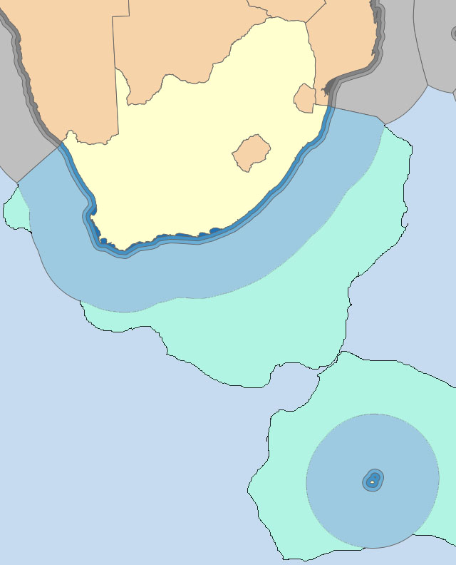
PROGRAMME 3: OCEANS AND COASTS
South Africa is a maritime nation with jurisdiction over one of the largest Exclusive Economic Zones.
Our oceans represent a significant asset for current and future generations, with enormous economic potential, and contributing directly and indirectly to human livelihoods, food security, trade and industry.
As we grow our ocean economy, we also have to be mindful of the impact of increasing human activity on the health of our oceans.
It is therefore essential that whilst we seek economic opportunities in our ocean space, we must also consider our footprint and impact.

Slide 24
PROGRAMME 3: OCEANS AND COASTS
Purpose: Promote, manage and provide strategic leadership on oceans and coastal management
What do we do?
Manage, coordinate, facilitate, analyze and report on the implementation of initiatives within the ocean economy.
Provide overall national strategic direction, leadership, management and support to ocean & coastal science; including undertaking national, regional and southern ocean science monitoring and analyses
Provide overall strategic direction, leadership & management within applicable legislation and policies on integrated coastal management
Provide specialist oceans & coastal monitoring services, establish measures for the conservation and sustainable use of the ocean environment and ecosystems, manage the logistics for the SA National Antarctic Program

Slide 25
Ocean and Coastal Conservation and Management (Sustainable Development)
Oceans and Coastal Research & Infrastructure
Marine Protected Areas and Species Management
International Engagements and Partnerships
Ocean and Coastal Information System
OCEANS ECONOMY
Early Warning Systems
Policy, Legislation and Regulation
Ecosystem Health & Productivity
Marine Spatial Planning
Access Strategy and Sustainable use
Antarctica Strategy and Support
Water Quality Monitoring
Coordinated Compliance and Enforcement
Coastal Infrastructure Development

Slide 26
Oceans Economy Focus Areas and Enablers
Marine Transport & Manufacturing
Offshore Oil & Gas
DFFE, DPME, DOT, DPE, DTI, DMR, DOE, DAFF, DST, DHET, DPW, DRDLR, DOL, DHA, NT, DSBD, DOD, EDD, DOW, NDT, DIRCO, DBE, DWS, Provinces, Private Sector, Civil Society, Labour and Academic
Aquaculture
Marine Protection Services & Oceans Governance
Small Harbours Development
Potential: R177 billion to Gross Domestic Product (GDP) by 2033 (compared to R54 billion in 2010) and create approximately 1 million jobs
(compared to 316 000 in 2010)
Coastal & Marine Tourism
Skills Development
and Capacity Building
Research Technology and Innovation

Slide 27
What are the key pieces of legislation, regulations, protocols and international agreements that govern your work?
Legislation | Regulations
National Environmental Management: Integrated Coastal Management Act, 2008 (Act No. 24 of 2008) | Dumping at sea regulations ICM Act Appeal Regulations Coastal waters discharge permit regulations Regulations on the reclamation of land from coastal water Regulations on the control of use of vehicles in coastal areas
National Environmental Management: Protected Areas Act, 2003 (Act No. 57 of 2003) | OC only administers the provisions of the Act related to marine protected areas (MPAs)
National Environmental Management: Biodiversity Act, 2004 (Act No. 10 of 2004) | Provisions of the Act related to species management and protection (as it applies to marine species including boat-based whale watching and white shark cage diving) The Marine Threatened and Protected Species Regulations
Marine Spatial Planning Act, 2018 (Act No. 16 of 2018)
International Conventions
1. Convention on the Conservation of Antarctic Marine Living Resources
2. Antarctic Treaty
3. Ramsar Convention on Wetlands
4. Convention on Biological Diversity
5. London Convention on the Prevention of Marine Pollution by Dumping of Wastes and Other Matter
Nairobi Convention for the Protection, Management and Development of the Marine and Coastal Environment -Western Indian Ocean Region
Abidjan Convention on Cooperation in the Protection, Management and Development of the Marine and Coastal Environment of the Atlantic Coast of the West, Central and Southern Africa Region
Benguela Current Convention for the promotion of a regional approach to the long-term conservation, protection, rehabilitation, enhancement and sustainable use of the Benguela Current Large Marine Ecosystem, to provide economic, environmental and social benefits
International Whaling Commission; Agreement on Conservation of Albatrosses and Petrels, Convention on Conservation of Migratory Species
Convention on International Trade in Endangered Species of Wild Fauna and Flora (inputs on marine species)

Slide 28
PROGRAMME 3
OUTCOME: GROWING OCEAN ECONOMY IN THE CONTEXT OF SUSTAINABLE DEVELOPMENT
OUTCOME INDICATORS | BASELINE | TARGET 2020/21 | 5 YEAR TARGET 2023/24
Number of jobs created through implementation of Ocean Economy Operation Phakisa programme | N/A | 1550 | 6200
Oceans Economy Master Plan developed and implemented | Ocean Economy Phakisa 3 feet delivery Plans | Ocean Economy Master Plan approved | Oceans Economy Master Plan approved Oceans Economy Master Plan implemented in 4 focus areas: Aquaculture and Fisheries Marine Transport & Manufacturing Offshore Oil & Gas Coastal Marine Tourism
OUTCOME: THREATS TO ENVIRONMENTAL INTEGRITY MANAGED AND ECOSYSTEM CONSERVED
National Oceans and Coasts Water Quality Monitoring programme developed and implemented | National Oceans & Coasts Water Quality Monitoring Programme implemented in 17 priority areas for 3 Coastal provinces | Water Quality Trends Report compiled | Water Quality monitoring programme providing monthly data for 60 priority areas, providing quarterly reports in less sensitive areas, and monthly data in highly sensitive Area
Marine spatial planning and governance system developed and implemented | Marine Spatial Bill (MSP) was submitted to Parliament for approval | MSP Sector Plans developed | 1st MSP sub-regional plan approved

Slide 29
PROGRAMME 3 Continued…
OUTCOME: THREATS TO ENVIRONMENTAL INTEGRITY MANAGED AND ECOSYSTEM CONSERVED (CONTINUED….)
OUTCOME INDICATORS | BASELINE | TARGET 2020/21 | 5 YEAR TARGET 2023/24
Number of Management Plans for declared Marine Protected Areas developed and implemented | 8 Management plans for old MPAs (Cape Nature MPAs, EKZN, SANParks, EC) | 2 Management plans for declared Phakisa MPAs developed | 13 management plans developed and implemented
Estuarine management strategy developed and implemented | 1 Estuary Management Plan (EMP) finalised for approval | 4 national estuaries management plans implemented: • Buffalo Estuary • Durban Bay Richards Bay Orange River Estuary | 4 national estuaries management plans implemented: • Buffalo Estuary • Durban Bay • Richards Bay • Orange River Estuary 2 Estuarine Management plans developed: • Mtamvuna Estuaries • Coega Estuaries
Antarctic Strategy developed and implemented | Draft strategy presented at the Economic, Sectors, Employment and Infrastructure Development Cluster (ESEID), MINTECH and Global and Continental Affairs Committee (GCAC) | Antarctic Strategy submitted to Cabinet for final gazetting | Antarctic strategy implemented (as per implementation plan)

Slide 30
PROGRAMME 3 Continued…
OUTCOME: STRENGTHENED KNOWLEDGE, SCIENCE AND POLICY INTERFACE
OUTCOME INDICATORS | BASELINE | TARGET 2020/21 | 5 YEAR TARGET 2023/24
Percentage increase of the EEZ under marine protected areas | 0,4% of the EEZ under protection | Research study conducted on additional 5% of oceans an coastal area protection | Final Research report on possible additional 5% of oceans an coastal area protection compiled
Number of peer-reviewed scientific publications (including theses and research policy reports) | 24 peer review publications have been produced | 16 peer-reviewed scientific publications compiled | 80 peer-reviewed scientific publications published
Number of relief and science voyages to remote stations undertaken to SANAE, Gough and Marion Islands | 3 relief voyages undertaken | 3 relief voyages to SANAE, Gough and Marion Islands undertaken (per annum) | 3 relief voyages to SANAE, Gough and Marion Islands undertaken (per annum)

Slide 31
Department of Fisheries, Forestry and the Environment – Operations and focus during COVID 19 Pandemic
 | LEVEL 5 RESTRICTIONS | LEVEL 4 RESTRICTIONS
OCEANS & COAST | Ocean Economy Master Plan: proceeding with the ocean economy master planning process, including targeted stakeholder engagements with virtual meeting arrangements. Marine Spatial Planning: proceed with work on the Southern Marine Area Plan, including through meetings by remote communications, with sector departments Ocean and Coastal Research: Proceed with work to write up publications. Reschedule site visits Marion Island Relief Voyage: proceed with planning and provisioning for the voyage (including two weeks quarantine period) | Ocean Economy Master Plan: As with level 5, and inclusion of specific areas of work to unlock progress with Ocean Economy deliverables Marine Spatial Planning: As with level 5, proceed with work on the Southern Marine Area Plan, including through meetings by remote communications, with sector departments Ocean and Coastal Research: As with level 5, proceed with work to write up publications. Reschedule site visits Marion Island Relief Voyage: The SA Agulhas II left for Marion Island on 21 April. Preparations for return of the vessel underway

Slide 32
PROGRAMME 4 :
CLIMATE CHANGE, AIR QUALITY AND SUSTAINABLE DEVELOPMENT

Slide 33
PROGRAMME 4: CLIMATE CHANGE, AIR QUALITY AND SUSTAINABLE DEVELOPMENT
Purpose: Lead, promote, facilitate, inform, monitor and review the mainstreaming of environmental sustainability, low carbon and climate resilience and air quality in South Africa’s transition to sustainable development.
What do we do?
Monitor and evaluate national climate change responses in order to ensure informed climate change response decision-making.
Lead and/or support, inform, monitor and report efficient and effective national, provincial and local climate change mitigation responses.
Lead and/or support, inform, monitor and report efficient and effective national, provincial and local climate change adaptation responses.
Ensure that reasonable legislative and other measures are developed, implemented and maintained in such a way as to protect and defend the right of all to air and atmospheric quality that is not harmful to health and well-being.
Prepare for, negotiate and inform the implementation of multi-lateral, mini-lateral and bilateral climate change agreements and reporting.
Oversee, facilitate and coordinate the department’s international relations, engagements and cooperation agreements.
Oversee the provision of information and advocacy for sustainable development through the development, implementation and management of knowledge and information management system.
Coordinate environment sector planning implementation and cooperate governance to improve performance.
Manage the provision of climate change support services, administration & negotiation processes of the Branch.

Slide 34

Key pieces of legislation that governs the work
The Constitution,
The National Environmental Management Policy,
The National Environmental Management Act (NEMA),
The Air Quality Act (NEM: AQA),
The South African Weather Service Act, 2001 (Act No. 8 of 2001),
The National Climate Change Response Policy,
The United Nations Framework Convention on Climate Change (UNFCCC)

Slide 35
PROGRAMME 4
OUTCOME: A JUST TRANSITION TO A LOW CARBON ECONOMY AND CLIMATE RESILIENT SOCIETY
OUTCOME INDICATOR | BASELINE | TARGET 2020/21 | 5 YEAR TARGET 2023/24
Number of sector jobs resilience plans developed and implemented | New | Sector Jobs Resilience Plans Developed for 5 value chains: • Coal • Agriculture; • Tourism • Petrol based transport • Metals | Sector Jobs Resilience Plans approved and implemented for 5 value chains: • Coal • Agriculture • Tourism • Petrol based transport • Metals. National Employment Vulnerability Assessment finalised
Number of climate change strategies and plans developed and approved | N/A | Low carbon growth strategy submitted to Cabinet for Approval | Low carbon growth strategy finalised
 |  | SA’s NDCs updated | National Climate Change Adaptation Strategy approved
 |  |  | South Africa’s Nationally Determined Contributions( NDCs) updated

Slide 36
PROGRAMME 4
OUTCOME: A JUST TRANSITION TO A LOW CARBON ECONOMY AND CLIMATE RESILIENT SOCIETY (CONTINUED)
OUTCOME INDICATOR | BASELINE | TARGET 2020/21 | 5 YEAR TARGET 2023/24
GHG emissions maintained within the emissions trajectory range | N/A | Report on GHG emission reductions compiled (emissions to be in the 398 and 614 Mt CO2-eq range) | Emissions between 398 and 614 Mt CO2-e range
Climate Change Regulatory Framework and tools developed and Implemented | Climate Change Regulatory Framework and tools developed and Implemented | National Climate Change Bill tabled in Parliament | National Climate Change Act implemented: • Adaption systems • Mitigation systems
Mitigation potential analysis studies conducted | N/A | N/A | Mitigation Potential Analysis (MPA) 2023 compiled
Number of sector adaptation interventions implemented | Draft National Climate Change Adaptation Strategy finalised and on-route for submission to Minister | 5 Climate Adaptation Sector plans implemented: • Agriculture • Health • Coastal • Human Settlements • Water and Sanitation | 8 Sector Adaptation Plans reviewed

Slide 37
PROGRAMME 4 Continued…
OUTCOME: THREATS ON ENVIRONMENTAL QUALITY AND HUMAN HEALTH MITIGATED
OUTCOME INDICATOR | BASELINE | TARGET 2020/21 | 5 YEAR TARGET 2023/24
National Air Quality Indicator | 0.9% | NAQI : Equals to or less than 1 | NAQI : Equals to or less than 1
Air Quality Management Plans (AQMPs) for priority areas developed and implemented | Annual plans of 3 Priority Area AQMPs implemented as follows: • Highveld, • Vaal Triangle Air shed • Waterberg-Bojanala | Inter-Ministerial Committee (IMC) establish | Inter-Ministerial Committee established Priority Area Working Group established (communities, NGOs and industry) 2nd generation Vaal Triangle Airshed Priority Area (VTAPA) AQMP approved and implemented (as per annual implementation plan) 2nd generation Highveld Priority Area (HPA) AQMP approved and implemented (as per annual implementation plan)
 |  | Priority Area Working Group (WG) established (Communities, NGOs and industries)
 |  | Draft 2nd generation Vaal Triangle Airshed Priority Area (VTAPA) AQMP developed
 |  | 2nd generation Highveld Priority Area (HPA) AQMP developed
Number of air quality monitoring stations reporting to SAAQIS meeting minimum data recovery standard of 75% | 42 air quality monitoring stations meeting minimum data requirements (80% data recovery) | 65 ambient air quality monitoring stations reporting to the SAAQIS meeting data recovery standard of 75% | 80 monitoring stations reporting to the SAAQIS meeting data recovery standard of 75%

Slide 38
PROGRAMME 4 Continued…
OUTCOME: STRENGTHENED KNOWLEDGE, SCIENCE AND POLICY INTERFACE
OUTCOME INDICATOR | BASELINE | TARGET 2020/21 | 5 YEAR TARGET 2023/24
Sector monitoring and evaluation studies and reports/ publications published | Draft 3rd South African Environment Outlook (SAEO) report developed | Web-based Environmental outlook - South African Environment (SAE 2019) – published South African Environment -2020 text approved | State of Environment Impact Assessment report published
Number of reports published on status of indicators of essential ocean variables for detecting ocean variability and climate change | Annual Report Card on key Ocean and Coasts indicators compiled | Annual Report Card on key Essential Ocean and Coasts Variables or Indicators Compiled | 5 South African Ocean and Coasts Environment Data reports published
State of the Forest Report (SoF) developed and published | SoF finalised and published | 2018 SoF finalised and published | 2 State of Forest reports published
Annual list of protected trees published | 1 | Annual list of protected trees published | 5
OUTCOME: INTERNATIONAL COOPERATION SUPPORTIVE OF SA ENVIRONMENTAL / SUSTAINABLE DEVELOPMENT PRIORITIES
Number of South Africa’s International Environment and Sustainable Development negotiating positions developed and approved | 11 position papers developed and approved: 2 Climate change positions | 7 positions approved: 2 Climate change (UNFCCC; PCC) | 40 positions approved: 10 Climate change (5 UNFCCC, 5 IPCC)
 | 4 Biodiversity positions | 4 Biodiversity positions: CBD COP15; CPB CoP-MOP10; Nagoya COP MOP4; IPBES8 | 18 Biodiversity positions approved: (UNCCD COP 16; AEWA; 5 World Heritage Convention; 2 CBD; 2 CMS; 5 IPBES; 2 CITES
 | 5 Chemical/Waste Management positions | 1 Chemical/ Waste Management (Montreal MOP) | 12 Chemical/ Waste Management positions: (2 Basel, 2 Rotterdam, 2 Stockholm, 4 Montreal MOP and 2 Minamata COP)

Slide 39
PROGRAMME 4 Continued…
OUTCOME: INTERNATIONAL COOPERATION SUPPORTIVE OF SA ENVIRONMENTAL / SUSTAINABLE DEVELOPMENT PRIORITIES (CONTINUED)
OUTCOME INDICATOR | BASELINE | TARGET 2020/21 | 5 YEAR TARGET 2023/24
Financial value of resources raised from international donors to support SA and African environment programmes | Total resources mobilised: USD 121 208 692 | US$ 40 million raised | US$ 250 million
OUTCOME: AN ADEQUATELY CAPACITATED LOCAL SPHERE OF GOVERNMENT WHICH IS ABLE TO EFFECTIVE EXECUTE ITS ENVIRONMENTAL MANAGEMENT FUNCTION
Number of local government support interventions implemented in line with the District Delivery Model | 100% (14/14) of annual action plan for Local Government Support Strategy were implemented | 2 interventions: Environmental priorities incorporated in IDPs of 44 district Municipalities | 2 Local Government support Interventions implemented in 44 district municipalities: Environmental priorities incorporated in IDPs of 44 district municipalities.
 |  | 250 Municipal Councillors and/or officials trained | 1 250 (Councillors and Municipal officials) trained

Slide 40
Department of Fisheries, Forestry and the Environment – Operations and focus during COVID 19 Pandemic
 | LEVEL 5 RESTRICTIONS | LEVEL 4 RESTRICTIONS
CLIMATE CHANGE, AIR QUALITY | Focusing on resource mobilization for much needed Adaptation interventions. Assisting the South African Revenue Service (SARS) to prepare for the first carbon tax declaration cycle starting in July 2020 ( effective date shifted to September due to COVID – 19) Air Quality Monitoring is continuing | Increased focus on resource mobilization from our traditional donors for much needed green economy, mitigation and adaptation interventions that have been prioritized for covid-19 recovery plan. Continue to align the carbon tax and carbon budgets. Continue to assist SARS to finalize its verification methods and systems for carbon tax. Air Quality Monitoring is continuing

Slide 41
PROGRAMME 5 :
BIODIVERSITY AND CONSERVATION

Slide 42
Biodiversity & Conservation Branch
Purpose: Ensure the regulation and management of all biodiversity, heritage and conservation matters in a manner that facilitates sustainable economic growth and development.
What we do?
Fair access and equitable
sharing of benefits from
biological resources
promoted
Biological resources
sustainably utilised and
regulated
Biodiversity conserved, protected and threats mitigated

Slide 43
Biodiversity & Conservation Branch Programmes
Protected Areas Systems Management
PA Planning, Expansion of protected areas Declarations,
Register
Management Effectiveness
TFCA
World Heritage Sites Management
Biodiversity Planning Management & Permitting
Ecosystems and Species protection and Conservation
Biodiversity Impact Management
Permitting (TOPS & CITES)
Desertification and Wetlands Management (Sustainable land management-UNCCD)
Biodiversity Economy & Sustainable Use
Bio-prospecting Economy
Wildlife Economy
Transformation
Co-management & Beneficiation
People & Parks
Nagoya Protocol on Access & Benefit Sharing
Biodiversity Monitoring & Specialist Services
International Coordination & Advisory Services(CBD, CMS)
Science Policy Interface
Biodiversity Mainstreaming
Biodiversity risk Management (CC, AIS, GMO)
Biodiversity bilateral implementation
Wildlife Information & Management
Integrated Strategy Management & Coordination
Demand Management
Wildlife Threat Monitoring & Risk Assessment

Slide 44

BIODIVERSITY & CONSERVATION GOVERNANCE
COOPERATIVE GOVERNANCE
CONSTITUTION
MULTILATERAL ENVIRONMENTAL AGREEMENTS
CBD and Protocols, CITES, UNCCD, CMS, AEWA, RAMSAR, WHC
NEMA
NEMBA
NEMPAA
WHCA
SANBI
SANPARKS
ISIMANGALISO
(Heritage Authorities)
National Government
Provincial Government
Local Government
Stakeholder Engagements
NGO’s & Private Sector
Traditional Authorities
Community and Civil Society

Slide 45
PROGRAMME 5
OUTCOME: ECOSYSTEMS CONSERVED, MANAGED AND SUSTAINABLY USED
OUTCOME INDICATOR | BASELINE | TARGET 2020/21 | 5 YEAR TARGET 2023/24
Percentage of land under conservation | 12.96% (15,797,120.74 /121,909,000.00) | 14.2% (17, 343,142 / 121,991,200 ha) | 15.7% (19 175 164 / 121,909,000 ha) in total under conservation for 2023/2024. 0.5% of land under conservation added
 |  |  | 2 national parks declared
Number of new national parks established | N/A | 1 national park declared
Percentage of area of state managed protected areas assessed with a METT score above 67% | 75% of area of state managed protected areas assessed with a METT score above 67% | 81% (5 910 280 / 7 296 641ha) of area of state managed protected areas assessed with a METT score above 67% | 90% (6 566 977 / 7 296 641ha of area of state managed protected areas assessed with a METT score above 67%
Number of interventions to ensure conservation of strategic water sources and wetlands developed and implemented | N/A | 3 Interventions: National Joint Wetlands Management Framework Developed | 3 Interventions: National Joint Wetlands Management Policy developed
 |  | 2 wetlands of international Significance (Ramsar sites) Designated | 5 wetlands of international significance (Ramsar sites) designated
 |  | 11 strategic water sources delineated | 11 of 22 strategic water source areas secured

Slide 46
PROGRAMME 5 Continued…
OUTCOME: BIODIVERSITY THREATS MITIGATED
OUTCOME INDICATOR | BASELINE | TARGET 2020/21 | 5 YEAR TARGET 2023/24
Number regulatory tools to ensure conservation and sustainable use of biodiversity developed and implemented | N/A | 4 Tools: High Level Panel’s report on the review of policies for the management, breeding hunting, trade and handling of elephant, lion, rhino and leopard compiled | 4 Tools High Level Panel’s recommendations implemented
 | N/A | Draft NEMBA Bill published for public comments and comments assessed | Nemba Bill promulgated
 | N/A | Revised National Biodiversity Framework (NBF) finalised for implementation | National Biodiversity Framework (NBF) approved
 | N/A | 2 Biodiversity Management Plans (BMPs) published for public comments: • Aloe ferox • Honeybush | 12 Biodiversity Management Plans (BMPs) approved

Slide 47
PROGRAMME 5 Continued…
OUTCOME: IMPROVED ACCESS, FAIR AND EQUITABLE SHARING OF BENEFITS
OUTCOME INDICATOR | BASELINE | TARGET 2020/21 | 5 YEAR TARGET 2023/24
Number of biodiversity economy initiatives implemented | 3 biodiversity economy initiatives implemented: 500 ha land identified for cultivation of indigenous species across the Country. 294.52 ha of land cultivated | 5 Biodiversity economy Initiatives Implemented: 500 hectares of land for indigenous species cultivated | 6 biodiversity economy initiatives implemented: 2500 hectares of land for indigenous species cultivated
 | N/A | 400 Biodiversity entrepreneurs trained | 2000 Biodiversity beneficiaries trained
 | N/A | 2 BioPANZA initiatives Implemented: Market Access programme of work developed BioPANZA pipeline platform established | 15 BioPANZA initiatives implemented
 | N/A | 800 Jobs Created | 4000 Jobs Created
 | Draft game donation guidelines developed and submitted to MINMEC | 2 500 heads of game donated to PDI’s and communities | 15 000 heads of game donated to PDI’s and communities

Slide 48
PROGRAMME 5 Continued…
OUTCOME: IMPROVED ACCESS, FAIR AND EQUITABLE SHARING OF BENEFITS (CONTINUED)
OUTCOME INDICATOR | BASELINE | TARGET 2020/21 | 5 YEAR TARGET 2023/24
Number of biodiversity economy initiatives implemented | 16 National Biodiversity Economy Nodes approved | Interventions for Biodiversity Economy Nodes implemented: (Champions for 3 Nodes appointed, Feasibility study for 3 Nodes conducted, Operational Plans for 3 Nodes developed) | Interventions for 15 Biodiversity Economy Nodes implemented : Champions for Nodes appointed Socio-economy impact studies for Nodes conducted Operational plans for Nodes implemented
Number of benefit sharing agreements concluded and approved | 7 Benefit Sharing Agreements concluded and approved | 5 Benefit Sharing Agreements approved | 25 benefit sharing agreements approved

Slide 49
Department of Fisheries, Forestry and the Environment – Operations and focus during COVID 19 Pandemic
 | LEVEL 5 RESTRICTIONS | LEVEL 4 RESTRICTIONS
BIODIVERSITY AND CONSERVATION | The High-Level Panel continued their work. Vulnerable ecological systems - including strategic water sources. Biodiversity Economy processes. Permitting management for TOPS, CITES, Bioprospecting . Protected Areas Management- updating the register and data verification as well as renewed focus on rationalisation of protected areas management. Post 2020 for Convention on Biological Diversity (CBD) & Protocols coordination as Africa leader in negotiations Interface with Entities on beneficiation programmes for community surrounding protected areas including support programmes for traditional Authorities | High Level Panel online sessions facilitated. Remote work continuing where possible virtual meetings with staff are held with regular reporting on work done Maintain Permitting operations. Cooperative governance coordination work with provinces International work continues on preparations associated with Convention on Biological Diversity (CBD) COP15 and its protocols, AMCEN and SADC Coordinating inputs to directions for conservation and wildlife activities in line with the applicable COVID-19 regulations Coordinating post COVID-19 biodiversity & protected areas regime Preparations for phased out employee’s return to work Vulnerable ecological systems - including strategic water sources.

Slide 50
PROGRAMME 6 :
ENVIRONMENTAL PROGRAMMES

Slide 51

PROGRAMME 6: ENVIRONMENTAL PROGRAMMES
Purpose: Implement the expanded public works programme and green economy projects in the environmental sector.
What do we do?
EP implements 14 environmental programmes, that seek social and specific environmental outcomes (see below).
DFFE leads the EPWP Environment & Culture Sector. It achieved 969 679 Work Opportunities over the past 5 years.
EP alone created approximately 400 000 Work Opportunities over the past five years.
EP has consistently achieved the employment targets for women (55%), youth (60%) & people with disabilities (2%).
EP co-ordinates Biosecurity for the country (see below).
NRMP secures ecosystem services from natural landscapes, critical for social and economic development.
EPIP develops economic opportunities from infrastructural and environmental enhancement
The Branch is supported by an Information Management and Sector Coordination Chief Directorate (see below)
Natural Resource Management Programmes
(NRMP)
  Working for Water
  Value-Added Industries
  Eco-Furniture Programme
  Working for Ecosystems
  Working for Forests
  Working for Wetlands
  Working on Fire
Environmental Protection & Infrastructure Programmes (EPIP)
  Biodiversity Economy
  Environmental Monitors
  People & Parks
  Greening & Open-Space Management
  Working for Land
  Working for the Coast
  Youth Environmental Service
Information Management & Sector Co-ordination (IMSC)
IMSC secures effective knowledge and information management for the EP Branch, and co-ordinates monitoring & evaluation for the Environment Sector.
Biosecurity
Co-ordinates research, prevention, regulation, advocacy, early detection and rapid response against invasive species, aligned to the Working for Water programme.

Slide 52
What are the key pieces of legislation, regulations, protocols and international agreements that govern your work?
Basic conditions of Employment Act (No 11 of 2002):
a. Ministerial Determination 4: Expanded Public Work Programme.
b. Code of Good Practice for Employment and Conditions of Work for the EPWP.
The National Environmental Management Act (Act 107 of 1998).
The National Environmental Management: Biodiversity Act (Act 10 of 2004).
NEM:BA - Alien and Invasive Species Regulations (2014).
National Veld and Forest Fire Act (Act 101 of 1998).
Conservation of Agricultural Resources Act (Act 43 of 1983).
Disaster Management Act (57 of 2002).
National Water Act (Act 36 of 1998).
Mountain Catchment Areas Act (Act 76 of 1981).
Public Finance Management Act (Act 1 of 1999).
Occupational Health and Safety Act (No 85 of 1993).
Convention on Biological Diversity.
Ramsar Convention.

Slide 53
PROGRAMME 6
OUTCOME: MORE DECENT JOBS CREATED AND SUSTAINED, WITH YOUTH, WOMEN AND PERSONS WITH DISABILITIES PRIORITISED
OUTCOME INDICATOR | BASELINE | TARGET 2020/21 | 5 YEAR TARGET 2023/24
Number of Full Time Equivalents (FTEs) created | 28 343 Full-Time Equivalents (FTEs) created | 30 665 | 31 511 (156 574)
Number of Work Opportunities created | 71 945 Work Opportunities (WOs) created | 61 378 | 60 939 (307 480)
Percentage of women benefiting from the implementation of Environmental Programmes (60% of WOs) | Women - 38 670 (54% of Work Opportunities) | 60% of WOs | 60% of Work Opportunities
Percentage of youth benefiting from the implementation of Environmental Programmes (65% of WOs) | Youth - 47 052 (65% of Work Opportunities) | 65% of WOs | 65% of Work Opportunities
Percentage of persons with disabilities (PWD) benefiting from implementation of Environmental Programmes (2% of WOs) | People with Disabilities - 220, Please this before the 0.3% | 2% of WOs | 2% of Work Opportunities
Number of participants on accredited training programmes declared competent | N/A | 22 231 | 20 585 (93 888)
OUTCOME: ECOSYSTEMS REHABILITATED AND MANAGED
Number of hectares receiving initial clearing of invasive plant species | 167 017 ha | 154 275 | 167 439 (794 419) ha)
Number of hectares receiving follow-up clearing of invasive plant species | 761 714.08 ha | 511 425 | 542 728 (2 609 289) ha
Number of discrete sites where biological control agents are released | 522 | 561 | 649 (3 066)
Number of wetlands under rehabilitation | 190 | 175 | 203 (919)
Number of estuaries under rehabilitation | N/A | 2 | 2 (10)
Number of hectares of degraded land under rehabilitation (including riparian areas) | 101 760 | 27 180 | 30 673 ha (142 212 ha)
Number of emerging invasive species or discrete populations targeted for early detection/rapid response | 85 | 250 | 250 (1 250)

Slide 54
PROGRAMME 6 Continued…
OUTCOME: INTEGRATED FIRE MANAGEMENT
OUTCOME INDICATOR | BASELINE | TARGET 2020/21 | 5 YEAR TARGET 2023/24
Percentage of wild fires suppressed (provided there are not more than 2 400 fires) | 100% (1 974 / 1 974) | 90% | 90%
OUTCOME: INFRASTRUCTURE, ADAPTATION AND DISASTER RISK REDUCTION
Number of Biodiversity Economy infrastructure facilities constructed | N/A | 20 | 22 (84)
Number of overnight visitor & staff accommodation units and administrative buildings constructed or renovated | 21 | 25 | 20 (134)
Number of community parks created or rehabilitated | 5 | 8 | 15 (39)
Number of coastal infrastructure facilities constructed or renovated | 0 | 7 | 7 (31)
OUTCOME: MATERIALS BENEFICIATION THROUGH VALUE ADDED INDUSTRIES
Number of wooden products made from invasive biomass | 31 665 | 40 000 | 50 000 (214 000)
Number of structures built with composite material using invasive biomass | 2 | 100 | 400 (1 100)
OUTCOME: HEALTHY, CLEAN AND SAFE COASTAL ENVIRONMENT
Number of kilometres of accessible coastline cleaned | 2 116 km | 2 116 | 2 116 km (per annum)

Slide 55
Department of Fisheries, Forestry and the Environment – Operations and focus during COVID 19 Pandemic
 | LEVEL 5 RESTRICTIONS | LEVEL 4 RESTRICTIONS
ENVIRONMENTAL PROGRAMMES | Maintain emergency service operations - Integrated fire management in the summer fire-season area; anti-poaching Environmental Monitors; protection of plantations. Distress Relief for remaining EPWP participants & capacity . Ensuring management compliance - Finance, Audit, Reports, Performance Assessments, Performance Agreements, Annual Plans of Operation. Prioritization of work in the current circumstances. Preparation for resumption of activities after restrictions are lifted | Payments to the Participants. Preparation is being done for the re-opening of projects in Level 4 of the lock-down. A risk assessment has been undertaken for the re-opening of the projects across the country. Completion of the training guidelines, for implementation. Completion of the health and safety guidelines, for implementation. Facilities is cleaning the offices, and we are securing the necessary PPE and equipment. Engagement with the EPWP in the DPWI, to ensure coherence in what is being done. Ensuring management compliance - Finance, Audit, Reports, Performance Assessments, Performance Agreements, Annual Plans of Operation

Slide 56
PROGRAMME 7 :
CHEMICAL AND WASTE MANAGEMENT

Slide 57
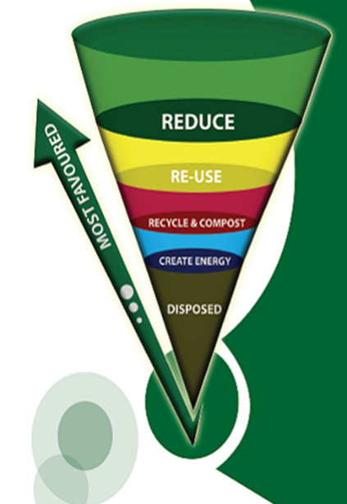
Waste Management Hierarchy
PROGRAMME 7
Purpose: Ensure the regulation and management of all biodiversity, heritage and conservation matters in a manner that facilitates sustainable economic growth and development.
What we do?
PREVENTION
GENERATION
REDUCE
REUSE
RECYCLE
RECOVER
COLLECTION
TRANSPORT
ILLEGAL DUMPING
TREATMENT / DISPOSAL
CONTAMINATED SITES

Slide 58
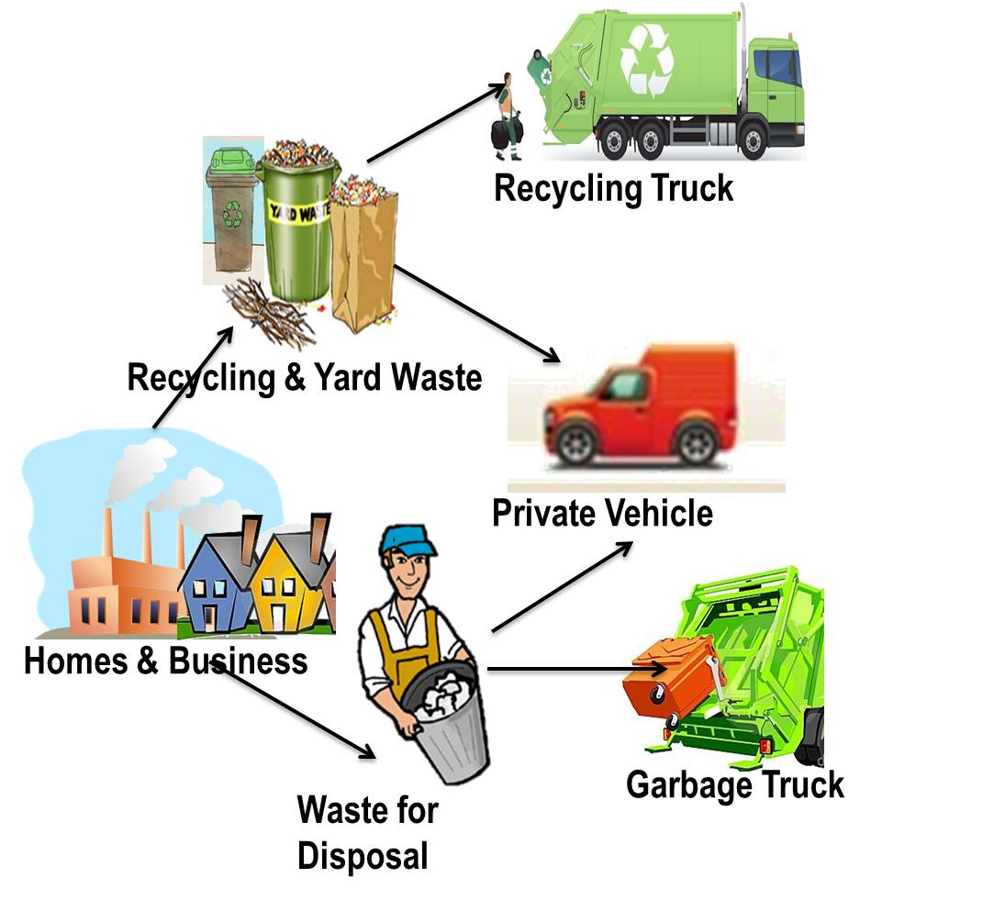
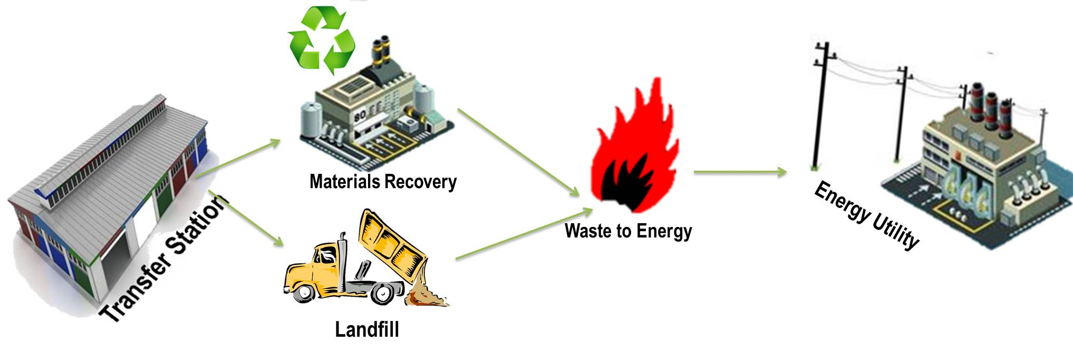
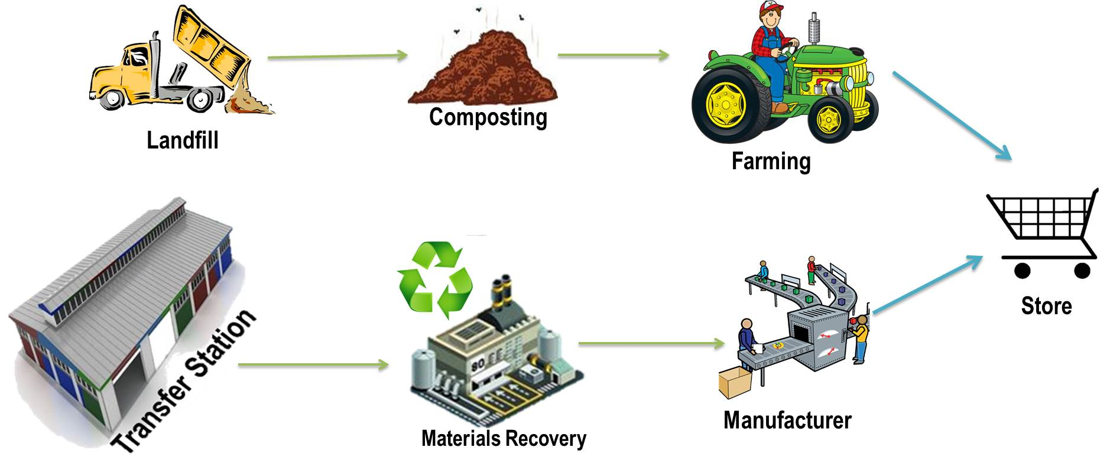
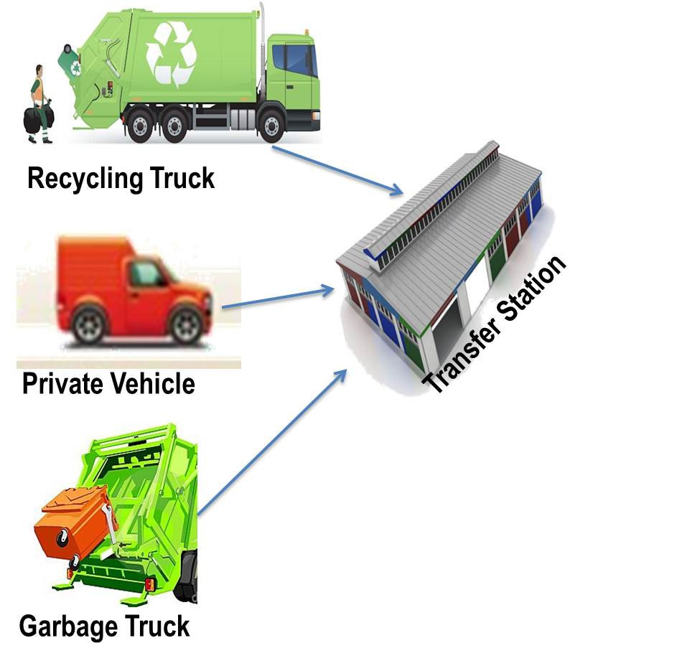
Waste Value Chain
WASTE VALUE CHAINS
Understand the recycling options of a particular product
Waste Collection
Energy
Recovery
Waste
Transfer

Slide 59
The Chemicals and Waste Economy Phakisa aims to reduce negative impact on the environment, while growing the GDP contribution and creating jobs
Phakisa Aspiration
Key objectives
  Grow the secondary resources economy
  by increasing local utilization and beneficiation
  of waste resources by 50%-75% through creation
  of an enabling regulatory environment
  Generation of opportunities from chemical
  and waste resources for the creation of jobs/ opportunities in new / existing markets specifically through enabling SMMEs
  Invest in R&D innovation (including IP)
  and infrastructure to enhance the utilization
  of local waste resources for new products, substances and services that will create jobs,
  and enhance the production of environmentally friendly chemicals
  Reduce waste to landfill by 75% of industrial waste
  and 50% of municipal waste through education
  and awareness, compliant society, application
  of cleaner production
Reduce the negative environmental and health impact of waste and risks posed by chemicals
Increase commercialisation of the circular economy and create value from resources currently discarded
as waste
Foster inclusive growth through positioning
of South Africa
as a globally competitive producer
of sustainable products

Slide 60
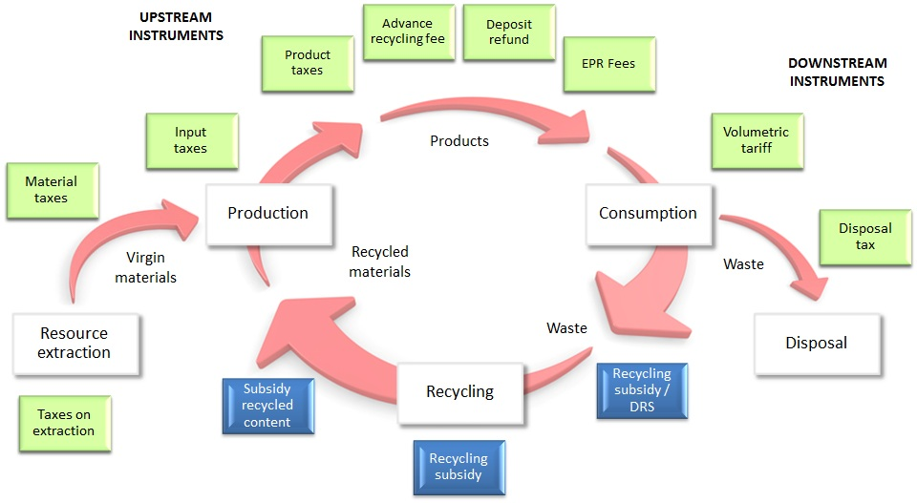

Economic Instruments
Economic Instruments

Slide 61
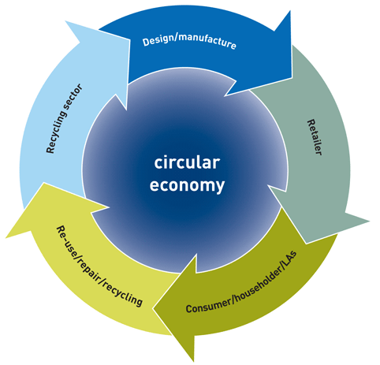


Slide 62
CHEMICALS AND WASTE POLICY, M&E ROADMAP
1. Information Management
SAWIC
SAWIS
SoWR
Waste info Regs
Legislation
Licences
Public Interface
Registered activities
Waste volumes
Data verification
Policy/ decision making
Compliance notices
Newsletters
Reports
2. IndWMP
EPR
S14
S18
S28
S35
NWMS
Circular Economy
Voluntary Plans
Mandatory plans
Waste diversion
Job creation
Transformation
SMME development
Poverty alleviation
WCMS, N&S,
Licencing,
Voluntary Plans, Mandatory Plans
3. M&E
Framework
NWMS
Monitoring
Assessments
M&E reports
Policy interventions
4. Enterprise Support
MinMEC
Operation Phakisa
Call for Proposals
Adjudicate
Award
Site verifications
Disburse 50% of award
Monitor
Award remaining 50%
5. Operation Phakisa
Packaging guideline
Food Waste
RDF
Agri hub
E-Waste levy
Work groups
Consultation
Project champion
Outsourcing
Standardisation
Efficiency
Diversion
6. Policy and Legislation
NWMS 2012
NEMWA 2014
NWMS 2019
NEMWAA 2018
Harmonized policy and legislation

Slide 63
Legislative Framework and MEAs
National Environmental Management Act
Waste Act
National Waste Management Strategy
Municipal Systems Act
National Domestic Waste Collection Standards
Industry Waste Management Plans
Waste Tyre Regulations (Stockpile abatement plans)
Waste Imports and exports Regulations
South Africa’s Foreign Policy
Basel Convention on the Transboundary Movements of Hazardous Wastes and their Disposal
Stockholm Convention on Persistent Organic Pollutants (POPs)
Rotterdam Convention on Prior Informed Consent Procedure for Certain Hazardous Chemicals and Pesticides in International Trade
Vienna Convention for the Protection of the Ozone Layer
Montreal Protocol on Ozone Depleting Substances (ODS)
Strategic Approach to International Chemicals Management (SAICM)
Minamata Convention on mercury
Waste Listed activities (2013)
Waste Classification and management regulations
Norms and Stds for the assessment of waste for landfill disposal
Norms and Stds for the disposal of waste to landfill
Norms and Stds for the extraction and management of landfill gas
Waste exclusion regulations
Regulations for the control of import and export of waste
List of Waste Management Activities that have, or are likely to have , a detrimental effect on the environment, 2013 & 15
National Waste Information Regulations, 2012
Waste classification and management regulations, 2013
Regulations regarding the planning and management of residue stockpiles and residue deposits, 2015
Compulsory specifications for Plastic carrier bags and plastic flat bags, 2003
Waste Tyre regulations, 2009
National Pricing Strategy for Waste Management

Slide 64
PROGRAMME 7
OUTCOME: THREATS ON ENVIRONMENTAL QUALITY AND HUMAN HEALTH MITIGATED
OUTCOME INDICATORS | BASELINE | TARGET 2020/21 | 5 YEAR TARGET 2023/24
Number of chemicals management legislative and regulatory instruments developed and implemented | Minamata Convention Impact Study approved by Cabinet and submitted to Parliament for ratification | Mercury Management National Implementation Plan for the Minamata Convention adopted | Mercury Management plan finalized and 8 products phased out: Thermometers Bulbs Compact flourescsent lamps (CFLs) Dental amalgam Baromters Batteries Switches and relays Mercury in cosmetics
Number of waste management legislative and regulatory instruments developed and implemented | Waste tyres: 4 IndWMPs received for one waste stream ( tyre industry) and the plans are under review E-waste; Lighting; Paper & Packaging. The final section 28 notice was published | Draft Section 29 plan on management of waste tyres developed Notice of intention in terms of Section 18 for management of paper & packaging, e-waste and lighting waste published for public comments | Extended Producer Responsibility (EPR) in term of s18 of NEMWA for 3 prioritised waste streams implemented to achieve: Notice on Extended Producer Responsibilities measures and programme gazetted

Slide 65
PROGRAMME 7 Continued…
OUTCOME: THREATS ON ENVIRONMENTAL QUALITY AND HUMAN HEALTH MITIGATED (CONTINUED)
OUTCOME INDICATORS | BASELINE | TARGET 2020/21 | 5 YEAR TARGET 2023/24
Number of waste management legislative and regulatory instruments developed and implemented (continued)… | Waste tyres: 4 IndWMPs received for one waste stream ( tyre industry) and the plans are under review E-waste; Lighting; Paper & Packaging. The final section 28 notice was published | Draft Section 29 plan on management of waste tyres developed Notice of intention in terms of Section 18 for management of paper & packaging, e-waste and lighting waste published for public comments | Paper & packaging waste diversion of 64% (2 519 tonnes of 3 877 tonnes) of waste E-waste diversion of 21% (77 000 of 360 000) of waste Lighting waste diversion of 10% (27 181 tonnes of 271 810) of waste Industry Waste Management Plan ( in terms of s29 of NEMWA) Waste tyre Plan finalised Waste tyres diversion: 30% (51 078 of 170 266) of waste

Slide 66
PROGRAMME 7 Continued…
OUTCOME: THREATS ON ENVIRONMENTAL QUALITY AND HUMAN HEALTH MITIGATED (CONTINUED)
OUTCOME INDICATORS | BASELINE | TARGET 2020/21 | 5 YEAR TARGET 2023/24
Percentage waste diverted from the landfill sites | N/A | 10% | 40% waste diverted from landfill sites
Percentage reduction in waste generated during manufacturing and industrial process | N/A | 7% reduction in waste generated during manufacturing and industrial process | 25% reduction in waste generated during manufacturing and industrial process
Percentage decrease of HCFC consumption | A decrease of 38% Hydro chlorofluorocarbons (HCFC) consumption (i.e. 1976.35 / 5140.2 x 100) tons allowable consumption ( 4112.16 Tonnes) was consumed | 35% (1799.07 tonnes) | 50% (2570.10 tonnes)
OUTCOME: SOCIO-ECONOMIC CONDITIONS IMPROVED (THROUGH CIRCULAR ECONOMY AND WASTE RECYCLING)
Waste Economy Master Plan developed and implemented | Chemicals and Waste Economy Phakisa 3 feet plan | Waste Economy Master Plan developed | Waste Economy Master Plan approved Master plan implemented across 3 work streams (Bulk industrial Waste, Municipal Waste and Product design & Waste Minimization)
Number of jobs created in the waste management sector | 952 jobs created | 500 (CWE Phakisa) | 5 500 jobs created: 5 500 jobs created (Chemicals and Waste Economy Phakisa)

Slide 67
Department of Fisheries, Forestry and the Environment – Operations and focus during COVID 19 Pandemic
 | LEVEL 5 RESTRICTIONS | LEVEL 4 RESTRICTIONS
CHEMICALS AND WASTE | The process of the development of tyre Industry Waste Management plan is proceeding with virtual consultations and comments. The reviewing of the National Waste Management Strategy is on track with the Department addressing the comments received. The industry is submitting input electronically on measures that are necessary for Extended Producer Responsibility for lighting, electrical and electronic, paper and packaging products. Relief measures for Waste pickers | Waste Licensing, issuance of Remediation Orders and issuance of Basel Convention permits will continue. A plan is in place to limit the number of officials accessing the office and the bulk of the work can be done remotely. Site inspections taking place where feasible Chemicals Management - Support the DTIC on the development of the Chemicals Master plan Processing of permits for the importation and exportation of chemicals into the country Electronic engagements for planning and implementation of MEA’s on chemicals and waste.

Slide 68
PROGRAMME 8 :
FORESTRY MANAGEMENT

Slide 69
PROGRAMME 8: FORESTRY MANAGEMENT
PURPOSE
Purpose: Develop and facilitate the implementation of policies and targeted programmes to ensure proper management of forests and the sustainable use and protection of land and water, Manage agricultural risks and disasters.
What do we do?
Support optimal sustainable production across the forestry sector
Implement best management practices across the forestry sector
Protection, conservation, rehabilitation of woodlands and natural forests
Develop and implement policy, legislative framework, tools and standards for forestry industry including both national and international obligations.

Slide 70
PROGRAMME 8
OUTCOME: SUSTAINABLE PRODUCTION OF STATE FORESTS
OUTCOME INDICATORS | BASELINE | TARGET 2020/21 | 5 YEAR TARGET 2023/24
Number of hectares of temporary unplanted areas (TUPs) plan | N/A | 1279,5 ha | 8493 ha
Number of hectares under silvicultural practice (i.e. weeding, pruning, coppice reduction, thinning) | N/A | 2169,5 ha | 12 138 ha
Number of nurseries refurbished | N/A | 3 nurseries refurbished | 12 nurseries refurbished
OUTCOME: A TRANSFORMED FORESTRY SECTOR
Number of hectares approved for afforestation | N/A | Afforestation Roadmap developed | 15 000ha
Number of Job Created in the forestry sector | N/A | 7550 | 37 750
Number of plantations handed over to communities | N/A | Appropriate model approved | 15 plantations
OUTCOME: INDIGENOUS FORESTS SUSTAINABLY MANAGED AND REGULATED
Number of State indigenous forest management units mapped | N/A | 5 indigenous forest management units mapped | 20 indigenous forest management units mapped
Number of hectares in State forests rehabilitated (clearing of alien invasive) | N/A | 300ha rehabilitated | 1500ha rehabilitated
Number of State indigenous forest transferred to conservation authorities | N/A | Indigenous forest transfer policy developed | 5 forest management units transferred
National Forests legislation and regulations reviewed and approved | National Forests Act,1998 | NFA amendment Bill approved by Parliament | National Forests Act,1998 (NFA) amendment bill approved regulations developed

Slide 71
PROGRAMME 8 Continued…
OUTCOME: INDIGENOUS FORESTS SUSTAINABLY MANAGED AND REGULATED (CONTINUED)
OUTCOME INDICATORS | BASELINE | TARGET 2020/21 | 5 YEAR TARGET 2023/24
National Veld and Forest Fires legislation and regulation reviewed and approved | National Veld and Forest Fires Act, 1998 | NVFFA Amendment Bill approved by Parliament | National Veld and Forest Fires Act, 1998 (NVFFA) amendment bill approved
Number of training interventions of the provisions of the National Forests Act,1998 (NFA) | N/A | 10 training interventions of the provisions of the Act | 50 training interventions of the provisions of the Act
Number of training interventions of the provisions of the National Veld and Forest Fires,1998 (NVFFA) | N/A | 10 training interventions of the provisions of the Act | 50 training interventions of the provisions of the Act
OUTCOME: THREATS ON ENVIRONMENTAL QUALITY AND HUMAN HEALTH MITIGATED
Number of trees planted outside forests footprint | N/A | 40 000 Trees planted | 200 000 trees planted
National strategy for reducing emissions from deforestation and forest degradation (REDD+ ) developed | N/A | 1 pilot study on REDD+ in the Eastern Cape Province | National REDD+ Strategy approved

Slide 72
Department of Fisheries, Forestry and the Environment – Operations and focus during COVID 19 Pandemic
 | LEVEL 5 RESTRICTIONS | LEVEL 4 RESTRICTIONS
FORESTRY | Work on the Draft framework for the release of Category B and C plantations(80 000ha) Forest Sector Master Plan: Fast track Phase 2 which deals with Stakeholder engagements through Video conferencing, | Work on the Draft framework for the release of Category B and C plantations(80 000ha) Forest Sector Master Plan: Fast track Phase 2 which deals with Stakeholder engagements through Video conferencing.

Slide 73
PROGRAMME 9 :
FISHERIES MANAGEMENT

Slide 74
PROGRAMME 9: FISHERIES MANAGEMENT
PURPOSE
Purpose: Ensure the sustainability utilisation and orderly access to the marine living resources through improved management and regulation.
What do we do?
Mainly promote the development and sustainable use of South Africa’s fisheries and aquaculture sectors.
  Aquaculture and Economic Development: Ensures aquaculture growth and development and the management of the 12 proclaimed fishing harbours.
  Fisheries Research and Development: Advises on, and promotes, the sustainable development of fisheries resources and ecosystems by conducting and supporting appropriate research (TAC/TAE recommendations).
  Marine Resource Management: Manages and regulates the commercial; recreational and small-scale fishing sectors.
  Monitoring, Control and Surveillance: Ensures protection and sustainable utilisation through compliance and enforcement efforts.
  Fisheries Operations Support: Support functions and governance of the MLRF.
  Financial Management: Financial, revenue and asset management of the MLRF/Fisheries

Slide 75
PROGRAMME 9
OUTCOME: EFFECTIVE AND ENABLING REGULATORY FRAMEWORK FOR THE MANAGEMENT AND DEVELOPMENT OF MARINE AND FRESHWATER LIVING RESOURCES (OCEANS, COASTS, RIVERS, AND DAMS.)
OUTCOME INDICATORS | BASELINE | TARGET 2020/21 | 5 YEAR TARGET 2023/24
Marine Living Resources Act and regulations reviewed and amended | N/A | N/A | MLRA and Regulations amended and promulgated
Aquaculture regulatory framework developed and finalised | N/A | Aquaculture Development Bill / Act revived | Aquaculture regulatory framework finalised
Fisheries Management policies developed and approved | N/A | Revised General Policy on the Allocation of Fishing Rights approved | Policies reviewed and approved: General Policy on Allocation of Commercial Fishing Rights. Sector Specific Fisheries Policies on allocation of Fishing Rights. Policy on the Transfer of Commercial Fishing Rights Policy FRAP application fees, levies, Harbour fees and Grant of Right fees reviewed. New Policies developed and approved: New Fisheries policy approved

Slide 76
PROGRAMME 9 Continued…
OUTCOME: EFFECTIVE AND ENABLING REGULATORY FRAMEWORK FOR THE MANAGEMENT AND DEVELOPMENT OF MARINE AND FRESHWATER LIVING RESOURCES (OCEANS, COASTS, RIVERS, AND DAMS.) (CONTINUED)
OUTCOME INDICATORS | BASELINE | TARGET 2020/21 | 5 YEAR TARGET 2023/24
National Freshwater (inland) Wild Capture Fisheries Policy developed and approved. | N/A | NEDLAC consultation on National Freshwater (inland) Wild Capture Fisheries Policy finalised | Inland fisheries management policy approved by Cabinet
Marine Living Resources Fund (MLRF) revenue model developed and approved | N/A | New MLRF revenue streams/ fees gazetted | New MLRF revenue streams/fees gazetted and implemented.
OUTCOME: A WELL-MANAGED FISHERIES AND AQUACULTURE SECTOR THAT SUSTAINS AND IMPROVES ECONOMIC GROWTH AND DEVELOPMENT
Commercial fishing rights applications reviewed and fishing rights allocated | Final draft FRAP framework approved by DDG | N/A For 2020 (Target start in 2021) | FRAP 2021 finalised (Fishing rights allocated in 12 commercial fishing sectors)
Number of aquaculture research studies conducted to improve competiveness and sustainability of the aquaculture sector. | 20 | 5 | 20
Number of Operation Phakisa registered aquaculture projects in production phase. | 26 | 4 | 16
Number of proclaimed fishing harbours functional | 12 | 12 proclaimed fishing harbours operational | 12 Proclaimed fishing harbours functional
Number of inspections conducted (in the 6 priority fisheries: hake; abalone; rock lobster; line fish, squid and pelagic) | 5566 | 5500 inspections conducted per annum | 5500 inspections conducted per annum

Slide 77
PROGRAMME 9 Continued…
OUTCOME: A WELL-MANAGED FISHERIES AND AQUACULTURE SECTOR THAT SUSTAINS AND IMPROVES ECONOMIC GROWTH AND DEVELOPMENT (CONTINUED)
OUTCOME INDICATORS | BASELINE | TARGET 2020/21 | 5 YEAR TARGET 2023/24
Number of verifications of right holders conducted | 276 | 280 verifications | 290 verifications per annum
Number of compliance awareness initiatives conducted | N/A | 10 initiatives per annum | 10 initiatives per annum
OUTCOME: IMPROVED SOCIO-ECONOMIC CONDITIONS FOR FISHING COMMUNITIES
Small-scale aquaculture support programme developed and implemented | N/A | Small-scale Aquaculture Support Programme Implementation Plan developed and approved | 20 of individuals / entities benefiting from Small-scale aquaculture support programme.
Number of small scale fishing cooperatives allocated fishing rights | Rights allocated to 31 Small scale fisheries cooperatives in the Northern Cape, Eastern Cape and KwaZulu Natal | Small-Scale Fishing rights allocated to co-operatives in Western Cape | 147 Small-Scale Fishing cooperatives allocated fishing rights
Integrated Development Support programme for small-scale fishers developed and implemented | Small scale Fisheries Fund Established. 25 cooperatives trained in Business Management | Draft Integrated Development Support Strategy developed | 147 small scale fishing co-operatives benefiting from an Integrated Development Support Programme
Alternative Livelihood Strategy for fishing communities developed and implemented | N/A | Alternative Livelihoods concept plan approved | 24 fishing communities benefiting from Alternative Livelihood interventions

Slide 78
SERVICE DELIVERY IMPROVEMENT PROGRAMME
OUTCOME: GOOD GOVERNANCE AND COMPLIANCE WITH LEGISLATIVE REQUIREMENTS AND EFFECTIVE FINANCIAL MANAGEMENT
OUTCOME INDICATOR | BASELINE | TARGET 2020/21 | 5 YEAR TARGET 2023/24
PROGRAMME 1
Percentage of legitimate invoices from suppliers paid with prescribed time frame (30 days) | 100% (32 017/32 017) | 100% | 100%
Percentage of parliamentary questions and requirements responded to within the time frames | 96% (101/105) | 100% | 100%
PROGRAMME 2
OUTCOME: IMPROVED COMPLIANCE WITH ENVIRONMENTAL LEGISLATION ANDENVIRONMENTAL THREATS MITIGATED
Percentage of reported Environment incidents and public queries responded to within the timeframe set in the referral protocol | 96% (177/185) | 95% | 95%
Percentage of national environmental impact management applications finalised/processed and decision issued within the stipulated time frames per year (subject to number of applications received) | 95% (160/168) | 100% | 100%

Slide 79
SERVICE DELIVERY IMPROVEMENT PROGRAMME
OUTCOME: BIODIVERSITY THREATS MITIGATED
OUTCOME INDICATOR | BASELINE | TARGET 2020/21 | 5 YEAR TARGET 2023/24
PROGRAMME 3
Percentage of applications for permits finalised within timeframe (Marine Research permits) | 100% (86/86) | 100% | 100%
Percentage of applications for permits finalised within timeframe (Off-road Vehicle permits) | 100% (29/29) | 100% | 100%
Percentage of applications for permits finalised within timeframe (Dumping permits) | 40% (4/10) | 100% | 100%

Slide 80
SERVICE DELIVERY IMPROVEMENT PROGRAMME
OUTCOME: THREATS ON ENVIRONMENTAL QUALITY AND HUMAN HEALTH MITIGATED
OUTCOME INDICATOR | BASELINE | TARGET 2020/21 | 5 YEAR TARGET 2023/24
PROGRAMME 4
Percentage of Atmospheric Emission Licenses applications issued within legislated timeframes | 100% (8/8) | 90% | 95%
PROGRAMME 5
OUTCOME: THREATS TO ENVIRONMENTAL QUALITY AND INTEGRITY MANAGED
Percentage of applications for CITES permits assessed and issued within prescribed timeframe | 100% (38/38 | 100% | 100%
Percentage of applications for TOPS permits assessed and issued within prescribed timeframe | 76% (81/107) | 100% | 100%

Slide 81
SERVICE DELIVERY IMPROVEMENT PROGRAMME
OUTCOME: THREATS ON ENVIRONMENTAL QUALITY AND HUMAN HEALTH MITIGATED
OUTCOME INDICATOR | BASELINE | TARGET 2019/20 | 5 YEAR TARGET 2023/24
PROGRAMME 7
Percentage of Waste Licence applications finalised within legislated timeframes | 100% (21/21) | 85% | 90%
Percentage of remediation orders finalised within timeframe | 87% (47/54) | 80% | 90%

Slide 82
Department of Fisheries, Forestry and the Environment – Operations and focus during COVID 19 Pandemic
 | LEVEL 5 RESTRICTIONS | LEVEL 4 RESTRICTIONS
FISHERIES | The fishing sector has been classified as an essential service in the provision of food and the food value chain. Efforts during the lockdown have been to ensure that the fishing sectors (both commercial and small-scale/Interim Relief) can continue operating, particularly during the snoek run). Staff have been deployed to all the fishing harbours to manage access control to the harbours, inspect fish landings and to provide slipping and docking of fishing vessels. The remaining staff are working from home and attending to business via online meetings Ensure that the Branch is ready to advertise all FRAP and other critical tenders immediately after restrictions are lifted Extension of the West Coast Rock Lobster (WCRL) & Abalone Fishing Season – the dramatic drop in exports to China All fishing sectors have been granted a 90-day exemption from having to re-apply for new or expiring permits and vessels licenses. The Customer Service Centre is responding to all queries via email or telephone. The Fisheries Branch issued exemption notices to small-scale/Interim Relief and Traditional linefishers to allow them to travel to catch snoek Fish Processing Establishments (FPE) – Licenced FPEs were engaged and encouraged to buy fish directly from the small-scale and traditional linefishers when they land their catch during the Lockdown period. Municipalities – Relevant municipalities were engaged to speedily issue trading permits to fishers, langanas and vlekkers. Law Enforcement Agencies – Have been engaged to assist the Department both enroute to and within the fishing harbours where there is increased activities as a result of the Snoek run to ensure that that all right holders comply with the Disaster Management Acts and amended Regulations. Access to International Market – Together with the Rock Lobster Industry Associations, The Department of International Relations and Cooperation (DIRCO) and Department of Trade and Industry (the DTI) were engaged to explore the possibility of exporting the available consignment of fish.

Slide 83

Vote 32:
Forestry, Fisheries and the Environment
Portfolio Meeting
MTEF 2020
Nosipho Ngcaba
Director-General
Portfolio Committee Briefing
12 May 2020

Slide 84

Presentation Outline
MTEF 2020: Allocations
MTEF 2020: Earmarked Amounts
MTEF 2020: Budget Allocations per Programme
MTEF 2020: Budget Allocations per Economic Classification
MTEF 2020: Transfers and Subsidies

Slide 85
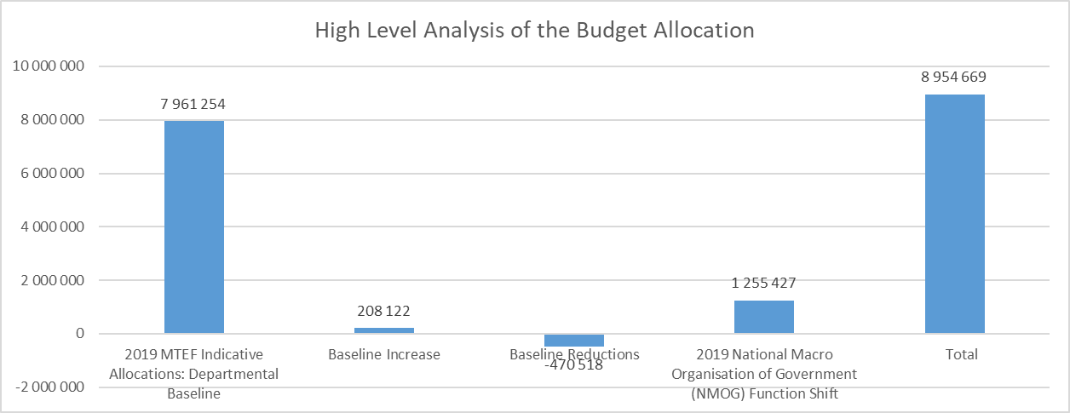
MTEF 2020: Budget Allocations

Slide 86
MTEF 2020: Budget Allocations

Slide 87
MTEF 2020: Earmarked Budget Allocations
Earmarked Budget Allocations | 2020/2021 R’000 | 2021/2022 R’000 | 2022/2023 R’000
Expanded Public Works Programme | 2 884 704 | 2 882 488 | 3 024 164
Environmental Protection and Infrastructure Programme: Projects Environmental Protection and Infrastructure Programme: Incentives Working for Water: Projects Working for Water: Incentives Working on Fire: Projects Working on Fire: Incentives Working for Forests: Incentives Working for Fisheries: Projects Working for Fisheries: Incentives | 811 431 180 344 903 990 203 542 536 705 146 108 4 945 88 035 9 604 | 809 125 190 263 870 814 214 736 535 180 154 144 5 217 92 877 10 132 | 847 963 199 396 915 973 225 043 560 869 161 543 5 465 97 298 10 614
Compensation of Employees Ceiling | 2 060 098 | 2 193 934 | 2 288 731
Other Earmarked Allocations | 386 580 | 339 691 | 356 780
Green Fund Waste Bureau: Tyre Recycling Initiatives | 66 105 320 475 | 0 339 691 | 0 356 780
Total Earmarked | 5 331 382 | 5 416 113 | 5 669 675

Slide 88
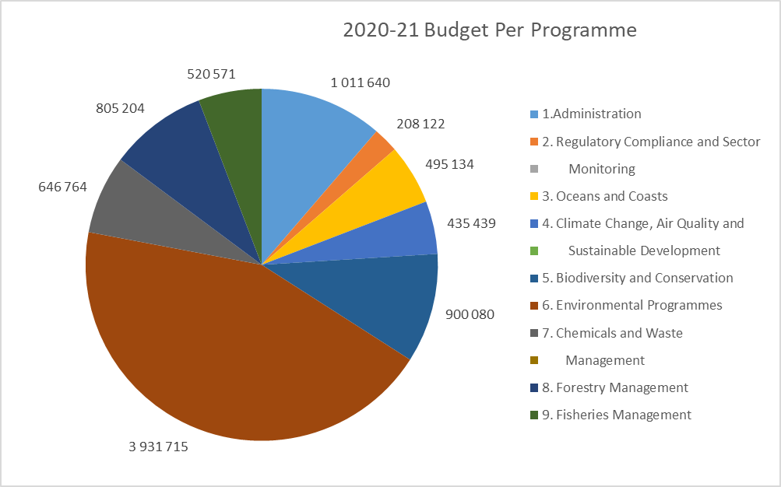
MTEF 2020: Budget Allocation per Programme

Slide 89
MTEF 2020: Budget Allocation per Programme

Slide 90
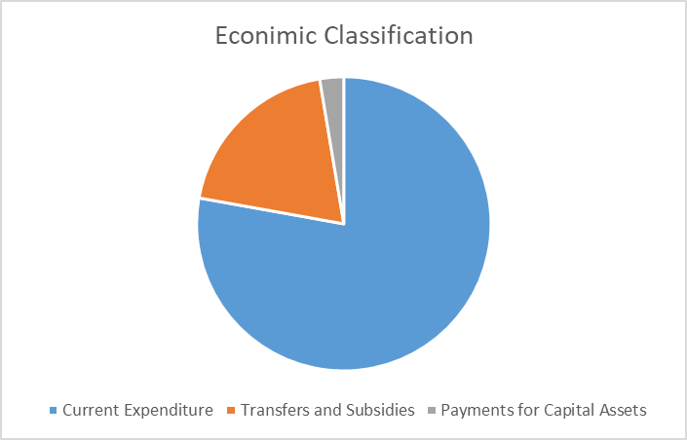
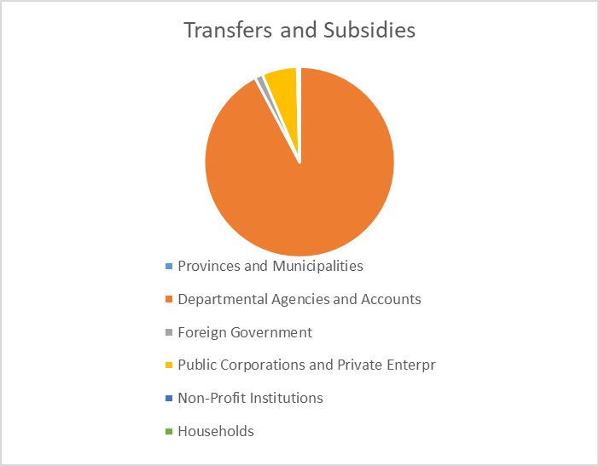
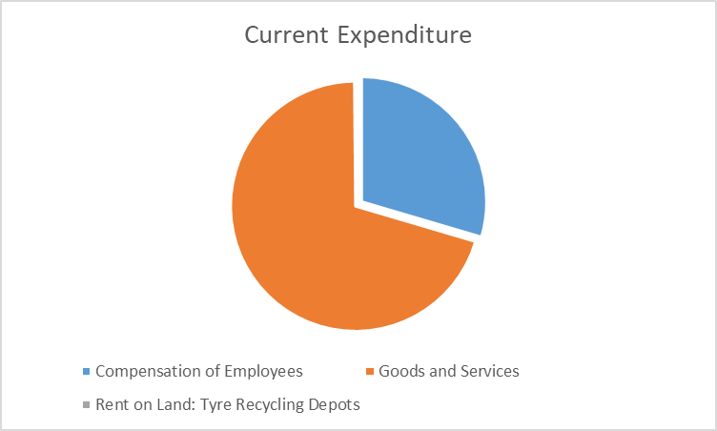
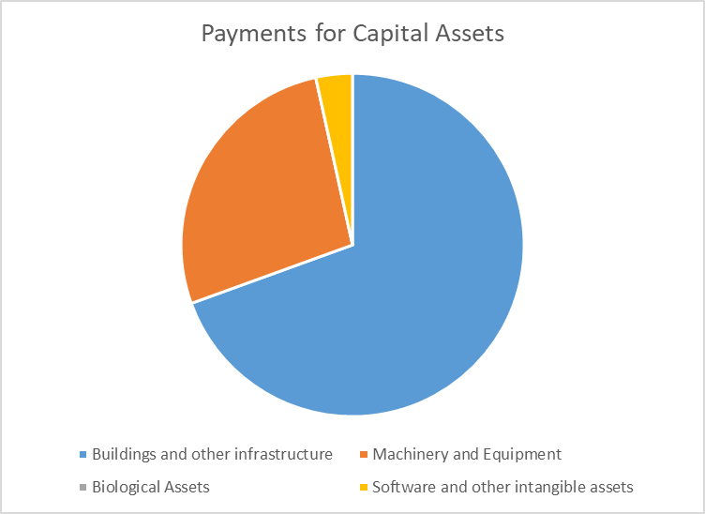
MTEF 2020: Budget Allocation per Economic Classification

Slide 91
MTEF 2020: Allocation per Economic Classification
Economic Classification | 2020/2021 R’000 | 2021/2022 R’000 | 2022/2023 R’000
Current Expenditure | 6 969 112 | 7 219 080 | 7 490 627
Compensation of Employees Goods and Services Rent on Land: Tyre Recycling Depots | 2 060 098 4 899 074 9 940 | 2 193 934 5 014 709 10 437 | 2 288 731 5 191 071 10 825
Transfers and Subsidies | 1 749 542 | 1 816 302 | 1 884 087
Provinces and Municipalities Departmental Agencies and Accounts Foreign Government Public Corporations and Private Enterpr Non-Profit Institutions Households | 874 1 613 439 23 512 104 718 6 396 603 | 887 1 703 596 23 513 80 793 6 877 636 | 928 1 766 930 24 632 83 797 7 134 666
Payments for Capital Assets | 236 015 | 252 442 | 265 759
Buildings and other infrastructure Machinery and Equipment Biological Assets Software and other intangible assets | 163 970 63 886 25 8 134 | 176 267 67 567 26 8 582 | 186 330 70 500 27 8 902
Total | 8 954 669 | 9 287 824 | 9 640 473

Slide 92
MTEF 2020: Transfers and Subsidies
Transfers and Subsidies | 2020/2021 R’000 | 2021/2022 R’000 | 2022/2023 R’000
Provinces and Municipalities | 874 | 887 | 928
- Vehicle licences | 874 | 887 | 928
Departmental Agencies and Accounts | 1 613 439 | 1 703 596 | 1 766 930
- South African Weather Service Operational Infrastructure - South African National Biodiversity Institute Operational Infrastructure - South African National Parks Operational Infrastructure - iSimangaliso Wetland Park Authority Operational Infrastructure - Marine Living Resources Fund - National Regulator for Compulsory Specifications | 208 179 140 633 374 200 77 838 244 025 154 861 38 058 78 614 284 135 12 896 | 219 739 142 868 403 405 81 946 255 799 163 378 40 151 82 938 299 767 13 605 | 227 907 148 151 418 445 84 992 309 234 125 517 41 642 86 021 310 909 14 112

Slide 93
MTEF 2020: Transfers and Subsidies (continue)
Transfers and Subsidies | 2020/2021 R’000 | 2021/2022 R’000 | 2022/2023 R’000
Foreign Governments and International Org | 23 512 | 23 513 | 24 632
- Global Environmental Fund - International Union of Forestry Research | 23 500 12 | 23 500 13 | 24 618 14
Public Corporations and Private Enterprises | 104 718 | 80 793 | 83 797
- DBSA: Green Fund - Forest Sector Charter Council - Recycling Enterprise Support Programme | 28 137 5 206 71 375 | 0 5 492 75 301 | 0 5 696 78 101
Non-Profit Institutions | 6 396 | 6 877 | 7 134
- Environmental Assessment Practitioners Association of South Africa - National Association for Clean Air - KwaZulu-Natal Nature Conservation Board - African World Heritage Fund | 2 583 1 400 1 358 1 055 | 2 778 1 505 1 460 1 134 | 2 880 1 562 1 515 1 177
Households | 603 | 636 | 666
- Social Benefits | 603 | 636 | 666
Total Transfers and Subsidies Allocations | 1 749 542 | 1 816 302 | 1 884 087

Slide 94
Department of Fisheries, Forestry and the Environment – Operations and focus during COVID 19 Pandemic
 | LEVEL 5 RESTRICTIONS | LEVEL 4 RESTRICTIONS
CHIEF FINANCIAL OFFICER | Finalisation of Financial Statements Payments to Service Providers Resolution of prior year audit queries Budget analysis and scenario planning for post Covid-19 reprioritisation Procurement of critical PPE for essential services staff | Financial and Supply Management unit of the Department kept operating with skeleton staff to support the essential/critical services units of the department. 1. SCM function responsible for the procurement of Personal Protective Equipment(PPE) for staff involved with essential/critical services. 2. Financial and Supply Management unit responsible for payment of service providers and EPWP beneficiaries. 3. Finalization of the 2019/20 Financial Statements 4. Budget and operational activity reprioritization to fund the economic and social impacts of the COVID-19 pandemic. 5. Administrative and reporting requirements are being attended to 6. Remote work continuing where possible

Slide 95


