Slide 1
City of Cape Town COVID-19 Strategy
COGTA PC Presentation
14 May 2020

Slide 2
Our Response: Responding to National Emergency and Embracing Resilience across sectors in Metro government
REFLECTIVE
Using past experiences to inform future decisions
RESOURCEFUL
Recognizing alternative ways to use resources
ROBUST
Well-conceived, constructed and managed systems
REDUNDANT
Spare capacity, purposefully created to accommodate disruption
FLEXIBLE
Willingness and ability to adopt alternative strategies in response to changing circumstances
INCLUSIVE
Prioritise broad consultation to create a sense of shared ownership in decision-making
INTEGRATED
Bring together a range of distinct systems and institutions

Slide 3
Data Modelling

Slide 4
Using Data and Models to Inform Response
Purpose: Ensure City response driven by relevant scientific/medical information
Anticipate resource needs for different predetermined scenarios
Unlikely to see single wave with bell-shaped distribution of cases over time
But planning is focussed on anticipating resources for the first and likely most precipitous wave.
Using Provincial Health Department model, which is aligned with the direction being issued by national.
Different data-driven products for City work from this: Logistics; Risk; Scenarios; Requirements model; Decision Support.
Data tools inform approach to inform municipal functions in response, which are driven by mandate and regulatory prescriptions issued by relevant authorities

Slide 5
CRU, Hostels, Backyards

Slide 6
Public Housing Action Plan
NB:
Action plan will assume a multi-directorate approach, coordinated by Public Housing.
Thus, the directorate will engage: City Health,
Environmental Health,
EPWP,
Communications,
Public Participation
Work-Stream 1: Building Management
Regular cleaning of all high-contact surfaces
Expanded waste removal services at sites
Provision of hand-sanitiser at main entrances to building
Deep-cleaning of all public spaces
Work-stream 2: Education and Awareness
Posters and Pamphlets
SMS & WhatsApp messaging
Distribution of promotional items:
Loud-hailing
Work-stream 3: Community Engagement
Development of a community engagement plan
Stakeholder Mapping:

Slide 7
Transport

Slide 8
Implementation Decisions Taken
PILLARS OF THE PLAN
Heightened awareness and an education campaign targeting commuters and training of drivers and front-line staff
Regular intensive cleaning and sanitizing of major stations and key points of embarkation and commuter handling facilities
Social Distancing Measures: Regulate passenger numbers within vehicles and reduce overcrowding within stations (queue management)
Investigate COVID – 19 screening facilities at public transport interchanges
Reduced control points through digital ticketing and payment procedures
RAPID RESPONSE- Taxi Ranks and MyCiti Stations
Taxi ranks reduced from 61 stations to 40
MyCiti stations reduced from 38 stations to 22
All affected staff redeployed to other stations in the same area
Ramped up cleaning staff, law enforcement and security
Introducing deep cleaning interventions at night once or twice a week per rank
Rapidly increased PPE and inventory (i.e. cleaning products)
Coordination will be via coordination task team (deployed on the ground)
This requires a considerable ramping up of staff and inventory associated with
Cleaning practices
Regulation and Enforcement

Slide 9
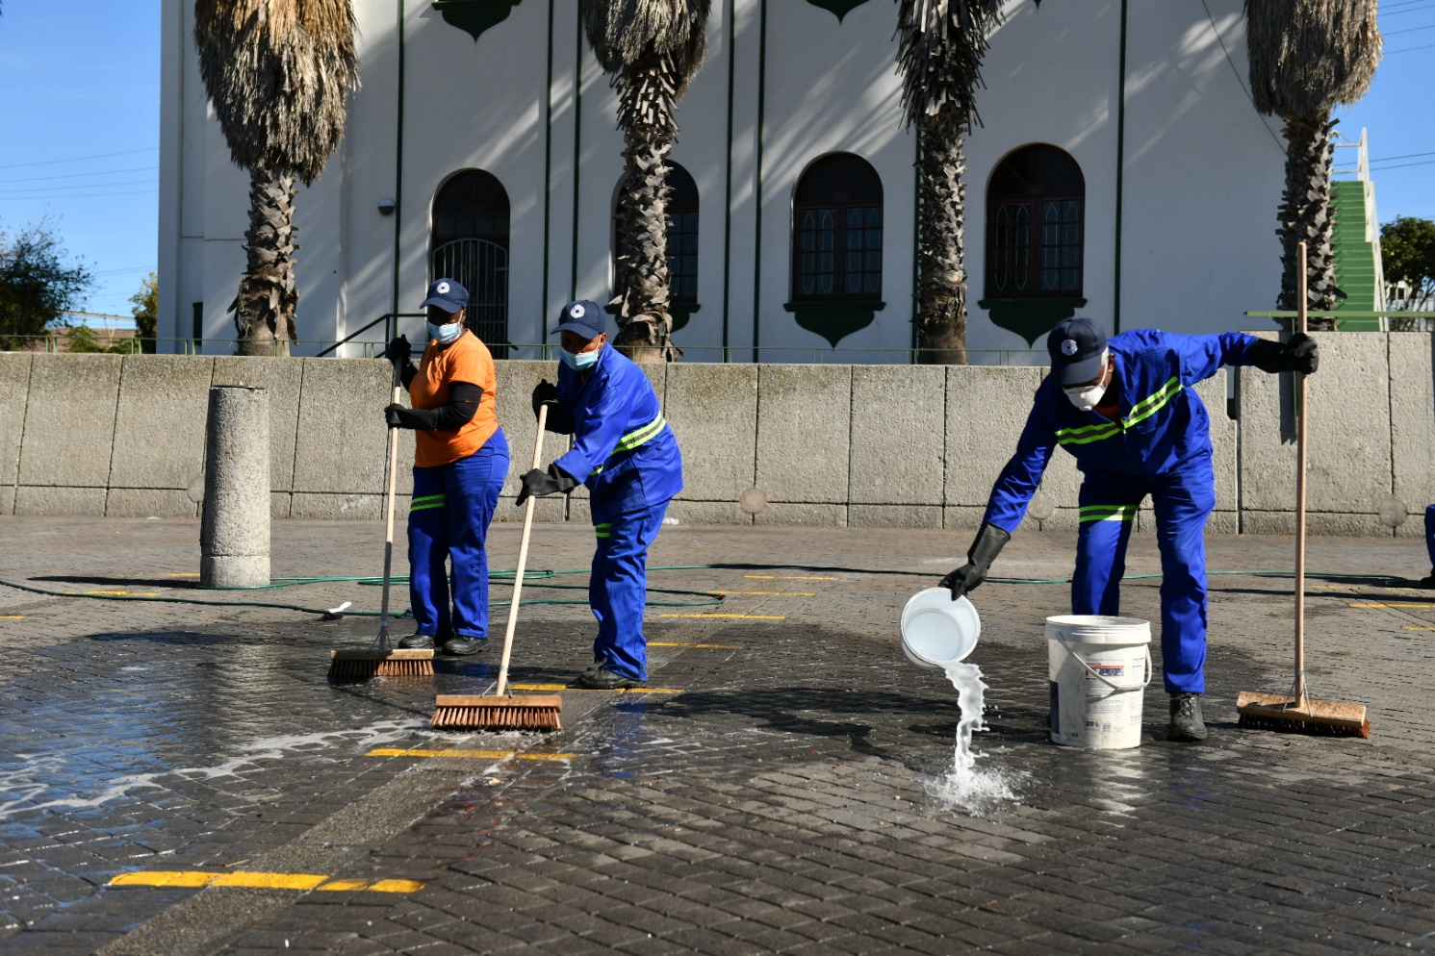
Implementation
PREVENTATIVE MEASURES
Screening at PTI’s
MyCiTi and GABS undertake temperature screening for all staff on entry and exit of all operational depots
Social distance adherence
Lines have been painted at a total to 45 PTI’s
Periodic deep cleaning and sanitizing of PTI’s
Enforcement of Regulations
The DMC monitoring of CCTV footage at PTI’s
The wearing of a face mask to cover the nose and the mouth when boarding a public transport vehicle
Only essential travel allowed, stay home stay safe

Slide 10
Informal Settlements

Slide 11
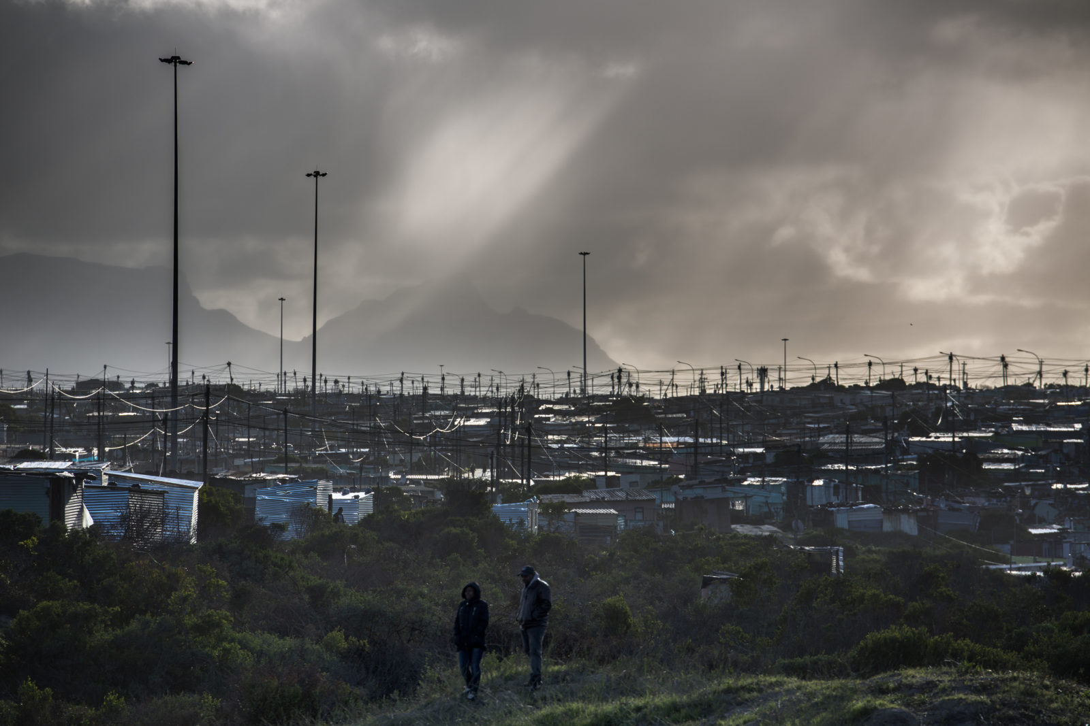
Informal Settlements: Basic Service Augmentation
= 150 000 + households in IS
CHARACTERISTICS:
inadequate access to municipal services;
insufficient public space and facilities;
lack of disposal of greywater;
the prevalence of rodents and other environmental health risks;
high social vulnerability such as poverty, unemployment and crime
(SHORT TERM SUPPRESSION STRATEGY)
CITY RESPONSE
↑ hygiene and sanitation mitigates the spread of the virus. W&S have designed an action plan for basic service provision to informal settlements.
NB: Basic services provision= access to potable water, sanitation, and cleansing services

Slide 12
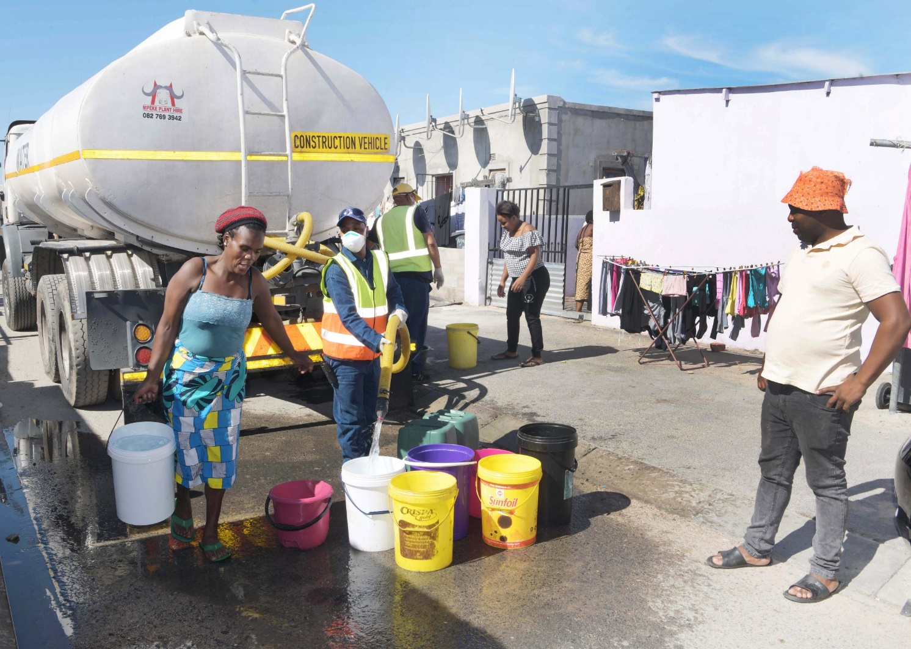
Informal Settlements: Basic Service Augmentation
(SHORT TERM SUPPRESSION STRATEGY)
CITY RESPONSE
Three priority areas:
Servicing existing informal settlements;
Over 25.1 million litres delivered from 28 trucks
1.2 million opportunities
Temporary services to new, unserved informal settlements;
93 water tanks installed to date
112 sites prepared for 214 tanks supplied by Dept. W&S
Additional health and hygiene measures to ensure virus doesn’t spread at service sites;
Targeted communication ready to go live
Focus on prevention when utilising shared facilities.
NB: Basic services provision= access to potable water, sanitation, and cleansing services

Slide 13
Informal Settlements: De-densification
(MEDIUM-TO-LONG TERM MITIGATION STRATEGY)
National Government has determined that all provinces will enter into a process of de-densification within pre-identified communities
The City has confirmed its commitment to:
DuNoon, (1500)
Kosovo, (2000)
Itemba (3000)
COSTING
WCPG = appointing professional teams to undertake design and planning of the sites
(R44.6 million through USDG – already approved by City)
Construction estimated at R500 million
PROJECT PHASES
Phase 1: Design including obtaining statutory approvals (development rights);
Phase 2: Construction, including site supervision and monitoring;
Phase 3: Beneficiary administration;
Phase 4: Project close out.
= 6 500 new housing opportunities
RISKS
An expedited planning approval process is needed to support delivery
Implications on other planned HS projects
Beneficiary identification and tenure transfer (sites may be permanent rather than TRA)

Slide 14
Fatality Management

Slide 15
Fatalities Value Chain
Testing
Hospitalisation
Fatality
Quarantine & Isolation
VALUE CHAIN AND KEY CONSIDERATIONS
Death
Body Collection and Storage
Body Preparation
Burial/Cremation
After Care
VALUE CHAIN COMPONENTS
Patient succumbs to Covid-19 in hospital
If home or homeless shelter death SAPS and Provincial Health responds.
If home or shelter death, body is tested to confirm if COVID-19 related death
Hospital alerts family of fatality
Mortuary issued with Certificate of Competency is alerted of fatality
Body is stored in hospital for 24-48 hours
Body is transported to a mortuary in leak-proof body bag by a public or private undertaker
Registration of Death and issue of Death Certificates and Burial Orders
Undertaker prepares body for burial/cremation
Engage with Religious groupings
Administrative process of scheduling burial/cremation time and site
Body is transported to cemetary, mass burial site or crematorium
Burial or cremation takes place
Mortuary personnel to follow sanitation procedures for all surfaces, people and equipment that came into contact with body.
Environ. Health process for decontamination and disinfection of affected facilities
KEY MODELLING CONSIDERATIONS AND PARAMETERS
Fleet: Transport of body to mortuary, and transport to burial/cremation sites, transport of materials, equipment and utilities to mortuaries, and transport of staff
Facilities: number, location and capacity of approved mortuary facilities. Consider capacity of burial/cremation sites, consider capacity requirement for mass burial sites at 50-60 burials a day, consider increase in pauper burials
Personnel: Staffing required to collect, process, and move body from Hospital to Burial site, and staffing capacity at facilities (social distancing)
Materials and Equipment: volumes of PPE, testing kits, sanitation products, burial/cremation boxes, and key equipment
Time: consider the time it takes for private mortuary to collect body,
Consider rate/time of processing the body at the mortuary, and time to bury/cremate body,
Frequency of burials a week
Current ratios of expected fatalities
KEY OUTCOMES
Expected number of facilities required to meet the mortuary spaces demanded
Throughput rate that needs to be met to support demand
Triggers for Pauper capacities (linked to City’s ability to pay)
Logistical requirements to transport bodies to mortuaries and to burial/cremation sites
Number of graves/burial sites/cremation reservations required
Required stock levels of Medical PPE, Equipment
Draft

Slide 16
Value Chain Analysis
High-level initial value chain analysis:
City mandated to cremate and to provide cemeteries for all fatalities.
Complex value chain with many stakeholders and processes - private sector a key stakeholder.
Key factor - managing quick turnaround times to prevent backlogs and bottlenecks in the system
Concern: Many dependencies resting on stakeholders that have to work together and collaborate fluently to enable efficient implementation of actual burials and cremations.
Ongoing work:
Clarification/unpacking (as a result of COVID requirements) of steps to ensure ease of flow and quick turnaround times.
Mitigation measures to be identified and agreed upon on with various stakeholders.
Stakeholder readiness assessment.
Key Actions:
Develop Communication Plan for stakeholder collaboration and engagement – in process.
Obtain clarity from various stakeholders regarding regulations/requirements, processes and potential for streamlining - initiated with Provincial Government.
Develop Implementation “ramp” up plan with triggers for cemeteries – in process.

Slide 17
Health Care

Slide 18
Primary Healthcare
City Health’s mandate is to Provide Primary Care (PHC) Services and Environmental Health Services in collaboration with WCPG to the communities of Cape Town, especially the most vulnerable. PHC services will be re-organised to increase social distancing at City Health facilities and to allow City Health to prepare for, and manage, the expected increase in patients with COVID-19 symptoms.
HEALTH LOGISTICS
FACILITIES
RESOURCES
INVENTORY
FLEET
Fortify our Existing Primary Health Care facilities – City Clinics
Know what we’re facing – through Rapid Testing
Focusing on Critical Need
Re-orientate & Decongest clinics
Strengthen Staff resources
To rapidly test those who may be infected with the virus
Secure PPE stocks – City Health cannot test or treat patients without PPE
Identification and set up of satellite clinics
Communicate with long-term Patients
Enhanced security
EPWP recruitment
Short Term Contracts
Fill Vacancies
Staff Transport
Rapid procurement
Prioritization of City Health in allocations
Communications with Public around PPE use
Support Provincial Govt.
Roll out of Mobile Testing
Staff Training
PPE
Actions
Actions
Actions

Slide 19
Screening, Testing and Tracing
City Health and Provincial Health is involved in collaborative rollout of community based testing, screening and tracing efforts in the Metro region.
123 182 screenings
In the Metro region
4 April -11 May

Slide 20
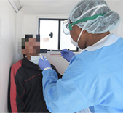
Screening, Testing and Tracing
City Health and Provincial Health is involved in collaborative rollout of community based testing, screening and tracing efforts in the Metro region.
10 114 Tests
In the Metro region
4 April -11 May
In the Metro there are 5620 cases with 7382 contacts out of 9238 contacts traced (85%)

Slide 21
Recovery

Slide 22
Recovery work stream
Four components:
Economic impact modelling & scenarios (underway) – informs financial scenarios
Economic recovery planning (planned)
Institutional recovery (TBC)
Social recovery (TBC)
Institutional recovery could consider elements such as:
lessons for CCT operations, capabilities and structure, leadership capabilities, DRM and inputs into National legislative changes
Maintenance of essential services
Changes in organisational strategy
Needs to be data and evidence led
Needs to be responsive to rapidly changing and uncertain local and international context

Slide 23
City Operations- General
More details on activity to enable work

Slide 24
Phased Approach to Full Operations- Driven by Risk Levels
Individual directorates to conduct an assessment and decide who must return to work taking into account the following;
Safety and hygiene protocols/measures put in place (incl. PPE)
Operational requirements
Accommodation arrangements (such as social distancing and other OHSA requirements)
Cleaning and sanitizing of work areas and due consideration to all OHSA factors.
Technology
Transport considerations
All the above will assist Directorates to identify how they phase in the employees that are currently at home and are not enabled to work
Ph 1 (-> end May)
Essential Workers (with permits)
Extensive Working from Home
Workers not able to work make use of quarantine leave
Ph 2 (June+)
Essential Workers
Continue working from home where possible
Workers not able to work from home start returning to offices (phased) or make use of quarantine leave
Ph 3 (TBC)
Working arrangements generally adopted and all staff are productive
Should the City not be able to accommodate the employees who are not enabled to work from home as a result of safety issues or accommodation issues, amongst other reasons, the following two ways might assist in rendering them productive;
The employees could be considered for secondment to other Directorates that might have a need for further staff, or to the broader provincial health and disaster systems as they surge their responses to the peak of the pandemic
Another alternative would be to consider recommending that these employees use their annual leave
Directorates would need to guide and recommend which employees would fall into either proposal category should this be feasible for the City

