Slide 1
PRESENTATION TO PORTFOLIO COMMITTEE 2020-2025 Strategic Plan and 2020/21 APP

Slide 2
Content
Introduction
Overview of Programmes
Schematic Overview of Strategic Plan and APP
2020-2021 MTEF Allocations per Programme

Slide 3
Introduction
The Mandate of the CPSI derives from the Public Service Act locating the responsibility for public service innovation in the Minister. This mandate is further expanded on in Government Notice 700 of 2 September 2011.
VISION: A solution focused Public Sector through innovation
MISSION: To entrench an innovative culture and practice in the Public Sector

Slide 4
Overview of Programmes
Programme 1: Administration: This programme provides strategic leadership, overall management of and support to the organisation. It has three sub-programmes, namely:
Strategic Management
Corporate Resource Management
Office of the Chief Financial Officer
Programme 2: Public Sector Innovation
Research and Development establishes the knowledge base in support of the programme to inform the selection and development of potential innovative models and solutions.
Solution Support and Incubation facilitates the testing, piloting, demonstration, replication and mainstreaming of innovative solutions for the public sector.
Enabling Environment nurtures and sustains an enabling environment, which entrenches a culture and practice of innovation in the public sector through innovative platforms and products.

Slide 5
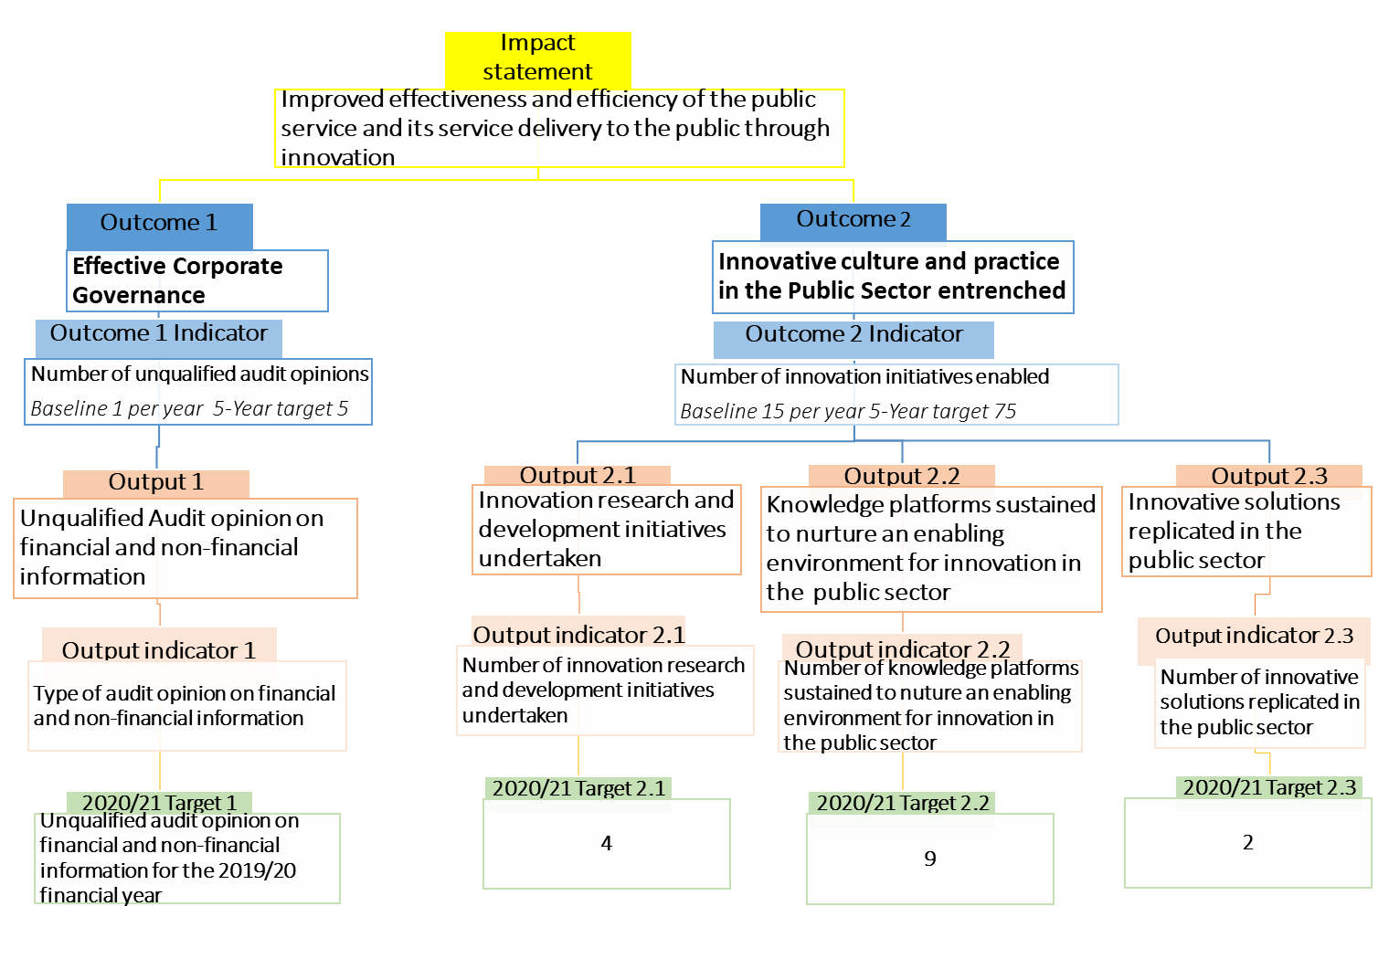
Schematic Overview of Strategic Plan and APP

Slide 6
VISION
A solution focused Public Sector through innovation
IMPACTS
(VISION/ MISSION)
MISSION
To entrench an innovative culture and practice in the Public Sector
Innovative culture and practice in the Public Sector entrenched
Effective corporate governance
OUTCOMES
Innovation research and development initiatives undertaken
Knowledge platforms sustained to nurture an enabling environment for innovation in the public sector
Innovative solutions replicated in the public sector
Unqualified Audit opinion on financial and non-financial information
OUTPUTS
Conduct innovation research
Facilitate solution development
Create knowledge sharing platforms
Ensure unearthing and recognition for innovation
Facilitate replication and mainstreaming of innovative solutions
Provide integrated corporate governance
ACTIVITIES
INPUTS
HUMAN RESOURCES, FUNDS, TECHNOLOGY, INFORMATION, ASSETS
VALUES
Innovative Committed Need driven Ethical Collaborative

Slide 7
2021-2022 MTEF Allocations per Programme
 | Revised Baseline
Rand thousand | 2020/21 | 2021/22 | 2022/23
Programmes
Administration | 20 745 | 21 745 | 22 289
Public Sector Innovation | 17 623 | 18 445 | 18 964
Total for Programmes | 38 368 | 40 190 | 41 253

Slide 8
THANK YOU!

