Slide 1

Portfolio Committee on Transport
11 May 2020

Slide 2
Contents
PRASA Corporate Plan
Administrator’s Mandate
Key Actions Taken
Priority Programmes Update
  3 Months
  6 Months
Corridor Recovery Programmes
  Central Line
  Mabopane Line
COVID-19
  Impact
  Readiness
Capital Programme

Slide 3



Vision, Mission and Values
Vision
  PRASA to become a backbone of public transport.
Mission
  To provide safe, reliable, affordable commuter rail, long-haul passenger rail and long-haul inter-city bus services.
Values

Slide 4

Mandate
The main objective and main business of PRASA is to:
  “Ensure that, at the request of the National Department of Transport, rail commuter services are provided within, to and from the Republic in the public interest and provide, in consultation with the National Department of Transport, long haul passenger rail and bus services within, to and from the Republic in terms of the principles set out in section 4 of the National Land Transport Act (2000) (Act no 22 of 2000, as amended).
The second objective and secondary business of PRASA is that it shall generate income from the exploitation of assets acquired by it.
A further requirement is that, in carrying out its objectives and business, PRASA shall have due regard for key Government social, economic and transport policy objectives.”

Slide 5
National Development Plan
PRASA plays a crucial role because it is responsible for providing a suitable public transport solution that is safe, efficient, reliable and cost-effective.
PRASA is impacted through:
  Increasing investment in public transport and resolving existing public-transport policy issues
  Devolving transport management to local government
  Providing incentives for public transport use
  Renewing the commuter train fleet
  Property development
PRASA contributes to the NDP through the impact it has on
  Employment : Reducing the costs of living by providing affordable rail fares for people travelling to and from places of employment.
  Environment: As provider of mass transport provide a low carbon footprint. PRASA facility development and upgrades focus on the reduction of greenhouse gas emissions to zero emissions from buildings by 2030.
  Integrated transport planning take into account future human settlements and transport corridors, cities’ urban planning and the densification strategy through the PRASA National Strategic Plan in addition also balance the location of jobs and human settlements.
  Education: PRASA also supports the development of learners engineering fields for rail, the development and training of rail specific artisans and other transport-related skills.

Slide 6
Medium Term Strategic Framework (MTSF)
Priority 1: Economic Transformation and Job Creation;
  Provide access to job opportunities.
  Job creation dependent on the contracts that will follow from the projects that fall under the Capital Programme. Many of these are still in the procurement phase, barring the Rolling Stock Fleet Renewal Programme and the Re-signalling Programme.
Priority 2: Education, Skills and Health;
  Specific focus on training programs for Customer Services, Security and Train Operations
Priority 4: Spatial integration, human settlements and local government;
  Address the declining public transport system a focus on interventions to make the public transport system affordable, safe and reliable. Whereas the MTSF focuses in the main on the modernization programme of PRASA, the currently unacceptable levels of performance in operations need to be dealt with in order to provide safe and reliable commuter (Metrorail) and long-haul passenger services through Autopax and MLPS.
Priority 6: A capable, ethical and developmental state. Also within the capital program and modernization stream.
  Restoring commuter rail services and long-haul passenger transport through MLPS and Autopax, as well as accelerating the implementation of capital projects aimed at modernizing the Rail network used by commuters. It will also strive to embed a culture of safety in the organization, especially in terms of operations.
  Establishing a functional, efficient and integrated organization through reviewing its operating model, addressing audit outcomes of the last number of years and institutionalizing an ethical culture.

Slide 7
Strategic Outcome Oriented Goals
Two goals for PRASA that is aligned with the priorities of MTSF
Rail and Bus passenger transport that works
  Rail and bus transport that is safe, affordable and reliable by Metrorail, MLPS and Autopax through maintaining and modernizing the Rolling Stock, Bus Fleet, Infrastructure, Facilities, Stations and Security.
A Capable Organization
  An organization that does business ethically and efficiently, placing commuters and passengers on top of the agenda and is financially sound.

Slide 8
Strategic Objectives
Five Strategic Objectives that are:
  Aligned to the Goals
  Aligned to the priorities of the Administrator

Slide 9
Strategic Objectives & Programs: Goal 1
Rail and Bus transport that works
  Service Recovery : ensure predictable and reliable train and bus services through operational planning and recovery of fleet (Metrorail, MLPS and Autopax) and Infrastructure, facilities and stations for Rail.
PROGRAMS
SUB PROGRAMS

Slide 10
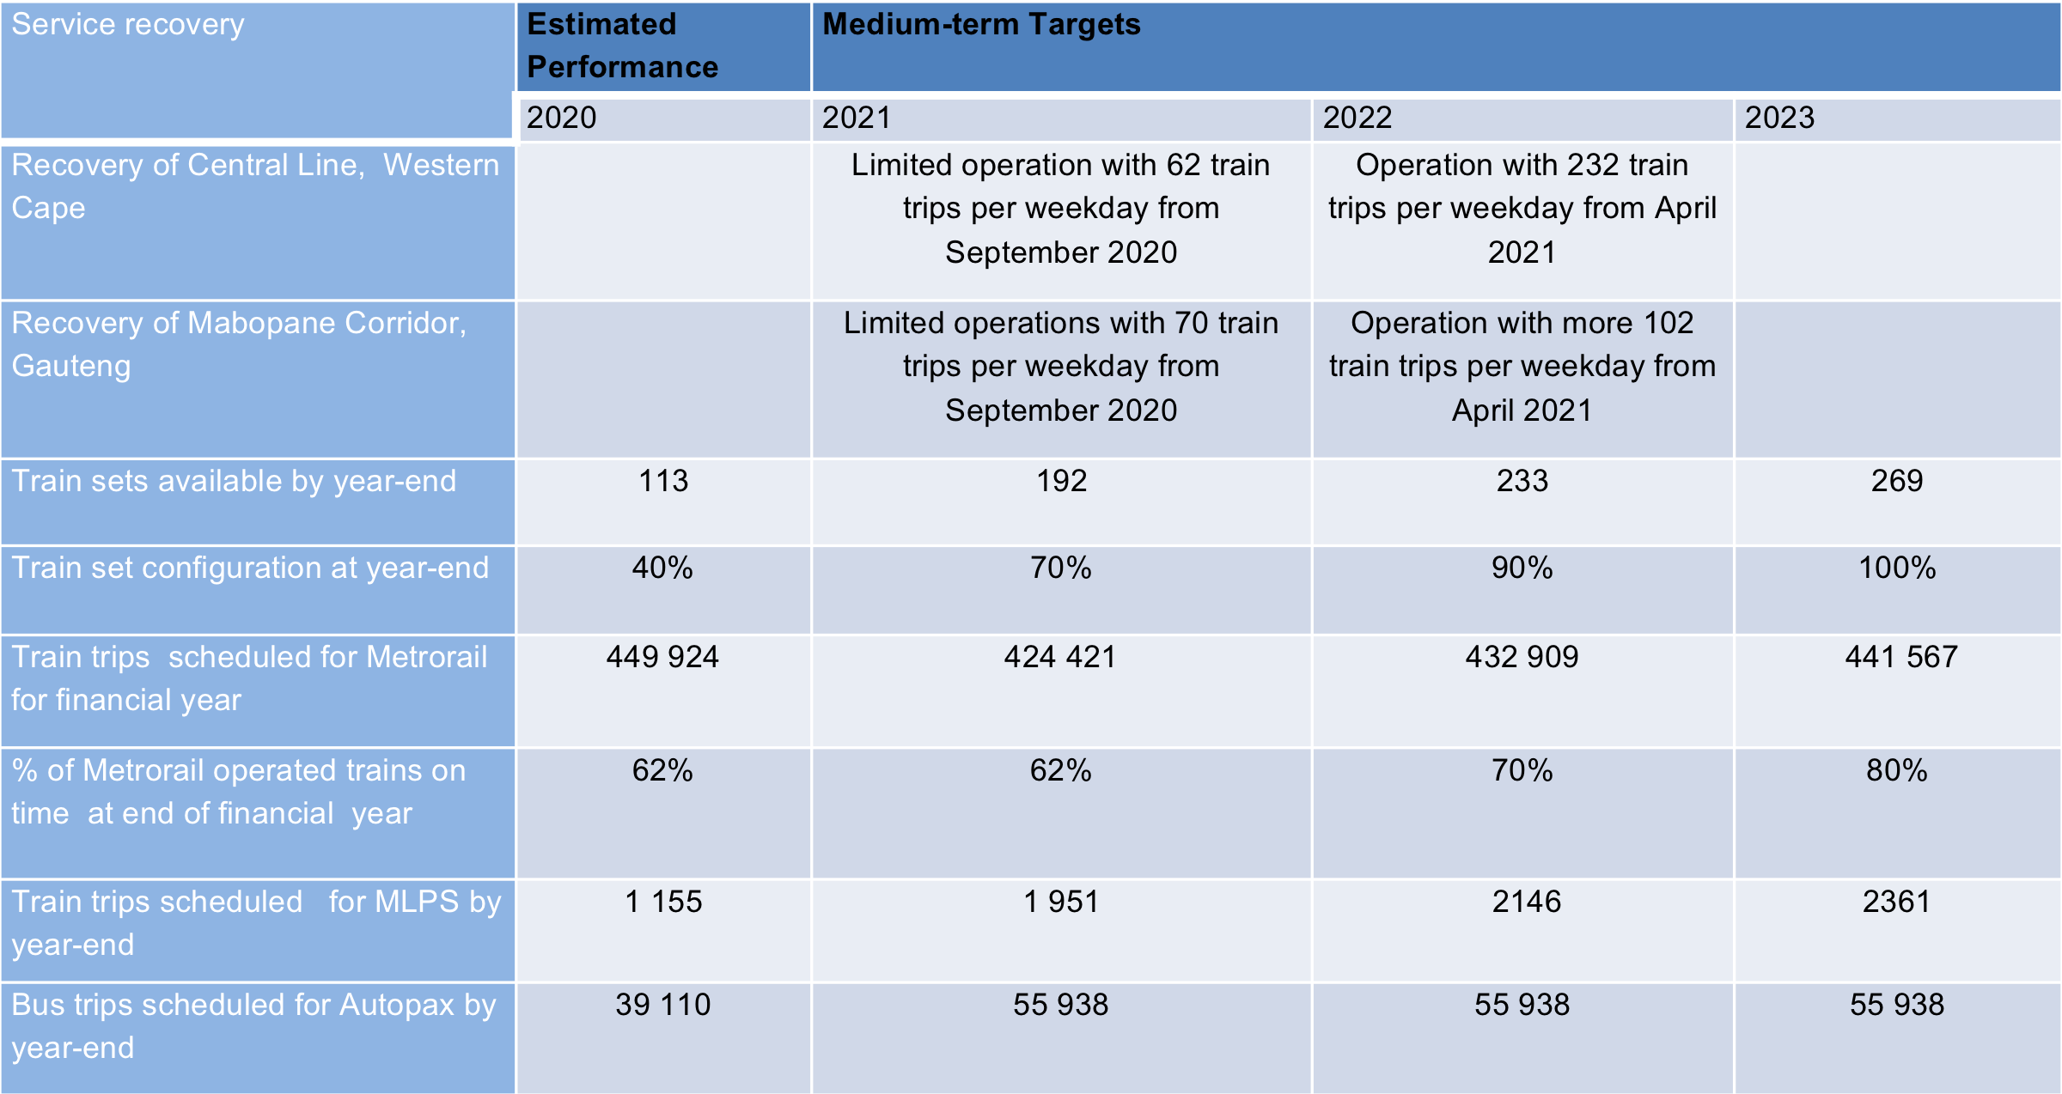
Indicators for Service Recovery

Slide 11
Strategic Objectives & Programs: Goal 1
Rail and Bus transport that works
  Safety and Security Management: improve safety management in line with RSR requirements, security of the PRASA asset base and implement security technology, physical security and integration.

Slide 12
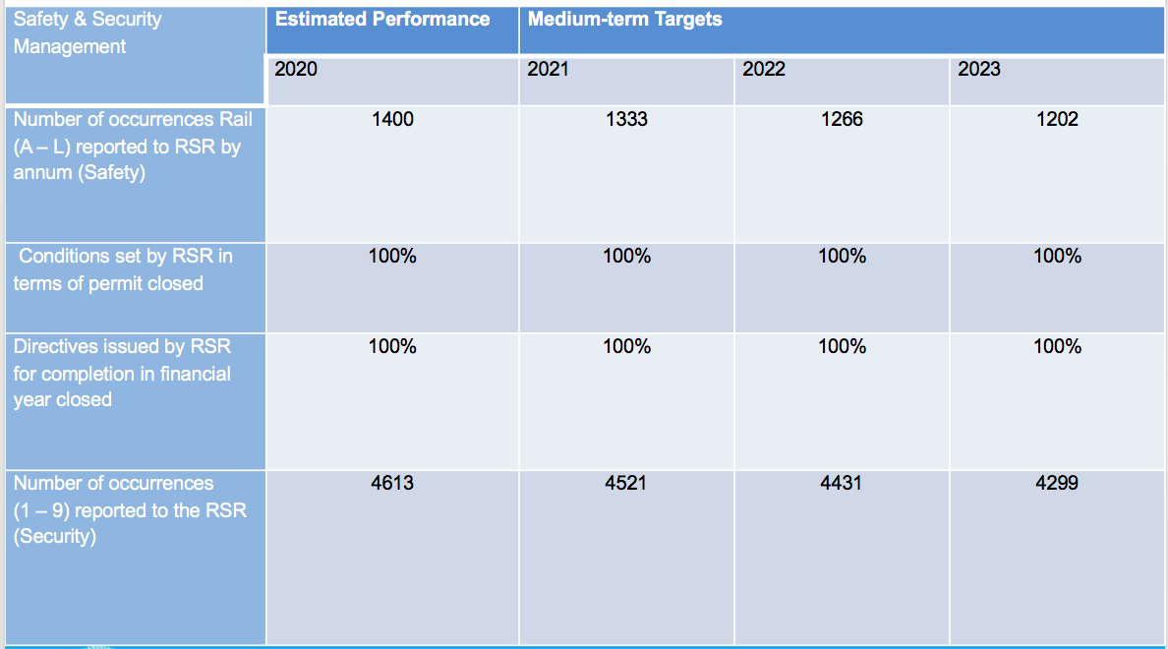
Indicators for Safety and Security Management

Slide 13
Indicators: Capital Programme and Modernization Acceleration
Capital Programme and Modernization Acceleration: develop a capital implementation process and implement such to accelerate service recovery and delivery through modernization of the rail system.

Slide 14
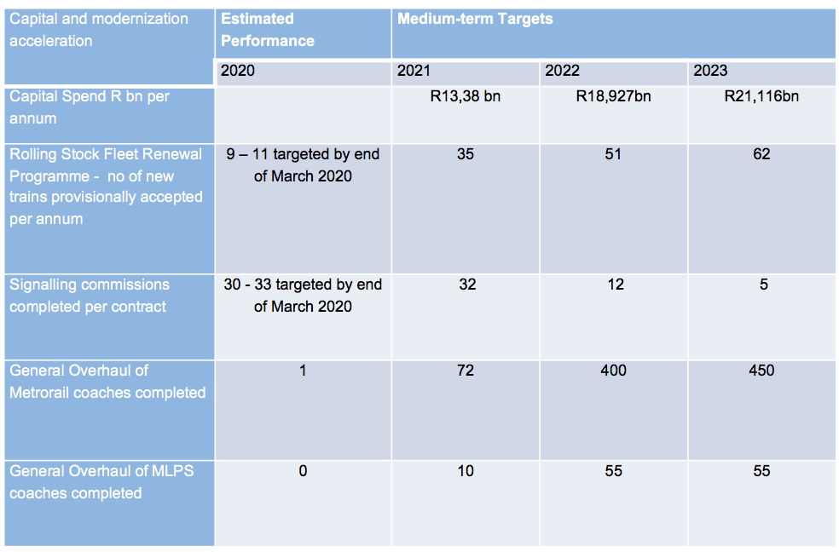
Indicators for Safety and Security Management

Slide 15
Strategic Objectives & Programs: Goal 2
A capable organization
  Revenue Enhancement and Cost Containment : review the organisational design and business model and address revenue protection and generation for commuter and passenger transport as well as properties and assets to ensure a sustainable organization that is financially sound.

Slide 16
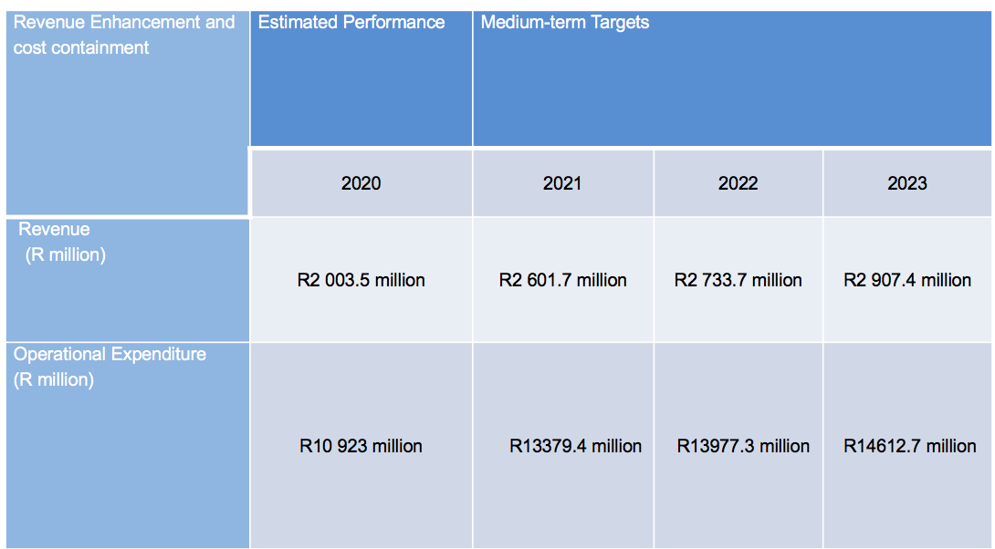
Indicators Enhancement and Cost Containment

Slide 17
Strategic Objectives & Programs: Goal 2
A capable organization
  Governance: address all Auditor General findings, ensure effective consequence management, establish or improve policies, systems and processes, ensure effective enterprise wide risk management, improve and streamline the procurement process, ensure governance structures are line with legal and business imperatives, insurance cover and divisionalization of PRASA subsidiaries.

Slide 18
Indicator for Governance
Governance | Estimated Performance | Medium-term Targets
 | 2020 | 2021 | 2022 | 2023
Auditor General Audit opinion on previous year audit | Disclaimer | Unqualified | Unqualified | Unqualified (Clean Audit in 2024)
At operational level : Reduction of repeat findings

Slide 19
How does it all fit together

Slide 20
Priority: Economic Transformation and Job Creation
Job Creation
PRASA contributes to the economy and job creation within its Capital Programme and Modernisation Acceleration.
  Creation of jobs and economic benefits is dependent on the contracts to be put in place that is still in the procurement phase.
  Currently Rolling Stock Fleet Renewal Programme, Re-signalling and Co-operatives already in place is contributing
Job Creation | Estimated Performance | Medium-term Targets
 | 2020 | 2021 | 2022 | 2023
Jobs from RSFRP cumulative | 1100 | 1300 | 1400 | 1500
Other projects in PRASA | 26 | 1575 | 2585 | 2800

Slide 21
Priority: Economic Transformation and Job Creation
Contribution will be with regards to
  Training Programmes
  Internships and Learnerships (incl. apprenticeships)
  Bursaries

Slide 22
Indicators on Procurement
Performance Indicator | Target 2021
Contract expenditure through contract management | 80%
BBBEE Compliant Spend as percentage of identified operational spend per annum | 60%
Qualifying Small Enterprise (QSE) spend as percentage of identified operational spend per annum | 15%
Exempted Micro Enterprise (EME) Spend | 15%
Black-Owned companies (BO) Spend | 9%
Black-Women owned companies (BWO) Spend | 6%
Enterprise and Supplier Development Spend | 2%

Slide 23

Administrator’s Turnaround Update

Slide 24
ADMINISTRATOR’S MANDATE

Slide 25
Administrator’s Mandate
Addressing all matters raised in the Auditor-General’s report and ensure that there are no repeat findings.
Accelerating interventions aimed at improving operational performance.
Expedite implementation of the modernization programme, with priority focus on fencing, signaling, perway and station upgrades.
Security interventions across all corridors
Undertake a review of PRASA’s organizational design and business model

Slide 26
Administrator’s Mandate
6. Urgently develop capacity to manage PRASA’s capital programme, working with other state entities in the short term.
7. Build capacity to support interventions aimed at recovering the system by establishing requisite supplier panels through competitive bidding or other means permissible.
8. Attend to issues that require engagement with Transnet in order to unlock blockages that negatively affect operations.
9. Ensure effective consequences management and provide support to investigations currently underway by law enforcement authorities.

Slide 27
Institutionalizing the Ministerial Mandate
Undertake a review of PRASA’s organizational design and business model | Revenue Enhancement and Cost Containment
Addressing all matters raised in the Auditor-General’s report and ensure that there are no repeat findings. | Governance
Attend to issues that require engagement with Transnet in order to unlock blockages that negatively affect operations
Ensure effective consequences management and provide support to investigations currently underway by law enforcement authorities
Accelerating interventions aimed at improving operational performance. | Service Recovery
Build capacity to support interventions aimed at recovering the system by establishing requisite supplier panels through competitive bidding or other means permissible.
Security interventions across all corridors | Safety Management
Expedite implementation of the modernization programme, with priority focus on fencing, signaling, perway and station upgrades. | Capital and Modernisation Programme Acceleration
Urgently develop capacity to manage PRASA’s capital programme, working with other state entities in the short term.
Turnaround Mandate
Sub-Committee

Slide 28
BROKEN BUSINESS

Slide 29
Broken Business
In January after my assessment of PRASA, I characterized it as a broken business. This, I indicated was largely due to the Systematic Erosion of value, the business had experienced over a number of years. I then made the commitment that we as PRASA officials, do not have a choice but to bring a Semblance of Order to this important institution, whilst striving to deliver Value to our customers.

Slide 30
Broken Business
The organization has seen countless changes at CEO level since 2015
Questionable Decisions have been taken by Leadership with disastrous consequences
Little or No consequence management at PRASA
No proper record keeping at PRASA. In some instances, there are no records at all
No adequate back up system
Operating systems are not fully deployed whilst in some cases they are non-existent
Policies and Standard Operating Procedures are either non-existent or outdated; This creates a serious loophole thus rendering the day-to-day operations rudderless
Inadequate SCM processes have contributed to hampering the procurement of goods and services
There is very poor implementation and spend on the Capital Programme
Irregular Expenditure remains high
Repeat findings keep increasing and not addressed
Exorbitant long outstanding liabilities

Slide 31
IMMEDIATE MEASURES TAKEN TO BRING A SEMBLANCE OF ORDER

Slide 32
Measures Taken
We are registering steady progress but there remains a lot of work to be done, as I will demonstrate during the course of this briefing.
I have taken a few key actions to ensure that we set the foundations for stability in this organization. We have set up a robust EXCO Structure that meets every two weeks since January. EXCO is supported by 5 Sub-Committees that also convene bi-weekly in order to feed into the EXCO agenda.
You will note during this briefing that the progress update is structured along these Sub-Committees. I raise this here as it is a fundamental requirement for instilling proper Governance at PRASA, which had for all intents and purposes been compromised over the last few years.
I have now bolstered the office of the Administrator by appointing a team of seasoned Technical Advisors. These professionals hail from Government Departments, a State Research Institution and industry. These Technical Advisors and their focus areas are as follows:
  Finance – Mr. Krishna Govender CA (SA)
  Supply Chain Management – Mr. Willie Mathebula (National Treasury)
  Legal Advisory – Mr. Sifiso Simelane (Department of Transport)
  Stakeholder Management, Communication & Business Performance – Ms. Phelisa Nkomo (Economist)
  Rail & Bus Operations – Dr. Mathetha Mokonyama (Transportation Engineer: CSIR)
  Technical & Engineering – Mr. Themba Camane (Civil Engineer)
These professionals have also strengthened EXCO capacity as there were a number of deficiencies at this level.

Slide 33
Measures Taken
We have also triggered a number of key Partnerships which seek to build strong operational relationships with other entities of State that we interface with. Some key examples here are the following:
Transnet
  Historically there have been a number of unresolved issues between Transnet and PRASA since the separation of passenger services from Transnet. This has had a detrimental effect for both parties as a result. Recently, the CEO of Transnet and I met and we have set up a number of workstreams that are focusing on mutually agreed business critical items. This process is going to strengthen the operational issues between our entities and I’m confident that our collaboration will be for the benefit of the South African public.
Eskom
  Eskom plays a very important role in our economy and one of those is to power our trains. Furthermore, there are a number of common areas that require us to join forces such as cable theft as well technical assessments and monitoring of substations. The CEO of Eskom and I have agreed to work together and we have set up a number of workstreams that will enhance our synergies.
SAPS
  With regards to enhancing our security capability, we have engaged the South African Police Service (SAPS) with the purpose of strengthening our relationship, as per the MOU we entered into in 2019. As such, they will be a force multiplier in our environment through some special operations. It is important to emphasize that PRASA’s rail and station infrastructure serves as an enabler to various economic sectors. It therefore goes without saying that it is in all our interests to protect these assets of national importance and keep criminals very far away from them.

Slide 34
Measures Taken
We have moved to institute consequence management on a number of matters cited in various investigation reports at PRASA. To this end we have suspended 12 senior members who will be undergoing disciplinary action. Where instances of possible corruption are picked up, these will be handed over to the National Prosecuting Authority. There are a number of matters that are being processed by ourselves, the SIU as well as the Directorate for Priority Crime Investigation (DCPI) the Hawks.
There have been quite a number of vacancies at Executive level and we have completed the process of filling these. Over the past few weeks, we have undertaken a fairly rigorous process of identifying suitable candidates. We will in the course of this month make announcements in this regard for the following positions:
  PRASA Rail CEO
  PRASA Tech CEO
  Autopax CEO
  Chief Information Officer
  Company Secretary

Slide 35
Finances
Over the past 10 years, we have seen a steady and sharp decline in fare revenue which has necessitated an increase in the operating subsidy. On the other hand, our expenses have increased unabated. (See below)

Slide 36
Finances
We are earnestly working on arresting and thus seeking to reverse. As we work on initiatives aimed at improving revenue over time, it is of primary importance that we reduce unnecessary costs. Towards this end, we are paying particular attention to the following cost items:
Overtime, Allowances, Casual/Risk labour pool, Fleet usage related costs – fuel, maintenance, etc., Train operations costs which are variable, but also with regards to fixed costs where we can negotiate elimination, reduced rates or deferrals, Traction/Energy related costs, Municipal related costs, Any ticket sales/office related costs, Negotiating reduced rentals for leased properties or deferral, Training, Travel and accommodation.
Furthermore, it has become an accepted practice at PRASA to budget for a deficit. The process I have outlined above seeks to change this unacceptable budgeting culture and this is one of the very important elements towards creating a sustainable business model.

Slide 37
Areas of Focus
01
3 Month Priorities: January-March 2020
STABILITY & ORDER
02
6 Month Priorities: January-June 2020
EXECUTION
03
12 Month Priorities: January-December 2020
COMMISSIONING, CONTINUITY & HANDOVER

Slide 38
PRIORITY PROGRAMMES UPDATE

Slide 39
3 Month Programmes
Service Recovery Sub-Committee
Turnaround Plan | Key Programme | Status
Accelerate interventions aimed at improving | Delivery of Critical Components | We have been receiving critical components particularly in the Gauteng region and we will be advertising a more comprehensive tender by Mid-June 2020.
 | Rolling Renewal Programme. 5-6 Trains provisionally accepted (Jan – Mar) | 4 new trains have been provisionally accepted from the Local Factory during the January – March 2020 period.
 | Develop Passenger Service Charter | 2013 Passenger Service Charter has been redrafted and approved by EXCO. We are now in the process of rolling it out.
Attend to Issues that require engagement with Transnet in order to unlock blockages that negatively affect operations | Technical Work Stream Operations Work Stream Property and Assets Work Stream Manufacturing Work Stream Commercial Work Stream Legal Work Stream | The Terms of Reference adopted and work plans with activities and milestones finalised by each stream.

Slide 40
3 Month Programmes
Revenue Enhancement Sub-Committee
Turnaround Plan | Key Programme | Status
Undertake a review of PRASA’s Organisational Design and Business Model | New Operating Model and Organisational Structure to be developed by in-house team | The operating model review has confirmed structural impediments that have worsened since PRASA creation in 2009. By design PRASA delivers its mandate inefficiently across divisions and subsidiaries. Strong internal focus has also stunted value creation for customers and stakeholders. The operating model review to date suggests streamlining of functions to service delivery and revenue generation mandates through removal of duplicated efforts, strengthening regions, accountability through measurable performance, and a functionary to enforce service value chain. Final recommendations are due at the end of May 2020.

Slide 41
3 Month Programmes
Capital Programme and Modernisation Acceleration Sub-Committee
Turnaround Plan | Key Programme | Status
Expedite implementation of modernisation programme with priority focus on fencing, signalling, perway and station upgrades | National Station Upgrades – Cape Town Station Tenant installation Project | Parade Concourse is delayed however the project is 69% complete. The delivery of lift has been delayed and the COVID-19 lockdown will increase the delays. The date for the completion of tenant installation is November 2020
Urgently Develop capacity to manage PRASA’s capital Programme working with other state entities in the short-term | Reviewing of EPMO | The EPMO Plan has been developed and approved by EXCO. This is being rolled out and will ensure close monitoring of project delivery.

Slide 42
3 Month Programmes
Safety and Security Sub-Committee
Turnaround Plan | Key Programme | Status
Security Interventions across all Corridors | Source uniform clothing for security personnel | Specifications have been compiled for Bid Specification Committee in preparation for tender advertisement.
 | Develop Security Strategy | The Security Strategy aimed at Integrated Security Management has been developed. I have further appointed Brigadier General Tebogo Rakau (retired), to lead and stabilise the Security Department.

Slide 43
3 Month Programmes
Governance Sub-Committee
Turnaround Plan | Key Programme | Status
Addressing all Matters raised in Auditor-General’s report and ensure there are no repeat findings | Update all policies | Policies that have been developed and approved include: Supply Chain Management, Fraud & Corruption Prevention Policy, Fraud & Prevention Plan, 3-year Internal Audit Plan, Internal Audit Policy, Lifestyle and Audit, Ethics, Human Factors , Incapacity, Overtime, Recruitment and selection, Asset Disposal, Competency Management, Workload planning, Human Factors Management Policy, Disciplinary Policies., Property Leasing Policy, Security Policy and Charter, Declaration of Interest Policy, Legal Policy, Policy Development and Approval Framework and Delegation of Authority Framework. Review of policies shall be conducted as gaps are identified.
 | Implement controls through the activation of dormant SAP modules | Specifications have been compiled for Bid Specification Committee in preparation for tender advertisement. Modules to be implemented include Real Estate, Plant Maintenance, Project Management, Employee Self Service and Recruitment.
 | Track and attend to audit findings in particular repeat findings | I have approved for implementation, a fundamental structural intervention that reports to my Office that will ensure management responses to Audit findings: • Are dealt with as part of a root cause analysis • Are complete in terms of key control points applied against a standardised internal control framework • Identify accountable executives and process owners, aligned to performance and consequence management • Undergo a quality assurance process
Build Capacity to support interventions aimed at recovering the system by establishing requisite supplier panels through competitive bidding or other means permissible | Set-up Panel of Service Providers to provide capacity to Capital Programme implementation | Specifications have been compiled for Bid Specification in preparation for tender advertisement.

Slide 44
3 Month Programmes
Governance Sub-Committee
Turnaround Plan | Key Programme | Status
Build Capacity to support interventions aimed at recovering the system by establishing requisite supplier panels through competitive bidding or other means permissible | Set-up Panel of Service Providers to provide capacity to Capital Programme implementation | Specifications have been compiled for Bid Specification in preparation for tender advertisement.
Ensure effective consequence management and provide support to investigations currently underway by law enforcements authorities | Conduct lifestyle audits on all employees in finance, supply chain and the top 300 of PRASA management employees. | 186 names of Senior PRASA employees have been provided to SSA for Vetting which will include Lifestyle Audits. These comprise of the following: • Group Executives; • Subsidiary & Divisional CEOs; • General Managers; • Regional Managers; • Senior & Executive Managers; • Company Secretariat; • Internal Audit; We have provided office space for SSA to undertake this exercise and are experiencing some delays with the advent of COVID-19.

Slide 45
3 Month Programmes
Governance Sub-Committee
Turnaround Plan | Key Programme | Status
Ensure effective consequence management and provide support to investigations currently underway by law enforcements authorities | Ensure consequence management is instituted | SIU Proclamation The SIU investigation on the 27 matters under the Proclamation continues and working with the DPCI, additional investigations have been initiated to determine the existence of possible criminal acts of individuals described herein and others. Relevant documents were collected and the SIU is busy with the desktop analysis thereof. Due to lockdown of the country, the SIU has not been able to conduct other investigations like interviewing of certain person of interest and PRASA officials. The SIU is currently assisting PRASA to collect and collate evidence to effect internal disciplinary matters due to lack of capacity internally. Internal Investigations SIU is currently assisting PRASA to collect and collate evidence to effect internal disciplinary matters due to lack of capacity internally. Six (6) Senior and Executive matters currently under investigation, lockdown created an impediment on face to face investigator interviews. Nine (9) Senior Managers’ charges finalised, process in place with SCM to appoint a panel to start disciplinary process. The SIU will immediately after lockdown, finalise the process of putting together evidence for the disciplinary processes is under way. Four (4) Senior Managers’ disciplinary matters are awaiting sanction from Mkhabela and Huntley Attorneys Documents (reports) that were at Strauss Daly were collected and the SIU is analysing the documents
 |  | The HAWKS are working on 23 PRASA matters and are in the process of collating information, 16 matters have been sent on 5 May 2020 by the HAWKS to the NPA Specialized Commercial Crime Court (SCCC), Johannesburg for allocation. Two Matters will be sent to the NPA Specialized Commercial Crime Court (SCCC) on Friday, 8 May 2020.

Slide 46
3 Month Programmes
Governance Sub-Committee
Turnaround Plan | Key Programme | Status
Ensure effective consequence management and provide support to investigations currently underway by law enforcements authorities | Ensure consequence management is instituted | CCMA All PRASA matters at the CCMA have been suspended during the Lockdown. There are 58 cases at the CCMA, some Conciliations, some Arbitrations and some Pre-dismissal Arbitrations CCMA issued an advisory on 1 May 2020, stating that it is not an essential service and therefore its offices will remain closed. Users and stakeholders can therefore not access any of the CCMA offices. Referrals can only be made via email or fax Pre-conciliation and Conciliation Meetings may continue telephonically if all parties and the CCMA agree to it. In this regard, PRASA has to date not received any requests from Labour or individual employees. The CCMA may approve, subject to written agreement by parties, that other matters be heard at alternative venues, other than CCMA venues, subject to strict health and safety conditions being satisfied. In this regard, PRASA has to date not received any requests from Labour or individual employees Labour Court PRASA has 49 matters at the Labour Court, at various stages. Matters are pending, awaiting dates for hearings

Slide 47
6 Months

Slide 48
6 Month Programmes
Service Recovery Sub-Committee
Turnaround Plan | Key Programme | Status
5. Accelerate interventions aimed at improving | Implement Cashless Ticketing | Specifications for the appointment of the service provider have been compiled for Bid Specification Committee in preparation for tender advertisement.
 | Automatic Fare Collection | Market analysis on available systems is being conducted. A benchmark is exercise is being conducted with Gautrain and other international rail operators.
 | Integration of Rail and Bus Service | Short-term recovery plan for Autopax has been completed and approved by EXCO. A longer term positioning strategy for Autopax to fully integrate with rail services is underway.
 | Improved and predictable time table for train service | Timetables are being systematically reviewed for Metrorail, MLPS, and Autopax to ensure accuracy, consistency, ease of communication, and direct linkage to infrastructure and fleet availability. These are informed by the Service Charter that has been approved by EXCO. The RSR is considering a submission on the extension of the already operating Mamelodi (Pienaarspoort) to Pretoria Corridor. The RSR has approved movement of further 8 train sets to the Western Cape (2 already delivered in 2019).
 | New Train Service Provided on Pretoria - Ring Rail Line (East Corridor , Tshwane Metrorail) Cape Town – Heathfield line (Southern Corridor, Western Cape) | Timetables are being systematically reviewed for Metrorail, MLPS, and Autopax to ensure accuracy, consistency, ease of communication, and direct linkage to infrastructure and fleet availability. These are informed by the Service Charter that has been approved by EXCO. The RSR is considering a submission on the extension of the already operating Mamelodi (Pienaarspoort) to Pretoria Corridor. The RSR has approved movement of further 8 train sets to the Western Cape (2 already delivered in 2019).

Slide 49
6 Month Programmes
Revenue Enhancement Sub-Committee
Turnaround Plan | Key Programme | Status
1. Undertake a review of PRASA’s Organisational Design and Business Model | Re-negotiate Eskom Tariffs PRASA and ESKOM peak periods coincide meaning PRASA operates during periods when electricity prices are high attracting huge invoice amounts versus revenue generated. Fixed cost charges means PRASA further subsidises electrification to rural and residential projects through affordability, electrification and rural subsidy charges Contractual terms of 15 day payment terms not in favour of PRASA resulting in further cash flow challenges | Engagements with Eskom has started Exploring joint submission to NERSA on tariff review Exploring sharing of technical and security expertise
 | Implement Shared Services Model | Development of the Shared Services Model is in progress with support departments (HCM, Supply chain, Finance and ICT). The realignment of reporting lines is underway.

Slide 50
6 Month Programmes
Capital Programme and Modernisation Acceleration Sub-Committee
Turnaround Plan | Key Programme | Status
8.Expedite implementation of modernisation programme with priority focus on fencing, signalling, perway and station upgrades | Recovery of Key Corridors : Western Cape: Central Line Corridor Gauteng: Mabopane - Johannesburg Kwazulu Natal: Umlazi – Durban Corridor | Specifications for the Procurement of Professional Service Provider being finalised. Tenders for construction of the fencing / walling will follow on completion of specialist studies and design.. The encroachment is a major risk for the Central line Lockdown is negatively impacting the recovery schedule
9. Urgently Develop capacity to manage PRASA’s capital Programme working with other state entities in the short-term | Consolidation of Engineering and Technical Functions | Steering Committee is being set-up to oversee implementation
 | Capacity support and Programme / Project Management Tools | Transnet is being engaged to offer support in terms of setting up project management methodology Business requirements are being consolidated for the Project Management Tool. The use of Microsoft Project tool is being explored in the short-term

Slide 51
6 Month Programmes
Safety and Security Sub-Committee
Turnaround Plan | Key Programme | Status
7. Security Interventions across all Corridors | Construction of modern control rooms | Specifications are being developed.
 | Implementation of security measures (fencing and technology) at priority corridors and hot spots | The specifications are being developed for Security technology. Depot Fencing designs have been concluded. Tender for the appointment of Depot fencing contractor will be advertised by June 2020 Tender for the appointment of the design consultant for the corridor walling design will be going to the market before the end of June 2020.
 | Appoint Long-Term Security | SAPS has assisted PRASA in developing tender security specification for the appointment of private security MOU has been signed between SAPS and PRASA 5 Sub Committees have been established and are meeting on a monthly basis. Intelligence gathering, Case Management, Prosecution, Compliance (PSIRA), Stakeholder Engagement & PRASA Tech & CRES SAPS Mounted units and Canine dog unit will commence mid May 2020 to assist PRASA protect its assets. Motivation for funding for internal PRASA security personnel was sent to DoT and approval is pending. Engagement to finalise MOU between PRASA and SSA are at an advanced stage

Slide 52
6 Month Programmes
Governance Sub-Committee
Turnaround Plan | Key Programme | Status
2. Addressing all Matters raised in Auditor-General’s report and ensure there are no repeat findings | Implement Document Management System | Records Management Policy is under review. The process for the appointment of the service provider is at bid adjudication stage. Office 365 is being used as the interim short term.
3. Build Capacity to support interventions aimed at recovering the system by establishing requisite supplier panels through competitive bidding or other means permissible | Set-up Panel of Service Providers to provide capacity to Capital Programme implementation | The SCM Policy has been reviewed to strengthen governance and transparency with the necessary agility to expedite infrastructure and capital projects delivery. Draft SOPs have been developed and will be finalised during this month. Delegation of Authority has been reviewed and being aligned to necessary thresholds to assist with clearing backlog on approval processes
4. Ensure effective consequence management and provide support to investigations currently underway by law enforcements authorities | Conclude vetting and screening of Divisions and Subsidiaries executives and their critical departments | Vetting process is underway and it anticipated that is should be concluded after the lockdown.
 | Performance Management system (PMS) strictly adhered to | Cascading of Performance Management scorecards for 2020/21 has been completed up to General Manager Level at the end of April 2020. Cascading of Performance Management scorecards to assistant management level will be completed 30 June 2020.
 | Implement Employee recognition and Reward programme | Employee Recognition and Rewards Programme is currently being developed and will be completed at the end of June 2020

Slide 53
CORRIDOR RECOVERY PROGRAMMES

Slide 54
Corridor Recovery
The programme has been reviewed in light of the lockdown, walling programme, and increased theft and vandalism. The revised dates are provided in the table below.

Slide 55
Corridor Recovery
It should however be noted that the above programme / timeframes will continue to be reviewed, as the impact of the COVID-19 Lockdown on the procurement and construction programme is not fully known at this stage. Weekly progress reports are prepared in this regard.
Teams have utilized the lockdown period to improve and finalise specification for the various infrastructure packages (electrical).
Procurement schedule for the corridor programmes have also been developed.
Specific SCM Committees (Specification and Evaluation) are being established to ensure the fast-tracking of specifications and tender evaluations. Advertising of projects under Level 4 lockdown being considered through deviations where applicable.
Stakeholder plan being developed to ensure effective communication and involvement of key stakeholders in the programme.
With regards to the Interim (Bus) service, consideration is being given to the repair and utilisation of some of the Autopax bus fleet.
The Central Line has been severely impacted by illegal settlements in the rail reserve in Langa, Philippi and Nonkqubela on Khayelitsha. The Minister of Transport is leading a process that is comprised of the National Department of Public Works, the Western Cape Provincial Departments of Human Settlement and Transport and the City of Cape Town. The intention is to find a solution through joints efforts to find alternative accommodation for these illegal settlers.

Slide 56
Central Line Corridor Programme
These timelines will be affected by Lockdown Regulations and when the construction industry will be allowed to return to normal. These dates will be updated when information becomes available.

Slide 57

Central Line Corridor Schedule

Slide 58
Mabopane Corridor Programme
The figure below shows the milestones of how when the bus and rail services could start
Interim Solution
Options of leasing/buying/using Autopax busses are being considered (80 buses required)
Autopax solution not yet finalised.
If business case submitted to DoT is approved by the end of May 2020 and the leasing option is chosen, earliest start date for bus operation is November 2020 due to procurement timelines.
Phase 1
Limited Service: PTA-MBP (construction: Aug 20 – Apr 21)
Operating times: 04h00 to 21h00
70 Train Trips per day
45 minute peak frequency
60 minutes off peak
Supplemented service: 25 Busses
Phase 2
Full Service: Re-signalling and pedestrian bridge construction: Aug 20 - Jul 21
Operating times: 04h00 to 21h00
102 Train Trips per day
20 minute peak frequency
45 minute off peak
November 2020 for a minimum period of 6 months
April 2021 for a period of 4 months
August 2021
These timelines will be affected by Lockdown Regulations and when the construction industry will be allowed to return to normal. These dates will be updated when information becomes available.

Slide 59
Mabopane Corridor Schedule

Slide 60
COVID-19 Impact

Slide 61
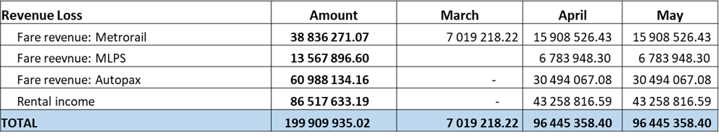
Impact of COVID-19 Lockdown
Financial Impact
PRASA terminated all services during the Lockdown period Level 5 and Level 4 in line with Regulations
Revenue loss due to lockdown period April to end May estimated R199m resulting in further cash constraints on an already strained financial situation. The estimated revenue loss for the year at this stage is R757m.

Slide 62
Impact of COVID-19 Lockdown
PRASA terminated all services during the Lockdown period Level 5 and Level 4 in line with Regulations
  Implementation of Key Projects
  Overall negative impact on planned project timelines and capital intervention programmes
  Priority corridors i.e. Central Line in Cape Town and Mabopane Corridor in Tshwane, negatively impacted
  No Bids advertised during the lock down period as directed by the National Treasury
  Closed Bids not evaluated, bid validities to be extended where required
  No construction activity (only essential / emergency works) during initial lockdown and limited work under Level 4,
  Active projects to be extended
  Planned critical maintenance work severely affected due to the continued shortage of required commodities, key suppliers / service providers to PRASA were closed during this period

Slide 63
Readiness to Resume Services
Train operations will commence under Alert Level 3
Precautions to limit community transmission and outbreaks.
  Screening and testing at stations in collaborations with Dep of Health
  Crowd management & Social distancing will be practised with clear commuter use protocols (wearing of masks/no eating& drinking on trains)
  Sanitation booths are in process of being sourced for Super-core and Core Stations, large depots and offices to handle mass numbers
  Deep Cleaning and disinfection programme has commenced for depots and stations.
  Trains disinfection commenced and all trains in use will be disinfected after every trip
Continuous announcements & Communication of hygiene measures (Washing of hands, wearing of mask, social distancing)
Simulations will be run to ensure teams are familiar with the handling of crowds at the stations and on-board the trains before the resumption dates
Weekly inspections undertaken on trains
    monitor any theft and vandalism activity,
    start-up the trainsets, in order to keep them road worthy,
  maintenance schedule developed for the resumption of service

Slide 64
CAPITAL PROGRAMME

Slide 65
Capital Programme
Over the last couple of years, PRASA has not delivered on its own capital programme for a myriad of reasons. This has had a detrimental impact on PRASA operations as well as the industry that services the organization, resulting in a lose-lose situation. We have been working to package and repackage these projects where required in order for us to release these tenders to go to market. This will serve a number of important objectives:
  Improve PRASA operations
  Stimulate the industry
  Contribute to boosting an ailing economy
We are of the opinion that this effort will act as a counter cyclical move to the economic downturn and thus be a welcome contribution. We therefore urge industry players to ready themselves as PRASA rolls out its infrastructure programme over the next few months. The typical projects in question are the following:

Slide 66
Procurement Programme
Capital Programme | Project Description | Benefits to PRASA | Benefits to Industry | 2020/21 Budget | Date to Market
Depot Modernisation Programme | Depot upgrades including high tech machinery such Under floor wheel lathe, synchronised lifting jacks, yard signalling. | Improved maintenance efficiencies and capacity to maintain new and old rolling stock | The availability of the fleet will be improved due to modern maintenance facilities | R398m (ETC - R13.5bn) | Appointments: June 2020: Wolmerton, Salt River and Durban Tender Adverts: Braamfontein, Paarden Eiland and Benrose depots
Depot Fencing | Installation of fencing and CCTV Cameras Rolling Stock Depots | Reduced theft and vandalism of depot infrastructure and trains in the depots | The depots will be protected resulting in operational maintenance facilities for the trains. Trains in staging yards will be protected from acts of vandalism. | R166m (ETC – R330) | Tender Adverts: June 2020
General Overhaul | Major Maintenance interventions on Metrorail and Shosholoza Meyl rolling stock | Extend life of aging fleet Increased fleet availability to service commuters | The Rolling Stock heavy maintenance to be resuscitated, this will not only be limited to the main contractors, but will positively impact components refurbishers eg. Rotating machines, HT/LT assemblers, etc. | R360 m (ETC – R8bn) | Tender Advert: May 2020.
Rolling Stock Components | Procurement of components for rolling maintenance including wheels and rotating machines | Improved Train Reliability and availability | This tender will also increase the rolling stock maintenance capacity within the industry. | R600 m (ETC – 1.85bn) | Tender Adverts: June 2020
Note ETC - Estimated Total Cost

Slide 67
Procurement Programme
Capital Programme | Project Description | Benefits to PRASA | Benefits to Industry | 2020/21 Budget | Date to Market
Signalling | Installation of new signalling system through complex programme of multi-disciplinary projects | Increase train operation safety (including, but not limited to, reduced train incidents and elimination of manual authorisations) and reliability Double capacity and flexibility resulting in increased revenue Development and training of internal resources on world-class systems and operations thereby increasing internal skills capacity | Implementing world-class leading technology adapted to local requirements Development and training of local resources on world-class systems and operations thereby increasing local skills capacity Financial stimulus to localized small to medium businesses and communities Exporting of knowledge and equipment to other countries especially in Africa | R1.26bn (ETC 22.3bn) | Tender Advert: KZN PRASA Train Control System Design and Construct - July 2020 Tender Advert: GP&WC Optic Fibre Design and Construct - July 2020 Tender Advert: GP&WC PRASA Train Control System Design and Construct August 2020 Tender Advert: National GSM-R Design and Construct - June 2020 - September 2020 Tender Advert: GP&WC Electronic Authorisation System Design and Construct - September2020
Mabopane & Central Line Corridors | Recovery of train Services | Resumption of services Reclaiming patronage Improved and reliable train service | Small construction companies will receive revenue Companies doing rail maintenance work and providing maintenance spares benefit as the rail service resumes | Mabopane – R808m (ETC R1.2bn) Central Line – R1.424bn (ETC – R1.8bn) | Tender adverts: Tenders for various packages will be advertised starting in June 2020 until August 2020.

Slide 68
Procurement Programme
Capital Programme | Project Description | Benefits to PRASA | Benefits to Industry | 2020/21 Budget | Date to Market
OHTE Refurbishment | Refurbishment of OHTE | Reliable Traction Power supply will enable operations to achieve shorter headways | Growth in demand for construction material needed to Refurbish the OHTE and Substations will contribute to sustainability of the industry . Approximately R2.5bn expenditure over the next 3 years would to some extend stimulate growth within the industry . | R30m (R2.5bn) | Tender Advert: July 2020
Perway Rehabilitation | Procurement of Rails | Improved network Reliability and availability Elimination of speed restrictions | Local procurement revitalizes the rail manufacturing industry for SA & SADAC | R189m (ETC – R308m) | Appointments: June 2020
Perway Rehabilitation | On-Track Machines | Improved network Reliability and availability Elimination of speed restrictions | Retaining skills & employment Revitalization of railway industry Increase trade in railway industry | R150m (ETC – R945m) | Appointments: June 2020 (6 months contract) Jan 2021 (3 yr contract)

Slide 69
Procurement Programme
Capital Programme |  | Project Description | Benefits to PRASA | Benefits to Industry | 2020/21 Budget | Date to Market
Security Programme | Deployment Security Technology | Procurement of Security Technologies, Fencing, Control Rooms, Specialised Investigations, Specialised Security Vehicles, Armored vehicles, Drones, Armed Response and Physical Security | Reduce Crime Reduced Maintenance owed to Crime Restore Public Confidence Increase Patronage Improve Revenue Collection Improve Security Efficacy Improved brand integrity Improve Service reliability and predictability | Reduce Socio-economic impact (passenger rail significantly cheaper than other modes) Stimulate Economy Improve real wage of poorest of the poor | R350m (ETC – R1.8bn) | Tender Adverts: June 2020
Corridor Walling | Erecting walls in between stations | Protection of PRASA infrastructure . Improvement of Infrastructure System Reliability as a result of reduction in theft & vandalism. . Curb Fare invasion. | Growth in demand for construction material needed to build walls will contribute to sustainability . Approximately R4.7bn expenditure over the next 4 years would to some extend stimulate growth within the industry . | Growth in demand for construction material needed to build walls will contribute to sustainability . Approximately R4.7bn expenditure over the next 4 years would to some extend stimulate growth within the industry . | R1.335bn (ETC R4.7bn) | Tender advert for Consultants: June 2020 Tender for Contactors:

Slide 70
Procurement Programme – Economic Impact
R7 billion Capital Injection
Boost to local economy
Reduce rate of unemployment
Increase disposable income to commuters
Revitalise local rail related industry
Provide sustainability to ailing construction industry
Increase Tax base
Increase youth employment opportunities
Approximately – 20 000 jobs
A majority of jobs will be temporary for the duration of the projects
Potentially 20% of the jobs could be permanent
Project durations vary from 12 months to 72 months
Tender advertisement dates will be impacted by COVID-19 Lockdown regulations

