Slide 1
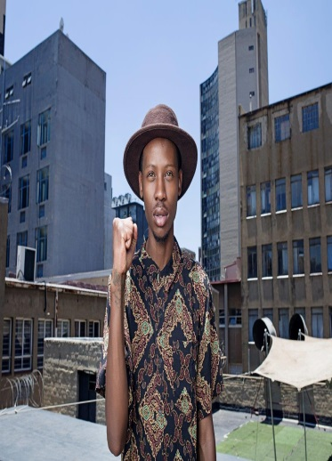
ELECTORAL COMMISSION
STRATEGIC PLAN &
ANNUAL PERFORMANCE PLAN

Slide 2
CONTENTS
Introduction
Statutory Mandate
Strategic Focus
Vision
Mission
Values
Change in external environment
COVID-19
Measuring Performance
Overview
Programme 1: Administration
Programme 2: Electoral Operations
Programme 3: Outreach
Programme 4: Party Funding
Budget

Slide 3
INTRODUCTION
A new vision
The following steps for the re-visioning have been followed in formulating the new vision:
A consultative process in the 2018/2019 period following the last review in 2011/2012.
The NDP 2030 and the integrated development planning in the public sector
Revised Framework for Strategic Plans and Annual Performance Plans.
An environmental scan was done noting the change in the digital age on politics and litigation in democracy.
Innovations in electoral democracy.
Economic and fiscal climate in the Republic of South Africa.
The imperatives for the Electoral Commission to deal with extant and future challenges in the electoral process.

Slide 4
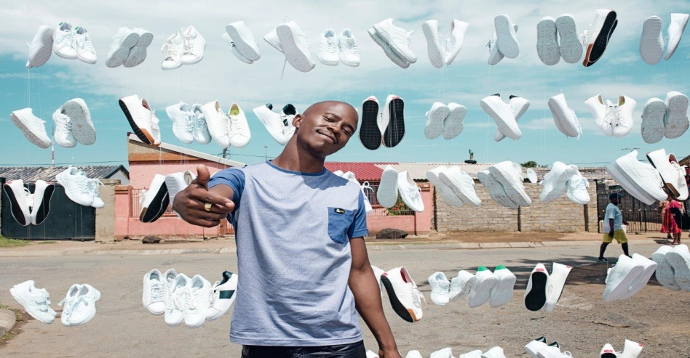
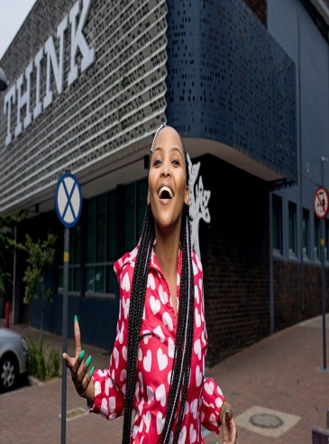
OUR STRATEGIC FOCUS

Slide 5
OUR MANDATE
Legislative and other mandates
In terms of Section 190 of the Constitution of the Republic of South Africa (Act 108 of 1996), the Electoral Commission must:-
manage elections of national, provincial and municipal legislative bodies in accordance with national legislation;
ensure that those elections are free and fair; and
declare the results of those elections within a time frame that is prescribed by national legislation and that is as short as reasonably possible.
The duties and functions of the Electoral Commission are defined in section 5 of the Electoral Commission Act, 1996. These include to:–
manage any election;
ensure that any election is free and fair;
promote conditions conducive to free and fair elections;
promote knowledge of sound and democratic electoral processes;
compile and maintain a voters' roll by means of a system of registering eligible voters by utilising data available from government sources and information furnished by voters;

Slide 6
OUR MANDATE
Legislative and other mandates
compile and maintain a register of parties;
establish and maintain liaison and co-operation with parties;
undertake and promote research into electoral matters;
develop and promote the development of electoral expertise and technology in all spheres of government;
continuously review electoral legislation and proposed electoral legislation, and to make recommendations in connection therewith;
promote voter education;
promote co-operation with and between persons, institutions, governments and administrations for the achievement of its objects;
declare the results of elections for national, provincial and municipal legislative bodies within seven days after such elections;
adjudicate disputes which may arise from the organisation, administration or conducting of elections and which are of an administrative nature; and
appoint appropriate public administrations in any sphere of government to conduct elections when necessary.

Slide 7
OUR MANDATE
Legislative and other mandates
Political Party Funding Act
On 23 January 2019, the President of South Africa enacted the Political Party Funding Act, Act No. 6 of 2018. The Electoral Commission was tasked to establish a separate unit within the Commission to establish a Represented Political Party Fund(RPPF), Multi-Party Democracy Fund(MPDF), coordinate and monitor private donations received by all registered political parties.
The purpose of the Political Party Funding Act is to provide for, and regulate, the public and private funding of political parties, in particular:
a)the establishment and management of Funds to fund represented political parties sufficiently;
b)to prohibit certain donations made directly to political parties;
c)to regulate disclosure of donations accepted;
d)to determine the duties of political parties in respect of funding;
e)to provide for powers and duties of the Commission;
f)to provide for administrative fines;
g)to repeal the Public Funding of Represented Political Parties Act, 199; and
h)provide for transitional matters.
The Act changes the landscape for political party funding and promotes transparency by regulating the disclosure of donations exceeding the prescribe threshold.

Slide 8
OUR VISION
To be a
pre-eminent
leader in electoral democracy
Notes:
https://unsplash.com/

Slide 9
OUR MISSION
The Electoral Commission is an independent constitutional body, which manages elections of legislative bodies and ensures that those elections are free and fair through the participation of citizens, political parties and civil society in order to strengthen electoral democracy
Notes:
https://unsplash.com/

Slide 10
OUR VALUES
Impartiality - to act free of favour
Integrity – the quality of being honest and having strong moral principles
Accountability– to take responsibility for one’s actions
Transparency– to invite trust by revealing that one has nothing to hide
Responsiveness – the quality of reacting quickly and positively
Notes:
10

Slide 11
CHANGE IN EXTERNAL ENVIRONMENT
Constitutional Court Ruling on Voter Addresses
The ruling by the Constitutional Court in June 2016 (Electoral Commission v Mhlope and Others) requires that the Electoral Commission must:
by 30 June 2018, have obtained and recorded all addresses of voters that were reasonably available as at 17 December 2003; and
obtain and record all available addresses for the relevant ward segments of the voters’ roll for purposes of municipal by-elections.
These orders have major implications for the current work and resources of the Electoral Commission and require significant additional address harvesting and capture initiatives.
In May 2018, the Electoral Commission applied to the Constitutional Court for an extension of the 30 June 2018 deadline. The court approved the request.

Slide 12
CHANGE IN EXTERNAL ENVIRONMENT
Constitutional Court Suspended Ruling
The suspension requires that the Electoral Commission must:
by 30 November 2019, have obtained and recorded all addresses on the national common voters’ roll that are reasonably available; and
furnish reports every two months, from 31 January 2019 until 30 September 2019. Such reports must set out the number of outstanding addresses and the steps taken to obtain those addresses. Furthermore, the reports must set out clearly which voters do not have addresses, and which voters have incomplete addresses.
Any party was granted leave to approach the court on new or supplemented papers to re-set the matter for argument if good cause is indicated.
New National Movement
Pending the Constitutional Court ruling on whether independent candidates should be allowed to participate in national and provincial elections, the Constitutional Court is expected to deliver judgment soon on the constitutionality of the Electoral Act insofar as it does not currently allow independent candidates to participate in national and provincial elections. The ruling may result in amendments to the electoral system.

Slide 13
CHANGE IN EXTERNAL ENVIRONMENT
Change in expectations
Recent Statistics
Voter turnout has declined from 89.3% in 1999 to 65.34% in 2019. The decline in participation and registration as a percentage of the eligible population is one of the key indicators of the change in the political and macro-social environment in which the Electoral Commission operates, and is a cause of deep concern for all stakeholders in electoral democracy. The IEC will work with key stakeholders to identify opportunities to jointly address this trend.
Political parties and the public’s expectations of an electoral administration have also changed significantly in this time. In response, the administration of elections has also become more structured and efficient.

Slide 14
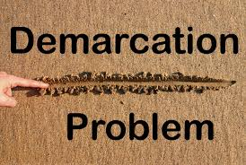
CHANGE IN EXTERNAL ENVIRONMENT
Potential demarcation changes
Composite Elections Debate
The potential demarcation and re-demarcation of provincial, municipal, and ward boundaries in response to representations made by communities is likely to impact on the work of the Electoral Commission over the medium to long term.
The debate about the benefits and challenges of combining national, provincial and municipal elections in future is likely to intensify over the planning period, driven in large measure by the deteriorating economic environment and challenging fiscal constraints

Slide 15
CHANGE IN EXTERNAL ENVIRONMENT
COVID-19
The World Health Organization (WHO) has confirmed Severe Acute Respiratory Syndrome Coronavirus 2 (SARS-COV-2) as the causative agent of Coronavirus Disease 2019 (COVID-19) and has declared the disease a global pandemic.
Since then, global and country specific measures have been implemented to contain the spread of the disease.
What is currently known is that the disease is spread through respiratory droplets produced when an infected person coughs, sneezes or shouts – in a same way as other respiratory pathogens spread.
Notes:
https://unsplash.com/

Slide 16
COVID 19
Our unfolding response to COVID-19 pandemic is as follows:
Deployment of Virtual Personal Network (VPN) to enable staff to work remotely;
Putting in place additional procurement for more laptops to include all staff;
Two protocols in terms of the Business Continuity Plan to ensure continued business operations
First protocol: Deep cleaning of offices in line with methods prescribed by World Health Organization, and departments of Health and Labour.
Second protocol: Focuses on gradual integration of staff into the workplace.
Consulting electoral stakeholders and postponing 37 by-elections by 120 days
.

Slide 17
COVID 19
Testing for all staff and commissioners
Daily screening mechanisms currently being implemented for employees, visitors, contractors and service providers who will come on site. Stringent measures for refusal of access if there is a refusal, including stringent measures on social distancing.
Personal protective equipment (PPE) including the provision of PPE for self-sanitation of work stations over and above routine cleaning frequency and methodology.
Training of all officials on reintegration into the work place in the ‘new normal’.
Continued communication plan specifically for COVID -19 to create awareness .
All OHS officers to be trained to be COVID -19 monitors.
We will need to re-prioritize budget and the Annual Performance Plan(APP). Therefore a revised APP will be submitted in due course.
.

Slide 18
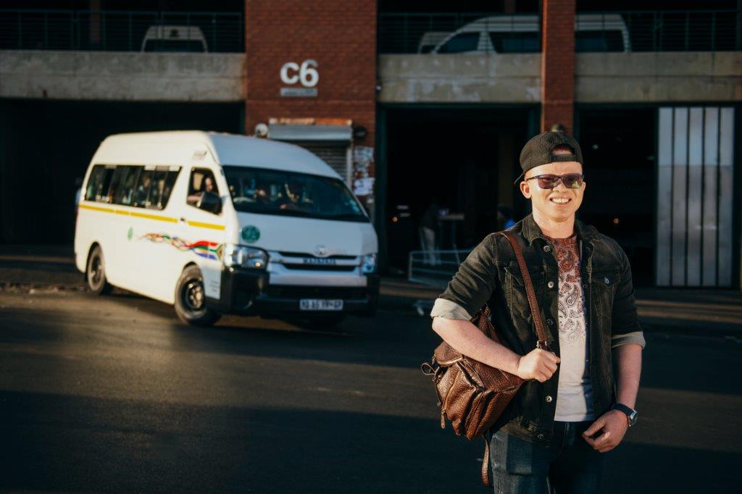
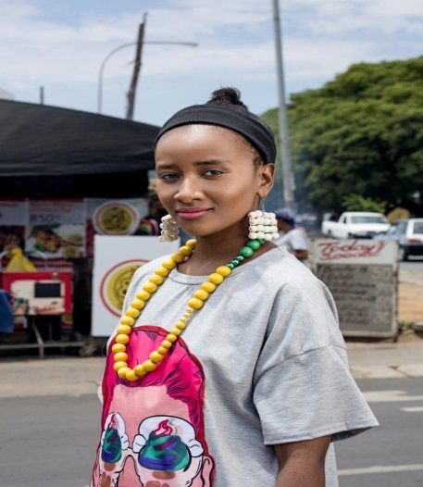
MEASURING PERFORMANCE

Slide 19
OVERVIEW OF PROGRAMMES
PROGRAMME 1:
ADMINISTRATION
PROGRAMME 2:
ELECTORAL OPERATIONS
PROGRAMME 3:
OUTREACH
PROGRAMME 4:
PARTY FUNDING

Slide 20
Financial Management
Programme 1
Administration
Human Resources Management
Legal
Information & Communication Technology
Internal Audit
Training

Slide 21
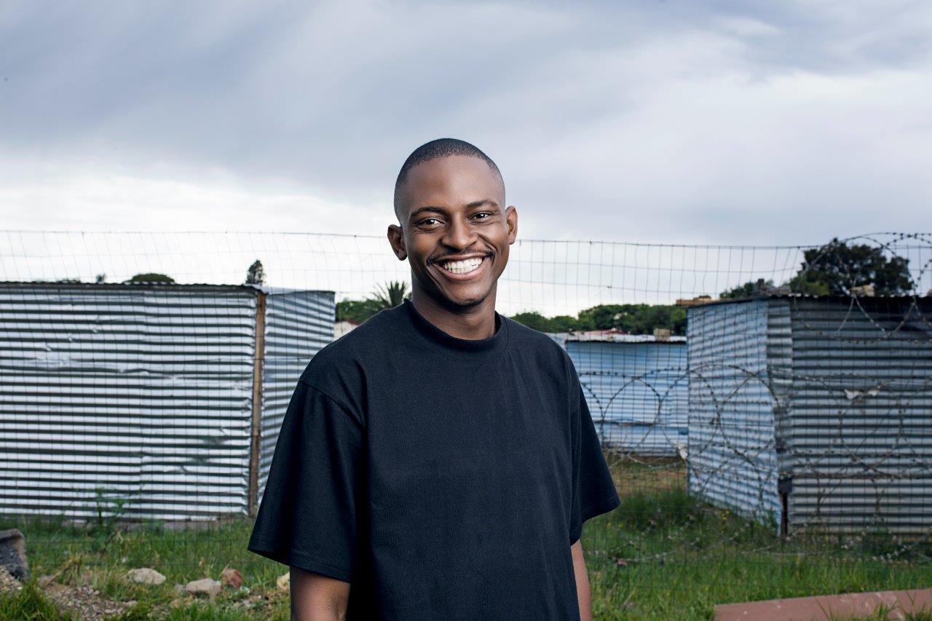
PROGRAMME 1: ADMINISTRATION
to achieve the strategic outcome of strengthening institutional effectiveness at all levels of the organisation.
It also provides the overall strategic management of the Electoral Commission, as well as centralised support and financial management services.

Slide 22
PROGRAMME 1: ADMINISTRATION
Sub-programmes
1.1 Management
1.2 Corporate Services
1.3 Financial Management
Management focuses on strengthening governance by refining institutional governance arrangements (including the Commission’s committees and structures), exercising oversight, and undertaking monitoring, evaluation and support.
Corporate Services focuses on building institutional capacity, expanding human capital development, adhering to performance standards, becoming people-centred, managing human resources well, maintaining sound industrial relations, striving to comply with national climate change policies (preserving the environment), and building institutional memory.
Financial Management focuses on managing
financial resources well.

Slide 23
Outcomes, outputs, performance indicators and targets for 2021
 |  |  |  | Estimated performance | MTEF period
No. | Outcome | Outputs | Output indicators | 2019/20 | 2020/21 | 2021/22 | 2022/23
1.1.1 | Strengthened institutional effectiveness | Exercise leadership and governance, monitoring and evaluation to ensure the effective implementation of the Electoral Commission’s core mandate, strategic outcomes and outputs, aligned with the corresponding budget allocations and risk mitigation. | Number of quarterly performance reports approved by the CEO within 30 days after the start of the next quarter and submitted to the Commission for review and input | 4 | 4 | 4 | 4
1.1.2 |  |  | Number of quarterly reviews of the strategic risk register by the Executive Risk Management Committee within 30 days after the start of the next quarter. | 4 | 4 | 4 | 4
1.1.3 |  | Strengthen assurance management procedures within the Electoral Commission. | Number of quarterly internal audit progress reports per annum prepared by the Chief Audit Executive and reviewed by the Audit Committee each year within 60 days after the start of the next year | 4 | 4 | 4 | 4
1.1.4 |  | Provide a cutting-edge, stable, secure ICT environment that meets all functional needs of the Electoral Commission and supports innovative business processes. | Minimum annual percentage network and application systems availability measured in hours (system-generated report available) | 97% of 2 232 hours’ achievement | 97% of 2 214 hours achieved | 97% of 2 232 hours achieved | 97% of 2 223 hours achieved
13
Electoral Commission Annual Performance Plan 2020

Slide 24
 |  |  |  | Audited/actual performance |  |  | Estimated performance | MTEF period
No. | Outcome |  |  | 2016/17 | 2017/18 | 2018/19 | 2019/20 | 2020/21 | 2021/22 | 2022/23
1.1.5 | Strengthened institutional effectiveness | Provide a cutting-edge, stable, secure ICT environment that meets all functional needs of the Electoral Commission and supports innovative business processes. | Review and approve or review, approve and implement an ICT governance framework in each year covered by this plan | New | New | New | New | Review and approve the ICT governance framework | Review, approve and implement the ICT governance framework | Review, approve and implement the ICT governance framework
1.1.6 |  |  | ICT upgrades of platforms and systems to be aligned with business needs and technological developments as indicated in the applicable year | Project was revised and deferred to the next year | 100% achieved (Phase 1) | Phase 2 at 87% and Phase 3 at 65% | Platform upgrade completed (Phase 3) Storage upgrade (SAN) completed 100% | Procure and build systems to support the management of the new electoral mobile devices (VRD) | SAP upgrade | SAP upgrade completed
 |  | Recruit and retain a talented permanent staff complement to meet operational requirements, as well as constitutional obligations. | Number of permanent staff positions filled per annum | 943 filled posts calculated pro-rata over the year | 929 filled posts calculated pro-rata over the year | 922 filled posts calculated pro-rata over the year | 90% | 90% of 1 113 posts calculated pro- rata over the year | 90% of 1 113 posts calculated pro-rata over the year | 90% of 1 113 posts calculated pro-rata over the year
1.1.7
 |  |  | Extent of compliance with performance management system as evidenced by the existence of performance agreements and performance assessments for the year under review | 25% (228) of agreements in place for 2016/17 and 100% (940) of performance assessments for 2016/17 were completed and moderated in May 2017 | 95% (892) of agreements in place for 2017/18 and 94% (873) of performance assessments for 2017/18 were completed and moderated in May 2018 | 85% (789) of agreements in place for 2087/98 and 0% (0) of performance assessments for 2017/18 were completed and moderated in May 2019 | 100% of qualifying staff | 100% of qualifying staff | 100% of qualifying staff | 100% of qualifying staff
1.1.8
 |  | Develop and upskill institutional capacity to enable the Electoral Commission to deliver on its constitutional mandate. | Number of permanent staff who were provided with developmental training interventions per annum | 180 bursaries and short courses | 734 | 2 478 | 180 | 372 | 200 | 400
1.1.9
1.1.10 |  | Effectively manage financial resources in compliance with legislation. | Number of repeat findings that result in irregular expenditure as defined in the audited annual financial statements | New | New | New | New | Zero (0) | Zero (0) | Zero (0)
1.1.11 |  |  | Number of quarterly statistical analysis reports of procurement spend towards B-BBEE per annum | New | New | New | New | 4 | 4 | 4
13
Electoral Commission Annual Performance Plan 2020

Slide 25
Indicators, annual and quarterly targets
 |  | Quarterly targets
No. | Output indicators | Annual target | Quarter 1 | Quarter 2 | Quarter 3 | Quarter 4
1.1.1 | Number of quarterly performance reports approved by the CEO within 30 days after the start of the next quarter and submitted to the Commission for review and input | 4 | 1 | 1 | 1 | 1
1.1.2 | Quarterly review of the Electoral Commission’s strategic risk register by the Executive Risk Management Committee within 30 days after the start of the next quarter | 4 | 1 | 1 | 1 | 1
1.1.3 | Number of quarterly internal audit progress reports per annum prepared by the Chief Audit Executive and reviewed by the Audit Committee each year within 60 days after the start of the next year | 4 |  |  |  | 4
1.1.4 | Minimum annual percentage network and application systems availability measured in hours (system-generated report available) | 97% of 2 214 hours achieved | 97% of 540 hours achieved | 97% of 576 hours achieved | 97% of 540 hours achieved | 97% of 558 hours achieved
1.1.5 | Review and approve or review, approve and implement an ICT governance framework in each year covered by this plan | Review and approve the ICT governance framework |  |  |  | Review and approve the ICT governance framework
1.1.6 | ICT upgrades of platforms and systems to be aligned with business needs and technological developments as indicated in the applicable year | Procure and build systems to support the management of the new electoral mobile devices (VRD) |  |  |  | Systems to support the management of the new electoral mobile devices (VRD) procured and built
1.1.7 | Number of permanent staff positions filled per annum | 90% of 1 113 posts calculated pro-rata over the year |  |  |  | 90% of 1 113 posts calculated pro-rata over the year
1.1.8 | Extent of compliance with performance management system as evidenced by the existence of performance agreements and performance assessments for the year under review | 100% of qualifying staff | 100% of performance agreements of qualifying staff |  |  | 100% of performance assessments of qualifying staff
1.1.9 | Number of permanent staff who were provided with developmental training interventions per annum | 372 | 160 | 140 | 36 | 36
1.1.10 | Number of repeat findings that result in irregular expenditure as defined in the audited annual financial statements | 0 |  |  |  | 0
1.1.11 | Number of quarterly statistical analysis reports of procurement spend towards B-BBEE per annum | 4 | 1 | 1 | 1 | 1

Slide 26
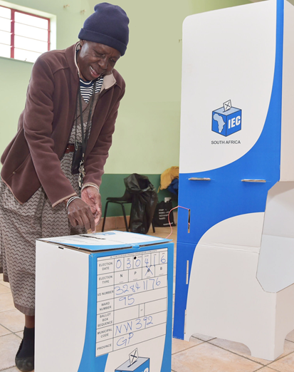
Electoral Operations
Management
Programme 2
Electoral Operations
Electoral Matters
Logistics & Infrastructure
Provincial &
Local Offices
Electoral Capacity
Building

Slide 27
PROGRAMME 2: ELECTORAL OPERATIONS
managing and delivering free and fair elections by striving for excellence at voting station level; ensuring accessibility and suitability of voting facilities and processes; managing results; maximising electoral justice for all stakeholders in the electoral process; enhancing the credibility of the voters’ roll; ensuring compliance with legal prescripts; and continuously improving the legislative framework.
Notes:
Photo by Albert Dera on Unsplash

Slide 28
PROGRAMME 2: ELECTORAL OPERATIONS
Sub-programmes
2.1 Electoral Operations
Management
2.2Electoral Matters
2.3 Logistics & Infrastructure
Electoral Matters facilitates the participation of voters in regular free and fair elections, using sustainable systems, people and processes. Activities included are the delimitation of election boundaries, maintenance of the national voters’ roll, and the planning and coordination of activities during registration weekends, on Election Day and special voting days, as well as for home visits.
Logistics and Infrastructure provides logistics, warehousing and distribution infrastructure such as voting stations and municipal electoral offices, electoral materials and equipment as specified in the bill of materials and voting station plans.
2.1 Electoral Operations Management provides the strategic management for Programme 2

Slide 29
PROGRAMME 2:ELECTORAL OPERATIONS
Sub-programmes
2.4 Local Offices
2.5 Electoral Capacity Building
2.4 Local offices provide for the resources and decentralised support costs in municipalities.
2.5 Electoral capacity building provides for the salaries, allowances and training costs of all categories of electoral staff. The staff structure is expanded significantly during election periods when additional resources are imperative for the delivery of the electoral programme to cope with the workload and difficult logistical arrangements.

Slide 30
Outcomes, outputs, performance indicators and targets for 2021
 |  |  |  | Audited/actual performance |  |  | Estimated performance | MTEF period
No. | Outcome | Outputs | Output indicators | 2016/17 | 2017/18 | 2018/19 | 2019/20 | 2020/21 | 2021/22 | 2022/23
2.1.1 | Free and fair elections of representatives delivered | Manage free and fair elections in accordance with the applicable electoral timetables to ensure the efficient and credible execution of the mandate of the Electoral Commission | Average number of calendar days within which elections are conducted from the date of the vacancy or the end of the term of office in each year covered by this plan | 76 days for LGE and 83 days for by- elections | 106 days for by-elections | 106 days for by-elections | Within 90 days for by- elections and for NPE 2019 | Within 90 days for by-elections | Within 90 days for by- elections and for LGE 2021 | Within 90 days for by- elections
2.1.2 |  |  | Average number of calendar days in which to fill proportional representation (PR) seat vacancies in each year | 9 days | 13 days | 19 days | Within 35 days | Within 35 days | Within 35 days | Within 35 days
2.1.3 |  |  | Number of calendar days in which election results for each election are announced by the Electoral Commission in each year | Within 7 days for LGE 2016 and within one day for all by- elections | 95 by- elections six days ahead of the deadline and 36 by- elections five days ahead of the deadline | 99 by-elections within one day and one by- election within five days | NPE and by-elections within 7 days | By-elections within 7 days | LGE and by-elections within 7 days | By-elections within 7 days
2.1.4 |  |  | Number of by-elections set aside each year 2 elections | 2 elections | 0 (None) | 2 elections | 0 (None) | 0 (None) | 0 (None) | 0 (None)
2.1.5 |  | Maintain a credible national common voters’ roll that is enabled by cutting- edge technology | Number of registered voters as at 31 March each year | 26 099 774 | 26 253 822 | 26 800 000 | 26 800 000 | 25 960 000 | 26 540 000 | 2 6180 000
2.1.6 |  |  | The number of registered voters who appear on the voters’ roll for whom the Electoral Commission does not have recorded addresses at 31 March each year covered by this plan. | New | New | 3 882 733 | 1 300 000 | 1 000 000 | 700 000 | 600 000
2.1.7 |  | Provide accessible voting facilities and comprehensive logistical resources at all voting stations to meet operational demands for main electoral events | Number of contracted voting stations in place on main registration weekends or general election days in the years when applicable | 22 612 | 22 617 | 22 924 | 23 000 | 23 200 | 23 200 | Not applicable in this year
13
Electoral Commission Annual Performance Plan 2020

Slide 31
Outcomes, outputs, performance indicators and targets for 2021
 |  |  |  | Audited/actual performance |  |  | Estimated performance | MTEF period
No. | Outcome | Outputs | Output indicators | 2016/17 | 2017/18 | 2018/19 | 2019/20 | 2020/21 | 2021/22 | 2022/23
2.1.8 |  | Provide accessible voting facilities and comprehensive logistical resources at all voting stations to meet operational demands for main electoral events | Electoral Materials to be delivered to all voting stations and voting streams for each main electoral event as required by the approved materials requirement plan and bill of materials. | 100% of 22 612 voting stations achievement | 100% of 22 617 voting stations achievement | 100% of 22 924 voting stations achievement | 100% of 23 000 voting stations achievement | 30 000 voting streams | 30 000 voting streams | Not applicable in this year
2.1.9 |  | Strive for excellence at voting station level to enhance the integrity of elections | Average number of registered voters per voting station stream during general election days. | New | New | New | New | N/A | 900 | Not applicable
2.1.10 |  |  | Number of electoral staff recruited and trained per annum | 262738 staff (58 001 for REG 2 and 204 737 for LGE 2016) | 67 289 | 68 276 | 208 000 | 68 000 | 208 000 | Not applicable in this year
13
Electoral Commission Annual Performance Plan 2020

Slide 32
Indicators, annual and quarterly targets
 |  | Quarterly targets
No. | Output indicators | Annual target | Quarter 1 | Quarter 2 | Quarter 3 | Quarter 4
2.1.1 | Average number of calendar days within which elections are conducted from the date of the vacancy or the end of the term of office in each year covered by this plan | Within 90 days | Within 90 days | Within 90 days | Within 90 days | Within 90 days
2.1.2 | Average number of calendar days in which to fill PR seat vacancies in each year | Within 35 days | Within 35 days | Within 35 days | Within 35 days | Within 35 days
2.1.3 | Number of calendar days in which elections results for each election are announced by the Electoral Commission in each year | Within 7 days | Within 7 days | Within 7 days | Within 7 days | Within 7 days
2.1.4 | Number of by-elections set aside each year | 0 (None) | 0 (None) | 0 (None) | 0 (None) | 0 (None)
2.1.5 | Number of registered voters as at 31 March each year | 25 960 000 | 0 (None) | 0 (None) | 0 (None) | 25 960 000
2.1.6 | Number of registered voters who appear on the voters’ roll for whom the Electoral Commission does not have recorded addresses at 31 March for each year covered by this plan | 1 000 000 | 0 (None) | 0 (None) | 0 (None) | 1 000 000
2.1.7 | Number of contracted voting stations in place on main registration weekends or general election days in the years when applicable | 23 200 | 0 (None) | 0 (None) | 0 (None) | 22 924
2.1.8 | Electoral Materials to be delivered to all voting stations and voting streams for each main electoral event as required by the approved materials requirement plan and bill of materials. | 30 000 voting streams | 0 (None) | 0 (None) | 0 (None) | 30 000 voting streams
2.1.9 | Average number of registered voters per voting station stream during general election days. | 930 | 0 (None) | 0 (None) | 0 (None) | 930
2.1.10 | Number of electoral staff recruited and trained per annum | 68 000 | 0 (None) | 0 (None) | 0 (None) | 68 000
13
Electoral Commission Annual Performance Plan 2020

Slide 33
Outreach
Management
Programme 3
Outreach
Communications
Education & Research
Stakeholder Relations Management

Slide 34
PROGRAMME 3: OUTREACH
Informing and engaging citizens and stakeholders in electoral democracy.
The programme fosters participation in electoral democracy by:
providing civic and democracy education on a continuous basis;
voter and balloting education as may be required by each election;
strategic and thought leadership on matters pertaining to electoral democracy;
broadening our research agenda and issuing publications;
increasing visibility through proactive consultation, effective communication, and presence among our stakeholders and communities;
facilitating platforms for political dialogue;
cultivating an environment conducive for the holding of free and fair elections; and constantly engaging the media.
Notes:
Photo by Albert Dera on Unsplash

Slide 35
PROGRAMME 3: OUTREACH
Sub-programmes
3.1 Outreach Management
3.2 Education & Research
Education and Research imparts the knowledge, teaches the skills and nurtures the attitudes and values that enable as many citizens as possible to access the opportunities presented by a participatory democracy.
Research optimises the available data in order to inform organisational planning and other decision-making processes. It tracks emerging trends (perceptions and attitudes) in the social context that assist the Electoral Commission to determine its response. It also considers the latest developments in democratic election administration.
Outreach Management provides the strategic management for Programme 3.
.

Slide 36
PROGRAMME 3: OUTREACH
Sub-programmes
3.3 Communications
3.4 Stakeholder Relations Management
Communications actively manages the reputation of the Electoral Commission as a trusted body for managing free, fair and credible elections. It further enhances and supports the Electoral Commission’s education and research agendas through strategic communication with the Electoral Commission’s stakeholders, including political parties..
Stakeholder Relations Management engages and liaises with a set of stakeholders nationally and internationally in order to promote knowledge of and adherence to democratic electoral principles and promotes collaboration with the same when necessary.

Slide 37
Outcomes, outputs, performance
indicators and targets for 2021
 |  |  |  | Audited/actual performance |  |  | Estimated performance | MTEF period
No. | Outcome | Outputs | Output indicators | 2016/17 | 2017/18 | 2018/19 | 2019/20 | 2020/21 | 2021/22 | 2022/23
3.1.1 | Informed and engaged citizens and stakeholders in electoral democracy | Provide impactful and visionary research and thought leadership to strengthen electoral democracy. | The number of research initiatives achieved per annum | 4 | 4 | 4 | 4 | 3 | 3 | 3
3.1.2 |  |  | The number of thought leadership interactions achieved per annum | New | New | New | New | 10 | 10 | 10
3.1.3 |  | Actively promote and foster awareness and participation in electoral processes through civic and democracy education programmes. | Audience reached by civic and democracy education (CDE) programmes through television, radio and YouTube in each year covered by the Annual Performance Plan | 8 275 432 viewers and listeners (1 505 432 according to TAMS and 6 770 000 according to RAMS) | Not applicable in 2017/18 | Overall 7 659 980 (6 682 000 RAMS and 977 980 TAMS) | Overall 5 000 000 (2 000 000 TAMS and 3 000 000 RAMS) | Overall 7 000 000 (2 600 000 TAMS and 4 400 000 RAMS and zero hits) | Overall 6 400 0000 (2 400 000 TAMS and 4 000 000 RAMS and 2,5 million hits) | Overall 5 000 000 (2 000 000 TAMS and 3 000 000 RAMS and 1 million hits)
3.1.4 |  |  | The number of face-to-face CDE events held per annum | 48 449 | 48 449 | 82 388 | 15 000 | 55 000 | 65 000 | 55 000
3.1.5 |  | Interact with domestic, regional and international stakeholders to build an understanding of the Electoral Commission’s role in delivering credible elections. | Number of meetings Commissioners hold with key stakeholders per annum | New | New | New | New | 10 | 15 | 10
3.1.6 |  |  | Number of interactions or liaisons internationally achieved per annum | 20 | 30 | 20 | 20 | 20 | 20 | 20
13
Electoral Commission Annual Performance Plan 2020

Slide 38
Outcomes, outputs, performance
indicators and targets for 2021
 |  |  |  | Audited/actual performance |  |  | Estimated performance | MTEF period
No. | Outcome | Outputs | Output indicators | 2016/17 | 2017/18 | 2018/19 | 2019/20 | 2020/21 | 2021/22 | 2022/23
3.1.7 | Informed and engaged citizens and stakeholders in electoral democracy | Advance and promote electoral processes through communication campaigns on diverse platforms to sustain visibility across the electoral cycle. | Public perception of the Electoral Commission held as evidenced by media reports for each year covered by this plan | 92.27% neutral/ positive achievement | 98.3% neutral/ positive achievement | 97% neutral/ positive achievement | 80% neutral/ positive achievement | 80% neutral/ positive achievement | 80% neutral/ positive achievement | 80% neutral/positive achievement
3.1.8 |  |  | Recorded reach across multimedia communications platforms (digital, television, print, radio and out-of- home) | New | New | New | New | Digital (all social media and online content: Facebook ad reach – 35 million impressions Twitter ad reach – 2 million YouTube ad views – 2 million WhatsApp – New Google Adwords – 1 million impressions SMSs sent – million Please Call Me – 100 million Television: 600 000 viewers Radio: 4 400 000 listeners Print: 6 million readers Out of home (150 billboards, 180 000 street pole posters, 2 000 transit TV screens, commuter transport – 20 long- distance buses | Digital.(all social media and online content: Facebook ad reach – 35 million impressions Twitter ad reach – 2 million YouTube ad views – 2 million WhatsApp – New Google Adwords – 1 million impressions SMSs sent – million Please Call Me – 100 million) Television: 400 000 viewers Radio: 4 000 000 listeners Print: 6 million readers Out of home (150 billboards, 180 000 street pole posters, 2 000 transit TV screens, commuter transport –- 20 long- distance buses | This a non-election year. No campaigns are planned.
13
Electoral Commission Annual Performance Plan 2020

Slide 39
Indicators, annual
and quarterly targets
 |  | Quarterly targets
No. | Output indicators | Annual target | Quarter 1 | Quarter 2 | Quarter 3 | Quarter 4
3.1.1 | The number of research initiatives achieved per annum | 3 |  |  |  | 3
3.1.2 | The number of thought leadership interactions achieved per annum | 10 |  |  |  | 10
3.1.3 | Audience reached by CDE programmes through television, radio and YouTube in each year covered by the Annual Performance Plan | Overall: 7 000 000 (2 600 000 TAMS, 4 400 000 RAMS and 0 hits) |  |  |  | Overall: 7 000 000 (2 600 000 TAMS, 4 400 000 RAMS and 0 hits
3.1.4 | The number of face-to-face CDE events held per annum | 55 000 | 3 000 | 3 000 | 9 000 | 40 000
3.1.5 | Number of meetings Commissioners hold with key stakeholders per annum | 10 | 2 | 2 | 3 | 3
3.1.6 | Number of interactions and liaisons internationally achieved per annum | 20 | 5 | 10 | 15 | 20
3.1.7 | The extent to which media reports indicate positive/neutral public perception of the Electoral Commission in each year covered by this plan. | 80% neutral/positive achievement | 80% neutral/positive achievement | 80% neutral/positive achievement | 80% neutral/positive achievement | 80% neutral/positive achievement
3.1.8 | Recorded reach across multimedia communication platforms (digital, television, print, radio and out-of- home) | Digital: all social media and online content: Facebook ad reach – 35 million impressions Twitter ad reach – 2 million YouTube ad views – 2 million WhatsApp – New Google Adwords – 1 million impressions SMSs sent – 1 million Please Call Me – 100 million Television: 2 600 000 viewers Radio: 4 400 000 listeners Print: 6 million readers Out of home: 150 billboards, 180 000 street pole posters, 2 000 transit television screens commuter transport – 20 long-distance buses |  |  |  | Digital: all social media and online content: Facebook ad reach – 35 million impressions Twitter ad reach – 2 million YouTube ad views – 2 million WhatsApp – New Google Adwords – 1 million impressions SMSs sent – 1 million Please Call Me – 100 million Television: 2 600 000 viewers Radio: 4 400 000 listeners Print: 6 million readers Out of home: 150 billboards, 180 000 street pole posters, 2 000 transit television screens commuter transport – 20 long-distance buses
13
Electoral Commission Annual Performance Plan 2020

Slide 40
Programme 4
Party Funding

Slide 41
PROGRAMME 3: OUTREACH
This programme focuses on the strategic outcome of contributing to the enhancement of transparency in elections and party funding. The programme manages party funding and donations in compliance with legislation, and strengthens cooperative relationships by providing consultative and liaison platforms between the Electoral Commission and political parties and candidates, using systems, people and processes that are sustainable. It also provides effective management of the registration of political parties and processing of the nomination of candidates for various electoral events.
Notes:
Photo by Albert Dera on Unsplash

Slide 42
PROGRAMME 4: PARTY FUNDING
Sub-programmes
Due to the fact that this is a new unit within the Electoral Commission, which is still in its infancy, the sub-programmes for the unit have not yet been finalised. Liaison with National Treasury in this regard is ongoing and will be finalised during the 2021 MTEF budget programme structure review process.

Slide 43
Outcomes, outputs, performance indicators and targets for 2021 |  |  |  | Audited/actual performance |  |  | Estimated performance | MTEF period
No. | Outcome | Outputs | Output indicators | 2016/17 | 2017/18 | 2018/19 | 2019/20 | 2020/21 | 2021/22 | 2022/23
4.1.1 | Contributed to the enhancement of transparency in elections and party funding | Manage party funding and donations in compliance with relevant legislation | Number of disbursements to represented parties per annum | New | New | New | New | At least 4 – one per quarter | At least 4 – one per quarter | At least 4 – one per quarter
4.1.2 |  | Provide consultative and cooperative liaison platforms between the Electoral Commission and political parties and candidates to facilitate free and fair elections. | Number of liaison sessions held with members of party liaison committees at national (1), provincial (9) and municipal (213) levels per annum | 1 937 liaison sessions 17 national, 57 provincial and 1 863 local | 1 285 liaison sessions 7 national, 47 provincial and 1 231 local | 2 084 liaison sessions 9 national, 59 provincial and 2 016 local | 1 338 liaison sessions | 1 338 liaison sessions | 1 784 liaison sessions | 1 784 liaison sessions
4.1.3 |  |  | Number of cooperative liaison forums conducted with political parties and candidates at national (1) and provincial (1) levels per annum | New | New | New | New | 10 | 10 | 10
4.1.4 |  | Provide effective management of the registration of political parties to strengthen multi-party democracy | Number of registered political parties as at 31 March of each year covered by this plan | New | New | New | New | 100% of all new applications that meet the requirements of the Act | 100% of all new applications that meet the requirements of the Act | 100% of all new applications that meet the requirements of the Act

Slide 44
Indicators, annual and quarterly targets |  | Quarterly targets
No. | Output indicators | Annual target | Quarter 1 | Quarter 2 | Quarter 3 | Quarter 4
4.1.1 | Number of disbursements to represented parties per annum | 4 | At least 4 – one per quarter | At least 4 – one per quarter | At least 4 – one per quarter | At least 4 – one per quarter
4.1.2 | Number of liaison sessions held with members of party liaison committees at national (1), provincial (9) and municipal (213) levels per annum | 1 338 | 335 | 334 | 335 | 334
4.1.3 | Number of cooperative liaison forums conducted with political parties and candidates at national (1) and provincial (1) levels per annum | 10 |  |  |  | 10
4.1.4 | Number of registered political parties as at 31 March of each year covered by this plan | 100% of all new applications that meet the requirements of the Act |  |  |  | 100% of all new applications that meet the requirements of the Act

Slide 45
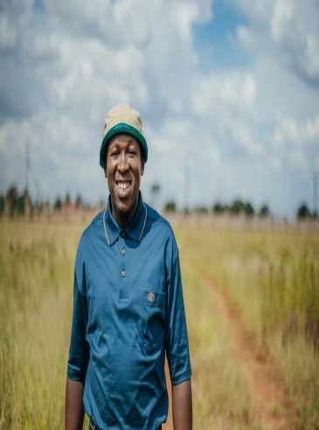
BUDGET

Slide 46
MTEF ANNUAL PROJECTIONS
R2,399
2019/20
2020/21
2021/22
2021/23.
1 REG LGE
REG +
LGE
NON-ELEC
NPE
R2,545
R2,233
R2,487
Notes:
https://unsplash.com/

Slide 47
Budget: Programme 1
Sub-programmes (R’000) | 2019/20 | 2020/21 | 2021/22 | 2022/23
Management | 23 815 | 24 966 | 25 603 | 25 978
Corporate Services Management | 3 141 | 3 408 | 3 650 | 3 906
Financial Management | 91 416 | 95 263 | 103 265 | 108 110
Human Resources Management | 84 889 | 76 289 | 78 967 | 86 291
Legal Services | 22 543 | 19 544 | 28 836 | 24 062
Internal Audit | 19 859 | 20 967 | 21 449 | 22 715
ICT | 272 373 | 247 138 | 284 252 | 295 318
Facilities Management | 59 531 | 42 606 | 60 917 | 45 844
Risk Management | 1 865 | 2 021 | 2 160 | 2 308
Accommodation | 140 940 | 151 486 | 165 840 | 174 181
Total for sub-programmes | 720 372 | 683 688 | 774 939 | 788 713
The budget allocation under this programme is directed at supporting the strategic management and core business of the Electoral Commission. The programme is largely made up of ICT costs and office accommodation . ICT is made up mainly of professional services to maintain the security and integrity of the data held at the IEC and office accommodation consists of the cost of the National IEC head office & nine provincial offices.
.
Notes:
Photo by Marius Ciocirlan on Unsplash

Slide 48
Budget: Programme 1
Economic Classification of Administration

Slide 49
Budget: Programme 2
Sub-programmes (R’000) | 2019/20 | 2020/21 | 2021/22 | 2022/23
Electoral Operations Management | 6 366 | 4 306 | 8 538 | 3 804
Electoral Matters | 136 189 | 83 363 | 126 030 | 89 212
Logistics and Infrastructure | 207 262 | 132 394 | 347 444 | 86 194
Political Parties | 51 838 | 3 345 | 26 540 | 26 800
Provincial and Local Offices | 485 645 | 527 419 | 564 338 | 600 973
Electoral Capacity Building | 357 604 | 369 793 | 338 937 | -
Total | 1 244 904 | 1 120 620 | 1 411 827 | 806 983
Expenditure under this programme increases significantly in an election year compared to a non-election year. During the 2020/21 financial year, expenditure for one main registration drive will be incurred with the actual registration weekend being in the first week of April 2021. Thus, expenditure for this registration weekend will be largely incurred in the 2020/21 financial year. New voter registration devices will also be procured in 2020/21 which has been included in programme 2.
.
Notes:
Photo by Marius Ciocirlan on Unsplash

Slide 50
Budget: Programme 2
Economic classification of Electoral Operations

Slide 51
Budget: Programme 3
Sub-programmes (R’000) | 2019/20 | 2020/21 | 2021/22 | 2022/23
Outreach Management | 5 180 | 5 121 | 5 486 | 5 870
Civic and Democracy Education and Research | 108 656 | 112 389 | 154 178 | 89 154
Communications | 75 895 | 100 830 | 113 566 | 17 483
International Liaison | 6 070 | 3 500 | 3 500 | 3 600
Total for sub-programmes | 195 801 | 221 840 | 276 730 | 116 107
Budget allocation under this programme is directed at informing and educating civil society on democracy and electoral processes. Expenditure peaks during registration and election periods when CDE and communication programmes peak. A further factor is the international observer missions that are hosted by Commission Services during these periods.
.
Notes:
Photo by Marius Ciocirlan on Unsplash

Slide 52
Budget: Programme 3
Economic Classification of Outreach

Slide 53
Budget: Programme 4
The Electoral Commission was allocated additional funding of R50 million in the 2019/20 financial year for the establishment of the new party funding unit. These funds were allocated to cover costs for both 2019/20 and 2020/21.
Of this R50 million, it is estimated that approximately R38 million will be rolled-over to fund the unit in 2020/21. The expenditure used to date has been for ICT systems implementation, staff costs and research and development of the unit.
The budget structure with sub-programmes is being drafted and will be submitted to National Treasury for approval during the 2021 MTEF process and the related indicators and targets in the amended APP.
.
Notes:
Photo by Marius Ciocirlan on Unsplash

Slide 54
Thank You
Notes:
Photos by unsplash

