Slide 1


Slide 2

Improving lives through data ecosystems
VISION

Slide 3

Transform
the production, coordination and use of statistics
through
optimisation, partnerships and innovation
MISSION

Slide 4
Strategic thrust
10 years +
5-10 years
2-5 years
1-2 years
Tactics
Strategy
Vision
Systems-level evolution
Thrust:
Optimise
Innovate
Partner
Diversify

Slide 5

an ecosystem that is powered by
Agile operating model
Transformed capabilities
Insightful data
Inter-connected statistical systems
Value add services
Business operating model
Data eco-system
New business model

Slide 6
Insightful data
By 2025 we serve users’ basic demands on an online self-service platform
Objectives
Year 1
Sustain the quality of national indicators
Rebasing GDP
Conduct Income and Expenditure Survey
Publish National Household Travel Survey
Conduct Census 2021 Pilot
Put stakeholders at the centre to increase trust and use
Roll out branding strategy
Revamping website
Deepen statistical analysis for better insights
Limited integrative and thematic reports (Year 1) – scale-up over 5 years
Explore the use of alternative data sources by harnessing and unlocking data in the ecosystem
Introduce limited research (Year 1) -
scale-up over 5 years

Slide 7

By 2025 efficiencies in the business operating model are underpinned by innovative methodologies
Agile operating model
Objectives
Year 1
Modernise and innovate business processes to improve efficiencies
Optimise business processes through automation
CAPI (TO-BE) business processes improved
Final testing of CAPI/CATI/CAWI in Census Pilot
Adopt/adapt international frameworks and standards to improve statistical practices
ISIC4: commence with reclassification of the Business Register
Leverage statistical infrastructure within the data ecosystem
Establish and maintain a Geo-Statistical analytics platform
Introduce dashboard reporting for GIF updates
Reposition and strengthen methodology function within the statistical system
Establish Innovation and Research Hub

Slide 8

By 2025 statistical systems are connected through statistical principles, standards and frameworks
Inter-connected statistical systems
Objectives
Year 1
Implement and enforce the amended Statistics Act
Draft Bill tabled in Parliament
Standardise methodological frameworks across the statistical system to enhance the comparability
SASQAF Online Self-Assessment Tool
Updated Integrated Indicator Framework
Expand the stock of alternative data sources to inform the IIF through strategic partnerships
No target for Y1
Envision and enable statistics in the data ecosystem
Develop concept note on the data ecosystem

Slide 9




By 2025 we have adopted agile technologies and built a diverse, skilled and versatile workforce that embrace change and are able to deliver innovative solutions
Transformed capabilities
Objectives
Year 1
Invest in innovative technologies and ICT infrastructure to enable an agile business operating model
Roll out Enterprise-wide architecture
Systems development applications (CAPI/CAWI)
Build a versatile and multi-skilled workforce to drive value in the data ecosystem
Develop Skills development strategy for the future
Leading transformation and change
Data analytics and data science
Technology
Invest in capacity building in the data ecosystem
Invest in capacity building in Municipalities
Build a united and diverse organisation that drives transformation and change
Implement phase 1 of restructuring
Redeployment of staff
Re-align Transformation and Change Agenda

Slide 10

Impact of COVID-19 on Stats SA
1
Impact on work programme
Targets in the work programme have already been affected
Will need to reprioritise activities, resources and funding
Impact on processes and methodologies
Data collection in the field (will not resume soon) – alternative approaches will be deployed where possible e.g. CATI and CAWI
Data collection from businesses (only if business return to work)
Impact on staff
SMS staff are working from home
Some professional and technical staff are working from home
Data collectors – cannot work from home (due to tools and accessibility)
Essential staff are working either from home or office
Impact on strategic plan
Disruption has been identified during strategy process
COVID-19 offers opportunities to fast track strategic intent e.g. alternative methodologies and technologies
2
3
4

Slide 11
Response to emerging data needs
1
Leading Data and statistics workstream at FOSAD
Launched online: Business impact survey of COVID-19 pandemic in South Africa
Businesses were asked how the current crisis affected their operations in the two-week period from 30 March to 13 April 2020
Survey will be repeated during lockdown
Launched Essential Products Consumer Price Index
Launched online survey: Impact of COVID-19 on society
1st wave: Health behaviour and perceptions
2nd wave: Employment and Income (incl. hunger)
3rd wave: Education and time spent
2
3
4

Slide 12

85,4% of businesses had turnover that was lower than their normal range
Percentage of businesses in each industry by turnover range
Note: Micro businesses (with an annual turnover below R2 million) were not included in the survey.
Results are based on the perceptions of respondents, and interpretation is based on limited responses.
Results only relate to businesses that responded to the survey.

Slide 13
46,4% of businesses have temporarily closed during the pandemic
Percentage of businesses in each industry by current trading status

Slide 14
85,4% of businesses had turnover that was lower than their normal range
Percentage of businesses in each industry by turnover range

Slide 15
46,4% of businesses have temporarily closed during the pandemic
Percentage of businesses in each industry by current trading status

Slide 16
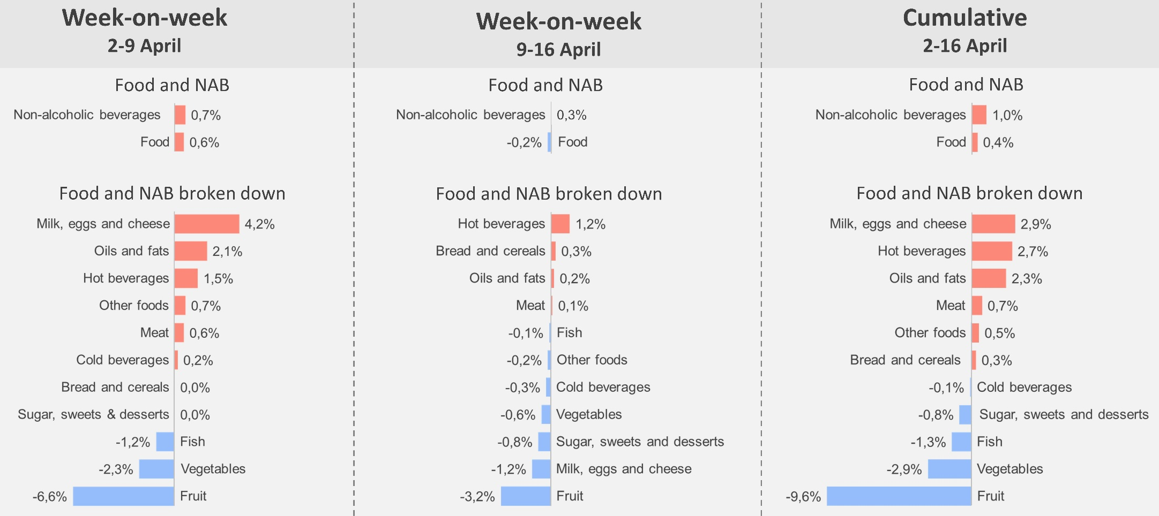
Results: Percentage change in prices
Week-on-week
2-9 April
Week-on-week
9-16 April
Cumulative
2-16 April

Slide 17

Strategic risks
1
DEMAND
1
2
BUDGET
Demand for statistical information growing
National/local
Continental
Global
Other
Budget for keeping the ship afloat
Financial investment in business transformation
4
2
4
SUPPLY
3
3
PEOPLE
COVID-19 disruptions: new technologies and methodologies – not tested
New entrants to the market
New partnerships
Skills requirement for the future
Impact of digital transformation

Slide 18
Strategic Priorities
1
Sustain and protect the quality of national indicators
2
Drive business transformation and change
3
Drive Legislative reform in the statistical system

Slide 19
Ndzi Hela Kwala!

