Slide 1
REPORT ON THE
Institutionalisation and Roll-out of the
District Development Model

Slide 2
Decisions of Presidential Coordinating Council
  IMPLEMENTING
  shared
  services to provide hands on support
  All spheres of government
  IMPLEMENTING
  the District Development Model
LAUNCH
District Development Model in the 3 pilots
  NOMINATING
  district political champions to oversee and support the implementation of the District Development Model
  DEVELOP
  One Plan, One Budget
  for all districts

Slide 3
Objectives of the District Development Model
The objectives of the Development Model (DDM) are as follows:
Solve the Silos at a horizontal and vertical level.
Maximise impact and align plans and resources at our disposal through the development of “One District, One Plan and One Budget”.
Narrow the distance between people and government by strengthening the coordination role and capacities at the District and City levels.
Ensure inclusivity by gender budgeting based on the needs and aspirations of our people and communities at a local level.
Build government capacity to support to municipalities.
Strengthen monitoring and evaluation at district and local levels.
Implement a balanced approach towards development between urban and rural areas.
Ensure sustainable development whilst accelerating initiatives to promote poverty eradication, employment and equality.
Exercise oversight over budgets and projects in an accountable and transparent manner.

Slide 4
District Development Model
Objectives
District/Metro Impact Oriented Planning, Budgeting, Implementation
Overcome current Pitfalls and Misalignments (for example):
Build correct number of schools according to where the population is (schools per population density)
Build schools in the correct locations
Determine whether we need new schools or better transport systems
Ensure schools have all basic services (water, sanitation, electricity, waste management , roads)
All Plans and Budgets follow agreed projections, targets and sustainable spatial growth patterns of districts and metros

Slide 5
District Development Model Outcomes
Communities Experience Seamless and Consistent service delivery
Communities Experience living in functional and vibrant places
All Plans and Budgets across State based on shared understanding of district / metro challenges, dynamics and opportunities using IDPs and SDFs as the base
All Plans and Budgets follow agreed projections, targets and sustainable spatial growth patterns of districts and metros
Capable, Ethical Developmental State
Improved State and Local Government Performance
Improved Cooperative Governance
District/Metro Impact Oriented Planning, Budgeting, Implementation

Slide 6
District Development Model
Outcomes
Local Government is base for building shared understanding of District/Metro Space
Localise NDP and MTSF Priorities
No parachuting of National and Provincial programmes outside of One Plan and LG consultation
NDP
Tackle Triple Challenges:
Unemployment
Poverty
Inequality
MTSF
Seven (7) priorities:
Transformation of the economy and job creation
Education, skills and health
Reliable and quality basic services
Spatial integration, human settlements and local government
Social cohesion and safe communities
Capable, ethical and developmental State
A better Africa and World

Slide 7
District Development Model
One Plan
A Strategic Framework to guide all state and private investment within the district/metro area
Not a detailed plan covering all departmental and municipal responsibilities
Developed through a collaborative process
Based on a shared understanding of the district/metro space
Outlines common vision and desired future outcomes
Outlines Key Commitments and targets
Adopted as an IGR and Social Compact

Slide 8
Progress on the launching of the District Development Model
DURATION | PROGRESS
Sep – Nov 2019 | Development of profiles for the 3 pilot sites Listing of national sector projects, spatially referenced budgets
Sep – Nov 2019 | Launched in the 3 pilots
Jan 2020 | Launch Narysec training programme
Feb 2020 | Extended PCC with district and metros on DDM
March 2020 | Draft Profiles developed
March 2020 | District Political Champions nominated

Slide 9

Lessons Learnt: Government investment in pilots
PROVINCIAL
43%
TOTAL 19/20 FY
NATIONAL
R71.648 billion
48%
R16.7 (23.3%)
LOCAL
R40.4 (56.4%)
9%
District | National | Province | Local | Total
OR Tambo | R5.2 bn | R5.4 bn | R648 m | R11.2 bn
eThekwini | R17.1 bn | R10.4 bn | R7.8 bn | R35.3 bn
Waterberg | R18.1 bn | R922 m | R6.1 bn | R46.2bn
R14.55 (20.3%)
Notes:
Since the adoption of the DDM by the PCC on 20 August 2019 and the endorsement by Cabinet on the 21st August 2019, the profiles of the three pilot sites have been concluded. Thus, providing a holistic view of the challenges and public sector investments in the three pilot sites, which totals R71.648 billion, with R11.2 billion in OR Tambo, R25.23 in Waterberg, and R35.3 in eThekwini.
The national, provincial and local government investments mirror the DORA allocations with national investing about 56.4%, provincial 23.3% and 20.3%. However, given that in line with DORA the provincial government receives about 43% of the budget allocations, it may have to invest more into the districts and metro.

Slide 10





Cross-cutting Lessons from Pilots: Socio-economic
YOUTH UNEMPLOYMENT
WOMEN-HEADED
HOUSEHOLDS
CHILD-HEADED HOUSEHOLDS
DISINTEGRATION
SOCIAL FABRIC
LOW ECONOMIC GROWTH
RURAL TO URBAN MIGRATION

Slide 11
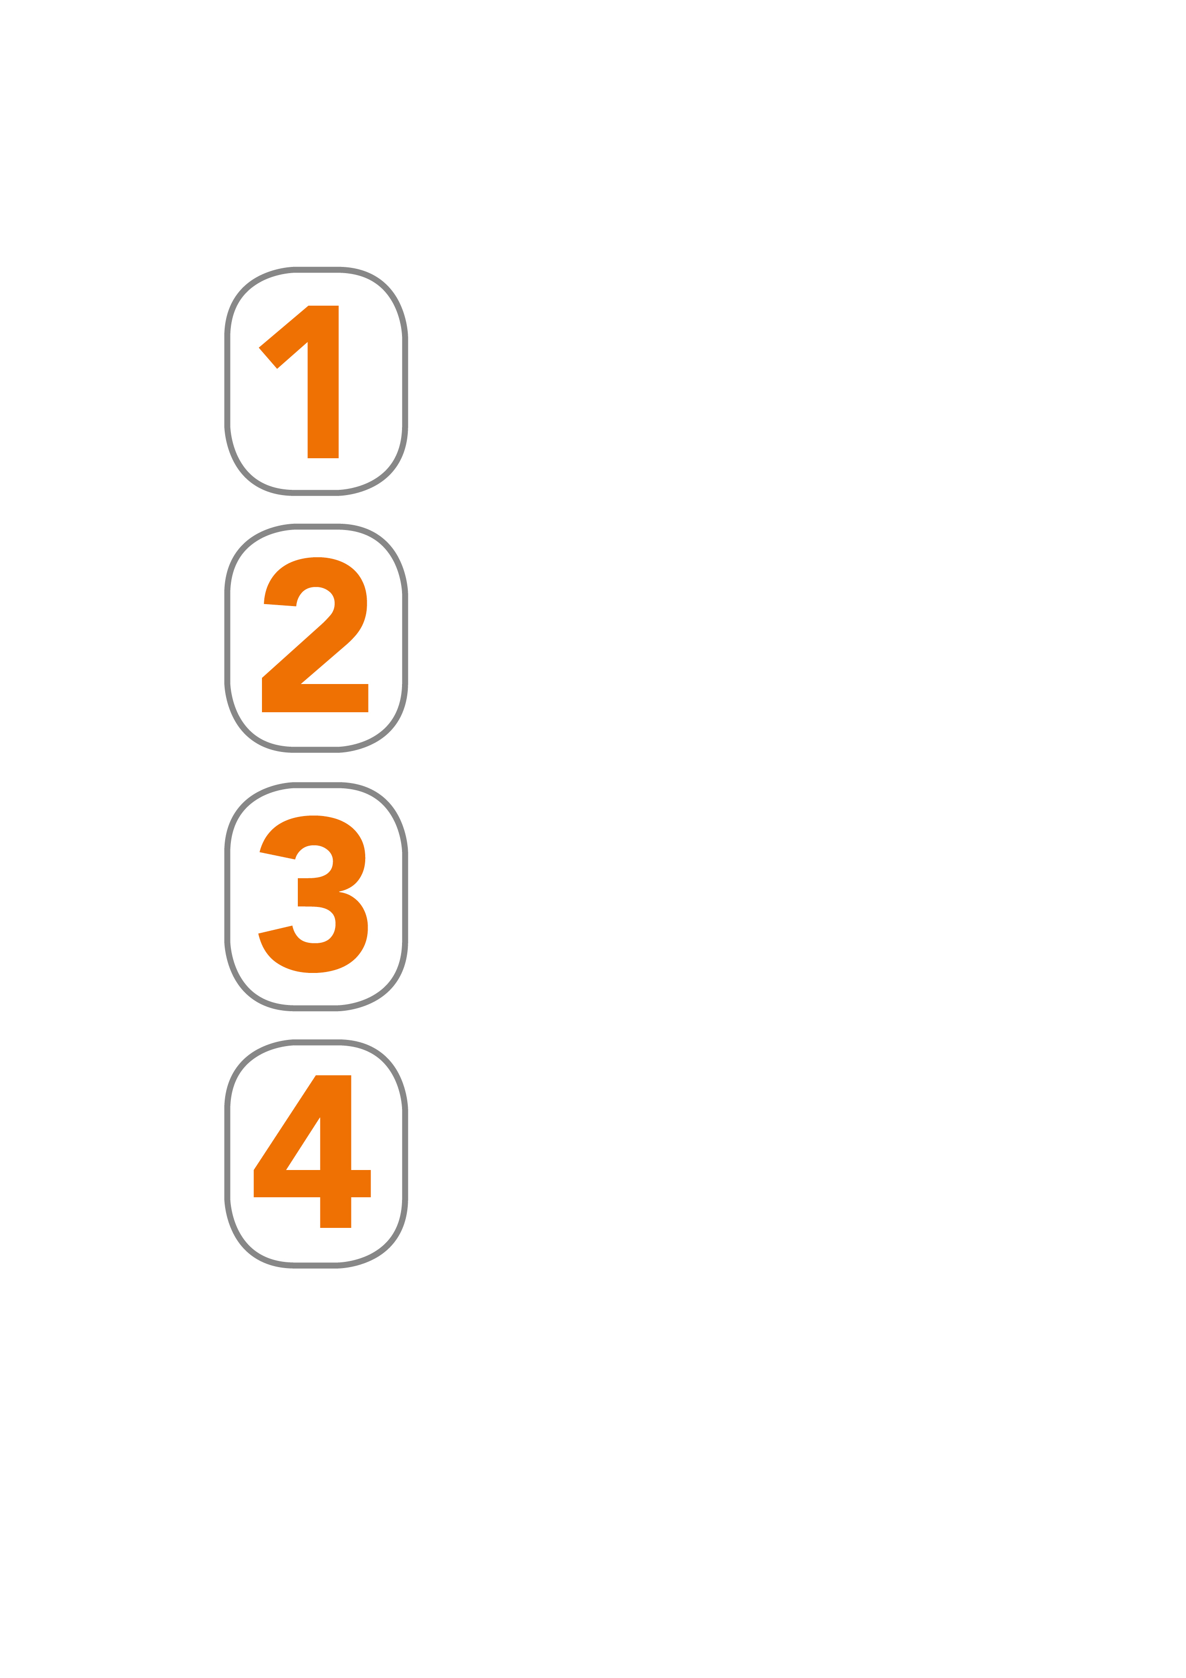
Cross-cutting Lessons from Pilots: Growth potential
Opportunities not used to grow local economies:
Agriculture potential for job creation
Tourism not unlocked
No clear strategy blue economy potential
No specialised learning institutions for economy support:
OR Tambo/eThekwini: agriculture, tourism, oceans economy
Waterberg: mining, agriculture and tourism
No proper LED frameworks, programmes only eThekwini
Poor linkage with national economic strategies

Slide 12
Cross-cutting Lessons from Pilots: Institutional
Most projects not spatially mapped
Strengthen our data gathering and research capabilities
There are skills gaps
in specific areas
of expertise
Poor integration, coordination of programmes/projects
Unclear on
the rationale of
the projects
Sector departments
do not collaborate

Slide 13
DDM: Institutional Arrangements
    5-pronged approach
    To institutionalise the District Development Model
The five-pronged approach towards institutionalizing the District Development Model are:
Political leadership
Intergovernmental Planning, Implementation and Budgeting processes
Intergovernmental Relations Structures that will monitor and report on the performance of the state overall, and in any given district.
DDM Information System/Dashboard
Legal and Policy Reforms

Slide 14

DDM: Institutional Arrangements
        Providing
        political leadership, capacity
  The President will deploy Ministers and Deputy Ministers as champions to each district and metro during implementation of the District Development Model.
  In provinces, the Premier and MECs should also be allocated to districts to work closely with Ministers that will be deployed.
    5-pronged approach
    To institutionalise the District Development Model

Slide 15
DDM: Institutional Arrangements
        Intergovernmental Planning, Implementation, Budgeting processes
  Alignment of the One Plans with Integrated Development Plans of Municipalities and COVID-19 Response Plans
  Alignment of One Plans of the 52 district spaces with provincial plans, the MTSF and the MTBF.
  This alignment process must be underpinned by a collaborative and intergovernmental process
    5-pronged approach
    To institutionalise the District Development Model

Slide 16
DDM: Institutional Arrangements
    Intergovernmental Relations Structures
    to monitor
    state performance
  Use IGR Structures for Coordination:
    President’s Coordinating Council;
    Premier’s Coordinating Forums;
    District Hubs to serve as the nucleus for intergovernmental coordination within the district spaces;
    Shared Services will provide hands-on support to districts and metros
    Align COVID-19 coordinating structures where possible
    5-pronged approach
    To institutionalise the District Development Model

Slide 17
DDM: Institutional Arrangements
        DDM Information System/Dashboard
  Overlay the profiles of 52 sites and the One Plans
  Overlay COVID-19 hotspots and epicentres
  Information system will be used for monitoring and reporting
  It will have a dashboard capabilities
    5-pronged approach
    To institutionalise the District Development Model

Slide 18
DDM: Institutional Arrangements
5
    Legal and Policy Reform
  COGTA will promulgate regulations in terms of Section 47 of the Intergovernmental Relations Framework Act.
  Review the local government planning system in the Municipal Systems Act.
  Rationalisation of the planning instruments
    5-pronged approach
    To institutionalise the District Development Model

Slide 19
District Development Model: Medium-Term Roadmap
Now to August 2020
Review, re-think and fast track implementation
Review the current DDM implementation plan
Update and finalize Profiles (national and provincial sector projects and budgets)
Include district and provincial COVID-19 response plans in the DDM implementation process
Development of One Plans
Establishment of shared services
Establishment of district hubs

Slide 20
Alignment of DDM and COVID-19
Overarching Approach:
COVD-19 response and recovery to be driven through and coordinated district and metro spaces and
Apply a differentiated district based approach to COVID response
Specific Interventions:
Collect spatial data in districts and metros on hotspots/epicentre
Spatially map infections, spread, quarantine sites, public spaces and any other critical intelligence within a district/metro to inform responses (Level 1 – 5)
Develop district and metro based response strategies and interventions
Develop COVID-19 inclusive One Plans that coordinates government and private sector programmes and responses over the short, medium and long term aimed at saving lives and economic recovery
Develop and implement district based budgets informed by the COVID-19 One Plans

Slide 21
COGTA - COVID-19 coordination
The COGTA Minister, Dr Dlamini Zuma, issued Regulations regarding the steps necessary to prevent an escalation of the disaster or to alleviate, contain and minimise the effects of the disaster.
The following structures were established for the purposes of coordinating and guiding government response to the pandemic by all spheres of government and the society:
  National Coronavirus Command Council (NCCC) chaired by the President
  Provincial Coronavirus Command Council (NCCC) Chaired by the Premiers
  District Coronavirus Command Council (NCCC) chaired by Mayors
  The following operational structures were also established to coordinate mitigation efforts:
  National Disaster Operations Centre (NDOC)
  Provincial Disaster Operations Centre (PDOC)
  District/Metro Disaster Operations Centre (PDOC)
The NATJOINTS has also been established to provide overall coordination of the response to COVID-19 and provide regular reports to the NCCC. In the same way the ProvJoints chaired by the Security cluster have been established and these report to the NATJOINTS

Slide 22
COGTA - COVID-19 coordination
The NATJOINTS Committee meets daily and processes progress reports from the various work streams. The NATJOINTS Committee also coordinates all the 9 PROVJOINTS and operates through a number of Workstreams were COGTA is presented have been established as follows:
  Intelligence Coordinating Committee;
  Public Health Infections Containment ;
  Economic Workstream;
  Legal Workstream; and
  Social Impact Workstream Ports of Entry
COGTA’s Key Areas of Work:
Quarantine sites - Identification, assessment and activation (working with the Depts of Public Works, Health and Human Settlements).
Temporary Homeless shelters – Development of standards, identification and activation, including post-lockdown protocols (working with DSD)
Disinfection of Public Facilities - Development of a Roll-out Plan Public for cleaning and disinfection of places during and post-lockdown (with Dept of Health)
Regulations – Development of regulations to support curbing the spread of COVID-19

Slide 23
COGTA - COVID-19 coordination
Coordination of service delivery and infrastructure delivery interventions with specific emphasis on:
Identification of critical infrastructure to address the COVID19 pandemic
Mobilisation of resources through the reprioritization and repurposing of existing grants (MIG, Disaster Relief Grants)
Mobilisation of resources through partnerships and donors
Acceleration of infrastructure delivery through MISA in collaboration with DWS
Developed Economic Recovery Strategy – Stimulus Package ( R20 billion)

Slide 24
THANK YOU

