Slide 1
PRESENTATION TO PORTFOLIO COMMITTEE 2020-2025 Strategic Plan and 2020/21 APP

Slide 2
Content
Introduction
Overview of Programmes
CPSI Structure
Schematic Overview of Strategic Plan and APP
Outcomes, outputs, performance indicators, and targets
Budget (Including compensation)

Slide 3
Introduction
The Mandate of the CPSI derives from the Public Service Act locating the responsibility for public service innovation in the Minister. This mandate is further expanded on in Government Notice 700 of 2 September 2011.
VISION: A solution focused Public Sector through innovation
MISSION: To entrench an innovative culture and practice in the Public Sector

Slide 4
Overview of Programmes
Programme 1: Administration: This programme provides strategic leadership, overall management of and support to the organisation. It has three sub-programmes, namely:
Strategic Management
Corporate Resource Management
Office of the Chief Financial Officer
Programme 2: Public Sector Innovation
Research and Development establishes the knowledge base in support of the programme to inform the selection and development of potential innovative models and solutions.
Solution Support and Incubation facilitates the testing, piloting, demonstration, replication and mainstreaming of innovative solutions for the public sector.
Enabling Environment nurtures and sustains an enabling environment, which entrenches a culture and practice of innovation in the public sector through innovative platforms and products.

Slide 5
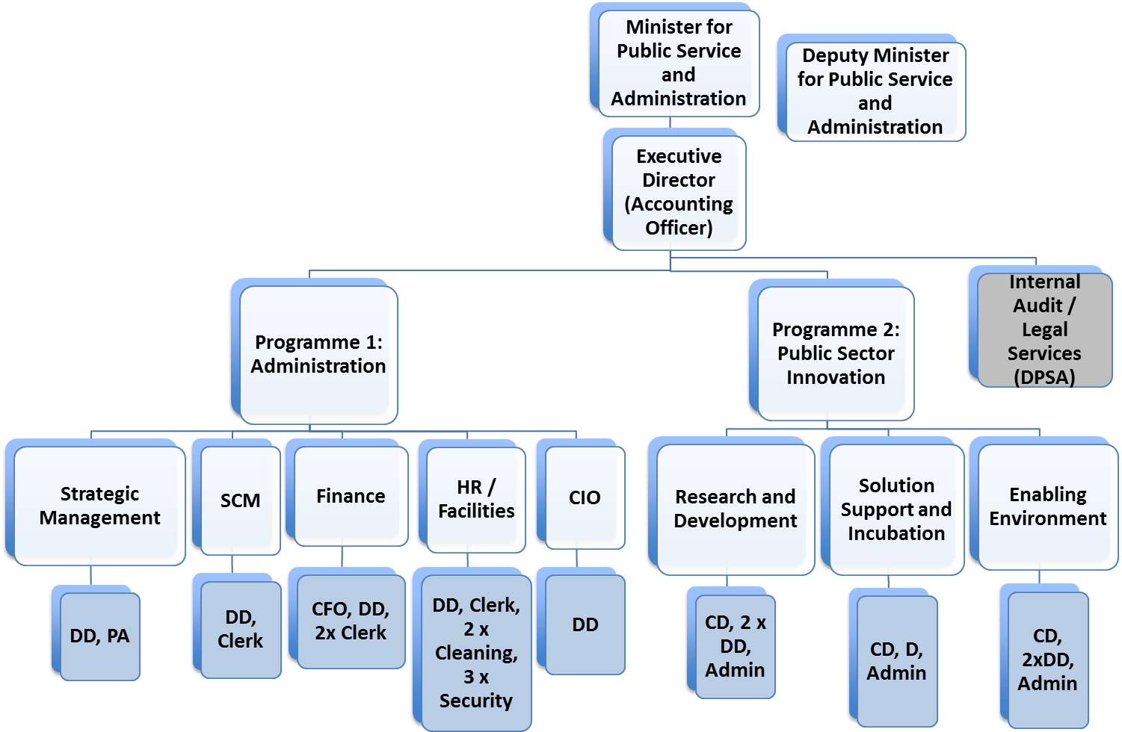
CPSI Structure
The organisational structure has 31 posts on its fixed establishment with the Executive Director post vacant and currently filled by an Acting incumbent.

Slide 6
VISION
A solution focused Public Sector through innovation
IMPACTS
(VISION/ MISSION)
MISSION
To entrench an innovative culture and practice in the Public Sector
Innovative culture and practice in the Public Sector entrenched
Effective corporate governance
OUTCOMES
Innovation research and development initiatives undertaken
Knowledge platforms sustained to nurture an enabling environment for innovation in the public sector
Innovative solutions replicated in the public sector
Unqualified Audit opinion on financial and non-financial information
OUTPUTS
Conduct innovation research
Facilitate solution development
Create knowledge sharing platforms
Ensure unearthing and recognition for innovation
Facilitate replication and mainstreaming of innovative solutions
Provide integrated corporate governance
ACTIVITIES
INPUTS
HUMAN RESOURCES, FUNDS, TECHNOLOGY, INFORMATION, ASSETS
VALUES
Innovative Committed Need driven Ethical Collaborative

Slide 7
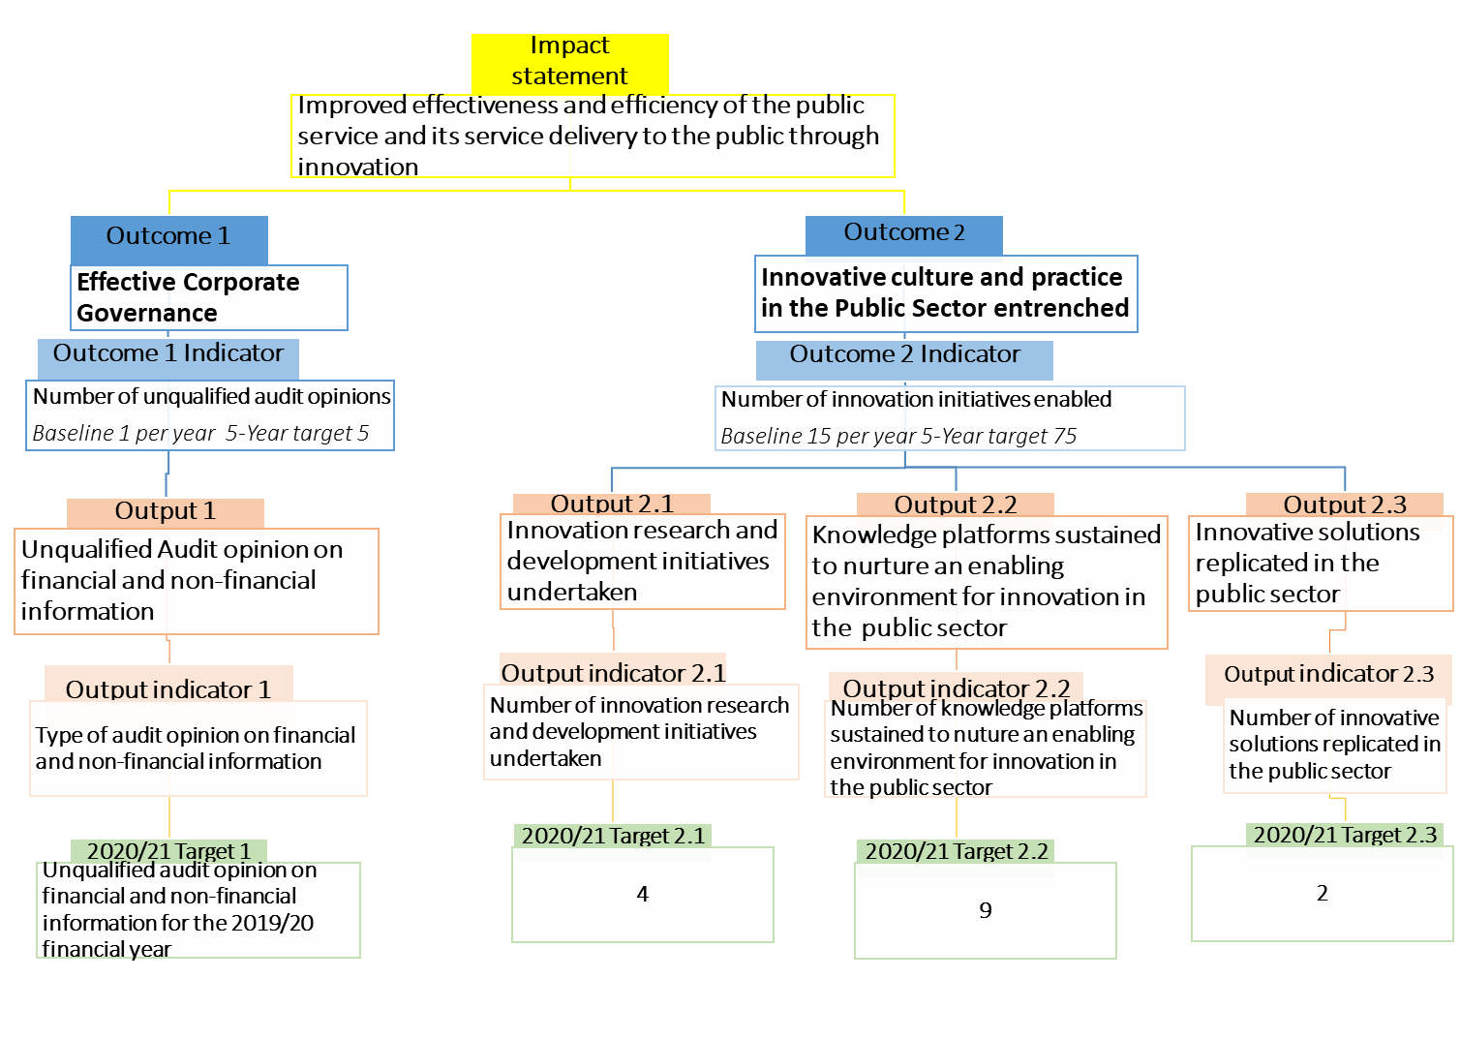
Schematic Overview of Strategic Plan and APP

Slide 8
Outcomes, outputs, performance indicators, and targets
Outcome | Outputs | Output Indicators | Annual Targets
 |  |  | Audited/Actual Performance |  |  | Estimated Performance | MTEF Period
 |  |  | 2016/17 | 2017/18 | 2018/19 | 2019/20 | 2020/21 | 2021/22 | 2022/23
Effective corporate governance | Unqualified audit opinion on financial and non-financial information | Type of audit opinion on financial and non-financial information | - | - | - | - | Unqualified audit opinion on financial and non-financial information for 2019/20 financial year | Unqualified audit opinion on financial and non-financial information for 2020/21 financial year | Unqualified audit opinion on financial and non-financial information for 2021/22 financial year
Innovative culture and practice in the public sector entrenched | Number of Innovation initiatives enabled | Innovation research and development initiatives undertaken | Number of innovation research and development initiatives undertaken | - | - | - | - | 4 | 4
 |  | Knowledge platforms sustained to nurture an enabling environment for innovation in the public sector | Number of knowledge platforms sustained to nurture an enabling environment for innovation in the public sector | - | - | - | - | 9 | 9
 |  | Innovative solutions replicated in the public sector | Number of innovative solutions replicated in the public sector | - | - | - | - | 2 | 2

Slide 9
Budget (Including compensation)
The CPSI’s budget is located within the budget appropriation of the DPSA. The current budget structure is according to the organisational structure.
Programmes | 2020/21 R’000 | 2021/22 R’000 | 2022/23 R’000
Administration | 20 745 | 21 745 | 22 289
Public Sector Innovation | 17 623 | 18 445 | 18 964
Total for Programmes | 38 368 | 40 190 | 41 253
Description | 2020/21 R’000 | 2021/22 R’000 | 2022/23 R’000
Strategic Management | 3 949 | 4 173 | 4 317
Corporate Resource Management | 10 444 | 10 823 | 10 918
Office of the Chief Financial Officer | 6 352 | 6 749 | 7 054
ADMINISTRATION | 20 745 | 21 745 | 22 289
Research and Development | 4 736 | 4 952 | 5 102
Solution Support and Incubation | 4 547 | 4 778 | 4 915
Enabling Environment | 8 340 | 8 715 | 8 947
PUBLIC SECTOR INNOVATION | 17 623 | 18 445 | 18 964
CPSI | 38 368 | 40 190 | 41 253

Slide 10
THANK YOU!

