Slide 1
STRATEGIC PLAN, ANNUAL PERFORMANCE PLAN AND MTEF ALLOCATION

Slide 2
STRATEGIC PLAN 2020-2025

Slide 3
Vision & MISSION
Vision
A Commission of excellence that ensures that effective, efficient and speedy redress is provided to victims of racially based land dispossessions.
Mission
We exist to provide redress to victims of racially motivated
land dispossession, in line with the provisions of the Restitution of
Land Rights Act, 1994 (Act No 22 of 1994), as amended.

Slide 4
LEGISLATIVE AND OTHER MANDATES
LEGISLATIVE MANDATES
The CRLR is an autonomous institution established by the Restitution of Land Rights Act, 1994 (Act No 22 of 1994) to solicit land claims, investigate them and attempt to resolve them through negotiation and mediation.
CONSTITUTIONAL MANDATES
Constitution of the Republic of South Africa, 1996 (Act No. 108 of 1996)
The mandate for restitution of land rights is derived from section 25 (7) of the Constitution of the Republic of South Africa, 1996 (“the Constitution”) which states that a “person or community dispossessed of property after 19 June 1913 as a result of past racially discriminatory laws or practices is entitled, to the extent provided by an Act of Parliament, either to restitution of that property or to equitable redress”.

Slide 5
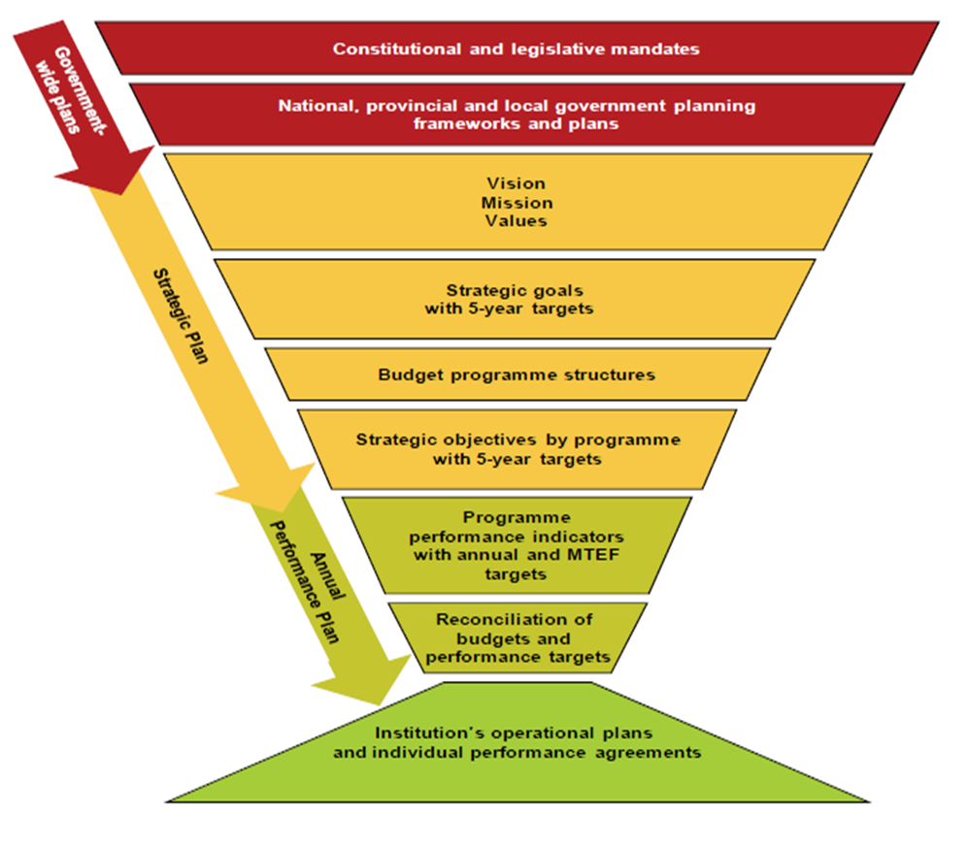
STRATEGIC OVERVIEW

Slide 6
PROGRAMME PURPOSE
Programme Purpose
The Restitution Programme exists to facilitate the settlement of claims, and providing restitution or equitable redress to victims of racially motivated land dispossession, in line with the provisions of the Restitution of Land Rights Act, 1994 (Act No. 22 of 1994), as amended.
We contribute to the DALRRD strategic goal: “Equitable access to and sustainable use of land for development promoted”

Slide 7
STRATEGIC OBJECTIVES
Strategic objective 1:
Land rights restored
- Facilitate the restoration of land rights and alternative forms of equitable
redress
- Equitable land dispensation and agrarian reform
Strategic objective 2:
Redress land rights lost after 1913
- Solicit and receive new land claims
- Equitable land dispensation and agrarian reform

Slide 8
STRATEGIC OBJECTIVES
Strategic objective 3: Internal
Improved governance and service delivery
- Organisational change management
- Contribute to a dedicated, loyal, result oriented, professional and people
focused workforce
Strategic objective 4: External
Improved customer satisfaction and communication
- Communication on performance & plans are properly communicated
- The objective will promote openness and transparency

Slide 9
STRATEGIC OBJECTIVES
Strategic objective 5: Internal
Clear Organisational mandate & Business Process supported by Resources
- Operational processes defined and implemented effectively
- This objective will increase productivity and accountability
Strategic objective 6: External
Improved information & project management
- Claims management electronically and information produced
- will improve reporting & responsiveness & promote service delivery

Slide 10
NATIONAL DEVELOPMENT PLAN VISION 2030
The contribution of the CRLR to the NDP and the Medium Term Strategic Framework (MTSF) will relate particularly to sustainable land reform and agrarian transformation, which is set out in more detail in the Strategic Plan of the Department of Rural Development and Land Reform (DRDLR).
The CRLR sees itself playing a key role towards radical rural economy transformation.
The primary focus of the CRLR is Land Restitution (which is one of the elements of the land reform programme) which will contribute to ensuring sustainable and rapid transfer of land to beneficiaries, without distorting land markets or business confidence.

Slide 11
NUMBER OF CLAIMS TO BE SETTLED 2020 - 2025
Outcome | Outcome indicator | Baseline | Five year target
Redress and equitable access to land | Number of land claims settled | 428 | 2150
 | Number of land claims finalised | 638 | 2200

Slide 12
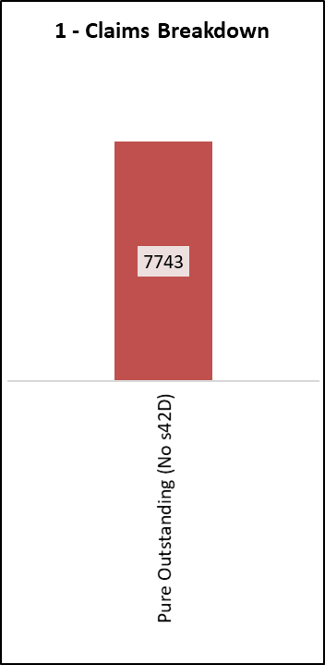
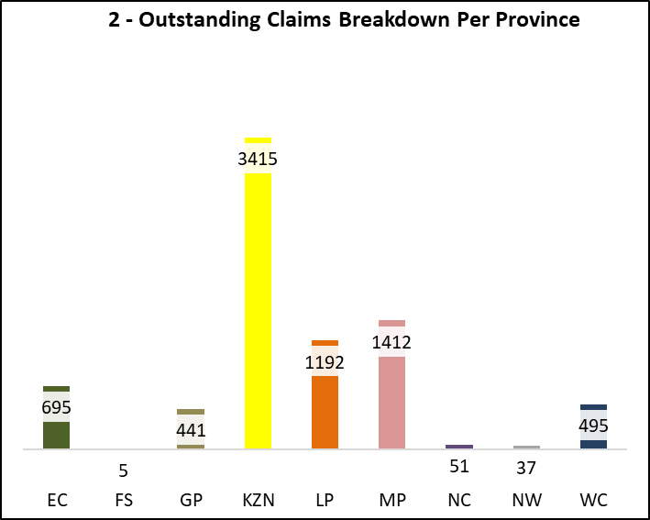
The CRLR consolidated provincial statistics as of Jan 2020
Total Pure Outstanding Claims
Pure Outstanding claims per province
Data is subject to change as it is still to be verified; this process is waiting the appointment of the external audit specialist as per the developed TOR
Note: Data as of 31st Jan 2020 – Still an unverified data set
Source: Outstanding claims management reporting tool

Slide 13
The backlog reduction strategy has been developed to help the commission accelerate the claims process (pre-1998 Claims), by addressing the following 4 impact areas
Key Backlog Reduction Impact Areas
1
Reduce
turnaround times
Legal Compliance
Standardisation
of processes
Reduce rework
2
4
3
Eliminate the areas of non-compliance which potentially exposes Commission to legal contestation by the stakeholders (e.g. claimants, landowners etc)
Standardise the ways of working across the provinces for the processes that are in place but are not documented
Reduce rework due to lack of quality assurance and oversight
These are the processes that have a lengthy turnaround time, however can be reduced if inefficiencies are eliminated
The backlog reduction initiatives have been identified in order to accelerate the settlement on the outstanding claims with the benefits expected across the above mentioned impact areas

Slide 14
The finalised backlog strategy will include 4 main areas; project charter development, planning timeframes and estimated costs
Finalised Backlog Strategy
Projects
Actual Plan
Timeframes
Estimated Costs
The strategy will include detailed charters for project that are required to successfully implement the identified strategic initiatives
The strategy will have a plan that integrates the proposed project deliverables with the upcoming targets
The strategy will indicate the claim settlement timeframes using the proposed benefit realisation based on the successful project implementation
The strategy will include high-level cost estimates for the settlement of claims and the operational costs required to execute the claims
Desired Strategic Outcomes
Improved Process Flows & Clearly Defined Handover Points
Secure Systems and Reduced Rework
Optimised Decision Making & Effective Skills Utilisation
If the strategic projects and initiatives are effectively implemented the Commission will see the benefits in terms of the desired outcomes and ultimately eliminate the outstanding backlog claims

Slide 15
Im Impact of COVID-19 for settlement and finalisation of claims – APP 2020/21 zation of claims

Slide 16
REVISED APP TARGETS FOR 2020/21 due TO covid 19
PROGRAMME 3: RESTITUTION
Strategic Objective |  | Performance Indicator | Medium term targets |  |  | Revised Quarterly Breakdown as per provincial input
 |  |  | 2020-21 |  |  | Quarter 1 |  | Quarter 2 |  | Quarter 3 |  | Quarter 4
 |  |  | Province | Initial Provincial Target | Revised Provincial Target | Initial | Revised | Initial | Revised | Initial | Revised | Initial | Revised
4.1 | Facilitate the restoration of land rights and alternative forms of equitable redress by 2020 | Number of land claims settled | EC | 100 | 60 | 15 | 14 | 20 | 14 | 35 | 21 | 30 | 11
 |  |  | FS | 0 | 2 | 0 | 1 | 0 | 1 | 0 | 0 | 0 | 0
 |  |  | GP | 10 | 7 | 0 | 0 | 3 | 2 | 4 | 3 | 3 | 2
 |  |  | KZN | 100 | 29 | 15 | 9 | 20 | 20 | 35 | 0 | 30 | 0
 |  |  | LP | 64 | 64 | 16 | 16 | 16 | 16 | 16 | 16 | 16 | 16
 |  |  | MP | 90 | 40 | 12 | 6 | 20 | 10 | 32 | 14 | 26 | 10
 |  |  | NW | 5 | 1 | 1 | 0 | 2 | 1 | 1 | 0 | 1 | 0
 |  |  | NC | 7 | 1 | 1 | 1 | 3 | 0 | 2 | 0 | 1 | 0
 |  |  | WC | 78 | 40 | 12 | 8 | 28 | 12 | 26 | 12 | 12 | 8
 |  |  |  | 454 | 244 | 72 | 55 | 112 | 76 | 151 | 66 | 119 | 47
 |  | Number of land claims finalised | EC | 85 | 65 | 15 | 10 | 24 | 10 | 27 | 25 | 19 | 20
 |  |  | FS | 6 | 6 | 4 | 0 | 1 | 4 | 1 | 2 | 0 | 0
 |  |  | GP | 20 | 9 | 5 | 0 | 5 | 4 | 5 | 1 | 5 | 4
 |  |  | KZN | 137 | 50 | 25 | 10 | 40 | 20 | 39 | 10 | 33 | 10
 |  |  | LP | 32 | 32 | 8 | 8 | 8 | 8 | 8 | 8 | 8 | 8
 |  |  | MP | 54 | 54 | 7 | 7 | 12 | 12 | 19 | 19 | 16 | 16
 |  |  | NW | 30 | 14 | 7 | 0 | 9 | 6 | 7 | 8 | 7 | 0
 |  |  | NC | 15 | 5 | 4 | 1 | 5 | 2 | 4 | 2 | 2 | 0
 |  |  | WC | 100 | 60 | 10 | 10 | 30 | 10 | 25 | 15 | 35 | 25
 |  |  |  | 479 | 295 | 85 | 46 | 134 | 76 | 135 | 90 | 125 | 83

Slide 17
STRATEGIC CRITERIA FOR SETTLEMENT OF CLAIMS DURING COVID 19
The CRLR intends to continue to settle claims
We have looked at risks involved and whether we would be able to continue to operate:
1. The Commission business processes is not desktop and requires human interaction therefore we will be required to find alternatives
2. The Commissions’ business process requires that different people are available at different stages
3. The settlement requires the signing of settlement agreements by the Community and their representatives
4. Stakeholder Consultations
5. Multiple requests for meetings by claimant beneficiaries
The CRLR is currently finalising a full implementation plan to ensure that we continue to operate while we comply with the Covid -19 Regulations.
Further the Commission has claims that are at different stages of the business process and as a result we will prioritise those Claims that have already gone through the pipeline and will require minimum contact.
Focus on Court Orders
Backlog Reduction Strategy
Dealing with partial payments and the Suspense Account
To provide tools for staff to be able to work remotely as far as possible so that work can continue compliment.

Slide 18
STRATEGIC CRITERIA FOR SETTLEMENT OF CLAIMS DURING COVID 19
In view of the declining budget and the imperatives of COVID 19, there would be a need to review the APP. Verification, research and stakeholder engagements (e.g. optioning etc) are key business processes ( BP) which have been identified as a major risk for the settlement of claims. The signing of agreements with claimants and other parties would pose a challenge for the finalisation of the claims. In order to mitigate the risk factors, a basic criteria in terms of legislation was applied to settle the remaining restitution claims in the most sustainable and affordable manner;
The Commission uses section 6(2)(d) of the Restitution Act to “ensure that priority is given to claims which affect a substantial number of persons, or persons who have suffered substantial losses as a result of dispossession or persons with particularly pressing needs”. An example of such claims would therefore fall in high poverty areas;
The Commission would naturally follow the District Development Approach as adopted by Government, where the poorest districts has been identified and where the Comprehensive Rural Development Programme (CRDP) of the Department shall be implemented. Here again the CRLR would invoke section 6(2)(d) in processing these claims in an area-based approach that serve as a catalyst for CRDP.
The Court and/or Minister may, amongst other things order:-
the restitution of land or a right in land to the claimant,
the state to grant the claimant an appropriate right in alternative state-owned land,
the state to pay compensation to the claimant
the state to include the claimant as a beneficiary of a state support programme for housing or the allocation and development of rural land,
or it may grant the claimant alternative relief.

Slide 19
There has been minimal impact on the CRLR operations as a result of the declaration of a national disaster due to COVID-19
Impact of COVID-19 Working Restrictions on the CRLR
CRLR’s Implemented Mitigation Measures
Overall Business Impact
Positive takeaways to consider:
Improved planning towards fasting elements in the process
Continuous management oversite
No break in the governance processes with effective utilisation of meeting time
Communication channels remain open
Challenging takeaways to consider:
Lost time on site - which can be made up utilising fast tracking processes
Communication breakdowns with claimants who have limited telecoms access
Active management of files – with copy of electric POE to be provided in support
Forced to work from home
Utilisation of technology to effectively work from home (online meetings, calls and emails)
Continued electronic communication with landowners and claimants
Utilised resource downtime to development fast track implementation measures (notably around bottleneck locations: research, Valuations, settlement negotiations)
Facilitated and participated in online meetings with key service providers
Management and council meetings where conduct using online meeting platforms
Reactivation of the site work can be immediate (once clear) as there is no external dependencies
No Site Access (for research and verification)
No Direct Contact with Claimants & Landowners
No physical meetings for management & Committees
Cannot meet directly with service providers
Despite CRLR’s “Business as Usual” being impacted by the delectation of a natural disaster, the organisation was able to quickly adapt and implement “Business Unusual” measures to effectively mitigate the overall impact

Slide 20
MEDIUM TERM EXPENDITURE FRAMEWORK 2020 - 23

Slide 21
MEDIUM TERM EXPENDITURE FRAMEWORK 2020 - 2023
RESTITUTION | 2020/2021 | 2021/2022 | 2022/2023
 | R'000 | R'000 | R'000
SUBPROGRAMME
RESTITUTION NATIONAL OFFICE | 209 194 | 231 521 | 240 350
RESTITUTION REGIONAL OFFICES | 547 296 | 570 958 | 592 136
RESTITUTION GRANTS | 2 580 296 | 2 749 712 | 2 852 069
TOTAL | 3 336 786 | 3 552 191 | 3 684 555

Slide 22
MEDIUM TERM EXPENDITURE FRAMEWORK 2020 - 2023
RESTITUTION | 2020/2021 | 2021/2022 | 2022/2023
 | R'000 | R'000 | R'000
Economic classification
Current payments | 746 907 | 792 369 | 821 946
Compensation of employees | 455 462 | 484 891 | 502 936
Goods and services | 291 445 | 307 478 | 319 010
Rent on land | - | - | -
Transfers and subsidies | 2 587 360 | 2 757 164 | 2 859 800
Provinces and municipalities | 6 704 | 7 073 | 7 334
Households | 2 580 656 | 2 750 091 | 2 852 466
Social benefits | 360 | 379 | 397
Other transfers to households | 2 580 296 | 2 749 712 | 2 852 069
Payments for capital assets | 2 519 | 2 658 | 2 809
Total | 3 336 786 | 3 552 191 | 3 684 555

Slide 23
TRANSACTION TOWARDS AUTONOMY

Slide 24
It is in envisaged that it will take up to 36 months to complete the Public Entity establishment process due to the requirement of the two main milestones such the business case approval process and the legislative requirements that need to be adhered to
Overall plan to becoming an Autonomous Unit
14-18 months
1
Business Case Development
Assessing the business case:
Formalisation of PE
Business case submission and Transition plan
3-6 months
9 months
1-3 month
Prepare the business cases for Joint evaluation panel between the MPSA and MoF to assess the business case for an intended PEs.
MPSA and MoF consent in writing to establishment of PE.
Inform Cabinet of the consent of the MPSA and MoF panel.
request in writing the listing and classification of a PE in terms of the PFMA.
Implementation
Development of the business case includes the following
Strategic plan outlining service delivery model, organisational structure, governance et al
budget plan
Transition Plan
6 months
.
Appoint the members of the controlling body.
Execute the plan as outlined on the transition plan
Appoint the Board and the Executive committee
Effect the transfer of the function and concomitant resources to the PE.
2
18-30 months
Legislation input gathering
Legislative bill submitted
Bill approved
Legislative Bill institutionalisation
plan
3-6 months
12-18 months
3-6 months
Obtain legal opinion from the State Attorney’s office
Draft the Bill
Table a Bill in Parliament for establishing PE.
Request Cabinet to introduce a Bill in Parliament for establishing the PE.
Bill promulgation and approval by Parliament
Source: INTERIM GUIDE FOR CREATING PUBLIC ENTITIES AT THE NATIONAL SPHERE OF GOVERNMENT
by Department of Public Service and Administration - National Treasury 2002

Slide 25
The commission plans to embark on a 3-year phased approach transition plan during which it will continue to receive support from DALRRD
Short/Medium/Long-Term plan to becoming an Autonomous Unit
Specialised Service Delivery Unit moving to Public Entity 3A
The commission plans to operate as a Specialized Service delivery Unit in the interim whilst undertaking the establishment of a completely autonomous entity
The Commission will continue to receive support over the transition period of 3 years. SLAs will be used to manage the relationship with DALRRD until the completion of the process
The commission plans to establish the various functions over three years, this means that the required addition funding allocations will be planned accordingly and aligned with the budget plan as per Medium-Term Expenditure Framework
Year 1
( 2020/2021)
Year 2
(2021/2022)
Establish the Commission as an Specialized Service Delivery Unit in order to obtain autonomy on Financial management and Human resource management function
Develop governance structures and establish a Board and Exco committee
Support functions will continue to be received from DALRRD and managed through SLAs
Year 3:
(2022/2023)
Recruit for unfunded posts viz. critical posts and vacant posts (as per current structure
Establish other functions such as Strategic Planning, Risk management et al.
Start the Human resource labour relations activities for the movement of employees
Take on operational costs such IT, Rental, Financial and Supply chain system and other Goods and services
Physical and administrative Transfer of employees into the new entity

Slide 26
Thank YOU

