Slide 1
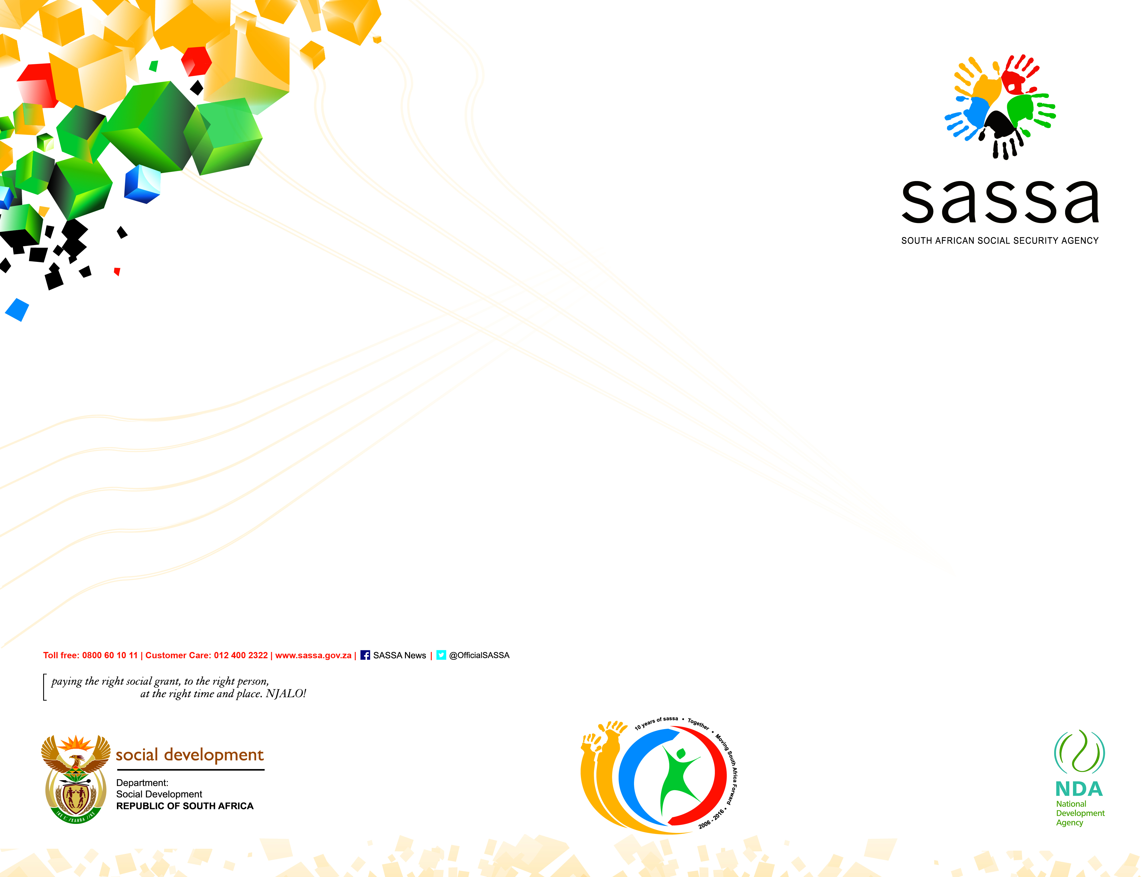
PRESENTATION TO THE WESTERN CAPE AD HOC COVID-19 COMMITTEE
30 APRIL 2020

Slide 2
Update on Calls Received
Regional Call Centre
DATE | CALLS RECEIVED | CALLED BACK | BALANCE
14-Apr | 2,138 | 2,138 | 718
15-Apr | 2,153 | 110 | 2,153
16-Apr | 1,431 | 0 | 1,431
17-Apr | 905 | 0 | 905
20-Apr | 825 | 0 | 825
21-Apr | 617 | 0 | 617
22-Apr | 2,065 | 0 | 2065
23-Apr | 2,563 |  | 2563
Total | 12,695 | 2,248 | 10,447

Slide 3
Local Office / District | 11 April 20 | 18 April 20 | 30 April 20 | Total
Cape Town | 49 | 23 | 100 | 172
Eerste River | 54 | 115 | 150 | 319
Gugulethu | 51 | 52 | 181 | 284
Mitchell’s Plain | 39 | 184 | 243 | 466
Metro 2 District | 193 | 374 | 674 | 1,241
Caledon | 35 | 117 | 142 | 294
Paarl | 31 | 79 | 248 | 358
Worcester | 71 | 125 | 136 | 332
Boland Overberg District | 137 | 321 | 526 | 984
Beaufort West | 8 | 34 | 100 | 142
Oudtshoorn | 38 | 42 | 144 | 224
George | 23 | 210 | 65 | 298
Eden Karoo District | 69 | 286 | 309 | 664
Vredenburg | 83 | 64 | 65 | 212
Vredendal | 46 | 139 | 148 | 333
West Coast District | 129 | 203 | 213 | 545
Athlone | 40 | 176 | 218 | 434
Bellville | 50 | 197 | 528 | 775
Khayelitsha | 48 | 213 | 538 | 799
Wynberg | 23 | 55 | 122 | 200
Metro 1 District | 161 | 641 | 1406 | 2,208
Regional Total | 689 | 1,825 | 3,128 | 5,642
SASSA Food Parcels
Update

Slide 4
Grants in Payment
May 2020
Grant type | Grants in payment 1 Apr 2020 | Grants to be paid 1 May 2020 | Value (R)
Grant for the Aged | 369,490 | 368,280 | 762,667,946.60
War Veterans Grant | 18 | 18 | 38 340.00
Disability Grant | 154,059 | 152,841 | 320,824 ,233.10
Foster Child Grant | 31,754 | 31,705 | 41,192,331.95
Care Dependency Grant | 16,577 | 16,549 | 34,942,441.22
Child Support Grant | 1,048,831 | 1,048,150 | 775,863,652.17
Grant-in-Aid | 25,141 | 24,883 | 10,971,746.03
TOTAL | 1,645,870 | 1,642,426 | 1,946,500,691.07

Slide 5
Grant Applications not finalized
End of March 2020
Local Office | No Per Local Office
Athlone | 46
Bellville | 144
Khayelitsha | 37
Wynberg | 39
Cape Town | 10
Eerste River | 107
Mitchells Plain | 96
Gugulethu | 77
Caledon | 33
Paarl | 47
Worcester | 33
Beaufort West | 11
George | 212
Oudtshoorn | 14
Vredenburg | 75
Vredendal | 6
TOTAL | 987
Grant type | No Per Grant type
Grant for the Aged | 164
War Veterans Grant | 0
Disability Grant | 209
Foster Child Grant | 32
Care Dependency Grant | 15
Child Support Grant | 476
Grant-in-Aid | 91
TOTAL | 987

Slide 6
Grant Relief Measures
Increase of R300 for the Child Support Grant to be paid in (only) May 2020 per child.
Thereafter from June – October 2020, a R500 grant will be paid to caregivers of the Children on the Child Support Grant.
All existing caregivers will automatically qualify and receive this benefit along with the existing CSG monthly benefit.
The amount per child will revert to R440 per month from June 2020.
All other existing social grants are increased by R250 per month from May to October 2020.

Slide 7
Special Covid-19 SRD Grant
The grant will be available to South African Citizen, Permanent Resident or Refugee registered on the Home Affairs system; who are resident within the borders of the Republic of South Africa;
Applicants must be:
Above the age of 18;
Unemployed;
Not receiving any income;
Not receiving any social grant;
Not receiving any UIF benefit and does not qualify therefore;
Not receiving a stipend from the NSFAS; and
Not resident in a government funded or subsidized institution.
Prospective Applicants will need to provide the following compulsory information for processing of their applications:
Identity Number/Department of Home permit;
Name and Surname as captured in the ID (and initials);
Gender and Disability;
Banking details - Bank Name and Account Number;
Contact details - Cell phone number;
Proof of Residential Address;

Slide 8
Special Covid-19 SRD Grant
Application for SRD or a social grant may be lodged electronically over and above any other available means of lodging such applications.
The measures applicable (for now) include -
Sending Whatsup message to 0600 123 456
& selecting SASSA; or
E-mail to SRD@sassa.gov.za.
Volunteers will be trained to assist applicants who cannot use technology and will be provided with gadgets to capture details on behalf of applicants.
Notification of the outcome for an application for the Special COVID19 SRD Grant will be provided in the same manner in which the application was made.
Payments mainly through bank accounts of the applicants and through cash send measures through banks.

Slide 9
Special Covid-19 SRD Grant
Continue…
The benefit/grant will be paid from the date of approval up to the end of October 2020 provided the qualifying criteria listed continues to be met. So if applicants apply in June their payments will be from June and there will be no back pay.
all applicants grant consent to SASSA to verify their residency, sources of income and/or social security benefits with government departments and financial institutions; including - All ID/ Permits will be cross checked against other data sources.
False applications will give rise to possible prosecution.

Slide 10
Thank you

