Slide 1
Policing, security and police brutality in the context of covid 19
Presentation to the Provincial Parliament Ad Hoc Committee on the COVID 19:
29 April 2020
Virtual meeting via MS Teams

Slide 2
The role of DoCS during the lockdown
Attendance of daily ProvJoc meetings to provide a brief report to the relevant stakeholders and to escalate provincial issues via the ProvJoc to the NatJoC.
Liaise on a daily basis between role-players to promote effective integration from a safety perspective, including providing clarity of the interpretation of the national disaster regulations.
Facilitated the process of issuing “Permits of essential work” as per annexure C of the national disaster regulations.
Monitoring of Covid-19 related court cases such as the Standfontein Shelter rape case and the distribution of fake news case.
Monitoring of cases of police misconduct through the IPID forum focussing on criminal cases against SAPS members during the lockdown period.
Assisted SAPS with emergency procurement of masks and sanitizer.
Continued with the processing of all invoices and payments for the Expanded Public Works Programme.
Integrated deployment of the 500 Law Enforcement Officers with Cape Town via Prov Jocs.
Assisted municipalities by making available about 289 Chrysalis graduates who have received the requisite training as Peace Officers to rural municipalities. With a process underway to mobilise an additional 230 previously trained peace officers at municipal level.
Managing the responses as requested from Municipalities and ensuring administrative and contractual obligations met.

Slide 3
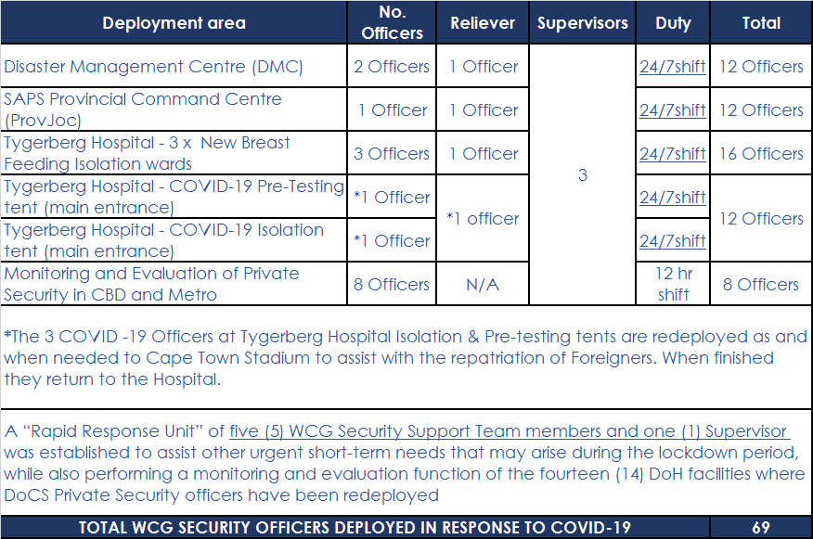
The role of DoCS during the lockdown cont.
The deployment of WCG Security Support Teams as follows:

Slide 4
The role of DoCS during the lockdown cont.
With the declaration of the 21-day lockdown certain WCG buildings were placed under partial lockdown by DoCS as of 27 March 2020.
By doing so, DoCS could avail physical security resources to the DoH for deployment at DoH facilities.
Private security officers are redeployed to DoH facilities, namely
Sechaba Security Services : 19 officers
Executive Decisions : 14 officers
MSecure : 8 officers
Note:
The effect of the Covid-19 on the deployment of WCG Security Support Teams – 2 WCG security officers separately tested positive for Covid-19. Contact was made with DoH and a list of “direct contacts” was provided to the DoH tracing teams.
53 WCG Security Officers are placed in 14 day self-isolation as positive contacts of these 2 officers.
DoCS facilitated and procured the Covid-19 testing of 69 officials associated with the Directorate Provincial Security Provisioning.
The results of 45 security officials were released and 2 more WCG security officers tested positive, bringing the total to 4.

Slide 5
The role of DoCS during the lockdown cont.
Conducting of Safety and Security Risk Assessment for DoH, WCED and DoLG.
Assisting Departmental Security Managers with mitigating interventions.
Providing guidance to WCG departments in respect of OHS issues related to Covid-19.
Facilitating the conducting of Hazard Identification Risk Assessments at WCG departments in the CBD.
Participation in the Humanitarian Relief Stream to advise on security measures.
List of accredited NHWs were provided to local authorities keen on exploring mechanisms to partner with NHW (disaster volunteers).
Written to National Minister of Police to consider the deployment of accredited NHW structures to provide especially rural and poor communities with additional soft security resources.

Slide 6
The role of the safety plan during lockdown
The current emphasis of the Safety Plan has shifted as a result of the Covid-19 lockdown, and more attention has been focused on a response to this situation, as outlined in the previous slides.
Additionally, DoCS provide support to WCED with baseline data by analysing the data collected from schools using the Safety and Security Resilience Scorecard to identify risks facing these schools.

Slide 7
Community Policing during the lockdown
Community policing is an approach to policing which recognises the shared responsibility between the police and the community to ensure a safe and secure environment for all inhabitants.
However, both CPFs and NHWs are prohibited from functioning during lockdown.
DoCS offered municipalities 3 options, based on availability in a specific municipality:
Activating Chrysalis graduates;
Deploying trained Peace Officers (to be paid by DM, using underspend on conditional grants paid by DoCS; and
Deploying NHW members as safety volunteers reporting to the municipality. The municipality to issue the requisite permits, provide supervision and supply protective gear, which must include gloves, masks and hand sanitizers.
DoCS requested municipalities to prioritize deployment at high risk schools in order to reduce acts of vandalism at schools within the Province.
District Municipalities are the entry point of communication.

Slide 8
Suspension of liquor licences during lockdown – Non-compliance
WCLA inspectors has conducted 37 investigations.
WCLA in terms of section 71, temporarily suspended 14 liquor licenses.
Licensees involved will be granted an opportunity to provide reasons why the order of the Liquor Licensing Tribunal should not be permanent.
Further proceedings will follow and subject to investigations, if found guilty, these licensees can have fines of up to R115 610.00 imposed or have their liquor licenses revoked.
The WCLA will work in partnership with SAPS and other enforcement agencies to continue the monitoring of licensed premises.
Members of the public can report any trading in liquor during this lockdown period by contacting the Western Cape Liquor Authority during office hours:
T: 021 204 9805
E: Liquor.Enquiries@wcla.gov.za

Slide 9
The policing environment during lockdown
DoCS are concerned that the shortage of police resources in the Western Cape will be exacerbated if and when SAPS members become ill or are under enforced isolation for a period.
Some of the most under-resourced police stations are in areas that are most affected by the Covid-19 virus.
A number of SAPS stations and policing units that have become affected by Covid-19, where members have tested positive.
SAPS have adopted a protocol to disinfect an affected police station, shut it down for a period of 48 hours, but continue to provide services from another police station or a temporary service point.
DoCS is undertaking oversight visits to monitor compliance.
Regular liaison with SANDF and Department of Correctional Services about their risks.
SAPS have also been monitoring and responding to social protest action and looting.
From monitoring the FPS data, DoCS observe that the number of murders in the WC has dropped significantly (by about 60%), but this drop is not as pronounced in the 11 priority areas in the Metropole and in some cases is almost the same.

Slide 10
Safety During Lockdown
DoCS is conducting a study, together with the Safety Secretariat, DTPW and Institute for Security Study (ISS) looking at the impact of the Covid-19 lockdown on safety.
Objectives:
To inform safety interventions in the identified priority areas during and after the Lockdown period, within the overarching framework of the Western Cape Safety Plan;
To make policy recommendations with respect to safety, including violence prevention; and
To consider how lessons learnt from the pattern of violent crime before, during and after the lockdown period could be applied within the context of the Western Cape Safety Plan.
Methodology:
Monitoring: Forensic Pathology data on homicides; EMS data and CoCT EPIC data;
Telephonic Surveys: with LEAP officials, SAPS station commanders, WCED officials and NGOs; and
In 3 priority areas, i.e. Delft, Philippi and Khayelitsha.

Slide 11
Thank you

