Slide 1
Contents
NSI WORK TOWARDS CURBING COVID-19
Chapter 01
Chapter 01
Chapter 01
Chapter 01
Chapter 01
Chapter 01
Chapter 01
DSI Presentation to the Portfolio Committee

Slide 2
COVID-19 TIMELINES
31 December 2019:
W.H.O China office is informed of pneumonia of unknown etiology detected in Wuhan City, Hubei Province of China
3 January 2020
A total of 44 case-patients with unknown etiology of pneumonia were reported to W.H.O
12 January 2020
Detailed information from National Health Commission of China associates the outbreak with seafood market in Wuhan
A new type of coronavirus isolated on 7 January is identified
China shares the genetic sequence of the novel Coronavirus for countries to use in developing testing kits

Slide 3
COVID-19 TIMELINES
13 January 2020
Ministry of Public Health in Thailand reports the first case of imported case from Wuhan
15 January 2020
Ministry of Health, Labour and Welfare, Japan reports an imported case from Wuhan
20 January 2020
National IHR Focal point of the Republic of Kora reports a first case of Coronavirus in Korea
23 January 2020
First imported case reported in the USA
5 March 2020
A first imported Coronavirus case is confirmed in South Africa

Slide 4
COVID-19 TIMELINES: DSI response
7 March 2020
Engages the MRC/SHIP for possible interventions in response to COVID-19 outbreak
9 March 2020
A team is put together to identify possible research projects to respond to COVID-19
15 March 2020
DSI redirects some of its funds to COVID-19 response
24 March 2020
An update of specific interventions including research projects as part of NSI response is prepared for the Minister

Slide 5
GOVERNMENT DEPARTMENTS
Entities tasked to implement the initiative with Universities:

Slide 6
COVID-19 Cycle: infection, hospitalization, recovery
Notes:
Most (80%) detected cases are mild and do not require hospitalization. Of cases that require hospitalization,
30% require critical care (ICU) (Ferguson and Team 2020).
• The time from onset to hospitalization is 5.9 days (Tindale et al. 2020).
• The time from hospitalization to admission to the ICU is 3.5 days (C. Huang et al. 2020).
• The time from hospitalization to discharge for patients not requiring critical care is 8 days (Ferguson and Team
2020).
• The time from hospitalization to discharge for patients requiring critical care who eventually recover is 16 days
(Ferguson and Team 2020).
• The time from hospitalization to discharge for patients requiring critical care who eventually die is 11.2 days
(Sanche et al. 2020).

Slide 7
National System of Innovation Response
Analytics & Modelling
Research and Innovation
International Cooperation
Manufacturing
Data generation and management

Slide 8
Research Prioritised
Development of tools to rapidly diagnose COVID-19;
Targeted surveillance and modelling;
Therapeutic trials for treatment and prophylaxis of health care workers or highly exposed individuals;
Re-purposing of drugs for treatment of mild cases;
Monoclonal antibodies, immunoglobulins and molecular epidemiology;
Research and development for candidate vaccines.

Slide 9
Development of diagnostics and reagents
Prioritise the development of rapid diagnostic tests that can assist relieve significant pressure on pathology services
PCR techniques
Various research groups and companies have diagnostic tests at various stages of development
Capabilities to develop/roll out testing.
Afrobodies

Slide 10
Research to understand the spread of the pandemic using DSI investments
Surveillance Studies:
Sentinel, hospital-based surveillance of adults hospitalized for Severe Acute Respiratory Infection
Serological and genomic investigations of SARS-CoV-2 among HIV-infected and HIV-uninfected and those with TB
Epidemiological and phylogenetic investigation of COVID-19 in KZN. Study design used to develop community testing
Establishing a repository of whole blood samples for possible genetic markers predisposing to severe COVID-19 disease
Assist with the modelling of the epidemic wrt estimated number of cases, number of ICU beds needed, number of deaths, within different timelines
10

Slide 11
Therapeutics and treatment
Therapeutic trials for treatment and prophylaxis of health care workers or highly exposed individuals
Solidarity core protocol, an international study of treatments for COVID-19 in hospitalized patients ( a treatment clinical trial where diagnosed patients will receive treatment with drug regimens believed to have an effect – ARV’s etc)
All medical schools requested to be involved
New or repurposed drugs and drug delivery systems
E.g. Complementary medicines with proven anti-viral activities including Pelargonium, etc

Slide 13
Modeling, analytics and data science
Models for predicting the spread of the virus.
Data visualisation dashboard
Response strategy modelling/ Integration Platform - CMORE
Epidemiological and response strategy modelling
COVID-19 vulnerability assessment – Gauteng City Region
Infection data, including recovery and mortalities
Research coordination with relevant HEIs and Science Councils
Survey to assess the understanding and attitudes of South Africans

Slide 14
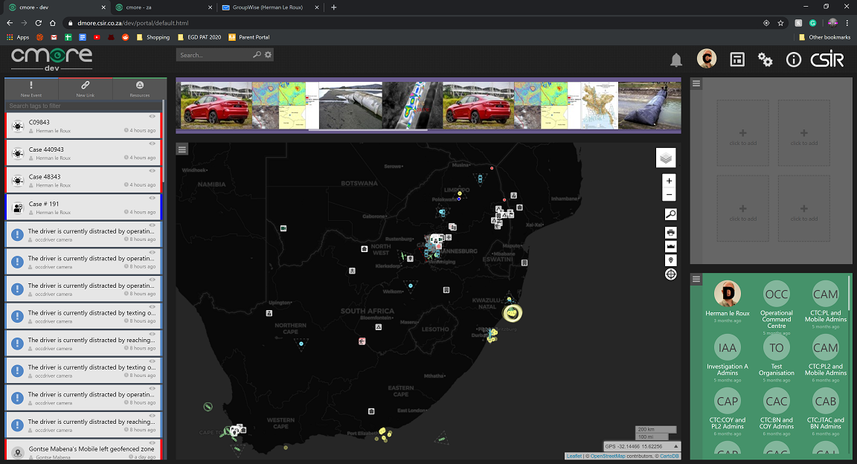
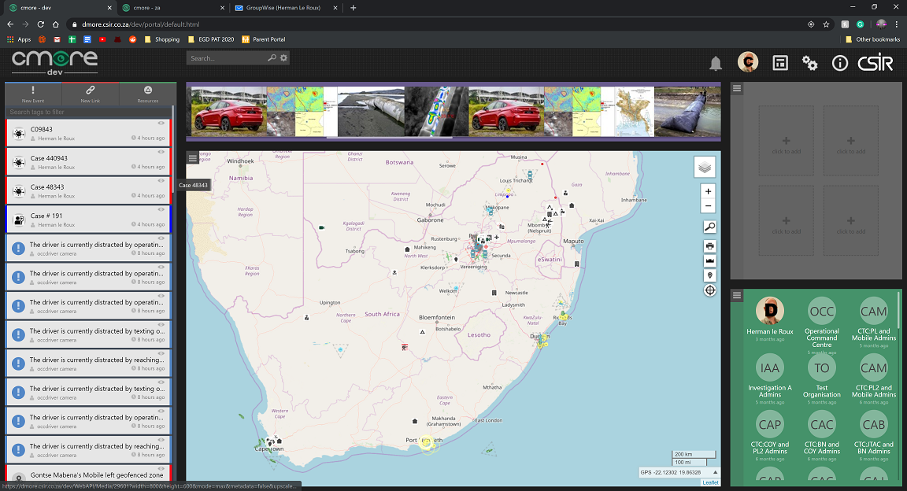
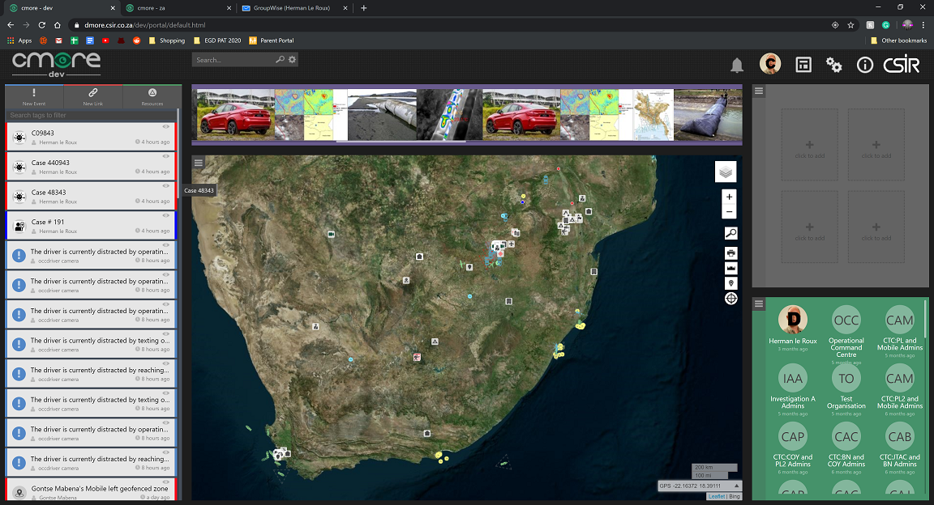
Data generation and management
Cmore – Use Different Base Maps
Base Maps
Open, public Map Sources
Own, vetted Map Sources
Use the Map that Suits your Visualization
Display cases and resources on the same map
Notes:
14

Slide 15
Understanding social behavior
A public survey via social media
understand SA public's knowledge about COVID-19,
how prepared people are to care for themselves and for other
how they feel about it.
The purpose is to identify the attitudes and behaviours of key informant groups
taxi drivers/commuters
religious leaders
traditional leaders
homes for elderly
shebeen owners
CEO's of private companies
health care workers
Medical aid schemes

Slide 16
International cooperation initiatives in support of global response
Part of the Solidarity core protocol, an international study of treatments for COVID-19 in hospitalized patients ( a treatment clinical trial where diagnosed patients will receive treatment with drug regimens believed to have an effect – ARV’s etc)
OECD debate: STI readiness and response in times of global emergencies: the COVID-19
Engagement with the South African diplomatic community: views and ideas with regards to Cooperation on COVID-19
Collaborative request from China on vaccines, diagnostics, therapy and IKS
SA (DSI) funded companies partnering with SADC countries for diagnostics reagents development (TokaBio, CapeBio) Reducing morbidity and mortality in health care workers exposed to COVID-19 through BCG vaccination
Biopharming – partnerships by CSIR and Cape Bio Pharms for Plant-based production of highly potent anti-viral antibodies approach to COVID-19 vaccine development with BAT via their subsidiary Kentucky Bioprocessing (KBP) and Merck (Geneva)

Slide 17
Progress to date :Diagnostics
3 companies are gearing up to locally produce serological tests: Life Assay, Lateral Flow Laboratories, Medical Diagnostech. They have applied to SAPHRA for approval. They should be up and running by mid May latest..
Cape BioPharms are gearing up to manufacture the raw proteins that will be provided to Lateral Flow Labs and Medical Diagnostech. Investorsalready lined up for raw proteins for 20mil tests kits by December.
CapeBio is able product PCR reagents. For 300 000 test kits by first week in May. Can scale up to 3mil. They are in the process of registering with SAPHRA.
Surveillance projects are ongoing and the results are being evaluated on daily basis – as the results become available from the labs.

Slide 18
Progress to date: Testing
Repurposed labs are now ready to do testing
The Centre for Proteomic and Genomic Research (“CPGR”) has validated various testing protocols, will install a laboratory information management system as required by the National Health Laboratory Services. Testing is scheduled to commence in the week starting 20 April 2020.
The KwaZulu-Natal Research Innovation and Sequencing Platform (KRISP) in partnership with Centre of AIDS Programme for Research in South Africa (CAPRISA) and the Africa Health Research Institute have validated the quantitative polymerase chain reaction (qPCR) and sequencing protocols from two manufacturers for COVID-19 testing kits.
CSIR labs repurposed to do testing in support of for government’s drive for massive roll-out of testing and will be ready to do so by the week of 20 April 2020

Slide 19
Progress to date: sequencing and behavioral survey
KRISP helping in outbreak response at Netcare St Augustine using sequencing and phylogenetic analysis after the outbreak of COVID 19
Request for KRISP by the Eastern Cape health to assist in understanding transmission dynamics following the outbreak at correctional facility and try to come up with corrective and preventative action plans to mitigate similar occurrences in the future.
HSRC has continued to make good headway in building up an evidence-based on perceptions and behaviors. It is vital to recognize that perceptions and behaviors are continually changing as conditions in the external environment change.

Slide 20
Progress to date: Satellite imagery provision
High resolution satellite imagery and data on map Spaza shops in being generated for Small Business Development Department
Mapping spaza shops and their proximity to each other and wholesalers
Providing time-series data and imagery to map Spaza shops that existed before the declaration of pandemic and support stimulus packages
Providing high resolution satellite imagery in partnership with to the Department of Human Settlement and Sanitation for:
National human settlement layer and spatial distribution of population density
Identification of open spaces and land use mapping within and around informal settlements
Monitoring de-densification of informal settlements and housing development projects using high resolution satellite imagery

Slide 21
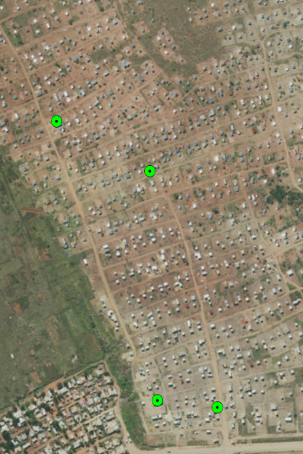
Mapping of Spaza shops for Small Business Development Department
Ha-Mphego Village; Limpopo
New informal settlement
Atteridgeville

Slide 22
Situational platform -Data visualisation visited by the President on 9 April 2020

Slide 23
Progress to date : Development of PPE and sanitizers
The Product Development Technology Station at the Central University of Technology has been developing personal protective equipment (PPE), specifically the airway protection device for healthcare workers.
The eNtsa Programme at Nelson Mandela University is making 3D printing face shield frames design and printing modifications to enable clinicians to easily replace standard A4 transparent sheets without the need for holes, adhesives, etc.
Technology Stations in Chemicals immediately started with the production of the first batch of 5 000 containers of hand sanitiser to be distributed to staff and to be placed at strategic points and assist vulnerable communities, like old age homes.

Slide 24
Progress to date – international cooperation
Participation in UNESCO Virtual Ministerial Conference on the role of Open Science in fighting Covid-19
Development of BRICS Science and Innovation partnerships to respond to Covid-19
Providing leadership to African Union science and innovation programmes as AU Chair – AU Ministerial Meeting on 30 April
Co-funding with European Union through European Developing Countries Clinical Trials Partnership
Development with NRF of pan-African rapid response research programme involving 15 countries looking at: understanding the virus; prevention and control; African health governance systems; socio-cultural dynamics of transmission; mental health; and vulnerability
Leveraging investments of SKA Africa partnership in human capability and research infrastructure to provide Covid-19 data science capacities in Southern African

Slide 25
Rolling out of energy solutions to support security deployments
Fuel cells systems available for deployment to provide power to hospitals and medical facilities managed by the Department of Public Works and infrastructure and Department of Defence that will support COVID- 19 patients. These are available for deployment immediately
SolarTurtle and BabyTurtle, a solar technology developed from DSI funded research
to deploy at police check points to ensure that policy can charge phones as well as other electrical appliances when they are out in the field.

Slide 26
Way forward
Continued support beyond lockdown, and beyond COVID-19
Support for local manufacturing of vaccines, PPEs, ventilators, diagnostics, and reagents
Coordination of effort around data generation, analyses and decision support
Uptake by government of local solutions
Improved engagements with Provincial and local government

Slide 27
Contents
Thank You Dankie Enkosi Ha khensa Re a leboga Ro livhuwa Siyabonga Siyathokoza
Chapter 01
Chapter 01
Chapter 01
Chapter 01
Chapter 01
Chapter 01
Chapter 01

