Slide 1
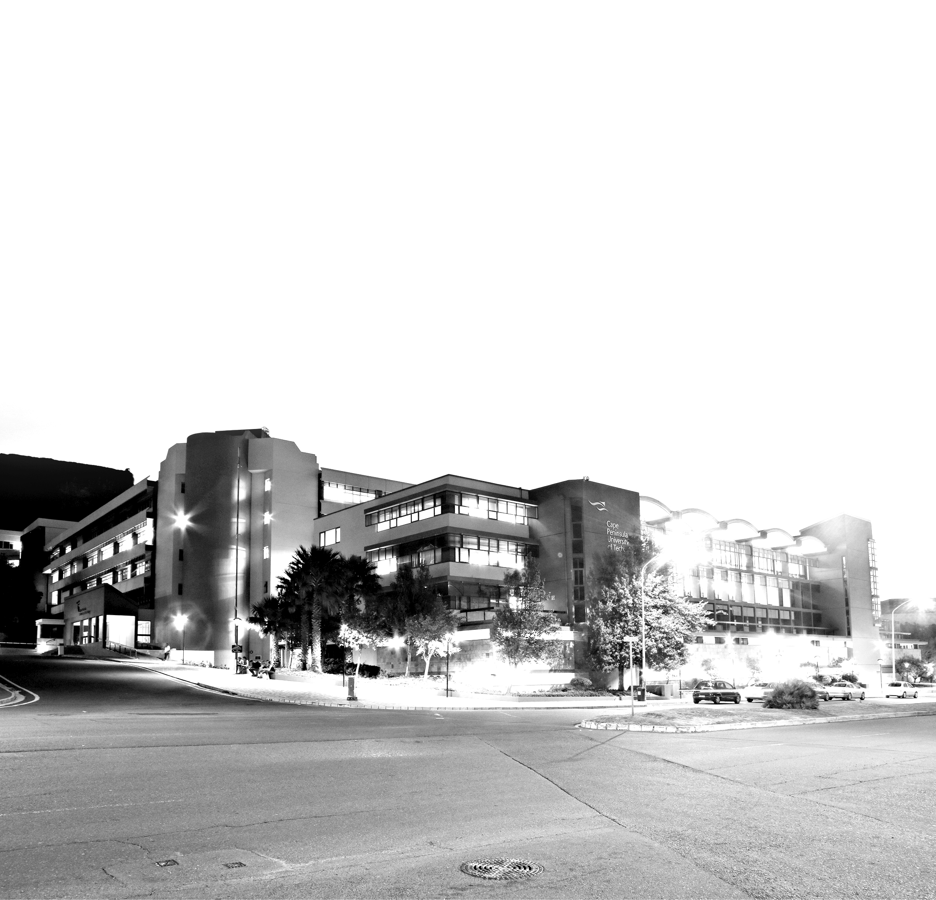
Presented by Prof Chris Nhlapo, CPUT Vice-Chancellor – 17 March 2020

Slide 2
Table of Contents
Registration and Enrolment
Teaching and Learning
Process of Disbursement of allowances to NSFAS qualifying students
NSFAS Status
NSFAS Interventions
NSFAS Batch Payment clarity
Report on Protest incidents
Mitigation

Slide 3
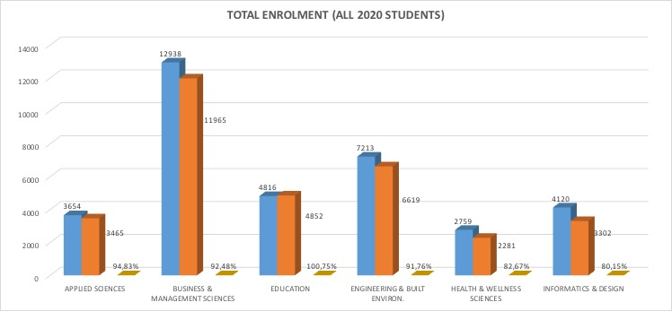
Registration and Enrolment

Slide 4
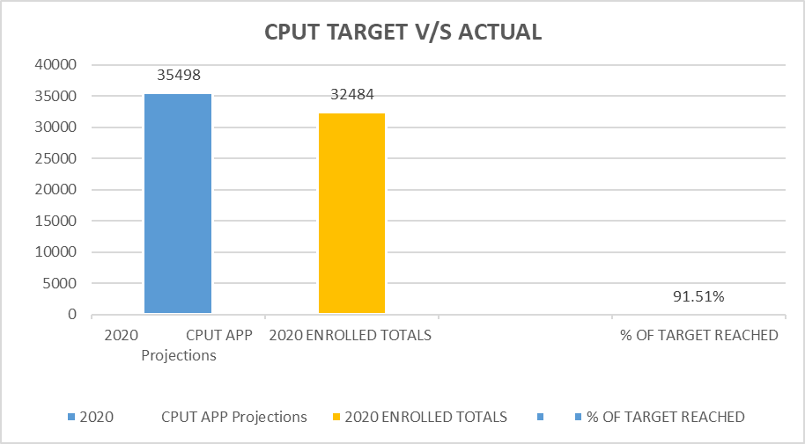
Registration and Enrolment

Slide 5
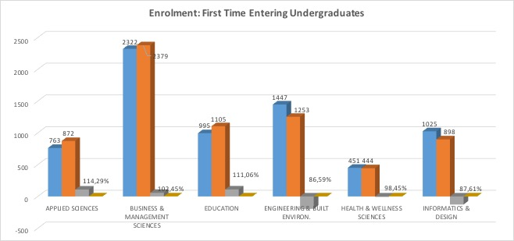
Registration and Enrolment

Slide 6
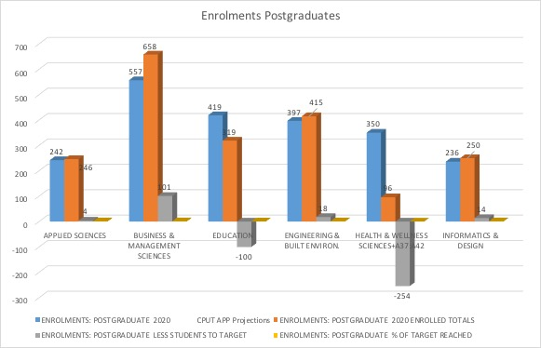
Registration and Enrolment

Slide 7
Teaching and Learning
Plans were workshopped and developed with Faculties in respect of the disruptions: This explored various scenarios on possible interruptions to the academic project.
This included the closure until the
20 March 2020
Realignment of academic activities were undertaken by individual faculties and at this point there was no need for institutional calendar amendments.
Teaching, Learning, Assessment, Postgraduate supervision, practical's, laboratory work and Work Integrated Learning activities will go ahead in accordance with the Faculty and departmental priorities.
Graduations have been postponed
At this stage there has been no impact on the June assessment period.

Slide 8
Process of Disbursement
of allowances to NSFAS qualifying students
Receive NSFAS Funded Report (provided by NSFAS or download from NSFAS Portal)
31 January
R126 810 912,00
1
  Verification of assessments (approx. 2 weeks)
  Preparation of NSFAS qualifying students Allowance Template (approx. 3 days max)
28 February
R29 126 363,00
Prepare Registration Template
Request NSFAS to validate the registration template and generate New Bursary Agreement (NBA)
Receive Remittance and disbursement report from NSFAS (NSFAS makes payments in tranches) and we reconcile
2
3
4
TOTAL
R155 937 275,00

Slide 9
NSFAS Status
1
2
3
Funds disbursed from CPUT
Number of approved NSFAS students as at 16 March 2020 -
Upfront payments received from DHET:
Amount: R126 810 912m on 31 Jan and R29 126 363m on 28 Feb
Total of R 155 937 275
Allowances
These issues are outlined below:
A total of 10 008 students have been paid their allowances with a total value of R80 190 400.
There are still 3 985 students that still need to receive a total of R32 677 000 in allowances but cannot be paid due to various banking issues.
1983
students
have failed the bank verification, meaning that the account is invalid or the ID number does not
match the
recipients
173
payments were rejected by banks due to accounts being closed or frozen
1 144 students
have not
provided banking details yet
685
students
have submitted incorrect banking details on the portal

Slide 10
NSFAS Status
A total of
R65 000 000
will be paid to students in April as monthly living allowances and backdated transport allowances.
VS
R50 million
which other
universities raise!
A transport allowance has not been paid to non-resident students as the process of private boarding accommodation and housing placement is still on-going.
This allowance
will be back-dated and paid with the April allowances upon the confirmation of the accommodation status of the students.
CPUT raises
R40 000
in contributions
from Alumn

Slide 11
NSFAS Status
Returning Students
The issues are listed below:
1256
students still have
NSFAS appeals in process.
NSFAS has extended the closing date to 20 March 2020. We are busy assessing these appeals to prepare for them for the Appeal Committee to recommend for 2020 funding decisions.
287
are not on the NSFAS funded report
482
students
have been linked to other bursaries
NSFAS has confirmed the funding of 6 786 returning students.
Of these students there are still 2 248 students with outstanding matters that are delaying their funding.
205
new applicants are transferring from other tertiary institutions and we are awaiting their academic results
18
have not signed the NBA (new bursary agreement)
880
submitted manual applications that are waiting for decisions from NSFAS.
1 004
need their private boarding arrangements to be assessed and verified.

Slide 12
NSFAS
What
CPUT has done about those students that did not receive their allowances?
1
SMS to students (weekly bulk sms)
2
Emails to students (weekly and on bank rejection)
Explored the option of dedicated/customised card and discussed with students (Not agreed on due to banking card cost to host?)
3
4
Man & SRC meetings (once per term)
Sub-committee of Man & SRC: 4 x 4 TT discussions between Management and CSRC (3 times a week)
5

Slide 13
NSFAS
Other
and future planned interventions
1
Newsflash (for example Sat 14 March)
Launch campaign to include and address challenges as listed:
2
Train and assist students to capture banking details in computer laboratories;
i.e. incorrect ID numbers;
engage banks and students on frozen accounts
signing of NBA

Slide 14
NSFAS
Batch payment clarity
All students are processed at the same time on the 1st of each Month.
delays by individual banks for clearance and money to reflect.
service providers also send confirmation to students.
further continuous payment as students are cleared and funded reports are received from NSFAS
CPUT confirmation of student payment is restricted to 500 at a time, but all are processed on the same day.

Slide 15
REPORT on protest incidents
Academic opening
Staff welcome
A peaceful start to
2020
Initial demands and constant engagement through task team throughout February

Slide 16
REPORT on protest incidents
Continuous disruption of classes across different campuses
Continuous damage of property
        2 March - Stoning of admin building at night; burning of L&T food truck;
        3 March - 17 cars stoned on campus
        5 March - Memorandum with 13 demands delivered to VC @ 15h30
        5 March evening - Before responses were given, students went on rampage (Burning of the security car and two investigation offices)
        9 March – attempted arson against security control room
        9 March - HWS pre-fab classrooms attempted arson;
        10 March – attempts to blow up gas cylinders at Applied Sciences; attempts to burn various buildings at Construction, Mechanical, Electrical, etc.
    Classes suspended for 6 March; 9 March; 11 – 13 March
13 March
Decision to bring the recess period forward up to Term 2 after consultation with Council Exco
Continuous vandalism on campus; defamatory statements; intimidation of staff and students; disruption of classes;

Slide 17
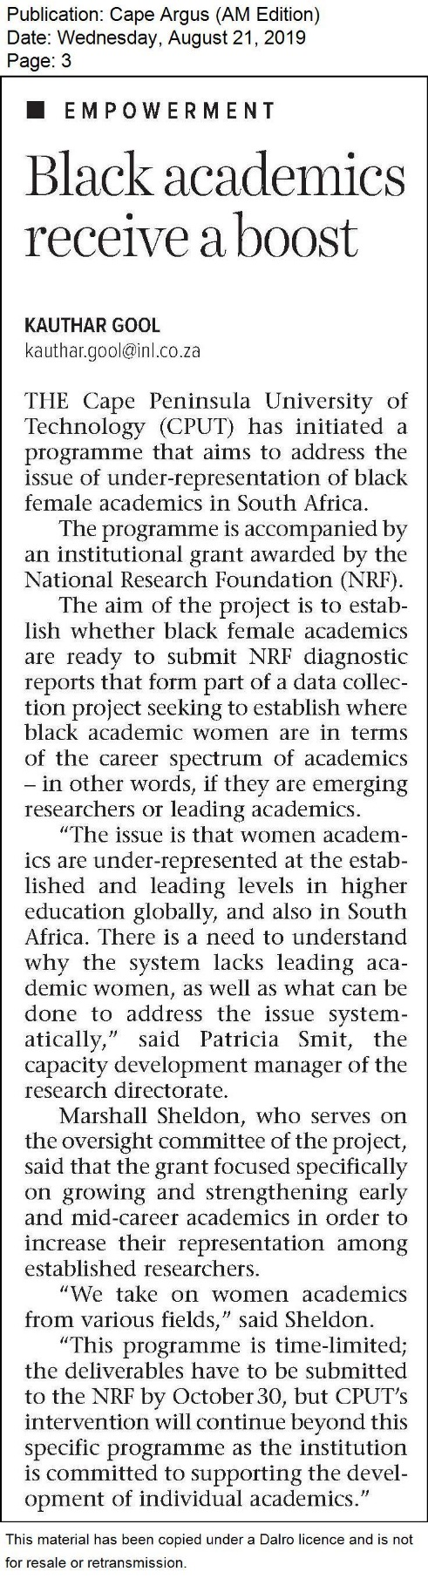
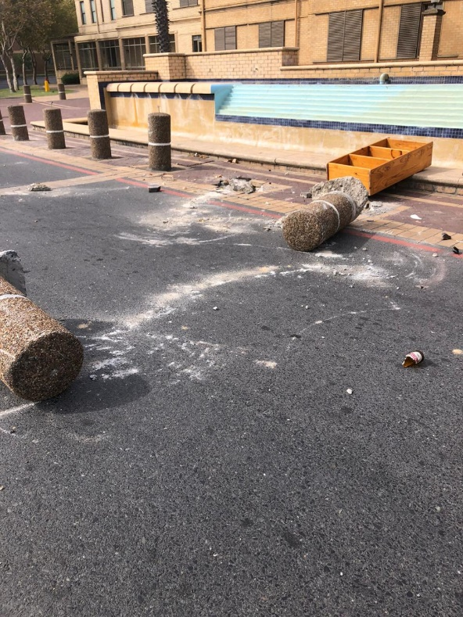
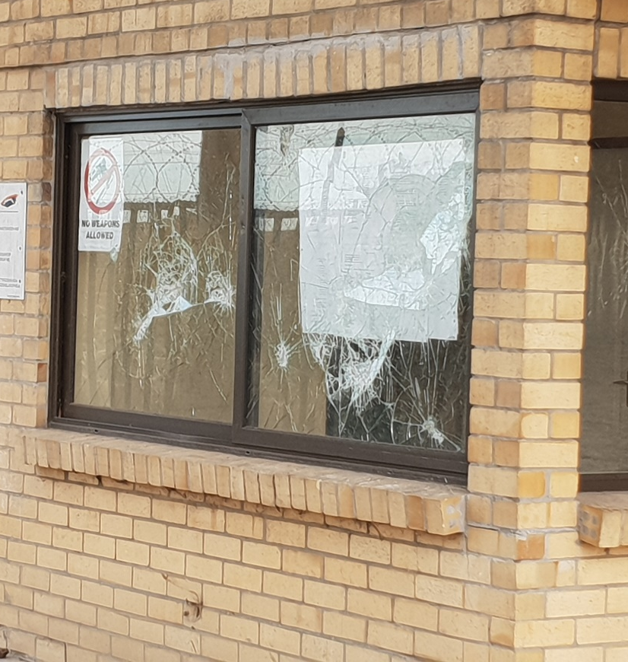
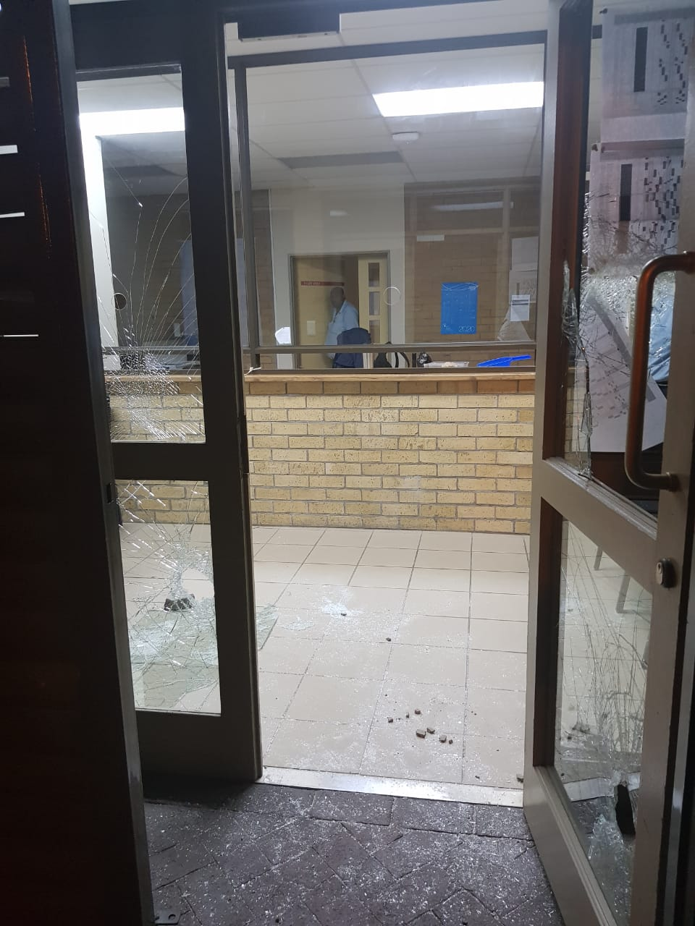
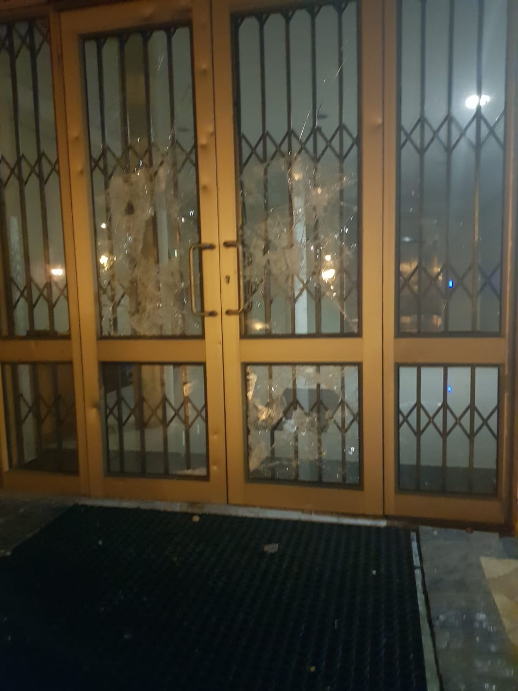
9 - 13
March
2020
Damage to buildings - 2 March 2020

Slide 18
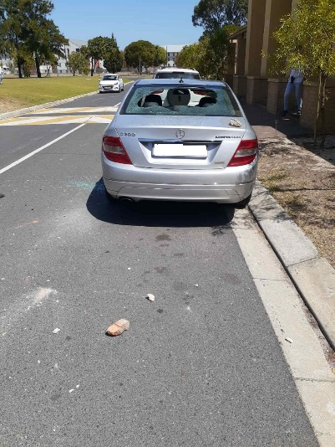
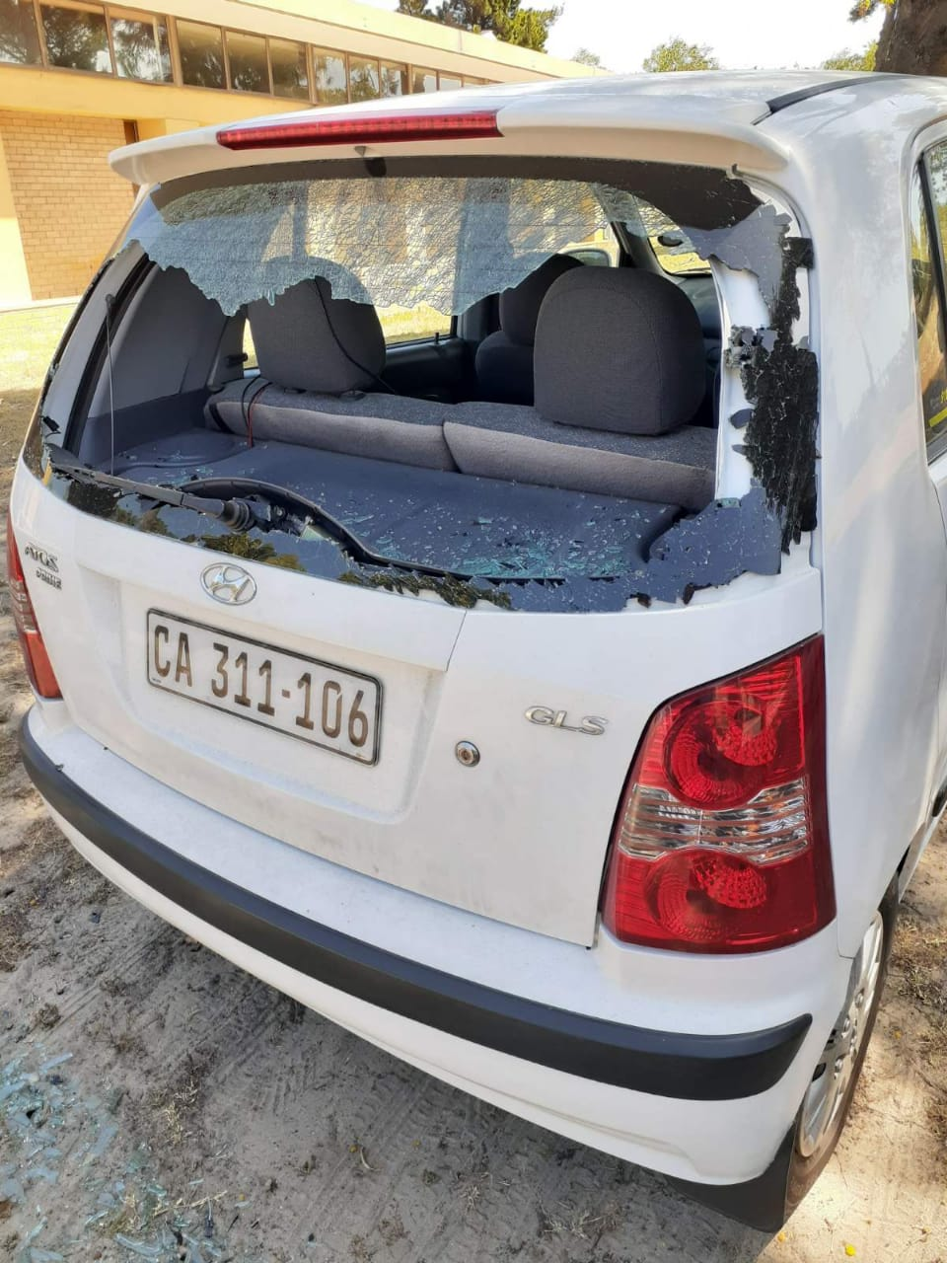
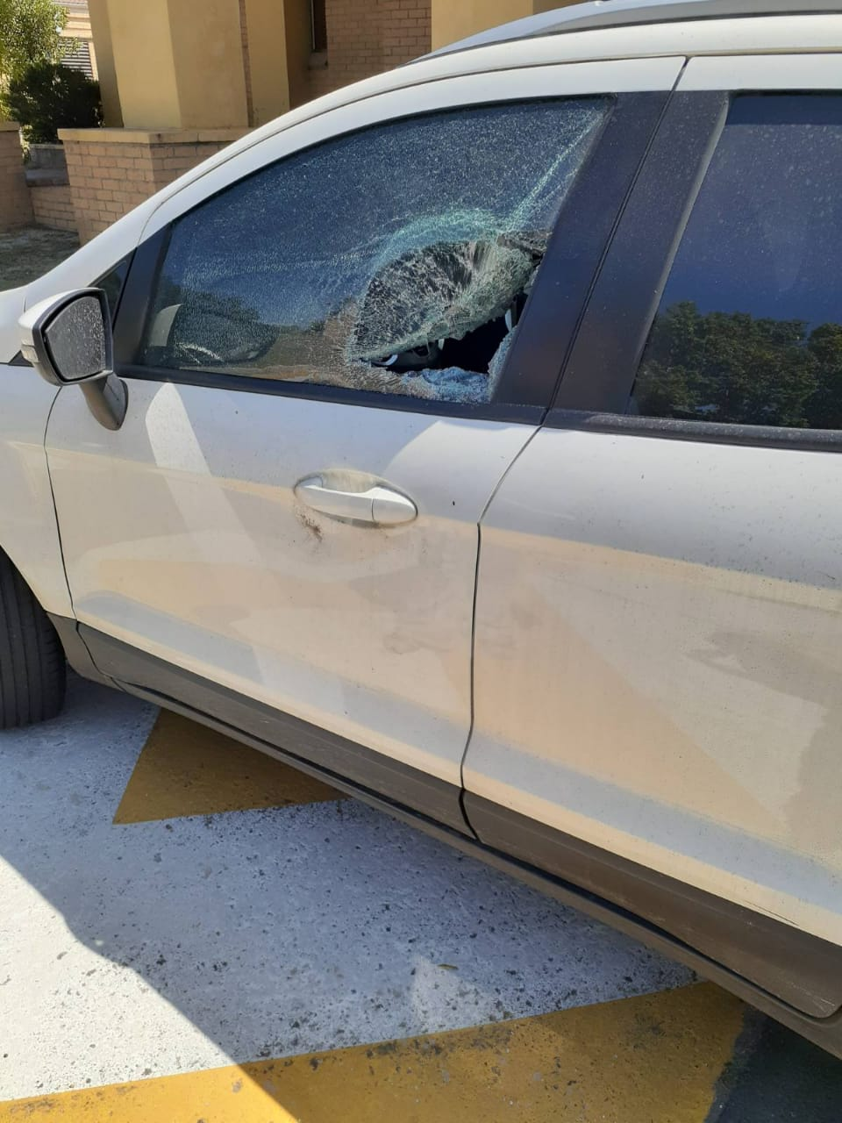
9 - 13
March
2020
Cars stoned - 3 March 2020

Slide 19
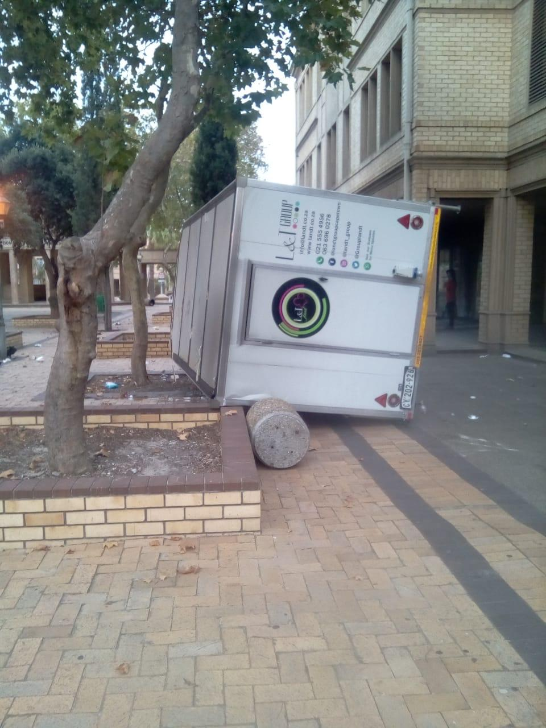
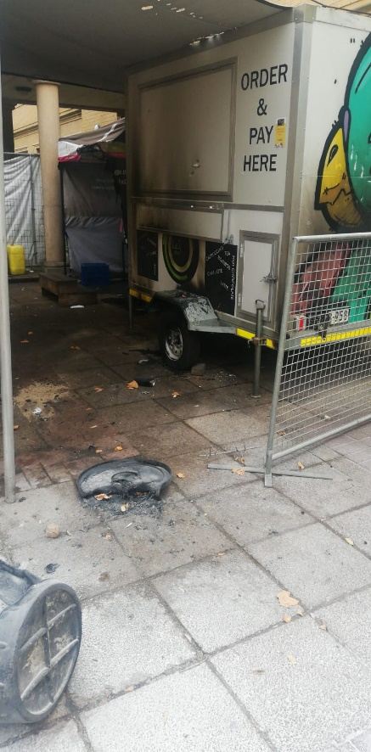
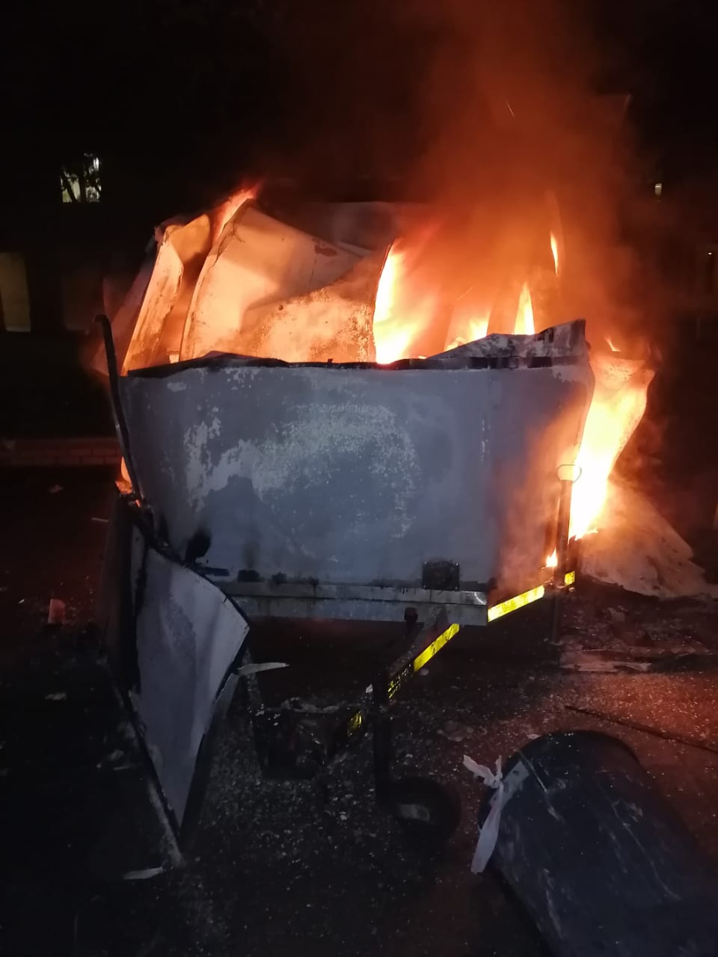
9 - 13
March
2020
Food truck damages- 3 March 2020

Slide 20
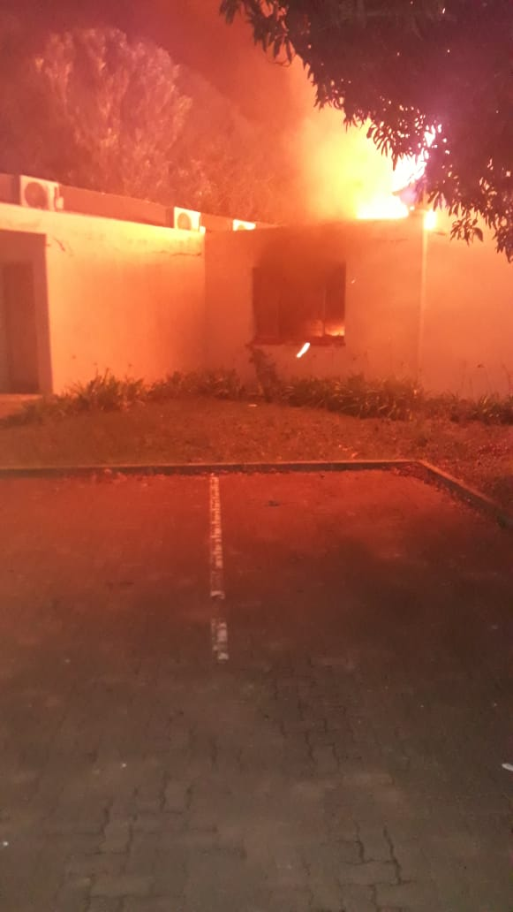
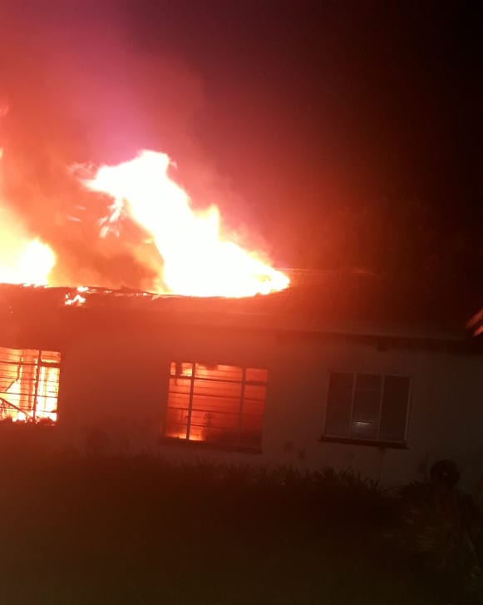
9 - 13
March
2020
Building damaged - fire
Investigation Offices burnt and sabotaged – evening 5 March 2020

Slide 21
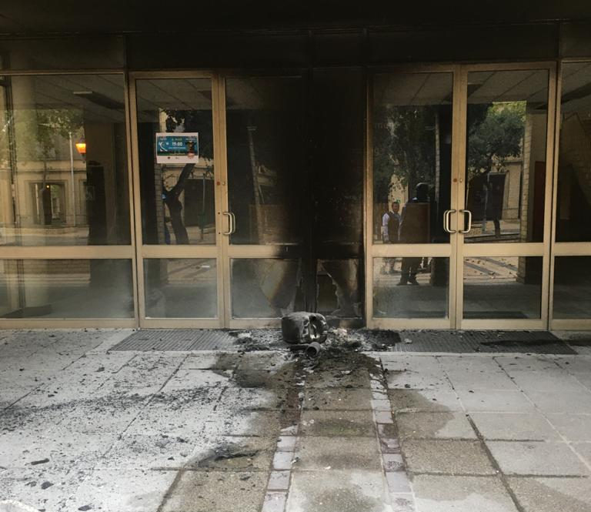
9 - 13
March
2020
Building damaged - fire
Failed Petrol Bomb
Construction Engineering Building - 5 March

Slide 22
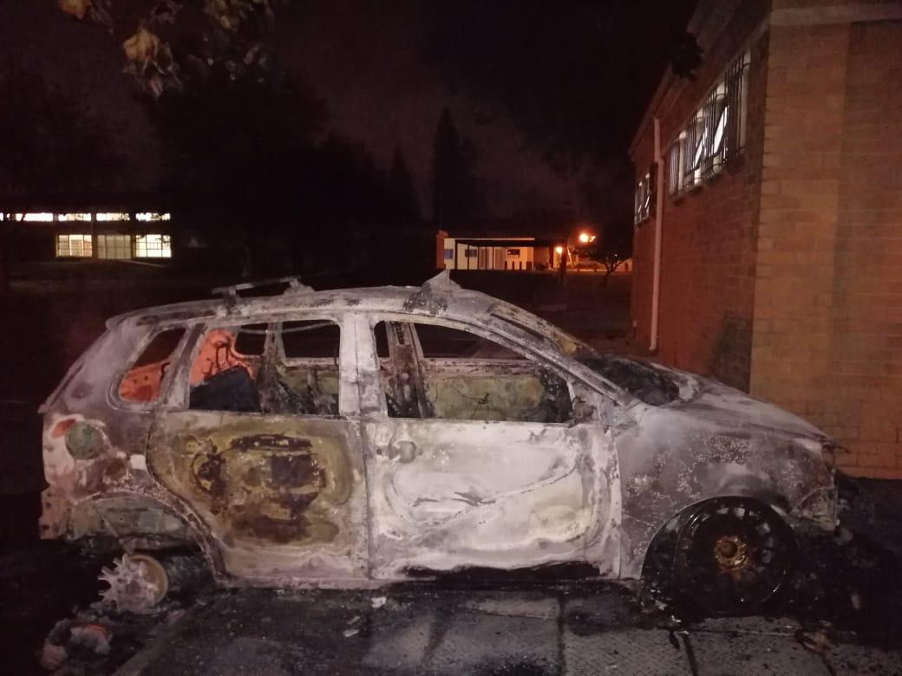
9 - 13
March
2020
Damage
caused by protests
Cars burnt and damaged - 5 March

Slide 23
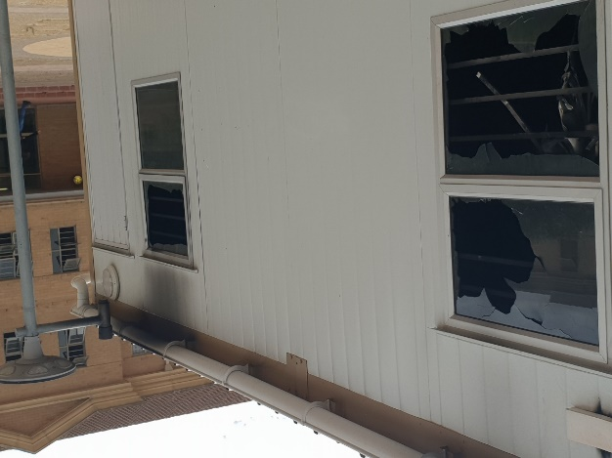
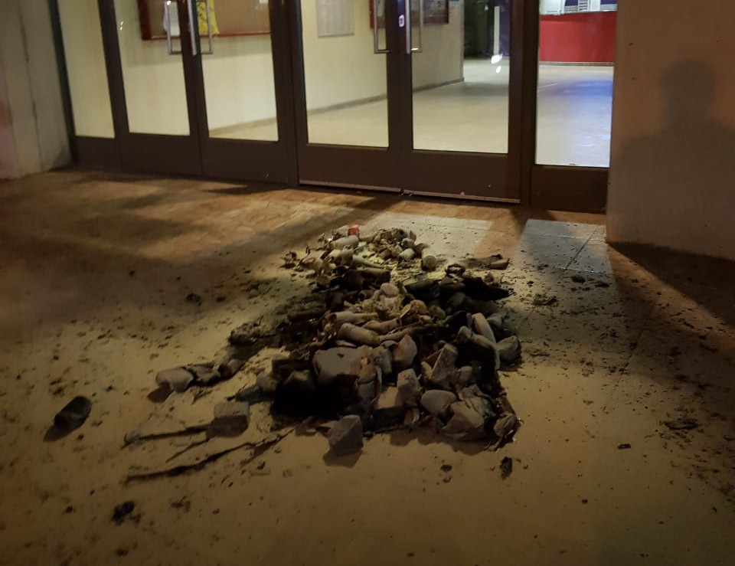
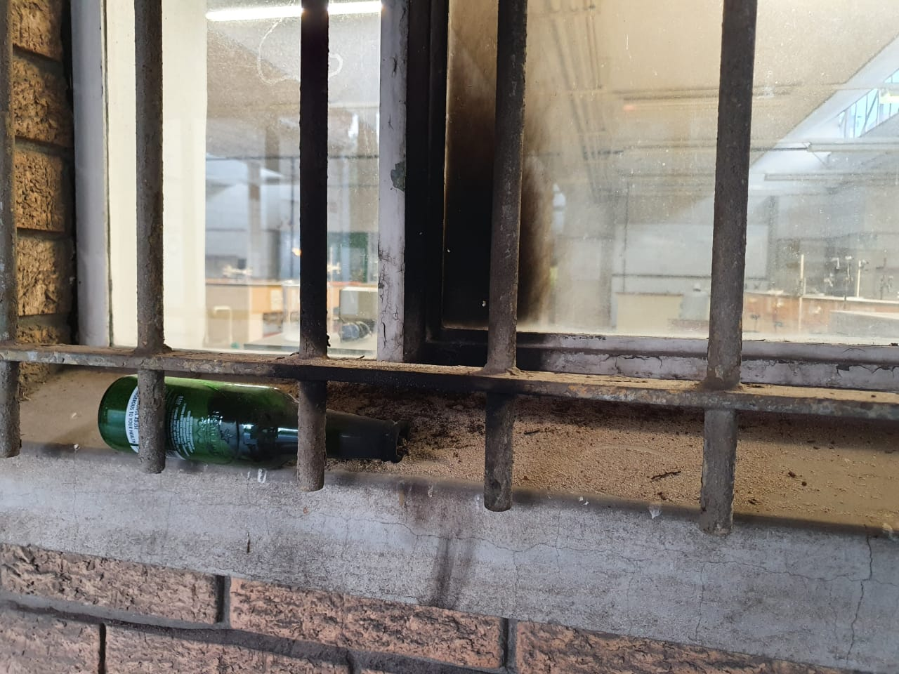
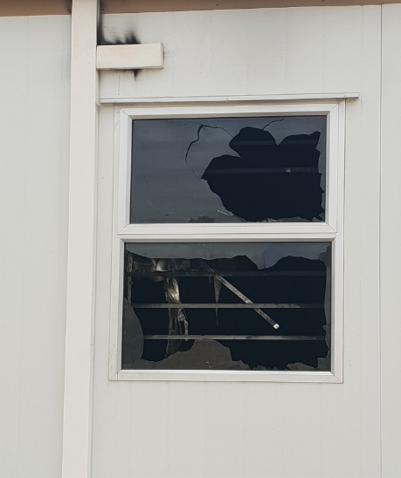
9 - 13
March
2020
Damage
caused by protests
Building and Prefab Classrooms –
Attempted arson - 9 March

Slide 24
MITIGATION
Steps taken to address
Stakeholder engagements
        Continuous attempts to engage with student leadership by Management
        Engagements with stakeholders such as Unions, Convex, Exco of Council,
        Engagements with SAPS; CoCT;
        Engagements with external stakeholders: DHET; USAF;
Continuous communication to students and staff

Slide 25
27 January
– 3 March
2020
        Engagement with students
        4 x 4 task team between Management and Students
        Meeting 2–3 times per week to discuss burning issues
        Reach solutions and execute implementation
        24/7 TT Communication network
        All demands responded to within the timeframe (Friday 6 March 2020)
        Ongoing security measures to protect people and property

Slide 26
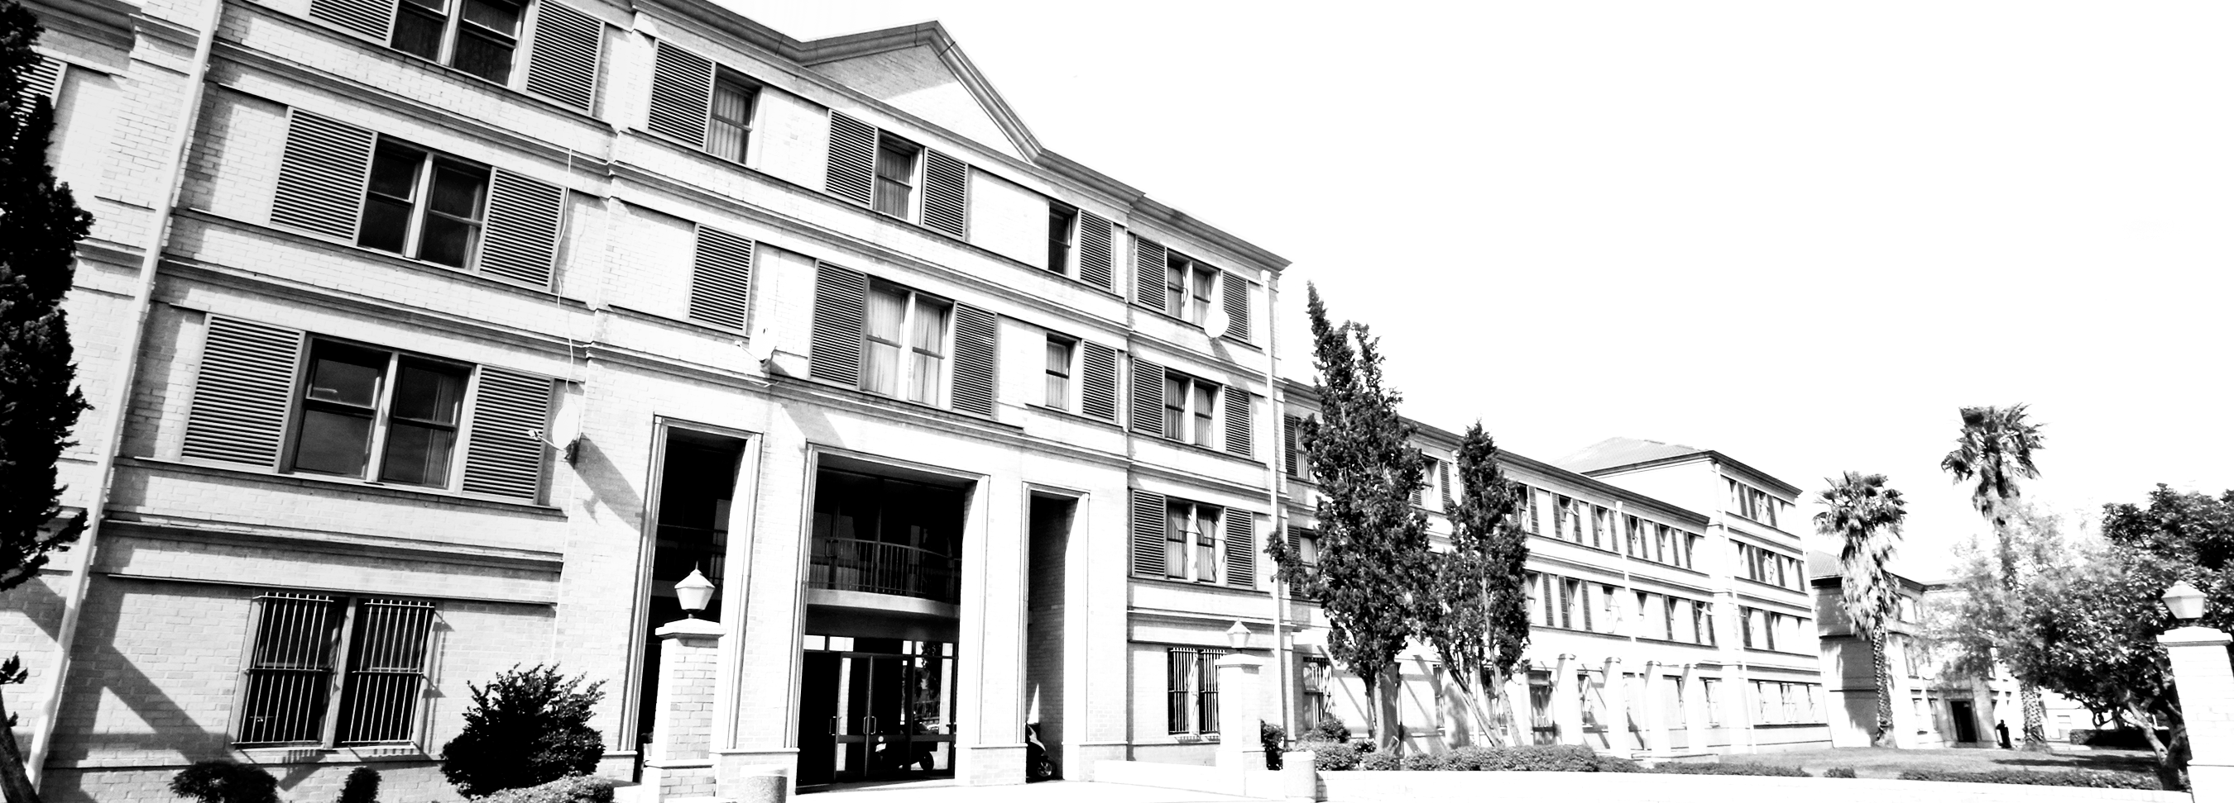
Thank you/Dankie/Enkosi

