Slide 1
Together Building A Better District

Slide 2
State of Water Services Delivery within the
Ugu District Municipality (WSA)
Presentation to Parliamentary Portfolio Committee of Co-Operative Governance and Traditional Affairs (COGTA)
13 March 2020

Slide 3
TABLE OF CONTENTS
Overview of Ugu District Municipality
Water Supply Challenges
Labour Relations Challenges
Technical Challenges
Required Interventions and Progress
Financial Management Issues
Conditional Grants Expenditure
Critical Vacancies
Communication Plan
Stakeholder Engagements
Customer Relations Management (Call/Control Centre)
Conclusion

Slide 4
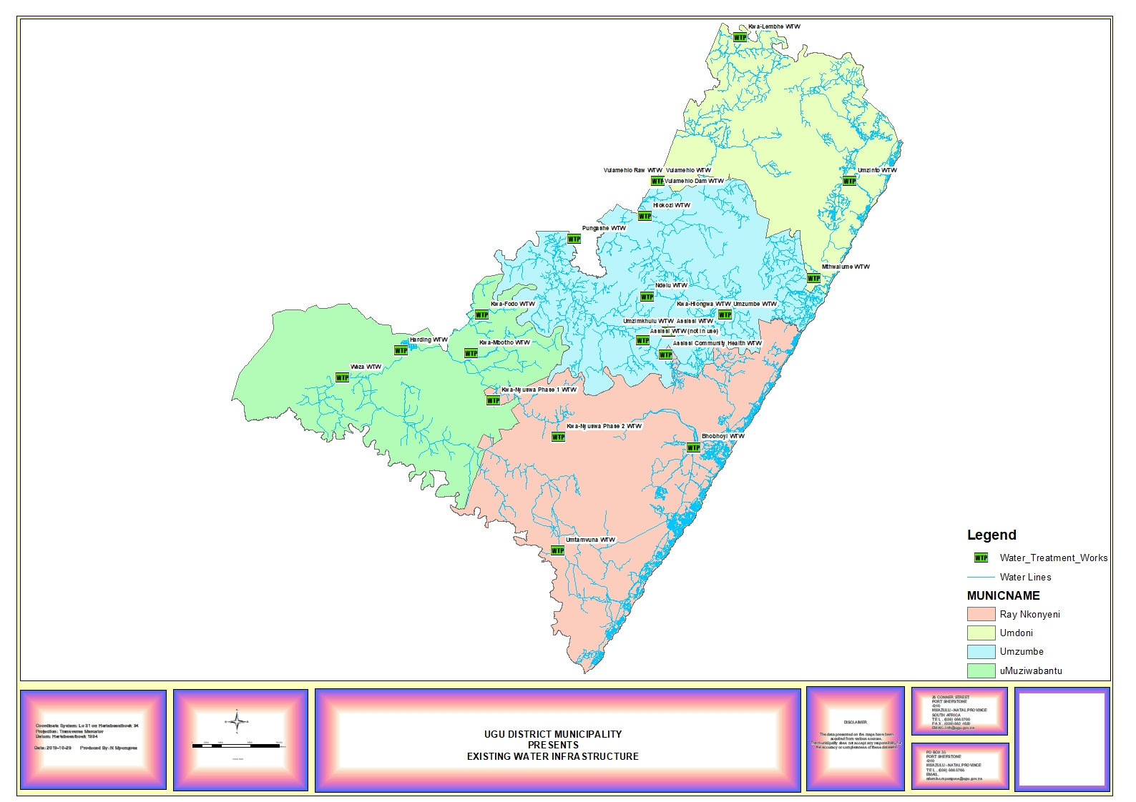
OVERVIEW OF UGU DISTRICT MUNICIPALITY

Slide 5
OVERVIEW: STATUS OF WATER SERVICES PROVISION
TOTAL NUMBER OF HOUSEHOLDS | NUMBER OF HOUSEHOLDS WITHOUT ACCESS TO WATER | NUMBER OF HOUSEHOLDS WITH ACCESS TO WATER | PERCENTAGE OF ACCESS | PERCENTAGE OF BACKLOG
175 146 | 26 529 | 148 617 | 84.9% | 15.1%
Total Population = 753 336 (Census 2016) with an Annual Growth Rate of 2.03%
Sanitation Backlog = 13%

Slide 6
WATER SUPPLY CHALLENGES
Labour Relations
Technical Challenges

Slide 7
LABOUR RELATIONS CHALLENGES
Since 2016 Ugu DM has been having persistent labour relations challenges leading to unprotected strikes
Initially 9 Shopstewards were suspended and charged for misconduct in January 2020
A further 5 Shopstewards were suspended and charged for misconduct in January 2020
This resulted in an unprotected strike which commenced from 08th January 2020 till the end of February 2020 where the services of 121 employees were terminated.
As the consequence of these actions, increases in incidents of vandalism of infrastructure, torching of municipal fleet, and intimation of staff, were experienced, with negative impacts on water supply throughout the district
All these criminal actions have been reported to the SAPS

Slide 8
TECHNICAL CHALLENGES
Inadequate Bulk Infrastructure and Raw Water Resources
Aged Infrastructure
Power Load Shedding

Slide 9
RAW WATER RESOURCES AND BULK INFRASTRUCTURE
SUPPLY SYSTEM / DAM | STORAGE LEVEL AS AT 10 MARCH 2020
Umzimkhulu Dam | 35%
Mthamvuna | 0%
Harding Dam | 20%
KwaFodo | 80%
Umzinto Dam | 100%
EJ Smith Dam | 100%
Mhlabashane Dam | 62%

Slide 10
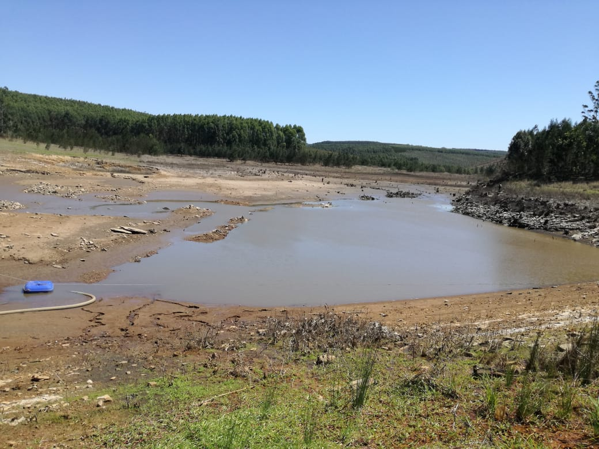
RAW WATER RESOURCES AND BULK INFRASTRUCTURE
Harding Dam

Slide 11
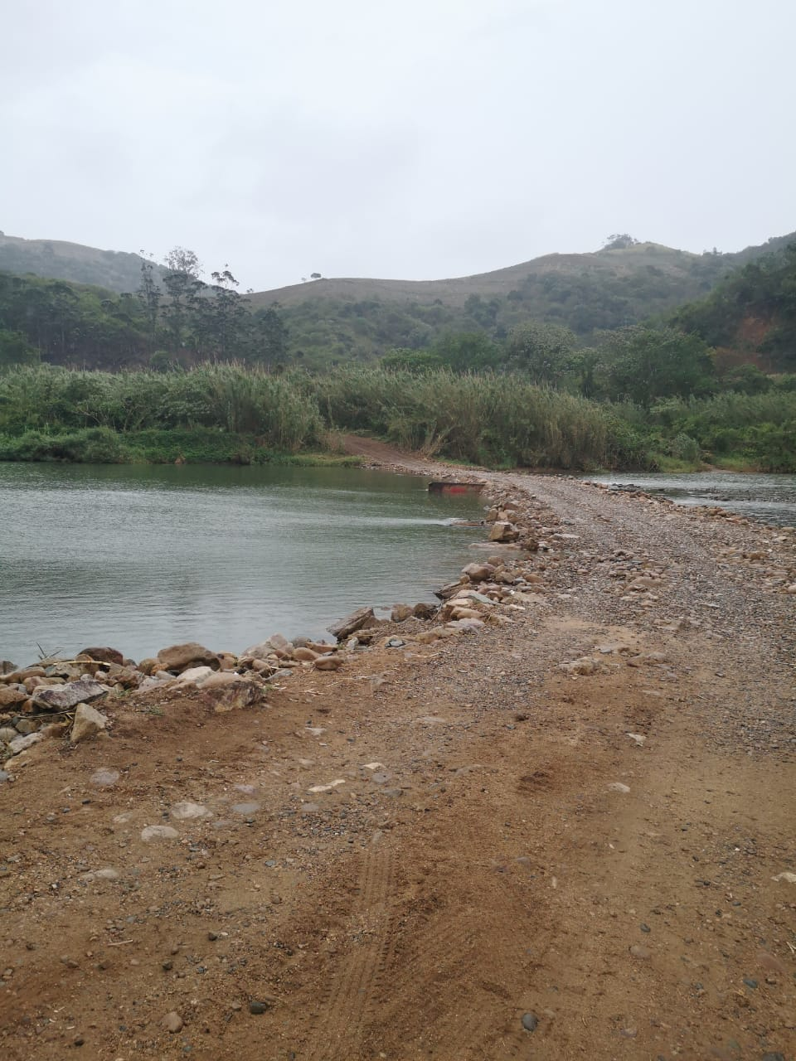
RAW WATER RESOURCES AND BULK INFRASTRUCTURE
Umzikhulu River Earth Berm

Slide 12
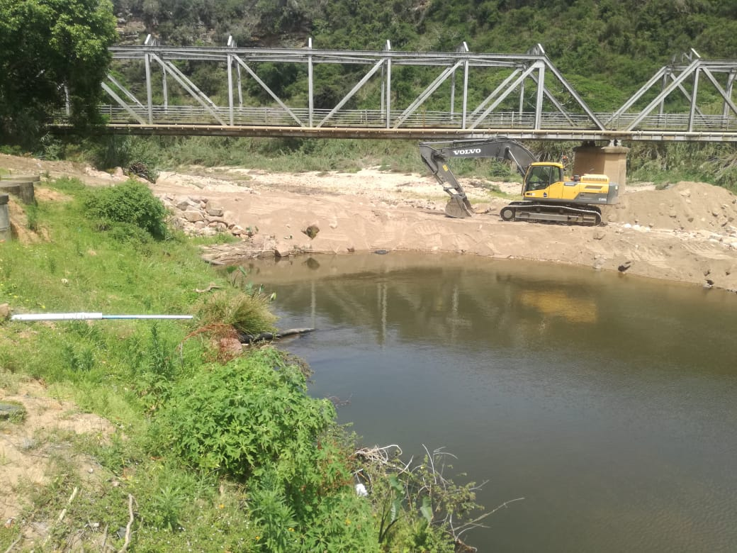
RAW WATER RESOURCES AND BULK INFRASTRUCTURE
Mthwalume River Raw Water Abstraction Point

Slide 13
WATER TREATMENT WORKS
Waterworks Name | Co Ordinates |  | River/ Source Water | Design Capacity |  | Utilisation vs Capacity | Population Served | ADD | Class of works
 | Longitude | Latitude |  | Ml's/Day |  | % | No. | (L/p/d)
Vulamehlo | 30.19.39S | 30.19.52E | Mtwalume River | 1.5 | Upgraded to 4.5 | 133.3 | 35740 | 55.96 | B
KwaNdelu | 30.30.15S | 30.18.41E | Umzumbe river | 1.4 | 1.4 | 50 | 15732 | 44.5 | C
Phungashe | 30.24.55S | 30.06.05E | Mhlabashane dam | 0.5 | 1 | 22 | 10930 | 20.13 | C
KwaLembe | 30.10.63S | 30.47.82E | Umkomaazi river | 0.75 | 2.5 | 68 | 9654 | 77.69 | C
Hlokozi | 30.22.51S | 30.18.30E | Stream | 0.36 | 0.36 | 55.6 | 4308 | 46.43 | C
KwaMbotho | 30.35.21S | 29.59.56E | Dam | 0.48 | 0.48 | 100 | 15492 | 30.98 | C
KwaFodo | 30.31.50S | 30.01.04E | Dam | 0.36 | 0.36 | 69.4 | 9372 | 26.68 | C
Assissi | 30.33.33S | 30.02.59E | Umzumbe river | 4 | 0.36 | 100 | 11000 | 81 | C
KwaNyuswa 1 | 30.39.42S | 30.02.16E | Stream | 0.36 | 0.36 | 69.4 | 7692 | 32.5 | C
KwaNyuswa 2 | 30.43.09S | 30.09.09E | Stream | 0.36 | 0.5 | 30 | 3006 | 49.9 | C
Harding (4Feb 2013)* | 30.35.03S | 29.52.30E | Harding Dam |  |  | 150 | 79326 | 135 | C
KwaHlongwa | 30.31.58S | 30.27.02E | Stream | 0.75 | 0.5 | 50 | 2814 | 88.84 | C
Weza* | 30.37.28S | 29.46.10E | Weza & Mzimkhulwana streams | 3.6 | 4 | 203 | 0 | 135 | C
Bhobhoyi | 30.44.09 S | 30.23.36 E | Umzimkhulu River | 54 | Upgraded to 81 | 107 | 105045 | 552 | B
Mtamvuna | 30*53’37.26” | 30*08’57” | Mtamvuna River | 20 | 20 | 80 | 65135 | 215 | B

Slide 14
REQUIRED INTERVENTIONS AND PROGRESS
Water Supply scheme | Local Municipality & Wards | Remedial Action | Cost | Progress
Harding Raw water supply | uMuziwabantu (1,2,3) | Raw water transfer pipeline from Weza River (Umgeni water), Boreholes and Spring Protection | R60 000 000 (Umgeni) R5 000 000 | Umgeni Water at Bid Adjudication Stage To be included in 2020/21 Draft Budget
uMtamvuna raw water pump station | Ray Nkonyeni (1,2,7,8,9,10,11,30,31,32,33,34,35,36) | Upgrade electricity supply with a new bulk connection from Eskom and new pumps | R14 000 000 (COGTA) R3 000 000 | Funding received on 10-03-2020 and will be paid to Eskom Pumps Purchased: 1st Pump arrived in February 2020 and 2nd Pump expected to be delivered by end of March 2020

Slide 15
REQUIRED INTERVENTIONS AND PROGRESS
Water Supply scheme | Local Municipality & Wards | Remedial Action | Cost | Progress
Malangeni water supply | Umdoni (7,8,9,11) | Upgrade of Esperanza pump station and associated pipework | R3 500 000.00 R 1 385 000.00 (COGTA) | R1 385 000.00 received from COGTA on 10-03-2020 and will do co-funding through MIG
Bhoboyi raw water abstraction | Ray Nkonyeni (5,6,12,13,14,15,16,17,18,19,20,21,22,23,2425,26,27,28,29) | Short term installation of a temporary berm Medium to long term permanent concrete weir | R2 700 000 (COGTA) R40 000 000 | Funding received and tender closed on 05-03-2020 Reprioritising of MIG Implementation Plans and include in 2020/21 Draft Budget

Slide 16
PROPOSED ALTERNATIVE WATER SUPPLY
SHORT-TERM
Spring Protection Systems (District wide) – R6 500 000.00
Replacement of critical mechanical and electrical components – R24 000 000.00
Borehole Refurbishment ( District Wide) – R5 000 000.00
URGENT FUNDING REQUIRED (SHORT TERM) – R63 700 000.00
MEDIUM TO LONG-TERM
Umgeni South Coast Pipeline (SCP) Phase 2B- (Umgeni water)
Cwabeni Off-Channel Storage Dam – R1 000 000 000.00
Mhlabashane Phase 2 – (Umgeni water)
MEDIUM TERM FUNDING REQUIRED – R1 109 000 000.00

Slide 17
REQUIRED INTERVENTIONS: WATER TANKERS
Ugu Owned | Ugu Operational | Hired Water Tankers | COGTA Yellow Plant Support | COGTA Strike Intervention
35 | 20 | 20 | 2 | 2
The 15 Non Operational Ugu owned Water Tankers have gone for repairs and a detailed conditional assessments are undertaken to consider auctioning those that need to be scrapped.

Slide 18
FINANCIAL MATTERS
Council Budget:
The municipality is indeed facing challenges around the budget which is being attended to in conjunction with Provincial Treasury hence the revision of the Draft Adjustments budget that was adopted by Council on the 28th February.
Provincial Treasury has requested further cuts on expenditure which the municipality implemented and was tabled to Council on the 12 March 2020.
Going forward our 2020/21 budget will be based realistic revenue assumptions and our expenditure will be aligned with anticipated revenue collection and cost containment measures.

Slide 19
DEBT RECOVERY
There’s been challenges with the billing system which are being attended to continuously. The reason for these challenges is that we moved from Revenue Management System (RMS) to Sage which is not fully configured.
There has been an improvement in the turnaround time in respect to attending to customer queries.

Slide 20
DEBT RECOVERY
We have had service interruptions with South African Post Office as payments were not made on time due to the financial constraints. Customer bills are now being sent to the customers on a monthly basis.
The municipality calculates its collection ratio based on the monthly billings vs receipts that is why there is a difference between the ratios.

Slide 21
DEBT COLLECTION RATE

Slide 22
CUSTOMER TYPE AGE ANALYSIS FOR MONTH ENDING 31 JANUARY 2020

Slide 23
METER READING STATISTICS

Slide 24
FINANCIAL INTERVENTION
Assistance is being provided by Provincial Treasury and COGTA to address government debt.
Focus is being placed on high consumers to strengthen collection
The municipality is considering the handing over of long outstanding debt.
Indigent register is being reviewed to align with the registers of local municipalities.
Financial recovery plan has been developed; it’s currently being reviewed to optimize the effectiveness of implementation.

Slide 25
CONDITIONAL GRANTS SUMMARY
DESCRIPTION | TOTAL ALLOCATION FOR 2019 / 2020 FINANCIAL YEAR | TOTAL RECEIPTS AS AT 29-02-2020 | ACTUAL EXPENDITURE AS AT 29-02-2020 | ACTUAL BALANCE AS AT 29-02-2020 | EXPENDITURE PERCENTAGE AT 29-02-2020 | FUNDER
MUNICIPAL INFRASTRUCTURE GRANT (MIG) | R241 038 000.00 | R156 000 000.00 | R131 942 490.05 | R24 057 509.95 | 54.74% (85%) | DCOG / COGTA
WATER SERVICES INFRASTRUCTURE GRANT (WSIG) | R50 000 000.00 | R35 000.00 | R30 742 363.34 | R4 257 636.66 | 61.48% (88%) | DWS

Slide 26
CRITICAL VACANCIES
The post of the Chief Financial Officer has advertised and shortlisted, interviews will be held shortly.
The Project Management Unit (PMU) is also being capacitated.
Also the Revenue Management Unit is being capacitated to prove revenue collection.

Slide 27
COMMUNICATION PLAN
Mayor has convened meetings with all ward councilors within the district to appraise them about the state of water challenges and interventions being implemented, with the view to communicate same to their constituencies.
The call centre has been upgraded and is receiving up to date information which is communicated to different stakeholders.
Through the Mayor engagement with different stakeholders has commence in particular business sectors and communities mostly affected by intermittent supply.
We are using all media platforms to communicate challenges and solutions.

Slide 28
CONCLUSION
Ugu District we acknowledge that we have challenges, but they are insurmountable.
We appreciate that the Premier’s office, COGTA, Provincial Treasury, Department of Water & Sanitation and Umgeni Water Board are on board to support us with resources.
The most urgent task on our side is to fill critical vacancies and to continue the engagement with stakeholder and give them hope that everything is under control.
We will appreciate inputs and recommendations of the Committee on how we can strengthen and improve on interventions already in place.

Slide 29
THANK YOU
ENKOSI
DANKIE

