Slide 1



sefa 3rd Quarter Performance Report
Financial Year 2019/20
Portfolio Committee on Small Business Development
11 March 2020

Slide 2
Presentation Outline
Dashboard Q3 FY2019/20
Introduction
Loan book performance
  Approvals
  Disbursements
Development impact
  SMMEs financed and jobs facilitated
  Support to targeted groups
Post-Investment Monitoring
  Portfolio at risk
  Collections
Financial performance
Governance
Human capital management
Balance score card (FY 2020)
Q3 Fy 2018/19 vs Q3 Fy 2019/20
DSBD’s Priorities

Slide 3
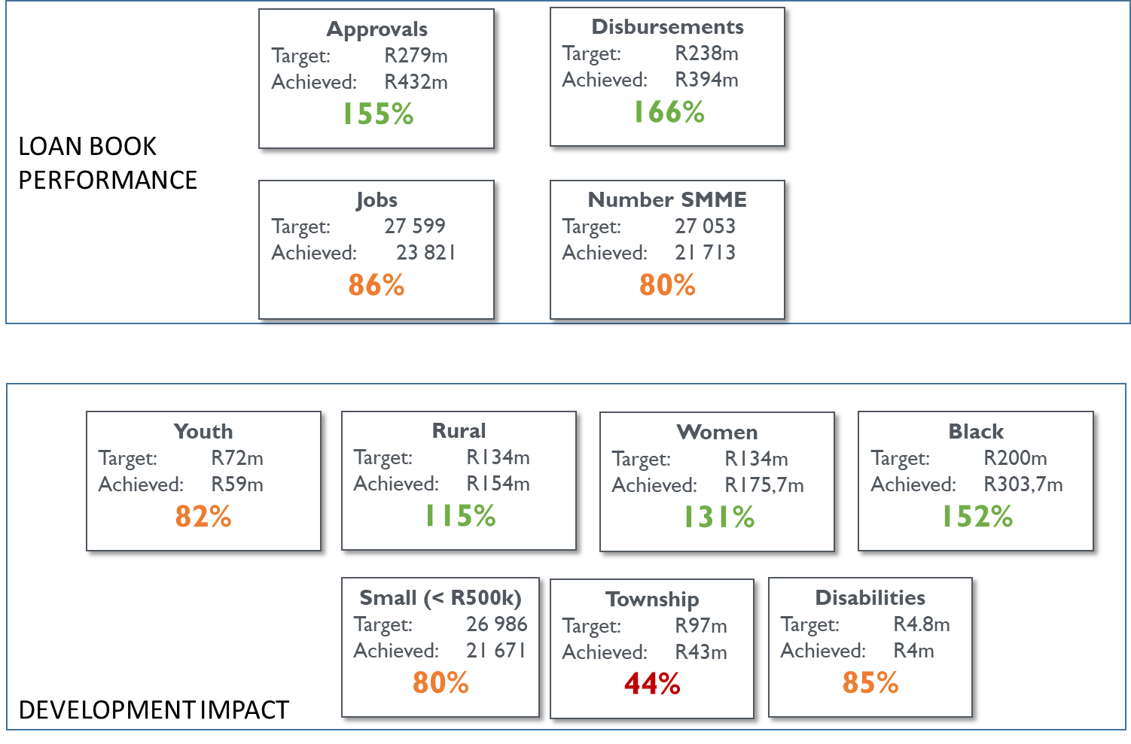
Q3 PERFORMANCE DASHBOARD

Slide 4
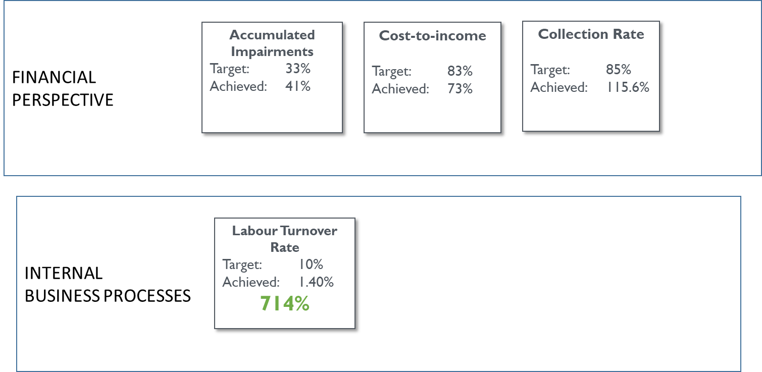
Q3 PERFORMANCE DASHBOARD
RAG Indicator | Description | No. of Indictors | % performance
 | 100% and above | 7 | 41%
 | Between 75% and 99% | 6 | 29%
 | Below 75% | 2 | 18%
 | Annual Measurement | 2 | 12%

Slide 5
Introduction

Slide 6
INTRODUCTION
An overview of Small Enterprise Finance Agency (sefa) 3rd quarter performance against the approved corporate plan for the financial year 2019/20.
sefa’s amortised Total Loan Book as at 31st December 2019 stood at R 1.7 billion:
  R876 million Wholesale Lending (WL) facilities and R892 million Direct Lending (DL) facilities.
A total of R432 million loan facilities were approved, representing 155% of the quarterly target and 104% year to date.
Total disbursements for the quarter were R394 million representing 166% of the quarterly target and 130% year to date.
In Q3, a total of 21 713 SMMEs received financial support via the sefa loan programmes, resulting in the creation and maintenance of 23 821 jobs.
R304 million was disbursed to black-owned SMMEs, R43 million to townships based SMMEs, R176 million to women-owned SMMEs and R59 million to youth-owned enterprises.
Overall organisational collections in Q3 amounted to R119.7 million.
  DL loan collections were R32,5 million while WL collected R87,2 million
The loan book portfolio at risk stood at 55% as at 31st December 2019.

Slide 7
Loan book performance

Slide 8
LOAN BOOK APPROVALS
The total approvals for the quarter were R432 million against the target of R279 million which represent 155% of the quarterly target.
  R104 million from Direct Lending (DL)
  WL SME R253 million
  Microfinance 75 million.
The over achievement was due to:
  The approvals made under the Small Business Innovation Fund (SBIF).
The year to date approvals achieved is R775 million.

Slide 9
LOAN BOOK DISBURSEMENTS
The total sefa disbursements for Q3 were R394 million against the target of R238 million and represent 166% of Q3 target.
DL disbursements were R85 million .
WL loan program disbursed R309 million.
  WL SME disbursed R155 million
  Microfinance disbursed R103 million
  The value of KCG’s taken-ups amounted to R50 million.
The year to date disbursements achieved is R828.7 million.

Slide 10
Development impact

Slide 11
DEVELOPMENT IMPACT: JOBS FACILITATED
DEVELOPMENT IMPACT: JOBS FACILITATED
The Q3 performance against target is as follows:
  Jobs facilitated - 86% of target achieved
The majority of Jobs facilitated were contributed by the Microenterprise sector.
The jobs facilitated year to date represent 90% of the annual target.

Slide 12
DEVELOPMENT IMPACT: JOBS FACILITATED
DEVELOPMENT IMPACT: SMMES FINANCED
The Q3 performance against target is as follows:
  Number of SMMEs financed – 80% of target achieved
The number of SMMEs financed year to date represent 83% of the annual target.
The majority of SMMEs facilitated were contributed by the Microenterprise sector.
About 36 cooperatives were financed during the quarter under review and year to date 60 cooperatives were financed.

Slide 13
Co-operatives Financed
Co-operatives Financed 2019/20 (Ytd)
 | Quarter 1 |  | Quarter 3 |  | Total No of Co-ops Financed | Total Sum of Total Amount
Co-operatives Financed per product | No of Co-ops Financed | Sum of Total Amount | No of Co-ops Financed | Sum of Total Amount
Portfolio Indemnity | 15 | R314 402 | 20 | R984 040 | 35 | R1 298 442
Wholesale | 9 | R754 851 | 16 | R2 890 778 | 25 | R3 645 629
Grand Total | 24 | R1 069 253 | 36 | R3 874 818 | 60 | R4 944 071

Slide 14
DEVELOPMENT IMPACT: TARGETED GROUPS
Targeted groups | Annual Target | Q3
 |  | Target | Actual | % Achieved
Facilities disbursed to youth-owned (18-35 years old) enterprises (R'000) | 239 229 | 71 769 | 59 063 | 82%
Facilities disbursed to enterprises in rural towns & villages (R'000) | 448 055 | 134 417 | 154 076 | 115%
Facilities disbursed to women-owned businesses (R'000) | 448 055 | 134 417 | 175 725 | 131%
Facilities disbursed to black-owned businesses (R'000) | 665 255 | 199 577 | 303 798 | 152%
Disbursements to township-based enterprises (R'000) | 324 254 | 97 276 | 43 100 | 44%
Facilities less than R500K disbursed to end-users - number of enterprises* | 89 952 | 26 986 | 21 671 | 80%
Enterprises based in the priority rural provinces received R154 million in Q3; those in the townships received R43 million; women-owned businesses received R175.7 million; black-owned businesses received R303.7 million over the quarter.
A total of 21 671 small loans (<R500k) were issued in Q3.

Slide 15
DEVELOPMENT IMPACT (SPATIAL)-PROVINCIAL
 | Disbursements (R ‘000)
Eastern Cape | 33 000
Free State | 11 782
Gauteng | 87 925
Kwazulu Natal | 70 833
Limpopo | 58 606
Northern Cape | 673
Western Cape | 81 446
Mpumalanga | 32 615
North West | 17 399
LP 15%
NW 4%
GP 22%
MP 8%
FS 3%
KZN 18%
NC 0.2%
EC 8%
WC 21%
In value terms, majority of sefa’s disbursements were done in Gauteng followed by Kwazulu Natal. The reason being that Gauteng and Kwazulu Natal has a higher density of SMMEs registered in South Africa.

Slide 16
Post-investment monitoring

Slide 17
POST INVESTMENT MONITORING: PORTFOLIO COMPOSITION
Loan Programme | Balance at end Quarter | % at Risk as per quarter 2 | % at risk for quarter 3
Direct Lending | R892m | 80% | 65%
Wholesale Lending | R876m | 38% | 37%
Total | R1.7bn |  | 59.5%
The total sefa loan book is worth R1.7 billion:
  comprising of WL- R876 million & DL- R892 million.
The Direct Lending portfolio at risk as at 31 December 2019 was 65%
The Wholesale portfolio at risk was 37%.

Slide 18
TOTAL SEFA COLLECTIONS Q3
Loan Programme | Total Arrears | Expected for the Quarter | Total collections for the quarter | Actual Quarterly Collections (on-time) | Arrears | % on-time collections | %Total Collections
Direct Lending | R543m | R62m | R32.5m | R22.5m | R9.9m | 36% | 52%
Wholesale Lending | R180m | R44.8m | R87.2m | R85.5m | R1.6m | 191% | 195%
Total | R723.7m | R107m | R119.7m | R108m | R10.4m | 101% | 115%
The expected collections for the first quarter were R107 million
The actual collections were R119.7 million representing 115% for quarterly target
  Direct Lending book collected R32.5 million.
  Wholesale Lending book collected R87 million.
101% of collection were on-time collections and 8.6% arrears payments.

Slide 19
Financial performance

Slide 20
FINANCIAL PERFORMANCE
Strategic Indicator 2019/20 | Target 2019/20 | Target Q3 | Q3 Achieved | % Achieved
Cost-to-income ratio before impairments* | 83% | 83% | 73% | 114%
Accumulated Impairment provision as a percentage of total loans and advances (excluding Direct Lending disbursement prior to 1 April 2016) | 33% | 33% | 41% | 80%
The cost to income ratio is in line with the target, and 73% was achieved.
Accumulated impairments are higher than targeted.
Favourable income was mainly by positive expenditure variances in Operating Expenses and Investment Property Expenses which were slightly offset by a negative variance in Personnel expenses.

Slide 21
GOVERNANCE
Governance Meetings | Key Decisions Taken
Board of Directors | The board Board of Directors considered and approved the following: Q2 Performance Report of sefa Procurement Policy 2 Funding Applications Delegation of Authority Matrix Risk Committee Charter Risk, Audit and CIC Annual Work Plans Appointment of Directors to sefa Subsidiaries
Audit Committee | The Audit committee considered and approved the following reports during Q3: Khula Credit Guarantee (SOC) Ltd Audited Annual Financial Statements 2018/19FY, Khula Credit Guarantee Internal Audit Report Independent External Auditor’s Report: Khula Credit Guarantee SOC Ltd on the quantitative reporting templates
Risk Committee | The Risk committee considered and approved the following during Q3: Delegation of Authority Matrix

Slide 22
HUMAN CAPITAL MANAGEMENT
Key Strategic Positions were filled for Executive PIM & Head of Legal.
Employee engagement initiative was conducted for sefa focusing on the CEO staff engagement.
  Employees with outstanding performance were honoured during the event.
Invest in organisational development and change management programmes
  Change Management for Head Office Relocation Project Implemented.
Improve Organisational Performance through Targeted Employee Skills Enhancement
  203 employees trained during the reporting period, 62% were females and 38% males.

Slide 23
Performance against pre-determined targets

Slide 24
Performance Scorecard - FY 2020
24

Slide 25
Performance Scorecard - FY 2020 (cont.)

Slide 26
Balanced Scorecard (cont.)
Q3 FY2018/19 vs Q3 FY2019/20

Slide 27
DSDB Priority interventions

Slide 28
DSBD’s Priorities
Area | sefa’s Intervention
Small Business and Innovation Fund (SBIF) | sefa was allocated R700m to implement SBIF in the FY2020 During Q3, R225m was approved as follows: R155m to finance three transactions under SMME Kickstart Window; & R70m to fund four transactions under the Innovation Window R150m will directly benefit approximately 520 SMMEs, R68m is earmarked for business development support & R7m is for management fees. The remaining uncommitted R475m is allocated as follow: R290m SMME Kickstart R150m Youth (Provincial Pitch for Funding) & R35m Innovation The above allocation is supported by the deal pipeline of approximately R535m expected to be approved in the month of February and March 2020.

Slide 29
DSBD’s Priorities (cont.)
Area | sefa’s Intervention
Review of the funding model | DSBD and Seda have been collaborating on the implementation SBIF. To date, sefa has committed grant funding across four Incubators to the value of R70 million. R28 million has been disbursed to the 4 as 1st tranche. Seda’s monitoring framework has been incorporated in the agreements between sefa and the Incubators to ensure that Incubatees obtain the necessary support to succeed.
Development of funding facility for township and village enterprises | sefa has a target and budget to fund enterprises based in townships and villages; This target is measured and reported quarterly to various stakeholders including DSBD and National Treasury.
Implementation of One Hundred Thousand Youth Fund | Since Nov 2019 sefa started ‘Pitch for Funding’ sessions via SBIF targeting youth-owned businesses. sefa supported 14 674 youth-owned businesses as at Q3 of FY 2019/20. In addition to the aforementioned Pitch for Funding sessions, through its partnership with Incubators and RFIs, youth-owned businesses will be part of funding support given to SMMEs and Co-operatives. During FY 2020/21, these sessions will continue under SBIF.

Slide 30
DSBD’s Priorities (cont.)
Area | sefa’s Intervention
Reduction of loan impairments | Post Investment Monitoring, Workout and Restructuring Unit has introduced the following initiatives: Pro-active analysis and monitoring of businesses that are in distress and providing timeous remedial measures in the form of restructuring of accounts The monitoring of Top 20 investment exposures in the loan book. Strengthening of the collections business unit
Establishment of the Call Centre | A joint project team comprising of sefa, Seda and DSBD was established. A functional specification for a national SMMEs call centre was developed and discussions between the project team and the State Information Technology Agency (SITA) are underway on hosting the call centre on SITA’s call centre platform.
One-Stop-Shop | In collaboration with DSBD, a new communications platform (www.mybindu.org.za) that is modern, linked to social media activity and mobile-friendly was developed. The Common Funding Template was developed and digitised to create a single business plan framework to be used in funding applications at various institutions. Seda and sefa are exploring physical shared services at district level.

Slide 31
Thank you

