Slide 1
HEALTH
MARKET INQUIRY
^{Findings and Recommendations}
BRIEFING TO THE PORTFOLIO COMMITTEE ON HEALTH
^{Dr N Bhengu}
^{Dr L Nkonki}
^{Ms M Ramokgopa}
^{11 March 2020}

Slide 2
Introduction
Market Inquiries are a general investigation into the state, nature and form of competition in a market
We were interested in the incentives which drive market behaviour
What reward / punishment mechanisms make stakeholders behave the way they do?
Is this behaviour conducive to achieving positive outcomes?
Positive outcomes are those that benefit consumers
E.g. competition on price, quality, and health-outcomes
If not, how can recommendations change incentives?

Slide 3
Introduction (2)
Overall Private Healthcare is characterised by:
High and rising costs
Significant overutilization
No documented improvement in health outcomes
The incentives in this market are failing consumers
In general governments/regulators act in the event of failing markets

Slide 4
Introduction (3)
Prevailing incentives in the private healthcare market include:
Fee-for-service remuneration dominates the market
High profits reduce any incentive to innovate or change the status quo
POs and Trustees receive remuneration regardless of scheme performance
Administrators appear to not be disciplined by their schemes
Hospital plans have led to unnecessary hospitalisations and increasing costs
Schemes compete on risk rather than pro-consumer metrics
Outdated regulations (PMBs at cost) and missing regulations (a RAM) has meant competition occurs on benefit design
Proliferation of incomparable benefit plans means consumers can’t discipline the market

Slide 5
Findings Facilities
At national level three big hospital groups dominate the market (83.1% - beds & 86.9% - admissions) and the majority of local markets (60%) are also highly concentrated
NHN to exert a minor competitive constraint, public sector and independent facilities do not exert competitive constraint
Drs bring in patients to hospitals – the big three can attract Drs more easily – hospitals benefit from and facilitate high admission rates
No measures of quality
Facilities hardly compete

Slide 6
Facilities – Recommendations
Creation of a supply-side regulator (SSRH)
Clear needs-based, central licencing regime which factors in competition assessments (NB)
Guided by national policy
In consultation with provincial departments which will have monitoring responsibilities
HMI report recommended that a multi-stakeholder working group be established urgently to commence the process.
CC to review approach to creeping mergers to address high levels of concentration
Need to have a more strategic / longer-term view on hospital mergers

Slide 7
Practitioners – Findings
Fee for service almost ubiquitous
No reliable database of practitioners
Innovative models (in particular multi disciplinary teams) are hampered by:
Funders
Practitioner Associations
HPCSA Rules
“Price vacuum” (CC ruling on collective bargaining) but too many funders and practitioners for individual negotiations to be practical
Out-of-date codes and unilateral code changes
Practitioner associations quasi-collusive

Slide 8
Practitioners – Findings (2)
No standardised measurement of quality and health outcomes
Consumers are uninformed and cannot compare
Practitioners cannot benchmark
Funders cannot contract on quality
There is excessive utilisation driving healthcare costs
Not necessarily improving outcomes
More practitioners → more admissions
Current market incentives promote overutilization
FFS
Reimbursement of PMBs at cost - shifted market power to practitioners who ‘up-code’ and can set their own reimbursement level
Hospi-centric benefit design

Slide 9
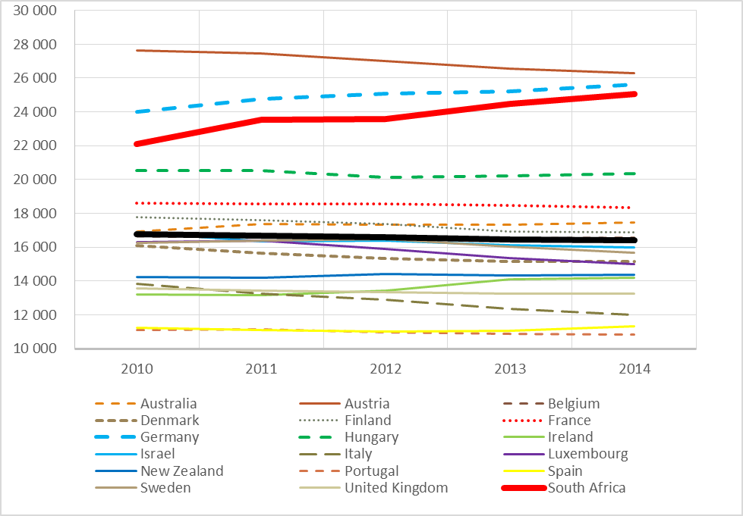
Age-standardised hospital admission rates for South African private sector and a subset of 17 OECD countries

Slide 10
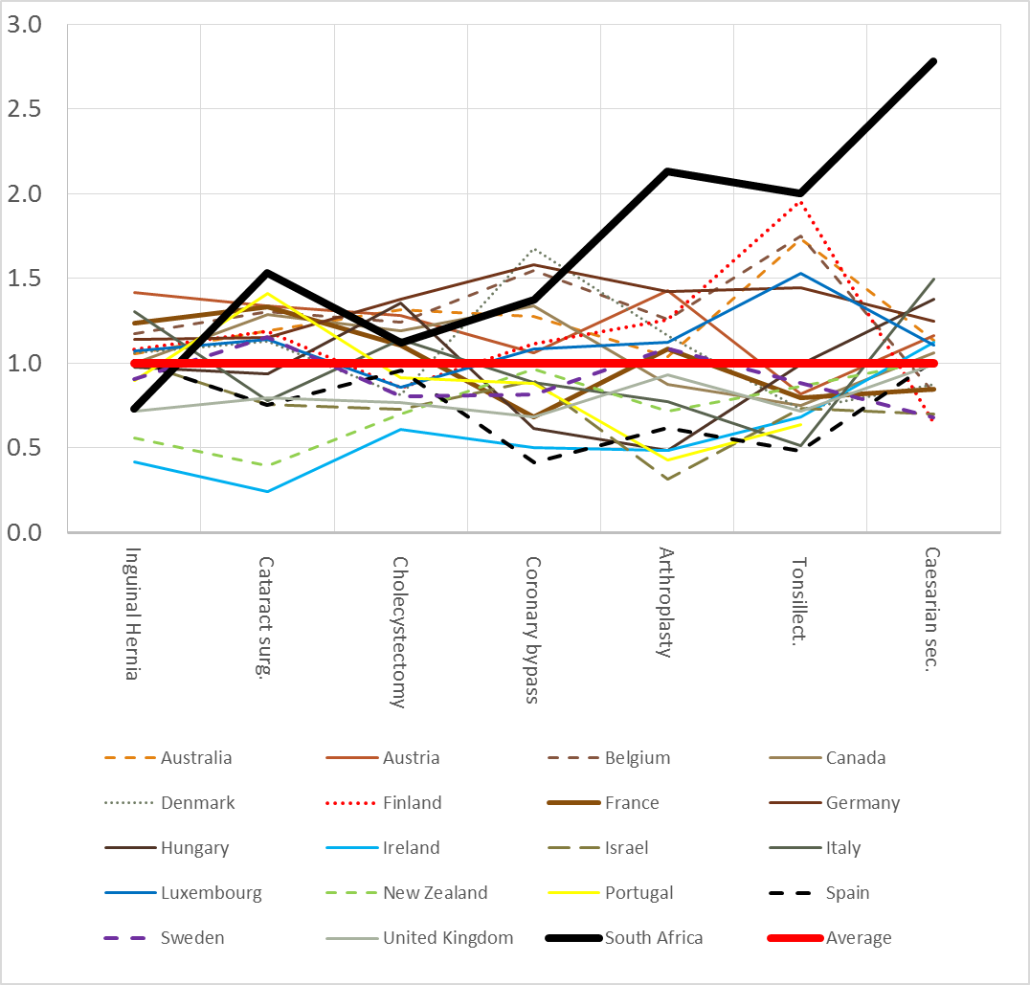
Relative age-adjusted admission rates (indexed to 1) for seven common discretionary admissions in South Africa and a selection of documented OECD countries.

Slide 11
Practitioners – Recommendations
Multi-lateral Negotiating Forum – max price for PMBs, guiding price for non-PMBs
CC and HMI Guidance to practitioner associations on conduct; Separate business and academic functions
Incentivise practitioners by linking billing number to various reporting requirements
HPCSA must update learning curriculum
HPCSA must review ethical rules regarding:
Multi-disciplinary practices, fee-sharing, and employment of doctors

Slide 12
Funders – Findings
Funders operate within an incomplete regulatory framework which distorts competition
Open enrolment and community rating ✓
Risk-adjustment mechanism (RAM) x
Mandatory membership x
Competition occurs on risk → proliferation of benefit options to attract younger and healthier members
Incomparable options means consumers are disempowered and cannot discipline the market
Scheme and administrator markets are highly concentrated
Remgro and Afrocentric have extensive shareholding across the industry – potentially limiting competition

Slide 13
Funders – Findings (2)
Open enrolment and community rating creates an enabling environment for anti-selection which exists and is entrenched in the premiums charged to consumers
Waiting periods and late-joiner fees may mitigate anti-selection to an extent
Mandatory membership would eliminate anti-selection
Is aligned with NHI
But market failings should be addressed before implementation

Slide 14
Funders – Recommendations
Single comprehensive base benefit package AND
Implement a RAM to make funders compete on value and not on risk
PMBs reviewed and aligned with base benefit package
Must include primary(out of hospital) and preventative care
Brokers - an opt-in system; you choose if you want one
Principal Officer and Trustee remuneration to be performance linked & adequate training
Administrators should have a clearly defined fiduciary duty
CC to provide oversight on industry ownership structure

Slide 15
Tariffs – Findings
Impractical for each funder to negotiate with each practitioner
Industry characterised by price uncertainty with regard practitioner services
Bilateral negotiations between funders and facilities is practical
Smaller number of negotiators (schemes / administrators / facility groups)
Standardised benefit package, OMRO, and collective administrator negotiations will make these negotiations more competitive.

Slide 16
Tariffs – Findings (2)
Negotiations are largely characterised by FFS tariff increases rather than on ARMs
ARMs can benefit consumers (quality metrics) funders (certainty on cost) and providers (reward for risk)
Should be more ubiquitous in line with international precedent
Where networks have been successfully implemented they are seen to be pro-competitive
Facility networks result in competition and lower prices / costs
Practitioner networks create price certainty by capping PMBs
Despite benefits, there is only limited evidence of effective implementation by funders

Slide 17
Tariffs – Recommendations
Multilateral tariff negotiation forum wherein funders and practitioners can collectively negotiate
Under the auspices of the SSRH
Set maximum PMB prices
Subsequent value and risk-based bilateral negotiations are supported
Important – allows for shared information
Funders and facilities to continue with bilateral negotiations; but not business as usual
Within three years FFS contracts replaced with ARMs
These contracts to be submitted to CMS/SSRH for vetting

Slide 18
Role of supply side regulator
Supply-side regulator (SSRH)
Healthcare facility planning (including licensing)
Broader than CON, explicitly includes competition concerns
Economic value assessments
Health services monitoring
Health services pricing – MLNF and bilateral contract review
Committee to oversee code reviews
Oversee research to advise on best practice
Practise numbering systems (billing number)
Support Outcomes Measurement and Reporting if required

Slide 19
OMRO Outcomes Monitoring & Reporting Organisation
Not a regulator, private enterprise/platform
Drs and patients report on outcome
Allow providers to benchmark and improve
Provide patients and funders information regarding quality
Initially voluntary, progress to mandatory

Slide 20
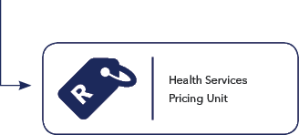
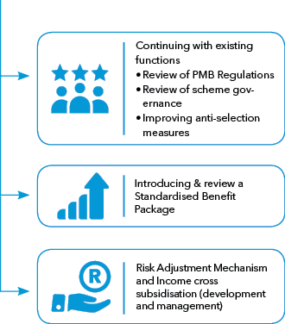
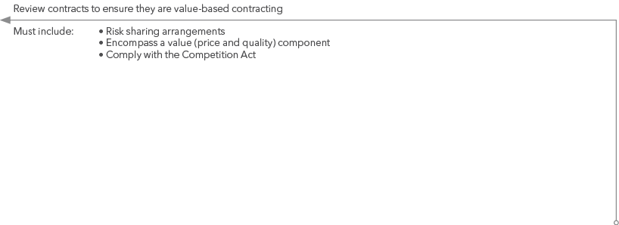
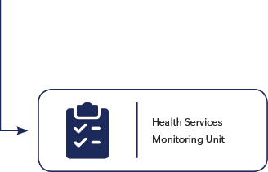
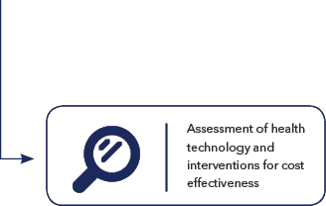
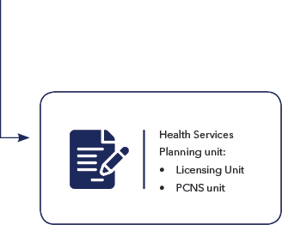
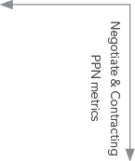
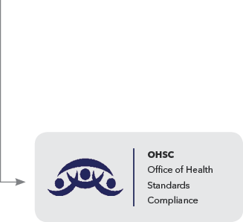
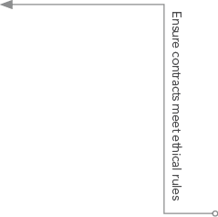
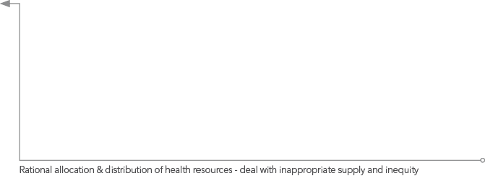
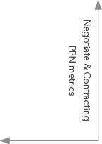
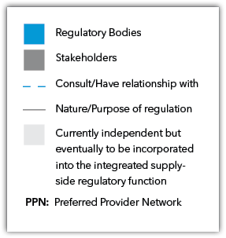
Recommendations

Slide 21
Relevance to NHI
The Competition Commission acknowledges and supports the overall objectives of the NHI Bill in achieving a unified health care system for the country.
It also acknowledges that healthcare markets may not be typical in that they:
involve high stakes as it could determine whether someone lives or doesn’t and but also makes consumers price insensitive,
have large implications for the productivity of the population (‘externalities’) and so are of great importance to government, and
involve many other market failures such as information asymmetries, which tends to impact healthcare costs

Slide 22
Relevance to NHI
Full implementation of NHI is still several years away - 2026 at the earliest
Private sector should continue to operate now and thereafter
This helps relieve the burden on the public sector
A more competitive private sector will have lower costs, prices, and greater value-for-money
Greater competition and efficiency will benefit state purchaser of services
NHI requires supply-side providers to be properly regulated – SSRH
Purchasing and monitoring requires oversight
Fixing incentives in the private sector is a necessary step towards successful NHI implementation

Slide 23
Relevance to NHI (2)
International example of the UK NHS single-purchaser system, has public and private providers regulated by:
Monitor - independent supply-side regulator
Competition Authorities
Netherlands has private providers regulated by both Health and Competition Authorities
Critical that NHI fund transactions be done under the auspices of the Competition Act:
The exemption sought in the current draft is particularly dangerous as this would exempt anti-competitive conduct on behalf of those that contract with the NHI.
This would undermine the NHI’s core purpose of contracting at the lowest cost.

Slide 24
Relevance to NHI (3)
Single basic benefit package focusing on primary and preventative health provides capacity to developing the defined package of comprehensive health services envisaged by NHI.
RAM will create a single risk-pool – ready to merge to the NHI, addresses current risk fragmentation.
OMRO will allow for value based purchasing, and to assess quality – existing institution Office of Health Standards Compliance does not extend to outcomes monitoring.
MLNF sets a useful forum for price negotiation and price determination.
Licencing and accreditation of service providers – 100% consistent with NHI
– Contracting Units (Cups) will be purchasing from private providers
SSRH will start data collection and oversee information sharing.
Treasury is constrained for resources and looking for solutions that does not further constrain them.
This is an opportunity to get the private sector to play a part in relieving the burden on the state.

Slide 25
Conclusion
Important that work begins to implement HMI recommendations.
These align with the objectives of the NHI.
CC established an advocacy team which will commence stakeholder engagements.

Slide 26
THANK YOU

