Slide 1
COMBATING FRAUD AND CORRUPTION
GOVERNANCE, RISK AND COMPLIANCE BRANCH
CONSEQUENCE MANAGEMENT REGARDING FRAUD AND CORRUPTION CASES
PORTFOLIO COMMITTEE ON PUBLIC WORKS AND INFRASTRUCTURE
11 MARCH 2020

Slide 2
Table of Content
No | ITEM | Slide
1. | Introduction | 3-8
2. | Guiding Principles | 9
3. | Fraud Prevention Measures | 10-16
4. | Fraud Detection Measures | 17-18
5. | Internal Investigations Statistical Overview on Allegations Reported Categories of Allegations Reported Statistical Overview on Disciplinary Action Statistical Overview on Criminal referrals to SAP | 19-23
6. | Advocacy and Awareness Campaigns Fraud Awareness Presentations Emerging Risks Lifestyle Audits Ethics Consequence and Ethics Management The Public Audit Amendment Act Business Process Review and IDMS Roll-out SAGE Archibus | 24-36
7. | The Special Investigating Unit Presidential Proclamation Statistical Overview | 37-42
8. | Systemic Recommendations Proclamation No. R54 as amended by Proclamation R44 Proclamation of R59 of 2014 Proclamation R27 of 2015 | 43-49
No. | ITEM | Slide
11. | Unscheduled Maintenance Introduction and Background Expenditure per Region Expenditure per Service Provider Expenditure Maintenance per Building Extract of Possible Duplicate Payments Frequency of Payments Internal Control Weaknesses identified and Possible Fraud Risks Internal Investigations Proclamation R 20 OF 2018 Systemic Recommendations made to Management to Date | 50-62
12. | Construction Projects | 63-67
13. | Financial Misconduct | 68-71
14 | Conclusions Achievements Key Priorities | 72-74

Slide 3
Introduction
“A HOLISTICAL APPROACH TOWARDS COMBATING FRAUD, CORRUPTION AND UNETHICAL BEHAVIOUR WITHIN THE DPW AND PMTE”
The Department is aware that services cannot be delivered in an effective and efficient manner in an environment of high fraud risk.
As with any other organisation and with a combined annual property budget of approximately R20bn, the Department is not immune to fraud and corruption risks. Industry Reports along with our own experience would indicate that the construction and property sectors are highly susceptible to fraud and corruption risks.
This is largely due to the vast money involved in the sector and the nature of the job to be done, which is highly technical and with a few skilled capacity around to effectively manage and oversee infrastructure projects. The infrastructure sector therefore remains vulnerable to bid-rigging, credential misrepresentations, collusive tendering, bribery and general fraudulent misdemeanours.

Slide 4
Introduction cont.
“….up to R30bn is being lost annually to corruption in all spheres of Government, emphasising the need for a tightening of systems
Review of R500bn (CIDB Research) on goods and services and construction work in the 2013-14 fiscal year revealed the following:
Public Sector Construction personnel do not understand the importance of what they did;
inadequate skills;
high staff turnover;
no separation of responsibilities between technocrats and political office-bearers;
no consequences for those who failed to perform appropriately;
cumbersome regulations and policies;
difficulty of balancing transformation with getting work of the right quality at the best prices, on time.
It is in responding to the above challenges that the DPWI Turnaround Strategy was founded as a three-stage process:
- Stabilisation
- Efficiency enhancement, and
- Sustainable development

Slide 5
Introduction cont.
The Governance, Risk and Compliance Branch and the Anti-Corruption and Fraud Unit within it was established to combat fraud and corruption and respond to poor governance in the department.
Turn-Around Strategy was based on two key pillars as articulated by the then Minister of Public Works, the key pillars were identified as the fight against fraud and corruption and improvement of organisational efficiency.
The objective of this intervention was to ensure that the Department enhances the implementation of the holistic fraud prevention strategy with emphasis being on the application of pro-active measures to enhance operational efficiency. Its key features were:-
Combat fraud and corruption in the Department in all its forms through the implementation of prevention measures;
Promote a culture of adherence to policies and procedures;
Promote good governance and best practices;
Promote ethical conduct by all stakeholders; and
Promote awareness, training and education about fraud and corruption including to promote a culture of whistle-blowing.

Slide 6
Introduction cont.
The Department of Public Works has a dedicated Anti-Corruption and Fraud Awareness Unit which is mandated to conduct investigations on allegations of fraud, corruption and serious maladministration within the Department of Public Works. This Unit is placed within the Governance, Risk and Compliance Branch and reports to the Deputy Director General Governance, Risk and Compliance
In January 2002 Cabinet approved that, as part of the implementation of the Public Service Anti-Corruption Strategy, a minimum anti-corruption capacity be established in Departments. The Department is participating in the development of new strategies developed by NICOC.
The Public Service Anti-Corruption Strategy also requires that, in order to fight corruption in Departments (as defined in the Public Service Act); each Accounting Officer must establish a capacity to investigate allegations reported in his/her Department / Organisation.

Slide 7
Review of the National Anti-Corruption Strategy
2014-2019
Anti-Corruption Inter Ministerial Committee (ACIMC) instructed the Anti-Corruption Task Team (ACTT) to initiate process of developing the National Anti-Corruption Strategy (NACS). A Steering Committee consisting of several Government Department and institutions was set up to oversee the development of the NACS.
Phase 1: Research, drafting, focused consultations and limited awareness raising. Drafting of a Diagnostic Report on the scourge of corruption and various anti-corruption measures. Draft strategy called the Discussion Document compiled and endorsed by Clusters and Cabinet for public consultation. Discussion Document launched in May 2017.
Phase 2: Public Consultations –provincial roadshows, sectorial consultation, widespread media campaign, etc. to solicit further inputs and buy-in.
Consultations with Nedlac, business and civil society involvement

Slide 8
Review of the National Anti-Corruption Strategy
2014-2019
NACS built around 6 Strategic Pillars namely:
Promote citizen empowerment and sustainable partnerships between all stakeholders in building a values-based culture of integrity, transparency and accountability in all spheres of society.
Advance the professionalization and enhance the performance management of employees to optimise their contribution to create corrupt-free workplaces.
Enhance and capacitate governance, oversight and compliance functions and processes and enforce timeous consequence management for all acts of transgression.
Improve the integrity and credibility of the public procurement system and administrative processes to maximise the effective and efficient utilisation of resources for enhanced service delivery.
Strengthen the resourcing, coordination, performance and independence of dedicated anti-corruption agencies.
Protect vulnerable sectors that are most prone to corruption and unethical practices with effective risk management

Slide 9
Guiding Principles (Legislative And
Regulatory Environment)
Public Finance Management Act (S 38 (b) (h, II): Procurement)
Prevention and Combating of Corrupt Activities Act
Protected Disclosure Act
Constitution
Additional legislation, policies & regulations
DPW Fraud Prevention Strategy
DPW Whistle-Blowing Policy
Public Service Anti-Corruption Strategy
Code of Conduct for the Public Service

Slide 10
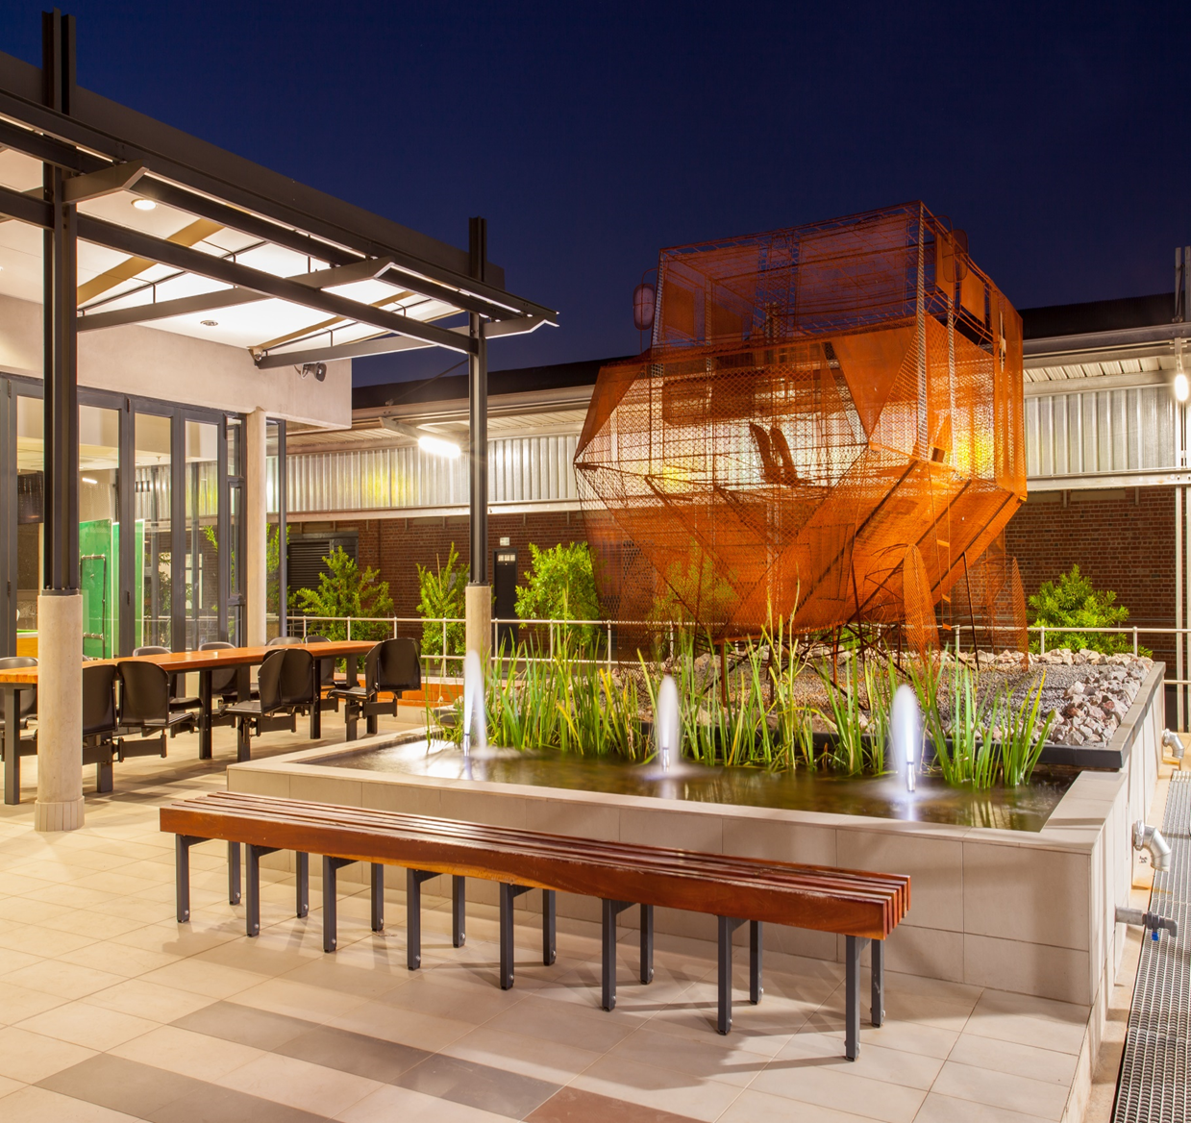
FRAUD PREVENTION / PRO-ACTIVE MEASURES

Slide 11
DPW Fraud Prevention Strategy
In order to achieve good governance and effective service delivery, an Anti-Fraud and Corruption Strategy and measures must be put in place to prevent fraud and corruption.
DPW has an approved Fraud Prevention Strategy which is being rolled out across the Department.
The strategy identifies basic fraud and corruption prevention measures, which are already in place within the DPW.
The strategy evolves as DPW makes changes and improvements in its drive to promote good governance, accountability and effectively fight fraud and corruption.
The Plan/Strategy is reviewed periodically to enable the strategy to be effective in responding to nature of the prevailing challenges.
The DPWI Anti-Fraud and Corruption Strategy is comprised of Four (4) elements:
Proactive | Reactive
Prevention e.g. Fraud Risk Management | Investigations e.g. Internal Capacity, SIU
Detection e.g. Whistle-Blowing and Reporting Mechanisms | Resolutions e.g. Improved Controls, Disciplinary, Criminal and Civil

Slide 12
Fraud Risk Management
The Department of Public Works (DPW) during the 2015/16 embarked on a journey to develop a Fraud Prevention Plan, which is in line with the Public Finance Management Act, No 1 of 1999 (PFMA) and related National Treasury Regulations promulgated in terms of the PFMA.
In this respect the DPW will focus on proactive measures designed to identify fraud and corruption risks and manage or mitigate these risks proactively. Placing emphasis on preventative action through a fraud and corruption risk management framework significantly reduces the time, effort, costs and potential reputational damage of reacting to incidents of fraud and corruption.
Over a number of years the Department has been associated with fraud and corruption and serious maladministration, central to this was procurement related e.g. Inflated pricing in prestige projects; and to a larger extent mismanagement of leases. This was also made worse by the negative media publicity e.g. SAPS leases.
Adverse reports from Chapter 9 institutions e.g. Public Protector and AG Reports further underscored the undesirable state the Department was in, with regards to acts associated with fraud, corruption and maladministration. Instability in Senior Management positions also played a significant role in the manifestation of such acts and further undermined efforts to effectively address the fraud/corruption risks posed to the Department.

Slide 13
Fraud Risk Management
Emanating from investigations conducted both by the Internal Investigation Unit and the Special Investigating Units there appears to be a strong indication that the investigations conducted seems to point to the same areas of concerns being raised repeatedly without such being addressed which points to poor fraud risk management practices.
In order to further demonstrate its commitment to the effective and efficient management of fraud and corruption risks within the Department, the Department’s has committed through its Strategic Plan to reduce the Fraud Risk Exposure By 85% by the 2019/20 financial year.
This fraud index was developed to measure fraud and corruption risks and risk owners were then expected to mitigate fraud risk within their area of responsibility and to report quarterly on their action plans to mitigate fraud risks, by implication the reduction in risk levels in respect of fraud and corruption risks.
The measuring of the reduction in risk levels also in itself a very contentious subject as it is not based on any scientific processes but rather a matter of perception from the end-user point of view. for instance if the action plan was to develop a policy to ensure minimum documents required to process a payment after the development of the policy one will thus assume that the risk has been mitigated thus the exposure level has decreased, which might not necessarily a true reflection of the status quo

Slide 14
Key Components of the Fraud Risk Plan
Journey of the DPW Fraud Risk Management Plan 2016/17 -
No. | Milestone | Activities
1. | Framework Development | Fraud Prevention Plan, Anti-Corruption Strategy etc.
2. | Fraud Risk Assessment | Conduct fraud risk assessment workshops etc.
3 | Code of Conduct | Code of Conduct - Best practices
4 | Employee Due Diligence | Vetting process for hiring
5 | Suppliers Due Diligence | Supplier vetting processes
6 | Process Specific Fraud Controls | Fraud Risk Register, identify and develop anti-fraud controls/measures
7 | Monitor Prevention Controls | Test Control effectiveness
8 | System of Reporting Incidents | Maintain internal and external reporting mechanisms
9 | Data Analysis | Develop an automated Fraud Detection Methodology and Implementation
10 | Response Programs | Investigation methodology, Accountability processes

Slide 15
Fraud Prevention Framework
Fraud Risk Management
Risk assessment at strategic and operational level of the Department will include the assessment of fraud and identification of mitigating action plans and controls.
Integrated Strategy for Fraud Prevention and Control
All business units within the Department will have to align their financial and business internal control systems to the fraud prevention plan putting in place key controls that specifically address the risk of fraud.
Develop an Ownership Structure from the Top to the Bottom of the Department
Branches will be responsible for implementation of the fraud prevention plan within their area of responsibility.
Sound Operational Control Procedures
Management must put in place basic internal controls to prevent and detect fraud and corruption
Periodic Reports on the effectiveness of risk control effectiveness
As part of the risk monitoring, management will be required to report periodically on the risk control effectiveness

Slide 16
High Fraud Risks
Currently the DPW Fraud Risk Register contains 10 high fraud risks identified through the fraud Risk Process
Risk No | Risk Title
1 | Abuse of unscheduled maintenance
2 | Collusion between DPW officials and contractors
3 | Inflation of prices and scope of work
4 | Conflict of interest
5 | Irregular award of tender contracts
6 | Constructions Projects Mismanagement
7 | Duplicate payments
8 | Cover Quoting
9 | Fronting / Credential Misrepresentation
10 | Illegal transfer of State Properties

Slide 17
FRAUD DETECTION MEASURES

Slide 18
Fraud Detection Measures
Code of conduct for Public Service requires every employee irrespective of position to report corruption to the appropriate authorities.
Prevention and Combating Corrupt Activities Act no 12 of 2004 requires a person in position of authority in both public and private sector to report corruption, and other crimes involving less or more than R100 000, to the police. If knowingly/ought to had known but fail to report, will be guilty of a crime.
Open Reporting
The Unit receive reports through Walk-in, emails, telephone via Director: FAI, DDG: GRC DG, Deputy Minister and Minister
Closed reporting:
Anonymous - 0800 701 701 (National Anti-Corruption Hotline)
The Unit maintains an Allegation Register of all cases reported to the Unit for investigation and in order to promote and maintain accountability the Unit reports all cases to the Audit Committee on quarterly basis

Slide 19
INTERNAL INVESTIGATION / ANTI-CORRUPTION UNIT

Slide 20
Investigations: Statistical Overview On The Allegations Reported
 | 2012/13 | 2013/14 | 2014/15 | 2015/16 | 2016/17 | 2017/18 | 2018/19 | 2019/20 | TOTALS
REGISTERED | 58 | 50 | 39 | 50 | 28 | 24 | 19 | 25 | 293
FINALISED | 58 | 50 | 39 | 40 | 26 | 24 | 14 | 5 | 256
INTERNAL REPORTING | 0 | 0 | 0 | 0 | 0 | 0 | 4 | 8 | 12
FIELDWORK | 0 | 0 | 0 | 0 | 0 | 0 | 1 | 5 | 6
REFERRED SIU/BU | 0 | 0 | 0 | 10 | 2 | 0 | 0 | 7 | 19
NOT STARTED | 0 | 0 | 0 | 0 | 0 | 0 | 0 | 0 | 0

Slide 21
Investigations: Statistical Overview On The Allegations Reported
CATEGORY | 2012/13 | 2013/14 | 2014/15 | 2015/16 | 2016/17 | 2017/18 | 2018/19 | 2019/20 | TOTALS
Fraud / Corruption | 21 | 18 | 10 | 28 | 6 | 7 | 8 | 11 | 109
Tender Irregularities | 15 | 10 | 18 | 15 | 12 | 7 | 5 | 3 | 85
Financial Misconduct | 5 | 8 | 6 | 6 | 7 | 6 | 3 | 7 | 48
Lease Irregularities | 6 | 4 | 2 | 0 | 1 | 1 | 0 | 2 | 16
Human Resources | 7 | 2 | 1 | 1 | 2 | 3 | 2 | 2 | 20
Project Mismanagement | 2 | 5 | 2 | 0 | 0 | 0 | 1 | 0 | 10
Security Breaches | 2 | 1 | 0 | 0 | 0 | 0 | 0 | 0 | 3
EPWP Beneficiaries | 0 | 2 | 0 | 0 | 0 | 0 | 0 | 0 | 2
TOTALS | 58 | 50 | 39 | 50 | 28 | 24 | 19 | 25 | 293

Slide 22
Resolutions: Statistical Overview On Disciplinary Actions
 | 2012/13 | 2013/14 | 2014/15 | 2015/16 | 2016/17 | 2017/18 | 2018/19 | 2019/20 | TOTALS
No of Recommended Dc | 39 | 23 | 40 | 61 | 76 | 41 | 14 | 31 | 325
Finalised | 39 | 23 | 39 | 58 | 73 | 28 | 14 | 14 | 288
Dismissals | 0 | 1 | 5 | 2 | 2 | 2 | 0 | 1 | 13
Demotion | 0 | 0 | 0 | 0 | 0 | 1 | 0 | 0 | 1
Final Written Warning | 3 | 7 | 7 | 6 | 5 | 2 | 8 | 2 | 40
Written Warning | 7 | 3 | 2 | 13 | 10 | 14 | 1 | 10 | 60
Suspension without pay | 2 | 3 | 6 | 1 | 0 | 7 | 2 | 0 | 21
Verbal warning | 4 | 1 | 3 | 1 | 1 | 0 | 1 | 0 | 11
Retire/Resigned/ Passed on/ before sanction | 4 | 5 | 3 | 6 | 4 | 2 | 0 | 0 | 24
Not charged / Not found guilty/Not pursued | 17 | 2 | 13 | 29 | 51 | 0 | 0 | 0 | 112
Charges Withdrawn | 2 | 1 | 0 | 0 | 0 | 0 | 2 | 0 | 5
Pending | 0 | 0 | 1 | 3 | 3 | 13 | 0 | 17 | 37

Slide 23
Resolutions: Statistical Overview On The Criminal Referrals To SAPS
2012/13 | 2013/14 | 2014/15 | 2015/16 | 2016/17 | 2017/18 | 2018/19 | 2019/20 | TOTALS
9 | 3 | 10 | 10 | 4 | 7 | 2 | 1 | 46

Slide 24
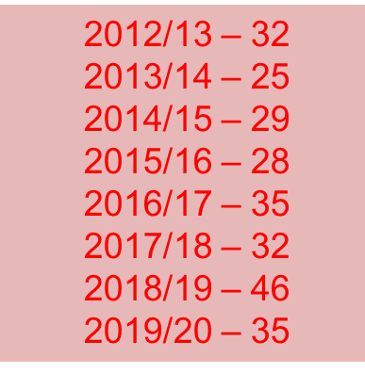
Advocacy And Awareness Programmes
The Department conducts regular Fraud/Corruption Awareness Workshops across the entire Department targeting all staff members regardless of levels.
The main purpose of these workshops is to create awareness and education to officials in respect of the Department’s fight against fraud and corruption.
To date a total of 262 fraud awareness presentations have been conducted within the Department since the 2012/13 financial year targeting all DPW officials regardless of levels.

Slide 25
Scope Of The Workshops
Latest development on regulations applicable to issues of unethical behaviour in the Public Services.
Fraud and corruption risks prevalent within DPW operations.
Pressing issues that require urgent attention to be escalated to Management.
Manifestations of forms of unethical behaviour in the Department.
Status on the nature of investigations conducted in the Department.
Status of disciplinary actions emanating from investigation conducted.
Impact of fraud and corruption.
Responsibility of officials and Management in the fight against fraud and corruption.
Reporting mechanisms.

Slide 26
Life Style Audits In The Public Sector
The Honorable President of South Africa during SONA on 16 February 2018 stated the following: “It is time that we implement our resolutions on the conduct of lifestyle audits of all people who occupy positions of responsibility, starting with members of the Executives”.
The National Development Plan and the proposed National Anti-Corruption Strategy , is thus clear in respect of the obligations of Government to ensure that systems, processes and instruments are introduced to effectively and efficiently deal with matters of fraud and corruption, including the use of life style audits to detect and deter employees and office bearers from engaging in corrupt practices.
The strategy applies to all government spheres. Phase 1 audits will focus on national and provincial executives, phase 2 on national government inclusive of public and state owned entities, phase 3 provincial government inclusive of public and state owned entities and phase 4 local government inclusive of municipal entities.
The Minister requested the SIU to conduct the lifestyle audits, processes are expected to commence during April 2020.

Slide 27
Ethics
The Ethics Function within the Department is geared towards:-
Promoting adherence to the Code of Conduct;
Promoting the implementation of the financial disclosure system; and
Development and implementation of an ethics management strategy.
The Department of Publics has an approved Ethics Framework. The Purpose of the framework is to:-
Articulate Department expectations of professional conduct;
Develop a common approach in enhancing quality of ethical decisions;
Setting premises for developing code of ethics;
Assist employees in identifying and resolve ethical dilemmas;
Increase awareness of ethical requirements;
Timely and appropriate manner of responding to unethical conduct;
Instilling a compliant and responsible ethical culture; and
Improve the Department’s reputation.
There is an urgent need for establishment of an Ethics Office within the Department to enable full implementation of the Ethics Framework.

Slide 28
CONSEQUENCE AND ETHICS MANAGEMENT UNIT

Slide 29
Consequence And Ethics Management Unit
The Honorable Minister announced during her Budget Vote speech that Consequences Management Unit will be established within the Department.
The Minister has chosen to introduce the Consequences Management Unit to add value to the existing consequences management structures within the department e.g Labour Relations Directorate, Internal Audit and Anti- Corruption Unit.
Consequences Management Unit amongst other things will conduct oversight of all the departmental activities as they pertain to the organisational discipline.
Consequences Management Unit will further address non-compliance actions identified within the department.
Internal Departmental Circular to all the departmental officials to implement consequences management and ethics practises within areas of their respective discipline will be issued to create awareness amongst the department officials.

Slide 30
Consequence And Ethics Management Unit
Governance, Risk and Compliance Branch was given the responsibility to implement the consequences management framework with immediate effect.
To effectively implement the Consequences Management Framework GRC requires the human resources at a level of a Director and 2 Deputy Directors.
The Unit will be centralised at Head Office but carry-out its mandate within the entire departmental operations (Head Office and 11 Regional Offices).
Submission was made for the Director-General to avail the resources ( human and capital) to implement the consequences management and ethics practises within the department and establish a task team to give effect to Minister’s instruction to implement the consequences and ethics management within the department.

Slide 31
Compliance Framework
The Compliance Framework of the Department was approved March 2017.
The framework provides a sense of assurance to the Director-General according to the PFMA that the operation of the Department, including those of all its branches are in line with the applicable compliance universe.
The department’s commitment to compliance management involves establishing and maintaining an effective compliance program as a key component in creating the highest standards of ethics and integrity.
The compliance program does not purport to eliminate all traces of improper conduct but rather to raise the expectation that officials and stakeholders of the department will abide by the compliance universe.
Governance, Risk and Compliance Branch was given the responsibility to implement the compliance framework within the department and to oversee the compliance processes implemented by the department entities.
Implementation of the compliance framework has not started due to the shortage of human resources.
To effectively implement the compliance framework GRC requires the human resources at a level of a Director, Deputy Director and Assistant Director.

Slide 32
The Public Audit Amendment Act
The law gives the Office of the Auditor-General more power to act against officials and employees who waste taxpayers’ money, as well as Accounting Officers aware of losses but decline/fail to act against the culprits.
In a nutshell, the Public Audit Act of 2004 provided the Auditor-General with the authority to establish auditing functions, but the office lacked the necessary power to then enforce the implementation of its recommendations. In comparison, section 3(1A) of the Amendment Act, the Auditor-General is be able to refer “suspected material irregularities” which arise from an audit, to a relevant public body for further investigation. Such public bodies would include the Hawks, the South African Police Service and the Public Protector.
Material irregularity is defined as “any non-compliance with, or contravention of, legislation, fraud, theft or a breach of a fiduciary duty identified during an audit performed under this Act that resulted in or is likely to result in a material financial loss, the misuse or loss of a material public resource or substantial harm to a public sector institution or the general public.”
These amendments mandates the AG to refer material irregularities to relevant public bodies for further investigation; take binding remedial action for failure to implement the AG’s recommendations for material irregularities; and issue a certificate of debt for failure to implement the remedial action if financial loss was involved.

Slide 33
Business Process Review And IDMS Rollout
As part of enhancing efficiencies within the core infrastructure delivery and property management functions of the Department, the implementation of the IDMS and the review of business processes, procedures and delegations associated with it, have been underway.
In this regard, the “To-Be” process development that commenced in June 2018, has been focusing on the optimisation of processes through best-practice benchmarking, piloting, as well as alignment with strategy, policy and the IDMS, as well as integration with ICT information systems, to be followed by the final process design and approval for implementation.
Even though the IDMS utilises an infrastructure gateway system that deals with the generic work flow associated with the delivery and maintenance of infrastructure, and generates information which informs decisions at particular points, it does allow for institutions to add additional gates within a stage although none may be removed at any stage.
The Business Operating Model was developed by Senior Management and fully complies with IDMS and SIPDM (now FIDPM). It represents an Integrated End-to-End view of the core operations of the Department in its simplest possible form that serves as a basis to inform all revised “To-Be” processes and procedures.

Slide 34
Business Process Review And Idms Rollout
All value chain process flows to deliver the above mentioned outputs had been developed, and all level 3 processes and associated activities has been reviewed and updated in the thirty (30) Standard Operating Procedures (SOPs).
The above are all captured in the draft Business Process Handbook that logically links all processes by level through hyperlink, thirty (30) SOPs that articulate all level 3 processes and associated activities, delegations, and performance indicators; as well as an Operational Process Management Framework to guide the implementation of the processes in the Department
STATUS
The project stands at approximately 95% completion, where the only outstanding deliverables are:
Verification of the above mentioned value chain process flows as part of the current IDMS rollout and training championed by the DDG:PMO for managers/champions involved in delivering those core outputs
Identifying key systems and responsible persons down to activity level; and
Updating the SOPs for final sign-off and implementation.
As is clear from the above, significant progress has been made towards finalising the Business Process Review project within the approved budget and scope towards the anticipated implementation date of 01 April 2020.

Slide 35
Implementation Of The Archibus System
MINISTERS PRONOUNCEMENTS
The Archibus System (modules that were originally procured) must be completed by July 2020. In essence this means that the Department of Public Works and Infrastructure must have a fully functional Immoveable Asset Register by July 2020 that has been accepted by the Auditor General.
This is an absolute priority in the Department meaning that all senior managers must give their full cooperation to the Programme and ensure its completion.
No additional capacity for REIRS until the Archibus Immovable Asset Management module has been implemented and it is operational.
Implementation of the Archibus System presents an opportunity to ensure that DPWI focus on its expanded mandate as a collective, ensuring that the Immovable Asset Register can be used for all purpose.

Slide 36
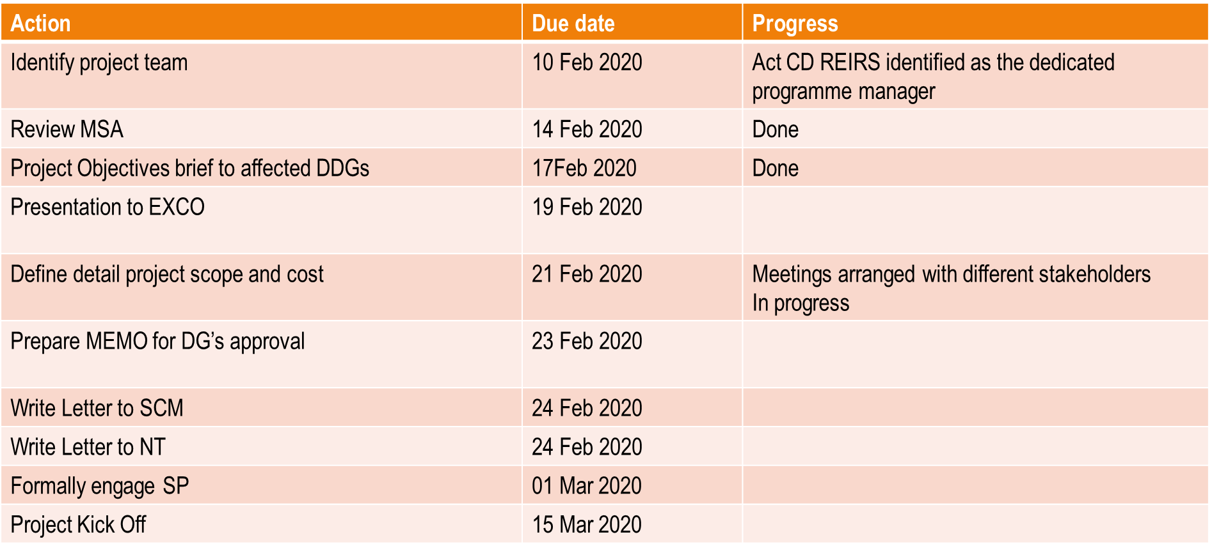
Implementation Of The Archibus System

Slide 37
THE SPECIAL INVESTIGATING UNIT - SIU

Slide 38
The Special Investigating Unit - SIU
The SIU has conducted and is continuing to conduct investigations in the Department in terms of four Presidential Proclamations. The focus areas of the Proclamations include the Capital Projects delivered by the department; property leased in from the private sector, and renovations to Prestige facilities.
Their investigations are guided by the terms of reference of the Proclamations. When an investigation has been finalized, SIU provides the President with a Report of their findings
Emanating from the investigations, the SIU recommends to the Department to institute disciplinary action against departmental officials where there is prima facie evidence justifying such action.
Where there is prima facie evidence of criminal transgressions by officials and/or other persons, for example contractors or service providers, SIU registers a criminal case with the South African Police Service (SAPS) for further criminal investigation. The objective of this action is to obtain a successful prosecution. In terms of the SIU’s legislation, the SIU also institutes civil action for recovery of monies due to the State (for example, in cases of over-payments, fraudulent claims, etc.) or for other legal remedy (for example, the cancellation of illegal contracts between the Department and landlords, in instances of leased property, etc.)

Slide 39
Presidential Proclamations
No. | Proclamation No. | Date published | Period covered by Proclamation | Subject
1. | R38 of 2010 | 30/7/2010 | 1/10/2003 – 30/7/2010 | SCM irregularities; Leases (Proc. has been extended by Proc R27 of 2015 & R 20 of 2018 – see 5 below)
2. | R59 of 2013 | 20/12/2013 | 1/1/2008 – 20/12/2013 | Prestige project: Security Upgrades at President’s private residence at Nkandla
3. | R59 of 2014 | 27/8/2014 | 1/1/2003 – 27/8/2014 | Lease Portfolio
4. | R54 of 2014, amended by Proc R44 of 2015 | 1/8/2014 10/12/2015 | 28/11/2007 – 1/8/2014 14/3/2004 – 10/12/2015 | Prestige Houses: W Cape
5. | R27 of 2015 R20 of 2018 | 20/7/2015 13/07/2018 | 31/7/2010 – 20/7/2015 20/07/2015 -13/07/2018 | Extensions of Proc R38 of 2010 (See 1 above)

Slide 40
Overview & Outcomes Of Investigations Conducted
 | Proc. R38 of 2010 – SCM/Leases | Proc. R27 of 2015 – extension of R38 of 2010 | Proc. R59 of 2013 – Nkandla | Proc. R59 of 2014 - Leases | Proc. R54 of 2014 -Prestige | TOTAL
Investigations
Finalised | 97 | 49 | 1 | 1,730 | 15 | 1,892
Pending | - | - | - | - | -
Outstanding | - | 1 | - | 432 | - | 433
TOTAL | 97 | 50 | 1 | 2,162 | 15 | 2,325
Disciplinary Action
Finalised (Resigned/retired/died before sanction) | 3 | - | 2 | 1 | 2 | 8
Finalised (Verbal warning) | 3 | - | - | - | - | 3
Finalised (Written warning) | 3 | - | 2 | 6 | 3 | 14
Finalised (Final written warning) | 9 | 3 | - | 8 | - | 20
Finalised (Final written warning and suspension without pay) | 1 | - | 8 | 6 | - | 15
Pending | - | - | - | - | -
Insufficient evidence to prove misconduct | 1 | 7 | - | 2 | - | 10
Finalised (Dismissed) | 8 | - | - | - | - | 8

Slide 41
Overview & Outcomes Of Investigations Conducted
 | Proc. R38 of 2010 – SCM/Leases | Proc. R27 of 2015 – extension of R38 of 2010 | Proc. R59 of 2013 - Nkandla | Proc. R59 of 2014 - Leases | Proc. R54 of 2014 -Prestige | TOTAL
Disciplinary Action
Found not guilty | - | - | - | 1 | - | 1
Settled – hearings called off | - | - |  | - | -
TOTAL | 28 | 10 | 12 | 24 | 5 | 79
Civil Action
Finalised (AOD’s signed) | 5 R2,227, 362 | - | - | 10 R990,510 | - | 15 R3,217,872
Finalised (matters settled) | 1 | - | - | - | - | 1
Tenants evicted | 11 | - |  | - |  | 11
Matters referred to AFU | 2 R336, 000 000 | - |  | 16 R131 420 521.80 |  | 18 R467, 420,521
Matters pending (Summons issued/in Court) | 6 R 216,831, 397 | - | 1 R 155, 324, 516 | 7 | 2 R5,707, 131.94 | 15 R 377,863,044
Matters pending (referred to State Attorney) | 1 R50,800,000 | - | - | 9 | - | 10 R 50,800,000

Slide 42
Overview & Outcomes Of Investigations Conducted
 | Proc. R38 of 2010 – SCM/Leases | Proc. R27 of 2015 – extension of R38 of 2010 | Proc. R59 of 2013 - Nkandla | Proc. R59 of 2014 - Leases | Proc. R54 of 2014 -Prestige | TOTAL
Civil Action
Matters pending (referred to DPW for recovery) | 1 R 82,000 000 | - | - | 149 R321 033 119 | - | 142 R403,033,119
Matters finalised (recoveries made) | - | - | - | 41 (R129 000 000) | -
TOTAL | 15 R685,858,759 |  | 1 R155,324,516 | 175 R453,444,150 | 2 R5,707,131 | 193 R1, 300,334,556
Criminal Action & Related Referrals
Matters Finalised (withdrawn by NPA/declined to prosecute) | 14 | - | 3 | - |  | 17
Matters referred to NPA for decision | 5 | 7 | 1 | 15 | 1 | 29
Matters referred to SARS | 3 | - | 14 | - | - | 17
Matters registered/investigated by SAPS | 5 | - | - | - | - | 5
Matters before Court | 2 | - | - | 2 | - | 4
TOTAL | 29 | 7 | 18 | 17 | 1 | 72

Slide 43
SYSTEMATIC RECOMMENDATIONS PER PRESIDENTIAL PROCLAMATION

Slide 44
Proclamation No. R54 of 2014
Proclamation No. R54 of 2014 as amended by Proclamation R44 of 2015 Prestige Portfolio
The SIU, during the course its investigations discovered a range of systemic weaknesses in the departments processes with respect to the relevant upgrades of ministerial houses that included the following:
There was no proper record keeping by Construction Project Managers and/or Supply Chain Managers
There was a general circumvention of proper procurement processes
Principal Agents conducted procurement on behalf of the DPW without proper approval
The DPW Quantity Surveyors did not properly keep record of interactions with contractors and other role players during the scrutiny of the final account.
Consultants were merely re-appointed on new projects without following a proper procurement process
Project costs escalated subsequent to the appointment of the professional consultants and that proper needs assessments were not conducted; and
Projects were identified and were then motivated to be conducted on an urgent basis, but an urgency did not in fact exist, and the true reason for the execution of the project was to ensure that the annual budget was spent, which led to the incurrence of irregular expenditure.

Slide 45
Proclamation No. R59 of 2014
PRESIDENTIAL’S PROCLAMATIONS R59 OF2014 (Leases Review)
The SIU, during the course its investigations discovered a range of systemic weaknesses in the departments processes with respect to Lease Reviews:
The landlords submitted false tax certificates to the department and the department relied on such tax certificates and awarded leases to such landlords. SIU has recommended that the department place such landlords on National Treasury’s Database of Restricted Suppliers.
Department is paying for more space than what is actually available in the leased building. In other words, the space as recorded in the lease agreement differs from what is actually available. The SIU has recommended that the department claim such losses back from landlords through offsetting such loss against future rentals due to those landlords. The department going forward should insist on a SAPOA certificate from landlords certifying the space and parking that is being made available.
Department is paying for more parking bays than what is made available. SIU has recommended that the department offset such loss against future rentals due to landlords.
There was a general circumvention of proper procurement processes
The Project Managers instructed Principal Agents to appoint various other consultants, and to claim their cost as a disbursement;
Principal Agents conducted procurement on behalf of the DPW without proper approval
The DPW Quantity Surveyors did not properly keep record of interactions with contractors and other role players during the scrutiny of the final accounts
Consultants were merely re-appointed on new projects without following a proper procurement process
Project costs escalated subsequent to the appointment of the professional consultants and that proper needs assessments were not conducted; and
Projects were identified and were then motivated to be conducted on an urgent basis, but an urgency did not in fact exist, and the true reason for the execution of the project was to ensure that the annual budget was spent, which led to the incurrence of irregular expenditure.

Slide 46
Proclamation No. R59 of 2014
Lease premises are in an unsatisfactory condition and do not comply with the relevant prescripts of the Occupational Health and Safety Act, No. 85 of 1993. SIU has recommended that where the lease agreement between the department and landlord provides that maintenance and repair of the premises is the responsibility of the landlord and where the landlord fails to carry out this responsibility then department to write a letter to the landlord to repair the premises in 30 days. Should the landlord fail to effect the said repairs then the Department.
Department has paid more than is due, owing and payable to landlords through in-correct application of escalation or incorrect calculations. SIU has recommended that the department offset these monies from future rentals due to landlords.
Department has incurred duplicate and over payments to landlords. SIU has recommended the department to offset these monies from future rentals due to landlords.
Leases are continually renewed without first testing the market. In some instances landlords were awarded short term leases which, through renewals over the years, eventually became long term leases. SIU has recommended that the department test the market before awarding the leases. There was a general circumvention of proper procurement processes.

Slide 47
Proclamation No. R27 of 2015
PRESIDENTIAL’S PROCLAMATIONS R27 OF 2015
The SIU, during the course its investigations discovered a range of systemic weaknesses in the departments processes with respect to SCM / Day-to-Day Maintenance :
In regard to day-to-day maintenance contracts, the largest single contributor to the abuse of the system is the Departments failure to follow proper procurement processes in establishing a list of service providers. Our investigations have revealed that the Department last utilised an open tender process for the establishment of service provider lists in 2009 and since then have adopted a process of inviting “preferred” service providers.
The move away from an open tender process resulted in the following increase in expenditure:
DAY TO DAY SERVICES | 2009 | 2010 | % INCREASE
Technical maintenance Expenditure | R133, 417,407.20 | R276, 490,174.96 | 107%
Mechanical Maintenance | R73, 393,322.71 | R172, 356,248.12 | 135%

Slide 48
Proclamation No. R27 of 2015
Some of the contractors that appeared on the list of preferred suppliers appeared to have links to others on the list. Our investigations have revealed several such entities. The invitation of contractors onto the database of suppliers appears to have created an environment where the supplier database is populated with various entities all linked to individuals who are the ultimate beneficiary of the contract award.
In regard to our analysis of employees of the Department who have interests in business entities, our investigations currently reveal that a significant percentage of these employees who are members of these entities were found not have declared such interests to the Department. There appears to be no mechanism within the Department that conducts an annual check on all employees as regards outside business interests. The current system adopts a self-declaration approach without any “policing” from the department itself.
Document management within the Department is extremely poor and this in itself inhibits historical investigations.
Day to day maintenance contracts appears to be open to significant abuse. It is highly recommended that the Department embark upon open tender processes in establishing lists of preferred service providers.
The terms of reference for such service providers to be included onto the list should be clearly set out in the tender advertisement. As far as possible the contracts should be fixed price contracts. A detailed Bill of Quantity should be compiled for each service which sets out the rates and the maximum budgets for each service for the duration of the contract.

Slide 49
Proclamation No. R27 of 2015
There should be a rotation system employed with works inspectors providing reports on the contractor’s ability to meet the requirements of the contract after each job is completed.
Monthly checks must be conducted on award practices within a service area to establish the following:
frequency of awards to contractors,
establish quoting trends e.g. which contractors tend to quote together
All documents received should be scanned onto a system that keeps an electronic copy of documents.
All employees should be subject to an annual declaration of interests. A random check with the CIPC should be conducted on employees to establish whether they hold any outside business interests

Slide 50
UNSCHEDULED MAINTENANCE / DAY TO DAY MAINTENANCE

Slide 51
Unscheduled Maintenance: Introduction & Background
The GRC conducted a detection review on day to day maintenance to identify anomalies in respect of suspected irregular payments effected and possible duplicate payments effected
A high level of frequency was noted for payments effected in respect of day to day maintenance of air conditioners, geysers, plumbing, boiler services, access control and pots
It is evident that the magnitude of the consolidated expenditure for day to day maintenance is not economic and does not constitute an effective and efficient use of resources. The ACU employed a data driven approach to conduct the Detection Review assisted by the Forensic Data Analytics team in the SIU
The team ran trends analysis on the data of the DPW, by identifying red flags, in order to highlight relevant trends and patterns in day to day maintenance expenditure
Red flags are not evidence of wrong-doing, they are an indication that something may need to be investigated or corrected from a management perspective
Red Flags are indicators that are detected once a criteria is set to identify anomalies in a business process

Slide 52
Unscheduled Maintenance: Introduction & Background
The ACU obtained the LOGIS (NT), PMIS (DPW) and WCS (DPW) data
65 queries have been written for the detection review in phase one
Contractors/Suppliers Rendering Service/Maintenance In PMIS Buildings
Suppliers With The Highest Number of Payments
Expenditure Incurred Per Building
Repeated Services Performed by Suppliers on Same Property
Frequency Of Payments for Services Performed on Premises By Contractor/Supplier
Suppliers using the same address/bank account number
Possible duplicate payments – same building/same amount
Whether contractors received payment for services after lease expire dates

Slide 53
Unscheduled Maintenance:
Expenditure Per Region
10 YEAR PERIOD |  |  | 3 YEAR PERIOD
REGION | TOTAL AMOUNT |  | REGION | TOTAL AMOUNT
PRETORIA | 2 572 511 011,01 |  | PRETORIA | 1 132 531 784,04
CAPE TOWN | 1 278 954 048,42 |  | CAPE TOWN | 629 117 681,68
DURBAN | 1 117 714 779,65 |  | DURBAN | 483 754 989,30
JOHANNESBURG | 643 027 871,21 |  | JOHANNESBURG | 349 377 903,02
POLOKWANE | 411 730 809,44 |  | MMABATHO | 161 808 548,06
PORT ELIZABETH | 294 932 432,20 |  | POLOKWANE | 161 535 601,19
MMABATHO | 284 130 392,69 |  | PORT ELIZABETH | 136 619 511,16
NELSPRUIT | 265 583 164,56 |  | NELSPRUIT | 96 232 959,06
BLOEMFONTEIN | 206 116 371,01 |  | BLOEMFONTEIN | 93 342 862,43
KIMBERLEY | 91 148 270,58 |  | KIMBERLEY | 31 468 200,58
UMTATA | 87 046 652,19 |  | UMTATA | 25 386 268,59
Grand Total | 7 252 895 802,96 |  | Grand Total | 3 301 176 309,11

Slide 54
Unscheduled Maintenance:
Expenditure Per Service Provider
10 YEAR PERIOD |  |  |  | 3 YEAR PERIOD
SUPPLIER NAME | REGION NAME | Total |  | SUPPLIER NAME | REGION NAME | Total
1ST GEAR TRADING 177 CC T/A ST | CAPE TOWN | 240 706 122,67 |  | 1ST GEAR TRADING 177 CC T/A ST | CAPE TOWN | 135 144 334,68
HAT H T SPECIALIST CC | POLOKWANE | 40 468 100,63 |  | THAMANDLA CONSTRUCTION AND MAI | PRETORIA | 93 847 746,14
HAT H T SPECIALIST CC | PRETORIA | 138 029 682,47 |  | SHANAAZ AND MEZAAN PLUMBING AN | CAPE TOWN | 81 951 569,34
SUPERFECTA TRADING 209 CC | JOHANNESBURG | 66 948 295,12 |  | LEFATSHE LA RONA TRADING AND P | PRETORIA | 73 694 165,63
SUPERFECTA TRADING 209 CC | PRETORIA | 102 891 229,89 |  | KROUCAMP PLUMBERS CC. | CAPE TOWN | 56 419 093,20
AUTUMN STAR INDOOR AIR QUALITY | PRETORIA | 131 868 312,67 |  | AMATOLA WATER | PORT ELIZABETH | 56 348 326,67
THAMANDLA CONSTRUCTION AND MAI | PRETORIA | 101 536 967,61 |  | INYAMEKO TRADING 1442 CC | CAPE TOWN | 52 877 674,94
MOTSENG FACILITIES MANAGEMENT | PRETORIA | 99 517 798,97 |  | ROY'S OIL AND GAS CC | CAPE TOWN | 51 713 229,43
SHANAAZ AND MEZAAN PLUMBING AN | CAPE TOWN | 89 070 127,47 |  | BNT MASINGA TRADING AND PROJEC | JOHANNESBURG | 47 842 852,20
JURO PIPING CC | CAPE TOWN | 76 192 626,79 |  | MALOTA TRANSPORT AND PROJECTS | PRETORIA | 46 231 157,68
AMATOLA WATER | PORT ELIZABETH | 74 376 647,41 |  | LEFHUMO LWA BAREMA TRADING ENT | JOHANNESBURG | 46 021 586,21
Grand Total |  | 1 161 605 911,70 |  | Grand Total |  | 742 091 736,12

Slide 55
Unscheduled Maintenance:
Expenditure Per Building
10 YEAR PERIOD |  |  |  |  | 3 YEAR PERIOD
PROPCODE | BUILDING | REGION NAME | Total |  | PROPCODE | BUILDING | REGION NAME | Total
005279 | COMPLEX:THABA TSHWANE DEFENCE | PRETORIA | 292 415 675,07 |  | 005279 | COMPLEX:THABA TSHWANE DEFENCE | PRETORIA | 152 351 806,83
008544 | PAUL KRUGER BUILDING | PRETORIA | 241 558 747,31 |  | 008544 | PAUL KRUGER BUILDING | PRETORIA | 69 226 862,69
312010 | ERF 28 | PRETORIA | 153 501 331,48 |  | 137485 | COMPLEX: CENTRAL PRISON | PRETORIA | 61 207 079,17
008838 | COMPLEX: AIR FORCE BASE | POLOKWANE | 90 217,943,62 |  | 095799 | COMPLEX: PRISON WESTVILLE | DURBAN | 47 561 931,15
137485 | COMPLEX: CENTRAL PRISON | PRETORIA | 89 592 705,62 |  | 004333 | NEW CO-OPERATION BUILDING | PRETORIA | 41 013 321,10
004333 | NEW CO-OPERATION BUILDING | PRETORIA | 76 361 294,67 |  | 012284 | COMPLEX: WONDERBOOM MIL BASE | PRETORIA | 40 004 876,04
095799 | COMPLEX: PRISON WESTVILLE | DURBAN | 74 166 226,15 |  | 061628 | COMPLEX: NAVAL BASE SALDANHA | CAPE TOWN | 35 575 360,06
012284 | COMPLEX: WONDERBOOM MIL BASE | PRETORIA | 71 548 218,03 |  | 004649 | CGO CENTRAL GOVERNMENT OFFICES | PRETORIA | 35 141 464,33
154900 | COMPLEX: TEK BASE | PRETORIA | 63 180 927,09 |  | 303413 | OLD SA RESERVE BANK | PRETORIA | 34 931 026,84
002825 | COMPLEX: ZONDERWATER PRISON | PRETORIA | 62 528 359,63 |  | 256001 | COMPLEX: SAPS LOGISTICS | PRETORIA | 34 596 033,56
Grand Total |  |  | 1 215 071 428,67 |  | Grand Total |  |  | 551 609 761,77

Slide 56
Unscheduled Maintenance:
Extract Of Possible Duplicate Payments
REGION NAME | BUILDING | SUPPLIER NAME | FROM DATE | LAST DATE | TOTAL AMOUNT PAID
CAPE TOWN |  | HLUMANI WASTEMAN PTY LTD | 20JUN2006 | 20JUN2006 | 22 644,46
CAPE TOWN |  | L D K INDUSTRIAL CC | 27JUN2006 | 27JUN2006 | 1 026,00
CAPE TOWN |  | GREYSTONE TRADING 389 CC | 28JUL2006 | 28JUL2006 | 24 954,60
PRETORIA | OKLAHOMA HOTEL STAND 1877 | HAT H T SPECIALIST CC | 13SEP2007 | 13SEP2007 | 8 447,40
PRETORIA | THIBAULT NAVARRE COMPLEX | SUPREMEAIR (PTY) LTD | 20APR2006 | 20APR2006 | 59 409,20
PRETORIA | THIBAULT NAVARRE COMPLEX | SUPREMEAIR (PTY) LTD | 25APR2006 | 25APR2006 | 59 409,20
PRETORIA | THIBAULT NAVARRE COMPLEX | BATTERY CARE CC | 02MAY2006 | 02MAY2006 | 113 930,00
PRETORIA | THIBAULT NAVARRE COMPLEX | METSI CHEM (PTY) LTD | 22MAY2006 | 22MAY2006 | 513,00
PRETORIA | THIBAULT NAVARRE COMPLEX | METSI CHEM (PTY) LTD | 09JUN2006 | 09JUN2006 | 410,40
PRETORIA | THIBAULT NAVARRE COMPLEX | D & F DIESEL FUEL SERVICES CC | 15JUN2006 | 10SEP2007 | 1 740,00
PRETORIA | THIBAULT NAVARRE COMPLEX | D & F DIESEL FUEL SERVICES CC | 13JUL2006 | 28JUL2006 | 1 160,00
PRETORIA | THIBAULT NAVARRE COMPLEX | BATTERY CARE CC | 25JUL2006 | 07MAY2007 | 318 613,99
PRETORIA | THIBAULT NAVARRE COMPLEX | SUPREMEAIR (PTY) LTD | 31JUL2006 | 15AUG2006 | 131 925,03
PRETORIA | THIBAULT NAVARRE COMPLEX | D & F DIESEL FUEL SERVICES CC | 06OCT2006 | 07MAR2008 | 79 306,54
PRETORIA | THIBAULT NAVARRE COMPLEX | BATTERY CARE CC | 23NOV2006 | 23NOV2006 | 132 886,68

Slide 57
Unscheduled Maintenance:
Frequency Of Payments
10 YEAR PERIOD |  |  |  |  | 3 YEAR PERIOD
SUPPLIER NAME | REGION NAME | NUMBER OF PAYMENTS | TOTAL AMOUNT |  | SUPPLIER NAME | REGION NAME | NUMBER OF PAYMENTS | TOTAL AMOUNT
1ST GEAR TRADING 177 CC T/A ST | CAPE TOWN | 16973 | 240 706 122,67 |  | 1ST GEAR TRADING 177 CC T/A ST | CAPE TOWN | 8302 | 135 144 334,68
HAT H T SPECIALIST CC | POLOKWANE | 4596 | 40 468 100,63 |  | SHANAAZ AND MEZAAN PLUMBING AN | CAPE TOWN | 5368 | 81 951 569,34
HAT H T SPECIALIST CC | PRETORIA | 10787 | 138 029 682,47 |  | KROUCAMP PLUMBERS CC. | CAPE TOWN | 3447 | 56 419 093,20
PEST RELIEVERS (40) | CAPE TOWN | 14116 | 7 169 823,02 |  | ANIL M JESSA CC | CAPE TOWN | 3127 | 34 882 068,22
SUPERFECTA TRADING 209 CC | JOHANNESBURG | 3682 | 66 948 295,12 |  | ROY'S OIL AND GAS CC | CAPE TOWN | 2850 | 51 713 229,43
SUPERFECTA TRADING 209 CC | PRETORIA | 2456 | 102 891 229,89 |  | JASAIR PTY LTD | JOHANNESBURG | 2697 | 25 888 624,71
SHANAAZ AND MEZAAN PLUMBING AN | CAPE TOWN | 5763 | 89 070 127,47 |  | NO FEAR SYSTEMS CC | CAPE TOWN | 2213 | 32 620 481,89
ELECTRIM CONTROL SYSTEMS CC | PRETORIA | 5635 | 27 004 112,72 |  | HENVEN VERKOELING BK | POLOKWANE | 2101 | 20 745 362,14
MMAMONIBOLLA TRADING CC | NELSPRUIT | 1 | 17 469,37 |  | INYAMEKO TRADING 1442 CC | CAPE TOWN | 1978 | 52 877 674,94
MMAMONIBOLLA TRADING CC | POLOKWANE | 5388 | 31 059 288,48
WESTPRO FLUID HANDLING SYSTEMS | CAPE TOWN | 5367 | 66 807 492,99
JASAIR PTY LTD | JOHANNESBURG | 5359 | 44 305 657,83
D & F DIESEL FUEL SERVICES CC | PRETORIA | 5186 | 27 219 863,18
L D K INDUSTRIAL CC | CAPE TOWN | 4963 | 19 588 184,04
Grand Total |  | 90272 | 901 285 449,88 |  | Grand Total |  | 32083 | 492 242 438,55

Slide 58
Unscheduled Maintenance: Internal
Control Weaknesses Identified & Possible Fraud Risks
Internal Control Weaknesses Identified
Lack of verification of serviceable items : geysers, boilers, air conditioners and pots
Non existence of maintenance plan reflecting scheduled maintenance per building and its components
There is no register reflecting building components, their life spans and conditions
Possible Fraud Risks
Fictitious calls from client departments resulting in the department effecting payments for services not rendered
Collusion between client department, control works manager and service providers resulting in payment for services not rendered
Abuse of emergency services : every service irregularly categorized as emergency in order to override normal SCM processes
Deliberate splitting of services to circumvent SCM processes

Slide 59
Unscheduled Maintenance:
Internal Investigations
PRETORIA REGIONAL OFFICE
At one state owned property at 6 Grace Av, Meyerspark, the swimming pool and water feature to be maintained are not in working order and had not been in a working order for more than a year. DPW has been and is currently continuing to pay for said maintenance at R7000 per month for the swimming pool and R7000 per month for the water feature.
Three (3) companies employed by the DPW to maintain the swimming pools and water features over the last two (2) years employed the brother of the Chief Horticulturist to conduct the actual work.
Disciplinary processes under way against implicated officials
Legal services to recover R84, 704.47 from Sakhile Business Enterprises and R 53, 405.16 from Gau-Flora for payments made for services not rendered

Slide 60
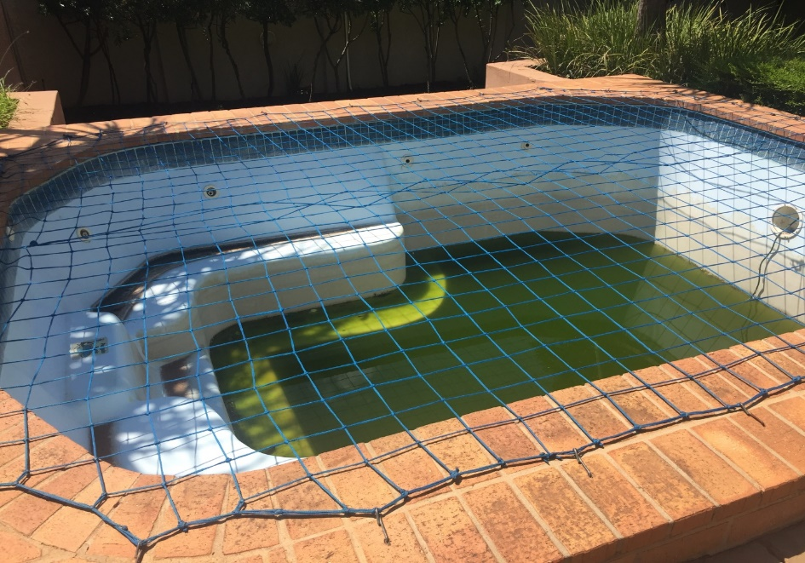
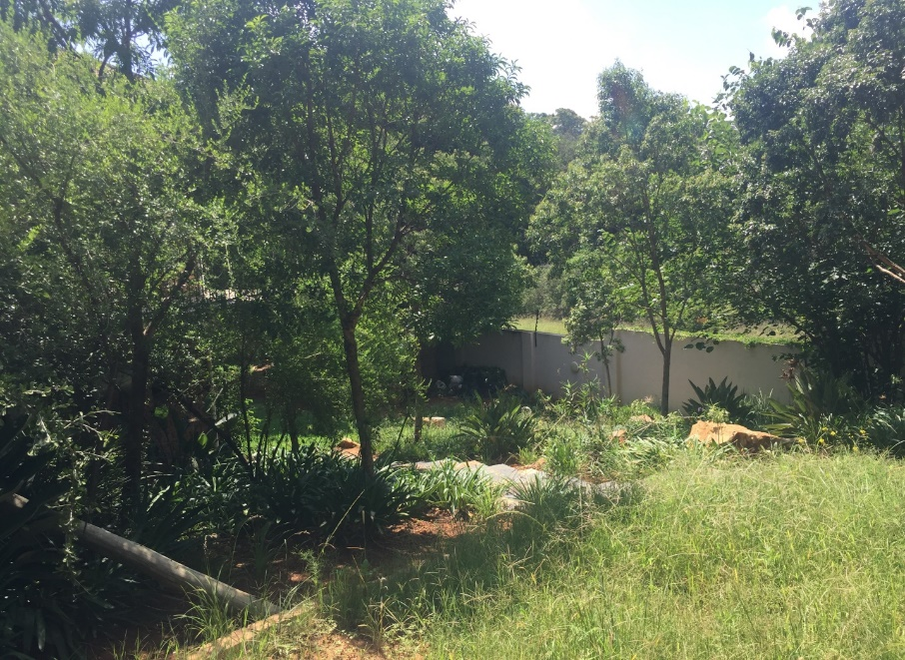
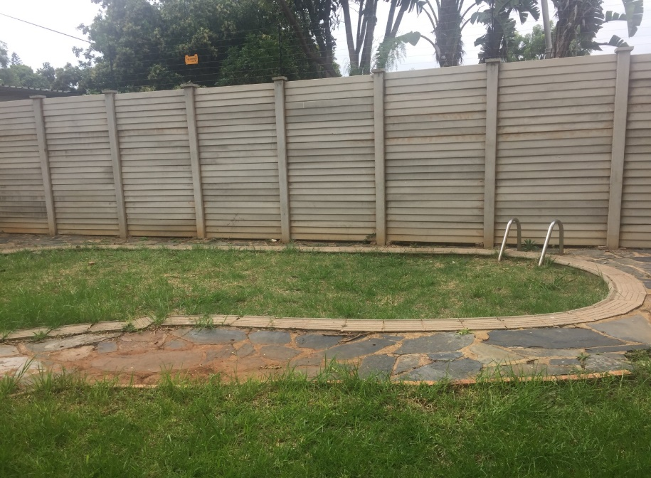
Unscheduled Maintenance:
Internal Investigations

Slide 61
Unscheduled Maintenance:
Motivation For SIU Proclamation
The GRC through the Office of the Director-General requested Ministry to motivate for the Presidential Proclamation (through the SIU) due to the serious allegations pertaining to unscheduled maintenance.
The Minister of Public Works approved the request on 31/01/2018 and correspondence was forwarded to the Head of the SIU motivating for a Presidential Proclamation on day to day maintenance.
The SIU acceded to the DPW Request, meetings were held between the DPW and the SIU to commence with the legislative processes to motivate for the Proclamation. The SIU made a motivation to the President to extend Proclamation 38 of 2010.
The President has signed the Proclamation Number R 20 of 2018 extension of Proclamation 38 of 2010 as amended by Proclamation 27 of 2015. The Proclamation was gazetted in government gazette on the 13 July 2018.
The Proclamation focuses on five DPW Regional Offices, namely:
- Pretoria Regional Office;
- Bloemfontein Regional Office;
- Cape Town Regional Office,
- Durban Regional Office; and
- Johannesburg Regional Office.

Slide 62
Unscheduled Maintenance: Systemic
Recommendations Made To Management To Date
Facilities Management should ensure that physical verification of all building components for each building is conducted to ascertain their existence
Facilities Management should conduct building conditions assessment to determine state of the building and its components
Facilities Management should develop maintenance plan reflecting scheduled maintenance per building and its components
Facilities Management should develop a register reflecting building components, their life spans, and condition equipment that has already passed its life span should be replaced
Facilities management with assistance from the Information Technology Unit should develop an early warning system to identify suspicious payments e.g. for same service, items, areas and period
Facilities management should engage Client Departments to develop framework in consultation with National Treasury to allow department to purchase capital equipment through Capital Expenditure budget on the client Department’s behalf
Facilities Management should consider the above proposed action plans when implementing Facilities Management contract for 300 earmarked building and in developing Facility Management Strategy

Slide 63
MAINTENANCE AND REPAIRS PROJECTS

Slide 64
Maintenance And Repairs Projects
The Anti-Corruption Unit conducted and is currently conducting investigation into allegations of serious maladministration in respect of projects awarded by the DPW.
The DPW engaged services of various suppliers to render various maintenance and repairs projects. These service providers failed to fulfil the terms of contracts as they failed to complete their work with due diligence, regularity and expedition and to bring the work to practical completion resulting in cancellations of their contracts.
Of particular concern to the Department was that huge amounts of money were paid to these contractors at the time of cancellations of their contracts in some instances to values exceeding the contract amount. It is suspected that the Department did not get value for money in this regard and/or there is no justification for the payments made. Of further concern to the Department was that when other service providers were appointed to complete the outstanding work the contract amounts were in all instances greater than the initial contract amount which fortifies the notion that payments made to the initial contractors cannot be justified and/or the Department did not receive value for money for payments made.

Slide 65
Maintenance And Repairs Projects
JHB RO Projects
The ACU conducted investigations relating to several projects awarded by the JHB RO – Maintenance and repairs Projects
No | Name of Contractor | Nature of services | Date of award | Contract amount | Payments at the time of cancellation of contract
1 | Mathabatha Building Suppliers CC | Eden Park Police Station: Repairs and renovation contract | 12 July 2011 | R4, 306, 181.28 | R7, 067, 797.00
2 | Zwa-Shu Trading JV Phumi Trading | Replacement of boilers and maintenance of boilers for period of 24 months | 20 January 2012 | R18, 824, 992.66 | R13, 464, 954.68
3 | Ineelo Trading Enterprise CC | Condition based maintenance for sewer plant | 13 March 2015 | R4, 114, 043.40 | R1, 632,143.70
4 | Nzwalo Investments | Repair and maintenance of mechanical and electrical installations | 10 December 2008 | R13, 811, 639.22 | R6, 855, 024.67
5 | Lumacon Air Conditioning | Benoni Modderbee Prison: Repair and Maintenance of mechanical and electrical installations | 17 December 2008 | R13, 811, 639.22 | R7, 758, 566.04
6 | Nthatheng Trading II | Tsakane Magistrate Office: Additional accommodation: construction of new building | 08 July 2005 | R10, 988, 743.26 | R12, 593, 026.70
7 | Mperere Legafe JV | SANDF Heidelberg Gymnasium: Head Quarters | 10 October 2008 | R4, 880, 000.00 | R4, 374, 491.57
8 | Sincindi Projects CC | Oberholzer Magistrate Office: Security measures upgrade including minor works sewerage pipes | 27 November
9 | Realeka Investments | Kagiso Magistrate Court: Construction of new building | 21 May 2007 | R27, 181, 957.60 | R22, 788, 956.14

Slide 66
Maintenance And Repairs Projects
JHB RO Projects
The investigation conducted by the ACU revealed that these projects were characterised by:-
The Project Risk Assessment conducted prior to the awards were disregarded by the Evaluation Committees, This led to the appointment of unsuitable contractors.
Poor Project Management, the assigned Project Managers and Principal Agents do not exercise due diligence during the execution of the Projects.
Payments made are not justifiable or in accordance with the Project Milestones.
Projects not completed within the Projects timeframes.
Contractors not delivering on their contract obligations leading to contract cancellations at a loss to the Department.
Project Managers/Principal Agents not issuing final accounts to recover cancellation losses.
Secondary contractors in most instances appointed in excess of the original contract amounts.

Slide 67
Maintenance And Repairs Projects
JHB RO Projects
On completion of the investigation the ACU recommended…
Disciplinary actions against 42 officials at the JHB Regional Office for various misconducts relating to project mismanagement and failure to comply with SCM directives.
8 contractors for Blacklisting from conducting business with the DPW / State due to failure to fulfil their contract obligations to the DPW / State.
The Legal Services Unit was also advised to consider instituting recovery processes to recover an amount estimated at R 27m for losses incurred to non-performance and subsequent cancelation of contracts.
3 Referrals to be made to Professional Bodies to consider sanctioning their members (Principal Agents) for failure to exercise due diligence in executing their tasks.

Slide 68
OTHER FINANCIAL MISCONDUCT CASES

Slide 69
Financial Misconduct
IRREGULAR EXPENDITURE
PROCUREMENT IRREGULARITIES JHB REGIONAL OFFICE
The investigation conducted revealed that officials at the DPWI Johannesburg Regional Office awarded contracts to a Manangwe Projects Enterprise owned by a Government employee in contravention of Public Service Regulation, 2016 13 (c). The contract was awarded to the entity despite its owner disclosing on PA-11 Form: Declaration of Bidder’s interest and past Supply Chain Management practices that she was Government employee. Further the company appointed was not included in the list of approved / vetted service providers for security services. Disciplinary Hearings against the Head of SCM (Mr M. Magoso) are currently underway. As a result the Department incurred irregular expenditure amounting to R 185,221.31.

Slide 70
Financial Misconduct
ABUSE OF VARIATION ORDERS BY DPWI OFFICIALS
C-MAX CORRECTIONAL CENTRE – PTA REGIONAL OFFICE
An investigation was conducted into a complaint of abuse of variation orders by DPWI officials. The project was characterized by inadequate project scoping, lack of proper planning and possible project mismanagement. The project was for upgrading an existing C-Max into high security detention facility at Pretoria Prison and the project amounted was initially budgeted for R 8, 127, 615.93 and the point of the investigation a total of R16, 267, 580.64 was paid to the contractor.
An investigation conducted by the Anti- Corruption Unit concluded that wasteful expenditure was incurred in respect of a project awarded by the Pretoria Regional Office (C- Max Prison). It was concluded that the officials overseeing the contract failed to oversee the work and approval of advance payment of R12 000 000.00. The investigation conducted recommended that the disciplinary action be considered against the Project Manager (Mr Bapela) and Head of Projects at the PTA Regional Office (Mr Sewada) for misconduct.
Mr Bapela was sanctioned to Demotion and three months suspension from work without pay, Mr Sewada was sanctioned to three months suspension from work without pay. Internal Legal services Unit is currently in the process of recovering losses suffered by the Department.

Slide 71
Financial Misconduct
ABUSE OF VARIATION ORDERS BY DPWI OFFICIALS
ZEERUST POLICE STATION – MMABATHO REGIONAL OFFICE
There was a contravention to DPWI processes in the construction of additional accommodation, repairs and renovations to existing facilities at Zeerust Police Station. The variation order was executed without the authority of the Director General and/ or the Delegated Authority.
Disciplinary action was instituted against the Project Manager Mr. Moeng at Mmabatho Regional Office for causing the Department to incur irregular expenditure amounting R1, 517, 700.80, by issuing an instruction to the Principal Agent without an approval from the Director General and/or having the necessary delegation. Mr Moeng was issued with a written warning.

Slide 72
CONCLUSION

Slide 73
Achievements
Minister’s of Public Works and Infrastructure have since 2018 regularly engaged the Media on the success of the Department and Special Investigating Unit in the fight against fraud and corruption
The Department ordinarily commemorates International Anti-Corruption day and re-commits the department in the fight against fraud and corruption
In responding to ethical dilemmas within the department the DPWI recognizes the importance of the implementation of the Integrity Management And Ethics Framework.
In recognition of the work the DPWI has done re: combating fraud and corruption the Justice, Crime Prevention and Security Cluster collaborates on issues of fraud and corruption affecting the DPWI
Improved consequence management within the Department which serves as a deterrence to fraud and corruption.

Slide 74
Achievements
Introduced the fraud risk management as the preeminent component of the anti-corruption strategy
More emphasis on Fraud Prevention through implementation of a robust and responsive fraud risk management process.
Implemented pro-active measures to combating fraud, such as the use of data analytics as value adding initiatives e.g. unscheduled maintenance interventions
Improved consequence management within the Department which serves as a deterrence to fraud and corruption.
Fraud Risk Management incorporated into the Business Plans and Performance Agreements of Senior Managers
The GRC further plays an active role in Management structures established within the DPW to promote accountability e.g. AMC, RMC
Closer working relationship with the (JCPS) Cluster and other law enforcement Agencies

Slide 75
Thank You
National Department of Public Works (NDPW)
Head Office: Public Works CGO Building Cnr Bosman and Madiba Pretoria Central Private Bag X65 Pretoria 0001
Website: http://www.publicworks.gov.za

