Slide 1


TPP MASEMOLA
PORTFOLIO COMMITTEE ON HIGHER EDUCATION, SCIENCE & TECHNOLOGY
NATIONAL ASSEMBLY

Slide 2


College: GERT SIBANDE TVET COLLEGE
College Council Chairperson: Mr. BJ Mwale
Acting Principal: Ms. TPP Mange
SRC President: Mr. Nkosinathi Ngwenya
Secretary General: Mr. Nduduzo Mncube
Outcome 5: A skilled and capable workforce to support an inclusive growth path
11 March 2020

Slide 3
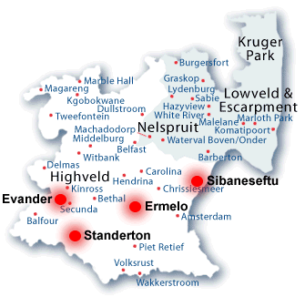
LOCATION OF CAMPUSES AND TRAINING SITES
6 Campuses
Skills Academy
15 training sites
New Campus: Perdekop

Slide 4
MANAGEMENT OF GERT SIBANDE TVET COLLEGE
On the 1 September 2017, the Principal was seconded to the Regional Manager Position of NW & MP and was permanently appointed in June 2019.
The Acting Principal was appointed from 1 September 2017 to date. The process of filling the post is still underway: interviews were conducted on the 17 October 2019, and waiting for finalization from the Minister.
The College has an Acting Deputy Principal Finance, Acting Deputy Principal Academic Affairs, Acting Registrar, Deputy Principal Corporate, five (5) appointed Campus Managers and two (2) acting campus managers for Standerton and Evander Campus.
The College has six (6) Campuses, Skills Academy and Artisan development in Standerton, satellite Skills Centre in Bethal and Piet Retief.

Slide 5
GOVERNANCE STRUCTURES
ESTABLISHED IN TERMS OF THE CET ACT NO. 16 OF 2006
The Minister of Higher Education and Training appointed five (05) Ministerial Council Appointees in April 2019 and granted concurrence with council to appoint four (4) additional members and (1) donor council member in October 2019 as informed by the CET ACT section 10(4).
The Council of the College is well constituted with sub-committees of council under the leadership of the Chairperson, Mr BJ Mwale.
The quality and expertise of council members is at a very high level with two SETA CEO’s, two advocates and members from industry appointed and already making an impact at Gert Sibande TVET College.
Council conducts oversight through the various sub-committees, and all reports are presented at a Council meeting quarterly.
Council is satisfied with the Management of the College, from the Academic, Financial Management, Inter-governmental Relations, Stakeholder management.

Slide 6
Abridged Profile of Ministerial Appointees (Council Members) 2019-2024
Name of the Council | Position | Brief Profile
Mr. Bongani June Mwale | Chairperson of Council, and EXCO & Finance | A PhD candidate with an MBA 17 years public sector experience Currently a Technical Specialist to the MEC
Ms. Maphefo Anno-Frempong | Deputy Chairperson of Council and of EXCO and Finance | Master Degree 12 years of experience in public service and 18 in the SETA environment Serves in Presidential Advisory Boards CEO of Transport TETA
Mr. Marthinus Zacharius Loots | Chairperson of the Audit committee | Holds Degree in Accounting Former CFO and Administrator at Tshwane North TVET College
Ms. Amanda Buzo-Gqoboka | CEO of Services SETA advocate | LLB >> B. Proc, Admitted Attorney of the High Court of SA, Experienced Legal, Business and Governance Executive Member, Law Society of the Northern Provinces
Dr. Amratlal Beeka | Member of the Academic board | A PHD holder and advocate Former circuit Manager (Highveld Ridge West Circuit) Member, Law Society of South Africa

Slide 7
Abridged Profile of Additional Council Members 2019-2024 (CET S10 (6))
Name of the Council | Position | Brief Profile
Mr. Tinyiko Lawrence Chauke | Member of the Academic Board | Holds MBA – Degree 17 years of experience in engineering management Eskom – Grootvlei Power Station
Mr. Tshepo Martin Tsotetsi | Member of the (ICT) Committee | Master Degree 10 years of experience in mining sector and 11 in Strategic Projects Specialist. Serves in Mpumalanga HRD Council and Mpumalaga Provincial Bursary Committee
Mrs. Ndou Mashudu Priscilla | Member of the Student Support Committee | Holds Management Degrees 12 years of experience in Sasol Synfuels management Serves in different in Human Development Transformation Forum
Mr. Albertus Meintjes | Member of the (ICT) Committee | Microsoft Certified Solutions Expert MCSE (15 years experience) IT specialist – ICT Infrastructure Design & Implementation
Mr. Kgabo Maitsa | Member of the Condition of Service Committee | Msc: Masters Science in Construction (Project Management) LLB – Legal Specialist
Ms. Nosipho Makhubu | Member of the Audit and Risk Committee | Holds Bcom: Accounting – Financial Accounting, Auditing & Taxation Certified Internal Auditor CIA (SA) Member of Associate General Accountant (AGA) SAICA

Slide 8
Financial Controls Adopted by Council
Council adopted a number of financial controls:
Reviewed the delegation of authority to reinforce the separation of duties and powers.
Reviewed the financial structure to allow for segregation of duties: appointment of the qualified and experienced financial manager (with external audit background).
conducted a risk assessment, developed a risk register, Adopted a risk management process for business continuity
Introduced a model to track and monitor the contract register on a monthly bases to reduce risk of duplication of service.
Monthly bank reconciliations to detect suspicious transactions that do not reconcile with the finance records and CFO report to EXCO and Council quarterly.

Slide 9
Financial Controls Adopted by Council
Council adopted a number of financial controls to curb the recurrence of the abuse of funds, elements of fraud and corruption:
Stopped the use of electronic signatures to eradicate unauthorised transactions.
Conducted financial discipline review, audit on asset and fleet, fraud and ethics management.
Audit Committee monitor the audit action plan to address audit findings raised by AG for 2018-19.
Principal to implement consequence management and enforce accountability to a lowest level possible.

Slide 10
Enrolment Targets per Campus
Campus | NCV |  | T1 |  | S1 |  | PLP
 | Target | Actual | Target | Actual | Target | Actual | Target | Actual
Ermelo | 1055 | 1045 | 564 | 564 | 358 | 352
Evander | 1275 | 1189 | 1331 | 670 | 775 | 538
Sibanesetfu | 1052 | 1062 | 125 | 161 | 305 | 271
Standerton | 1003 | 959 | 220 | 223 | 345 | 324
Balfour | 340 | 328 | 80 | 19 | 165 | 199
Perdekop | 392 | 404 |  |  | 65 | 45
Skills Academy |  |  |  |  | 95 | 83 | 100 | 116
TOTAL | 5117 | 4987 | 2320 | 1637 | 2108 | 1812 | 100 | 116

Slide 11
College: Governance, Strategy and Communication
ASPECT | College TARGET (Annual) | College Target (YtD) | College Actual (YtD) | INTERVENTION/ REMARKS
College Council | 4 |  |  | 30 March 2020 – CHAIRED BY EXTERNAL MEMBER – SRC part of the council
EXCO & Finance Committee | 4 | 1 | 1 | CHAIRED BY EXTERNAL MEMBER
Audit and Risk Committee | 4 |  |  | 23 March 2020 – CHAIRED BY EXTERNAL MEMBER
Academic Board | 4 | 1 | 1 | CHAIRED BY THE ACTING PRINCIPAL – SRC part of the board
SRC (with Principal) | 4 | 1 | 1 | Meet the President, the SG and Chairpersons of Campuses
FAC meetings | 10 | 2 | 2 | CHAIRED BY THE ACTING DP: FINANCE and Head of SSS
Condition of Service Committee | 4 |  |  | CHAIRED BY THE EXTERNAL COUNCIL MEMBER and DP Corp
ICT Committee | 4 |  |  | CHAIRED BY EXTERNAL COUNCIL MEMBER
Student Support Services Committee | 4 |  |  | CHAIRED BY EXTERNAL COUNCIL MEMBER

Slide 12
Skills Academy & Occupational Programmes
Engineering Programmes | Funders | Actual Students
Learnerships
Furniture Making and Upholstery Community House Building Level 2 | SACPO/CETA | 97
Apprenticeships
Electrician | CETA/AgriSETA/MerSETA/NSF/Air Liquide/Silica Quartz/Sparrow/Rula | 97
Carpenter | CETA/NSF | 27
Bricklayer | CETA/NSF | 40
Plumber | CETA/Sparrow/NSF | 74
Mechanical Fitter | AgriSETA/MerSETA/NSF/Air Liquide/Silica Quartz/Sparrow | 60
Welder | CETA/AgriSETA/MerSETA/NSF/Sparrow | 60
Milwright | AgriSETA/NSF/Silica Quartz/CoS | 72
Trade Test |  | 54

Slide 13
Skills Academy & Occupational Programmes (Cont.)
Soft Skills Programmes | Funders | Actual Students
Learnerships
Chemical Operations Early Childhood Development End-user Computing Wholesale & Retail Operations Mixed Farming Accounting Technician | CHIETA/AgriSETA/ MDoE/ETDPSETA/NSF/ServicesSETA/SASOL/W&RSETA | 408
Vocational Programmes
Prevocational Learning Programme | DHET | 116
Clothing Production | DHET | 25
Apprenticeship
Hairdresser | serviceSETA/NSF | 20

Slide 14
The State of Affairs at Gert Sibande TVET College
Student Registrations took place successfully across all campuses from 13 January 2020.
The College developed enrolment plans and implemented as planned.
Teaching and learning has commenced on all sites form 20 January – 02 March 2020. and all students received learning materials.
Evander Campus experienced interruptions from 30 January – 17 February 2020 due to taxi and bus conflict
From the 5th of March 2020, there were interruptions at Ermelo and Sibanesetfu Campus due to NSFAS payment issues. This had an impact on Quarter one (1) assessments for the affected campuses.
College Officials visited NSFAS to resolve bursary payment issues from the 04-06 March 2020.
The College suspended two officials on the 21st October 2019 on grounds of alleged fraud and investigations are underway.
The college received an Unqualified audit opinion in the 2018/19 financial year.
The Auditor General is on site for the 2019/20 financial year audit.
The team is compiling Annual Financial Statements to be reviewed by the internal auditors and presented to Audit Committee and Council before submission to AG and DHET by 31 March 2020.
The DHET approved R10,203,267.26 for Infrastructure & Maintenance, SCM processes are underway (tender closed on the 3 March 2020 for Sibanesetfu Campus).
The college is a Centre of specialization for Millwright Trade, the Construction of this Training Centre commenced in January 2020.
The Construction of a new Campus in Balfour commenced on 11 October 2019
The college unveiled a new logo and new corporate colours on the 13 November 2019
The College Driving Academy and Mandarin class for the transport and logistic students commenced in February 2020.
Gert Sibande TVET College has been nominated as a Centre of Excellence in ICT, this will bring alignment to the vision of becoming a leading college brand in the 4IR dispensation.
University of Pretoria has been appointed to conduct a Program Qualification Mix Research on behalf of Gert Sibande TVET College – Final Report on 30 March 2020, finding to be evaluated and implemented in 2021.

Slide 15
Structure of Teaching and Learning
A six (06) day, six (06) period time table is followed at all campuses
36 Periods for NCV students and 32 periods for Report 191 students.
NCV Lecturers teach 30 periods per cycle
Report 191 lecturers teach 32 periods per cycle.
The College has a Lecturer-in-training project. Currently 16 Lecturers-in-training is involved in the project. (04 absorbed by college)
The College is piloting a project where engineering lecturers in training will first qualify as artisans through our skills academy and then do the professional qualification to enhance the practical training of students.
Each campus has 6 workshop/classroom assistants to assist with practical classes.
An additional 4 interns per campus assist with administrative tasks.
Number of class groups per campus is determined by available infrastructure.
College has appointed Principal agents to develop 30 new classroom at Evander-, Ermelo- and Standerton campuses to allow increase in access.
We installed motor gates, turnstiles and procured license scanner at Standerton Campus to control access as a pilot project, it will rolled over to all sites.

Slide 16
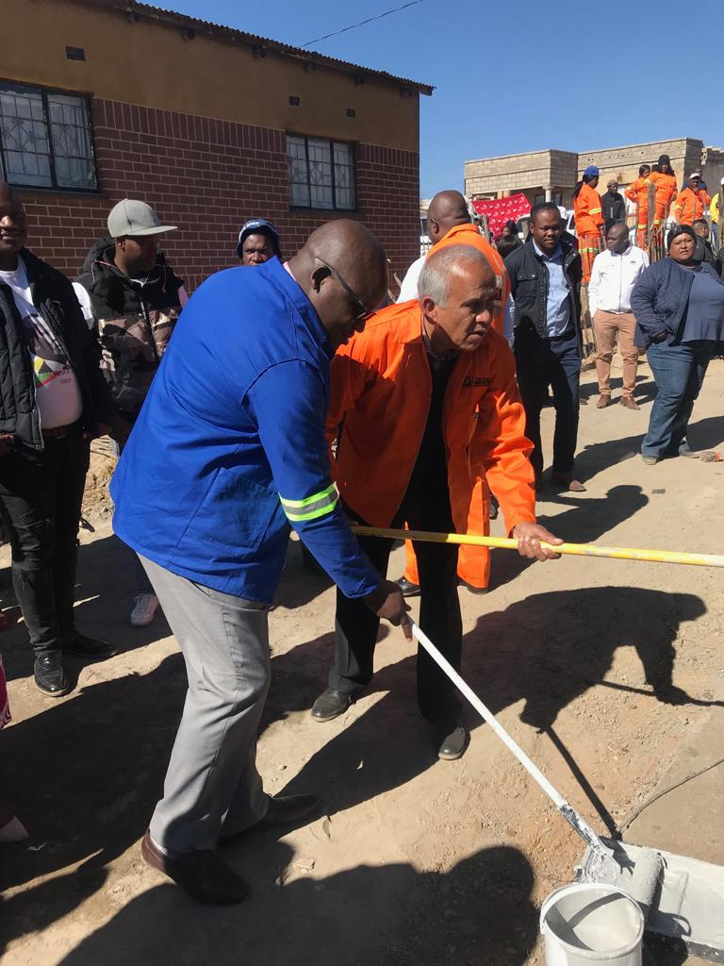
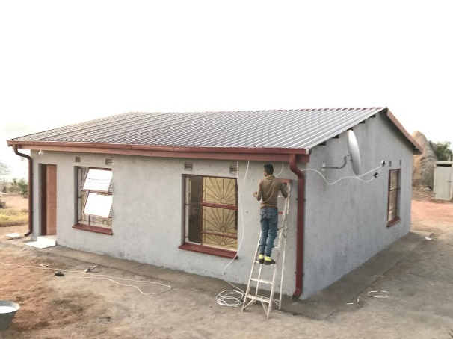
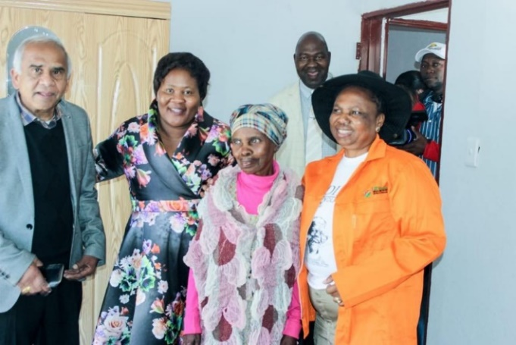
Mandela Day 18 July 2019
Every year the college and students construct a house for an elderly needy family, in the selected Municipality in our Region for that year.
House handover – Glenmore, Dundonald

Slide 17
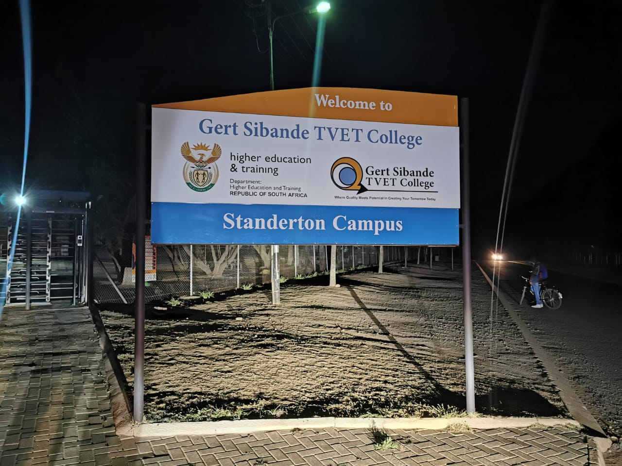


Logo Unveiling
OLD COLLEGE LOGO | CURRENT COLLEGE

Slide 18



Driving Academy at Evander Campus
The Driving Academy is established at Evander Campus from February 2020.
The Driving simulator has been procured and delivered.
Forty (40) transport and logistics Graduates are registered.

Slide 19

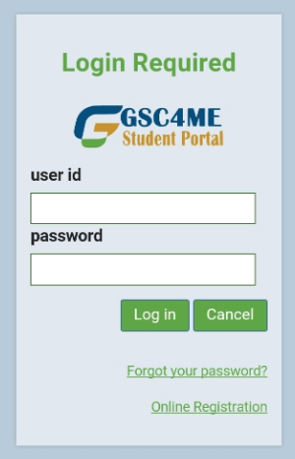

College launched a GSC4ME Mobile App
GSC4ME is also available on a Mobile App for Android downloadable from Play Store

Slide 20
State of Affairs Concerning NSFAS
Programme | No. of students enrolled | No: Students declared | Tuition Fees Declared | Total Allowance | No: Students on Wallet disbursed | Total Tuition fees received | Total wallet Disbursed
NCV | 4967 | 3145 | R 39 412 612,00 | R 55 552 550,00 | 2165 | R 29 900 950,00 | R 8 641 410,00
Report 191 S1 | 1637 | 1000 | R 2 880 070,00 | R 8 775 850,00 | 769 | R 2 100 150,00 | R1 828 908,00
Report 191 T1 | 1812 | 643 | R 1 273 744,00 | R 3 970 988,00 | 258 | R 713 324,00 | R 677 632,00
Totals | 8416 | 4788 | R 43 566 426,00 | R 68 299 388,00 | 3192 | R 32 714 424,00 | R 11 612 080,00
Challenges: My NSFAS portal – students login/malfunction of the system Students Allowance payments Students Accommodation – one hostel (Standerton Campus) Recommendations: NSFAS system be fixed Consider building students accommodation Find universal system to capture students attendance

Slide 21
Gert Sibande TVET College Digital Attendance App for NSFAS (Pilot)
VID-20200308-WA0001.mp4

Slide 22
GERT SIBANDE TVET COLLEGE: NCV SUBJECT PASS RATES 2015 - 2019

Slide 29
Work Based Experience / Job Placement

Slide 30
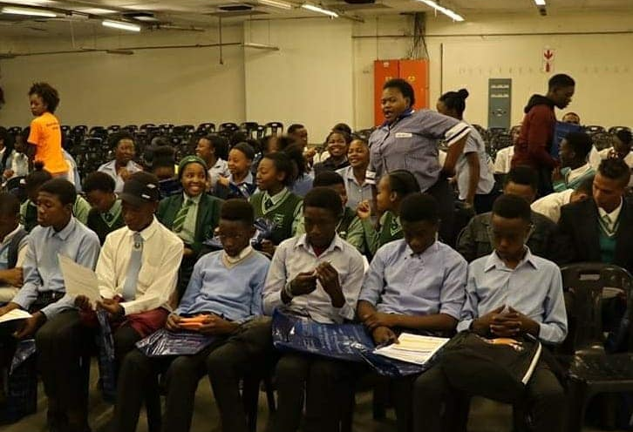
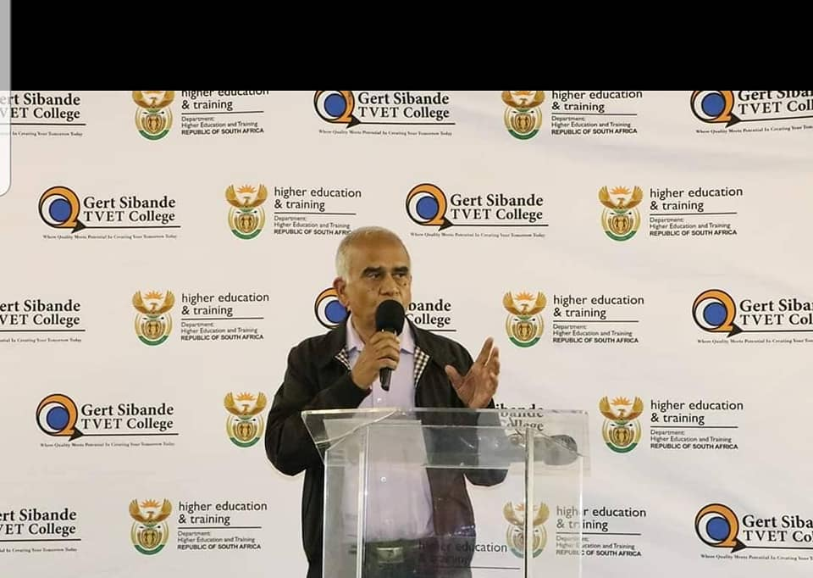
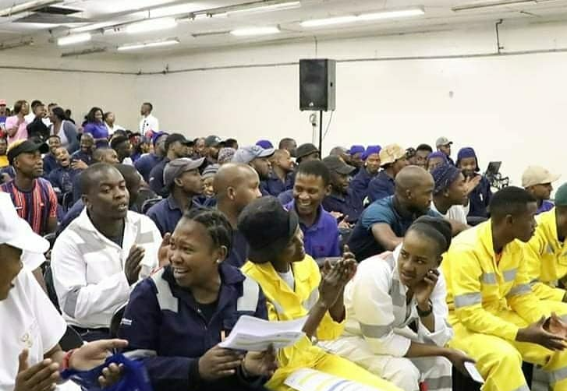
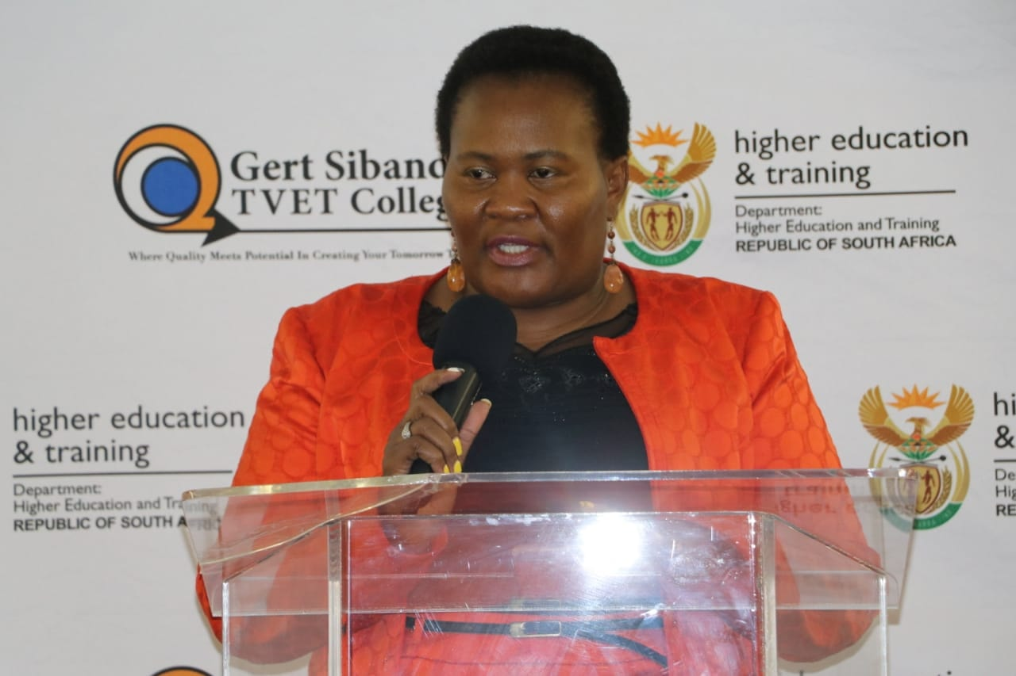
MARITIME ACADEMY
24 October 2019: Maritime Career Awareness
Gert Sibande TVET College Hosted a 2 days Maritime Career Awareness workshop to promote maritime careers to the local youth.
This initiative generated a lot of interest in the maritime and we started receiving a lot of enquiries.

Slide 31

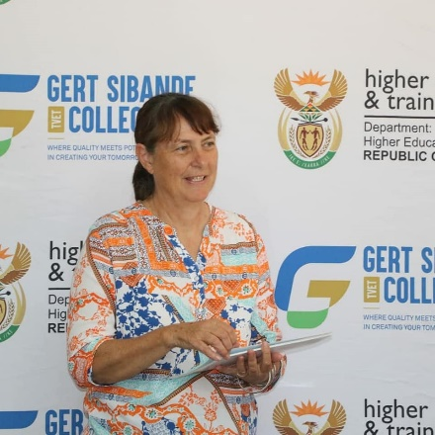

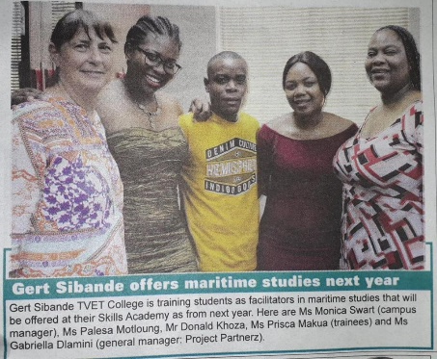
Progress to Date
Introduction to Maritime:
  From July 2019 – September 2019: a very informative program was conducted to the Staff members and facilitators that will be involved with the maritime training academy

Slide 32
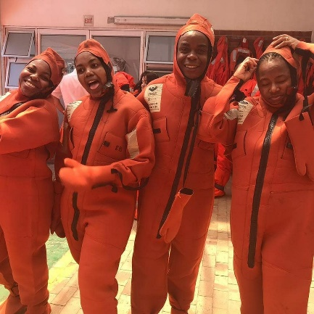

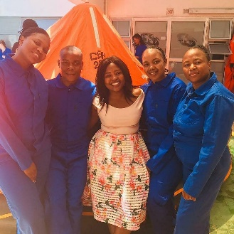
Progress to Date
STCW Training (Sea Safety and Sea Survival Training):
Date: 27th February 2020
Junior Maritime Facilitators for the STCW programs

Slide 33

I thank you

Slide 34
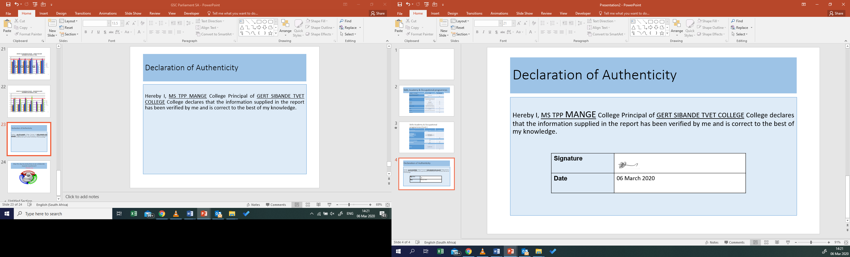
Declaration of Authenticity
Hereby I, MS TPP MANGE College Acting Principal of GERT SIBANDE TVET COLLEGE declares that the information supplied in the report has been verified by me and is correct to the best of my knowledge.

