Slide 1
Central Johannesburg TVET College
Strategic Plan 2020 – 2024
Focus on Strategies and Interventions
Central Johannesburg TVET College Presentation: Parliament Portfolio Committee on Higher Education,
Science and Technology
11 March 2020
Parliament of the Republic of South Africa Committee Room E249

Slide 2
Contents
Background to Central Johannesburg TVET College Names of Campuses Geographical location of Campuses. Status of Central Johannesburg TVET College Governance Structure Management Structure Registration 2020 Teaching and Learning Student Accommodation Linkages and Partnerships State of Finances Disbursement of NSFAS Achievements Challenges Staff on Precautionary Transfer / Suspension Conclusion
Notes:
Please list the key interventions for SO1 that the college will implement over the 5 year period.

Slide 3
Background to the Central Johannesburg TVET College
The Central Johannesburg TVET College was established through the General Notice, 7311 of 2001 which enabled the merger of FIVE former Further Education and Training Colleges.
This was implemented with effect from 1 January 2002.
Notes:
Please list the key interventions for SO1 that the college will implement over the 5 year period.

Slide 4
Name of Campuses
Alexandra Campus
Crown Mines Campus
Ellispark Campus
Langlaagte Campus
Parktown Campus
Riverlea Campus
Smit Street Campus
Troyeville Campus
All Campuses are within a 15km radius from the Central Office (5 Ubla Road, Parktown).
Notes:
Please list the key interventions for SO1 that the college will implement over the 5 year period.

Slide 5
Geographical Location of Campuses

Slide 6
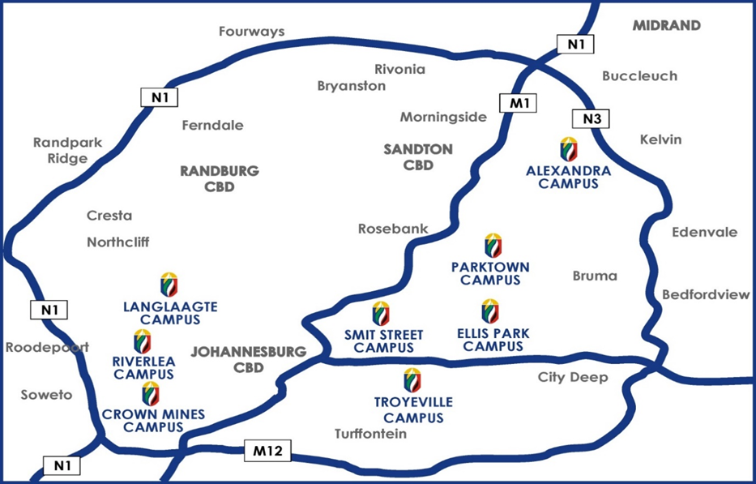
Geographical Location of Campuses
Notes:
Please list the key interventions for SO1 that the college will implement over the 5 year period.

Slide 7
Status of Central Johannesburg TVET College (CJC)

Slide 8
Status of CJC
The Central Johannesburg TVET College was officially placed under Administration by the former Minister of Higher Education and Training, Dr N Pandor.
PE Kedama assumed his responsibility as the Administrator on 06 May 2019.
This was done in line with the Continuing Education and Training Act (CET Act 16 of 2006) (as amended) clause 46 (1) – (6).
Notes:
Please list the key interventions for SO1 that the college will implement over the 5 year period.

Slide 9
Status of CJC (Cont.)
Some of the reasons that led to the College being placed under administration, after the commissioned phase 1 investigation, amongst other things included:-
Poor governance
Lack of internal controls
Qualified audit outcomes
Continuous students and community protests that are disrupting teaching and learning
A number of disruptions emanating from staff members due to various issues, etc.
Notes:
Please list the key interventions for SO1 that the college will implement over the 5 year period.

Slide 10
Governance

Slide 11
Governance
As per the CET Act (Act 16 of 2006) (Chapter 3 – Clause 9) any Public Technical and Vocational Education and Training College must have the following:
College Council (i.e. Administrator in this instance)
Academic Board
Student Representative Council
Academic Board
The established Board had its 1st meeting on the 29th of January 2020.
Comprised of external member from Wits University to strengthen academic delivery and forge partnerships
UJ also being approached for participation
Notes:
Please list the key interventions for SO1 that the college will implement over the 5 year period.

Slide 12
Governance (Cont.)
Student Representative Council (SRC)
The SRC was established in July 2019, amidst strong resistance, given that previous attempts (before administration) had failed.
Inducted and worked well with management
Improved communication with student population in the college
Notes:
Please list the key interventions for SO1 that the college will implement over the 5 year period.

Slide 13
Other Governance Structures
Other Governance Structures that were established
Committee | Responsibility
Audit and Risk Committee | In the absence of a Council an Audit and Risk Committee was appointed to provide independent and objective oversight on governance and compliance
Labour Forum | Promote engagement and consultations between College management and three unions (Nehawu, Sadtu and Naptosa)
Student Financial Aid Committee | The FAC was formerly constituted with regular meetings of all the stakeholder including SRC, Campus and Central representatives to enable financial aid decision making required, in line with the DHET rules
Management structures | Management Executive: Administrator and DPs College Management Committee: Executive and Campus Managers Campus Management: CMs and DPA
Notes:
Please list the key interventions for SO1 that the college will implement over the 5 year period.

Slide 14
Management Structure

Slide 15
Management Structure
Principal
Deputy Principal: Corporate Services*
Deputy Principal: Finance
Deputy Principal: Academic Affairs
* The only permanently appointed Deputy Principal at start of Administration.
8 x Campus Managers
Notes:
Please list the key interventions for SO1 that the college will implement over the 5 year period.

Slide 16
Registration 2020

Slide 17
Registration 2020
Programme | Funding Grid Numbers (FTE) | Trimester 1 of 2020 | Trimester 2 of 2020 | Trimester 3 of 2020 | Semester 1 of 2020 | Semester 2 of 2020 | Year 2020
National (Certificate Vocational) | 1 694 |  |  |  |  |  | 1 770
Report 191 (Engineering) | 2 683 | 961 | TBC | TBC
Report 191 (Business) | 2760 |  |  |  | 1236 | TBC
Prevocational Learning Programme | 100 |  |  |  |  |  | 43*
Total FTE’s | 7237
National Certificate (Vocational) at 104%
Report 191 (Engineering) 36% of total planned for 2020
Report 191 (Business Studies) 45% of total for 2020
PLP intake throughout year.
*TBC – To Be Completed during next cycle (Trimester/Semester)
Notes:
Please list the key interventions for SO1 that the college will implement over the 5 year period.

Slide 18
Teaching and Learning

Slide 19
Teaching and Learning
Programme | Pass Rate Achieved
 | 2016 | 2017 | 2018 | 2019
National Certificate (Vocational) | 44% | 67% | 65% | 71%
Report 191 Business & General Studies | 68% | 80% | 78% | 77%
Report 191 Engineering Studies | 58% | 57% | 55% | 51%
Notes:
Please list the key interventions for SO1 that the college will implement over the 5 year period.

Slide 20
Student Accommodation

Slide 21
Student Accommodation
Central Johannesburg TVET College currently has 2 Student Residences.
Crown Mines Hostel
First phase renovations of The Crown Mines Campus Residence has been completed with students fully occupying the place
Berea Hostel
The hostel was reclaimed in December 2019 from students, staff & other people who had hijacked it since 2016
The hostel will under-go significant renovations because it is in extremely poor condition - budget has now been approved.
Notes:
Please list the key interventions for SO1 that the college will implement over the 5 year period.

Slide 22
Linkages & Partnerships

Slide 23
Linkages & Partnerships
Various partnerships have been formed and established with a number of organisations, namely
CATHSSETA
FOODBEV SETA
W&R SETA
NHBRC
Note: Employer organisations are being engaged for work integrated learning opportunities, especially for the learners’ practical's and job placements.
Notes:
Please list the key interventions for SO1 that the college will implement over the 5 year period.

Slide 24
State of Finances

Slide 25
Financial Management
Sound financial management of finances in place
Income is generated through Tuition from NSFAS and direct transfers from DHET.
No significant alternative revenue generating streams. Hence, the following was done
Venue hire,
Usage of parking by external stakeholders, etc.
Expenditure management, is now done in line with approved budget, since the budget has been decentralised
Available funds are well managed, and we are also tapping into reserves in 2020 to improve infrastructure, fleet, ICT, etc.
Internal capacity is being built as the finance unit, mainly consists of Interns / junior personnel.
Notes:
Please list the key interventions for SO1 that the college will implement over the 5 year period.

Slide 26
Supply Chain Management
As part of internal capacity build, we insourced the procurement of goods & services (previously outsourced)
Established compliance structures in SCM namely; specifications committee, Bid Evaluation Committee, Bid Adjudication Committee.
Updated policies e.g. Admissions policy, SCM policy (Incl. SOP) etc.
Created economic opportunities for entities within the area of jurisdiction of the campuses especially SMMEs.
Service providers are paid within 30 days.
Notes:
Please list the key interventions for SO1 that the college will implement over the 5 year period.

Slide 27
Major Controls Introduced & Implemented
Approved delegation of authority for payments and procurement introduced
Approval process for ALL spend requirements in place
Monthly reconciliations of all significant balance sheet items, introduced
Payment of suppliers within 30 days
Improved and updated SCM policy
Notes:
Please list the key interventions for SO1 that the college will implement over the 5 year period.

Slide 28
Disbursement of NSFAS

Slide 29
Disbursement of NSFAS
Challenges
Delays in NSFAS remittance of Tuition, resulting in long outstanding student debt, non-recoverability of the student debt and impacting cash flow.
Delays in NSFAS paying allowances to students for transport and accommodation increasing risk of protests and pressure on the college to assist students with alternative transport and living arrangements
Risk of fraud relating to NSFAS accommodation allowances identified. Student disciplinary processes initiated and expulsion of students who have brought disrepute to the college.
Achievements
Better stakeholder management, i.e. students, SRC, campuses, central financial aid and NSFAS
Intervention by Administrator during crisis to have dedicated NSFAS team to assist to close out NSFAS queries, where approximately 500 students were assisted.
Fewer protests under the Administration which were non-violent and adequately managed.
Walk- in – applications process streamlined and managed
Notes:
Please list the key interventions for SO1 that the college will implement over the 5 year period.

Slide 30
Achievements

Slide 31
Successes & Achievements
CJC is currently stable with teaching and learning progressing satisfactorily, as various interventions (with the support of DHET & NSFAS) appear to be bearing fruits – including the overall culture of doing things
Various internal controls introduced has allowed for better management of finances, improved planning / processes, etc.
Major or significant issues continue to be addressed with positive outcomes
Support and the working relationship with various stakeholders like DHET, AGSA, NSFAS, etc. is on a positive trajectory.
Notes:
Please list the key interventions for SO1 that the college will implement over the 5 year period.

Slide 32
Challenges

Slide 33
Challenges
Late payment of allowances by NSFAS remains a risk that could lead to sudden protests by students. This includes the slow progress in capturing registered ‘walk ins’ into the NSFAS system
Dilapidated infrastructure requires significant financial injection to address it and the College has very limited resources.
Outstanding student debt a threat to long term sustainability of the College, due to no financial exclusions of students being applied.
Notes:
Please list the key interventions for SO1 that the college will implement over the 5 year period.

Slide 34
Staff on Precautionary Transfer/Suspension

Slide 35
Status of Central Johannesburg TVET College
On inception of administration the following management positions were vacant owing to staff suspensions and transfers
Principal – Precautionary Transferred
Deputy Principal: Finance – Precautionary Suspended
Human Resources Manager – Precautionary Suspended
Campus Manager: Ellispark Campus - Precautionary Suspended
Student Financial Aid Manager – Precautionary Suspended
Many of these cases are concluded if not about to be concluded
Notes:
Please list the key interventions for SO1 that the college will implement over the 5 year period.

Slide 36
Status of Central Johannesburg TVET College
During Administration a number of staff were placed under precautionary suspension:
Campus Manager: Crown Mines - Precautionary Suspended
IT Manager: Central Office: - Precautionary Suspended
Lecturers (PL1) : Alexandra Campus x 4 - Precautionary Suspended
Lecturer (PL1): Parktown Campus x 1 - Precautionary Suspended
General Assistant: Alexandra Campus x 1 - Precautionary Suspended
Cases ranged from neglect of duties, abuse of property, disrepute, etc.
Notes:
Please list the key interventions for SO1 that the college will implement over the 5 year period.

Slide 37
Conclusion

Slide 38
Conclusion
Notwithstanding resistance, significant progress has been made since the start of the administration and there has not been a students or labour unrest since June 2019.
The College is in a stable state, which has resulted in huge interest from students during the recent 2020 registration process (i.e. walk ins)
The academic performance is gradually improving due to various interventions aimed at assisting students who are struggling particularly in maths, engineering related subjects, etc.
The spend on infrastructure has improved and refurbishments of selected areas in all campuses are currently underway
A new culture of compliance has been embraced by staff
Notes:
Please list the key interventions for SO1 that the college will implement over the 5 year period.

Slide 39
Conclusion (Cont.)
Finances are in stable condition and supply chain management measures introduced are heading in the right direction – obviously, capacity & skills challenges are still an issue
Notwithstanding progress to date, much more still needs to be done to address some of the persistent challenges, which can be resolved, as follows:
The move into an integrated management system, is already underway
Skilling and capacitating support staff & lecturers
Improved support for students so that we produce employable students and/or entrepreneurs
Introduction and utilisation of smart boards to infuse 21st century teaching & learning, etc.
Notes:
Please list the key interventions for SO1 that the college will implement over the 5 year period.

Slide 40
Thank You

