Slide 1
SEDA ANNUAL REPORT 2018/2019
PRESENTATION TO THE SELECT COMMITTEE
10 MARCH 2020
By Ms M. Tshikwatamba
Chief Executive Officer

Slide 2
Presentation Outline
Performance statement
Seda performance Highlights and trends analysis
Performance per programme & Success stories
Delivery network and Partnerships
Human Resources Report
Financial Information
2018/19 success stories
Governance & Compliance

Slide 3
Performance statement Performance Priorities
Seda’s planning and interventions for the year under review take into account the following Stakeholder Priorities
National Development Plan | Medium Term Strategic Framework | Nine Point Plan
To enhance economic growth through SMMEs as assessed through an increased contribution by the sector to GDP; To create 90% of South Africa’s 11 million needed jobs by 2030 through the SMME sector, and so contribute to reducing the unemployment rate to 6%; | Outcome 4: Decent Employment through Inclusive Economic Growth: Township and rural economies Programmes to ensure increased access to employment and entrepreneurship Provide coaching, incubation, intensive support Outcome 7: Vibrant, equitable, sustainable rural communities: Promote sustainable rural enterprises and industries in areas with economic development potential | Public Procurement Access to Finance and Non-Financial Support Building market access Township and Rural Enterprises strategy

Slide 4
Performance statement Tracked outcomes
Seda’s performance information is structured in line with Seda’s approved Annual Performance Plan 2017/18 – 2019/20. It gives information on performance against targeted indicators, both on outcome and output level,
Seda’s programmes are designed and implemented to result in the following:
Improvement in turnover on supported SMMEs and cooperatives.
Improvement in jobs created by supported SMMEs and cooperatives.
Improvement in jobs sustained by supported SMMEs and cooperatives.
Improvement in support for SMMEs and cooperatives based in rural and township areas.
Improvement in support for women, youth and disabled owned SMMEs and cooperatives.
Improvement in performance measure and organisational well-being

Slide 5
Performance statement Seda strategic map
To strike a balance between internally focused, leading and externally focused, lagging indicators, the objectives in red will be tracked and reported internally

Slide 6
Performance highlights Overall performance against 2018/19 app targets
Seda Performed well against set Targets in its Annual Plan
From a total of 29 strategic indicators that were considered for the review, the organisation performed well on 27 indicators, this reflect an organisational performance of 93%.
The organisation did not achieve the following indicators:
Number of clients supported through enterprise couching
Value of support leveraged through partners

Slide 7
performance against 2018/19 app targets Areas of Concern
Number of clients supported through enterprise couching
Due to drop-outs during the year, the final number was reduced to 153
Time it takes to address governance matters in new incubators
Value of support leveraged through partners
Limited financial commitments have been leveraged from stakeholders
Client clearing through diagnostics assessments
Clients not completing their assignments and ratio of clients per Business advisor within a given time
Budgets Demand
Budget demand for incubators, technology transfer and Enterprise Development fund on the rise while there could be funds spent on specific ring-fenced funds programmes, switching of funds between ring-fenced funds and other client support demand areas not granted in time if granted at all

Slide 8
Performance highlights 2018/19 app: key performance indicators
Outreach
12,024 learners participated in entrepreneurship in schools
Finalists
App connecting companies/people with charities - Grade 12, Secunda (MP)
App for booking hospital appointments –Grade 12, Sir Pierre Van Ryneveld High School ( GP)
Accommodation booking app for lower income market – Grade 12, Charlotte Maxeke High School (GP)
42,848 clients reached through Provincial promotional and marketing actions
30,049 clients attended entrepreneurship awareness session and
4,773 interventions implemented ( branch network Projects for Business Advisors)
Companies assisted on specific projects received support as follows;
10,732 diagnostic assessments conducted on client’s businesses
9,110 enterprises trained in business management
901 cooperatives adopted and assessed
861 clients trained on national and international standards

Slide 9
Performance highlights 2018/19 app: key performance indicators
2,860 clients supported through incubation
465 clients supported through innovation and technology transfer
266 clients supported with quality interventions
Impact
498 new SMMEs established from the incubation support network
The incubated enterprises created a collective revenue of R917 600 000
6,957 new jobs created by all supported clients
19,064 jobs sustained by all supported clients
1,75 billion turnover measured across supported clients

Slide 10
performance trends Services frequently needed-branch network
Frequent Clients Needs
Finance and Legal access
Human Resources
Management and Planning
Marketing
Quality and Standards
Productivity Management
Technology Transfer and Technical Assistance
Cooperatives Support
Franchise Support
Trade and export promotion support

Slide 11
performance highlights programmes and projects responding to key client needs
Special Projects Implemented for the DSBD
On-boarding and remodelling of DSBD Enterprise Incubation Programme (EIP) to form a single Seda Incubation Programme started in September 2018. New partnerships secured and 4 new centres were supported in the automotive, food technology and biotechnology sectors.
Successful implementation of DSBD’s Informal Micro Enterprise Development Programme (IMEDP) by approving support to 4 317 micro enterprises with equipment to the value of R40 351 218. These enterprises are mostly located in townships and rural areas.

Slide 12
performance highlights programmes and projects responding to key client needs
Strengthening South Africa’s business incubation ecosystem
Reviewed Technology Transfer and Incubation support policies to enable management of external party funding and establish a mechanism to leverage private sector funding.
Growth Garage Supplier Development model was developed as an incubation partnership model enabling SMMEs access to corporates’ supply chain; R20m funding partnership (5yrs) with Gibela for the establishment of an incubator in Nigel was signed and Phase 1 implemented. Currently busy with the implementation of Phase 2.
Three (3) Centres for Entrepreneurship Rapid Incubators (CFERIs) were funded to establish MakerSpaces equipped with high-end design production technology and software.
Launched the Incubation Governance Management Development Programme (IGMDP) in partnership with University of Pretoria on 31 May 2019. In total 45 students have graduated and the 3rd cohort have completed their studies at the end of September

Slide 13
performance highlights programmes and projects responding to key client needs
Strengthening South Africa’s business incubation ecosystem
Seda continued to expand the network of supported incubators and launched 4 new incubators. The Incubator Portfolio supported grew from 64 incubators at the end of March 2018 to 76 at the end of March 2019.
Seda hosted the 2nd SABIC from 14 to 16 November 2018, the largest incubation and accelerator knowledge platform in Africa which attracted over 700 local and international delegates. The theme of the conference was “Creating Inclusive Entrepreneurial Growth through Innovation”
The 3rd national final Pitch & Perfect competition was held during SABIC with 20 finalists. Judges included representatives from Sefa, Absa, Innovation Summit and 2 venture capital representatives from Silicon Valley.

Slide 14
performance highlights programmes and projects responding to key client needs
Facilitating SMME Innovation and Supplier Development
Roundtable with private sector and SOEs – The roundtable was held in November 2018 with the objective of unpacking the role of Seda in Enterprise Supplier Development and highlighting opportunities for collaboration ( Strategic need identified during SABIC 2018)
Industry 4.0 roundtable – Held in March 2019 in partnership with Microsoft’ focused on unpacking 4IR to manufacturing companies, highlighting business opportunities for digital solutions with practical demonstrations.
Automotive aftermarket information and opportunities– The Innovation Forum was held in June 2018 in partnership with Bosch Automotive.
SABTIA Tech Camp –Seda Participated with presentations on the future of incubation in South Africa and the event was also used for the official media launch of SABIC 2018.

Slide 15
performance highlights programmes and projects responding to key client needs
Implementing Business Development Support Ecosystem Partnerships
The SA National Accreditation System (SANAS) – concluded 3 year funding agreement to the amount of R200 000 per year to support SMMEs operating in the Conformity Assessment space
Youth Employment Service (YES) – concluded a 3 year agreement to promote youth entrepreneurship opportunities and support at incubators.
Export Credit Insurance Corporation of South Africa (ECIC) – Concluded a 3 year MOA to assist in the distribution of their Export Development grant through TTF.
AfricArena 2018 – An annual conference showcasing Africa’s best start-ups and innovators in front of international and local investors looking for world-class talent; In 2018 the event was hosted by Seda supported French/SA Tech labs in cooperation with Silicon Cape.

Slide 16
performance highlights programmes and projects responding to key client needs
SMME Support through International Cooperation
Participation in international benchmarking exposure re SME readiness for Industry 4.0 led to the creation of digital hubs, hosting of an Industry 4.0 awareness round table for SMEs and testing an Industry 4.0 readiness assessment tool for manufacturing SMEs.
In May 2018 a partnership agreement between Seda and MECAD (Dassault Systemes - France) was signed to provide SolidWorks software access to incubatees to improve their design capabilities and shortening time to produce prototypes and gaining market access. The value of the contract is R92 million.

Slide 17
SUCCESS STORY PROJECTS
Branch Network | Incubation | Technology Transfer
Cleaning Solutions and Body Care Solutions (2) Phutaditjaba (FS) Mthatha (EC) JHB(GP) | iHUB - Port Elizabeth Work scheduling, tracking and invoicing for field workers Load Faults, Generate Job cards (designed for schools ) Internet Connectivity through community cooperatives) –Possibilities of Free Wifi for villages | Mechanical Engineering Services Richards Bay (KZN) – Certification
Hospitality and Food Services (3) Richards bay (KZN) Bojanala (NW) Pretoria ( GP) | SAVANT – Cape Town Boitech-Medical Diagnosis for bacterial and fungal testing Smartblade- Airway management | Ethnic Hare Care Products Bryanston (GP) –product testing, branding and packaging designs
Call Centre Operations Claremont ( WC) | Invotech Tech Park -Durban Electro-coal technologies
Horticulture Kuruman ( NC) | Lepharo Incubator in JHB Oil and Gas Products
Agricultural Cooperative Brits (NW) | SAREBI – Cape Town Solar Power generation technologies
Plastic Moulding & Furniture Witbank ( MP)
Transport Logistics, Tyre & Fitment Centre Kroonstad (FS) Polokwane (LP) | DUT - Centre for Entrepreneurship and Rapid Incubator Prototype Umbrella for people with disabilities | Coffee Brew Cosmo City – (GP)-Bean Roasting and blending
Cement and Concrete Products- Port Elizabeth (EC)

Slide 18
Performance per programme balanced score-card perspectives and 2018/19 app

Slide 19
PROGRAME 1: ORGANISATIONAL CAPACITY
STRATEGIC OBJECTIVE | STRATEGIC INITIATIVE | PERFORMANCE MEASURE OR INDICATOR | ANNUAL TARGET | ACTUAL ACHIEVEMENT | REASONS FOR VARIANCE | MEASURES TAKEN TO RECTIFY
Programme 1: Enteprise Development
Improve Service Access | Increase number of enterprises accessing Seda services | Number of clients who attended entrepreneurship awareness (Briefing Sessions) | 20,000 | 30,049 | There was a high number of pre-start up clients who showed an interest in starting small businesses which resulted in an increased number of briefing sessions. | None
 |  | Number of diagnostic assessment conducted on clients businesses | 10,679 | 10,732 | The impact of partnerships, successful outreach initiatives and an increased focus on business assessments contributed to this performance. | None
 |  | Number of enterprises trained in business management (Group training etc.) | 5,000 | 9,110 | Pre-exhibition training sessions and partnerships with stakeholders has resulted in increased number of training interventions. | None

Slide 20
PROGRAME 1: ORGANISATIONAL CAPACITY
STRATEGIC OBJECTIVE | STRATEGIC INITIATIVE | PERFORMANCE MEASURE OR INDICATOR | ANNUAL TARGET | ACTUAL ACHIEVEMENT | REASONS FOR VARIANCE | MEASURES TAKEN TO RECTIFY
PROGRAMME 1: ENTERPRISE DEVELOPMENT
Improve Service Access (continued) | Increase number of enterprises accessing Seda services (continued) | Number of interventions implemented | 4,000 | 4,773 | Business Advisors played a proactive role in assisting clients with internal initiatives and interventions. | None
 | Increase number of cooperative accessing Seda services | Number of cooperatives assessed/ adopted | 600 | 901 | Referrals received from external stakeholders for cooperatives support resulted in more interventions being implemented. | None
 |  | Number of interventions implemented on adopted cooperatives | 100 | 359 | Referrals received from external stakeholders for cooperatives support resulted in more interventions being implemented. | None
 | Increase number of enterprises supported through enterprises development programmes | Number of clients supported through National Gazelles | 40 | 70 | 40 new Gazelles –(cohort 2) were added into the programme | None
 |  | Number of clients supported through enterprise coaching | 350 | 153 | The number of enterprises participating in the programme was 170, However, due to drop outs during the year, the final number was reduced to 153. | Going forward there will be improved recruitment and better engagement with selected enterprises to ensure that the observed challenges are mitigated.

Slide 21
PROGRAME 1: ORGANISATIONAL CAPACITY
STRATEGIC OBJECTIVE | STRATEGIC INITIATIVE | PERFORMANCE MEASURE OR INDICATOR | ANNUAL TARGET | ACTUAL ACHIEVEMENT | REASONS FOR VARIANCE | MEASURES TAKEN TO RECTIFY
PROGRAMME 1: ENTERPRISE DEVELOPMENT
Improve Service Access (continued) | Increase number of enterprises supported through enterprises development programmes (continued) | Number of learners participating in entrepreneurship in schools | 10,000 | 12,042 | This performance was due to increased interest by supported schools. | None
 |  | Number of clients supported through export, exhibitions & training | 400 | 799 | Different clients across the country benefited from Export Awareness workshops, Export Orientation Course, International Trade workshops, and local and international exhibitions. | None

Slide 22
PROGRAME 1: ORGANISATIONAL CAPACITY
STRATEGIC OBJECTIVE | STRATEGIC INITIATIVE | PERFORMANCE MEASURE OR INDICATOR | ANNUAL TARGET | ACTUAL ACHIEVEMENT | REASONS FOR VARIANCE | MEASURES TAKEN TO RECTIFY
PROGRAMME 1: ENTERPRISE DEVELOPMENT
Improve Service Access (continued) | Increase number of Informal businesses Accessing Seda Services | Number of informal Businesses supported (BESD) | 350 | 430 | The achievement is due to mentorship support offered to informal business by Enterprise Development Practitioners. | None
 | Increase Number of clients trained in quality improvement | Number of clients trained on national and International standards | 850 | 861 | The increase in the number of client supported is due to additional requests received from branches. | None
 | Increase service Access points | Number of colocation points | 43 | 74 | 53 colocations were carried over from the previous financial year, there are 21 new colocations points established for the current financial year. | None

Slide 23
PROGRAME 2: INTERNAL PROCESSES
STRATEGIC OBJECTIVE |  | STRATEGIC INITIATIVE | PERFORMANCE MEASURE OR INDICATOR | ANNUAL TARGET | ACTUAL ACHIEVEMENT | REASONS FOR VARIANCE |  | MEASURES TAKEN TO RECTIFY
PROGRAMME 2: SEDA TECHNOLOGY PROGRAMME
Improve | Increase the number of incubated clients |  | Number of clients Supported through Incubation | 2,210 | 2 860 |  | Newly launched EIP incubators have contributed to the increased number of clients supported. | None
Service
Access
 | Increase the number of clients supported through innovation |  | Number of clients Supported through innovation | 225 | 465 |  | There was an increased interest in Pitch and Perfect from SMMEs. | None
 | Improve product and service quality of supported clients |  | Number of clients Supported with quality interventions | 150 | 266 |  | Increased requests from branches as well as additional budget support from ECIC contributed in this achievement. | None

Slide 24
PROGRAME 2: INTERNAL PROCESSES
STRATEGIC OBJECTIVE |  | STRATEGIC INITIATIVE | PERFORMANCE MEASURE OR INDICATOR | ANNUAL TARGET | ACTUAL ACHIEVEMENT | REASONS FOR VARIANCE |  | MEASURES TAKEN TO RECTIFY
PROGRAMME 2: SEDA TECHNOLOGY PROGRAMME
 | Increase |  | Number | 27 | 50 |  | ECIC provided extra | None
 | in number |  | of clients |  |  |  | funding and this
Improve | of clients |  | supported |  |  |  | enabled more clients
Service | supported |  | through |  |  |  | to be supported.
Access | through |  | Technology
 | TTF |  | Transfer
 | Increase |  | Number of | 338 | 498 |  | Newly launched EIP | None
 | in number |  | new SMMEs |  |  |  | incubators contributed
 | of new |  | established |  |  |  | to the increased
 | SMMEs |  |  |  |  |  | number of new
 | established |  |  |  |  |  | SMMEs established.
 | Increase in |  | Number | 140 | 199 |  | More incubates | None
 | incubation |  | of SMMEs |  |  |  | completed their
 | graduates |  | graduated |  |  |  | graduation milestones
 |  |  |  |  |  |  | and have graduated
 |  |  |  |  |  |  | from the incubation
 |  |  |  |  |  |  | programmes.

Slide 25
PROGRAME 3: INTERNAL PROCESSES
STRATEGIC OBJECTIVE | STRATEGIC INITIATIVE | PERFORMANCE MEASURE OR INDICATOR | ANNUAL TARGET | ACTUAL ACHIEVEMENT | REASONS FOR VARIANCE | MEASURES TAKEN TO RECTIFY
PROGRAMME 3: ADMINISTRATION
Improve strategic alignment | Delivery on shareholders compact | Percentage achievement Of shareholders compact Deliverables | 100% | 100% | There were 29 deliverables that were tracked for the whole year and all of them were achieved. | None
Improve stakeholder engagement | Implement stakeholder Engagement plan | Percentage of Stakeholders engaged | 50% | 66% | 200 stakeholders were identified for engagement in the 2018/19 financial year and 133 Stakeholders were effectively engaged by the end of the year. | None
Improve Organisational Performance | Jobs Created | Number of new jobs created by supported Clients | 3,000 | 6 957 | Interventions implemented, consultations and business advice contributed in the increased number of new jobs created by supported clients. | None
 | Jobs sustained | Number of jobs sustained by supported clients | 8,000 | 19 064 | Interventions implemented, consultations and business advice contributed in the increased number of new jobs sustained by supported clients. | None
Improve Organisational Performance (continued) | Turnover increase | Amount increase in turnover in supported clients | 1,25 Billion | 1,75 Billion | Interventions implemented, consultations and business advice contributed in the increased number of new jobs sustained by supported clients. | None

Slide 26
PROGRAME 3: INTERNAL PROCESSES
STRATEGIC OBJECTIVE | STRATEGIC INITIATIVE | PERFORMANCE MEASURE OR INDICATOR | ANNUAL TARGET | ACTUAL ACHIEVEMENT | REASONS FOR VARIANCE | MEASURES TAKEN TO RECTIFY
PROGRAMME 3: ADMINISTRATION
Increase funding | Improve partnering with stakeholders | Value of support leveraged from partners | R30 million | R23 million | Limited financial commitments from stakeholders |  | Engage more stakeholders in order to receive more financial support
Improve cost efficiencies | Allocating most of Financial resources to core service delivery | Percentage of Seda budget allocated to core delivery | 75% | 79.01% | The 2018/19 focus on core service delivery and more than 75% of the budget was allocated to service delivery. |  | None
Improve Customer satisfaction | Measure customer satisfaction | Customer satisfaction index | 4 on a scale of 1-5 | 4.7 | 92% of the surveyed clients were satisfied with the quality of Seda’s services. |  | None
 | Measure stakeholder satisfaction | Stakeholder satisfaction index | 3 on a scale of 1-5 | 3.3 | More than 65% of engaged stakeholders indicated that they are satisfied with Seda services. |  | None
Improve Customer Satisfaction (continued) | Reduce the vacancy rate | Percentage of vacancy rate in funded positions | 5% | 4% | Continuous follows ups with Line managers and HRBPs done to accelerate the recruitment processes and staff requisitions completed as a position becomes vacant. |  | None

Slide 27
Performance: Key Client Demographics
 | EC | FS | GP | KZN | LP | MP | NC | NW | WC | TOTAL
% of clients which are black owned business | 96% | 97% | 97% | 98% | 100% | 99% | 97% | 99% | 88% | 96%
% of clients which are women owned business | 37% | 45% | 36% | 43% | 55% | 57% | 34% | 50% | 39% | 43%
% of clients which are youth owned business | 51% | 51% | 52% | 53% | 49% | 42% | 49% | 43% | 52% | 49%
% of clients which are owned by people with disabilities | 2% | 0% | 5% | 1% | 0% | 4% | 3% | 3% | 2% | 2%

Slide 28
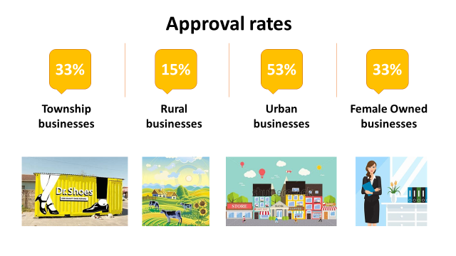
performance trends Services FREQUENTLY NEEDED-STP
Technology Transfer Fund
TTF received 306 applications and 46 clients were approved for TTF assistance and 4 for ECIC ( at R540 000 maximum spending per company) - Budget demand increasing

Slide 29
performance trends Services frequently needed -STP
Quality and Standards
Typical interventions included ISO9001 Quality Management Systems, ISO14000 Environmental Management Systems, SANS18000 Health and Safety, and ISO22000 Food Safety.
An impact assessment study on a sample of Management System interventions showed that after 1 year the average turnover of clients had increased by 17% and employment by 23%.

Slide 31
Seda delivery network

Slide 32
Increased Seda Delivery Network 2018/19
Provinces | Seda Branches | Colocations | Mobile units | Incubators | Total per province
Eastern Cape | 5 | 14 | 0 | 10 | 29
Free State | 5 | 9 | 5 | 3 | 22
Gauteng | 2 | 5 | 0 | 16 | 23
Kwa-Zulu Natal | 6 | 11 | 0 | 13 | 30
Limpopo | 5 | 4 | 3 | 3 | 15
Mpumalanga | 5 | 20 | 0 | 6 | 31
Northern Cape | 5 | 5 | 1 | 3 | 13
North West | 5 | 5 | 0 | 4 | 14
Western Cape | 14 | 1 | 0 | 6 | 21
TOTALS | 52 | 74 | 09 | 76 | 198

Slide 33
Key Partnerships
Nature of Partnership
SERVICE SETA Support & Capacity Building to improve Business Advisory Standards development (Support to 1200 Learners with Stipend of 8100)
Gibela Rail Transport Consortium and MERSETA Support for Incubation establishment and Support & Capacity Building, Provision of 3,583M to incubators in 3 Provinces (KZN,WC and FS)
Eskom, Liquid Telecom, Cell-C, Cold Press Enterprise & Supplier Development
City of Ekurhuleni Training of graduates on Empretec & Tools
MTN Foundation and City of Ekurhuleni Contribution of awards to Seda’s event [SABIC]

Slide 34
Key Partnerships
Nature of partnership
Masisizane Fund (OLD MUTUAL) Graduate Incubatees Seed Funding (Seda Rapid Incubation Centers located in Technical Vocational and Training Colleges( TVET), Technology Transfer Funds and Conformity Standards, Partnership on Various Projects ( Youth Rapid Incubators)
Mercantile bank Access to Finance
SAIPA Capacity Building, Provision of pro-bono accounting training to business advisory services of Seda as well as to the SMME’s.
MICROSOFT Hosting Roundtable discussion on -Industry 4.0-Opportunies for digitalisation in manufacturing for small and medium sized businesses in South Africa
Monash South Africa Outreach, Collaboration on the Entrepreneurship Day
DSBD/NAFCOC & SEDA/SEFA DSBD and NAFCOC, with support from Seda, shall co-operate in small business policy co-ordination including facilitating access to opportunities in various Departments of Government to ensure that small businesses reach Government’s target of contracting 30 % of its contractible goods and services to small business.

Slide 35
Key Partnerships
Nature of partnership
Henley Business Capacity Building, empowering small and medium enterprises through the provision innovation and capacity acceleration training programme to ensure that small and medium enterprises gain access to both national and international markets so as to ensure that small enterprises grow and become sustainable.
SAB Biz-on-Tap Entrepreneurship Education and awareness interventions in the spirit of the SAB Kick-start entrepreneurship programme. To support an enabling environment for youth entrepreneurs to access information and business development skills training including tools and resources to be delivered across the Republic of South Africa (“South Africa”) with an intention to build a quality pipeline of small businesses and/or start-ups.
DETEA- Free State Implementation of supplier development programmes alongside the tourism programmes, Delivery of other tourism enterprise development and support products and instruments through SEDA and Sharing of SMME information. Hosting the Annual Stakeholder Forum 2018

Slide 36
Key Partnerships
Nature of partnership
Government Communications and Information Services (GCIS) Integrated Marketing and PR Campaign Provision / Sharing of marketing platforms in support of Government’s Programme of Action
SEDA/North West Provincial Department of Economy and Enterprise Development To develop and promote cooperation in all strategic business and reasonable intervention spheres of Business training, Business Funding, Facilitation of Access to Procurement Opportunities in the Provincial Government for SME’s, Business Incubation, Industry Related Research, Data and Information Sharing , recording and preservation of information.
Polokwane Municipality, Limpopo Province Business Support Services project are ongoing in partnership with the Municipality.

Slide 37
Human Resources Report

Slide 38
Key Human Resources Figures
Total number of staff as at end March 2019 was 673 against an approved structure of 704
Of this number, 179 are Business Advisors (168 as per approved structure +11 MOU)
Work being done on professionalising the sector.
Staff vacancy rate currently at 4.40%, which has been the trend for the past year.
About 75% of the staff are in the provincial network.
Significant part of National Office are staff in the Enterprise Development Division and Seda Technology programme, which are part of the core services.

Slide 39
Financial Performance Information

Slide 40
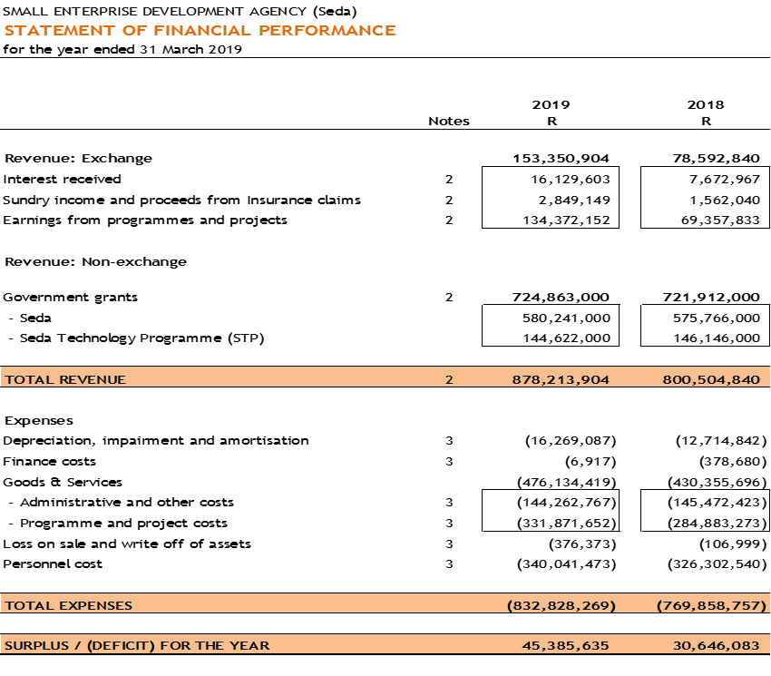
Financial Report
Note: Expenditure excludes expenditure on CAPEX R6,3 m (R8,2m 2018)

Slide 41
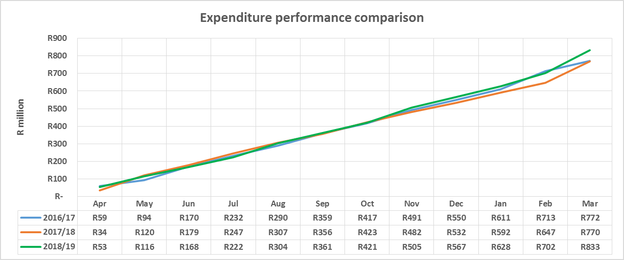
Expenditure Performance
Expenditure comparison for past 3 Financial years 2016/17 - 2018/19 (R’million)
Note: Expenditure excludes expenditure on CAPEX

Slide 42
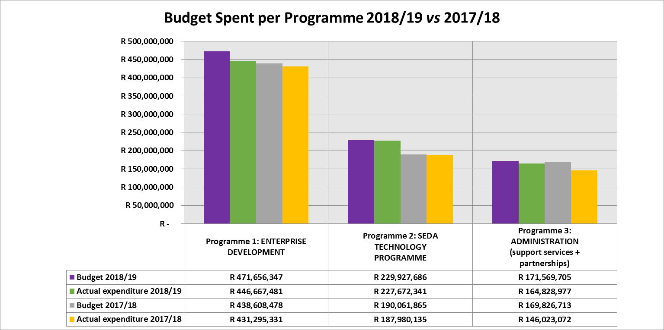
Portfolio spend per programme
Budget spent per programme 2018/19 vs 2017/18
79.01% of Seda budget allocated to core delivery

Slide 43
Statement of financial performance Areas of Concern
The operating surplus of Seda as at 31 March 2019 is R45 million, which is 3.89% of the budget of Seda, any operating deficit amount is classified as an irregular expenditure.
Amount made of
R11 million on vacant positions, which were filled later in the year and in 2019/20,
R24 million on National Gazelles project due to time taken to internalize the program as it was run by an External Service provider until April 2018, and transitional challenges in the payment of Gazelles grants from BBSDP to the National Gazelles project that were resolved towards the end of the third quarter of 2018/19,
R5 million on Capacity Building program due to expired Memorandum of Agreements and National Treasury CSD non-compliance by clients. These challenges were subsequently resolved, and
Other small amounts of R5 million.
We await National Treasury response on whether to retain or surrender the operating surplus of R45 million.

Slide 44
Statement of financial performance Addressing Underspending in 2019/20
National Gazelles Project: Grant amounts of R22 million to clients have been adjudicated, and an additional adjudication taken place, to date R20m approved. Procurement process already taking place for all approvals already made, in quarter four final adjudication and approvals taking place.
Project Plan for CPPP Project & Cooperate Assistance Program (EDTEA) Project in KZN is finalized, thus the procurement process commenced to ensure spending to a sum of R13 million by year-end. The KZN Provential Government, which fund these projects, delayed to finalise their list of Co-Operatives interventions.
Some tranche payments to incubators of R23 million were late due to expired MoA and CSD non-compliance matters, that had to be addressed before 2019/20 disbursements. To date, tranche payments from prior year paid or re-allocated to other incubators /digital hubs

Slide 45
AGSA Audit
 | 2017/18 | 2018/19
Programme 1 – Enterprise Development | Unqualified | Unqualified
Programme 2 – Seda Technology Programme | Unqualified | Unqualified
Audit outcome - Financial results | Unqualified clean audit | Unqualified clean audit
Responsiveness to shareholder specific requirements
100% delivery on shareholders compact

Slide 46
Governance & Compliance

Slide 47
Governance & Compliance
Committee | Actual No of Meetings | Dates
Board meetings | 7 | 30/05/18 31/07/18 28/08/18 27/09/18 31/10/18 30/01/19 27/03/19
Strategy and organisational performance Committee (sopc) | 7 | 23/04/18 24/05/18 25/07/18 15/08/18 24/10/18 23/01/19 19/03/19
Audit and Risk committee (arc) | 5 | 24/05/18 with SOPC Members in attendance 24/07/18 with SOPC Members in attendance 25/10/18 23/01/19 19/03/19
HUMAN RESOURCES AND Remuneration Committee | 6 | 23/05/18 15/08/18 with SOPC Members in attendance 28/08/18 25/09/18 with SOPC Members in attendance 24/10/18 with SOPC Members in attendance 14/03/19

Slide 48
THANK YOU

