Slide 1



COMMISSION FOR CONCILIATION, MEDIATION AND
ARBITRATION
2019/20 QUARTER 2
PERFORMANCE
PRESENTATION TO PARLIAMENTARY PORTFOLIO COMMITTEE ON EMPLOYMENT & LABOUR
04 MARCH 2020

Slide 2

QUARTER 2 NON - FINANCIAL PERFORMANCE

Slide 3
2019/20 QUARTER 2 NON – FINANCIAL PERFORMANCE RESULTS
ENTITY | 2019/20 PLANNED INDICATORS | ACHIEVED | NOT ACHIEVED | OVERALL % ACHIEVEMENT
CCMA | 8 | 5 | 3 | 63%
2

Slide 4
YEAR ON YEAR PERFORMANCE COMPARISON
(2015/16, 2016/17, 2017/18, 2018/19, 2019/20) (CONT…)
3

Slide 5
COMPARISON OF PERCENTAGE PERFORMANCE
(2019/20 FINANCIAL YEAR-QUARTER ON QUARTER)
4

Slide 6
2019/20 QUARTER 2 NON – FINANCIAL PERFORMANCE RESULTS
STRATEGIC OBJECTIVE PERFORMANCE FOR THE 2019/20 FINANCIAL YEAR
STRATEGIC OBJECTIVES | PLANNED ANNUAL TARGET | ACTUAL ANNUAL ACHIEVEMENT | DEVIATION | COMMENT ON DEVIATIONS
ENHANCING THE LABOUR MARKET TO ADVANCE STABILITY AND GROWTH | 2 | 1 | 1 | Please refer to Slide 6.
ADVANCING GOOD PRACTICES AT WORK AND TRANSFORMING WORKPLACE RELATIONS | 0 | 0 | 0 | Not applicable.
BUILDING KNOWLEDEGE AND SKILLS | 1 | 1 | 0 | Not applicable.
OPTIMISING THE ORGANISATION | 5 | 3 | 2 | Please refer to Slide 6.

Slide 7
QUARTER 2: REASONS FOR DEVIATIONS FOR UNDER – PERFORMING TARGETS
NO. | TARGET | PERFORMANCE | REASON FOR NON - ACHIEVEMENT
1. | Deliver nine (9) capacity building interventions on effective negotiation skills covering aspects of the COGP and the Accord to strategically identified Users | Seven (7) capacity building interventions on effective negotiation skills covering aspects of the COGP and the Accord delivered to strategically identified Users | Non-achievement on this target is due to the cancellations by parties with short notice. Management has put in interventions in place to ensure that this target is reached by the end of the financial year.
2. | Conciliate (hear) 100% of all cases at first event within 30 days of the date of receipt of the referral (this excludes agreed extensions) | 98.3% (65 871 of 67 033) of all conciliated (heard) cases at first event within 30 days of the date of receipt of the referral (this excludes agreed extensions) | Measures to improve internal controls have been implemented at Regional level in order to mitigate the risk of re - occurrence.
3. | Send 100% of arbitration awards rendered to parties within 14 days of the conclusion of the arbitration proceeding (this excludes extensions granted and heads of arguments filed) | 99.6% (10 866 of 10 912) of arbitration awards rendered to parties sent within 14 days of the conclusion of the arbitration proceeding (this excludes extensions granted and heads of arguments filed) | Measures to improve internal controls have been implemented at Regional level in order to mitigate the risk of re - occurrence.
6

Slide 8

QUARTER 2 EFFECTIVE AND EFFICIENT DISPUTE RESOLUTION
PRIORITY 1 contributes towards Outcome 14: Transforming society and uniting the country
The CCMA received 67 033 referrals received by the end of Quarter and heard 65 871 conciliations within 30 days, (98% compliance rate). 10 866 of arbitration awards were sent to parties by the fourteenth (14th) day after completion of the arbitration process (99.6% compliance rate). The CCMA conciliated cases within 23 days, and arbitration awards and 54 days to deal with arbitration cases.
Approximately 61% of all case referrals related to unfair dismissal (a reduction of 11%, compared to the 2018/19 financial year), with 9% relating to unfair labour practice disputes (a reduction of two percent (2%) from the previous financial year).
The Business Professional Services sector remained the highest referring sector at 29% of total referrals. The Private Security is the second highest referring sector with 14% a total of total referrals. The Retail sector on the other hand, experienced a decrease of one percent (1%) from the 2018/19 financial year, accounting for 11% of the total cases in 2018/19. All other sectors remained consistent compared to the preceding financial year, apart from Domestic and Construction, with a proportion of 6% and 7% each, representing a 1% reduction each, respectively.

Slide 9

QUARTER 2 LEGISLATIVE IMPACT AND SOCIAL PROTECTION
      PRIORITY 2 contributes towards Outcome 4: Decent employment through inclusive economic growth”, “Outcome 11: Create a better South Africa, a better Africa and a better World”, and “Outcome 14: Transforming society and uniting the country”.
      The CCMA Vulnerable Programmes, focused on advocacy, educating and capacitating targeted vulnerable groups (sectors, gender, work arrangements and income streams etc) of their employment law responsibilities and rights, directly contributing towards the realisation of legislative objectives. In the second quarter of 2019/20 financial year, the CCMA conducted 514 outreach services (inclusive of awareness raising activities, capacity building activities and social justice blockages activities, resulting in 23 262 intended beneficiaries being capacitated.
      The CCMA has delivered seven capacity building interventions on effective negotiation skills covering aspects of the COGP and the Accord to strategically identified Users
      Through the Essential Services Committee, observance of four Essential Service Designations (ESDs), Minimum Service Agreements (MSAs), Minimum Service Determinations (MSDs) and/or Maintenance Service Determinations were monitored for compliance.

Slide 10


QUARTER 2 LABOUR MARKET STABILITY AND ECONOMIC DEVELOPMENT
PRIORITY 3 of contributes towards Outcome 4: Decent employment through inclusive economic growth, Outcome 11: Create a better South Africa, a better Africa and a better World, and Outcome 14: Transforming society and uniting the country.
Of the 46 public interest matters dealt with, the CCMA settled 36 public interest matters, resulting in 78% settlement rate. This is largely due to the CCMA’s proactive monitoring, support and guidance provided to labour market in respect of Collective Bargaining matters.
.
      Priority 4 contributes towards Outcome 4: Decent employment through inclusive economic growth, Outcome 11: Create a better South Africa, a better Africa and a better World and Outcome 14: Transforming society and uniting the country.
      The In the effort to contribute towards the alleviation of the triple crisis of unemployment, poverty and inequality, the CCMA conducted large-scale retrenchment or ‘Section 189A facilitation processes involving 22 558 employees who were facing potential retrenchment.
      Of these 22 558 employees, the jobs of 9 559 (42%) were saved, while the rest were either retrenched opted for voluntary retrenchment or had their matters concluded in an alternative way.

Slide 11

QUARTER 2 GOVERNANCE AND ADMINISTRATION
      PRIORITY 5 contributes towards Outcome 12: An efficient, effective and development-oriented public service.
      The CCMA is financially stable with cost containment measures being implemented.
      133 complaints were received across all platforms for the second quarter of 2019/20 financial year. All complaints received were investigated, responded to.
      As per the CCMA annual Training Plan, 25 interventions have been delivered to internal staff to capacitate the workforce for efficient and effective delivery of the CCMA mandate in Quarter 2.

Slide 12









THE CCMA IS MAKING A DIFFERENCE
2019/20 QUARTER 2 DASHBOARD
1 JULY 2019 – 30 SEPTEMBER 2019
58 037 cases were referred to the CCMA during the period under review, compared to 48 664 cases in the 2018/19 financial year
The CCMA conducted 514 outreach services (inclusive of awareness raising activities, capacity building activities and social justice blockages activities
On average, the CCMA took 23 days to deal with conciliation cases as compared to the legislated target of 30 days
23 262 people were capacitated to better understand the law and their rights through the outreach activities conducted
42% of jobs (9 559 out of 22 558 jobs at stake) were saved compared to employees facing retrenchments (cases referred to the CCMA)
On average, the CCMA took 54 days to deal with arbitration cases against a target of 60 days
The CCMA held the following events:
2019 CCMA and Councils Labour Dialogue on 04-05 September 2019 at the Lakes Hotel and Conference Centre, Benoni Gauteng Province.
3rd Annual CCMA Shop-stewards and Union Officials Conference on 12-13 September 2019 at Gallagher Convention Centre, Midrand Gauteng
The CCMA settled 78% (36 out of 46) public interest matters (Section 150)
The CCMA settlement rate for the period under review is 77%
The CCMA received 133 complaints during the period under review, compared to 100 complaints received in the second quarter of 2018/19 financial year. Out of the 133 cases received, 130 were investigated and responded to, and 3 are pending investigations
DASHBOARD

Slide 13
QUARTER 2 - FINANCIAL PERFORMANCE RESULTS

Slide 14
FINANCIAL PERFORMANCE
RESULTS FOR PERIOD ENDING SEPTEMBER 2019
EXPENDITURE ANALYSIS
ITEM | BUDGET | ACTUALS | VARIANCE | VARIANCE | COMMENTARY
 | R’000 | R’000 | R'000 | %
Compensation of Employees | 284 988 | 274 690 | 10 298 | 4% | The variance is mainly due to the unfilled vacancies
Transfer Payments | 2 760 | 2 271 | 489 | 18% | The variance results from less inflow of Bargaining Council claims submitted that relates to awards rendered and settlement agreements.
Goods & Services | 231 514 | 236 941 | (5 427) | (2%) | The variance is a result of utilisation of PT Commissioners which is 3% higher than the projected efficiency of 60%,as well as the increase in variable case disbursements cost a such as venue and travelling costs in response to case load. The other contributing factor is as result of the depreciation not budgeted for, only CAPEX considered during the planning.
Total OPEX | 519 262 | 513 902 | 5 360 | 1%
CAPEX | 5 000 | 1102 | 3 898 | 78% | The variance is resulting from the timing difference in procurement of furniture and ICT projects planned for.
Total Expenditure | 524 262 | 515 004 | 9 258 | 2%

Slide 15
FINANCIAL PERFORMANCE
RESULTS AS AT END OF SEPTEMBER 2019
CASE DISBURSEMENT SPEND
CASE DISBURSEMENT | BUDGET | ACTUALS | VARIANCE | VARIANCE | COMMENTARY
 | R’000 | R’000 | R'000 | %
Commissioner Fees | 147 470 | 168 938 | (21 468) | (15%) | The variance is a result of utilisation of PT Commissioners which is 3% higher than the projected efficiency of 60%,as well as the increase in variable case disbursements cost a such as venue and travelling costs in response to case load.
Case Disbursements Travel and Subsistence | 10 093 | 10 054 | 38 | 0% | The spending is in line with the projected budget. The variance is a result of under expenditure on travel costs related to the Commissioners in execution of cases to the outlying areas.
Case Disbursement Admin Costs | 5 722 | 3 935 | 1 787 | 31% | The variance due to variable administrative costs related to dispute management and prevention activities that did not materialised as planned such as printing of manuals.
Interpreter fees | 42 987 | 43 539 | (552) | (1%) | The spending is in line with the projected budget.
Total Expenditure | 206 271 | 226 466 | (20 194) | (10%)

Slide 16
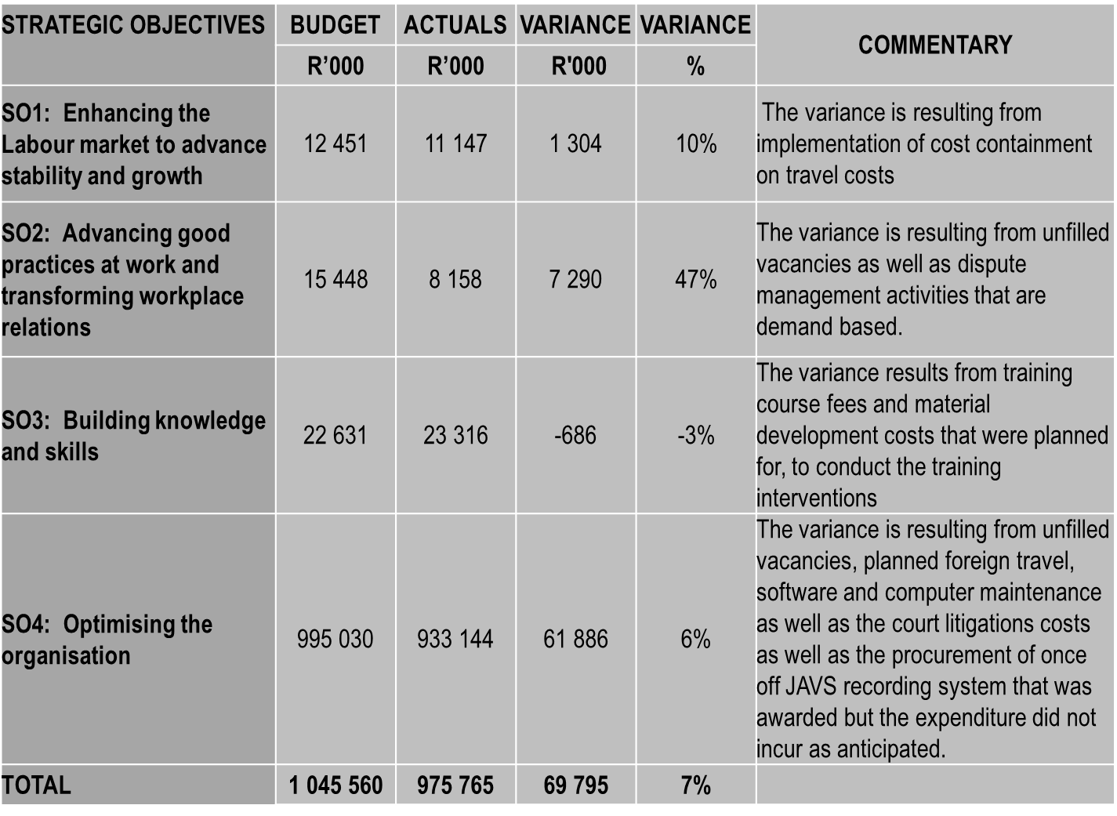
FINANCIAL PERFORMANCE
RESULTS FOR PERIOD ENDING SEPTEMBER 2019
SPENDING BY STRATEGIC OBJECTIVE
STRATEGIC OBJECTIVES | BUDGET | ACTUALS | VARIANCE | VARIANCE | COMMENTARY
 | R’000 | R’000 | R'000 | %
SO1: Enhancing the Labour market to advance stability and growth | 7 380 | 5 785 | 1 596 | 22% | The variance results from unfilled vacancies as well as the utilisation of PT commissioner fees in respect of Section 189 that were planned for but not utilised as anticipated.
SO2: Advancing good practices at work and transforming workplace relations | 9 646 | 4 750 | 4 896 | 51% | The variance results from unfilled vacancies as well as less utilisation of PT commissioner for Mediation activities. The other contributing factor is due to saving related to the Advocacy of National Minimum Wage that was planned for but not incurred as planned
SO3: Building knowledge and skills | 16 021 | 10 460 | 5 561 | 35% | The variance results from training and bursary costs that were planned for but not utilised as anticipated due to lower number of applicants for bursaries.
SO4: Optimising the organisation | 491 214 | 494 010 | (2 796) | (1%) | The variance is a result of utilisation of PT Commissioners which is 3% higher than the projected efficiency of 60%,as well as the increase in variable case disbursements cost a such as venue and travelling costs in response to case load.
TOTAL | 524 262 | 515 005 | 9 257 | 2%

Slide 17
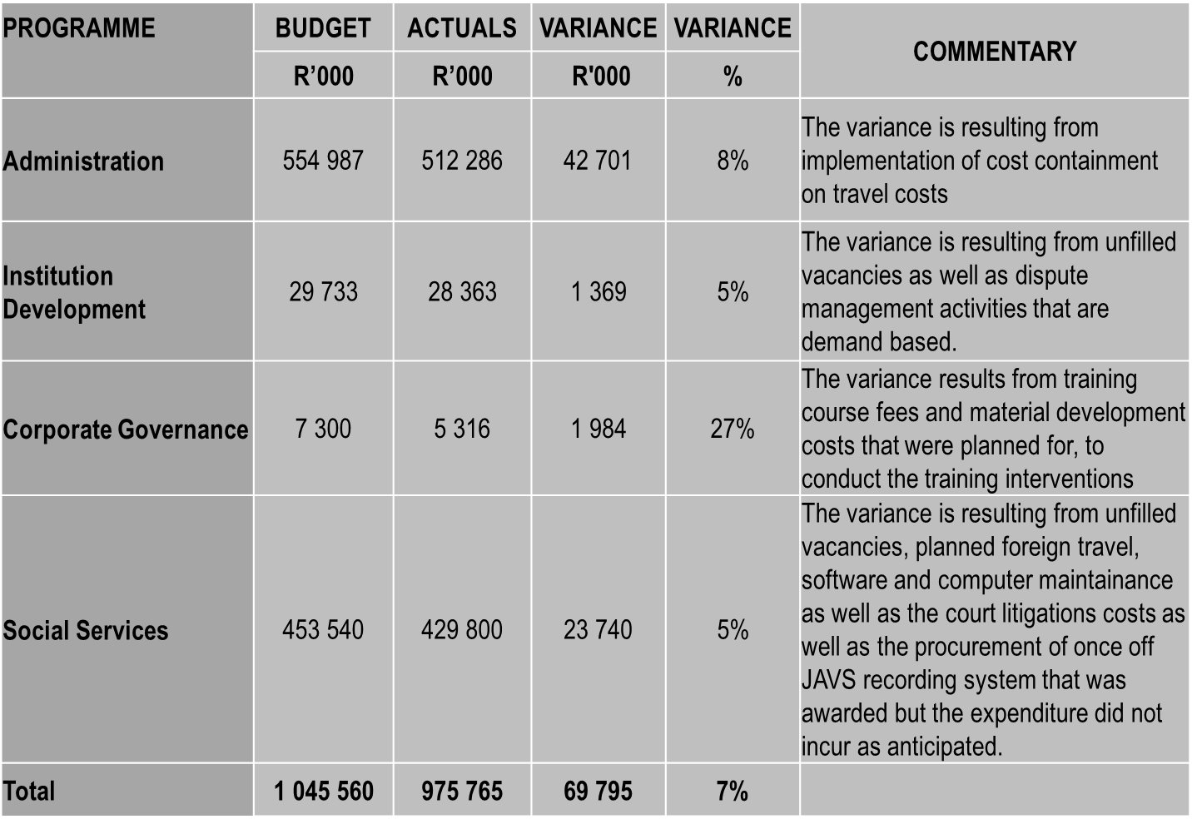
FINANCIAL PERFORMANCE
RESULTS FOR THE PERIOD ENDING SEPTEMBER 2019
SPENDING BY PROGRAMME
PROGRAMME | BUDGET | ACTUALS | VARIANCE | VARIANCE | COMMENTARY
 | R’000 | R’000 | R'000 | %
Administration | 278 496 | 263 611 | 14 885 | 5% | The variance results from utilisation of court litigation costs, balloting and automation of predictive tool, provision for audit fees , as well as timing difference as a result of Oracle Audit Vault contract not yet signed, Disaster Recovery Solution, Helpdesk solution and Business Reengineering contracts not yet awarded, delay in procurement of furniture.
Institution Development | 21 700 | 13 265 | 8 435 | 39% | The variance results from training and bursary costs that were planned for but not utilised as anticipated due to lower number of applicants for bursaries.
Corporate Governance | 5 293 | 3 129 | 2 165 | 41% | The variance results from timing difference in filling of vacancies as well as under expenditure on board fees and training for the Board Committees.
Social Services | 218 772 | 235 001 | (16 228) | (7%) | The variance is a result of utilisation of PT Commissioners which is 3% higher than the projected efficiency of 60%,as well as the increase in variable case disbursements cost a such as venue and travelling costs in response to case load.
Total | 524 262 | 515 005 | 9 257 | 2%

Slide 18
STATUS OF AGSA AUDIT FINDINGS

Slide 19
Thank You…
MAKING A DIFFERENCE

