Slide 1




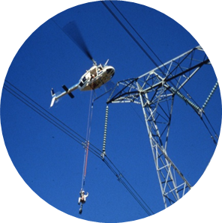
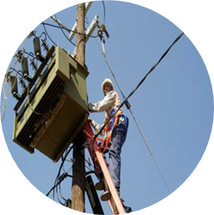
Annexure 2
Details of all Expansions and Deviations
SCOPA and PC on Public Enterprises
26 February 2020

Slide 2
Contents
1
Overview
2
Modifications under investigations
3
Deviations rejected by CPO and resubmitted
4
Deviations & Expansions not supported by National Treasury
5
All other Deviations & Expansions submitted to National Treasury
6
Conclusion

Slide 3

Overview
Procurement through deviations compromises the principles of fairness, equitability, transparency, competitiveness and cost-efficiency.
National Treasury introduced instructions on procuring through deviations because some organs of state were abusing this mode of procurement.
Single source procurement may occur when more than one supplier exists in the market that can perform the contract, but a particular supplier is identified as the preferred supplier for various reasons, eg continuation of service. Prior approval is required from National Treasury for single source procurement.
Sole source supplier is where one supplier possesses the unique and singularly available capacity to meet Eskom’s requirements. National Treasury approval is not required for sole source procurement.
Motivations must also be provided as to why procurement should be done through deviation as opposed to testing the market and concluding a new contract.
Center of excellence in the Office of the Chief Procurement Officer is responsible for reviewing such motivations and advise on whether deviations should be allowed or not.
The reviews of motivations were stopped previously to enable state capture.
Our focus is on reducing the number of procurements that are done through deviations.

Slide 4
Overview
Compliance function in procurement was not capacitated to enable state capture
Contingencies in some contracts were and still not used for their intended purpose, e.g. Tenova claimed R10 million from contingency and pay a supplier who claimed to have trained co-operatives. Mugazi submitted an invoice of R8 million which was paid in advance.
Projects were removed from one supplier and given to the other supplier without following any bid process and funded through modifications.
Chief Procurement Officer requested that historical modifications should be investigated to establish if they were used for their intended purposes.
Sub contractors connected to project managers were appointed by main suppliers, eg Staffanuti package 28 in Kusile, which is still under investigation.

Slide 5
Contents
1
Overview
2
Modifications under investigations
3
Deviations rejected by CPO and resubmitted
4
Deviations & Expansions not supported by National Treasury
5
All other Deviations & Expansions submitted to National Treasury
6
Conclusion

Slide 6
Modification of PB Africa Contract
Description | Values | Dates
Original total approved value (Including contingency) | R 100 000 000.00 | 26 February 2006
Duration | 60 months
Modification 1 - Comments on Bravo Project |  | 05 September 2007
Additional contract amount | R 1 322 303 754.00
Additional contingency amount | R0.00
Additional contract duration | 60 Months
Total | R 1 422 303 754.00
DCF1 | R 773 539 687.00 | 08 April 2010
 | R 2 195 843 441.00
DCF2 | R 1 404 156 559.00 | 03 September 2012
 | R 3 600 000 000.00
DCF3 | R 520 000 000.00 | 14 July 2014
 | R 4 120 000 000.00
DCF4 | R 830 400 000.00 | 21 April 2015
 | R 4 950 400 000.00
DCF5 | R 450 000 000.00 | 03 May 2016
 | R 5 400 400 000.00
DCF6 | R 477 066 747.00 | 14 July 2016
Total | R 5 877 466 747.00

Slide 7
Cont. Modification of PB Africa Contract
Total | R 5 877 466 747.00
Modification 2 |  | 21 December 2017
Additional contract amount | R 350 000 000.00
Additional contract duration | 24 Months
Additional time contingency | N/A
Total Values (incorrect - arithmetic error) | R 6 194 466 747.00
Modification 3 |  | December 2019
Additional contract amount | R 0.00
Additional contingency amount | R 0.00
Additional contract duration | 30 Months
Additional time contingency | 0 Month
Total contract amount | R 6 227 466 747.00
Total contingency amount | N/A
Total approved value | R 6 227 466 747.00
Combined contract duration | 196 Months
Value spent to date 31 July 2019 | R 5 827 163 276.00
Amount available | R 370 303 472.00

Slide 8
Modification of Alstom Contract
Base Cost | R 13 416 641 808.00 | 12 June 2007
Contingency | R 1 207 497 763.00
Provision | R 0.00
Total | R 14 624 139 571.00
Time | 73 Months
Time Contingency | 0 Months
Modification No 1 |  | 30 May 2013
Base Cost | R 0
Contingency | R 1 443 443 713.00
Provision | R 0
Total | R 1 443 443 713.00
Time | 37 Months
Time Contingency | 0 Months
Modification No 2 |  | 11 February 2015
Base Cost | R 0.00
Contingency | R 1 021 305 258.00
Provision | R 0.00
Total | R 1 021 305 258.00

Slide 9
Cont. Modification of Alstom Contract
Modification No. 3 |  | 23 October 2015
Base Cost | -R54 034 994.00
Contingency | R54 034 994.00
Provision | 000.00
Total | 000.00
Time | 31 Months
Time Contingency | 3 Months
Modification No. 4 |  | 16 August 2016
Base Cost | R2 034 994.00
Contingency | R278 254 930.00
Provision | R231 007 451.00
Total | R511 297 375.00
Time | 0 Months
Time Contingency | 6 Months
Modification No. 5 |  | December 2019
Base Cost | R 116 567 868.00
Contingency | R 0.00
Provision | R 141 703 991.00
Total | R 258 271 860.00

Slide 10
Cont. Modification of Alstom Contract
Time | 12 Months
Time Contingency | 9 Months
Total Values
Total contract amount | R 13 364 641 808.00
Total contingency amount | R 4 004 536 658.00
Total provisional sum | R 231 007 451.00
Total approval value | R 17 600 185 917.00
Combined contract duration | 141
Value spent to date on contract amount | R 13 364 034 406.00
Value spent to date on contingency | R 3 844 032 512.00
Value spent to date on provisional sum | R 230 457 997.00
Contract amount available | R 607 402.00
Contingency amount available | R 160 504 146.00
Provisional amount available | R 549 454.00

Slide 11
Modification of Stefanutti Contract
Original approved contract value | R1 632 321 742.11 | 02 June 2011
Original contract duration | 68 months
Original contingency amount | R163 232 174.20
Original contingency time | 3 months
Value of modification No. 1 (excluding contingency) | R739 849 498.47 | 17 April 2013
Additional contingency - modification No. 1 | R163 151 844.13
Additional time - modification No. 1 | 12 months
Contract amount – re-allocated to Contingency | (R520 739 655.45) | 2015/2016
Contingency Increased re-allocation | R520 739 655.45
Value of modification No. 2 (excluding contingency) | R920 419 061.05 | 19 October 2016
Additional contingency - modification No. 2 | R118 306 898.40
Additional time - modification No. 2 | 19 months
Value of modification No. 3 (excluding contingency) | N/A
Additional contingency - modification No. 3 | N/A
Additional time - modification No. 3 | 14 months
Additional contingency - modification No. 3 | 7 months
Value of modification No. 4 (excluding contingency) (foreign portion – USD2 091 581.07) | R268 251 506.24 | December 2019
Additional contingency - modification No. 4 | N/A
Additional time - modification No. 4 | N/A
New combined contract value (excluding contingency) | R3 040 102 152.20
New combined contract duration (excluding contingency) | 116 months
Value spent to date (including contingency) | R3 726 070 287.82
Amount available (including contingency) | R11 210 930.55

Slide 12
Modification of Stefanutti Contract
Original approved contract value | R1 632 321 742.11 | 02 June 2011
Original contract duration | 68 months
Original contingency amount | R163 232 174.20
Original contingency time | 3 months
Value of modification No. 1 (excluding contingency) | R739 849 498.47 | 17 April 2013
Additional contingency - modification No. 1 | R163 151 844.13
Additional time - modification No. 1 | 12 months
Contract amount – re-allocated to Contingency | (R520 739 655.45) | 2015/2016
Contingency Increased re-allocation | R520 739 655.45
Value of modification No. 2 (excluding contingency) | R920 419 061.05 | 19 October 2016
Additional contingency - modification No. 2 | R118 306 898.40
Additional time - modification No. 2 | 19 months
Value of modification No. 3 (excluding contingency) | N/A
Additional contingency - modification No. 3 | N/A
Additional time - modification No. 3 | 14 months
Additional contingency - modification No. 3 | 7 months
Value of modification No. 4 (excluding contingency) (foreign portion – USD2 091 581.07) | R268 251 506.24 | December 2019
Additional contingency - modification No. 4 | N/A
Additional time - modification No. 4 | N/A
New combined contract value (excluding contingency) | R3 040 102 152.20
New combined contract duration (excluding contingency) | 116 months
Value spent to date (including contingency) | R3 726 070 287.82
Amount available (including contingency) | R11 210 930.55

Slide 13
Modification of ABB Contract
Original approved contract value | R2 214 056 184.34 | 18 March 2015
Original contract duration | 61 months | EWO Legal Opinion
Original contingency amount | R268 036 742.12
Original contingency time | 12 months
Original Provisional Sum | R40 690 887.50
Original total approved value (Including contingency & Prov. Sums) | R2 522 783 813.96
Value of modification No.1 (excluding contingency) | R550 044 229.42 | 16 August 2016
Additional contingency - modification No.1 | R30 000 000.00
Additional time - modification No.1 | 0 months
New combined contract value (excl contingency & Provisional Sum) | R2 764 100 413.76
Total approved value (incl. contingency and prov. Sums) | R3 102 828 043.38
Value spent to date (including contingency) | R 2 964 926 905.70
Amount available (contingency) | R 45 617 074.90
Amount available (including contingency & Prov. Sums) | R137 901 137.68
Rejected Modification 2

Slide 14
Modification of Tenova Contract
Original approved contract value | R962 383 802.66 | 10 March 2010
Original contract duration | 73 months
Original contingency amount | R49 487 425.05
Original time contingency | 03 months
Original total approved value (Including contingency & Prov. Sums) | R1 010 502 973.91
Modification 1 |  | 11 October 2012
Value of modification No. 1 (excluding contingency and T&S) | R44 115 056.23
Additional time - Modification No. 1 (excluding contingency) | None
Modification to contingency amount | R100 762 329.80
Modification 2 |  | 19 May 2016
Value of modification No. 2 (excluding contingency and T&S) | R890 221 795.59
Additional time - Modification No. 1 (excluding contingency) | 38 months
Modification to contingency amount | R89 022 179.56
Modification 3 |  | NB: Not Approved
Value of modification No. 3 (excluding contingency and T&S) | R0.00
Additional time - Modification No. 3 (excluding contingency) | 27 months
New combined contract value (excluding contingency and T&S) | R1 896 720 654.48
New combined contract duration (excluding contingency)** | 138 months
Value spent to date (excluding contingency and T&S) | R1 586 541 577.37
Amount available (excluding contingency) | R310 179 077.11

Slide 15
Modification of Black & Veatch Contract
Modification Number | Contract Value | Percentage of Increase in comparison to the original one | Modified Contract Amount | Approval Dates
B&V Proposal | R 114 000 000.00 | 0% | R 114 000 000.00 | 12 December 2005
1 | R 2 706 194 678.34 | 2373.85% | R 2 820 194 678.34 | 05 September 2007
2 | R 806 492 930 .46 | 707.45% | R 3626 687 608.80 | 08 April 2010
3 | R 4 353 312 391.20 | 3818.70% | R 7 980 000 000.00 | 05 August 2011
4 | R 4 560 000 000.00 | 4000.00% | R 12 540 000 000.00 | 14 March 2013
5 | R 1 345 267 374.00 | 1180.06% | R 13 885 267 374.00 | 04/04/2016
6 | R 1 068 819 084.00 | 937.56% | R 14 954 086 485.00 | 21 December 2017
Delegation Consent Form
B&V Construction Management

Slide 16
Contents
1
Overview
2
Modifications under investigations
3
Deviations rejected by CPO and resubmitted
4
Deviations & Expansions not supported by National Treasury
5
All other Deviations & Expansions submitted to National Treasury
6
Conclusion

Slide 17
Deviations rejected and resubmitted
Eskom Treasury
Appointment of experienced lawyers to provide legal services – White and Case
Appointment of advisory services to advise on possible turnaround strategy - Lazard International
First submission in June 2019 and second submission in September 2019.
Rejected as the end-user could not provide evidence that the suppliers in the existing Legal Panel do not have the capacity.
Open enquiry issued after second requests were rejected

Slide 18
Deviations rejected and resubmitted
Additional security requirements - Medupi @ R9.8 million and Kusile @ R15.9 million
First submission through the General Manager of Security
Second submission through the Chief Operating Officer
Additional requirements include:
The Project accelerating Bonus
Tactical team
On-site vehicles
Site-specific equipment
Transport requirements
NB - These requirements were not included in the enquiry that was issued to the market.

Slide 19
Deviations rejected and resubmitted
Appointment of Bowmans or Ryno Pepler
First submission through Eskom project managers
Second submission through SIU
Rejected as the end-user wanted to pursue a sole source procurement without issuing a mini tender (closed bid) to the existing Legal Panel service providers.
Purpose of the investigation
To investigate allegation of corrupt activities on the part of the project manager relating to Kusile package 28.

Slide 20
Deviations rejected and resubmitted
Appointment of T systems
Appointment of T – systems to render Capex work for R40 million.
Contract to be modified by R49 million, not justifiable to modify by more than 100%.
First submission in May 2019 and second submission in February 2020
Appointment of HKA
First submission through Eskom project managers in July 2019
Second submission was received in February 2020.
Rejected as the end-user wanted to pursue a single source procurement without utilizing the existing panel.

Slide 21
Contents
1
Overview
2
Modifications under investigations
3
Deviations rejected by CPO and resubmitted
4
Deviations & Expansions not supported by National Treasury
5
All other Deviations & Expansions submitted to National Treasury
6
Conclusion

Slide 22
Deviations Not Approved - Quarter 1
NT Ref. No | Project Description | Reason for Deviation | NT Response
31 | Appointment of ABB for the Maintenance Services of Oil Flame Scanners at a contract value of R8 573 3172,00 | ABB was the only successful tenderer | Not Supported for 3 years – but supported for two years.
NT Recommendation: That the contract be awarded for 24 months |  | Eskom’s Action: The contract was placed for two years

Slide 23
Expansions Not Approved - Quarter 1
NT Ref. No | Project Description | Reason for Deviation | NT Response
23 | Request to modify a contract with Actom (Pty) LTD to continue providing Unit Transformer System and Earthing Equipment For Kusile Power Station. Original Value: R215mil Time extension only. No increase in value | To maintain business continuity | Not Supported
NT Recommendation: The contract had expired at the time of the request. |  | Eskom’s Action: The condonation process has been initiated.

Slide 24
Expansions Not Approved - Quarter 1
NT Ref. No | Project Description | Reason for Deviation | NT Response
30 | Modification of a contract with Tlakula Occupational Health Services (Pty) Ltd to continue providing the Occupational Health and Professional Services Original Con Value: R3m Expansion by R1.8m | To maintain business continuity | Not Supported
NT Recommendation: That a new contract be established |  | Eskom’s Action: The contract expired in December 2019. Employees are being serviced by using internal occupational health resources at MWP and Generation Sites

Slide 25
Deviations Not Approved - Quarter 2
NT Ref. No | Project Description | Reason for Deviation | NT Response
None | None | None | None
NT Recommendation: |  | Eskom’s Action:

Slide 26
Expansions Not Approved - Quarter 2
NT Ref. No | Project Description | Reason for Deviation | NT Response
17 | Modification of a contract for the Construction of Majuba Rail Lines 1 and 2 at Majuba Power Station with SS4P Joint Venture Original Con Value: R83,3m Expansion by R17,6m | Deferment of outage | Not Supported
NT Recommendation: That the market be tested |  | Eskom’s Action: An enquiry was issued to the market.

Slide 27
Expansions Not Approved - Quarter 2
NT Ref. No | Project Description | Reason for Deviation | NT Response
22 | Modification of a contract for the Provision of Physical Security Guarding Services for the Ankerlig Transmission Secondary Supply (ATKSS) Project Site, National Key Point – with Analytical Risk Management (Pty) Ltd t/a 2RM Security Original Value R886,116.24 Expansion value R443,028.12 | Continuity of service | Not Supported
NT Recommendation: That the market be tested |  | Eskom’s Action: Utilizing the new contract which was established effective September 2019

Slide 28
Expansions Not Approved - Quarter 2
NT Ref. No | Project Description | Reason for Deviation | NT Response
23 | Modification of a contracts for the Provision of Physical Security Guarding Services at Permanent Sites, Ad hoc Security Services, Crime Prevention Patrols and Security Escorting Services at Identified Sites within Eskom Divisions and National Key Point with various security service providers Original Value R 80,7mil Expansion value R76.mil | Continuity of service | Not Supported
NT Recommendation: |  | Eskom’s Action: The rejected was appealed and NT response is yet to be received.

Slide 29
Expansions Not Approved - Quarter 2
NT Ref. No | Project Description | Reason for Deviation | NT Response
25 | Modification of a contract for the Provision of Catering Services at Hendrina Power Station with Duduza Hospitality Solutions (Pty) Ltd Original Value R 31,0mil Expansion value R15,2mil Value of prev. expansion R4,1mil | Funds depleted on contract | Not Supported
NT Recommendation: Eskom must test the market. |  | Eskom’s Action: Market was tested

Slide 30
Deviations Not Approved - Quarter 3
NT Ref. No | Project Description | Reason for Deviation | NT Response
55 | Establish contract for Manufacture, Supply and Delivery of Pulse Jet Fabric Filter Bags for Various Power Stations with Beier Envirotec (Pty) Ltd & Filtafelt (Pty) Ltd At a contract value of R1,0bn | Two Dti approved suppliers for Fabric Filter Bags | Not Supported
NT Recommendation: That the market be tested |  | Eskom’s Action: inquiry was issued to the market and the process is being finalised.

Slide 31
Deviations Not Approved - Quarter 3
NT Ref. No | Project Description | Reason for Deviation | NT Response
57 | Establish a contract for Design Monitoring and Construction Supervision at Majuba Power Station with Jones and Wagner (Pty) Ltd At a contract value of R42mil | Holds full liability for designs | Not Supported
NT Recommendation: That the market be tested |  | Eskom’s Action: An enquiry was issued to the market and the process is being finalised

Slide 32
Deviations Not Approved - Quarter 3
NT Ref. No | Project Description | Reason for Deviation | NT Response
59 | Establish a contract with SAP for Licences, Cloud Subscription services, MAX attention, SAP OEM Accredited Professional Training Services of African User Group Membership Fees At a contract value of R298,7mil | Continuity of service | Not Supported
NT Recommendation: |  | Eskom’s Action: The rejection was appealed and conditional approval was granted

Slide 33
Expansions Not Approved - Quarter 3
NT Ref. No | Project Description | Reason for Deviation | NT Response
54 | Modification of a coal supply contract with South32 Original Value R 11,4bn Expansion value R1.2bn Previous Expansions R28mil | Continuity of service | Not Supported
NT Recommendation – concern on the reasons for the expansion not being justifiable |  | Eskom’s Action: The GCE sent another appeal letter to NT and the response is awaited

Slide 34
Contents
1
Overview
2
Modifications under investigations
3
Deviations rejected by CPO and resubmitted
4
Deviations & Expansions not supported by National Treasury
5
All other Deviations & Expansions submitted to National Treasury
6
Conclusion

Slide 35
All other Deviations & Expansions submitted to
National Treasury
A package of all other Deviations and Expansions submitted to National Treasury will be provided as an Annexure to the submission (Quarter 1 to Quarter 3 of 2019/20).

Slide 36
Conclusion
Eskom’s turnaround will continue to require a partnership approach
Eskom is committed to fulfilling its commercial and developmental mandate and to regain its reputation as South Africa’s trusted and credible electricity supplier
Critical to gain support of all stakeholders in ensuring that governance is entrenched across Eskom value chain.
We remain grateful for the financial and strategic support from Government.
We thank all South Africans and customers for being patient with us and for heeding
the call to use electricity sparingly.

Slide 37
BACKUP SLIDES

Slide 38
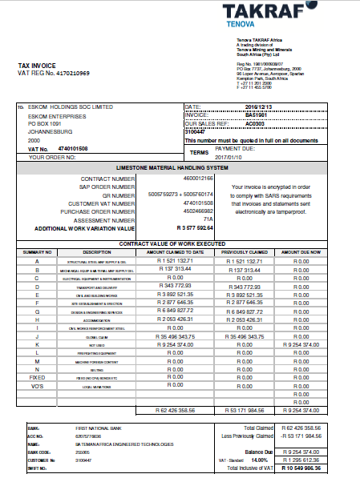
Tenova Invoice

Slide 39
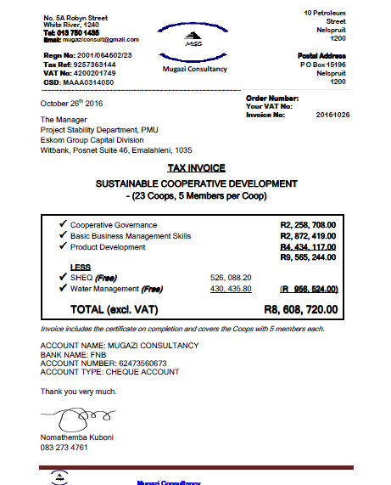
Mugazi Invoice

Slide 40
Comments on Bravo Project

Slide 41
Comments on Bravo Project

Slide 42
PB Africa modification 1

Slide 43
Alstom modification 1

Slide 44
Stefanutti Cost re - allocation

Slide 45
Rejected ABB Modification 2

Slide 46
Tenova modification1

Slide 47
Tenova modification 3

Slide 48
Delegation consent form – Black and Veatch

Slide 49
Bravo implementation proposal

Slide 50
Construction Management
Primary Objective is to Administer Construction Contracts
The Project Field Manager (provided by Black & Veatch) will be the lead Black & Veatch person at the site and will be responsible for all onsite activity including startup. The PFM will be assisted by an Eskom provided Assistant Project Field Manager (APFM).
The Construction Managers (provided by Black & Veatch) will monitor construction progress, provide progress reports, and coordinate construction efforts between contractors.
The Loss Control Manager (provided by Eskom) will develop and administer the project safety and health, security, first-aid, and labor relations programs.
The Project Controls Manager (provided by Black & Veatch) will be responsible for Field Project Controls, including cost, schedule, contracts accounting, and material control.

Slide 51
Construction Management
The Quality Assurance Manager (provided by Black & Veatch) will have the primary role to assure the Construction Contractors have an acceptable quality control program, which is being implemented. The Contractors are responsible for compliance with their contract specifications and drawings, in addition to applicable codes and standards for their scope of work.
Field Engineering Managers (provided by Black & Veatch) will coordinate internal and external interfaces to ensure a cooperative and efficient working relationship between project organizations and to prevent disruptions to construction activities. Field Engineering will also coordinate interdisciplinary engineering activities, including providing field engineering, inspection, and testing support (when not performed or assistance required by quality inspectors), and will collect “as-built” information.

Slide 52
Construction Management
The Startup Managers (provided by Black & Veatch) and their assistants, and including discipline engineers and support technicians, will create startup packages, coordinate equipment testing, accept systems from construction, and manage the startup and energization process.

Slide 53
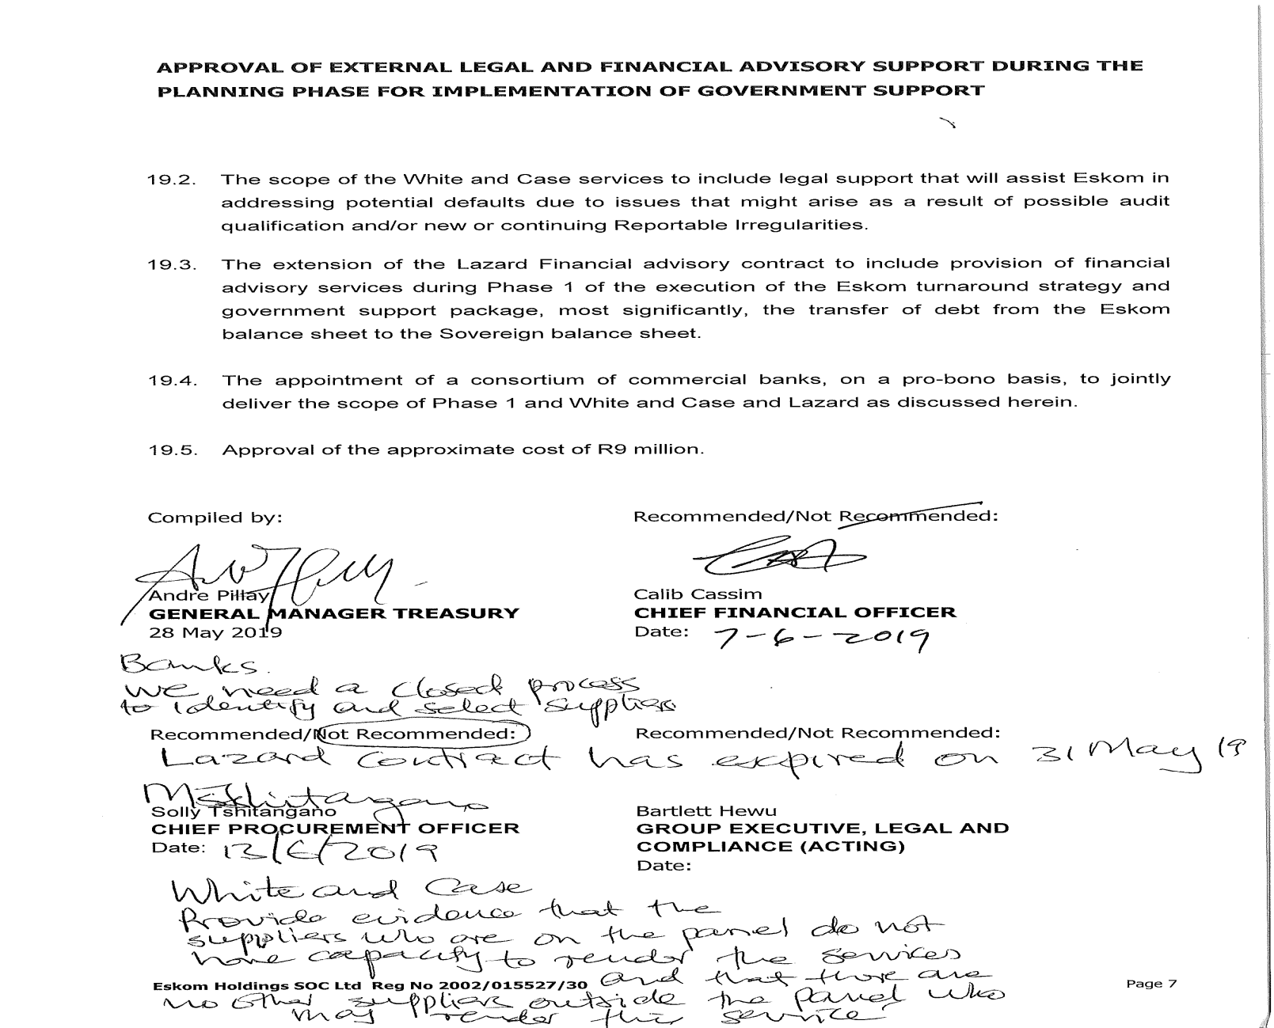
White & case rejected by CPO & Legal

Slide 54
Extract of BTC Minutes – 5 September 2007

Slide 55
Extract from legal opinion - ABB contract

Slide 56
Extract from legal opinion - ABB contract

Slide 57
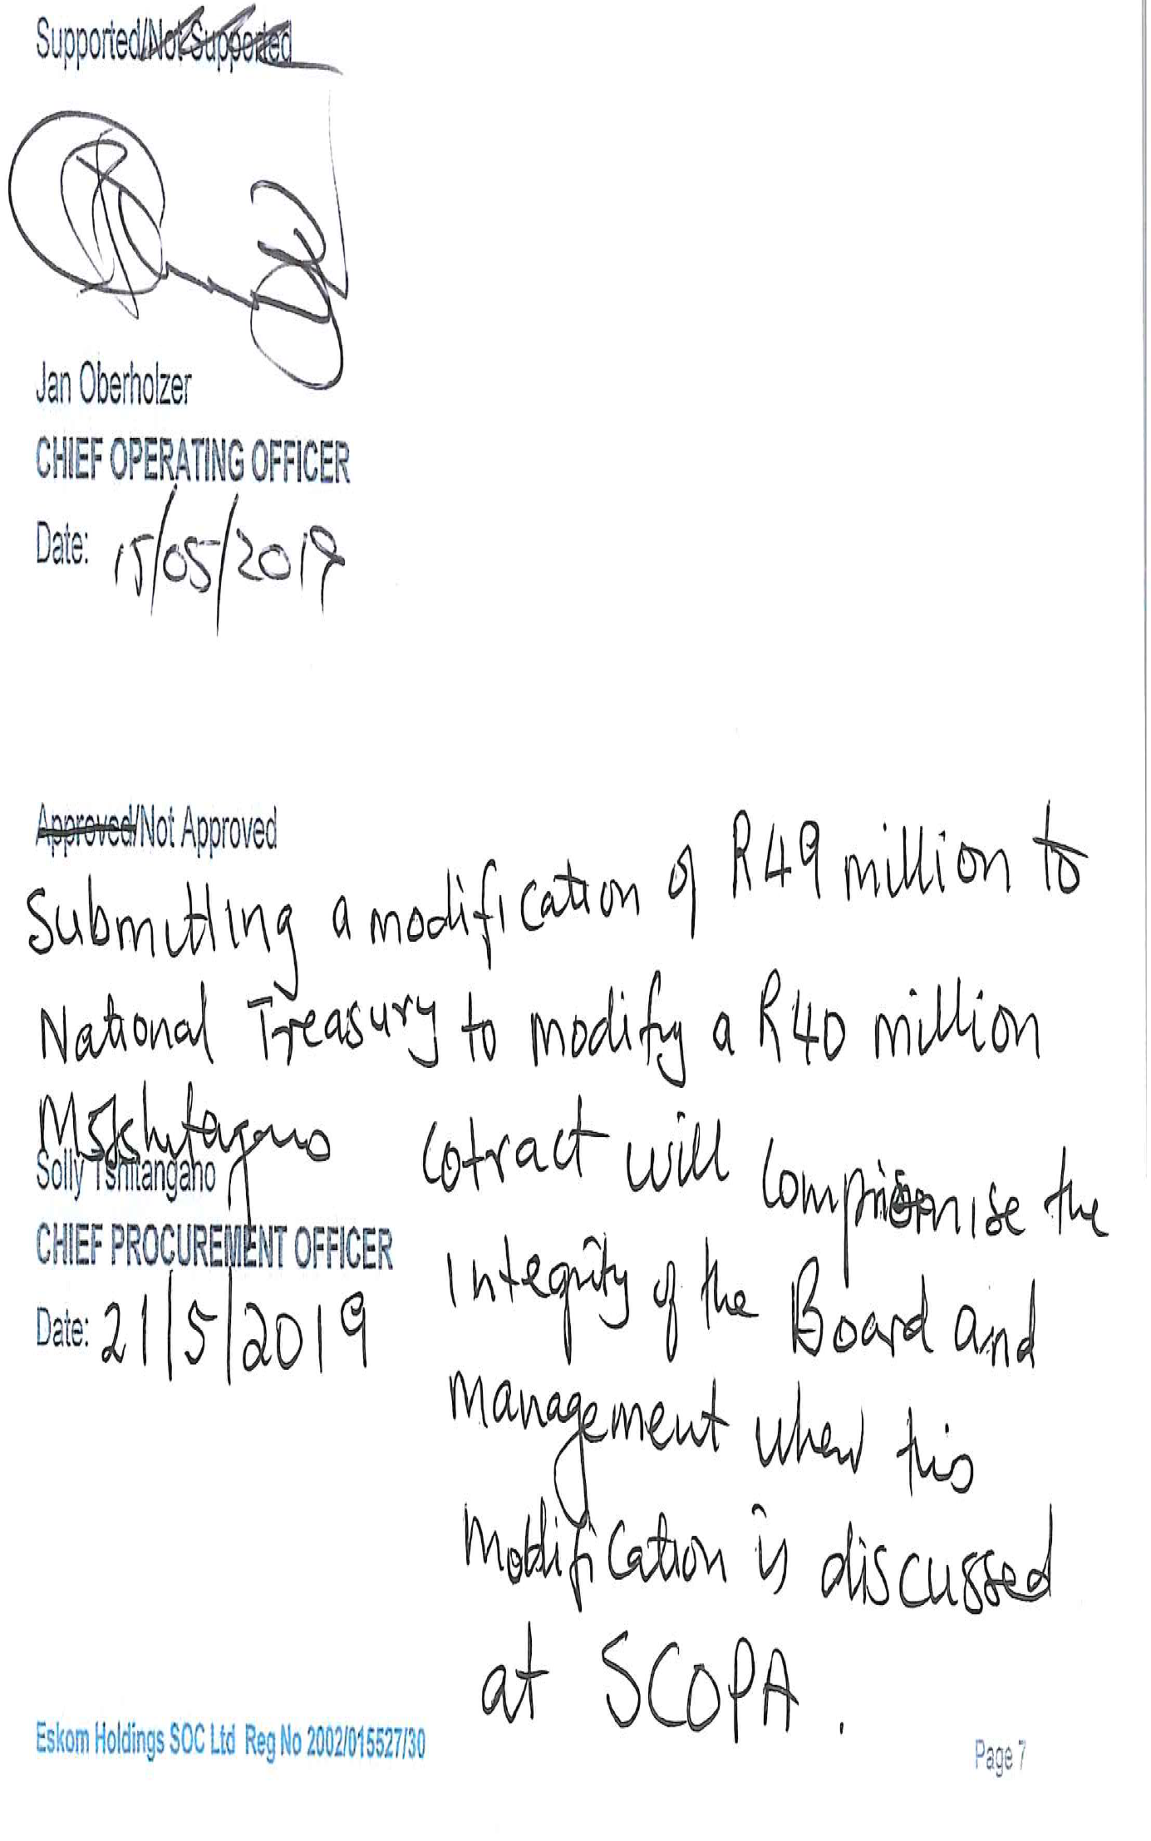
T-systems rejected and resubmitted

Slide 58
Quarter 1 - Expansions submitted to National Treasury
GOVERNANCE MONITORING AND COMPLIANCE: 2019/2020 QUARTER 1 (APRIL-JUNE 2019) REPORT- EXPANSIONS
Eskom Number | NT Number | Project Description | Supplier |  | Reason for extension | Original Contract Value | Value of Contract Extension | NT Decision
1 | 22 | Terrace Ash Coal System | ELB Engineering |  | Continuity of service | 972,425,261.00 | 87,661,835.00 | Supported
2 | 23 | Unit Transformer System and Earthning Equipment For Kusile Power Station | Actom (Pty) Ltd |  | Continuity of service | 215,192,778.28 | 0.00 | Not supported
3 | 24 | Provision of Fuel Cards Facilities for Fuel, Oil, Toll Fees, Repairs and Managed Maintenance | Standard Bank |  | Continuity of service | 7,217,841.84 | 8,875,380.06 | Conditional support
4 | 25 | Support and Maintenance of Eskom Finance Bnaking Systems and IT Infrastructure | Ernest and Young |  | Continuity of service | 18,954,495.00 | 3,667,950.00 | Conditional support
5 | 26 | Provision of Milling Plant Maintenance Services and Rigging at Komati Power Station | Actom John Thompson (Pty) Ltd |  | Continuity of service | 37,134,338.15 | 5,219,910.39 | Conditional support
6 | 27 | Main Civil Works for Kusile Power Station Project | Kusile Civil Works JV |  | Continuity of service | 2,898,939.00 | 545,931,498.00 | Conditional support
7 | 28 | Transmission Power Delivery Projects- Construction of the 400kV Medupi Borutho Transmission Line-Section B | Consolidated Power projects (Pty) Ltd |  | Continuity of service | 158,259,330.15 | 23,982,908.77 | Conditional support
8 | 29 | Supply, Transportation, Erection and Dismantling of Scaffolding and Insulation Material for Generation Power Stations Including Group Capital (Refurbishment Projects) | Southey Contacting (Pty) Ltd Kafer Thermal Contracting Services (Pty) Ltd SGB-Cape TMS Group Industrial Services (Pty) Ltd |  | Continuity of service | 329,130,000.00 | 294,653,718.19 | Noting
9 | 30 | Occupational Health Professional Services | Tlakula Occupational Health Services (Pty) Ltd |  | Continuity of service | 3,000,000.00 | 1,811,480.05 | Not supported
10 | 31 | Provision of Physical Guarding Services at Permanent Sites, Adhoc Security Services, Crime Prevention Patrols and Security Escorting Services at Identified Sites within Eskom Divisions and National Key Points | Metro Security Golden Security Quick Save Security Venus Security Reliable Security Bhakani Abantu Security Full Serve Ligit Security Solutions Maximum Security/ Sihlomile Moas Investments |  | Finalise the bidding process | 129,515,705.93 | 11,359,151.68 | Conditional support
11 | 32 | IT Services during disengangement | T-Systems SA (Pty) Ltd |  | Continuity of service | 2,936,231,859.00 | 135,000,000.00 | Conditional support

Slide 59
Quarter 1 - Deviations submitted to National Treasury
QUARTER 1 (APRIL -JUNE 2019) REPORT - DEVIATIONS
Eskom No. | NT No. | Project Description | Supplier | Divison | Value of Contract | Reason for Deviation | NT Decision
1 | 30 | Substation Control Systems Equioment for Transmission, Group Capital and Distribution | Integrators of Systems Technology (Pty) Ltd | Transmission Distribution Group Capital | Not stated | Noting | Within AA/AO mandate Noting
2 | 31 | Maintenance Services for Oil Flame Scanners | ABB South Africa (Pty) Ltd | Generation | 38,573,172.00 | Only successful tenderer | Not supported
3 | 32 | Provision of Milling Plant Maintenance during an Outage at Arnot Power Station | Steinmulller Africa (Pty) Ltd | Generation | 2,720,285.83 | Cost savings | Conditional support
4 | 33 | Provision of DSTV and Radio Services | Multi Choice Africa (Pty) Ltd | Generation | 407,512.62 | Industry Player | Within AA/AO mandate Noting
5 | 34 | Maintenance and Support of Energy Trading System | Energy System | Information Technology | 3,364,020.00 | Original Equipment Manufacturer | Within AA/AO mandate Noting
6 | 35 | Provision of Training Centre Upgrade Project at Camden Power Station | Hula U Gude | Generation | 1,550,000.00 | Continuity of service | Conditional support
7 | 36 | Oracle Developer Suite Maintenance and Support | Blue Turtle | Information Technology | 1,366,093.00 | Original Equipment Manufacturer | Conditional support
8 |  |  | Time Quantum
9 | 37 | Laser Welding Technique for Re-Instatement of Shroud Bands and Rivers on GEC (Duvha, Majuba and Tutuka) Design LP Rotor Blades | CSIR Laser Weleding Centre | Generation | 4,500,000.00 | Research was done to develop this technique | Conditional support
10 | 38 | Proactive Assurance on the Free Carrier FCA Transporters | Nexia SAB& T | PED | 414,538.29 | Continuity of service | Conditional support

Slide 60
Quarter 2 - Expansions submitted to National Treasury
GOVERNANCE MONITORING AND COMPLIANCE: 2019/2020 QUARTER 2 (JULY – SEPTEMBER 2019) REPORT- EXPANSIONS
Eskom No. | NT No. | Project Description | Supplier |  | Division | Reason for extension | Original Contract Value | Value of Contract Extension | NT Decision
1 | 22 | Terrace Ash Coal System | ELB Engineering |  | Group Capital | Continuity of service | 972,425,261.00 | 87,661,835.00 | Supported
2 | 23 | Unit Transformer System and Earthning Equipment For Kusile Power Station | Actom (Pty) Ltd |  | Group Capital | Continuity of service | 215,192,778.28 | 0.00 | Not supported
3 | 24 | Provision of Fuel Cards Facilities for Fuel, Oil, Toll Fees, Repairs and Managed Maintenance | Standard Bank |  | Finance | Continuity of service | 7,217,841.84 | 8,875,380.06 | Conditional support
4 | 25 | Support and Maintenance of Eskom Finance Bnaking Systems and IT Infrastructure | Ernest and Young |  | Eskom Finance Company | Continuity of service | 18,954,495.00 | 3,667,950.00 | Conditional support
5 | 26 | Provision of Milling Plant Maintenance Services and Rigging at Komati Power Station | Actom John Thompson (Pty) Ltd |  | Generation | Continuity of service | 37,134,338.15 | 5,219,910.39 | Conditional support
6 | 27 | Main Civil Works for Kusile Power Station Project | Kusile Civil Works JV |  | Group Capital | Continuity of service | 2,898,939.00 | 545,931,498.00 | Conditional support
7 | 28 | Transmission Power Delivery Projects- Construction of the 400kV Medupi Borutho Transmission Line-Section B | Consolidated Power projects (Pty) Ltd |  | Group Capital | Continuity of service | 158,259,330.15 | 23,982,908.77 | Conditional support
8 | 29 | Supply, Transportation, Erection and Dismantling of Scaffolding and Insulation Material for Generation Power Stations Including Group Capital (Refurbishment Projects) | Southey Contacting (Pty) Ltd Kafer Thermal Contracting Services (Pty) Ltd SGB-Cape TMS Group Industrial Services (Pty) Ltd |  | Generation | Continuity of service | 329,130,000.00 | 294,653,718.19 | Noting
9 | 30 | Occupational Health Professional Services | Tlakula Occupational Health Services (Pty) Ltd |  | ERI | Continuity of service | 3,000,000.00 | 1,811,480.05 | Not supported
10 | 31 | Provision of Physical Guarding Services at Permanent Sites, Adhoc Security Services, Crime Prevention Patrols and Security Escorting Services at Identified Sites within Eskom Divisions and National Key Points | Metro Security Golden Security Quick Save Security Venus Security Reliable Security Bhakani Abantu Security Full Serve Ligit Security Solutions Maximum Security/ Sihlomile Moas Investments |  | Security | Finalise the bidding process | 129,515,705.93 | 11,359,151.68 | Conditional support
11 | 32 | IT Services during disengangement | T-Systems SA (Pty) Ltd |  | Information Technology | Continuity of service | 2,936,231,859.00 | 135,000,000.00 | Conditional support

Slide 61
Quarter 2 Deviations submitted to National Treasury
GOVERNANCE MONITORING AND COMPLIANCE: 2019/2020 QUARTER 2 (JULY 2019 - SEPTEMBER 2019) REPORT- DEVIATIONS
Eskom No. | NT No. |  | Project Description | Supplier | Division | Value of Contract | Reason for Deviation | NT Decision
1 | 46 | Recruitment of Eskom Chief Executive - HR Executive Search Registered |  | Not applicable | HR | Not stated | Amount exceed more than R1 million | Conditional support
2 | 47 | The Supply, Delivery and Off-Loading of Lubricants to Various Power Station |  | BP Southern Africa (Pty), Engen Petroleum (Pty) Ltd & Astron (Chevron) South (Pty) Ltd | Generation | 287,828,816.58 | RFP process failed | Conditional support
3 | 48 | Installation of Oil Flame Scanners |  | ABB South Africa (Pty) Ltd | Generation | 38,573,172.00 | Viable solution | Conditional support
4 | 49 | e-Tender Portal |  | Not applicable | ERI | Not applicable | e-Tender portal was down | Noting
5 | 50 | Replacment of the exisitng blowdown air compressors at Palmiet Pumped Storage Scheme |  | Lesedi Nuclear Services (Pty) Ltd | Nuclear | 8,139,347.90 | Continuity of service | Conditional support
6 | 51 | Shot Peenign of GEC Design (Duvha, Majuba & Tutuka) LP Rotors’ Last Stage Steepels |  | GEC Power Services (Pty) Ltd | ERI | 68,985,016.80 | OEM | Conditional support

Slide 62
Quarter 3 - Expansions submitted to National Treasury
GOVERNANCE MONITORING AND COMPLIANCE: 2019/2020 QUARTER 3 (OCTOBER - DECEMBER 2020) REPORT- EXPANSIONS
Eskom No. | NT No. | Project Description | Supplier | Division | Reason for extension | Original Contract Value | Value of Contract Extension | Value of previous extensions | NT Decision
1 | 42 | Coal supply | South32 | PED | Ensure Continuity supply | 11,416,000,000.00 | 1,238,832,900.00 | 28,080,800.00 | Not supported
2 | 43 | Waste Water Treatment at Kusile Power Station | Mott McDonald | Group Capital | Continuity of service | 809,016,356.17 | 111,597,403.74 | 226,368,737.60 | Conditional support
3 | 44 | Supply, transportation, erection and dismantling of scaffolding and insulation material for generation power stations including Group Capital | Southey Contracting (Pty) Ltd, Kaefer Thermal Contracting Services, SGB-Cape and TMS Group Industrial Services (Pty) Ltd | Generation | Continuity of service | 286,200,000.00 | 1,654,850.00 | 559,653,718.19 | Conditional support
4 | 45 | Construction of Ankerlig –Sterrekus 400kv double circuit overhead transmission line and its associated works | Mkhulu Electro Distribution Project (Pty) Ltd | Group Capital | Change of supplier and increased assets value | 173,426,575.90 | 16,838,213.48 | 20,319,156.44 | Conditional support
5 | 46 | Rotor Pole Replacement with New Poles For Units 1 and 2 at Palmiet Pumped Storage Scheme | Voith-FujiHydro KK | Generation | OEM | 62,016,888.04 | 0.00 | 0.00 | Conditional support
6 | 47 | Supply, Overhaul, Maintenance, Repair, Inspection and Commissioning of all Maintenance and Outage Actuators | Dhemo Africa (Pty) Ltd | Generation | Funds depleted | 21,780,574.64 | 6,777,293.45 | 0.00 | Conditional support
7 | 48 | Support and Maintenance of Eskom Finance Company Core Banking Systems and Infrastructure | Ernest and Young | Eskom Finance Company | Continuity of service | 18,954,495.00 | 1,833,957.00 | 33,187,172.94 | Conditional support
8 | 49 | Application and Support of MeterData Repository, TX MDMS and KSACS Metering Data Management Support | Nextec (Pty) Ltd | Information Technology | Continuity of service | 13,377,733.58 | 11,913,528.93 | 0.00 | Conditional support
9 | 50 | Conversion and Editing of Portal Document Format (PDF) Software Subscription | Adobe Ireland Limited | Information Technology | Continuity of service | 2,739,532.89 | 0.00 | 563,299.89 | Conditional support
10 | 51 | Legal Services for Medupi Borutho Line | Gildenhuys Malatji Inc | Group Capital | Continuity of service | 1,000,000.00 | 0.00 | 0.00 | Conditional support

Slide 63
Quarter 3 - Deviations submitted to National Treasury
GOVERNANCE MONITORING AND COMPLIANCE: 2019/2020 QUARTER 3 (OCTOBER -DECEMBER 2020) REPORT- DEVIATIONS
Eskom No. | NT No. | Project Description | Supplier | Division | Value of Contract | Reason for Deviation | NT Decision
1 | 1 | Rental of Site Camp at Howick North for Storing Project Equipment and Material For Ariadne Venis 2400KV Line Project | Willowgrange cc | Group Capital | 999,426.36 | Continuity of service | Conditional support
2 | 2 | Manufacture, Supply and Delivery of Pulse Jet Fabric Filter Bags for Various Power Stations | Beier Envirotec (Pty) Ltd | Generation | 1,038,631,607.77 | Two approved suppliers | Not supported
 |  |  | Filtafelt (Pty) Ltd
3 | 3 | Not publishing on CIDB-i-Tender Portal and Support | Not applicable | ERI | 0.00 | Could not upload the bids for less than 10 working days | Within AA/AO mandate Noting
4 | 4 | Design Monitoring and Construction Supervision at Majuba Power Station | Jones and Wagner (Pty) Ltd | Group Capital | 42,253,272.82 | Holds full liability for designs | Not supported
5 | 5 | Unfair Dismissal Dispute | Bowman Gilfillan | Legal | 862,040.00 | Continuity of service | Conditional support
6 | 6 | SAP Licenses, Cloud Subscription services, MAX attention, SAP OEM Accredited Professional Training Services of African User Group Membership Fees | SAP SA (Pty) Ltd | Information Technology | 298,799,739.29 | Continuity of service | Not supported
7 | 7 | Detection of possible harmful elements in both crop and soils, final leaching of lasts soil and final reporting | University of Pretoria | Risk & Sustainability | 1,115,500.00 | Finalize outstanding work | Conditional support

