Slide 1
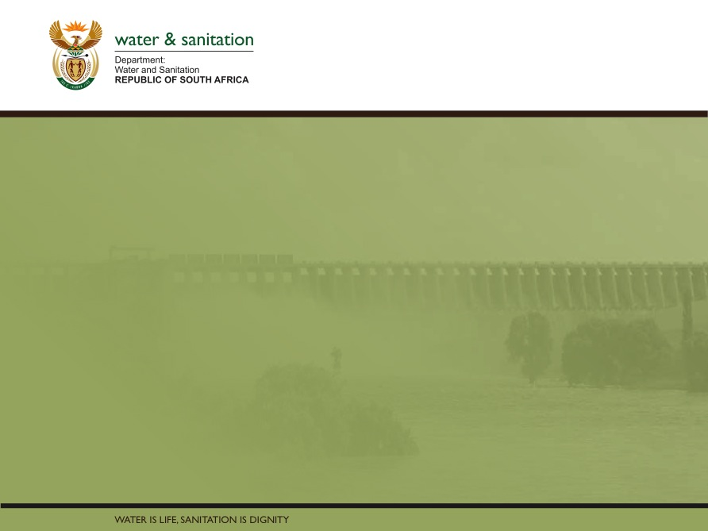
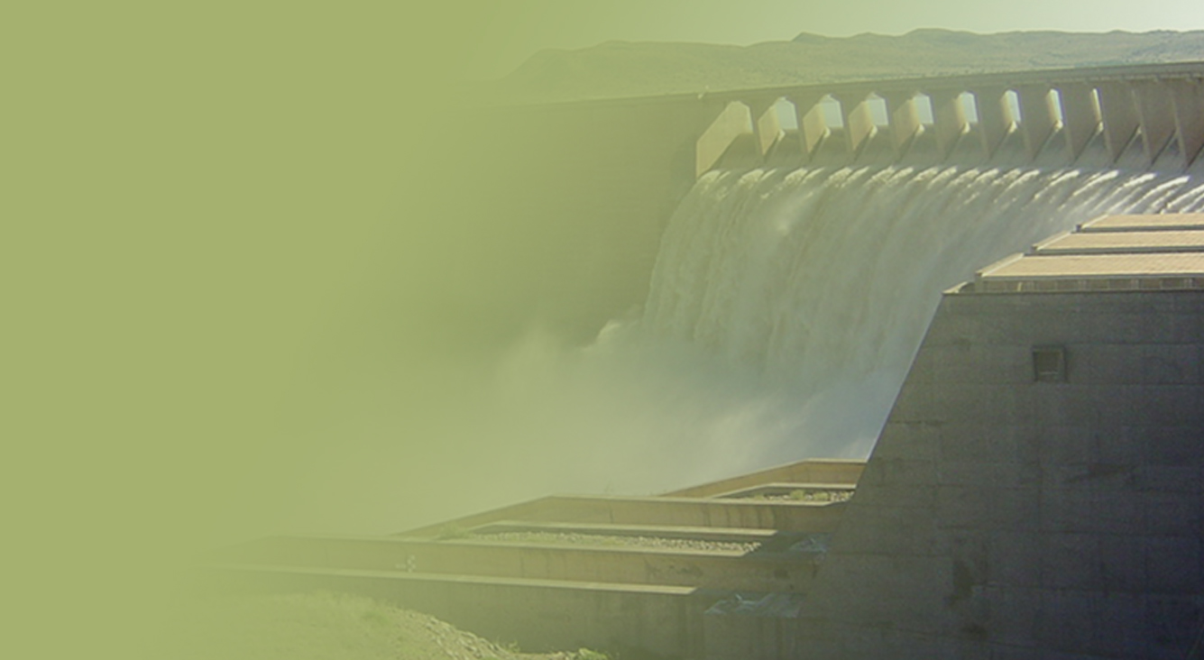
PRESENTATION TITLE
Presented by:
Name Surname
Directorate
Date
LIMPOPO MUNICIPAL PERFORMANCE
Presented by:
Acting Director-General
Date: 03 March 2020

Slide 2
Contents
LIMPOPO MUNICIPAL PERFORMANCE
Purpose ……………………………………………………… 3
Part A: Municipal performance as per regulatory evaluation………………………………………………..4-14
Part B: Status of Water Services Technical Reports – MIG Monthly Reporting as at February 2020………………15-17
Part C: Grant spending trend on transfers from 2017/18 to 2019/20…………………………………………………..18-22

Slide 3
Purpose
To brief the Portfolio Committee on the Limpopo:
municipal performance as per regulatory evaluation;
status of water services technical reports – MIG Monthly Reporting as at February 2020;
grant spending trend on transfers from 2017/18 to 2019/20

Slide 4
Part A: municipal performance as per regulatory evaluation

Slide 5
Limpopo municipal WWTW status
WSA | Number of WWTW | Design Capacity (Ml/d) | Average Inflow (Ml/d) | Performance (%) | Number of WWTW Authorised
Polokwane LM | 3 | 43.6 | 49.0 | 112% | 1
Capricorn DM | 5 | 3.0 | 7.0 | 233% | 0
Sekhukhune DM | 17 | 21.7 | 14.7 | 68% | 4
Mopani DM | 9 | 37.3 | 14.3 | 68% | 1
Vhembe DM | 12 | 40.0 | 28,5 | 71% | 4
Mogalakwena LM | 2 | 9.8 | 11.0 | 112% | 1
Modimolle/ Mookgophong LM | 4 | 12.5 | 8.5 | 68% | 3
Bela Bela LM | 3 | 6.0 | 6.3 | 105% | 2
Thabazimbi LM | 3 | 10.5 | 8.3 | 79% | 2
Lephalale LM | 3 | 14.0 | 11.7 | 84% | 2
Total (10) | 61 | 198.4 | 159.3 | 80% | 20

Slide 6
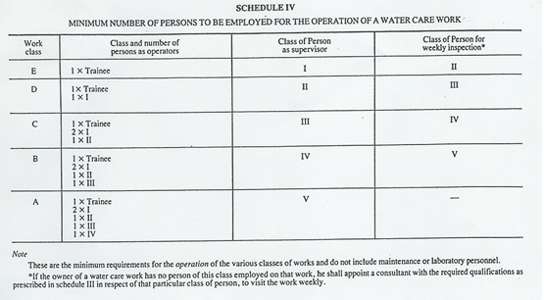
Regulation 2834
6

Slide 7
Process Controller (PC) status
WSA | Number of WWTW | Available PC | Required PC
Polokwane LM | 3 | 6 (2 Class III, 1 Class IV & 3 Class V) | 12 (8 Class III & 4 Class IV)
Capricorn DM | 5 | 16 (2 Class II, 4 Class III, 6 Class IV & 4 Class V ) | 13 (6 Class I , 3 Class II 4 Class III)
Sekhukhune DM | 17 | 20 (5 Class 0, 2 Class 1, 6 Class III, 4 Class IV & 3 Class V 5) | 41 (14 Class I , 17 Class II, 7 Class III, 2 Class IV & 4 Class V )
Mopani DM | 9 | 39 (14 learners, 6 Class II, 7 Class III, 9 Class IV & 14 Class V) | 35 (16 Class I, 10 Class II & 9 Class III)
Vhembe DM | 12 | 38 (4 Learners, 2 Class II, 1 Class III, 8 Class IV & 14 Class V) | 40 (15 Class I, 10 Class II, 12 Class III, 3 Class IV & 0 Class V)
7

Slide 8
Process Controller (PC) status
WSA | Number of WWTW | Available PC | Required PC
Mogalakwena LM | 2 | 4 Class IV | 17 (8 Class I, 4 Class II & 4 Class III)
Modimolle/ Mookgophong LM | 4 | 4 (1 Class I,1 Class II & 2 Class IV) | 27 (10 Class I, 7 Class II, 8 Class III & 2 Class IV )
Bela Bela LM | 3 | 4 (2 Class II, 1 Class IV & 1 Class V) | 13 (6 Class I, 4 Class II and 3 Class III)
Thabazimbi LM | 3 | 5 (2 Class I, & 3 Class II) | 15 (6 Class I, 3 Class II, 4 Class III, 2 Class IV & 1 Class V)
Lephalale LM | 3 | 2 Class V | 18 (6 Class I, 4 Class II, 4 Class III & 2 Class IV)
Total (10 WSAs) | 61 | 138 | 231
8

Slide 9
WASTEWATER QUALITY COMPLIANCE

Slide 10
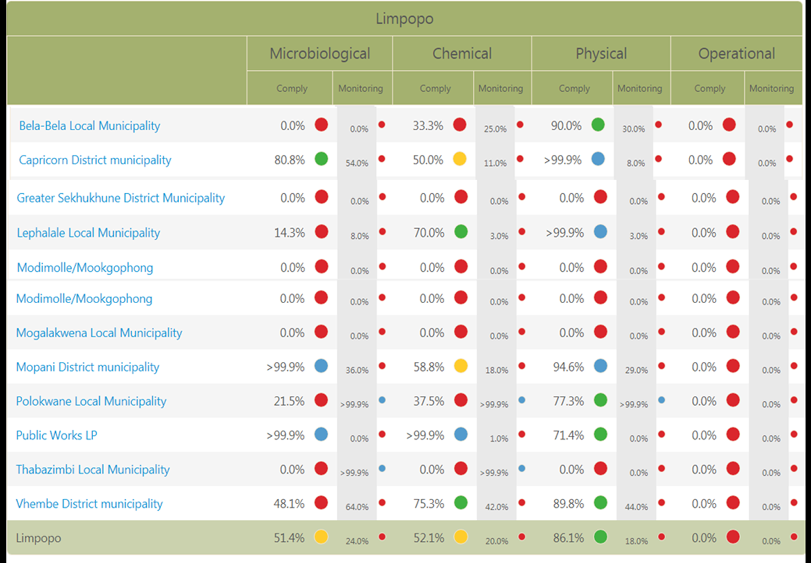
10

Slide 11
Limpopo wastewater quality compliance
Belabela has 3 systems, only Warmbath is monitored
Capricorn comprises of 5 systems which are monitored, however Mogwadi and Senwabarwana need urgent attention.
Greater Sekhukhune has 17 systems, which there are inconstantly monitored.
Lephalale has 3 systems and only Paarl WWTW is monitored.
Modimolle / Mookgophong has 4 systems and only Thusang Ponds is inconstantly monitored.
Mogalakwena has 2 system only Rebone ponds was inconstantly monitored.
Mopani, there 9 systems that are all monitored and some data is not complying to Standards.
Polokwane, 3 systems being monitored but some data is complying.
Thabazimbi, there are 3 systems which are inconstantly monitored and not complying with standard.
Vhembe , 12 systems that are all monitored and some data is not complying to Standards.

Slide 12
Intervention to ensure compliance
Name of WSA/Institutions | WWTW Issued with notices | WWTW Issued with Directives
Vhembe DM | Vleifontein, Waterval, Elim Orbal, Malamulele and Makhado Louis Trichardt | Elim
Polokwane LM | Polokwane, Seshego and Mankweng
Lephalale LM one | Marapong/ Zongesien | Paarl, Marapong/ Zongesien
Modimolle-Mookgophong LM | Vaalwater, Modimolle and Mookgophong | Vaalwater, Modimole sewage spillages, Mookgopong R101 pumpstation
Mogalakwena LM | Sekgakgapeng, Masehlaneng, Radium
Capricorn DM | Alldays, Senwanabarwana, Mogwadi)
Modimolle-Mookgophong LM | Court order

Slide 13
Challenges
WWTWs are overloaded (they are due for upgrade)
Partially treated effluent – poor process controlling
Poor sludge management
Process controllers and maintenance team are not complying with NWA Regulation 813
Poor Operation & Maintenance.
Limited access to waste water treatment works
The Waste Water Risk Abatement Plan are not reviewed and implemented
Non uploading of effluent quality results on the IRIS of a monthly basis
Non responsive to issued notices and directives

Slide 14
Proposed solutions
WSA to :
Conduct Process Audit
Develop Improvement Plans
Align Planning for Settlements and Towns, water supply with wastewater treatment works.
Develop and Implement water quality management plans
Application for Water Use Licence

Slide 15
Part b: Status of Water Services Technical Reports – MIG Monthly Reporting as at February 2020

Slide 16
Planning on MIG Technical Reports
Non-compliance with DoRA MIG MTEF Schedule
Poor quality of technical reports (information gaps)
Lack of Integrated planning-
  Incomplete WSDPs
  Unplanned projects- no feasibility studies
Non compliance with the TR / Guidelines / Format
Technical Reports submitted to DWS by PSPs
Incomplete / abandoned funded projects
Implementing unregistered projects
1 out of 10 WSA’s have approved WSDP (Capricorn)

Slide 17
Considerations
WSAs should:-
Commit to comply with DoRA MIG MTEF schedule
Improve on water services planning
  Review & adopt WSDPS in 2014/15 onwards
  Conduct feasibility studies to inform tech reports
Appoint Professional Engineers for water services planning
Effect final PSP payment after delivering recommended TR, etc.
Adhere to the Technical Reports guidelines / format
Always submit TR with duly signed Municipal covering letter
Complete funded projects
Register project before implementation

Slide 18
Part C: Grant spending trend on transfers from 2017/18 to 2019/20

Slide 19
Regional bulk infrastructure grant
Financial year | Municipality | Revised Budget Allocations | Budget Transferred | Actual Expenditures | % Spent | Unspent Funds
2017/18 | Polokwane | 180 159 | 180 159 | 63 540 | 35% | 116 619
2018/19 | Polokwane | 370 505 | 370 505 | 370 505 | 100% | 0
2019/20 | Polokwane | 630 998 | 346 346 | 161 856 | 46% | 184 490
Total |  | 2 181 662 | 897 010 | 595 901 | 66.4% | 301 109

Slide 20
Water services infrastructure grant 2017/18
Municipality | Revised Budget Allocations | Budget Transferred | Actual Expenditures | % Spent | Unspent Funds
Mopani DM | 95 000 | 95 000 | 58 161 | 61 | 0
Vhembe DM | 32 478 | 32 478 | 34 070 | 100 | 0
Capricorn DM | 90 000 | 90 000 | 90 000 | 100 | 0
Thabazimbi | 20 000 | 0 | 0 | 0 | 0
Lephalale | 50 000 | 50 000 | 45 871 | 91,7 | 4 129
Bela Bela | 35 000 | 35 000 | 35 000 | 100 | 0
Mogalakwena | 50 000 | 50 000 | 50 000 | 100 | 0
LIM368 | 80 000 | 80 000 | 15 422 | 0 | 64 578
Fetakgomo | 0 | 90 013 | 66 700 | 74 | 23 313
Sekhukhune DM | 95 000 | 95 000 | 67 659 | 71 | 27 341
Sub-Total | 527 478 | 527 478 | 396 638 | 75 | 130 840

Slide 21
Water services infrastructure grant 2018/19
Municipality | Revised Budget Allocations | Budget Transferred | Actual Expenditures | % Spent | Unspent Funds
Mopani DM | 107 000 | 107 000 | 107 000 | 100 | 0
Vhembe DM | 45 000 | 45 000 | 41 623 | 92 | 3 377
Capricorn DM | 148 000 | 148 000 | 134 638 | 91 | 13 363
Thabazimbi | 26 000 | 26 000 | 13 000 | 50 | 13 000
Lephalale | 24 500 | 24 500 | 4 150 | 17 | 20 350
Bela-Bela | 45 500 | 45 500 | 38 895 | 85 | 6 605
Mogalakwena | 52 975 | 52 975 | 39 705 | 75 | 13 270
LIM 368 | 25 000 | 25 000 | 23 698 | 95 | 1 302
Sekhukhune DM | 65 000 | 65 000 | 26 180 | 40 | 38 820
Sub-Total | 643 475 | 643 475 | 428 889 | 67 | 214 586

Slide 22
Water services infrastructure grant 2019/20
Municipality | Revised Budget Allocations | Budget Transferred | Actual Expenditures | % Spent | Unspent Funds
Mopani DM | 40 000 | 0 | 0 | 0 | 0
Vhembe DM | 50 000 | 35 000 | 0 | 0 | 35 000
Polokwane | 96 650 | 77 655 | 10 170 | 13 | 67 485
Capricorn DM | 105 000 | 75 000 | 22 026 | 29 | 52 974
Lephalale | 40 000 | 30 000 | 0 | 0 | 30 000
Bela-Bela | 45 000 | 35 000 | 2 294 | 7 | 32 706
Mogalakwena | 60 000 | 45 000 | 7 136 | 16 | 37 864
Sekhukhune DM | 70 000 | 20 000 | 0 | 0 | 20 000
Total | 506 650 | 317 655 | 41 626 | 65 | 276 029
The expenditure by municipalities is slow, it will pick up during last quarter of the municipal financial year

Slide 23
END

