Slide 1
Submission on the 2020 fiscal framework and revenue proposals
3 March 2020

Slide 2
Contents
Mandate
Economy
Fiscal framework and revenue proposals

Slide 3
Mandate

Slide 4
Mandate
Constitution S220:
establishes Financial and Fiscal Commission
to make recommendation envisaged in Constitution/legislation
Recommendations on Division of Revenue (DoR) to be considered and lists to consider for DoR
FFC Act 99 of 1997 as amended
To make recommendations to organs of state on financial and fiscal matters in accordance with section 220 of the Constitution
Invited to comment on fiscal framework and DoR

Slide 5
Economy

Slide 6
Growth slowdown associated with rising unemployment
Sources: SARB; StatsSA

Slide 7
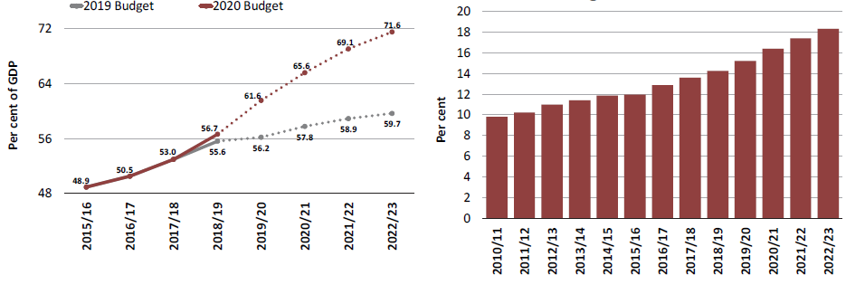
Slowdown impacting on public finances
Gross debt to GDP projections
Debt-service cost to main budget revenue
Source: National Treasury, Budget Review 2020

Slide 8
Lagged effect on poverty ?
Source: Zizzamia, Schotte and Leibbrandt (2019) based on NIDS

Slide 9
… and inequality
Source: Zizzamia, Schotte and Leibbrandt (2019) based on NIDS

Slide 10
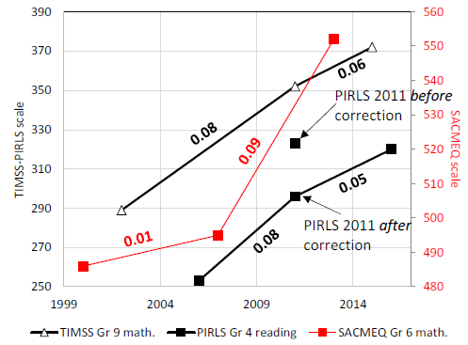
… and gains in education and …
Source: Gustafsson 2020

Slide 11
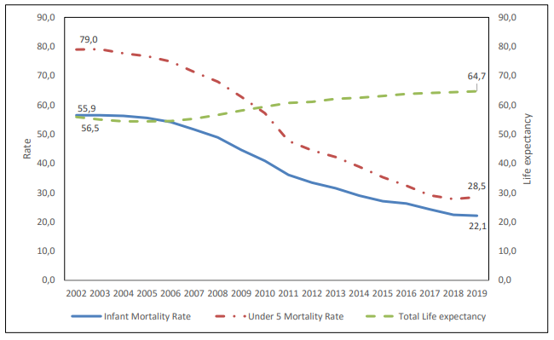
… life expectancy and mortality
Source: StatsSA, Mid-year population estimates, 2019

Slide 12
Prospects
Big risks in the international environment
Trade: trade environment and Coronavirus
Investor sentiment to emerging markets
No real green shoots in the local environment
Investment
Consumption
But some investments have been paying off:
Basic education outcomes
Life expectancy
Must guard the gains (education, health, poverty, inequality)

Slide 13
Government (Budget) Strategy
Macroeconomic policy and fiscal consolidation
Structural change – reducing cost of business, work and living through
Network industries, competition, boosting exports labour intensive sectors
Education
Regulatory environment and government efficiency
Capable, developmental & efficient (& clean state)
Regulatory efficiency
Policy certainty and implementation

Slide 14
FFC Perspectives
Need to look at factors behind policy uncertainty
Balance of power between winners and losers – and the need for buying all in
Ability to block change: spectrum licensing; digital transition; e-tolls; ride-hailing
Need to create a stakeholder society (social protection? shared wealth fund?)
The structural drivers: climate, technology, population and power shifts – are we positioning ourselves to minimise costs and maximise benefits
The long list of structural factors and the need for focus
The potential of a moderate, phased approach
Clarity on sectoral focus, and the promotion of informal activity
The real government capacity issues – structure, systems, clear allocation of functions
Inequality remains exceptionally high and influences a range of other factors: social cohesion and respect for the “rules of the game”

Slide 15
FISCAL FRAME AND REVENUE PROPOSALS

Slide 16
Weakening in fiscal framework; urgent action required
2018/19
2019/20
2022/23
GDP:R5 157.3 billion
Expenditure: R1 843.5b
35.7%
33.4%
35.7%
34.9%
29.4%
Govt Revenue:
R1 517b 29.4%
Def: R326.6b
6.3%
29.2%
29.4%
6.3%
4.0%
5.7%
Debt R3 176.1b
56.7%
61.6%%
71.6%
Key issues:
Rapid weakening, difficulty of turning around
Comparative picture (e.g. tax:GDP 26.3%)
Weakens composition of spend
Impact on perceptions, confidence and cost of borrowing

Slide 17
Weakening in fiscal framework; urgent action required
Key issues:
Rapid weakening, difficulty of turning around
Comparative picture (e.g. tax:GDP 26.3%)
Weakens composition of spend
Impact on perceptions, confidence and cost of borrowing

Slide 18
Government strategy for consolidation
No tax increases – adjustment for inflation, arguing
“Tax rates comparatively high”
“Increased taxes may hurt short-run economic recovery”
Increased tax rates may not bring in more tax
Cut back on expenditure: Reduce over MTEF
Reduce programme baseline (Budget 2019) allocations over MTEF (R101b over MTEF)
Reduce baseline wage bill allocations (R160b)
Bargaining on
Return of confidence: containing borrowing costs (credit rating) and investment trends turning around
Impact on composition of revenue

Slide 19
DoR baseline cuts
19

Slide 20
Trends in dor - funds available
National allocation erratic, because of financial support to SOCs, declines over MTEF
Some real growth in provincial and local transfers
Key expenditure lines somewhat protected but confronted by demand pressure (population growth) and high cost increases (especially on personnel and network services)
Much hinges on the wage agreement

Slide 21
Spending by Functional Classification
Shift from ‘social sector’ to a focus on economic development, community development, social development
Peace and security (Defence and State Security and Home Affairs) and general public services (Public Administration and Fiscal Affairs) see reductions
Unhealthy composition of spending: debt service costs fastest growing item and towards end of 2020 MTEF, will be larger than community development and health
Real Annual Average Growth over the Periods 2016/17-2019/20 and 2020/21-2022/23

Slide 22
… but little change in structure of revenue

Slide 23
Other revenue initiatives
Strengthening SARS (infrastructure support, legislative change)
Broadening base & eliminating incentives and deductions (where possible)
Moving forward on taxing the digital economy – OECD process
Environmental fiscal reform

Slide 24
FFC Considerations
Questions being raised about the strategy:
Can the wage agreement be successfully renegotiated?
Can it an agreement be effectively implemented? (unintended consequences)
Is the strategy fair to civil servants? (teachers, nurses, prosecutors, social workers, police, etcetera)
SoC risk: economy and expenditure risk
Are there alternatives for structuring the costs of consolidation – from civil servants (teachers, nurses, police, social workers) to a broader social pact
Lack of trust in capacity of government and impact on strategy: the moderate strategy/start small?
Need greater debate about synchronising our fiscal system and the democracy we envisage
“Revenue future” – ensuring a handle on “new assets” and income streams
“Expenditure future”- extent of solidarity and care and implications for fiscal framework

Slide 25
Thank You

